Slide 1

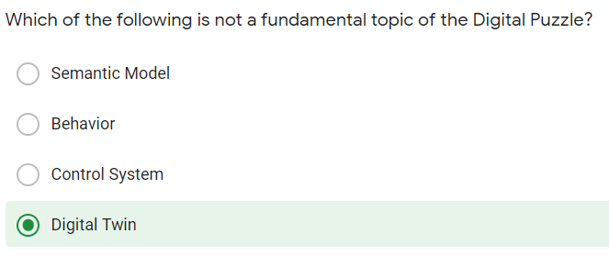



Which field label is missing in the following SenML measurement? [{"n":"urn:dev:ow:10e2073a01080063","u":"Cel","_":23.1}]
Answer: v
Look closely
SenML can be represented in
JSON,EXI
For a device, the digital twin...

Slide 2
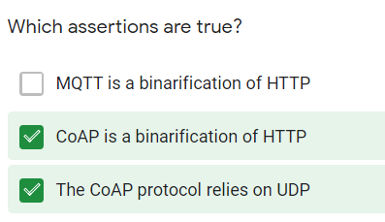




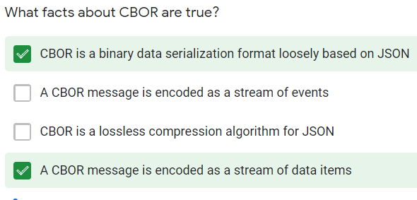

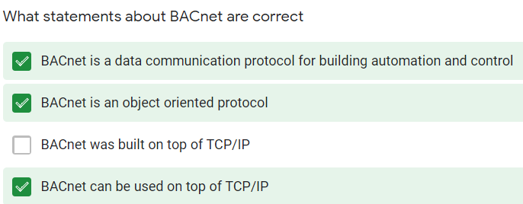

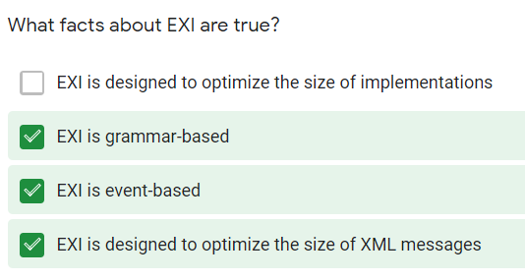
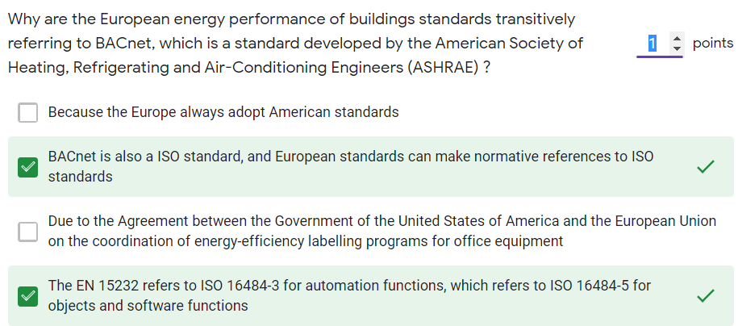


Slide 3



