Slide 1




EnOcean Alliance Members Meeting
Technical overview
Marian Hönsch / Technical Working Group
05.04.2018

Slide 2
Agenda
Technology Explained in few slides
Organization: How the TWG Works & 2018 Programs Roadmap Focus 2018, Technology & Programs
IoT
EnOcean over IoT, Next gen EEP,
Product Database
Standard product Labels
2

Slide 3







Focus 2018
Technical Task Groups
Ongoing Technical Programs
EEP Approval Committee
Remote Commissioning
EEP – Communication Profiles
Certification Program
Security
Strategic initiative
Product Labeling
EnOcean IoT

Slide 4
Technology Explained in few slides
Protocols:
EEP / Signal Telegram
Remote Management – ReMAN
Remote Commissioning - ReCOM
Smart Acknowledge
Security / Encryption
Next gen EEPs – Ideas
EnOcean over IP
Product definitions
Certification
EOA Labeling
Electronic Datasheet
Protocol Stack
Application
EEP
RECOM - REMAN
REMAN
Smart Acknowledge
Security
EnOcean Radio Protocol 1 & 2
868.3, 902, 928 MHz (Radio)
Title of presentation | Author | 18-04-05
4

Slide 5
Smart acknowledgement between the sensor and the actuator
EEP(EnOcean Equipment Profile): to know what kind of device, you’re actuating
Application Layer, gives the provision to potentially develop some applications, if we decide to use the complete protocol stack

Slide 6
Technology Explained in few slides
Remote Commissioning
Title of presentation | Author | 18-04-05
Page 5

Slide 7
Remote Management – REMAN
Remote Commissioning (RECOM) :
Builds on REMAN
Defined new function codes for SYS_EX
Complex processes – link tables, device parameters, discovery
This is the interesting protocol
Remote Commissioning
Remote Management
Remote Management (REMAN) :
the SYS_EX telegram and structure definition
Basic processes and function
SYS_EX telegram:Telegram with a
Specific structure
Title of presentation | Author | 18-04-05
6

Slide 8




Remote Commissioning
- Use Cases
Set Up - During commissioning of newly installed networks
Maintenance - When modifications, by adding and removing devices and/or changing devices’ configuration parameters.
Replace - When replacing a non-operating device with a pre-commissioned, ready to install one.
Troubleshooting - When trouble shooting an operating EnOcean network.
EnOcean Technical Training| M. Hönsch | Oct 30-31, 2013

Slide 9



Three pillars
Interoperable Remote Commissioning
Remote Commissioning Specification
Standardized Device Features Description
Commissioning Tools
+
+ +
Cross-Device Interoperable Communication Standard
Unified Product Labeling & Reference in Field
Remote Commissioning Device Certification
Device
Device
teach-in manually
configured proprietary
limited device description
teach-in automatically
standardized remote configuration
full device description
EnOcean Eco System
(c) EnOcean | EnOcean at a Glance
8

Slide 10



Get Product Id
Commissioned device
1. Scan Product ID and EnOcean ID
https://www.qr-code-generator.com/
EnOcean Technical Training|
M. Hönsch |
Oct 30-31, 2013
Page 9

Slide 11



Get Device Description file
1. Query Device Description File with Product ID
https:\\enocean-alliance.com\ddf\[MAN-ID]\[PRODUCT-ID]
2. Get DDF - XML
EnOcean Technical Training| M. Hönsch | Oct 30-31, 2013
Page 10

Slide 12




Use case – Linking
1. Scan the switch
2. Add switch to Link Table
3. Switch will immediately work

Slide 13





Use Case - Paramters
Set temperature in HVAC
Dimmer settings
Energy settings
Control panel set up
Timers in occupancy

Slide 14
Technology Explained in few slides
Smart Acknowledge
Title of presentation | Author | 18-04-05
Page 13

Slide 15

Smart Acknowledge
Smart acknowledge bi-directional communication between a self-powered device and a line-powered device..LinePowered: In reference to equipment that is electrically powered by the telecommunications circuit to which it connects, thereby eliminating the need for local power.
1st : Measurement Value
(e.g. temperature, humidity, set+, set-)
2nd (SMART ACK): Parameter Update
(e.g. display value, set-point zero, display “window open!”)
Introducing the EnOcean world | A. Pelka, M. Hönsch| May 22, 2012

Slide 16
Smart ACK Principle
sd Reclaim process
Energy autarkic sensor
/ Post Master
Init telegram()
Extremely short time interval
Only here the receiver is
switched on!
Reclaim()
Acknowledge()
Introducing the EnOcean world | A. Pelka, M. Hönsch| May 22, 2012

Slide 17
Technology Explained in few slides
Security
Title of presentation | Author | 18-04-05
Page 16

Slide 18
Security level survey
 | Metering Products (Sensors) | Comfort & Energy Saving Products (Controls power consuming or –generating devices) | Safety & Security Products (Protecting high value assets or human life)
Confidentiality | AES encryption | AES encryption | AES encryption
Authenticity | AES CMAC with counter | AES CMAC with counter | AES CMAC with counter
Integrity | AES CMAC | AES CMAC | AES CMAC
DoS Protection | Absence & Relay detection | Absence & Relay detection | Absence & Relay detection
Page 17
Telegram encryption (hide meaning) and authentication (avoid unauthorized control)
EnOcean score high in Fraunhofer (AISEC) security survey
© EnOcean

Slide 19
Encryption in Radio Telegrams – Data
> EnOcean GmbH - © 2013
En- \ decapsulation of non-secure RORG
Non-secure
RORG | DATA | TXID | STATUS
Secure
0x31 | RORG | ENC_DATA | RLC | CMAC | TXID | STATUS

Slide 20


VAES
PUBLIC KEY
PUBLIC KEY
RLC
XOR
RLC
XOR
PRIVATE KEY
AES128
PRIVATE KEY
AES128
ENC
ENC
DATA
XOR
DATA_ENC
XOR
DATA_ENC
DATA
PUBLIC KEY is for all devices same
= 0x3410de8f1aba3eff9f5a117172eacabd
> Titel der Präsentation > Autor > 05.04.2018
> EnOcean GmbH - © 2013

Slide 21
Technology Explained in few slides
EEP / Signal Telegram
enOcean Equipment Profile
Page 20

Slide 22
EEP / GP (Application Interface)
EEP
What is it
“Translation between Bytes and Meaning”
Mechanism to encode / interpret EnOcean telegrams based on a “magic number”
Foundation for functional interoperability between products
What should be done
Number of defined EEP keeps growing, but support for new EEP is limited
Short term item is to separate status & configuration from normal reporting
Long term item is secure application level interoperability and next gen profiles
Page 21

Slide 23





Signal Telegramm
Extending devices EEP functionality with common features.
Energy storage at: 80 % Energy harvesting conditions are: “very good”
Trigger: last device status
Signal: device status
I can hear:
10 IDs with very good radio quality
5 IDs with average radio quality
Title of presentation | Author | 18-04-05
22

Slide 24
Technology Explained in few slides
EnOcean over IP
Title of presentation | Author | 18-04-05
Page 23

Slide 25














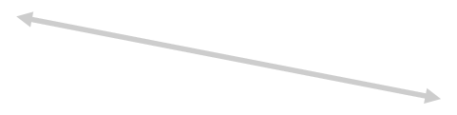











IoT - All about connecting devices
Open Connectivity
Foundation
Apple
(c) EnOcean Alliance | Wireless Congress 2015 | EnOcean becoming Things
Page 24

Slide 26
EnOcean IP
Representation of EnOcean devices in IP – mostly EEP related REST Api, JSON Data Model
Nr. | JSON model
1 | systemInfo
 | version of Interface with EnOcean base information
2 | profile
 | EEP functionality / functions: Which information will send a specific profile or device and which states can be set?
3 | device
 | informations about known devices of the Interface
4 | telegram
 | incoming and outgoing telegrams
5 | state
 | saved states of devices
(c) EnOcean Alliance | Wireless Congress 2015 | EnOcean becoming Things
Page 25

Slide 27

https://www.enocean-alliance.org/wp-content/uploads/2017/05/EnOcean_Equipment_Profiles_EEP_v2.6.7_public.pdf
REST route
HTTP method
Basic structure of Interface response:
/devices/states or /device/{deviceId}/stream
GET
{
"header" : {
"status" : 200, "content" : "states",
"timestamp" : "2015-08-11T18:10:15.574+0200"
},
"states" : [ {
"deviceId" : "019604F9", "friendlyId" : "valve", "functions" : [ {
"key" : "setPointInverse", "value" : "0",
"valueKey" : "false",
"timestamp" : "2015-08-11T18:09:54.115+0200", "age" : "21459"
}, {
"key" : "valve",
"value" : "15",
"unit" : "%",
"timestamp" : "2015-08-11T18:09:54.115+0200", "age" : "21459"
} ]
} ]
}
146
{
"deviceId" : "019604F9", "friendlyId" : "valve",
"timestamp" : "2015-08-11T18:11:24.205+0200",
"direction" : "from",
"functions" : [ {
"key" : "valve",
"value" : "0",
"unit" : "%"
} ],
"telegramInfo" : { "data" : "8",
"status" : "0",
"dbm" : -45,
"rorg" : "A5"
}
}
26

Slide 28
Technology Explained in few slides
Certification
Title of presentation | Author | 18-04-05
Page 27

Slide 29
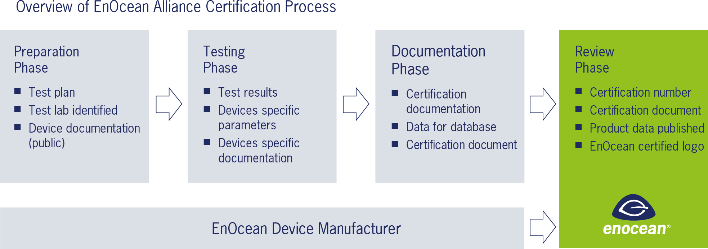
Certification
Title of presentation | Author | 18-04-05
28

Slide 30

Certification Versions
Air Interface Certification
“Certified Platform”
Only for module & platform manufacturers.
Air Interface Certification
+ Profile Declaration
“Certified Product 2.0”
Only for legacy products.
Air Interface Certification
+ Profile Certification
+ Energy Harvesting Certification (Dec 17)
+ Radio performance Certification (Nov 17)
“Certified Product 3.0”
For all new products. Legacy products optional.
EnOcean Alliance | Certification| Armin Pelka | 18th July.2017 |

Slide 31
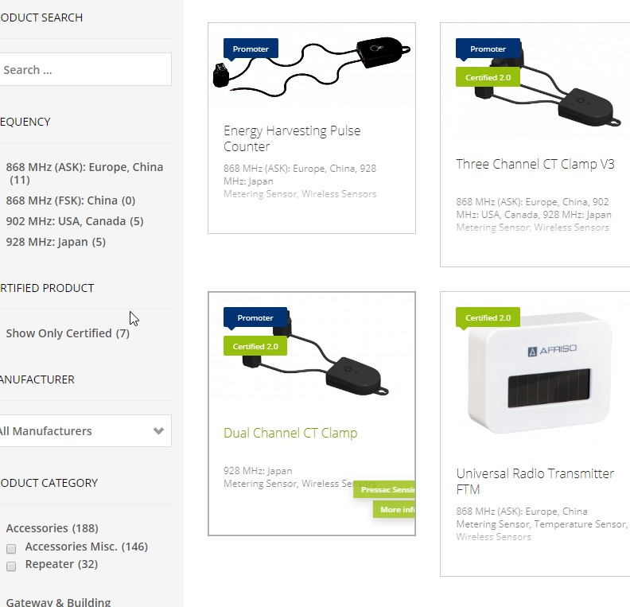
Self-Certification. Low Effort. Low / No Cost.
EnOcean Alliance Certification Manager Armin Pelka
certification@enocean-alliance.org
Certified Product Database
https://www.enocean-alliance.org/ja/products/
EnOcean Alliance | Certification| Armin Pelka | 18th July.2017 |

Slide 32
Technology Explained in few slides
Labeling
Title of presentation | Author | 18-04-05
Page 31

Slide 33
Labeling
What is defined?
Label content is separated into fields (according to ANSI MH10.8.2-2010)
Label shall be machine readable too
Mandatory Fields:
Product ID
6 bytes
Manufacturer Assigned
EURID
4 bytes
Module manufacturer assigned
Optional Fields:
AES Security Key
16 bytes
Recom code
4 bytes
Manufacturer tags
…
32

Slide 34
Labeling
What is up to the manufacturer?
Label type – NFC, QR, BAR etc.
Label properties: pixel size, coding, dimensions
Label position
33

Slide 35
Organisation
How the TWG Works
Page 34

Slide 36
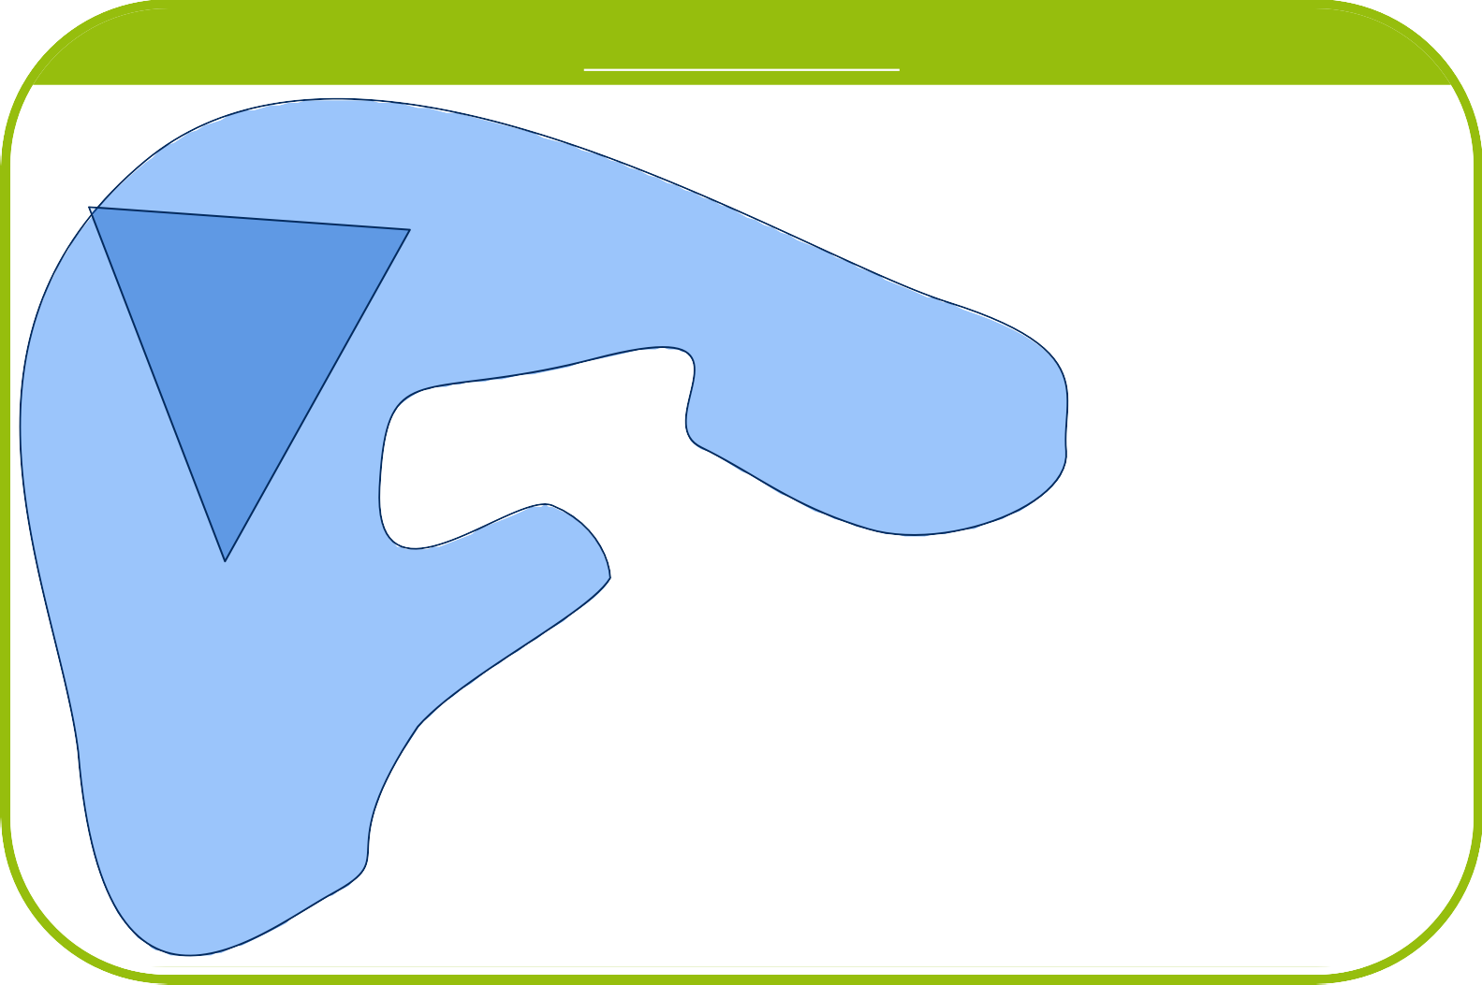



Organisation
EnOcean Alliance
TWG
TTG
TTG
TTG
TWG – Technical Work group
TTG – Technical Task group

Slide 37
Rules of the Game.. For content creation
TTG Create 6-12 Months
(exclusive access)
TWG
TWG Approve 4 weeks

Slide 38
Organization
Focus 2018
Title of presentation | Author | 18-04-05
Page 37

Slide 39
Focus 2018
Technical Task Groups
Ongoing Technical Programs
EEP Approval Committee
Remote Commissioning
EEP – Communication Profiles
Certification Program
Security
Strategic initiative
Product Labeling
EnOcean IoT

Slide 40
Focus 2018
Remote Commissioning & Remote Management
Secure communication
Range Extension over repeater
Range Extension over multiple hops
Device Description File – extension promotion amongst members TTG Head:
EnOcean ViCOS

Slide 41
Focus 2018
EEP Communication Profile
Definition of Signal Telegram and associated features
EEP v3 – new concept – long term
Simplified EEP Specification release process
Tool for profile submission and description
TTG Head:
TWG Chair

Slide 42
Focus 2018
Security
Incorporate (bidirectional) high Security concept to existing specification
Review and extend existing features
Secure communication inside Recom
TTG Head:
EnOcean

Slide 43
Focus 2018
Labeling
Review standard for multi-purpose protocol use
Promote standard to members
Incorporate feedback and expand
TTG Head (Specification owner): EnOcean GmbH

Slide 44
Focus 2018
EAC – EEP Approval Committee (Program)
Ongoing meetings and review of new submissions of EEPs
ensure high quality standards
active support interoperability
EAC Program Updates - New Profile submits include:
Test for EEP Certification
IP Representation
Program Head:
Diehl

Slide 45
Focus 2018
Certification program
Add Energy harvesting specification to the list of specifications
Promote Certification v2.0 & 3.0
Extend existing product database
Certification Manager: Armin Pelka

Slide 46
Focus 2018
EnOcean IoT
Initiative to introduce new generation of devices with IoT features
Short Term goals:
Include IP Description of additional EEPs
Mid Term goals:
Certification 4.0 – application behavior certification
Database of Device Description Files – electronic datasheet
Mandatory Product labeling according to specification
Next Generation EEPs 3.0
Alliance approved commissioning tool Head:
Digital Concepts, ViCOS, EnOcean

Slide 47
Next gen EEPs – Ideas
EEP 3.0
Similar to IP representation of Profiles
Few ideas
Fixed ranges & scaling for all future profiles
(endless variance caused more pain than gain)
Temperature | 10 bits | 0.1 Steps | -40°C to 60°C
Atomic functions (no complex hidden process)
Status reports & synchronization & acknowledges
Title of presentation | Author | 18-04-05
46

Slide 48
IoT - All about connecting devices
(c) EnOcean Alliance | Wireless Congress 2015 | EnOcean becoming Things
Page 47

Slide 49
Installers Tool
Planning
Key features:
Precise end application identification - Product label
Electronic data sheet
Device complies with certification and IoT ideas
Atomic functionality
All parameters can be read / write
Status of synchronized over all user interface (display, phone, cloud)
Application decision take outside end-devices
Remote commissioning support
Installation
Commissioning
Documentation
Documentation: Back Up file
ReCOM & Installers Tool – Wireless Congress 2016 | Thomas Rieder – ViCOS GmbH | 2016-11-09
Page 48

Slide 50
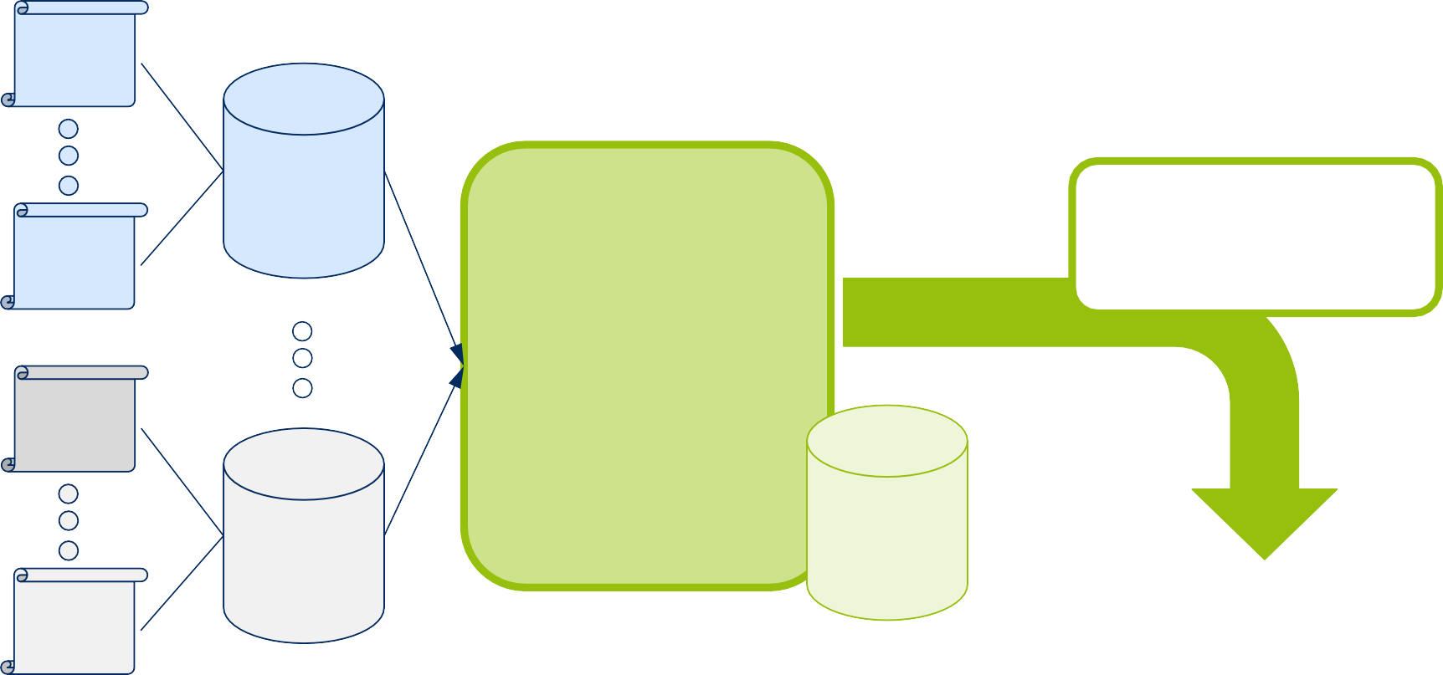
Installers Tool – Implementation Scenario
Product Manufacturers Distribution Channels
EnOcean Alliance Tool Manufacturer
Product Manufacturers Distribution Channels
PRODUCT #A-1
Installers Tool
PRODUCT CATALOG
Manufacturer A
EnOcean Alliance
Look & Feel
One Single Tool, All Devices
Devices Interoperability
ReCOM Compliant, ReMAN Compliant
Software Package EnOcean TRX Customer Support
PRODUCT #A-n
PRODUCT #Z-1
PRODUCT CATALOG
Manufacturer
Z
BACK-UP FILE
Installer
Typically NO EnOcean Alliance Member!
Local language support is a MUST!
PRODUCT #Z-n
EnOcean Product-ID EnOcean Standardized Label / QR-Code
Device Description File EnOcean Back-Up File (all standardized)
DDF Format (standardized)
PCAT Format
Page 49

Slide 51

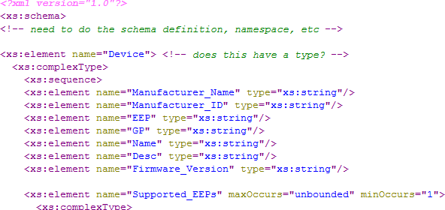
Electronic Datasheet
Describes all features and aspects of the end product with given
semantics – configuration parameters
Publically available Standardized form
(c) EnOcean Alliance | Wireless Congress 2015 | EnOcean becoming Things
Page 50

Slide 52



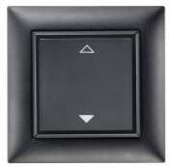


Precise end-application identification
Requirement for perfect and seamless operation:
Precise end-application - Specific for final look & features
End-application reference: A
B
C
D
…
(c) EnOcean Alliance | Wireless Congress 2015 | EnOcean becoming Things Source: https://icondoit.files.wordpress.com/2010/04/nm_lightbulb.png
Page 51

Slide 53










Localization in field
Localization (e.g. in room) is required for remote set up
network identification (communication ID)
Communication ID | Product reference
X | Light
Y | Light
Z | Light
W | Light
?
?
?
?
ACTION: Localize Z
?
?
Z
?
(c) EnOcean Alliance | Wireless Congress 2015 | EnOcean becoming Things Source: https://icondoit.files.wordpress.com/2010/04/nm_lightbulb.png
Page 52

Slide 54

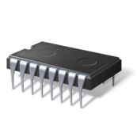





EnOcean becoming Things
Scan communication ID
and application identification
Get via air
Product
2. Query Electronic Datasheet
with End-application reference
XML
3. Commission Device
Product
(c) EnOcean Alliance | Wireless Congress 2015 | EnOcean becoming Things
Page 53

Slide 55

EnOcean becoming Things.
Key:
Specific end-application description
Identification in field
Remote control of features and configuration
(c) EnOcean Alliance | Wireless Congress 2015 | EnOcean becoming Things
Page 54

Slide 56
IoT Spec – Coming up
EnOcean over IP
First Specification that lays the groundwork for a complete IoT Spec
Describes the communication behavior of a gateway between EnOcean Radio and IP-
World
Doesn´t specify the behavior of devices (actuators, sensors)
Doesn´t specify organizational rules for an End to End (Device to User Interface) usage
Why we need a IoT Spec.
EnOcean has to reflect the changes and progresses in the IP/IoT world for the Ecosystem to
grow and prosper.
First Paper Created: EnOcean devices becoming Things_IP Regulations V0.4
Quick look through to get the idea…
What should be part of the IoT Spec
EnOcean Specifications 2.0, 3.0
EnOcean over IP Spec
Existing Specifications need to be extended
New Specifications have to be created.
EnOcean over IP – EO Alliance Meeting London | Oliver Fischer| 24-26.04.2017
Page 55

Slide 57
IoT Spec –Content excerpt ...
Physical, Data, Network Layer
Timing behaviour GW <-> Device
Timeslots in Adressing of devices (100 ms) Burst Avoidance
GW -> Dimming with slider
Device -> State reports blind actuator
Remote Management/Remote Commissioning extension: ReMan/ReCom over repeater (similar: From Hub to Switch) ReCom: 2-Channel Actuator -> Which Switch for which channel ? ReCom: Integration of application logic into ReCom definition
Addressing of devices with ADT, answer of devices with Broadcast)
Transport, Session Layer
Existing Security
Key Exchange over the air …
Security “Plus” or 2.0
Presentation, Application Layer
Ack after Receive
Ack after Execution
EnOcean over IP – EO Alliance Meeting London | Oliver Fischer| 24-26.04.2017
Page 56

Slide 58

marian.honsch@enocean.com
Contact
For further information please feel free to contact us
EnOcean Alliance
2400 Camino Ramon, Suite. 375 San Ramon, CA 94583
USA
info@enocean-alliance.org www.enocean-alliance.org
Title of presentation | Author | 18-04-05 Page 57

