Slide 1
Exploring Data Loading and Augmentation Strategies
For Tensorflow Deep Learning Models
Illuminate-AI Meetup 2021 Lightning Talks
Anindya Saha
Machine Learning Platform Engineer @ Lyft Inc
mail.anindya@gmail.com

Slide 2
Agenda
Performance Optimization (Speeding Up Training)
Exploring Image Loading Strategies
Keras ImageDataGenerator
Parallelized Keras ImageDataGenerator
Using tf.data.DataSet from Pandas DF
Creating tf.data.DataSet from TFRecord
Exploring Image Augmentation Strategies
Keras ImageDataGenerator with Augmentation
Image Augmentation pushed to Model Layers
Image Augmentation in TFRecord via Pre-processing functions
Live Q&A

Slide 3
Use Cases: Data Loading Benchmark Results
Dataset Generator | GPUs | Time / Epoch | Total Time | Learning
Keras ImageDataGenerator - No Image Augmentation | 4 GPUs | 253s for 1st epoch; ~80s/epoch afterwards; 620ms/step; | Overall 17min; 10/10 epochs | 1st try. Baseline Performance. Keras ImageDataGenerator can be a bottleneck because it is a CPU bound job and by default it uses only 1 worker to generate those images.
Keras ImageDataGenerator with multi workers and increased queue size - No Image Augmentation | 4 GPUs | 212s for 1st epoch; 60s/epoch afterwards; 448ms/step; | Overall 13min; 10/10 epochs | Using larger queue size definitely helped to bring down the overall training time a bit. We cannot really use multi workers with flow_from_dataframe of Keras ImageDataGenerator with Tensorflow. The idea was to engage the CPUs in fetching and augmenting images while the GPUs remain busy training the model.
TF Dataset - No Image Augmentation | 4 GPUs | 218s for 1st epoch; 56s/epoch later. | Overall 12 mins; 10/10 epochs | Performance is further improved with tf.dataset but not significantly from Keras Image Datagenerator. I think the solution is overfitting as evident from the Loss & Accuracy plots. Most likely due to lack of augmentation techniques.
TFRecord - No Image Augmentation | 4 GPUs | 227s for 1st epoch; 60s/epoch later. | Overall 13 mins; 10/10 epochs | Performance did not improve over tf.dataset approach.

Slide 4
Use Cases: Image Augmentation Benchmark Results
Dataset Generator | GPUs | Time / Epoch | Total Time | Learning
Keras ImageDataGenerator - With Image Augmentation | 4 GPUs | 316s for 1st epoch; ~148s/epoch afterwards; 1s/step; | Overall 28min; 10/10 epochs | Overall time is almost double the time needed without any augmentation (Use Case 1). This is expected as the CPUs would be spending more cycles in augmenting the data and will be a source of bottleneck while the GPUs are sitting idle.
Keras ImageDataGenerator - But Image Augmentation pushed to Model | 4 GPUs | 239s for 1st epoch; ~72s/epoch afterwards; 546ms/step; | Overall 16min; 10/10 epochs | By pushing the augmentation the overall time is almost 1/2 of just using Keras ImageDataGenerator. Clearly, GPUs have been leveraged well.
TFRecord - With Image Augmentation pre-processing functions | 4 GPUs | 230s for 1st epoch; 56s/epoch later. | N/A; 6/10 epochs | Performance is comparable to pushing the augmentation to GPU but much better than vanilla Keras ImageDataGenerator with augmentation. Training early stopped with 6 epochs.

Slide 5
Conclusion
Switching to tf.data API will provide perceivable performance boost over Keras Image Data Generators if you are using data augmentation.
If you do not have significant pre-processing logic then you would not gain much.
Switch to TF dataset APIs due to their fast processing.
However, setting up exact 1:1 data augmentation between Keras Image DataGenerator and TF Dataset can be a bit tricky though since you may not have exact equivalence of some transformation such as zoom etc.

Slide 6
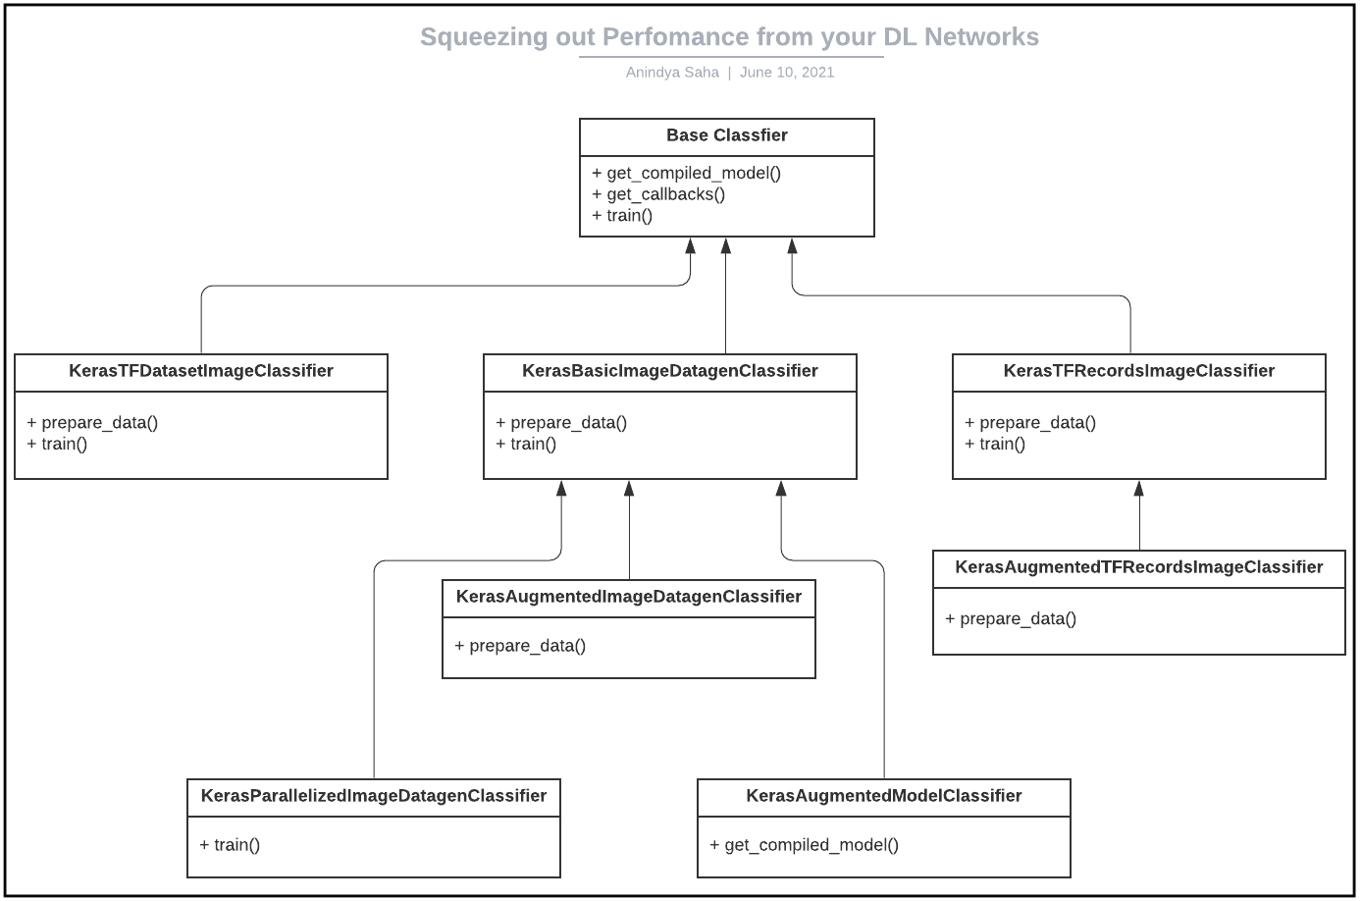
Use Cases: Class Diagram
These are the following classes we will be using to cover the use cases. We will try to override minimally only the parts that are needed by each use case while implementing the common functionalities in the parent classes.

Slide 7
Demo
Notebook on GitHub
Notebook on NBViewer

