Slide 1
RAY SUMMIT 2025
ANINDYA SAHA, ZOOX INC.

Slide 2

SCALING POST-TRAINING WORKFLOWS WITH RAY DATA, RAY DATA LLM AND vLLM
ANINDYA SAHA, ZOOX INC.
ML Platform Engineer

Slide 3
Agenda
Post training workflow; Relevant Use Cases
The Solution stack with Ray Data LLM
Why Ray Data LLM
Prototype to Production scale
Integrating Prometheus & Grafana
Optimizations
When not Ray Data LLM
Learnings and going forward

Slide 4
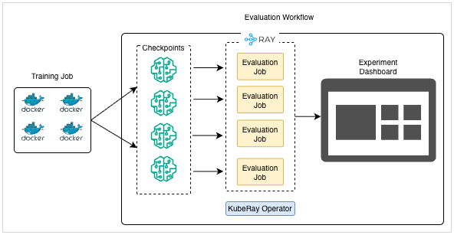
USE CASES - BUSINESS NEEDS
Fine tuning LLM models create several checkpoints and validation on the test set consumes significant time
Evaluation of checkpoints can be offloaded to a separate offline process to not interfere with the main training loop
Custom evaluator such LLM as a Judge can be added independently of training loop

Slide 5
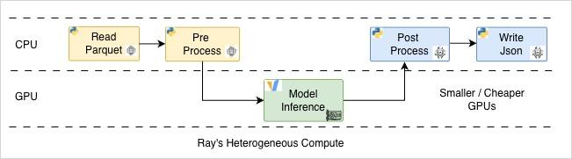
USE CASES – POSSIBLE TECHNICAL DIRECTIONS
Evaluation of all checkpoints can happen together or one at a time
The evaluation workflow can scale up and down on its own
The evaluation can also be fired off asynchronously while training is still going on
We can leverage smaller / cheaper GPU nodes for evaluation rather then costly GPU nodes needed for training

Slide 6
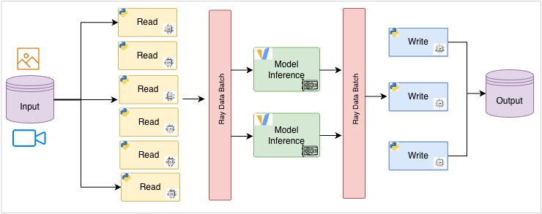
WHY RAY DATA LLM
Ray Core: Heterogeneous CPU / GPU Clusters
Ray Data LLM: APIs for offline batch inference
Integrate with existing Ray Data Pipeline ecosystem
First class integration for vLLM and OpenAI compatible endpoints
Scale up preprocess, postprocess and vLLM evaluation independently
Our existing process already use VLMEvalKit
It uses vLLM under the hood
Migration effort to scalable Ray is not significant

Slide 7
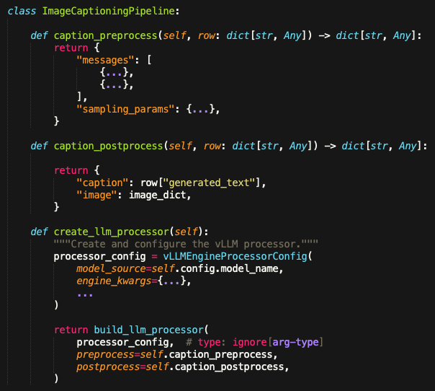
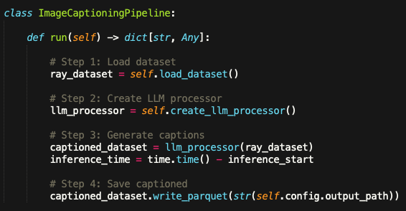
BUILDING THE 1st PIPELINE
01_image_caption_demo.py

Slide 8
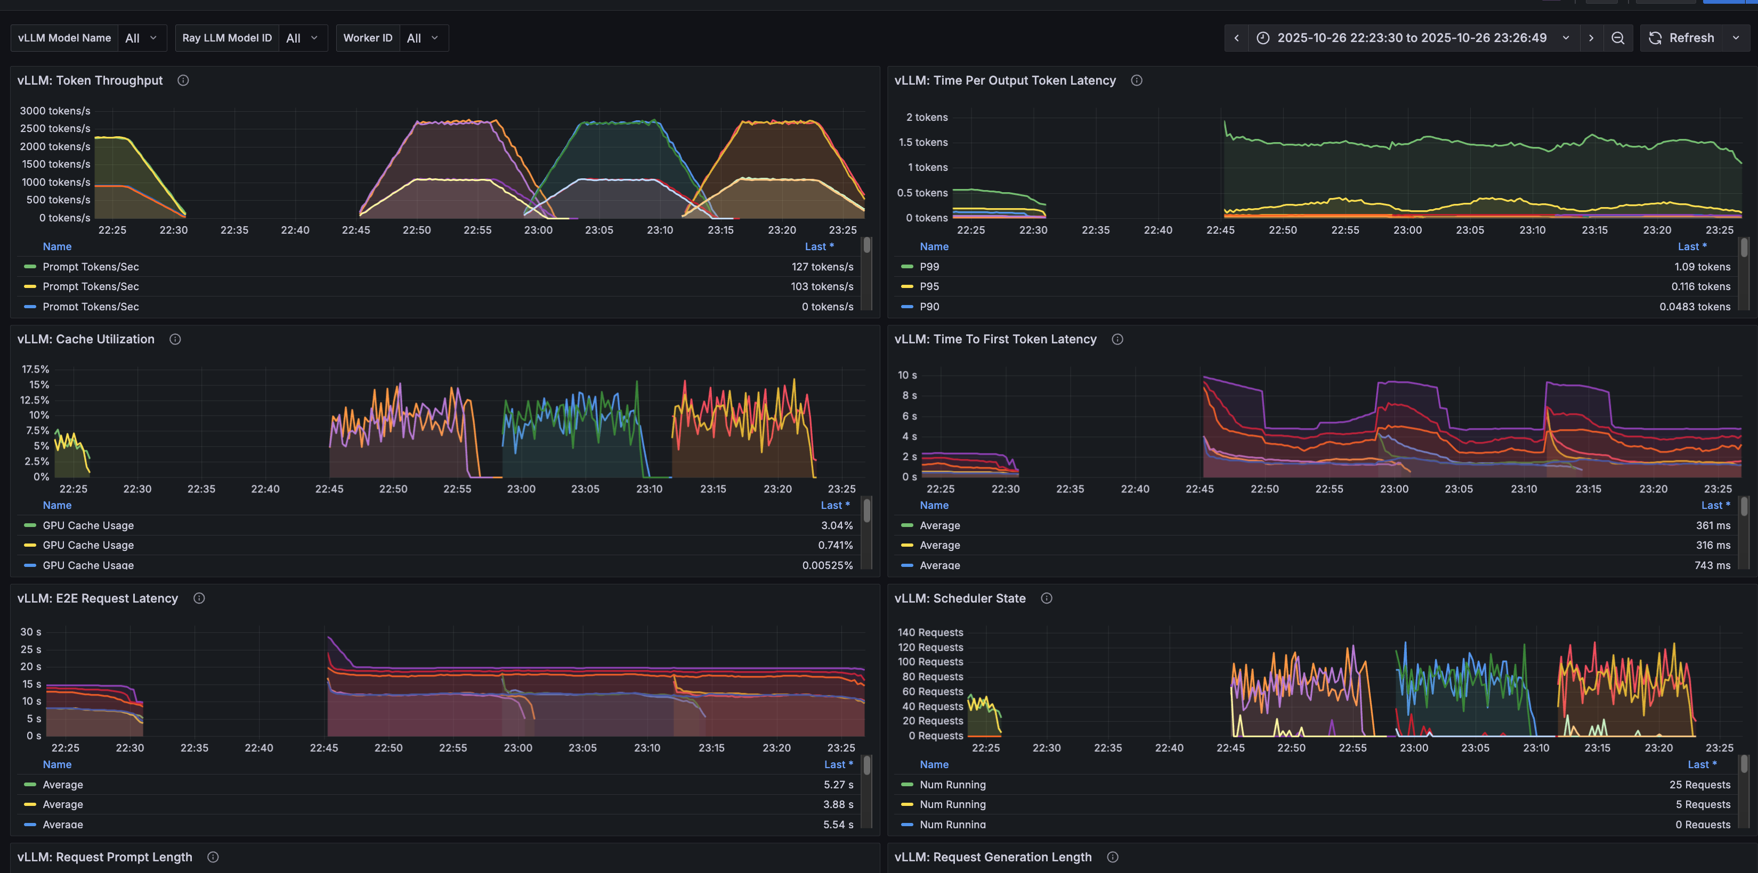
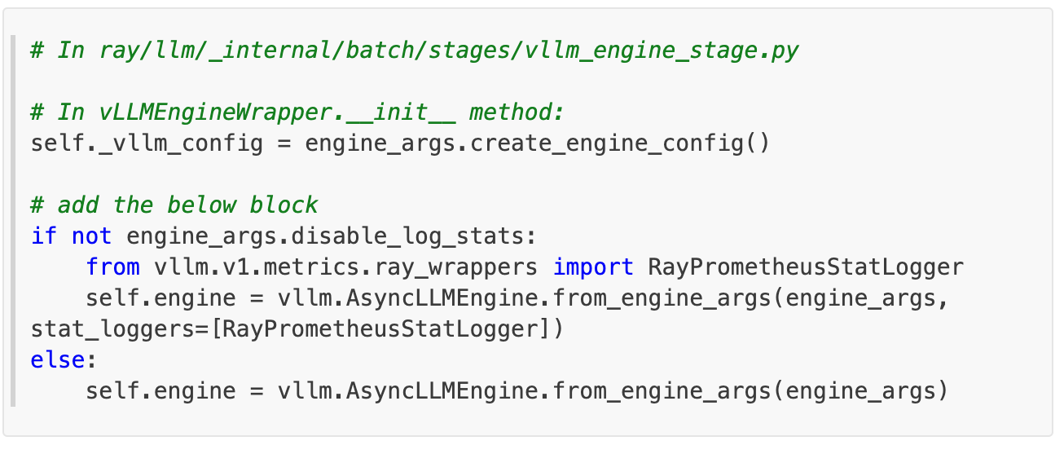
PROMETHEUS & GRAFANA
Stages vllm_engine_proc.py
Needs modification to vllm_engine_stage.py
https://github.com/anindya-saha/ray-summit-2025/blob/main/vllm_ray_metrics_integration.md

Slide 9
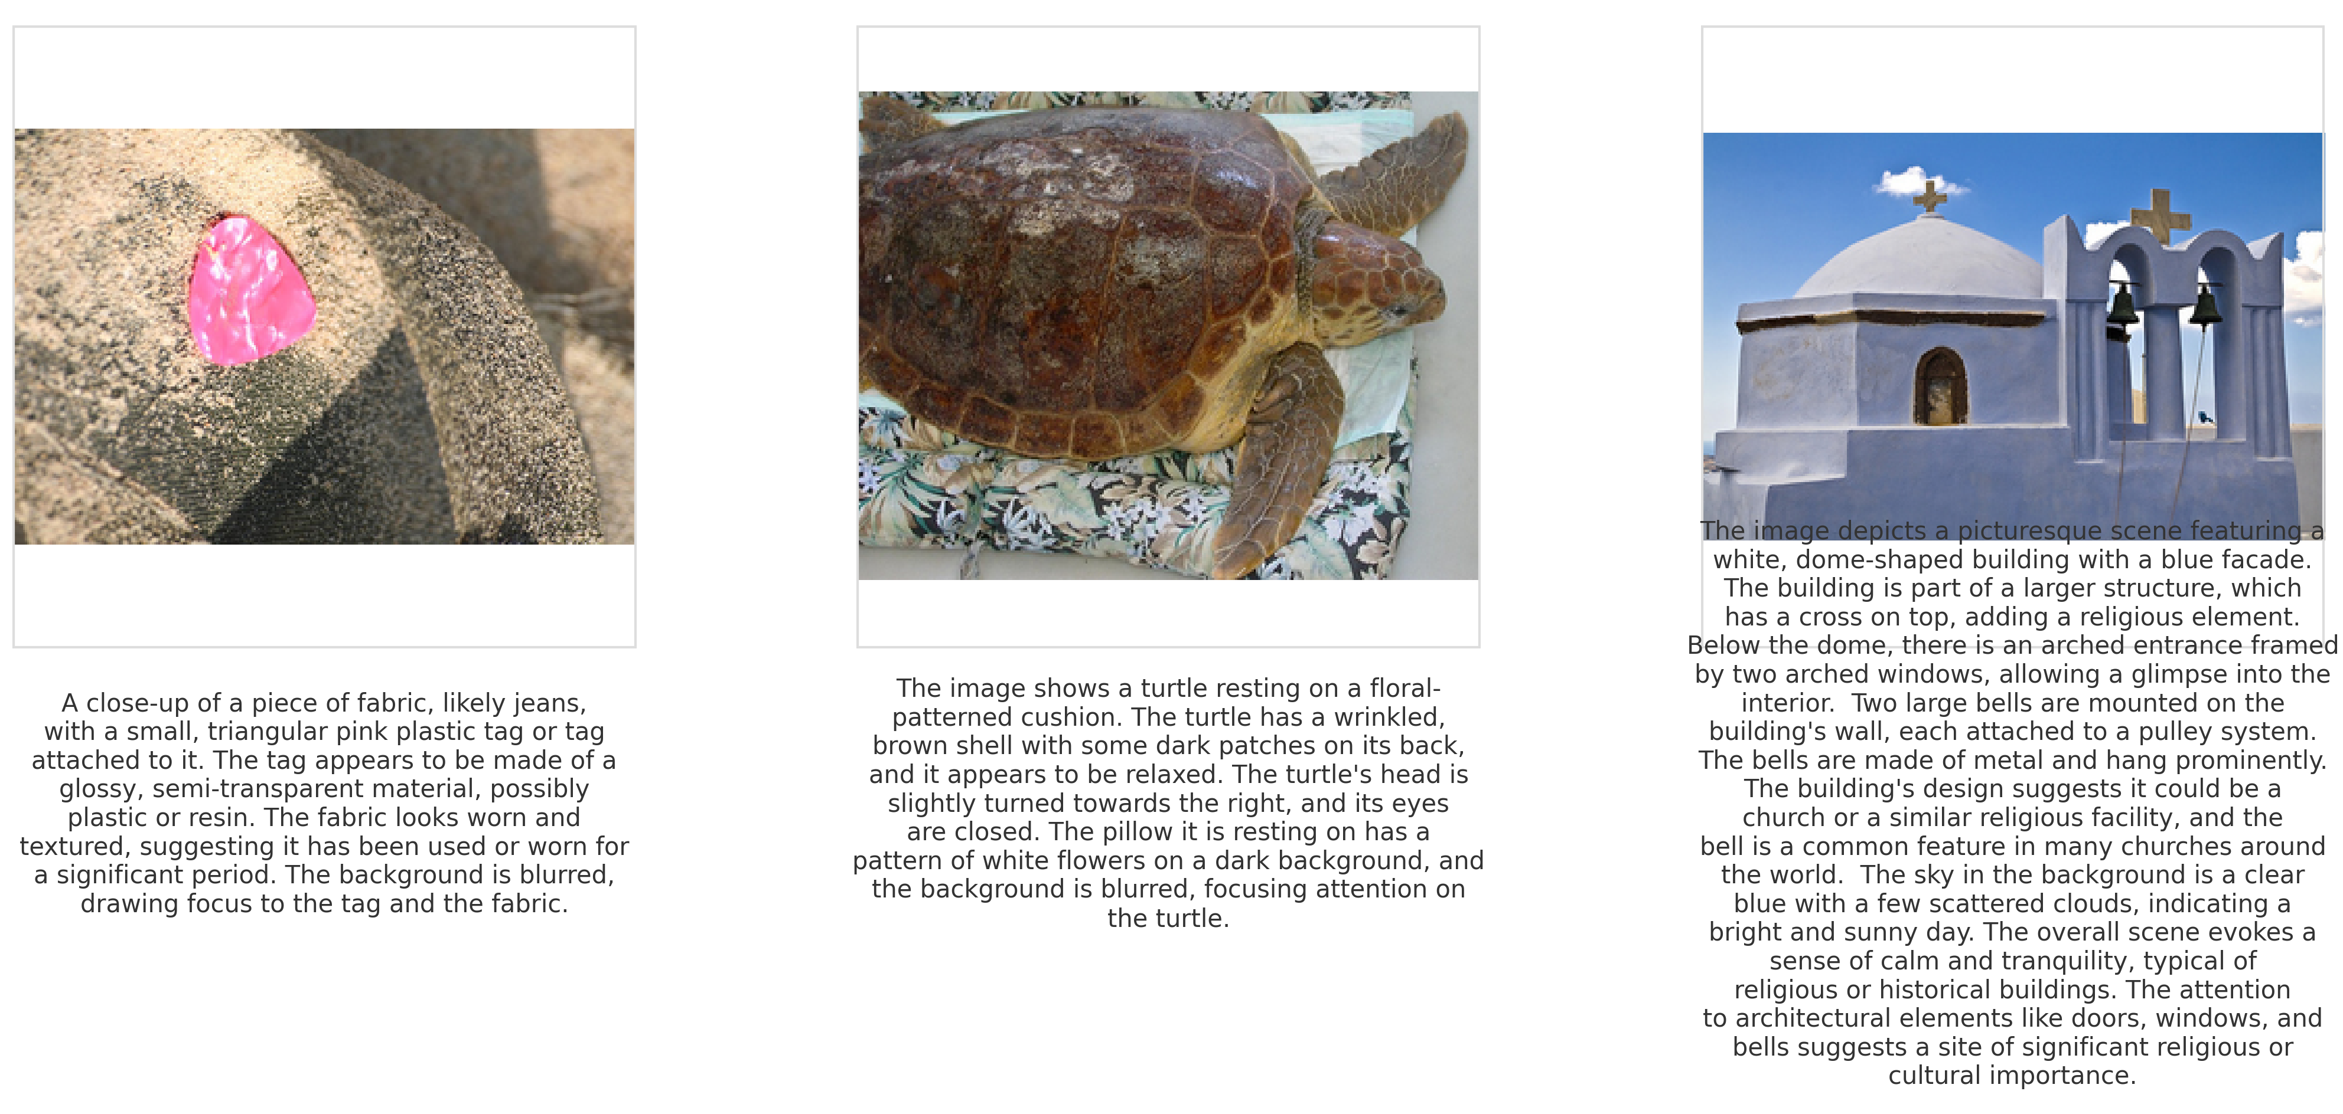
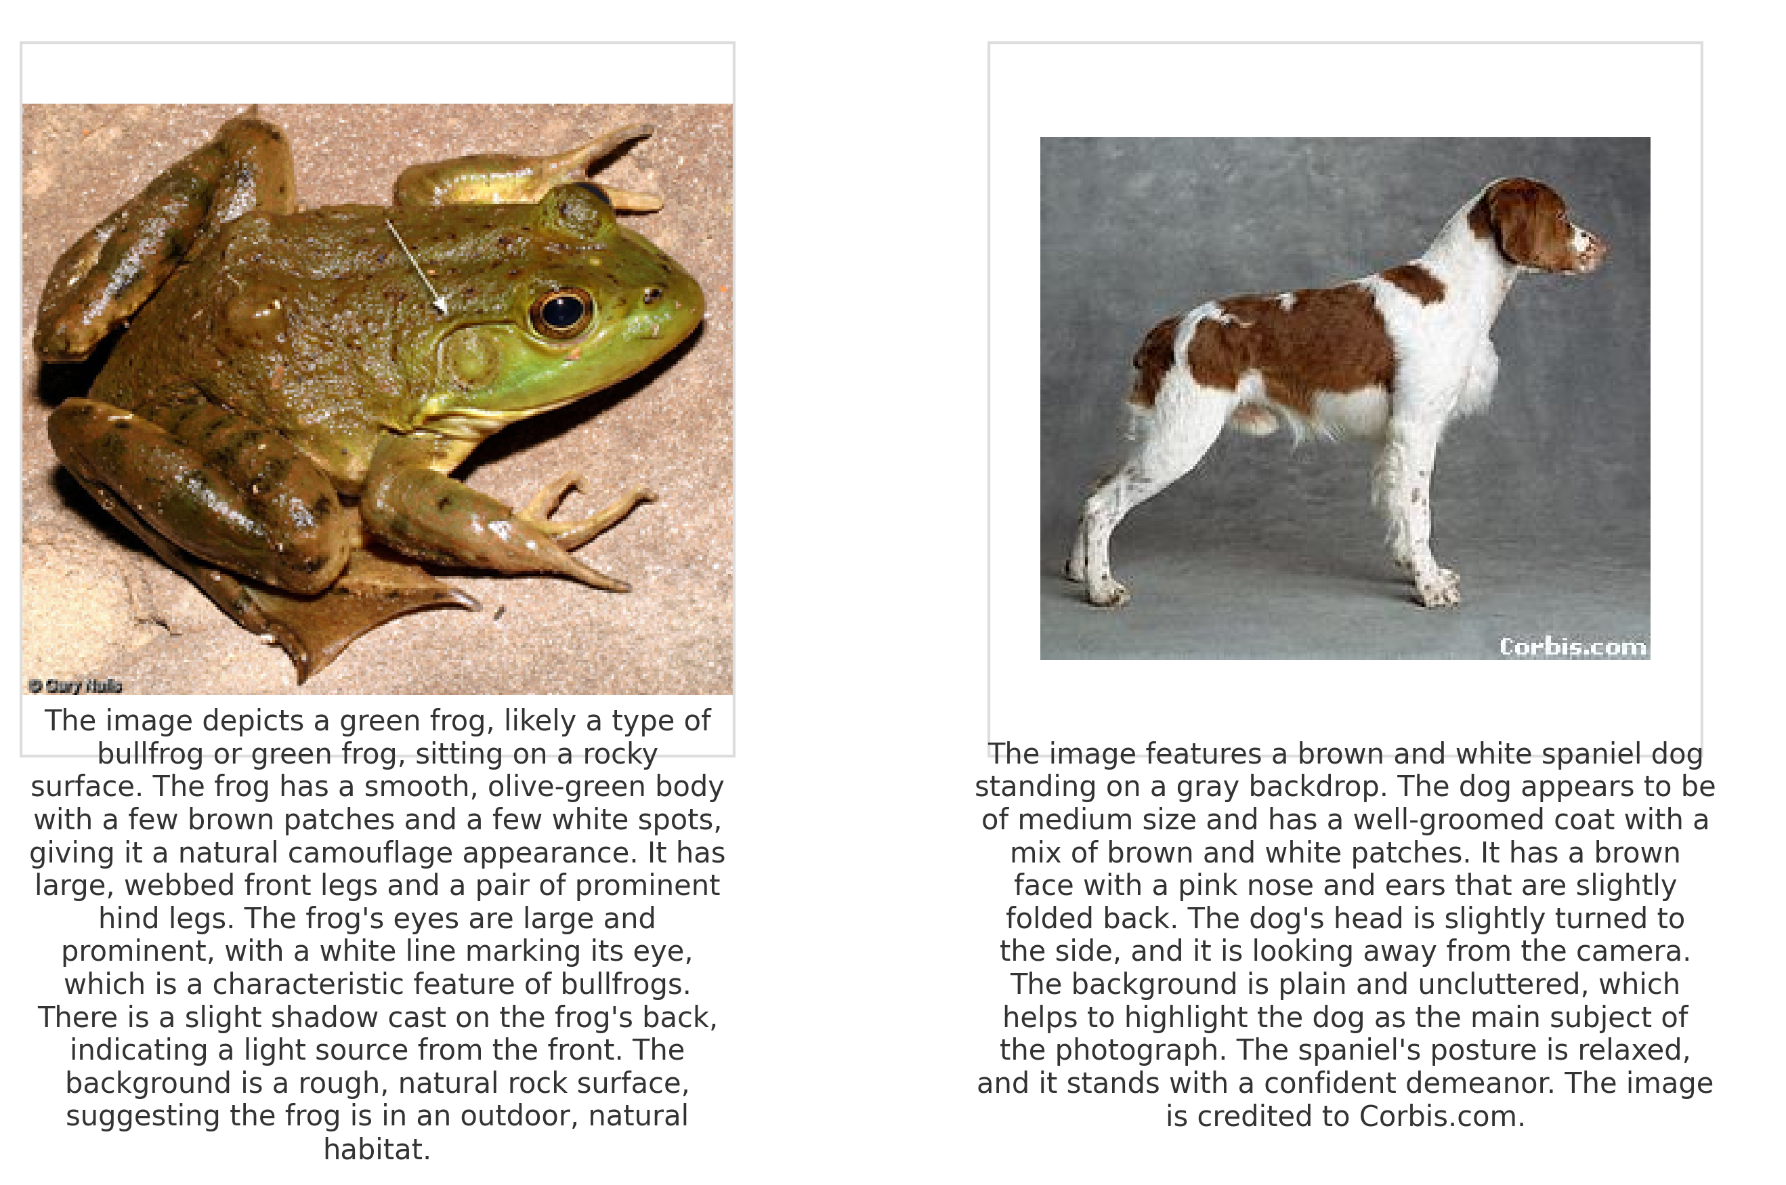
CAPTIONS

Slide 10
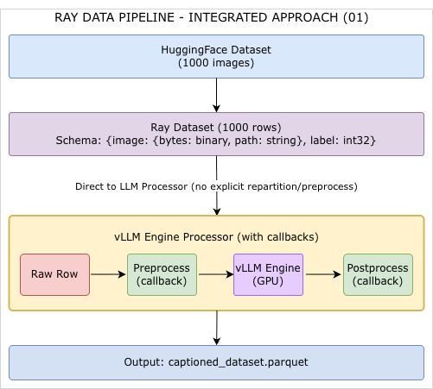
SUMMARY OF THE 1ST PIPELINE
Automatic batching and parallelization
Callbacks execute within the processor's execution context
Single map_batches operation handles everything
for simpler pipelines where preprocessing is lightweight

Slide 11
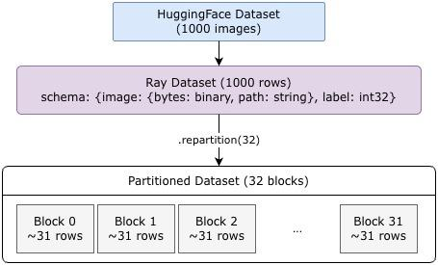
OPTIMIZATION - REPARTITIONING DATA
For CPU-bound preprocessing (like image resizing)
num_blocks = num_cpus * 2 # Oversubscribe for better utilization
dataset = dataset.repartition(num_blocks)
For I/O-bound preprocessing (like downloading)
num_blocks = num_cpus * 4 # More blocks to hide I/O latency
dataset = dataset.repartition(num_blocks)
For memory-intensive preprocessing
num_blocks = available_memory / max_block_size
dataset = dataset.repartition(num_blocks)
Let Ray decide (often good default)
# Don't repartition - Ray will use heuristics

Slide 12
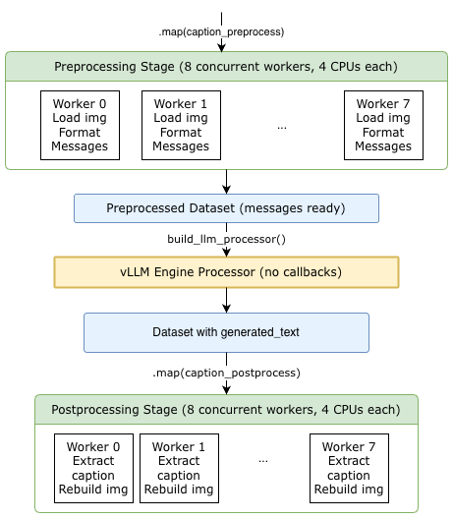
OPTIMIZATION - SCALING UP PRE AND POST PROCESSOR
Control preprocessor and postprocessor independently
Instead of map use map_batches to process samples

Slide 13
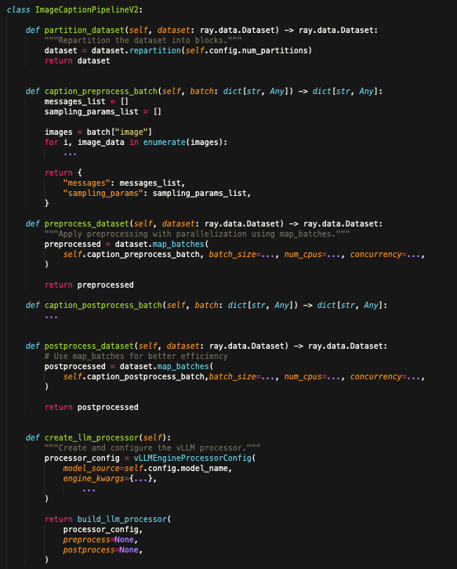
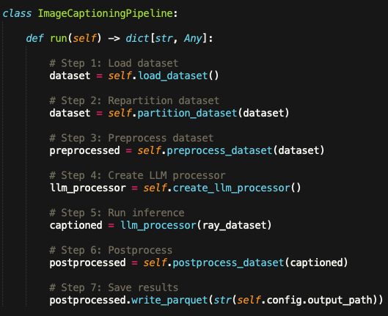
BUILDING THE 2nd PIPELINE
02_image_caption_demo.py
Notes:
Show by comparing the code files

Slide 14
PERFORMANCE RESULTS
Metric | V1 (Baseline) | V2 (Improved) | Improvement
Configuration
GPUs | 2 | 2 | Same ✓
Batch Size | 4 | 32 | 8x
Partitions | Default | 256 | Optimized
Concurrency | 2 | 16 | 8x
Performance
Preprocessing | 136-153 rows/s | 15,500 rows/s | 101x
Memory Usage | 3.2GB (13%) | 19.8GB (84%) | 6.2x
vLLM Throughput | ~14.5 rows/s | ~17.8 rows/s | 1.2x
https://github.com/anindya-saha/ray-summit-2025/blob/main/performance.md

Slide 15
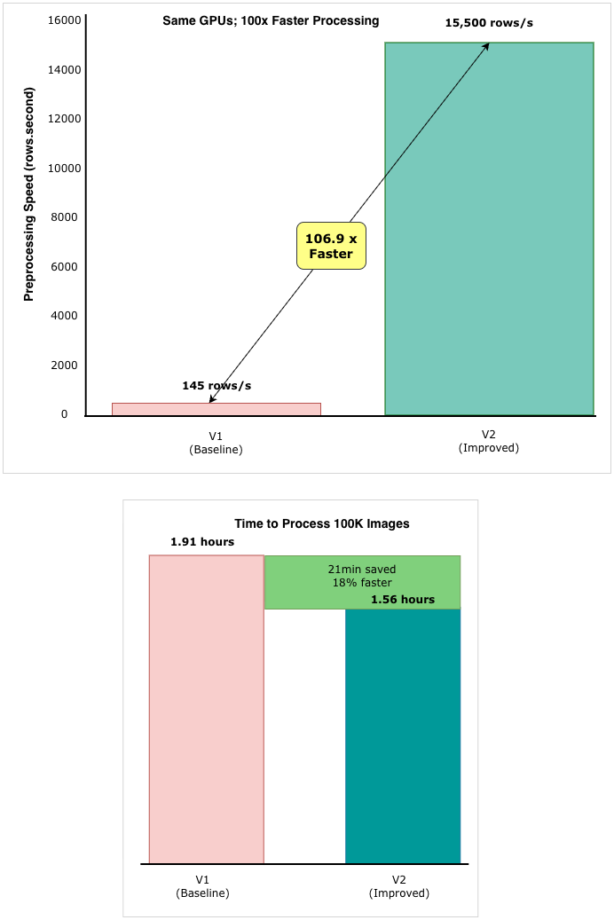
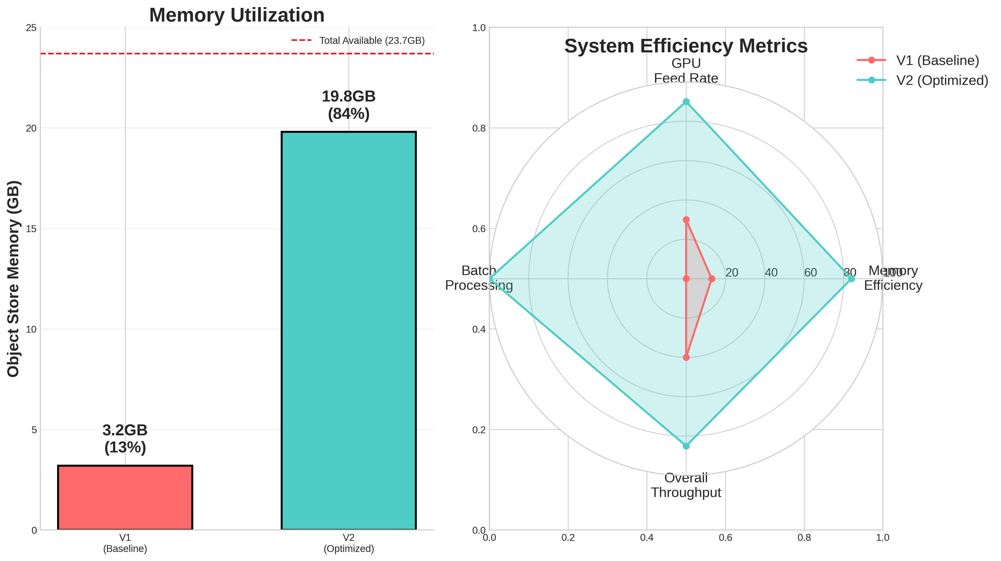
PERFORMANCE COMPARISON

Slide 16
FULL PIPELINE CONTROL
Leverage qwen_vl_utils
Dedicated CaptionProcessor class with state management
avoids: huggingface_hub.errors.HfHubHTTPError: 429 Client Error: Too Many Requests for url: https://huggingface.co/api/models/Qwen/Qwen2-VL-2B-Instruct
Direct integration with HuggingFace Qwen2_5_VLProcessor
Processor instance reuse across workers for efficiency
Explicit process_vision_info() for image handling
Fine-grained vLLM Config

Slide 17
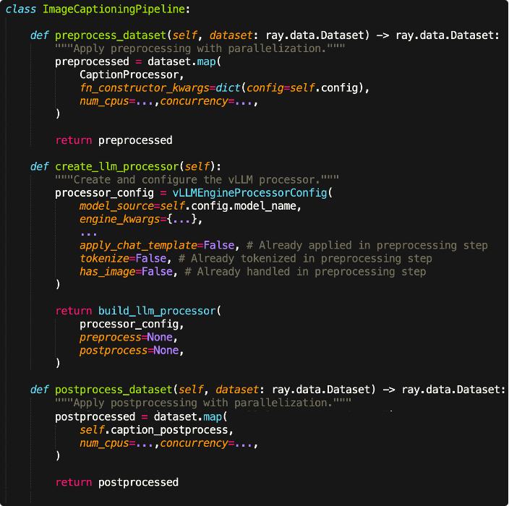
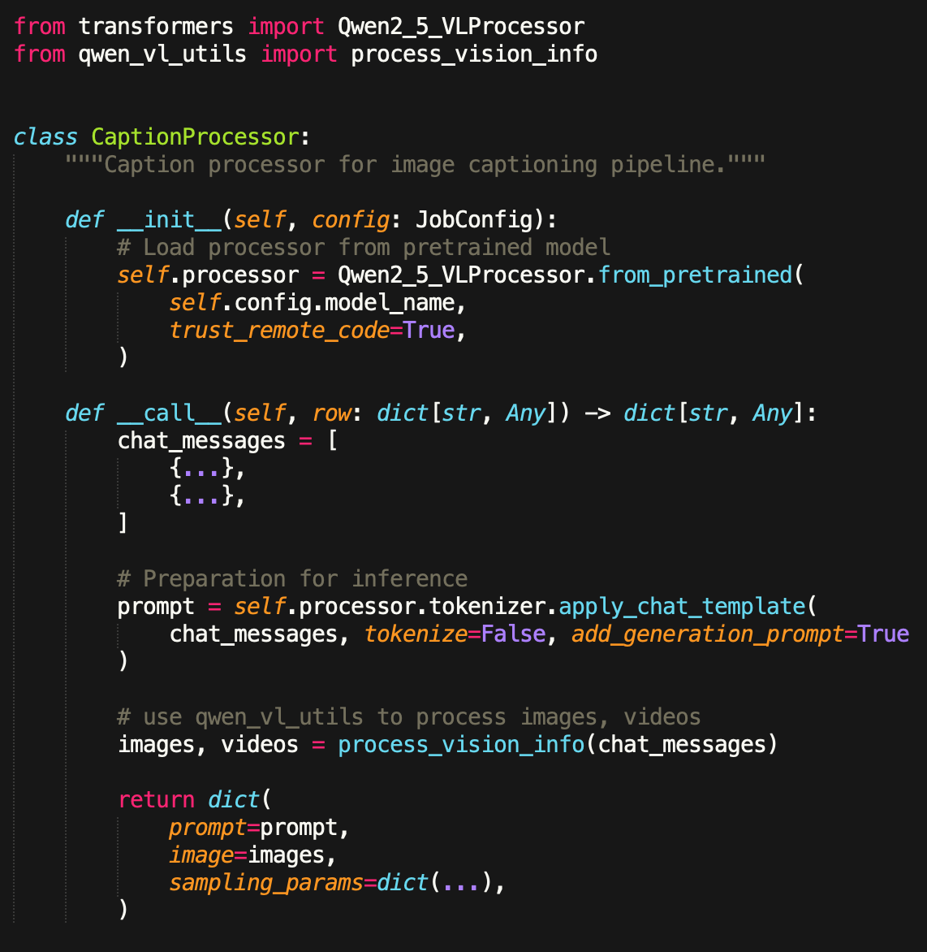
BUILDING THE 3rd PIPELINE
04_image_caption_demo.py
Notes:
Show the code difference between 03 and 04
Refer: https://docs.vllm.ai/en/latest/features/multimodal_inputs.html#video-inputs

Slide 18
WHEN NOT TO USE RAY DATA LLM
Interactive/Real-time Serving
Single request latency matters more than throughput
Need immediate per-image responses
Use: Ray Serve with vLLM directly
Small Jobs (1000 images)
Overhead exceeds benefits
Use: Simple batch script
Heavy CUDA Preprocessing
Custom CUDA kernels for image processing
Use: Ray Data with custom GPU actors

Slide 19
LEARNINGS & KEY TAKEAWAYS
Progressive Complexity is Your Friend
Start with build_llm_processor() callbacks for MVP
Add explicit stages when you need resource control
Go full custom when performance is critical
Lesson: Premature optimization is the root of all evil
Separation of Concerns Matters
CPU Tasks: Image loading, preprocessing, formatting
GPU Tasks: Pure inference without I/O
Memory: Keep large objects (images) out of GPU pipeline
State Management in Distributed Systems
Model loading is expensive - do it once per worker
Use class-based processors for state persistence
Ray handles worker lifecycle automatically

Slide 20



Special Thanks to: Nikhil G, Kourosh H @ Anyscale
Code Reviewing, Fixing Ray Data codes, Feedbacks on Slides etc.
https://ray.slack.com/archives/C08H0M37WLQ/p1760636442990289
https://ray.slack.com/archives/C08H0M37WLQ/p1759776795931939
https://github.com/ray-project/ray/pull/57826
https://github.com/ray-project/ray/issues/57812
https://github.com/ray-project/ray/pull/57980
THANK YOU.
asaha@zoox.com
https://www.linkedin.com/in/anindyacs/
https://github.com/anindya-saha/ray-summit-2025
We’re hiring!!

