Slide 1
Impact of Car Features on Price and Profitability
Here is where this template begins

Slide 2
TABLE OF CONTENTS
1. PROJECT DESCRIPTION
2. TASK: ANALYSIS
3. TASK: DASHBOARD
4. TECH- STACK USED
5. APPROACH
6. INSIGHTS
7. RESULT
8. CONCLUSION
9. DRIVE LINK

Slide 3
PROJECT DESCRIPTION
The automobile sector has grown quickly, emphasizing technical innovation, environmental sustainability, and fuel efficiency.
It is critical to comprehend the elements influencing demand for cars as customer tastes change and competition heats up.
Along with alternative fuels like hydrogen and natural gas, electric and hybrid cars are growing in popularity. Conventional gasoline-powered vehicles continue to be popular, and many fuel kinds and grades are offered. Car manufacturers can examine the link between features, market categories, and price to uncover popular features and lucrative categories, which will help them improve pricing and product development decisions. Regression analysis and market segmentation are two data analysis approaches that businesses may employ to assist them create a pricing plan that balances profitability and customer demand while concentrating on product characteristics for future development. Over time, this strategy can improve profitability and competitiveness.

Slide 4
TASK
A Task- 1: How does the popularity of a car model vary across different market categories?
A Task- 2: What is the relationship between a car's engine power and its price?
A Task- 3: Which car features are most important in determining a car's price?
A Task- 4: How does the average price of a car vary across different manufacturers?
A Task- 5: What is the relationship between fuel efficiency and the number of cylinders in a car's
engine?
TASK: DASHBOARD
Task- 1: How does the distribution of car prices vary by brand and body style?
Task- 2: Which car brands have the highest and lowest average MSRPs, and how does this vary by
body style?
Task- 3: How do the different feature such as transmission type affect the MSRP, and how does this
vary by body style?
Task- 4: How does the fuel efficiency of cars vary across different body styles and model years?
Task- 5: How does the car's horsepower, MPG, and price vary across different Brands?

Slide 5




TOOLS USED
Jupyter Notebook: USING FOR CLEANING AND VISUALIZATION
EXCEL: FOR VISUALIZATION
TABLEAU :FOR DASHBOARD
MICROSOFT POWERPOINT (VERSION: MICROSOFT 2016): FOR
CREATING THE REPORT

Slide 6
APPROACH
1.Data Collection and Familiarization
2.Data Cleaning and Preparation
3.Data Analysis
4.Building the Interactive Dashboard
5.Project Report

Slide 7
APPROACH
Data Gathering and Familiarization: Downloading the given dataset marked the beginning of the research.• Next, in order to fully comprehend the goals and specifications, I began by carefully reviewing the project specifics that had been supplied.
Data Preparation and Cleaning: Excel was used to do data cleaning on the dataset.• To guarantee ease of analysis, data types were adjusted, missing values were handled, and additional formatting was completed.
Data Analysis: To get an understanding of how automotive attributes affect pricing and profitability, the dataset was analyzed at the beginning of the process.• To summaries and aggregate the data and provide a clearer understanding of the correlations between various variables, pivot tables were made.• To determine which factors had the highest correlation with the price of an automobile, regression analysis was done.• Visualizations using graphics, including bar charts and scatterplots, line charts, and bubble charts, were used top resent the findings.
Creating the Interactive Dashboard: An interactive dashboard that allowed users to explore the data and extract insights was built using Tableau.• The dashboard was enhanced with slicers and filters to make it more interactive.• To create an educational dashboard, visual aids including scatter plots, line charts, and stacked column charts were employed.
Project Report: Following the completion of the dashboard and data analysis, a project report was created.• This report includes a thorough discussion of the project and was created using Power Point.

Slide 8
INSIGHT AND RESULT

Slide 9
Task- 1: How does the popularity of a car model vary across
Popularity by Market Category:
With 19,33,488 models, the "Flex Fuel" market category is the most popular. With a popularity of 16,86,521 it is closely followed by the market category "Crossover."•
There are more models available for "Crossover" than for "Flex Fuel," despite the fact that "Flex Fuel" is a more popular market segment.
* Although they are less popular than other market categories, "luxury," "performance," and "performance" nevertheless have a sizable number of vehicles available.

Slide 10
Task- 2: What is the relationship between a car's engine power and its price?
2. Price Variation Depending on Engine Power: • The price of cars and engine horsepower are positively correlated. The average cost of the automobile rises along with the engine horsepower.* automobiles with an engine horsepower of 55, for instance, cost an average of $2,000, but automobiles with an engine horsepower of 1001 cost an average of $17,57,223.67.

Slide 11
Which car features are most important in determining a car's price?
Relative Importance of Car Features on
Price:
• According to the regression analysis, the car feature
that has the least importance on the price of the
vehicle is “vehicle size”. On the other hand, the
“engine cylinder” has the highest importance.
• Other features that show relative importance in
determining the price of a car include “City MPG”,
“Highway MPG”, “engine HP”.

Slide 12
Task- 4: How does the average price of a car vary across different manufacturers?
• “Bentley," "Rolls Royce," and "Bugatti" are the automakers with the highest average automobile pricing.
Among the manufacturers, "Bugatti" has the greatest average price range and “OldsMobile" the lowest average price range.

Slide 13
5. Relation between Cylinders and Highway MPG:
• Vehicles with fewer engine cylinders often have higher average highway MPG, whereas vehicles with more engine cylinders typically have lower average highway MPG.
• There is an inverse relationship between the number of engine cylinders and the average highway MPG

Slide 14
DASHBOARD TASKS

Slide 15
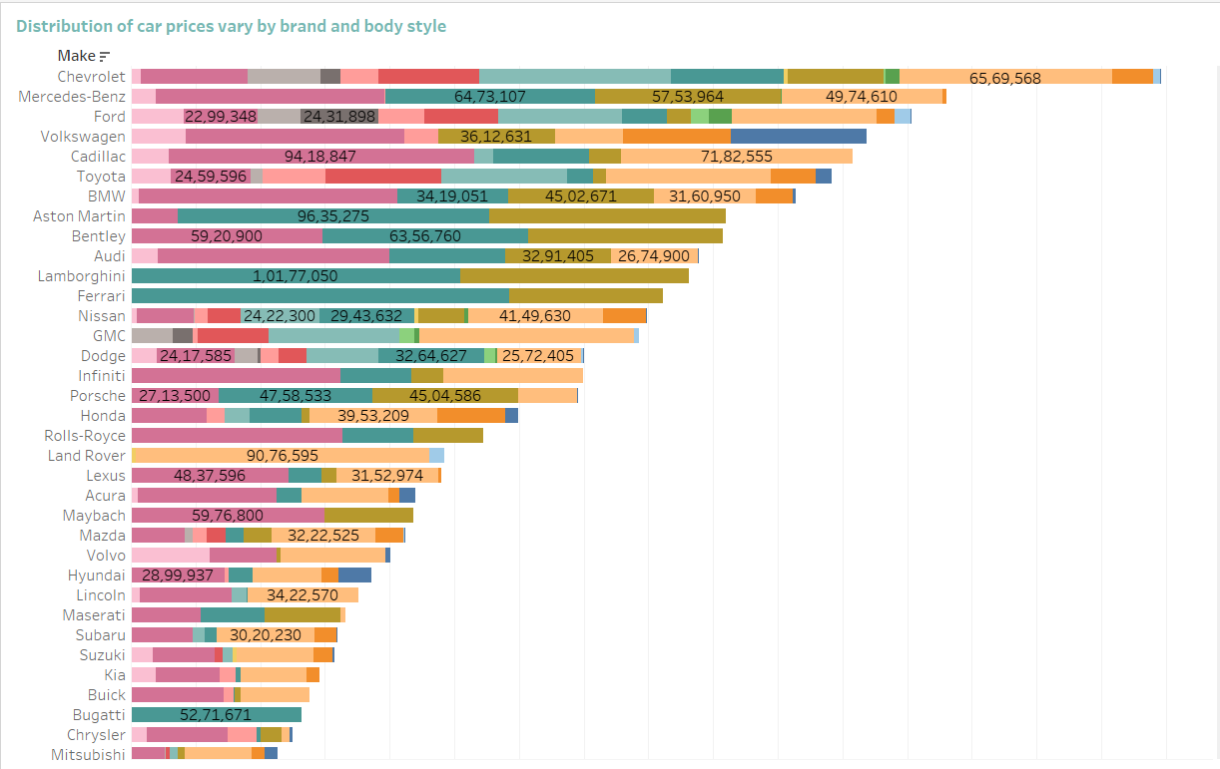
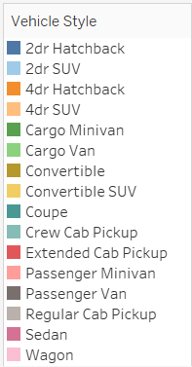
D_Task- 1: How does the distribution of car prices vary by brand and body style?
Car pricing Distribution by Brand and Body Style: Different brands and body styles have different pricing distributions. Price ranges varies for various brands and body types.
• For instance, "Chevrolet" provides a variety of body types.

Slide 16
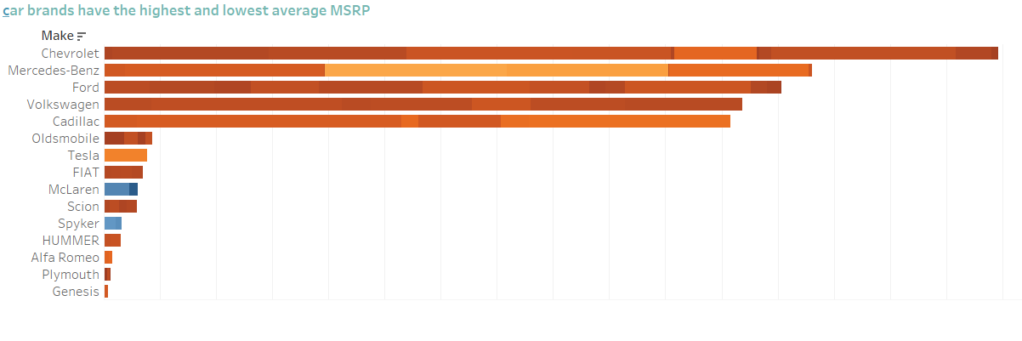
7. Average MSRP by car brands have the highest and lowest average MSRP as per body style:
I have used set operation to create 2 sets top and bottom as per the MSRP on Make, combined those sets, placed them in the filter, and got the details of the top and bottom car details as per the AVG MSRP.
And I found that Chevrolet has more style with the good average.

Slide 17
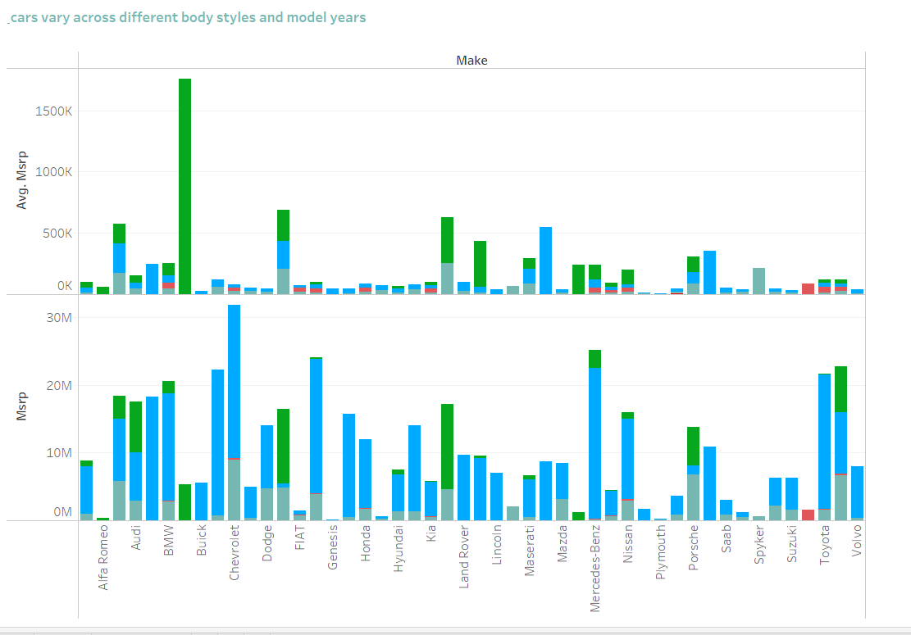
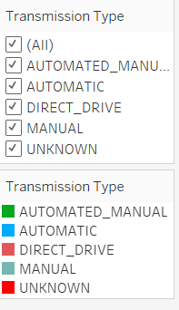
Impact of Transmission Type on MSRP by Body Style:
The choice of transmission type also
affects the average MSRP, especially
when considering different body styles.
Here I have created the visualization of the transmission type as per the price, and I have rearranged the two axes, one normal and one with AVG Msrp

Slide 18
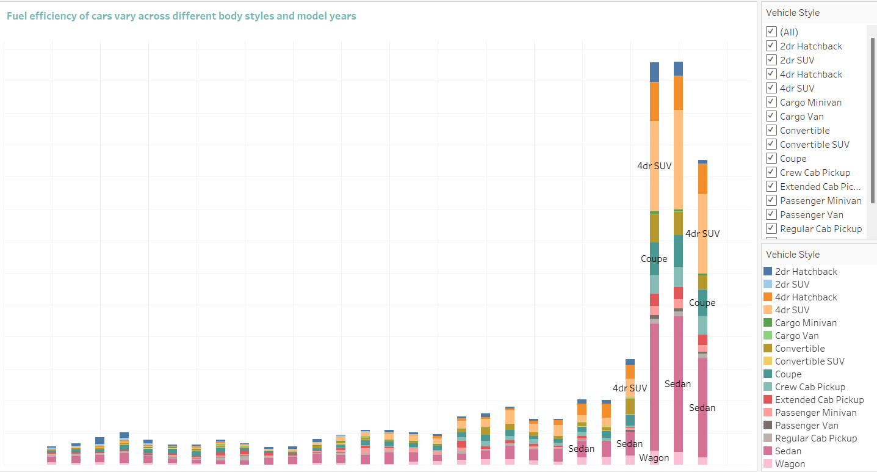
Fuel Efficiency Across Body Styles and Model Years:
The city and highway MPGs, which are used to calculate fuel efficiency, varied for various model years and body types. Transmission with a some what smaller the mean.
There are fluctuations in fuel efficiency over the years, but
overall, there is a trend of improvement in city and highway
MPG.

Slide 19
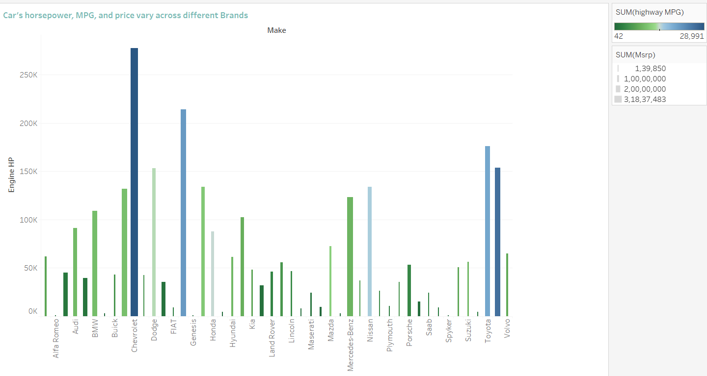
Car's horsepower, MPG, and price vary across different Brands
Different automobile brands have different engine horsepower, pricing, and city/highway MPG ratings.• "BMW," for example, strikes a mix between engine horsepower (120k), city/highway MPG (111.40), and average cost of 2.05C.

Slide 20
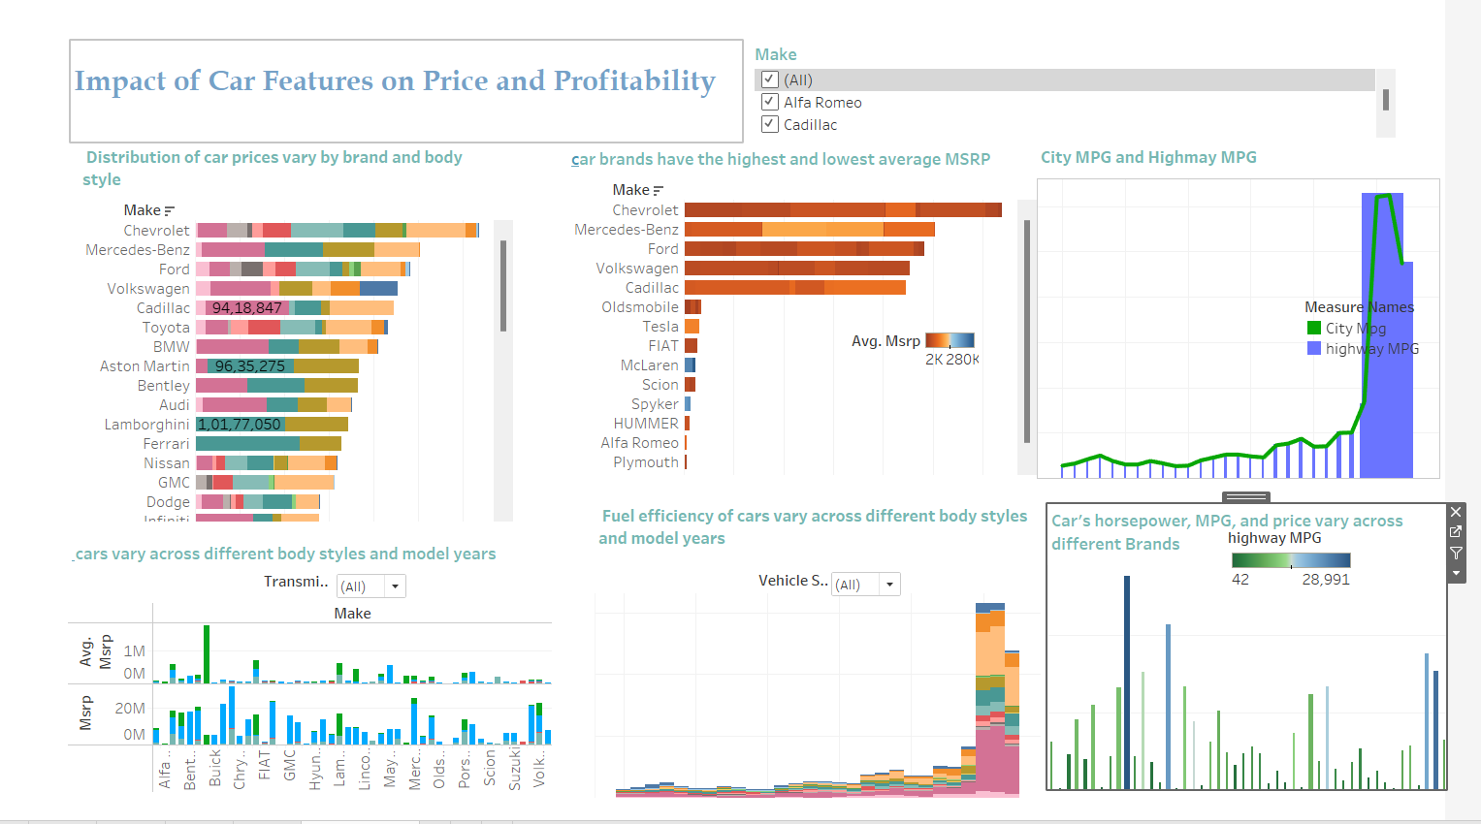
DASHBOARD

Slide 21
CONCLUSION
Numerous significant insights on car pricing, market segments, automotive characteristics, and fuel efficiency were found by analysing the car dataset. The findings allow for the important conclusions to be reached as follows:
• Brands and body styles have a big impact on car costs. The typical MSRP of some brands, such Rolls Royce, Maybach, and Bugatti, is greater than that of other brands.
• Engine power, expressed in horsepower (HP), is a key factor in deciding automobile costs.
• The choice of body shape also affects the price range of cars, with certain body types fetching higher prices. Higher horsepower vehicles often have higher average prices. This suggests that consumers are prepared to spend more for more powerful engines.

Slide 22
DRIVE LINK
Link for clean dataset.csv:
https://docs.google.com/spreadsheets/d/1NQs6b4bp7ZC3kab5dSnX5t9u1LqanEw-/edit?usp=share_link&ouid=113119245928557471712&rtpof=true&sd=true
Link for Python Code Script .ipynb:
https://docs.google.com/spreadsheets/d/1NQs6b4bp7ZC3kab5dSnX5t9u1LqanEw-/edit?usp=share_link&ouid=113119245928557471712&rtpof=true&sd=true
Link for Python Code PDF:
https://drive.google.com/file/d/169Fgd8jZxCsK2H-LXhewCf9XwUPFhk7I/view?usp=share_link
Dashboard: https://public.tableau.com/app/profile/anindya.das3408/viz/book1_16978205615450/Dashboard1?publish=yes

Slide 23
THANK YOU

