Slide 1
Dynamic College Website CMS
Techno India Main Project
Spring Boot Implementation

Slide 2
Problem Statement
Static websites require manual code editing for every update.
Lack of real-time communication between college admin and students.
Difficulty in managing course curriculum and notices efficiently.
Dependency on technical staff for minor content changes.

Slide 3
Objectives
To develop a dynamic Content Management System (CMS).
To provide an intuitive Admin Interface for data management.
To ensure real-time updates of academic programs and facilities.
To implement a secure and scalable backend architecture.

Slide 4
Project Overview
A full-stack web application replacing legacy static pages.
Built with Java Spring Boot for robust backend processing.
Features a decoupled architecture with Thymeleaf frontend.
Focuses on usability, performance, and data integrity.

Slide 5
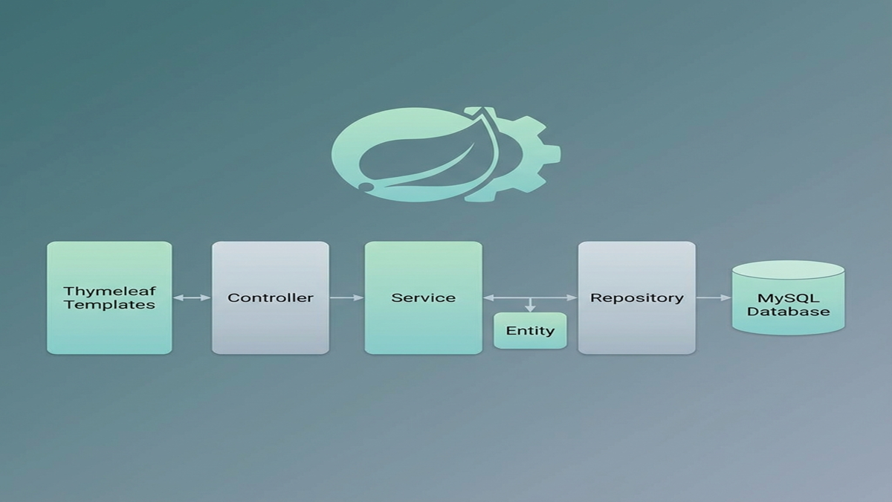
System Architecture

Slide 6
Architecture Details
MVC Pattern: Model-View-Controller separation.
Controller: REST endpoints receiving client requests.
Service: Core business logic and transaction management.
Repository: Data persistence using Spring Data JPA.
Database: Relational schema storing structured data.

Slide 7
Key Features
Dynamic Content Management: Update courses/notices instantly.
Admin Dashboard: Secure access to CRUD operations.
Responsive UI: Mobile-friendly design with Bootstrap/CSS.
Search & Filter: Easy navigation for academic programs.
Scalable Database: Optimized for high data volume.

Slide 8
Technology Stack
Backend: Spring Boot 3.3.0, Java 17
Frontend: Thymeleaf, HTML5, CSS3, JavaScript
Database: MySQL
Tools: Maven, STS IDE

Slide 9
Database Design
Entities: Degree, Course, PageSection, PageContent.
Relationships: One-to-Many mapping (e.g., Degree -> Courses).
Normalization: ensuring data consistency and reducing redundancy.
JPA Entities handling automatic table generation.

Slide 10
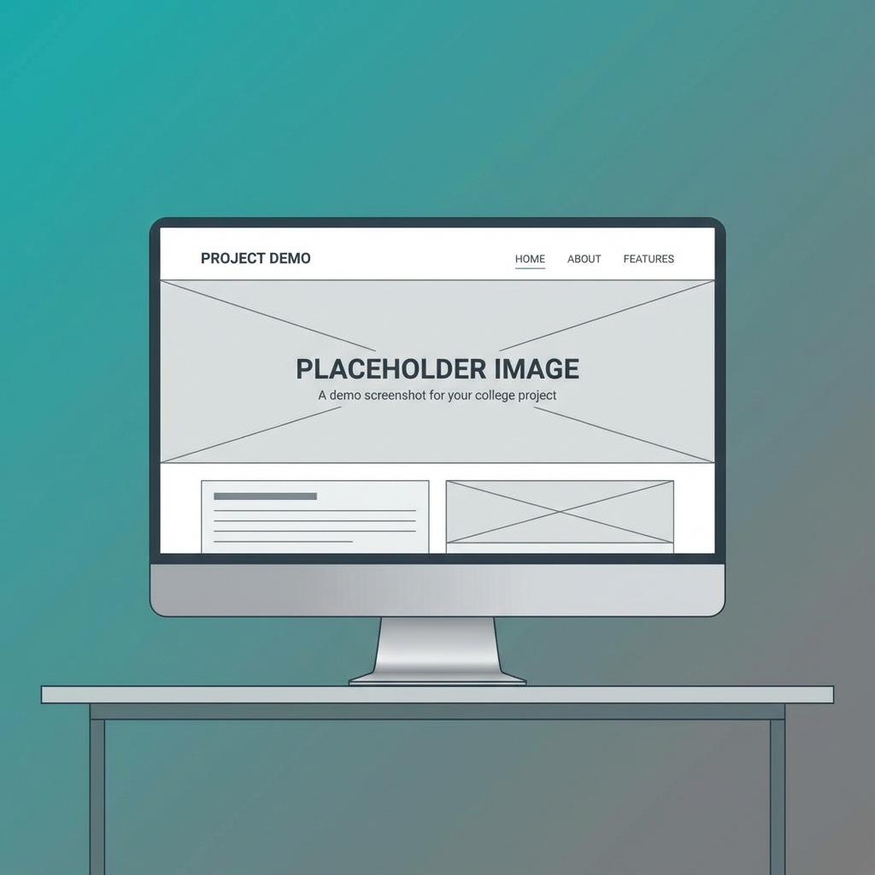
System Demo

Slide 11
Future Scope
Integration with Payment Gateway for admissions.
AI-based Chatbot for student queries.
Role-based Access Control (RBAC) implementation.
Mobile Application development using REST APIs.

Slide 12
Conclusion
Successfully delivered a functional Dynamic CMS.
Streamlined the process of website content updates.
Demonstrated effective use of Spring Boot ecosystem.
Project will be ready for deployment and future enhancements.

