Slide 1
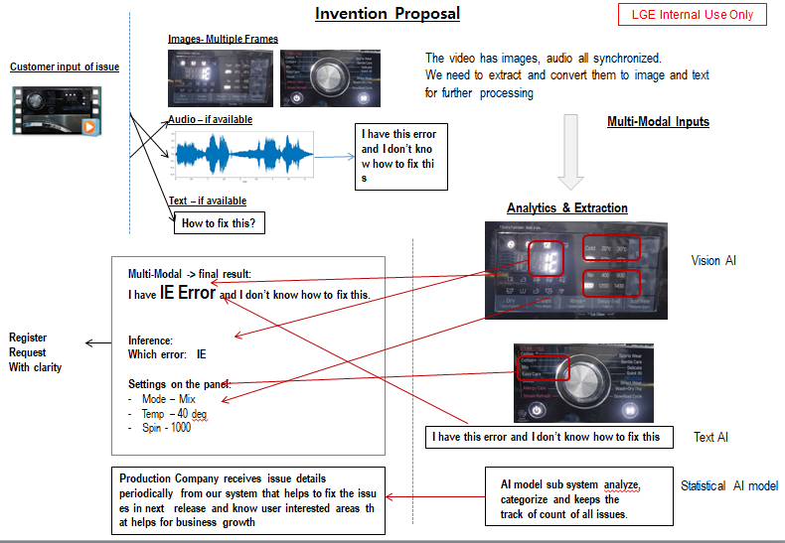
01. Title
LG – Smart Service based product feedback system
02. Inventor(s)
Vanitha Alagarsamy, Anindya , Balaji Haridass
03. Abstract
This system can have some intelligent statistical AI models which will be integrated with ThinQ system and continuously monitor user conversations (multimodal) with ThinQ device and form a meaningful complete query from multimodal data. This AI model will keep the track of issues that user is reporting and automatically notify the production system. So that , the frequent occurrence issues will be resolved in next release
04.
Problem
User’s may encounter problem with their devices anytime.
Intelligent query formation using text, audio, images and interact with ThinQ , get the problem solved OR reported at the service centre.
Currently there is no intelligent statistical AI model to leverage on the multimodal data and to categorize the issues and track the count.
Goal is to keep the track of issues and notifies back to the company
06. Refer to Page 3
05.
Solution
Our system, Intelligent Statistical AI model integrated with ThinQ system will analyze, categorize and keeps the track of count of all issues.
It leverages on multimodal data, capture all the aspects of the issues.
It notifies the issues to the company that are mostly faced by users.
It helps in fixing the issues in next release
Can find User interested areas and apply in feasible products that helps business growth
Application: In general for all LG device – connected with ThinkQ App
07.
Prior Art
To be checked
Flowchart or block diagram or 3d model
08.
Project Information
08-1. Project Name
LG – Smart Service
(Could be extension of KER)
09. keyword
Smart Service, Trouble Shooting, Service registration, Fixing issues
08-2. Release date
2022
08-3. Counterpart in Korea
AI Lab

Slide 2
Problem Scenario
User’s may encounter problem with their devices anytime.
Intelligent query formation using text, audio, images.
They will interact with ThinQ system and get the problem solved
Our system, Statistical AI model integrated with ThinQ system will analyze, categorize and keeps the track of count of all issues.
It notifies the issues to the company that are mostly faced by users.
It helps in fixing the issues in next release
Can find User interested areas and apply in feasible products that helps business growth
Application: In general for all LG device – connected with ThinQ App

Slide 3
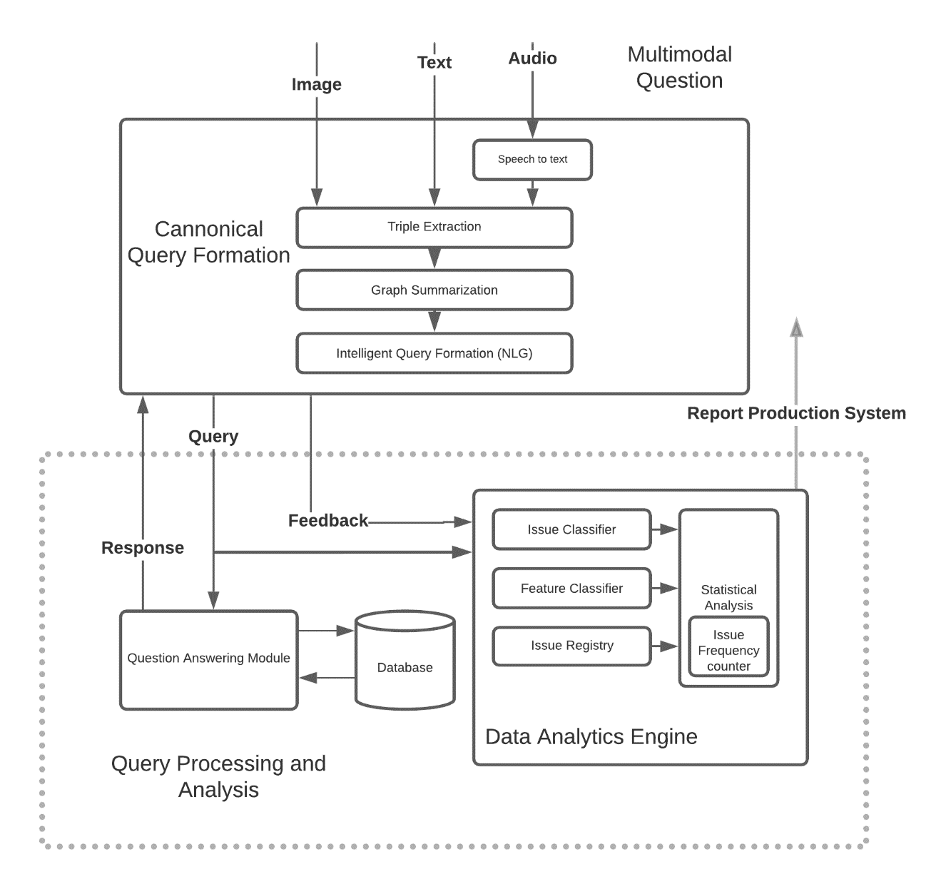
Architecture Diagram

Slide 4
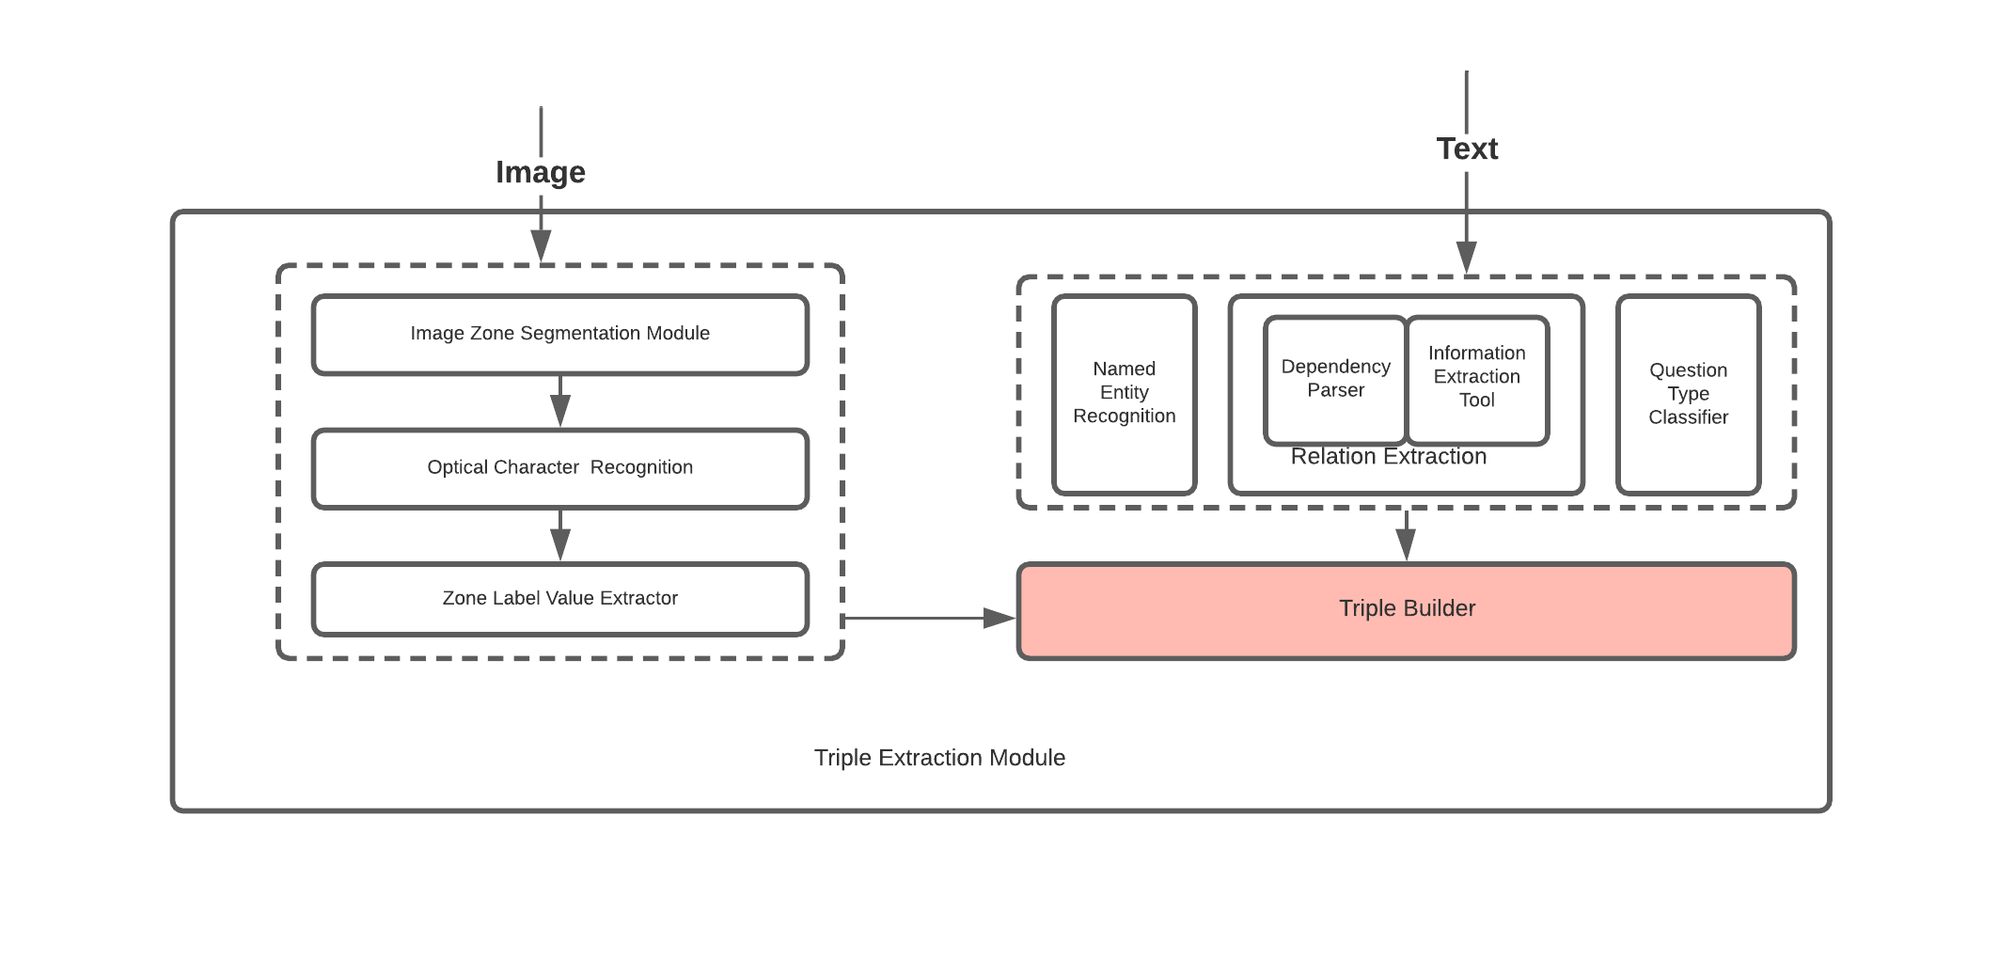
Triple Extraction Module:

Slide 5
Triple Extraction Module:
Extract Triples from Text
Named Entity Extraction:
  Text is passed through Named Entity Recognition system to identify Named Entities (Stanford NER or Spacy NER tools) or custom NER tools to be fine-tuned on Domain Specific(LG Product Manuals) . Named Entity eg. IE Error, Ice Plus Function.
  Resultant NER Triple (Output of triple builder): (Topic, has_type, IE Error), (Topic , has_type, Ice Plus Function)
Relation Extraction (RE)(Dependency Parsing and Information Extraction tools to Extract the relations):
  eg. Query=How to fix IE Error – (Relation Extraction)-->(How to, fix, IE Error)—Triple Builder->(Query, REL, fix)
Rule based script/module to categorize the type of the question types: How or What.
  eg. Query= Please tell me how to use Ice Plus function.—(QuestionTypeClassifier)-->”how” type—Triple Builder→ (Query, quesntion_type, how)

Slide 6
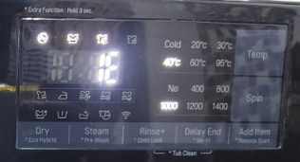
    eg. Query= Describe 3 Ice Mode.--> (Query, question_type, what)
    eg. Query= How to fix IE Error--> (Query, question_type, how)
Extract Triples from Images
  Image Zone Segmentation and Object Character Recognition:
    Images are divided into multiple zones (eg. "Temp" Zone, "Spin” Zone, "Mode" Zone). The OCR extracts text from the zones
  Zone Label Value Extractor: A module labels Zone name and extracts the associated value. Eg. If OCR extracts "temp", "Cold", "20deg", "40deg", "60deg", 95deg" for a given zone. The module takes [ "temp", "Cold", "20deg", "40deg", "60deg", 95deg" ] as input and outputs, Zone_name= temp and Zone_value=40 deg
  The Triple Builder module processes the output of Zone Label Value Extractor along to construct triples
    Eg.
    (Topic, has_temp, 40 deg)
    (Topic, has_spin, 1000)
    (Topic, has_mode, Mix)
    (Topic, has_type, IE error)

Slide 7
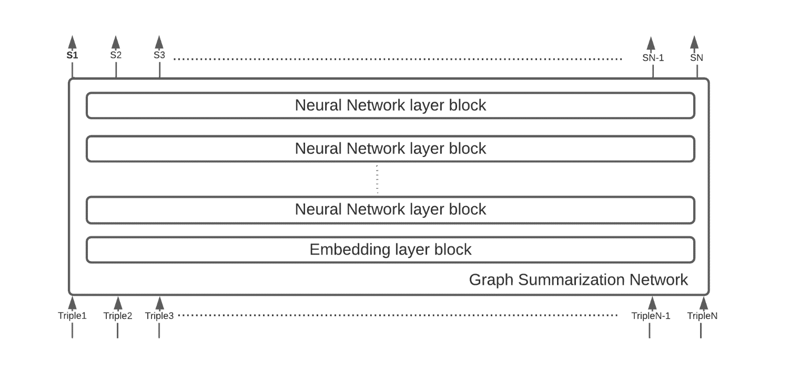
Graph Summarization Network:
Trained deep Neural Network model takes N-triples and each triple is converted into a d-dimensional vector, the network outputs N-scores(S1,S2..,SN) which indicates the probability that a triple is relevant, we take triples with score greater than a threshold value.
Eg. 10 triples are input to the Summarization model , out of which 6 triples have score greater than threshold( say 0.8 in a scale 0-1), we discard rest of the 4 triples.

Slide 8
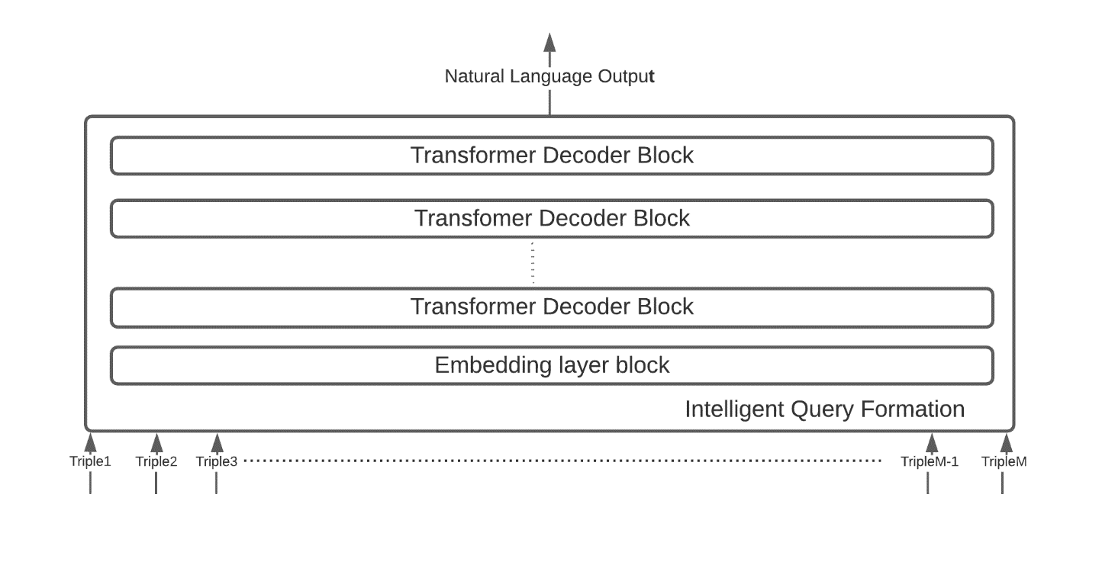
Intelligent Query Formation:
Intelligent Query formation network is a GPT/Transformer- based network fine tuned to generate natural language query from selected triples M triples from total N-1 triples. Triples are converted to embeddings and feed to Generative network which generates natural language query.

Slide 9
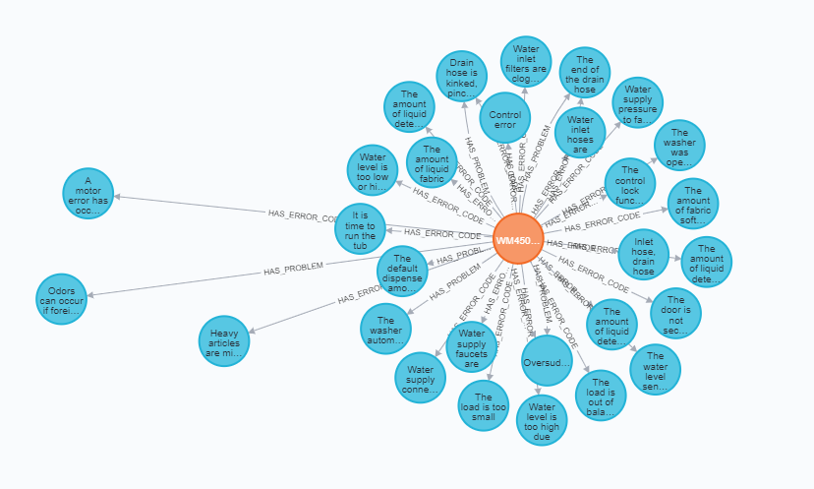
Database:
LG manual is extracted and stored as Knowledge Graph.
User can ask queries to thinQ app related to manual
Our pipeline needs to understand different queries from different users to accurately fetch the content from KG and present to the user

Slide 10
Question Answering Module:
Question answering is a very popular natural language understanding task.
It has applications in a wide variety of fields such as dialog interfaces, chat bots,
and various information retrieval systems. Answering questions using knowledge graphs
adds a new dimension to these fields.
It has many components in the pipeline,
  Classifier,
  text similarity mapper,
  Knowledge Graph
  Natural answer generation (NLG)

Slide 11
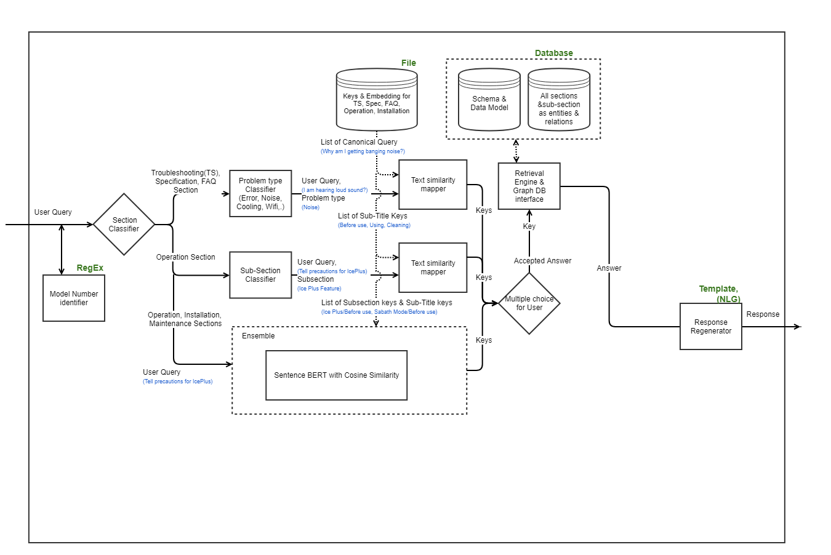
Question Answering Module Contd…

Slide 12
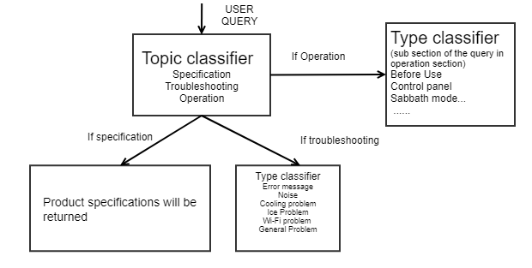
Issue Classifier
This module classifies the user problem to error, noise, problem and feature
Following types of classifier are required. Each classifier is trained for a particular purpose for better accuracy
  Topic classifier : Classifies a given query into one of Troubleshooting , Specification, Operation (or) Installation
  Type classifier :If the query for troubleshooting section, then identifies the problem type(error/noise/problem). If the query for operation section, then identifies the specific feature

Slide 13
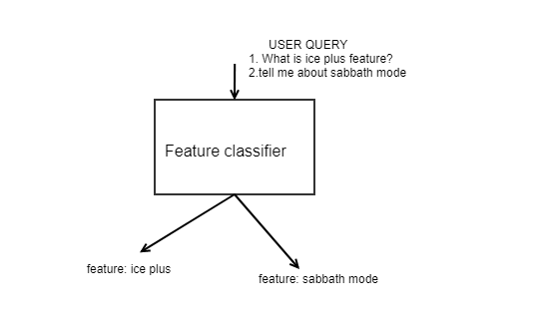
Feature Classifier:
This classifier helps us to extract main feature/issue from the user query. It will use info extraction to extract specific feature information and issue information

Slide 14
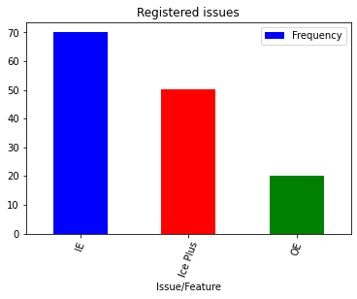
Statistical analysis:
This module uses AI models to take insights from the user query and examine sets of data to find the most occurrence/frequency, patterns of user interested areas.
As shown in below figure, this module extracts features and holds the frequency of every issues/features.
Statistical AI model
User query
Examples:
1.I am facing IE error.
what should I do?
2.How can I resolve OE error?
3. what is ice plus feature?
Using info extraction module it extracts feature and maintains frequency

Slide 15
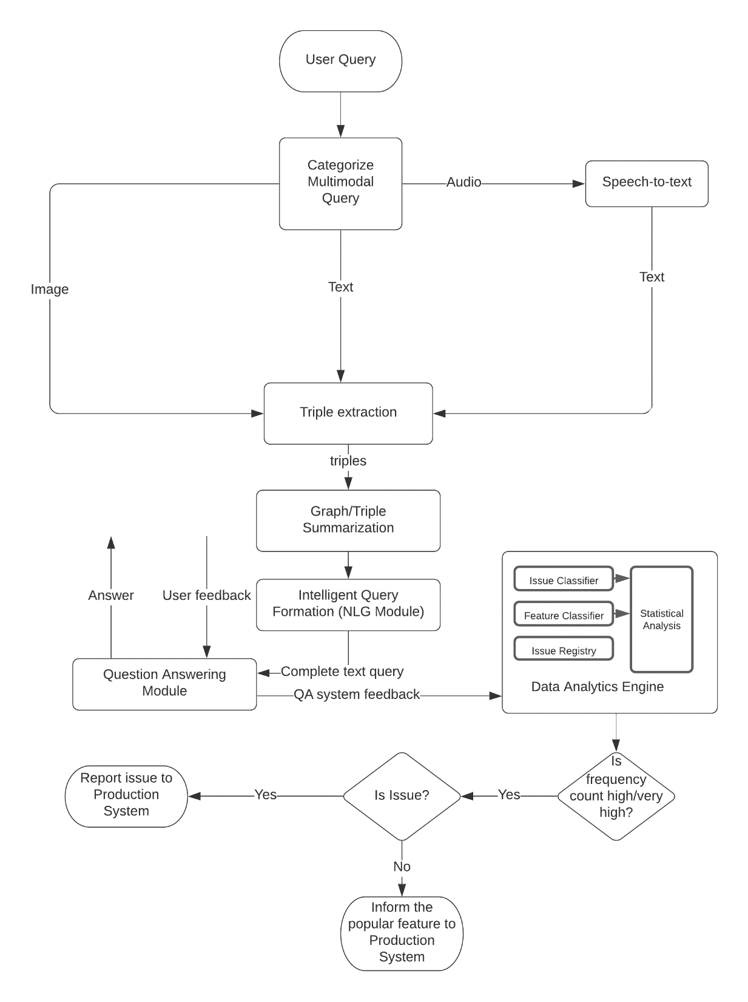
Flow Diagram

Slide 16
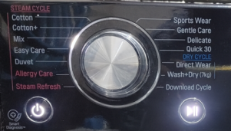

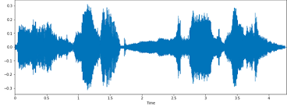
Use Case 1
(Issue Reporting)
Images- Multiple Frames
Image Inputs
Audio – if available(Audio or Text)
How to fix this?
Speech-to-text
Text – if available (Audio or text)
OCR, Image Zone Segmentation & Entity Extraction
Answer
Feedback
How to fix this?
Vision AI
Which topic: IE Error
triples: (topic, has_specific_type, IE error)
From Settings on the panel triples:
(topic, state_mode , Mix)
(topic, state_temp, 40 deg)
(topic, has_spin , 1000)
Final Complete Query(NLG):
How to fix IE Error with mode as Mix,
at temp 40 degree, Spin 1000?
Entity & Triple Extraction
Question Answering Subsystem
System Feedback
Statistical AI model
Report Production System to provide permanent fix in the next release
AI model sub system analyze, categorize and keeps the track of count of all issues.
Issue type: IE, Mode: Mix, Feature: N/A, Frequency: Very High

Slide 17
Use Case 1:
The User asks a question through chatbot application (Image, Text, Audio). At least one modality (say text) and at most three modalities ( Image, Text, Audio) could be the inputs to the application for a single query.
In this use case the user ask using either text “How to fix this?” or uses audio “How to fix this”?.
If the input is audio, the audio is converted to text using existing speech-to-text system.
Image is segmented into zones by Image Zone Segmentation Module. (eg. "Temp" Zone, "Spin" Zone, "Mode" Zone) and OCR extracts the relevant text from each zones
From the text information such as , question type, Relation, Named Entity Extracted
Triple builder module processes the information extracted from text and images and build triples. Eg.
  (Query, question_type, how)
  (Query, REL, fix)
  (topic, has_specific_type, IE error)
  (topic, state_mode , Mix)
  (topic, state_temp, 40 deg)
  (topic, has_spin , 1000)

Slide 18
Use Case 1:
All the extracted triples might not be relevant to form the Complete Query(Intelligent Query). A deep learning based module selects the triples with score greater than the some empirical threshold.
These shortlisted triples are used to generate Intelligent Query. In this case, the generated query should be “How to fix IE Error with mode as Mix, at temp 40 degree, Spin 1000?“
The Intelligent Query gets processed by the Question Answering subsystem and the subsystem provides the answer to the user.
Based on the answer, the user provides a feedback to the QA subsystem.
The QA subsystem receives the feedback and analyze the query to identify if the query is an “Issue” or a “Feature”, In this particular example. “How to fix IE Error with mode as Mix, at temp 40 degree, Spin 1000?“, is an issue. It will also categorize the issue based on frequency (“Low”, “Medium”, “High”, “Very High”)
As this is an “Issue” not a “Feature” . So the Feature tag will be set as “NA” while the issue type would be “IE” . Eg the following properties are identified by the Statistical Analysis Module:
  Issue type: IE, Mode: Mix, Feature: N/A, Frequency: Very High
Based on the Severity and Frequency the system reports to the production system so that the product solution which require hardware/software fix, could be given in the next release.

Slide 19
Use Case 2
(Popular feature
Identification)
Audio – if available(Audio or Text)
How to use Ice Plus function?
Speech-to-text
Text – if available (Audio or text)
Answer
Feedback
How to use Ice Plus function?
Entity & Triple Extraction
Which topic: Ice Plus function
triples: (topic has_specific_type, Ice Plus function)
(topic, has_query_objective, usage)
Final Complete Query(NLG): (Note: Final Query completion is same as original question)
How to use Ice Plus function?
Question Answering Subsystem
System Feedback
Statistical AI model
AI model sub system analyze, categorize and keeps the track of count of all issues.
Inform Production System that Ice Plus Function feature is a popular feature
Issue type: N/A, Mode: N/A, Feature: Ice Plus, Frequency: High

Slide 20
Use Case 2:
The process is same for Use Case 2. The only difference is here the Query (“How to use the Ice Plus Function?”) is of type “Feature” , not an “Issue” type.
So the Statistical Analysis module will have the Issue Type as “NA” .
  Eg. Issue type: N/A, Mode: N/A, Feature: Ice Plus, Frequency: High
And based on statistical analysis, the system will inform the production system if these feature is an important feature often asked about by the users. In that case, the production team may decide to include such features in similar products, in future.

Slide 21
Novelty
Support multi modal inputs where as most of the chat bots will support only text
Intelligent Query formation from Multimodal inputs
  Takes inputs as image, audio/video and apply NLP methods like Pronoun substitution , Entity extraction and forms complete query
  Processes multimodal query with help of Knowledge Graphs, summarization methodology and natural language generation , into intelligent text query with complete information
Automatic feedback to Production system about frequent issues or popular features
  Our statistical model analyze the user logged issues and extracts the informations like issue category, feature and frequency
  Then it will send automatic feedback to Production system about frequent issues or popular features Periodically
Single point application that not only, responds to user queries , but also draws important insights ,conclusions and provide intelligent feedback to the production system
Business value
Applied to all LG products
Single point to solve all the issues reported by user , analyze their queries, identify the popular features and feedback to production system
It helps the Company to understand Its consumers better and to provide them with quality services
Its ongoing project and text based partially completed and its improvement of ongoing project

Slide 22
Prior Arts Check and Comments .
Below patents has been checked and found that our proposed idea is different than this
Prior art. | Comment
https://patents.google.com/patent/US10931724B2/en?oq=US10931724.pdf+ | Facilitating virtual assistant customer care . It is used to communicate with a virtual assistant operating on a user device, thereby automating and improving contact center to customer communications
https://patents.google.com/patent/US20210072741A1/en?oq=US20210072741.pdf+ | This idea handles in monitoring electrical equipment assets that is configured to receive user-provided asset data associated with operation of a plurality of electrical equipment assets operated by a plurality of users/owners, where the identity of any asset in the database is restricted and only known to the user that owns/operates the asset
Our Proposal differentiated | Intelligent query forming from user actions with multi modal (text, voice , image, gesture) Statistical model to analyze and categorize the user issues. Sends feedback/details of most frequent issues/user interested areas periodically to production company to improve the products in next release Can find User interested areas and apply in feasible products that helps business growth

