Slide 1

LENDING CLUB CASE STUDY ASSIGNMENT SUBMISSION
Name: RAJAGOPAL SHENOY G
ANINDYA SUDHIR

Slide 2
Problem Statement – Business Objective
Identify the risky loan applicants using EDA, so that such loans can be reduced to cut down the amount of credit loss
Understand the driving factors (or driver variables) behind loan default, i.e. the variables which are strong indicators of default.
Business Understanding
Consumer finance company which specializes in lending various types of loans to urban customers. When the company receives a loan application, the company has to make a decision for loan approval based on the applicant’s profile. .
2 risks associated with banks decision to approve loans.
1. If the applicant is likely to repay the loan, then not approving the loan results in a loss of business to the company
2. If the applicant is not likely to repay the loan, i.e. he/she is likely to default, then approving the loan may lead to a financial loss for the company

Slide 3
Approach
Data cleaning
Analysis
Data Plot
Deleting NA and single valued columns
Duplicate Check
Formatting the data in correct format. Like remove % from interest rate.
Converting data to correct data types.
Taking domain knowledge by understanding Lending Club related loan and financial terms and processes.
Exploratory data analysis performed:-
Univariate and Segmented Univariate
Bivariate analysis on various continuous and continuous variables
Visualizing results from the analysis in form of bar charts, distplot etc to have a clear understanding of it.

Slide 4
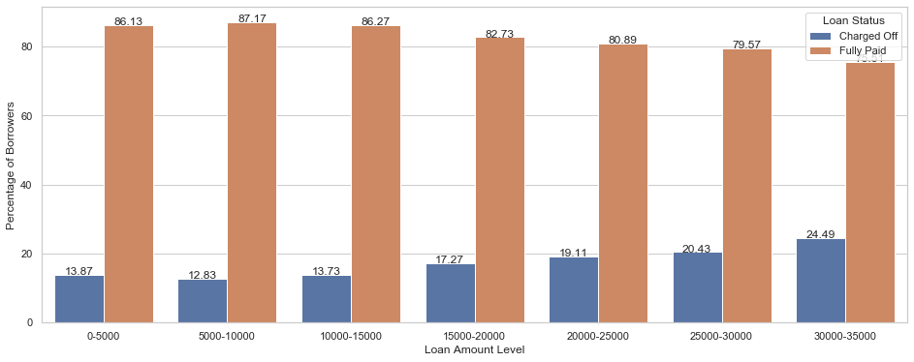
Plot – Loan Amount vs Loan Status
Borrowers with loan amount > 15,000 USD tend to default, those with < 15,000 USD tend to pay
Also, borrowers who apply for bigger amounts of loan have relatively higher chances of defaulting.

Slide 5
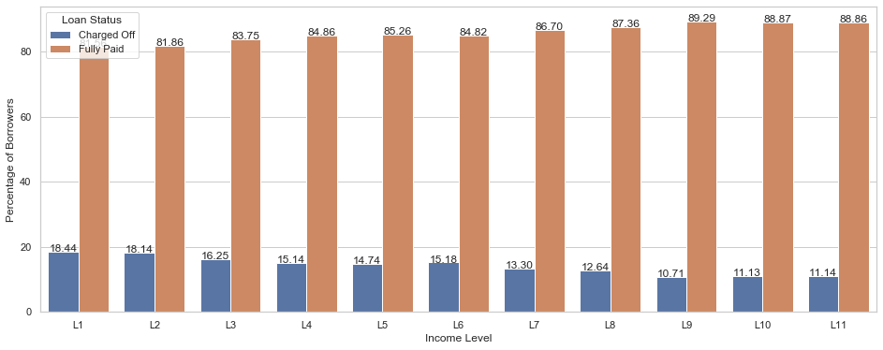
Plot – Annual Income vs Loan Status
Borrowers with annual income < 55,000 USD tend to default and those with > 65,000 USD tend to pay
Also, borrowers with higher annual income have relatively lesser chances of defaulting.
Note - L1 to L11 represent [4000, 30000.0, 37196.16, 44500.0, 50004.0, 58868.0, 65004.0, 75000.0, 90000.0, 115000.0, 234144, 6000000] USD.

Slide 6
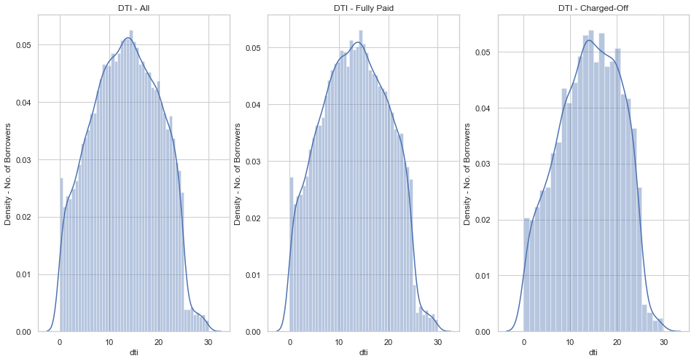
Plot – DTI vs Loan Status
The upper critical value for Fully Paid normal curve: 13.21 considering 5% α
The lower critical value for charged off normal curve: 13.86 considering 5% α
Borrowers with DTI lesser than 13.21 are more likely to pay off their loans. Borrowers with DTI higher than 13.86 are more likely to default.

Slide 7
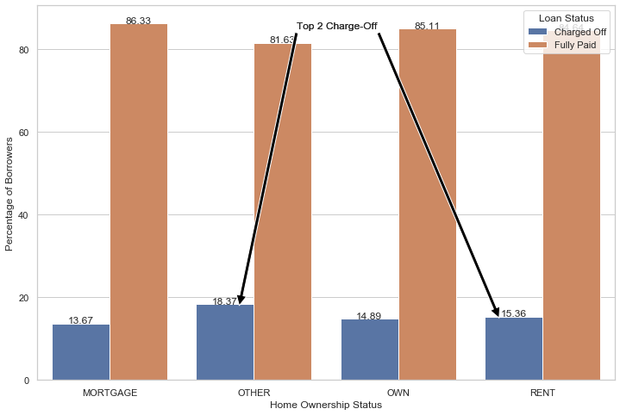
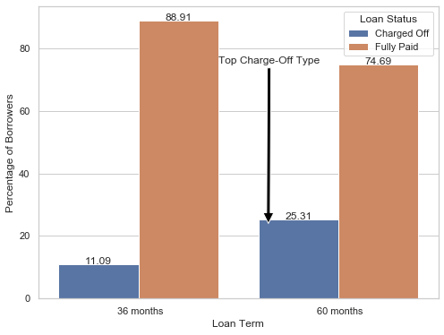
Plot – Home Ownership and Loan Term vs Loan Status
Borrowers living in rented houses or with home ownership status as Other are more likely to default
Borrowers who apply for 5 years term loan are defaulting more compared to borrowers who apply for 3 years term loan

Slide 8
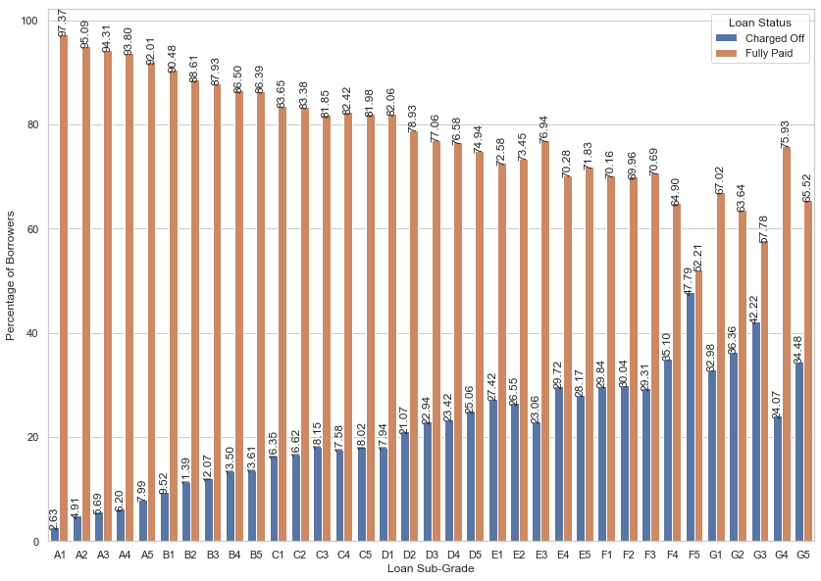
Plot – Sub-Grade vs Loan Status
Borrowers who have taken loan with Grade beyond D2 tend do Default more than others
Borrowers who have taken loan with Grade A or B tend to pay off the loan more than others
A has the least default rate and the default rate keeps on increasing from A to G.

Slide 9
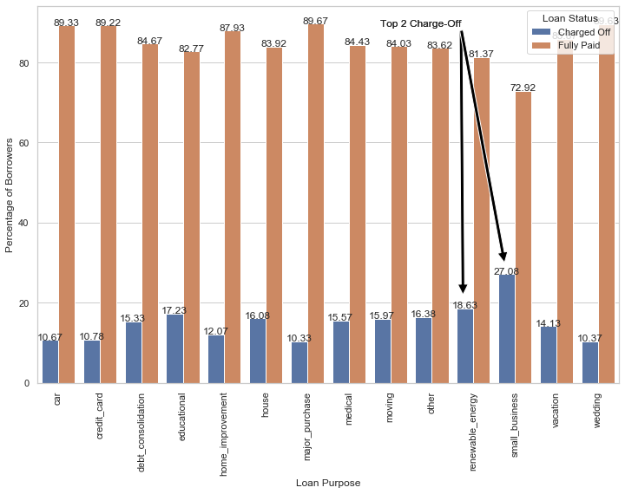
Plot – Purpose vs Loan Status
Borrowers applying for loans for purposes of “Small business” and “renewable energy” are more likely to default.
Borrowers applying for loans for purposes of “major purchase” and “wedding” are less likely to default.

Slide 10
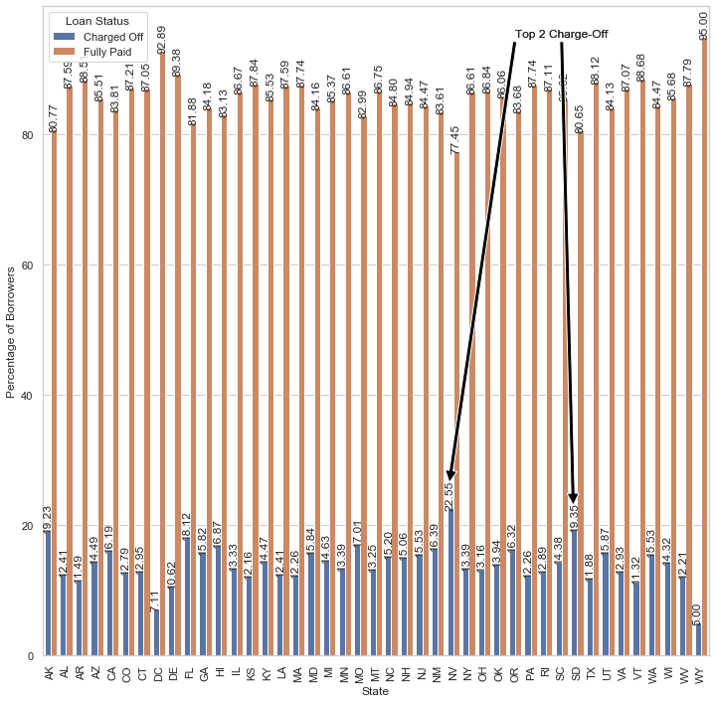
Plot – State vs Loan Status
Borrowers living in US states of Nevada (NV) and South Dakota(SD) are more likely to default
Borrowers living in US states of Wyoming (WY) and Washington DC (DC) are least likely to default

Slide 11
SUMMARY
The driving factors (or driver variables) behind loan default are :-
Loan Amount
Annual Income
DTI
Home Ownership
Default:- more than 15,000 USD
Fully Paid:- Less than 15000 USD
Higher the loan amount, higher is the default rate
Default:- Less than 55,000 USD
Fully Paid:- More than 65,000 USD
Higher the annual income, lower is the default rate
Default:- More than 13.86
Fully Paid:- Less than 13.21
Higher the DTI, higher is the default rate
Default:- Rent and Other
Fully Paid:- Own and Mortgage
Loan Term
Sub Grade
Purpose
State
Default:- 5 years
Fully Paid:- 3 years
Default:- D2 and above
Fully Paid:- A and B
The default rate keeps on increasing from A to G.
Default:- Small business and renewable energy
Fully Paid:- Major purchase and wedding
Default:- Nevada (NV) and South Dakota(SD)
Fully Paid:- Wyoming (WY) and Washington DC (DC)

