Slide 1
An ‘Object-use Fingerprint’: The use of Electronic Sensors for Human Identification
Mark R. Hodges and Martha E. Pollack

Slide 2
Motivation
Identify individuals from their behavior.
Identifying people from object-use fingerprints
Track the performance of individual at the risk of cognitive decline
Notes:
Determine weather individual people have regular and recognizable patterns of interaction with objects
Cognitive decline: Deterioration of cognitive function.

Slide 3
State-of-the-Art
Activity Recognition
Use of Data-rich sensors such as video camera or microphones.
Privacy concern
Expensive
Use of very basic sensors like accelerometers, motion detectors
Large number of sensors required
Installation in often difficult
Use of RFID readers
Not used for person identification
Notes:
Ben-Arie, et al employed video cameras to distinguish among eight basic actions including jumping, walking, picking up a object etc.

Slide 4
State-of-the-Art
Identifying a person using biometrics
Keystroke dynamics
Gait Recognition
Face Recognition
Identifying individuals based on their object interaction patterns
Notes:
Ben-Arie, et al employed video cameras to distinguish among eight basic actions including jumping, walking, picking up a object etc.

Slide 5
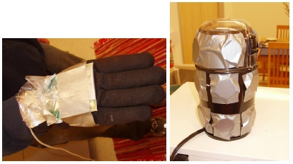
Methodology
Selection of Task
Has to be a regular activity
Would be relatively constraint
Might have some natural variance
Selection of Technology
Has to be inexpensive
Has to be small
Easy to install
Making a cup of coffee
Passive RFID tags with RFID Reader

Slide 6
Experiment Setup
10 subjects recruited to participate in the experiment.
Each of the subjects are to make a cup of coffee.
General instructions to make coffee was provided for persons who didn’t know how to make coffee.

Slide 7
Learning Approach
Decision tree induction algorithm
Based on ID3 algorithm
Two types of features used for classification
Observation granularity
Interaction measure
Notes:
The ID3 algorithm can be summarized as follows:
Take all unused attributes and count their entropy concerning test samples
Choose attribute for which entropy is minimum (or, equivalently, information gain is maximum)
Make node containing that attribute

Slide 8
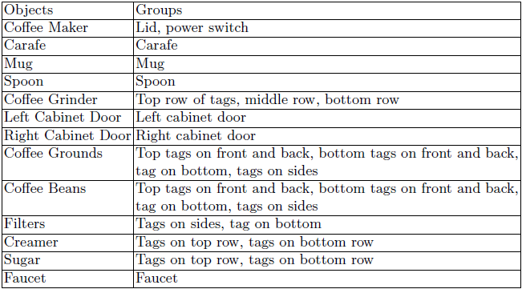
Observation Granularity
Tag
Group
Object
Notes:
Tag: interaction with an individual tag
Group: interaction with any of a group of tags that are equivalent except for the orientation of the object
Object: interaction with an object

Slide 9
Interaction Measure
Detected
Count
Total Duration
Average Duration
Order

Slide 10
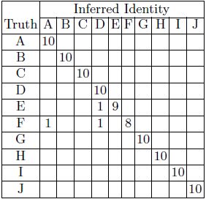
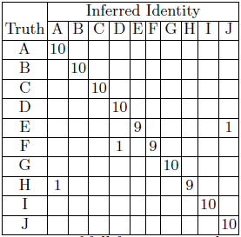
Results
Accuracy is 97%
Confusion matrix with full feature
set using cream and sugar
Confusion matrix with full feature set without cream and sugar

Slide 11
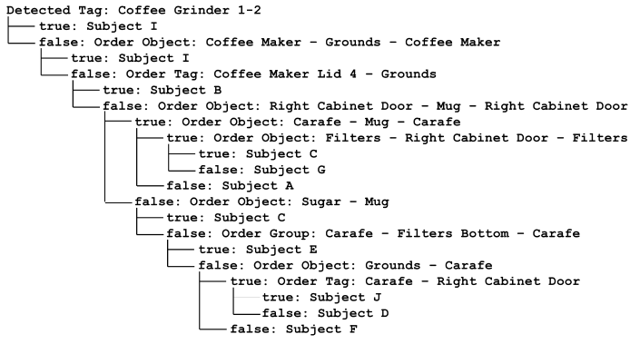
Results

Slide 12

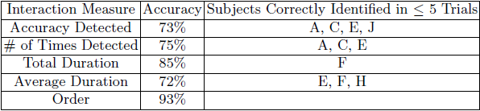
Results
Very promising result
Oh no! A bug was found in the code after the paper was published
Overall accuracy with all the features is 73%

Slide 13
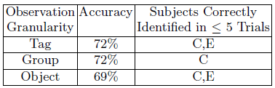
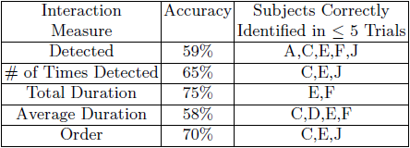
Corrected Result

Slide 14
Solution Critique
Very controlled experiment
Only one task considered
No segmentation of the task was required
Corrected results are not so promising
Slightly complex classification algorithm might have been tried
Issues with RFID gloves and tags

Slide 15
Scientific Critique
Metrics
Accuracy
Cost
Ease of Installation
Performance
Independent variables
Number of subjects
Number of different tasks
Number of objects
Orientation of the objects

Slide 16
Critique
Ground truth
Controlled experiment
Baseline for comparison
None

Slide 17
Final Comment
Novel idea
Good starting point as a exploratory work
Need to brush up the experiments a little
A better machine learning approach can be tried

Slide 18
Comments

