Slide 1


FRILMART USE CASE
TEAM
Sirisha Ganta
Anirudh Kulkarni
Sai Teja Suvarapu
MENTOR
Harshavardhan Chinthalapalli

Slide 2
INDEX
Problem Statement
IOT Data
Client Requirements
Data Types
AWS Services
Overview Design
Technical Architecture
Business Intelligence

Slide 3
PROBLEM STATEMENT
FrilMart is a largest retail store wanted to move the historical data storage, analytics and data warehousing functionalities to AWS to get better business insight to improve overall business operations.
FrilMart runs its data center, where all their servers and services are located and managed in their data center consists of 100’s of racks, 2000s plus servers.
Having in business for more than a decade, FrilMart has captured more than 10 PB of data for analytics and generating at least 200 GB daily data on transactions and logs on e-commerce and data center operations and monitoring.

Slide 4

IOT DATA
The Data center is equipped with Temperature, Humidity Sensors for each server rack.
The data is captured in every minute interval and posted to MQTT server using JSON messages.
The topic where message are posted, “metrics/temperature”
FrilMart wants its IoT data to be shifted to AWS
PAYLOAD EXAMPLE
{"temp": 45,
"humidity": 80,
"device_id": "dev-11",
"type": "temp",
"timestamp": 1615745262473}

Slide 5
CLIENT REQUIREMENTS
IOT data to be captured by Data Lake
IOT data stored “Parquet” into S3 every 15-minute interval.
Calculations to be made in S3 and stored in ORC format
Min Temperature/Humidity
Max Temperature/Humidity
Avg Temperature/Humidity
Use (3(a, b, c)) above Data is stored in Redshift for report generation and analytics queries.
The data lake data [Item 2,3,4 above] queried in Redshift, where Redshift has a mapping table that helps to map device_id to rack and building.

Slide 6
DATA TYPES
RACK DEVICE MAPPING
Column | Type | Description
rack_id | String | Rack ID
device_id | String | Device ID
Dc_id | String | Data Center ID
Zone_id | String | Data Center Area/Zone ID
REDSHIFT/DATALAKE TEMPARATURE DATA
Column | Type | Description
Device_id | String | Device id
min_temp | Double | Min temperature of the day
max_temp | Double | Max temperature of the day
avg_temp | Double | Avg temperature of the day
Min_humidity | Double | Min humidity of the day
Max_humidity | Double | Max humidity of the day
Avg_humidity | Double | Avg humidity of the day
timestamp | Long | In ms since 1970
TEMPERATURE RAW DATA
Column | Type
Temp | Double
humidity | Double
device_id | String
type | String
timestamp | Long

Slide 7



AWS AS A SERVICE
CLOUD/ CRITERIA
Availability Zones | 55 + 8 (Incoming) | 44 + 12(Incoming) | 18 + 3(Incoming)
Market Share | 40% | 30% | 10%
Services | 200+ | 100+ | 60+
Compute | EC2 – 1 Mins | VM – 3 Mins | Cloud Engine – 5 Secs
Database | RDS | SQL DB | SQL DB
Storage | S3 | Blob Storage | Cloud Storage
Troubleshooting | Cloud Trail | Azure Op Insight | Stack Driver Login
Monitoring | Cloud Watch | Azure App Insight | Stack Driver Monitor
Downtime | 2 Hr 69 Mins | 39 Hr 77 Mins | 14 Mins
Billing | Per Min | Per Min | Per Min

Slide 8

DATA LAKE STAGING
Landing Zone (JSON)
Raw Zone (Parquet)
Processed Zone (ORC)
Temp_Json
Temp_Parquet
Temp_Daily
Temp_Hourly

Slide 9













AWS IoT
Amazon Lambda
Amazon Kinesis
Amazon SNS
Amazon SQS
Amazon S3
DynamoDB
Amazon Redshift
IAM
Lake Formation
Athena
QuickSight
Cloud Watch

Slide 10




OVERVIEW
Amazon Kinesis
Amazon S3
Data Center
Athena
Temperature
Sensor
AWS IoT
Email
Amazon SNS
Amazon Redshift
Cloud Watch
Humidity
Sensor
QuickSight
Users
Amazon SQS
Amazon Lambda
DynamoDB

Slide 11

WHAT IS IOT ?
The Internet of things (IoT) describes the network of physical objects—“things”—that are embedded with sensors, software, and other technologies for the purpose of connecting and exchanging data with other devices and systems over the Internet​
MQTT(Message Queuing Telemetry Transport) is a standard publish/subscribe protocol for moving data between an IoT device and a server.​
At the core of MQTT is the MQTT broker and the MQTT clients. The broker is responsible for ​dispatching messages between the sender and the rightful receivers.​
Each MQTT message includes a topic​​
Rules gives your things the ability to interact with AWS and other web services .​

Slide 12
AWS SERVICES INTRO
AWS Glue is a fully managed extract, transform, and load (ETL) service that makes it easy for customers to prepare and load their data for analytics.
Apache Parquet is a columnar file format designed to support fast data processing for complex data, with several notable characteristics:
The CRAWLER creates the metadata that allows GLUE and services such as ATHENA to view the S3 information as a database with tables.
Amazon Redshift is a fully-managed cloud based data warehouse product designed for large scale data set storage and analysis. It is also used to perform large scale database migrations.
Amazon S3 or Amazon Simple Storage Service is a service offered by Amazon Web Services that provides object storage through a web service interface.
Amazon Athena is an interactive query service that makes it easy to analyze data in Amazon S3 using standard SQL. Athena is serverless, so there is no infrastructure to manage, and you pay only for the queries that you run

Slide 13
IOT ARCHITECTURE
"temp": 45,​
"humidity": 80,​
"device_id": "dev-11", ​
"type": "temp", ​
"timestamp": 1615745262473
IOT CORE
GROUPING DATA EVERY 15 MINS
Dev - 11
Rules
Action
Amazon S3 Landing zone
(JSON)
Rule 1
Firehose
Temperature
Sensor
Rule 2
SQS
TEMPERATURE >= 45
Amazon SQS
MQTT
Rule 3
SNS
Humidity
Sensor
TEMPERATURE >= 45
& HUMIDITY >= 80
Amazon SNS

Slide 14
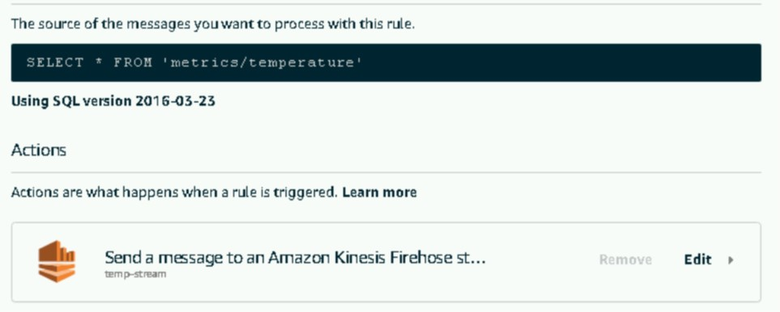
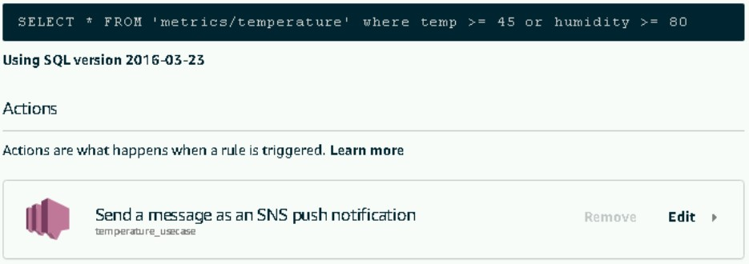
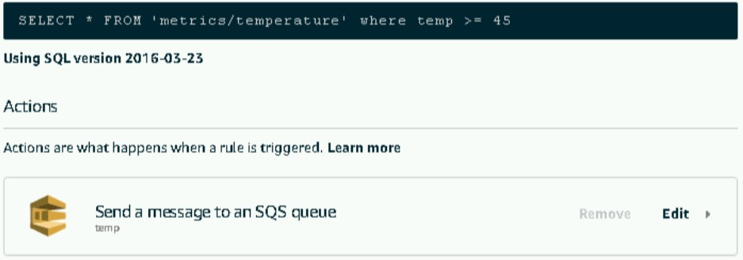
IOT RULES
Rule 1
Rule 3
Rule 2

Slide 15
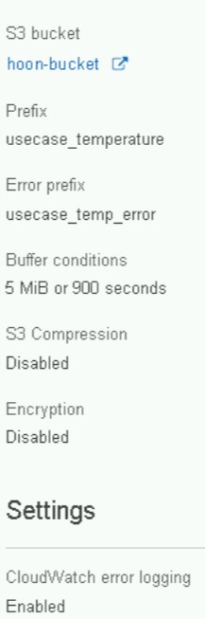
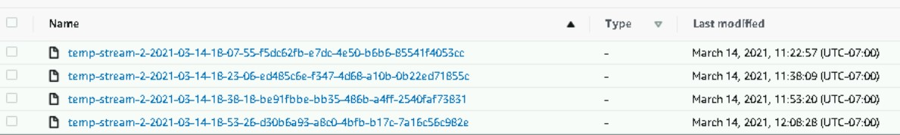
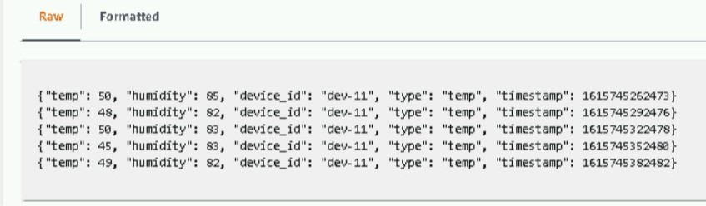
Firehose configuration:
Grouped Data for every15 minutes:
S3 Landing Data (JSON Format):

Slide 16

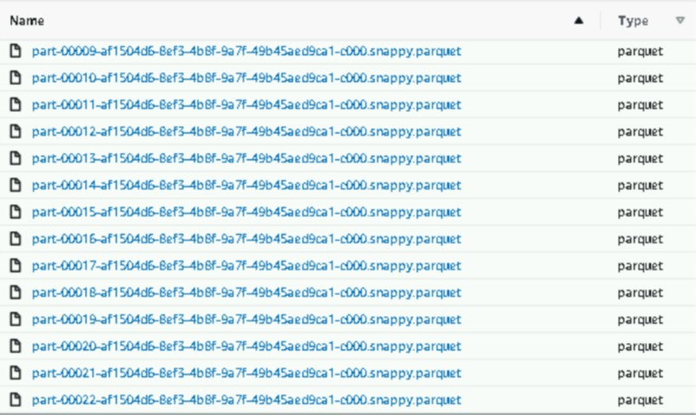


Writing to S3 RAW ZONE
Crawler
Athena
Amazon S3 Raw zone
(Parquet)
JSON -> Parquet
Amazon S3 Landing zone
(JSON)
Database
Landing DB
Glue Job
Glue Job
Scheduled every hour.
Enable Bookmark to process recent data
Crawler
One time run to setup Schema
Runs only if Schema Changes.

Slide 17
GLUE JOB : JSON->PARQUET
Dynamic DF
Column Selection
Reads Dynamic DF
Mappings
Amazon S3 Landing zone
(JSON)
converting
Writing to S3
Converting Parquet
Dumping
Amazon S3 Raw zone
(Parquet)

Slide 18



S3 PROCESSED ZONE
Crawler
Amazon S3 Processed zone
(ORC)
Athena
DAILY AGGREGATION
Glue Job - Daily
Amazon S3 Raw zone
(Parquet)
Amazon S3 bucket
Database
RAW DB
HOURLY AGGREGATION
Glue Job - Hourly
Glue Job
Enable Bookmark to process recent data
Daily job -> once a day
Hourly Job -> once every hour
Crawler
One time run to setup Schema
Runs only if Schema Changes.
Temp_Daily
Temp_Hourly

Slide 19
AGGREGATE GLUE JOB FLOW
Dynamic DF
Converting
Data Frame
Group By
Hour & Day
Amazon S3 Raw zone
(Parquet)
Aggregations
Min
Max
Avg
(Temp/Humidity)
ORC Format
Write
Dynamic DF
Converting
Amazon S3 processed zone
(ORC)

Slide 20
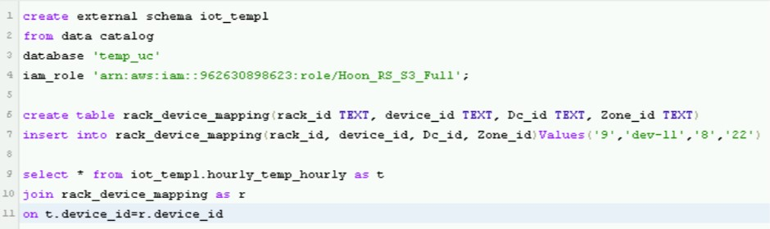
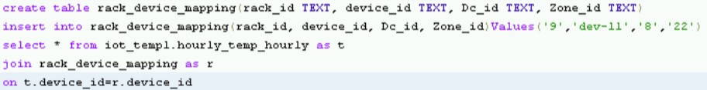
CRAWLER FOR SCHEMA CHANGE
Amazon Redshift
Spectrum
Amazon S3 Processed zone
(orc)
Crawler
Athena
Temp_Daily_Crawler
Amazon Redshift
Native
Amazon S3 bucket
Crawler
Athena
Temp_Hourly_Crawler
Temp_Daily
Temp_Hourly
Crawlers are run only once

Slide 21
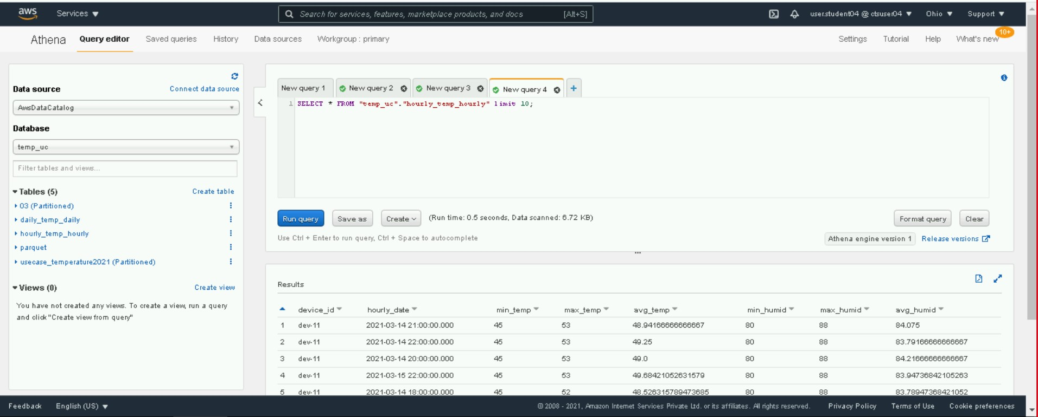
TEMP_HOURLY

Slide 22
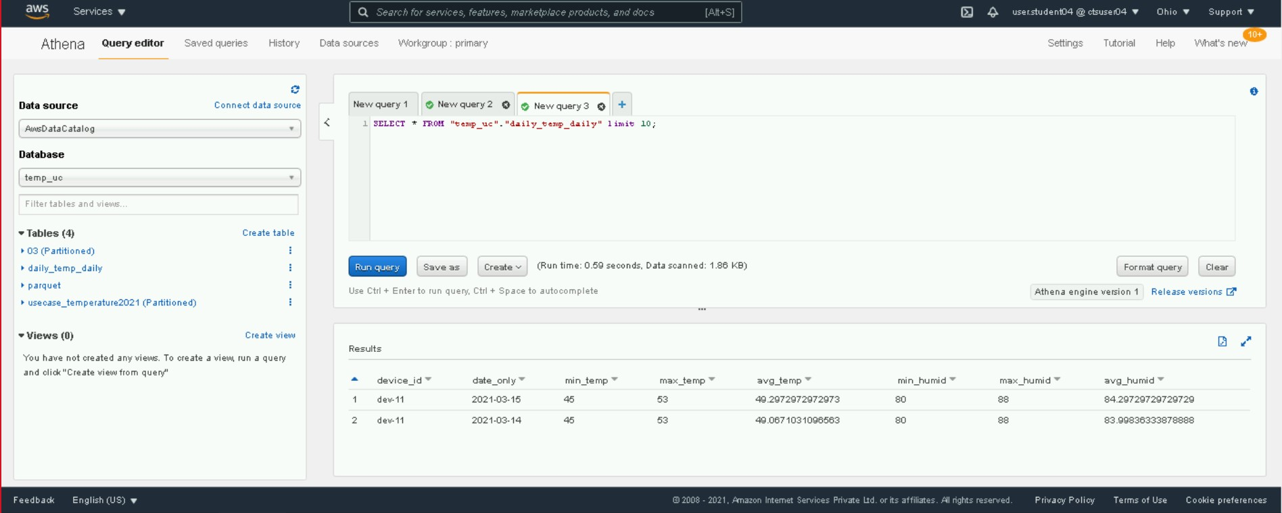
TEMP_DAILY

Slide 23
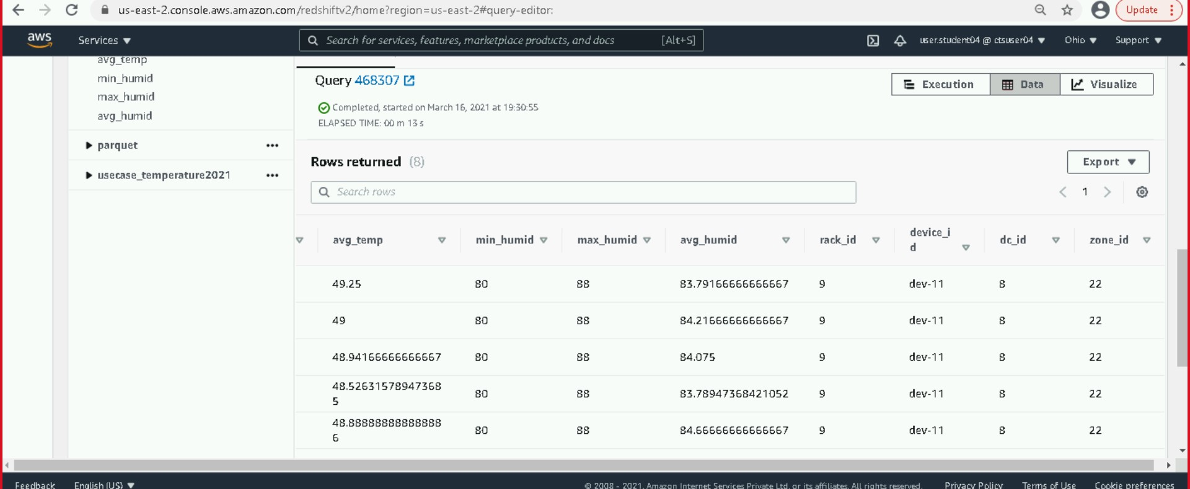
DEVICE_RACK_MAPPINGS

Slide 24
IOT DATA RULES
If the temperature is > 45 C, message to be placed in SQS with IoT Rule2.
A Python lambda should read data from SQS regarding temperature data and create an incident record in Dynamo DB “Incidents” table, this lambda should be scheduled for every 5 minutes.
If the temperature > 45 OR humidity > 80, then an email message is sent to an email id specific to data center monitoring team using SNS

Slide 25
AWS SERVICES
DynamoDB
Amazon Lambda
Amazon SQS
QuickSight
Amazon SNS

Slide 26
DynamoDB
Fully managed NoSQL database suitable for document and Key – value store models.
Benefits:
Always store data on SSD memory
Spread across three geographically distinct data centers
Fast and flexible
Suited to read heavy applications
Read Consistency Types:
Eventually Consistent Reads (ECR)
Strongly Consistent Reads (SCR)
Pricing Concept:
“Provisioned Throughput Capacity”
Write throughput – Charges/hour for every 10 units of write capacity ( 36,000 writes/hour)
Read throughput – Charges/hour for every 50 units of read capacity (180,000 SCR’s, 360,000 ECR’s)

Slide 27
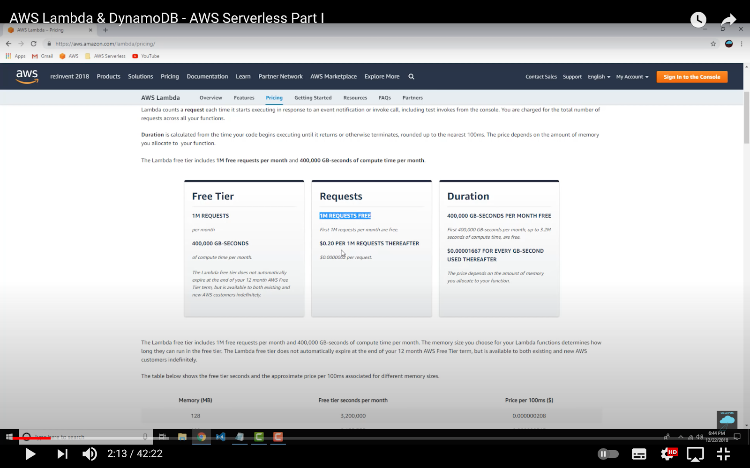
Amazon Lambda
AWS Lambda is basically one ingredient in the Amazon’s overall serverless computing paradigm
Benefits:
Pay for your compute time
Cost effective way to run a code
Time to production & deployment is very low
Lambda is event driven
Pricing Concept:

Slide 28
Amazon SQS
SQS (Simple Queue Service) provides a fully managed queue to send, store and receive messages at any volume, as they travel between different applications or microservices
Benefits:
Ensures safety of messages
Reliably deliver messages (Standard queue, FIFO queue)
Keep sensitive data secure
Scale elastically and cost – effectively
Custom retention period (30 sec is default)

Slide 29
Amazon SNS
SNS (Simple Notification Service) is a message publishing and processing
Foundation:
Publisher and Subscriber model (PubSub)
One to many relationship concept
one – Publisher
many – Consumer
Benefits:
Consumer receives notifications in Email, Text messages and HTTP endpoints

Slide 30
QuickSight
Quick Sight is a fast, cloud powered BI service that makes it easy to build visualizations, perform analysis and quickly get business insights from the data
Benefits:
Allows users to choose different data sources
Allows data ingestion from various AWS resources
Provides slick and smooth engine called “SPICE”
SPICE allows users to run interactive queries on huge data sets with quick results
Smart visualizations developed can be shared within other users
Easily Accessible & Scalable

Slide 31
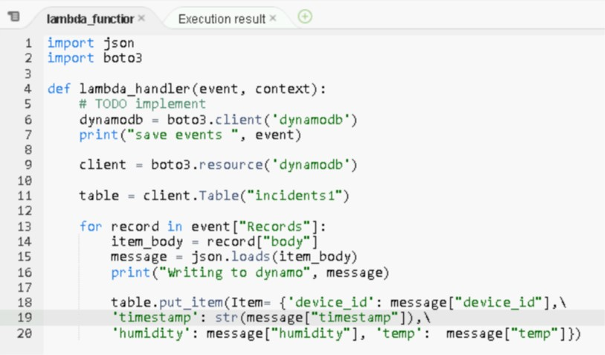

SQS CONFIGURATION
Lambda function to insert into Dynamo DB
Amazon Lambda
Amazon SQS
TEMPERATURE >= 45
AWS IoT
Lambda Trigger
Lambda IAM Role :
DynamoDB Access
SQS Access
IAM

Slide 32
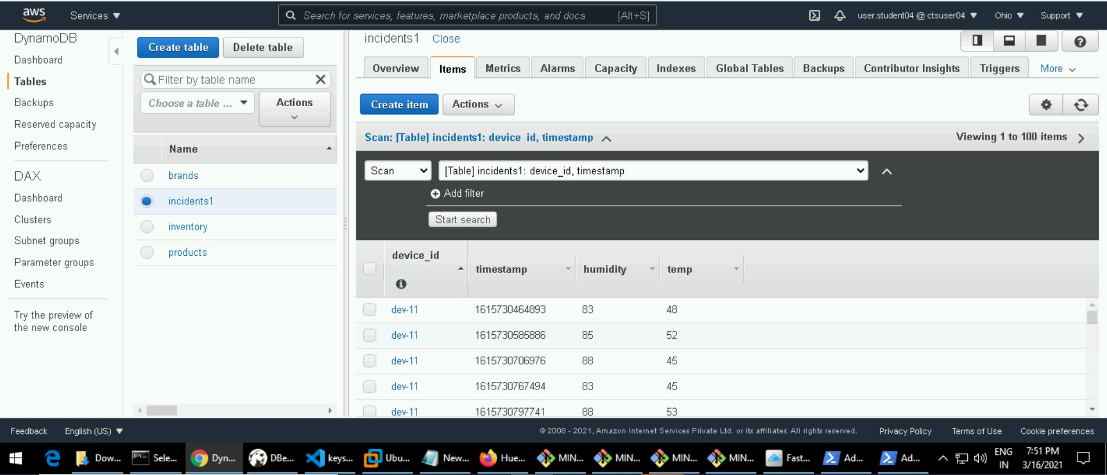
DYNAMODB INCIDENT TABLE
DynamoDB

Slide 33
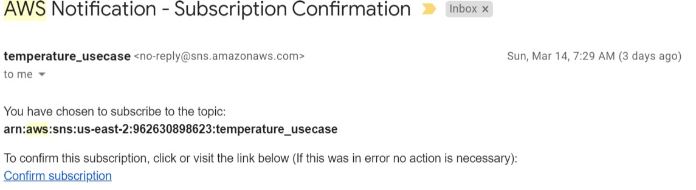
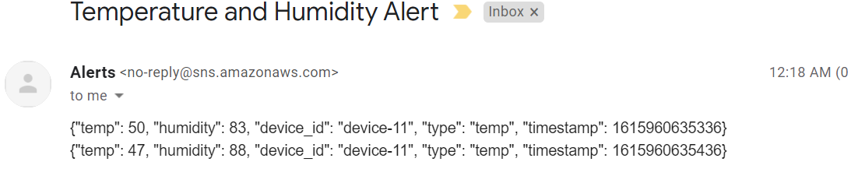
SNS ALERTS
Amazon SNS

Slide 34
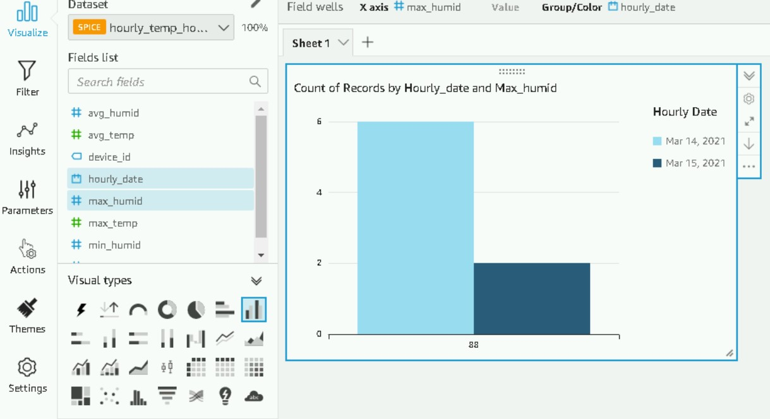
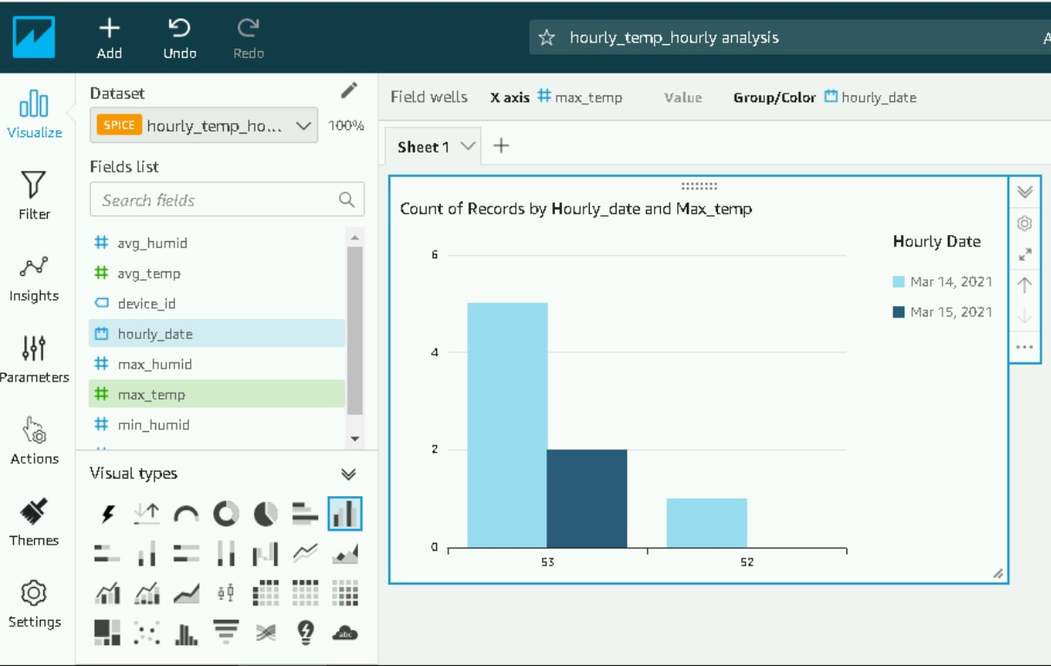
REDSHIFT DATSOURCE
Hourly/Max Humidity
Hourly/Max Temperature

Slide 35
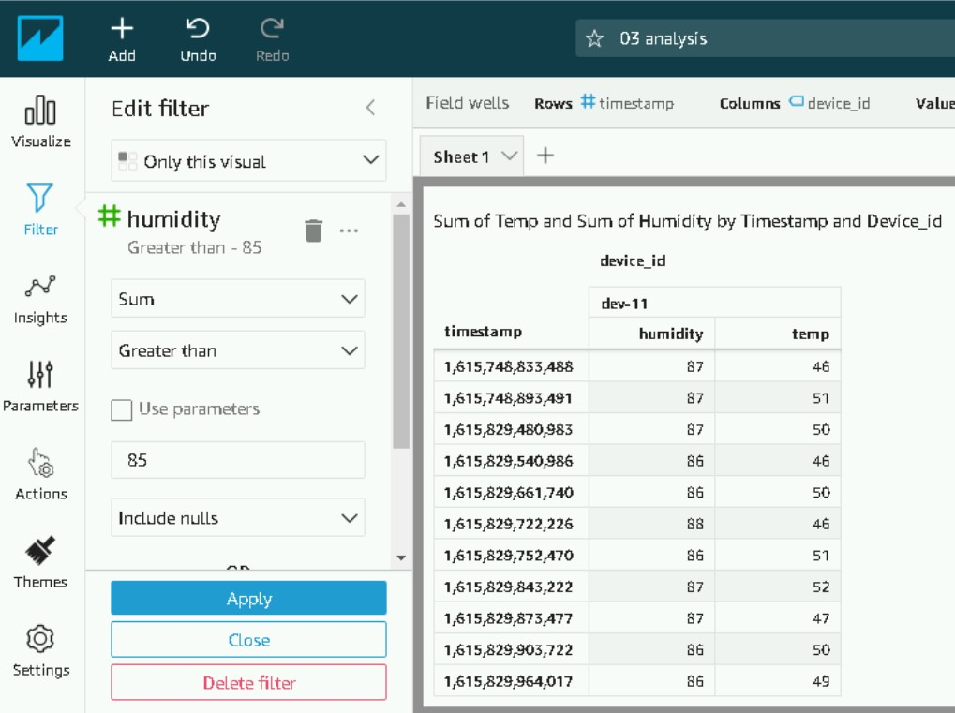
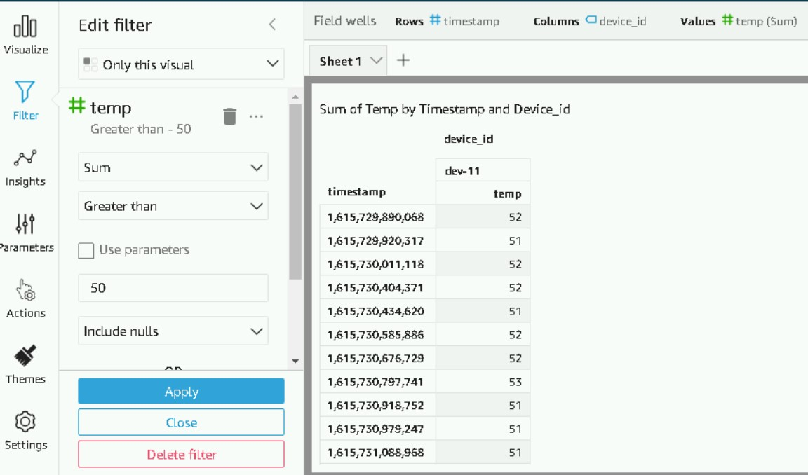
S3 DATA SOURCE (RAW DATA)
Humidity > 80
Temperature > 45

Slide 36
