Slide 1

SQL Project
On
Hospital Database Analysis
Presented By: Aniqa Siddiqui

Slide 2
INTRODUCTION
The Hospital Management Database Project is a system to centralize and streamline hospital operations, including patient records, appointments, prescriptions, and billing. It features a robust database schema with tables for patients, doctors, departments, and billing, supporting efficient data management and analysis. The project aims to improve decision-making through insights into patient demographics, revenue trends, and resource utilization. Scalable and efficient, it can handle large data volumes and adapt to future needs. Key benefits include enhanced administrative efficiency, better patient care, and actionable business intelligence.

Slide 3
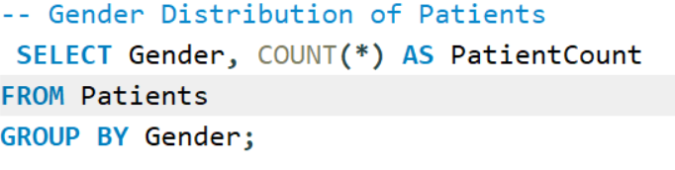
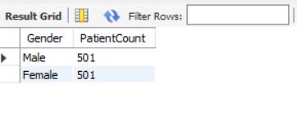
1. Demographic Distribution of Patients
-- Gender Distribution of Patients

Slide 4
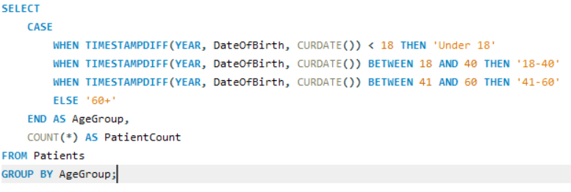
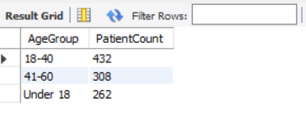
-- Age Group Distribution

Slide 5
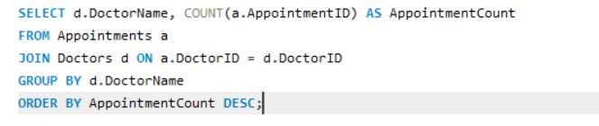
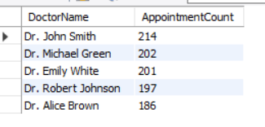
2. Doctor Appointment Insights
-- Most Popular Doctors (By Number of Appointments)

Slide 6
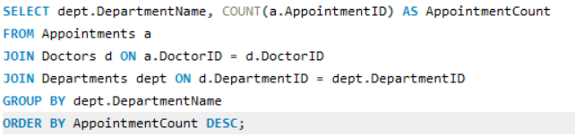
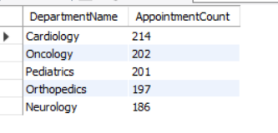
-- Most Active Departments (By Number of Appointments)

Slide 7
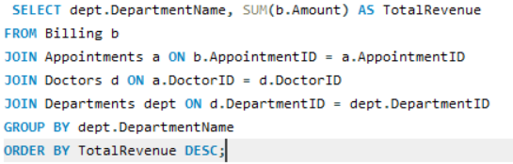
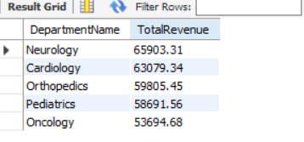
3. Revenue Analysis
-- Revenue by Department

Slide 8

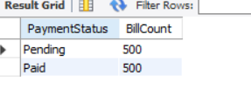
-- Payment Status Analysis

Slide 9
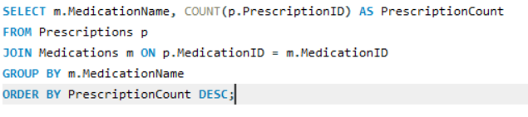
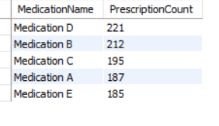
4. Prescription Patterns
-- Most Prescribed Medications

Slide 10
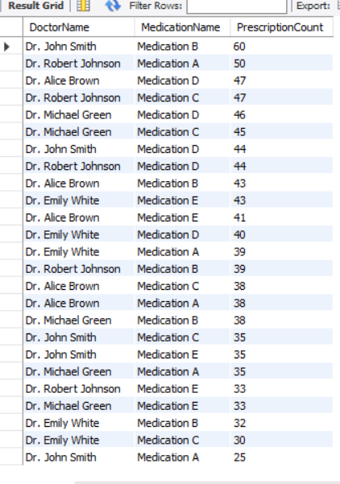
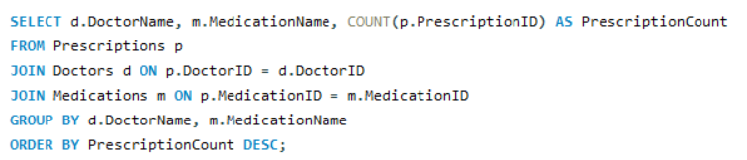
-- Doctor Prescription Patterns

Slide 11
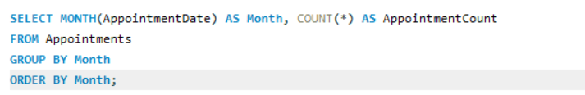
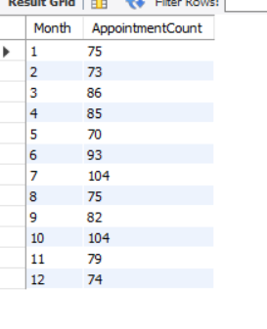
5. Appointment Trends (By Month)
-- Monthly Appointment Trends

Slide 12
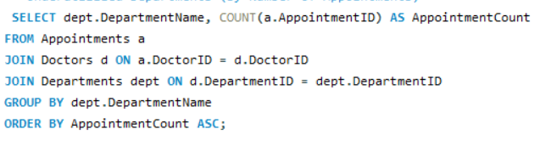
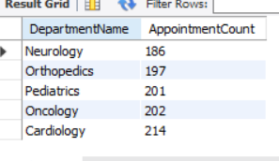
6. Utilization of Underutilized Departments
-- Underutilized Departments (By Number of Appointments)

Slide 13

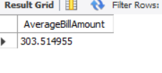
7. Billing Insights (Average Bill Amount and Payment Status)
-- Average Billing Amount

Slide 14


-- Billing Payment Status Breakdown

Slide 15
INSIGHTS
Demographics: Analyse gender and age distributions .
Doctor and Department Demand: Identify popular doctors and high-demand departments for resource allocation.
Revenue: Focus on high-revenue departments like Cardiology and Oncology.
Prescriptions: Monitor frequent medications to update treatment protocols.
Appointments: Use monthly trends to manage seasonal demand.
Payments: Address pending payments with improved billing processes.
Underutilized Departments: Promote less visited departments through marketing efforts.

