Slide 1

BLACKJACK: “Are you feeling lucky, punk?”
Team Carolina: Delano, Paula, Dean, Anirban, Anthony

Slide 2
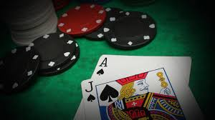

A few things about blackjack to preface our data
According to Wikipedia (the most unbiased and true source of information). “Blackjack is the American variant of a globally popular banking game known as Twenty-One, whose relatives include Pontoon and Vingt-et-Un It is a comparing card game between one or more players and a dealer, where each player in turn competes against the dealer. Players do not compete against each other. It is played with one or more decks of 52 cards. It is also the most widely played casino banking game in the world.

Slide 3
Outcomes
Win
Push
Loss
Blackjack 😃
Player is dealt a starting hand of two cards totaling 21
Beat the Dealer
Players draws cards without exceeding 21 but beats the dealer’s hand value at the end of the hand
Dealer Busts
Player stays on any hand total and Dealer draws too many cards; exceeds 21 and busts
Blackjack 😭
Dealer is dealt a starting hand of two cards totaling 21; all players without Blackjack lose
Dealer Wins
Player does not draw enough cards to beat the Dealer
Player Busts
Player draws too many cards; exceeds 21 and busts
Push
Player’s hand and Dealer’s hand tie in card value at the end of the hand

Slide 5

The objective of our research:
We’ve poured over 900,000 possible blackjack hands to bring you the statistical odds a few different scenarios.
Scenario 1: What is the probability of a player winning Blackjack (Win/Loss/Push)?
Scenario 2: What's the probability of a player winning with 3 hits?
Scenario 3: Using the 'Hard 17' methodology, what is the probability of a player winning on the starting hand (first 2 cards)?
Scenario 4: What is the probability of a player winning against a particular ‘up card’?

Slide 6
Blackjack strategy
Never take insurance or "even money."
If there is no row for splitting (fives and tens), then look up your hand as a hard total (10 or 20).
If you can't split because of a limit on re-splitting, then look up your hand as a hard total.

Slide 7
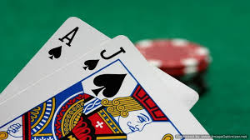
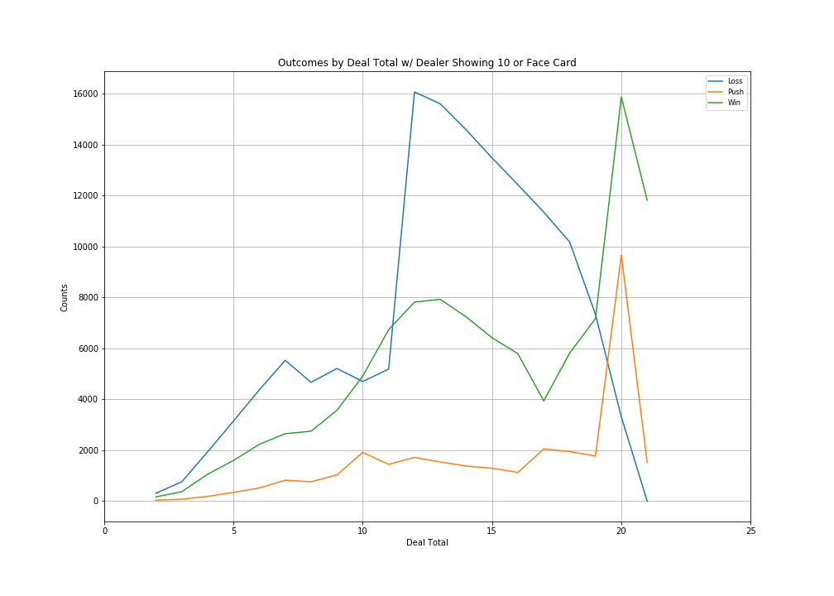
Outcomes by Dealer Total w/ Dealer Showing 10 or Face Card
30.77% chance of a dealer having a 10
61.54% chance of a dealer winning his final hand after a 17
Your wins spike around 20 after a mild falloff around 17.
Your losses initially spike at 7, spike again at 12, then dip at 12.

Slide 8
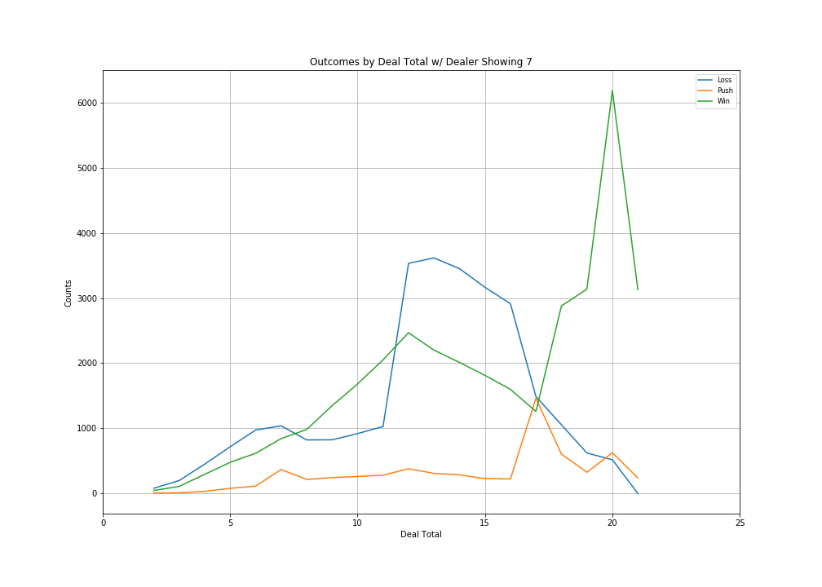
Outcomes by Dealer Total w/ Dealer Showing 7

