Slide 1

BLACKJACK: “Are you feeling lucky, punk?”
Team Carolina: Delano, Paula, Dean, Anirban, Anthony

Slide 2
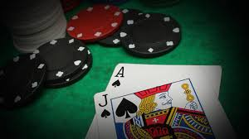

Blackjack:
Blackjack is an American variant of a globally popular banking game known as Twenty-One
It is played with one or more decks of 52 cards whereby all numbered cards equal their face value; J’s, Q’s, K’s also have a value of 10. Aces can have the value of 1 or 11 depending on strategy needed
It is a comparing card game between 1 to 7 players and 1 dealer, where each player in turn competes against the dealer’s hand.
Players do not compete against each other.
It is the most widely played casino banking game in the world.

Slide 3
Outcomes
Loss
😭
Win
😃
Push
🤷‍♂️
Blackjack Player is dealt a starting hand of two cards totaling 21
Beat the Dealer
Players draws cards without exceeding 21 but beats the dealer’s hand value at the end of the hand
Dealer Busts
Player stays on any hand total and Dealer draws too many cards; exceeds 21 and busts
Blackjack Dealer is dealt a starting hand of two cards totaling 21; all players without Blackjack lose
Dealer Wins
Player does not draw enough cards to beat the Dealer
Player Busts
Player draws too many cards; exceeds 21 and busts
Push
Player’s hand and Dealer’s hand tie in card value at the end of the hand

Slide 4
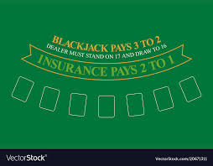
Research Objectives:
Blackjack outcome probability
Probability of NOT losing
Projected outcomes by starting hand
Projected outcomes when Dealer showing a 7
Projected outcomes when Dealer showing a 10, J, Q, K
Projected outcomes when Dealer showing an Ace
Can a player win more than they lose?

Slide 5
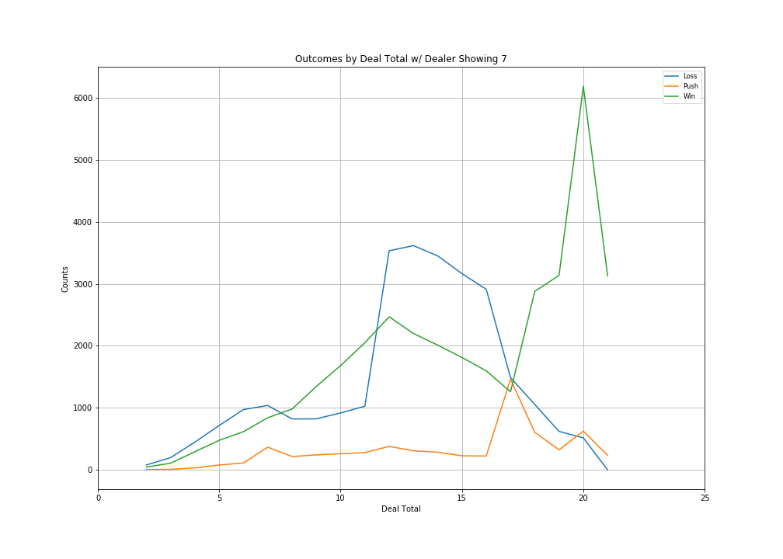
Outcomes by Dealer Showing a 7
61.54% chance the dealer has 17 or higher as their starting hand
Significantly more wins with a starting hand of 20 against a dealer showing a 7
Losses are greater when starting hands total 12 – 16 against a dealer showing a 7
As expected player pushes spike when starting hands equal 17 against a dealer showing 7

Slide 6
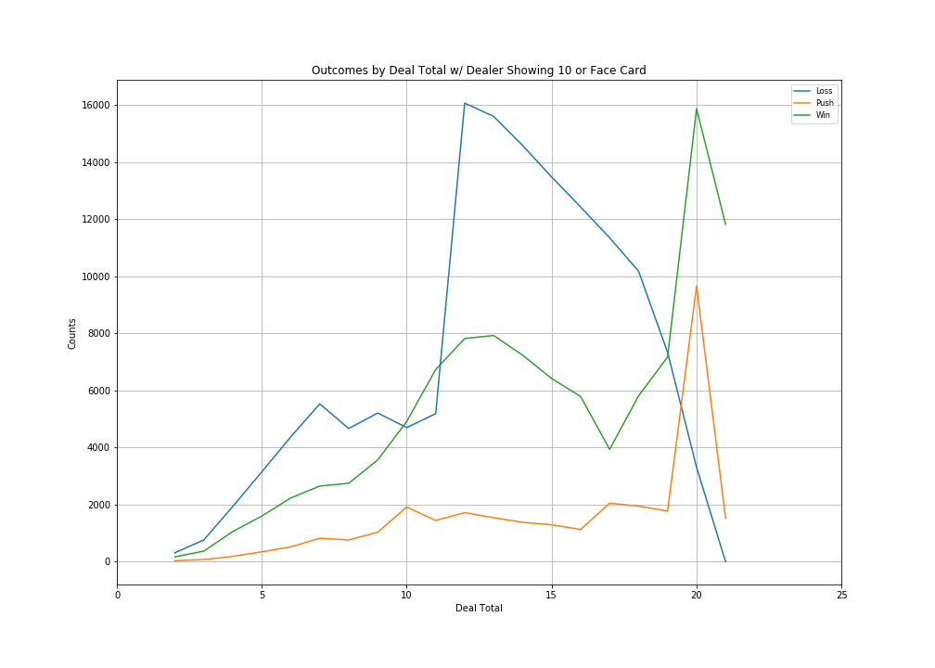
Outcomes by Dealer Showing 10 or Face Card
38.46% chance of the dealer having another 10 or an Ace as the down card
Wins spike with a starting hand of 20 after a dip at 17; due to the ‘Hard 17’ casino rule
Losses increase with starting hands of 12, then decline gradually with a sharper decline for hands greater than 17

Slide 7
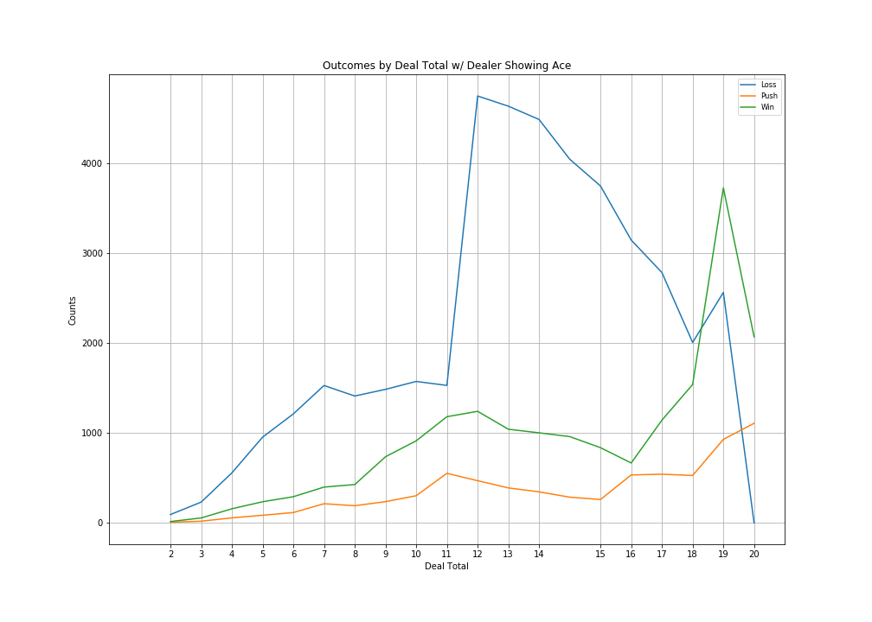
Outcomes by Dealer Showing an Ace
30.77% chance the dealer has Blackjack
Wins are hard to come by against an Ace; spike with starting hands of 18
Losses spike at starting hands of 12 and slowly decline until 18

Slide 8
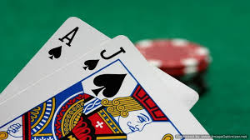

Slide 12
Outcomes by Dealer Total w/ Dealer Showing 7

Slide 13
Scenario 2: What's the probability of a player winning with 3 hits?
Scenario 3: Using the 'Hard 17' methodology, what is the probability of a player winning on the starting hand (first 2 cards)?
Scenario 4: What is the probability of a player winning against a particular ‘up card’?

Slide 14
Blackjack strategy
Never take insurance or "even money."
If there is no row for splitting (fives and tens), then look up your hand as a hard total (10 or 20).
If you can't split because of a limit on re-splitting, then look up your hand as a hard total.

