Slide 1
MAKING LARGE TRANSFERS FAST FOR IN-MEMORY DATABASES IN MODERN NETWORKS
Aniraj Kesavan
Chinmay Kulkarni, Feifei Li, Robert Ricci, Ryan Stutsman and Tian Zhang
Notes:
Thank yous, Intro

Slide 2
Today’s world
Extremely fast In-memory Databases.
RAMCloud [Ousterhout et al] , FaRM [Dragojevic et al]
New NIC capabilities
Kernel bypass => few µs latency, millions of ops/sec/server.
Userlevel access to DMA
FDR Infiniband (7GB/s) => HDR(25GB/s)
What about large transfers (Range scans, Data migration)?
Squall [Elmore et al], Morphus [Ghosh et al]
1-20 MB/s with operational SLAs of 50-200 ms.
My work; Profiled NIC for cost tradeoffs of new capabilities.
Result; Light weight Zero Copy data migration of RAMCloud.
Notes:
Large transfers slow. We profiled cost tradeoffs of capabilities.

Slide 3
Why does the NIC matter?
Everything is in memory, Did we solve Database I/O?
Lion’s share of a query in spent in network.
Today: Copy records to buffer and send (Copy Out)
Zero Copy: Transmit Data directly from where records live.
Do you copy or not for large transfers?
What’s the cost of additional copies?
Notes:
NIC should be first class citizen, today socket send, do you or do you not?

Slide 4
Migration (RAMCloud)
Hash Table
Hash Table
In memory log
In memory log
Check if candidate
Reconstruct
Transmit Buffer
Receive Buffer
source
destination
Notes:
Remove additional copies

Slide 5
Why is it slow?
Notes:
Removing copy gives highest boost

Slide 6
Indexed range query
Result buffer
Transmit buffer
Network

Slide 7
Contributions
For Copy Out and Zero Copy:
Analysis of NIC’s transmission performance and CPU efficiency.
Analysis of impact of Memory Bandwidth.
Client assisted design for delta records and column stores using Zero Copy.
Guidelines for the design of a low-impact, fast migration protocol for RAMCloud.

Slide 8
Copy Out
A 10
…
B 20
Record 1
Record 2
Header
NIC
WQE
Transmit Buffer (In Memory)
NIC Buffer (On Device)

Slide 9
Copy Out
A 10
…
B 20
Record 1
Record 2
Header
memcpy
memcpy
ptr
NIC
WQE
A 10 B 20
Transmit Buffer (In Memory)
NIC Buffer (On Device)

Slide 10
Copy Out
A 10
…
B 20
Record 1
Record 2
Header
memcpy
memcpy
ptr
NIC
WQE
A 10 B 20
Transmit Buffer (In Memory)
NIC Buffer (On Device)

Slide 11
Copy Out
A 10
…
B 20
Record 1
Record 2
Header
memcpy
memcpy
ptr
NIC
WQE
A 10 B 20
Transmit Buffer (In Memory)
NIC Buffer (On Device)

Slide 12
Copy Out
A 10
…
B 20
Record 1
Record 2
Header
memcpy
memcpy
ptr
NIC
WQE
A 10 B 20
Transmit Buffer (In Memory)
DMA Copy
NIC Buffer (On Device)

Slide 13
Takeaways – Copy Out
Involves CPU to copy (pure overhead *).
Involves a memcpy – some memory bandwidth utilisation.
Notes:
Will tell you how we arrived at the number

Slide 14
Zero Copy
A 10
B 20
Header
s_g_list[0]
s_g_list[1]
NIC WQE
NIC Buffer (On Device)

Slide 15
Zero Copy
A 10
B 20
Header
s_g_list[0]
s_g_list[1]
NIC WQE
NIC Buffer (On Device)

Slide 16
Zero Copy
A 10
B 20
Header
s_g_list[0]
s_g_list[1]
NIC WQE
NIC Buffer (On Device)

Slide 17
Zero Copy
A 10
B 20
N 80
Record 1
Record 2
Header
s_g_list[0]
s_g_list[1]
…
s_g_list[31]
NIC WQE
NIC Buffer (On Device)

Slide 18
Zero Copy
A 10
B 20
N 80
Record 1
Record 2
Header
s_g_list[0]
s_g_list[1]
…
s_g_list[31]
NIC WQE
NIC Buffer (On Device)

Slide 19
Zero Copy
A 10
B 20
N 80
Record 1
Record 2
Header
s_g_list[0]
s_g_list[1]
…
s_g_list[31]
NIC WQE
DMA Copy
DMA Copy
DMA Copy
NIC Buffer (On Device)

Slide 20
Takeaways – Zero Copy
No memcpy.
Number of records per transmission limited by hardware.

Slide 21
Complications – Zero Copy
NIC registration/address translation
Synchronization between NIC and host threads
Need to be aware of hardware constants
What are the gains??

Slide 22
Experiment Setup
Apt Cluster (r320 nodes)
Mellanox Connect-X 3 and Connect-IB
FDR Infiniband.
DPDK (limited knowledge, didn’t evaluate).
iWarp, ROCE(didn’t do).
Xeon E5-2450 (Sandy Bridge, 8 cores, 2.1Ghz).
Measured peak throughput: 5.9 GB/s.
ibv-bench
Microbenchmark built on top of ibverbs (SEND/RECEIVE).
1 server; 15 clients.
Mimic data transfer from an In-Memory Store.
Profile the NIC for tx throughput and CPU cycles.
Use Intel PMU tools to get un-core measurements for memory bandwidth.
code available at: https://github.com/utah-scs/ibv-bench

Slide 23
Zero Copy vs Copy Out
Varied record sizes (128 B and 1024 B).
Why do small record size matter?
Varied total transmission size (number of records).
Send them as Zero Copy (multiple entry s/g list) and Copy Out (single entry s/g list).
Measured throughput and CPU Efficiency.
Measured DRAM bandwidth utilization and effect of other metrics such as DDIO induced memory traffic.

Slide 24
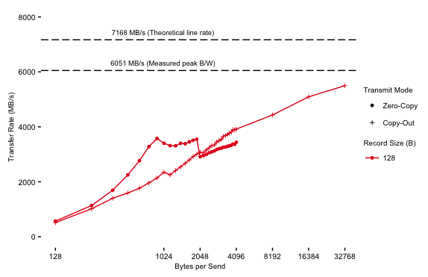
Throughput (128 B records)
Zero Copy
tx limit for 128B
Notes:
Axes, dotted lines, x –axis (#records), bigger better, CO better from 16, limit

Slide 25
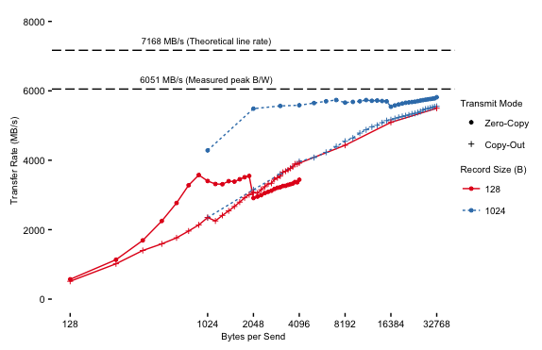
Throughput (Combined)
83%
68%

Slide 26
Takeaways - Throughput
Larger transmissions lead to better throughput.
Zero Copy transmission limited to record size X 32.
128B records too small to hide the DMA cost.
Copy Out can perform better in certain scenarios and the DB designer should tune his transmissions carefully if using Zero Copy.
Copy out performs better for small records, at what cost, specifically for the memcpy?

Slide 27
What is a copy (memcpy) ?
void * memcpy(void * buf1, const void * buf2, size_t n)
Read from the source (read cache line)
Write to the destination (modify and write cache line)
Read the dest ??
DMA Copy: common for Zero Copy and Copy Out.
Estimate:
For every byte transmitted, at least 3x memory bandwidth overhead
Experimental Result:
Not as bad, at worst 2x, why?

Slide 28
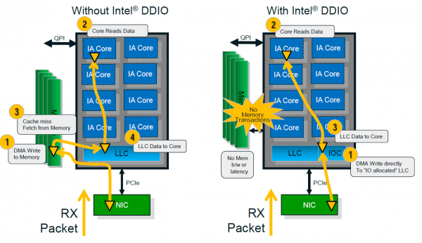
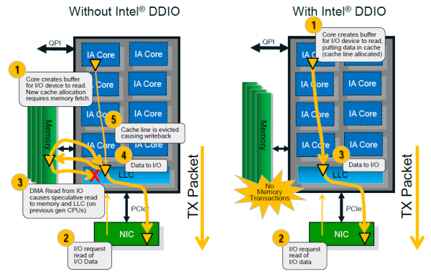
When is a copy not a copy?
Intel DDIO®
Slide Courtesy: https://us.hardware.info
Notes:
Don’t say inlining. Latency.

Slide 29
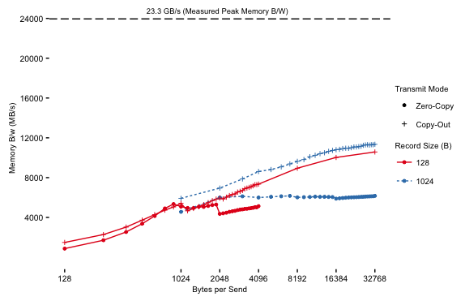
Memory Bandwidth
2x

Slide 30
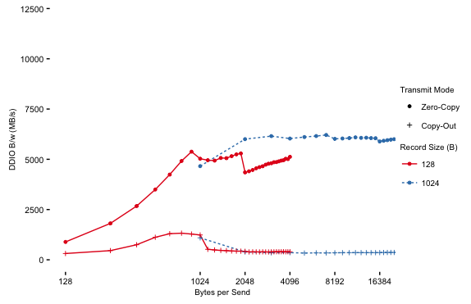
Memory reads from DDIO
Notes:
Absolute don’t say.

Slide 31
Takeaways
Memory Bandwidth
Zero Copy consistently consumes less memory bandwidth.
The benefit is roughly 2X for larger transmissions.
At high throughput, Copy Out consumes close to half of all available memory bandwidth.
Effects of DDIO
The upfront cost of the memcpy helps Copy Out while doing the actual transfer.
Most of consumed memory bandwidth for Zero Copy results from LLC misses in the DDIO region.
Notes:
Absolute don’t say.

Slide 32
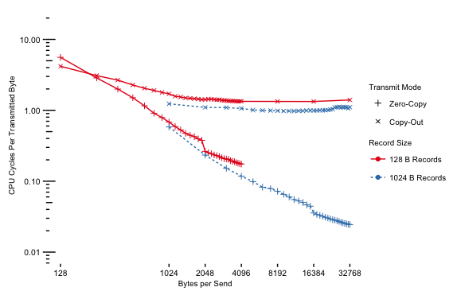
CPU Efficiency (combined)
~10x
~100x

Slide 33
Takeaways – Efficiency
Larger transmissions lead to better CPU Efficiency.
Zero Copy leads to CPU Efficient transmissions.
Efficiency gains of Zero Copy are multiplied at bigger transmissions.
Notes:
Absolute don’t say.

Slide 34
What does the NIC like?
Large Chunks of data
Better Throughput
A few chunks of data that it can gather
Avoids CPU overhead and memory b/w utilization.
Stable data
Zero Copy requires records to be locked over transmission.

Slide 35
Are there structures that can take advantage of these NIC friendly requirements?

Slide 36
Bw-Tree
A modern B-link tree from Microsoft Research
Lock and latch free
No updates in place

Slide 37
Bw-Tree
Base Page

Slide 38
Bw-Tree
Update 1
Δ
Base Page

Slide 39
Bw-Tree
Update 2
Δ
Update 1
Δ
Base Page

Slide 40
Bw-Tree
Reader
Δ
Δ
Base Page

Slide 41
Bw-Tree
Reader 2
New reader
after transmit init
Latest update after transmit init
Reader 1
Δ
Δ
Δ
Base Page

Slide 42
Bw-Tree
Latest update after transmit init
Δ
Header
Δ
sg_list[0]
sg_list[1]
Δ
sg_list[2]
NIC WQE
Base Page

Slide 43
Bw-Tree
Consolidate??
Reader
Δ
Δ
Base Page

Slide 44
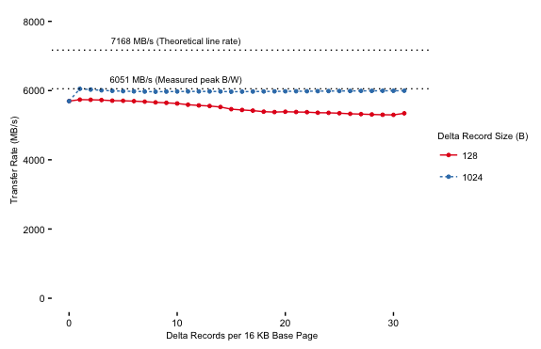
Delta Records (Throughput)
Notes:
Hekaton – Bwtrees secondary index.

Slide 45
Takeaways – Delta Records
NIC prefer records in some order.
Around 1.7x throughput than regular zero copy without the additional copy.

Slide 46
Column Stores - Thoughts
Row oriented
Column oriented

Slide 47
Column Stores - Suggestions
Use late materialization on client-side.
Transmit encoding along with results.
Use Zero Copy for queries with low selectivity.

Slide 48
Migration (Ongoing work)
Use Zero Copy.
Could layout data such that there is some order.
Defer re-replication to the end. If possible, use RDMA to re-replicate.
Use parallel and pipelined methods to fetch data from source and replay them on target.

Slide 49
Future Directions
New migration protocol (ongoing work).
More discussion on impact of column stores.
Build a client assisted system and evaluate benefits (possibly on Bw-Tree).

Slide 50
Conclusion
Modern NICs expose new capabilities.
Large transfers are important for In-Memory Databases
Tuning your layout and client assisted design can help to get best of throughput and efficiency.
Total ordering of data might be hard, but some order helps with efficiency and transmission.
Fast and resource efficient data movement can be achieved by careful co-design of Data layout and NIC features
There is no single solution that works well for all problems.

Slide 51
Questions
“Scale-out in-memory stores are optimized
for small requests under tight SLAs, and bulk data movement, for rebalancing an range queries, interfere;
The thesis argues carefully leveraging data layout and advancements in modern NICs will
yield to gains in performance and efficiency
for large transfers in these systems.”
Notes:
Pitch

Slide 52
THANK YOU

Slide 53
Timeline
Profiled impacts of a modern NIC on data layout
Compared Zero Copy and Copy Out
Measured Throughput and CPU load varying record sizes
Proposed a client assisted design using Bw-Tree
Published results in IMDM 2016
Analysed State of the art in Migration
Started write up and proposal
Spring 2016
Jul 2016
Aug 2016
Oct 2016

Slide 54
Throughput (Combined)
82.4%
67.25%
Zero Copy
tx limit for 128B
Notes:
Dip, tput is not improving
Blue tpu, cyxles spendt
Red and blue, red and blue (with arrows)
When is a copy not a copy?
DDIO. Raw cpu cycles cost, we did measure that, at least some aprt doing memcpy.
We predict DDIO maynot impact as much.
Copy Out, 6G->cache->6GB + 6G write it back
Cacheline writes are read modified writes (12GB/s) zerio copy
Except – NIC in zerop copy, cpu is copy out
DDIo actual measurements.

Slide 55
Timeline (contd)
Investigate impacts of DDIO
Measure actual memory impact
Get uncore, off core measurements
Profile Current Migration Protocol in RAMCloud
Measure Throughput for large transfers and migrations
Compare with Upper bounds
Analyze bottlenecks
Suggestions for new migration protocol
List out fundamental principles for new migration protocol from learnings
Write up and defend Thesis
Nov - Dec 2016
Jan 2017
Feb 2017

Slide 56
Memory Bandwidth
Notes:
Absolute don’t say.

Slide 57
Memory reads from DDIO
Notes:
Absolute don’t say.

Slide 58
Memory / Throughput

Slide 59
Throughput Anomaly (PCIe)

Slide 60
RDMA verbs - Takeaways
ibv_post_send(READ, ptr, VA)
RDMA READ
Client initiated; One Sided.
Server CPU not involved.
One read per op
RDMA WRITE
Server Initiated; One sided.
Some CPU offloading from the client.
Needs a secondary notification mechanism.
SEND/RECIEVE
Two sided; Client and Server initiated.
WRITE to a registered receive buffer.
Can gather entries
CPU
CPU
ptr
NIC
NIC
server
client
ibv_post_send(WRITE, ptr_list, RVA)
ptr
CPU
CPU
ptr
NIC
NIC
server
client
ibv_post_send(SEND, ptr_list, RVA)
ptr
CPU
CPU
ptr
NIC
NIC
server
client
Notes:
Target put from the fall, partitioned up front. Source had to pasdaartitioned anyway.
Writes don’t need to notify, doesn’t matter.
Send is a write into a reg recvd buffer.

Slide 61
Delta Records (Throughput)
Notes:
Hekaton – Bwtrees secondary index.

Slide 62
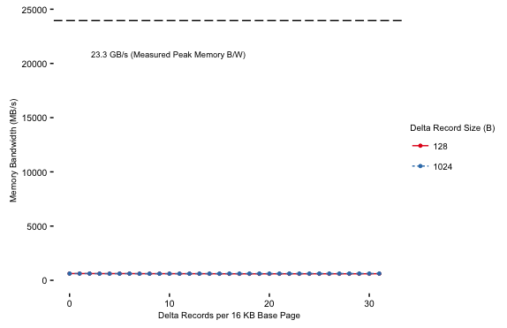
Delta Records (memory)
Notes:
Hekaton – Bwtrees secondary index.

Slide 63
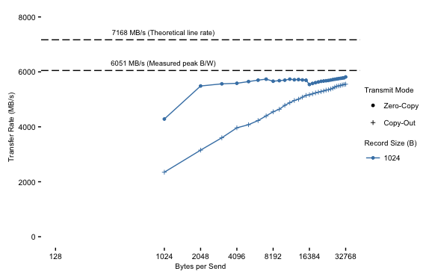
Throughput (1024 B records)
Notes:
Dip, tput is not improving
Blue tpu, cyxles spendt
Red and blue, red and blue (with arrows)
When is a copy not a copy?
DDIO. Raw cpu cycles cost, we did measure that, at least some aprt doing memcpy.
We predict DDIO maynot impact as much.
Copy Out, 6G->cache->6GB + 6G write it back
Cacheline writes are read modified writes (12GB/s) zerio copy
Except – NIC in zerop copy, cpu is copy out
DDIo actual measurements.

Slide 64
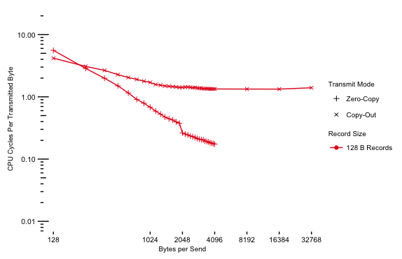
CPU Efficiency (128B)

Slide 65
CPU Efficiency (combined)
~10x
~100x

Slide 66
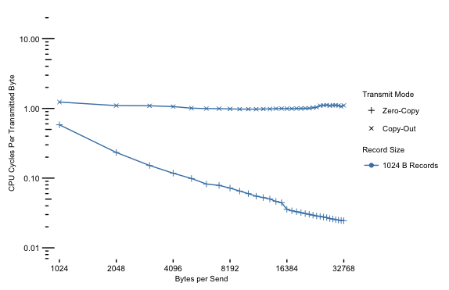
CPU Efficiency (1024B)

Slide 67
Takeaways - Efficiency
Larger transmissions lead to better CPU Efficiency.
Zero Copy leads to CPU Efficient transmissions.
Efficiency gains of Zero Copy are multiplied at bigger transmissions.
Notes:
Absolute don’t say.

Slide 68
Copy Out CPU Overhead

Slide 69
NIC – key memory regions
DMA Copy
MMIO
(Host Mapped Device Memory)
Thread Stack (Unregistered)
Record Heap
(NIC registered Huge Pages)
NIC
(On-device Memory)
Descriptor Copy
Tx Work
Request
memcpy
Tx Work
Request
A
10
DMA Copy
len
B
20
Pointers
len
len
len
Zero Copy
Posted PCIe Write
Copy Out
A
10
Tx Work
Request
Tx Work
Request
memcpy
len
B
20
len
DMA Copy
Posted PCIe Write
Tx Buffer

Slide 70
Migration (state of the world)
Squall – fine grained units, reactive pulls, arbitrary splits.
Morphus – Online reconfiguration for sharded systems, master-slave replication, range partitioning.
Common themes:
Requires up front partitioning of data
~1-20MB/s throughput on latencies 3-5 orders of magnitude worse than RAMCloud.

Slide 71
State of RAMCloud Migration
Synchronous and safe
Migrate tablet/indexlet
Scan entire log (data is not contiguous)
Synchronously
Send entries (transfer segments)
Replays entries on the target
Re replicates each entries on 3 backups
Still slow (~100MB/s) by the NIC standards
Notes:
Locality – obvious costs, application, machine locality and inside machine locality are different.
Order of records in memory from client is random. Hot and cold separation
Strictly order records, we can’t have hot and cold ordering.
Records aren’t sorted in an order that correlates clients key.
Memory utilisation will suffer if we order the keys the way clients want. DRAM is expensive.
Utilisation are

Slide 72
Why is it slow?
Notes:
Mention re-replication

Slide 73
Locality within a server
Assumes no locality within a server
Stored in temporal order, compacted in a different access order (hot and cold separation)
Intra server locality in a machine might hurt memory utilization
Notes:
Locality – obvious costs, application, machine locality and inside machine locality are different.
Order of records in memory from client is random. Hot and cold separation
Strictly order records, we can’t have hot and cold ordering.
Records aren’t sorted in an order that correlates clients key.
Memory utilisation will suffer if we order the keys the way clients want. DRAM is expensive.
Utilisation are

Slide 74
Locality benefits
Notes:
Locality – obvious costs, application, machine locality and inside machine locality are different.
Order of records in memory from client is random. Hot and cold separation
Strictly order records, we can’t have hot and cold ordering.
Records aren’t sorted in an order that correlates clients key.
Memory utilisation will suffer if we order the keys the way clients want. DRAM is expensive.
Utilisation are

Slide 75
Motivating Experiment
Show the piece wise distribution of time spent on migration.
See how far removing each of the bottlenecks takes us.

Slide 76
Factor Analysis - Migration

