Slide 1

INTRODUCTION OF MACHINE
WHY 4 POINT BENDING BENCH /MACHINE
BIBLIOGRAPHIC RESEARCH
KEY WORDS
RESEARCH PAPER RELATED SUBJECT
FUTURE WORK
INSTALLING STEPPER MOTOR
POSITIONING OF SENSORS

Slide 2
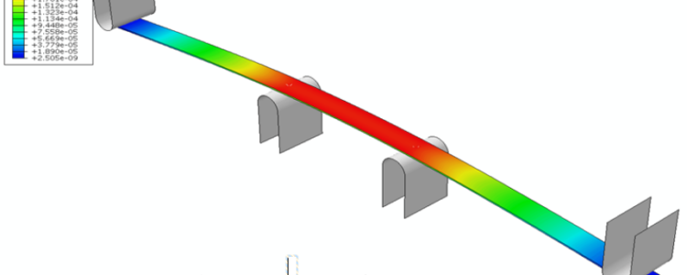
INTRODUCTION OF MACHINE (4 POINT BENDING BENCH /MACHINE )
https://www.univ-smb.fr/symme/en/emplois-stages/stagiaires/fourpointsbendingbench/

Slide 3
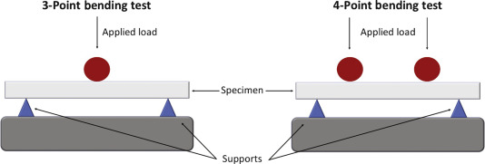
WHY 4 POINT BENDING BENCH /MACHINE
https://www.sciencedirect.com/topics/engineering/bending-tests

Slide 4
WHY 4 POINT BENDING BENCH /MACHINE
1.In four point bend tests, the maximum flexural stress is spread over the section of the beam between loading points.
2.A four point test tends to be the best choice if the material is not homogeneous, such as composites or wood. 3.the stress concentration of a four point test is over a larger region, avoiding premature failure.
https://www.testresources.net/blog/what-are-the-differences-between-3-point-and-4-point-bending-test/

Slide 5
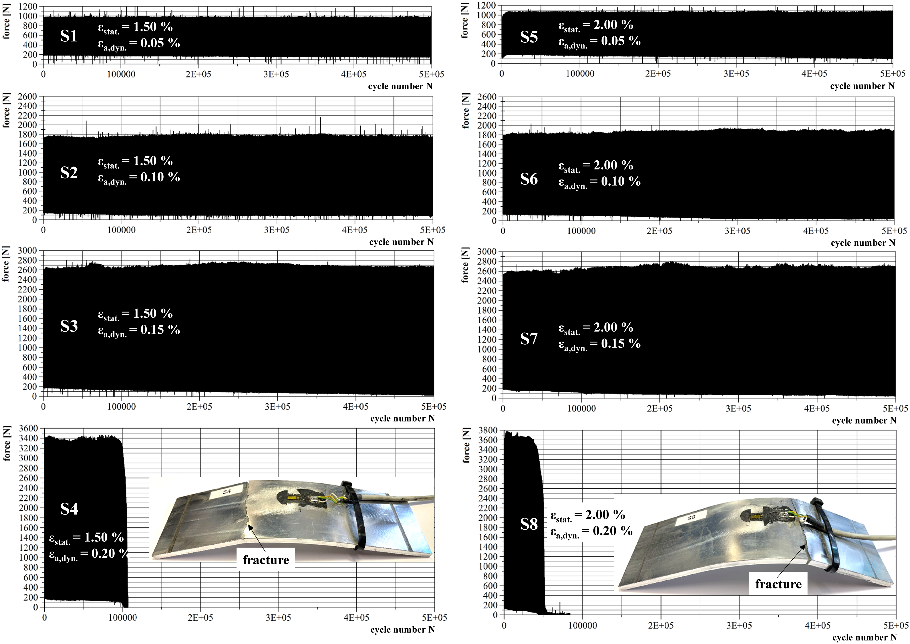
BIBLIOGRAPHIC RESEARCH
(4 POINT BENDING BENCH /MACHINE )
1ST PAPER
TITLE -Analysis of residual stress relaxation of aluminum alloys EN AW 6061/-82 T6 under cyclic loading
Measured cyclic four-point-bending force for samples S1–S8 (EN AW 6061 T6) [Colour figure can be viewed at
wileyonlinelibrary.com]

Slide 6
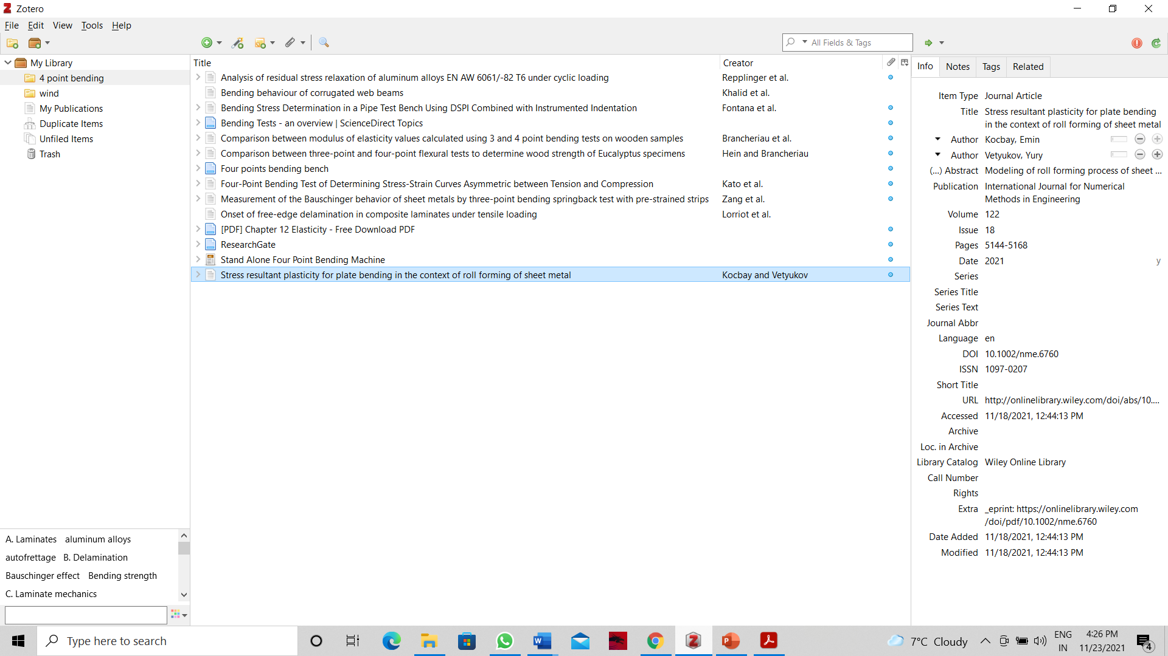
BIBLIOGRAPHIC RESEARCH
(4 POINT BENDING BENCH /MACHINE )
Bending Stress Determination in a Pipe Test Bench Using DSPI Combined with Instrumented Indentation.
(This paper presents the application of a modular device based on digital speckle pattern interferometry (DSPI) combined with an instrumented indenter, in order to determine bending loads in a reference pipe bench.)

Slide 7
KEY WORDS (4 POINT BENDING BENCH /MACHINE )
four-point bending
Four-point bending
Stress-strain curve
Twinning
Bauschinger effect

Slide 8
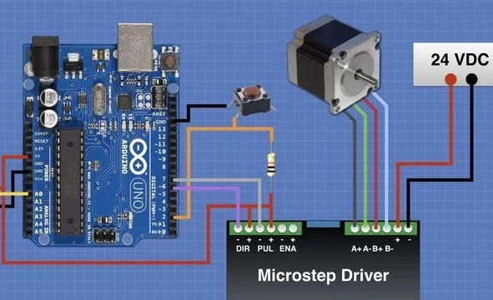
FUTURE WORK (4 POINT BENDING BENCH /MACHINE )
1.INSTALLING STEPPER MOTOR
1.1MANUFACTING THE PART TO FIX
THE MOTOR ON TOP OF BENDING
BENCH.
2. POSITIONING OF SENSORS
https://dronebotworkshop.com/big-stepper-motors/

