Slide 1

Cummins Service System - Oracle Solution
Anirban Bagchi

Slide 2
Agenda
Overview and a little background
Customer’s Requirement – The Ask!
The approach in Proof of Technology
The Solution
Engaging UX – The Demo
Architecture Diagram
MCS
UX on Ionic Framework
Learnings
Notes:
By enriching your CX Cloud with Oracle Cloud PaaS, you can receive the following benefits:
Extend capabilities to create new features and new applications
You get one platform for your entire business with standards based tools that are the most widely used in the industry
Streamlined development with applications portable to other platforms
Some ways your IT folks can enrich your CX cloud today are:
Create mobile apps
Share documents externally on any device
Simplify and unify BI across the business
Use certified 3rd party apps from Oracle Cloud partners
Aggregate data fast with DB Cloud Service, Java Cloud Service
Develop/test fast with DB Cloud Service, Java Cloud Service, Developer Services

Slide 3

Overview and a little background
Cummins – $20 Billion – Heavy Equipment Manufacturer
Engines Business Unit owns the Customer Service System (CSS) Project
Engines arrive for troubleshooting and servicing across thousands of dealerships across the world
There are different stages in the engine servicing starting with the initial fault report by the dealership
There are multiple roles involved in diagnostics, quoting, ordering parts, repair, and warranty claim.
Currently all these roles execute their work in disparate systems and use systems some of which are on the cloud and some on-prem
RFP was floated a few months back which Oracle Service Cloud and SalesForce Service Cloud were competing.
Was rejected by customer because of huge SaaS costs.
Also IT put their foot down against creating a fresh new Silo on the cloud and wanted to leverage existing investments
That’s when they opted for this Proof of Technology to build a PaaS solution.
Notes:
By enriching your CX Cloud with Oracle Cloud PaaS, you can receive the following benefits:
Extend capabilities to create new features and new applications
You get one platform for your entire business with standards based tools that are the most widely used in the industry
Streamlined development with applications portable to other platforms
Some ways your IT folks can enrich your CX cloud today are:
Create mobile apps
Share documents externally on any device
Simplify and unify BI across the business
Use certified 3rd party apps from Oracle Cloud partners
Aggregate data fast with DB Cloud Service, Java Cloud Service
Develop/test fast with DB Cloud Service, Java Cloud Service, Developer Services

Slide 4
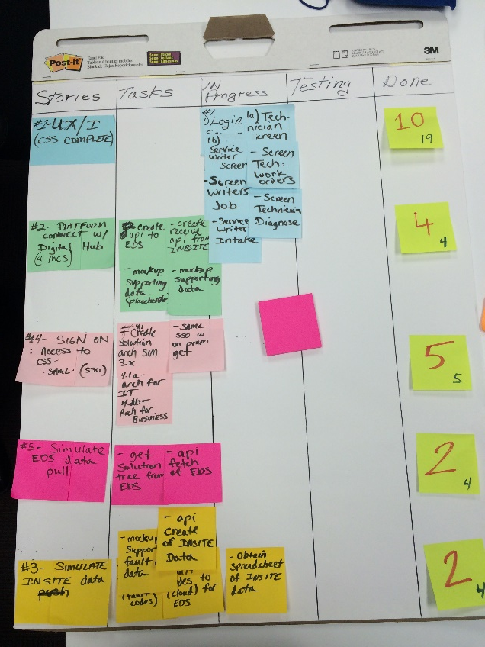
Customer’s Requirement – The Ask!
Attend the Proof of Technology(POT) at Cummins office
Each platform vendor was partnered with services vendor to deliver the POT
Execute the POT by adhering to the Agile Development approach following SCRUM guidelines
Necessary to have continuous onsite presence by each team
SCRUM Master had daily stand-up meetings where business and IT was there to address bottlenecks
Regular checks on development by Biz and IT to provide feedback and align approach
Build the CSS solution
Build a cloud solution leveraging what they have on-premise.
Provide seamless Omni channel experience
Adhere to UX guidelines and frameworks provided
20 point evaluation criteria
Demonstrate our solution and how we build it - Continuous assessment.
Demonstrate solution Agility - changes to the requirements every day for the first 2 weeks.
Make services vendors comfortable and on-board with our solution
Photo of the actual SCRUM board
Notes:
By enriching your CX Cloud with Oracle Cloud PaaS, you can receive the following benefits:
Extend capabilities to create new features and new applications
You get one platform for your entire business with standards based tools that are the most widely used in the industry
Streamlined development with applications portable to other platforms
Some ways your IT folks can enrich your CX cloud today are:
Create mobile apps
Share documents externally on any device
Simplify and unify BI across the business
Use certified 3rd party apps from Oracle Cloud partners
Aggregate data fast with DB Cloud Service, Java Cloud Service
Develop/test fast with DB Cloud Service, Java Cloud Service, Developer Services

Slide 5







CSS Storyboard
Service Writer : Creates Work Order when Engine comes in with problems
Technician is Assigned to the Work Order by a Scheduling System
Technician : Works on the Work Order and starts diagnosis
Fetch Fault Codes from Engine (INSITE)
Fetch Suggested Solution Trees
Technician : Works on the Suggested solutions and figures out parts requirement
Generate Quote from Parts information
Service Writer : Notifies customer for Quote and asks for approval to proceed
Notes:
By enriching your CX Cloud with Oracle Cloud PaaS, you can receive the following benefits:
Extend capabilities to create new features and new applications
You get one platform for your entire business with standards based tools that are the most widely used in the industry
Streamlined development with applications portable to other platforms
Some ways your IT folks can enrich your CX cloud today are:
Create mobile apps
Share documents externally on any device
Simplify and unify BI across the business
Use certified 3rd party apps from Oracle Cloud partners
Aggregate data fast with DB Cloud Service, Java Cloud Service
Develop/test fast with DB Cloud Service, Java Cloud Service, Developer Services

Slide 6
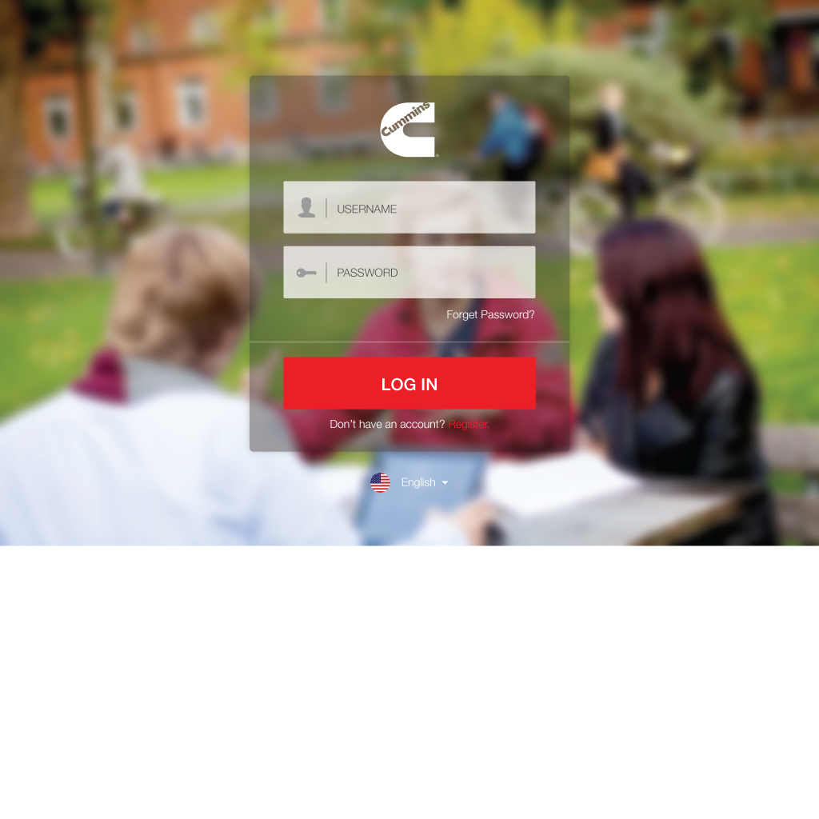
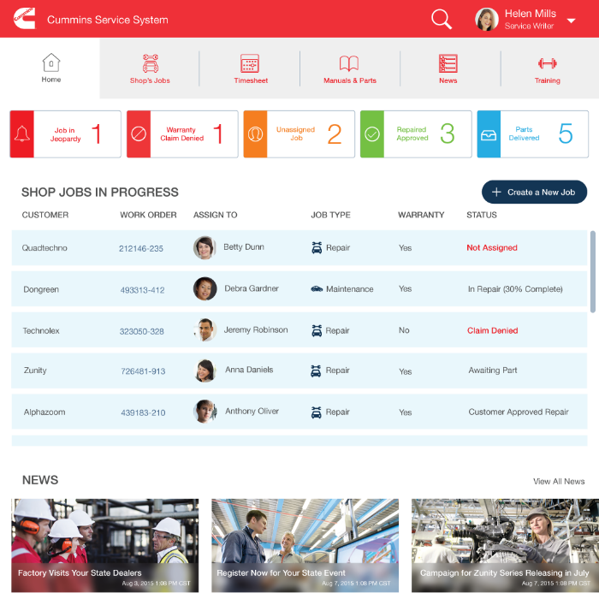
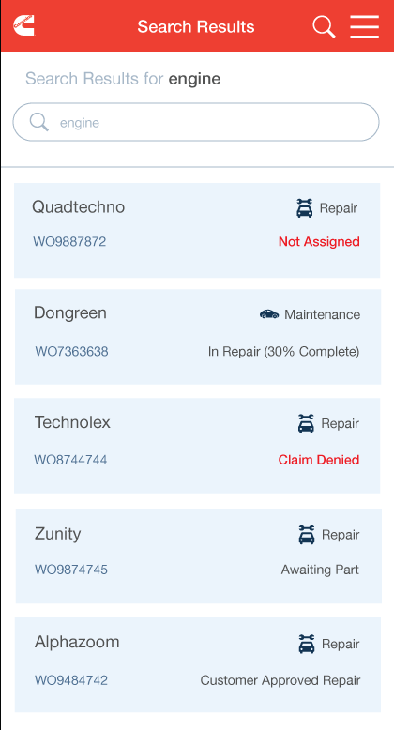
Our Approach to the POT
System of Engagement Driven Design and Development
Cummins put a lot of emphasis from day one on the UX for the solution
Wireframes created by our UX Specialist adhering to Cummins defined standards and validated with customer
Responsive Design was key to meet omni-channel requirements
UX to define the API contract to ensure user gets what they want providing Agility
System of Record Agnostic Approach - API Hub on the Cloud
APIs provide the abstraction to the data and process
Create and manage APIs on the cloud
Data and process can be anywhere, on-prem/cloud, new/existing, DB/SaaS
API provides agility for fast change
API contracts ensure rapid parallel development of UX and Services.
Photo of the actual SCRUM board
Notes:
By enriching your CX Cloud with Oracle Cloud PaaS, you can receive the following benefits:
Extend capabilities to create new features and new applications
You get one platform for your entire business with standards based tools that are the most widely used in the industry
Streamlined development with applications portable to other platforms
Some ways your IT folks can enrich your CX cloud today are:
Create mobile apps
Share documents externally on any device
Simplify and unify BI across the business
Use certified 3rd party apps from Oracle Cloud partners
Aggregate data fast with DB Cloud Service, Java Cloud Service
Develop/test fast with DB Cloud Service, Java Cloud Service, Developer Services

Slide 7
The Solution Compelling and Engaging UX – The Demo

Slide 8



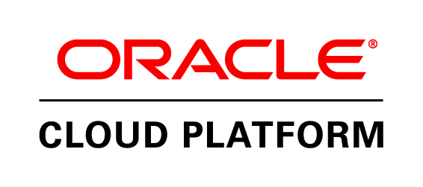




The Solution - Architecture Diagram
Multi-Channel
API
INSITE
Federated Sign-On
Siteminder
Create Work Order
Get Fault Codes
Get Solution Tree
Generate Quote
Seamless connectivity
Cummins Digital Hub
EDS

Slide 9
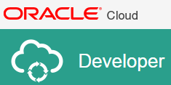
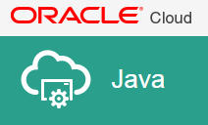
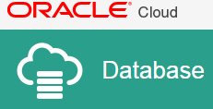


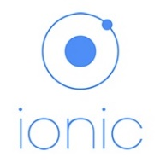


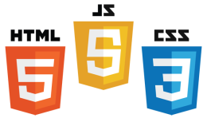

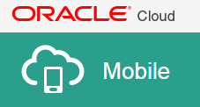


The Solution – Detailed Diagram
Siteminder
PUT
GET
PATCH
INSITE
Cummins Digital Hub
Expert Diagnostics

Slide 10
Solution – Challenges faced to Implement
Security – Authentication against Cummins Siteminder which is their Identity Store
SIM 3.0 does not support Federated authentication.
Engaged IDM A-Team to work on creating the necessary change in the Weblogic instance under the hood to be able to federate.
Added complexity because JCS and MCS are not in same domain, MCS is behind firewall
Challenges in integration with other cloud services like Process Cloud
Challenge in omni-channel architecture as browsers and MCS blocks Cross Origin Request
MCS not on Public Cloud : Causes a lot of problem to demo as customer/partners needs to go into Oracle VPN to access the instances. This causes problems in data push to MCS.
Learning curve in Ionic Framework to build the UX. Had to bring Infosys up-to speed on this too
Notes:
By enriching your CX Cloud with Oracle Cloud PaaS, you can receive the following benefits:
Extend capabilities to create new features and new applications
You get one platform for your entire business with standards based tools that are the most widely used in the industry
Streamlined development with applications portable to other platforms
Some ways your IT folks can enrich your CX cloud today are:
Create mobile apps
Share documents externally on any device
Simplify and unify BI across the business
Use certified 3rd party apps from Oracle Cloud partners
Aggregate data fast with DB Cloud Service, Java Cloud Service
Develop/test fast with DB Cloud Service, Java Cloud Service, Developer Services

