Slide 1

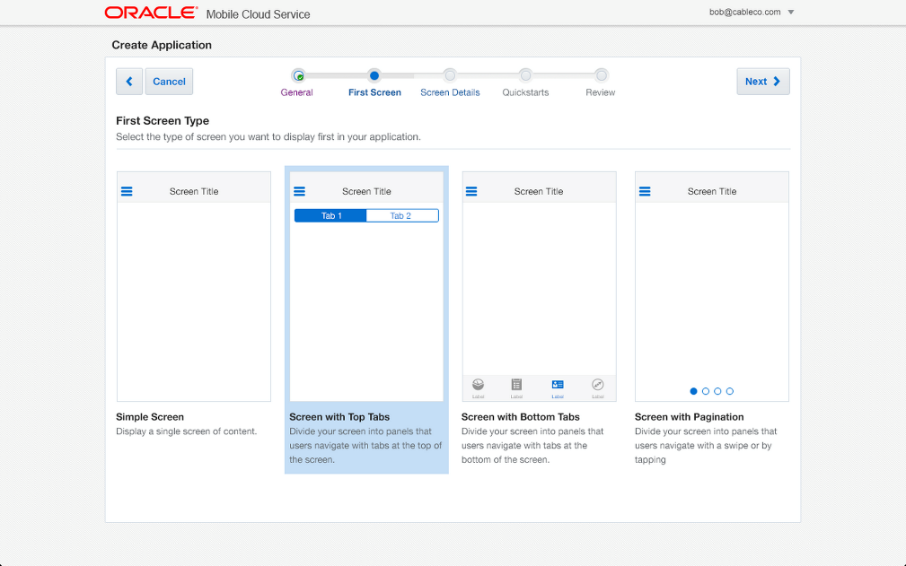
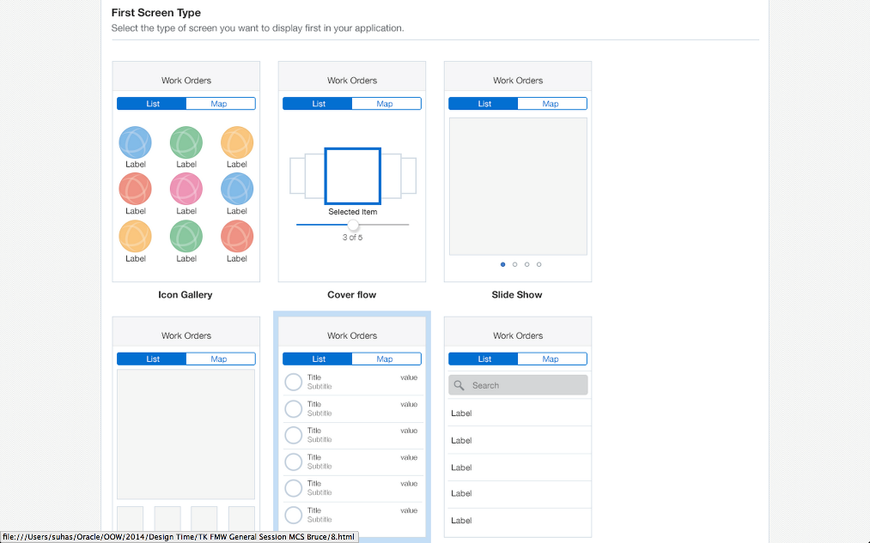
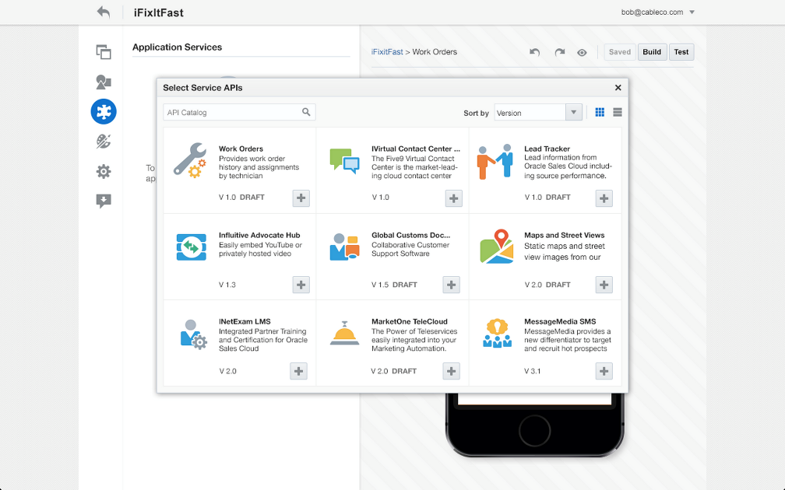
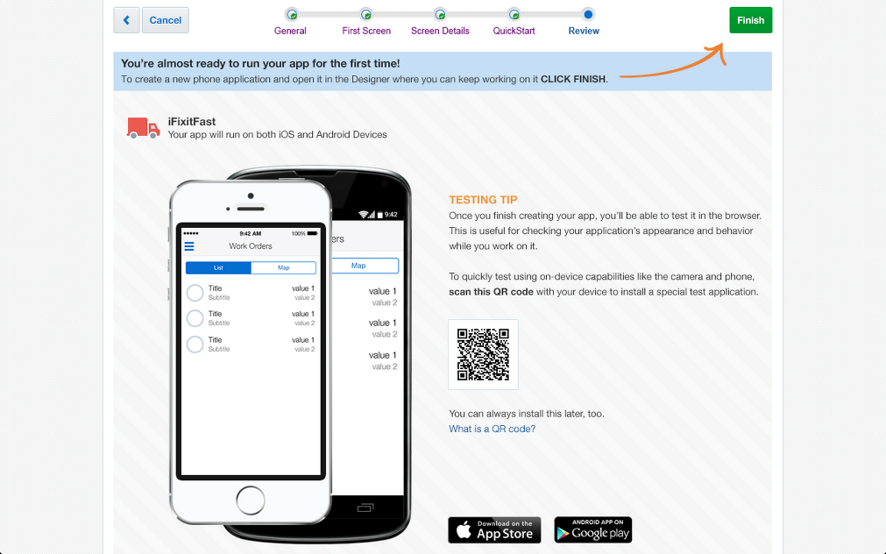
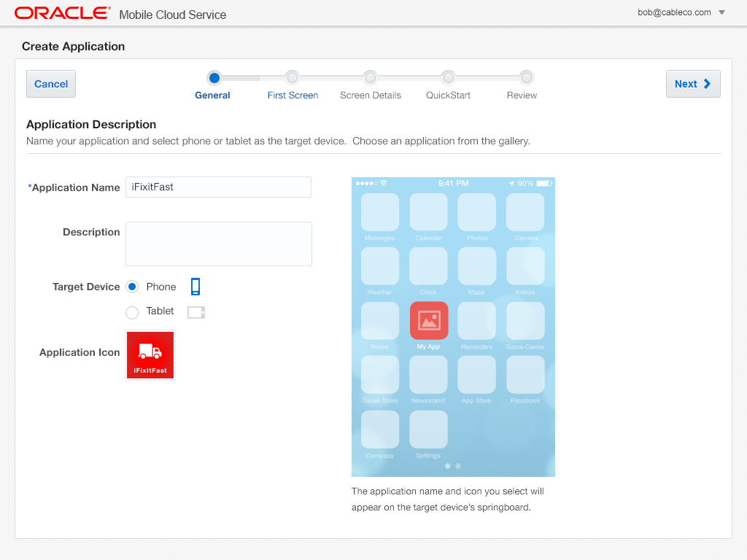
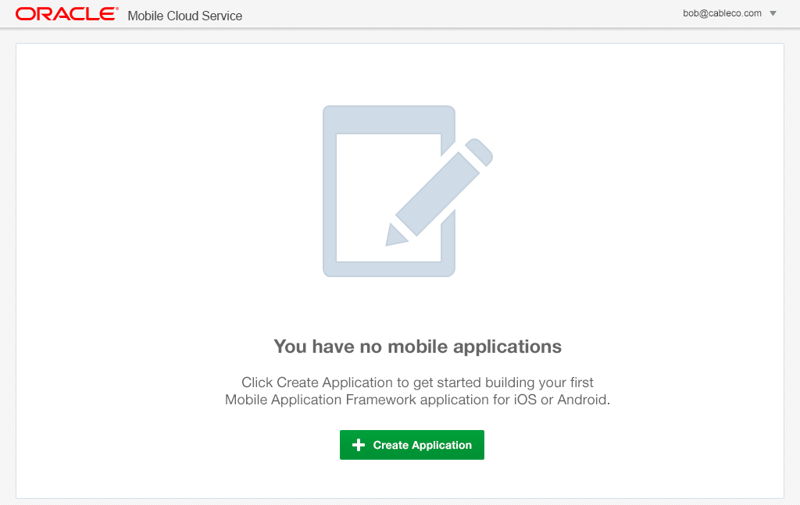
Mobile Application Accelerator (MAX)
Business Analyst - Mobile App Composition in the Cloud
Browser based development
No coding required
Easily map to business services
Preview app in line
Edit, test, and publish from browser
Notes:
The Oracle Mobile Service goal is to easily enable mobile application developers that are continually looking for new ways to accelerate development of apps to meet their consumers’ needs. MCS will be a set of cloud-based, server-side mobile services to make app development quicker and easier to deploy. MCS reduces the complexities of the application development by dealing with the complex server side programming, reducing the redundancy in creating backend code blocks, providing ready to integrate features and template backend.
Developers can focus more on the front end of the applications and can have their choice of mobile client development tools including ADF-Mobile for cross platform hybrid apps, native development or other Javascript tools – creating a new meaning for BYOD – Bring your own development
MCS provides a set of rich RESTFul interfaces for all the operations required by the mobile app that abstracts the backend from the mobile developer. In addition it also provides mobile specific interfaces for notification (multi channel – app, SMS), offline data sync, persistence services (to store mobile generated data and user preferences) as cloud data storage service.
From a backend perspective, MCS provides all the tools required by API developers to expose and shape the services to be consumed by the mobile developer. This includes mechanisms to design, create and expose these services in a catalog that can be easily and securely discoverable by mobile developers and integrated into their app.
Security is a critical component and is designed ground up in the MCS. From tokens to developers to develop and consume APIs to encryption policies for data in rest, data in motion, policies for single sign on and federated authentication across multiple data sources via Oauth or SAML and policies for defining access rights to applications via mobile application management or container technologies are services that will be available in MCS
A key component of MCS is to provide developers, IT and business with metrics on service usage and business impact. MCS will be designed to provide technical metrics, engagement metrics, business metrics along with the monitoring and management of the service.

