Slide 1






Mobile Cloud Service
Making Mobile Simple
Mobile
Cloud Service
Consumer style
front-end experience
Enterprise grade
backend
Systems of Record
&
Services
Notes:
So what is the answer to solving these problems – Mobile Cloud Service
Whether it is consumers or employees, they expect superior front end experience, tying to a secure enterprise grade backend service that connects and integrates to multiple systems of record and services.

Slide 2






Geared for all involved Personas
Line of Business Stakeholders
“I am responsible for the success of our mobilization strategy”
Enterprise Architect
“I make sure we have a secure, scalable solution”
Amanda – MCS Administrator
Mobile App Developer
“I create the mobile applications that call backend services”
Service Developers
MCS Admin
MCS Admin
“I administer MCS for our company”
.
Service Developers
“I create the backend services that mobile applications call”
LOB Stakeholder
Enterprise Architect
Mobile Developer
Notes:
Any successful mobile application is a collaboration among multiple groups within the enterprise. Gartner recommends a bimodal approach to unite IT teams and combine agility with stability to address digital opportunities. MCS was designed with a persona based approach with a deep understanding on the roles and needs of these personas and the tools required to make it easy for these personas to deliver on their roles and functions and to collaborate with the other personas. A quick look at the personas, focal with Mobile Cloud Service.
All starts with the LOB Stake holder that has the business requirement – they are responsible for the overall success of the mobile app.
Mobile client developer – responsible for building the client side engaging experiences and consuming services provided from the mobile backend
Service developers – developing or shaping services for mobile client developers to consume
IT Architect – ensuring IT security and architecture compliance
MCS admin – managing the operational maintenance of MCS

Slide 3



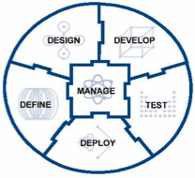



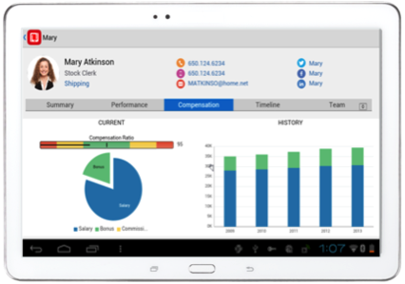
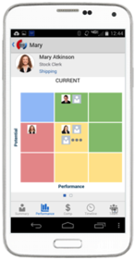



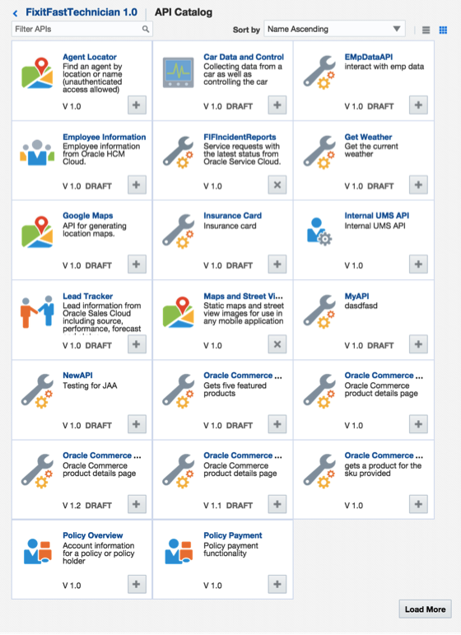


















Oracle Mobile Cloud Service
Outside-in, Mobile First
Analytics
Continuous Development
MOBILE APPLICATION FRAMEWORK
Diagnostics
Usage
Engagement
Monitoring
Inside-out, Service first
SDLC
Built-in APIs
Offline Sync
User Mgmt
Native
Mobile
Cloud Service
ICS
OSB / SOA
Cloud
Notifications
Storage
Connectors
Mobile APIs / SDKs
SECURE
Public Cloud
Oracle Cloud
Enterprise SaaS
On-premise
On-Premise Packaged Applications
3rd Party API
Others
Custom API
Users
Data Shaping
Objs
Custom
Logic
Orchestrate
CUSTOM Applications
Notes:
The Oracle Mobile Service goal is to easily enable mobile application developers that are continually looking for new ways to accelerate development of apps to meet their consumers’ needs. MCS is a set of cloud-based, server-side mobile services to make app development quicker and easier to deploy. MCS reduces the complexities of the application development by dealing with the complex server side programming, reducing the redundancy in creating backend code blocks, providing ready to integrate features and template backend.
Developers can focus more on the front end of the applications and can have their choice of mobile client development tools including ADF-Mobile for cross platform hybrid apps, native development or other Javascript tools – creating a new meaning for BYOD – Bring your own development
MCS provides a set of rich RESTFul interfaces for all the operations required by the mobile app that abstracts the backend from the mobile developer. In addition it also provides mobile specific interfaces for notification (multi channel – app, SMS), offline data sync, persistence services (to store mobile generated data and user preferences) as cloud data storage service.
From a backend perspective, MCS provides all the tools required by API developers to expose and shape the services to be consumed by the mobile developer. This includes mechanisms to design, create and expose these services in a catalog that can be easily and securely discoverable by mobile developers and integrated into their app.
Security is a critical component and is designed ground up in the MCS. From tokens to developers to develop and consume APIs to encryption policies for data in rest, data in motion, policies for single sign on and federated authentication across multiple data sources via Oauth or SAML and policies for defining access rights to applications via mobile application management or container technologies are services that will be available in MCS
A key component of MCS is to provide developers, IT and business with metrics on service usage and business impact. MCS will be designed to provide technical metrics, engagement metrics, business metrics along with the monitoring and management of the service.

