Slide 1
Mobile Cloud Service
Analytics
Abhishek Verma
Oracle Confidential – Internal
Notes:
This is a Title Slide with Picture slide ideal for including a picture with a brief title, subtitle and presenter information.
To customize this slide with your own picture:
Right-click the slide area and choose Format Background from the pop-up menu. From the Fill menu, click Picture and texture fill. Under Insert from: click File. Locate your new picture and click Insert.

Slide 2
Notes:
This is a Safe Harbor Front slide, one of two Safe Harbor Statement slides included in this template.
One of the Safe Harbor slides must be used if your presentation covers material affected by Oracle’s Revenue Recognition Policy
To learn more about this policy, e-mail: Revrec-americasiebc_us@oracle.com

Slide 3
Why is Mobile Analytics important for you ?
Measures key business indicators in app from installs to engagement and usage
Helps create better app experiences, leading to passionate users that ultimately drive engagement, loyalty and revenue
Tracks key stages from first discovery & download to in-app purchases
Finds out what works in your mobile app and what doesn’t

Slide 4
MCS Analytics
Real-time Engagement Analytics
Usage
Engagement
Events
Funnels
Location
API Calls

Slide 5
How MCS Analytics work ?
Mobile App User creates Mobile App using MCS as Mobile Backend
(As API calls start flowing into MCS, in Real-Time, view insight about your MCS Server)
User uses Analytics SDK or REST API in Mobile App to track Business events and properties in Client
(As Events start flowing into MCS, on Mobile App usage, in Real-Time, view insights about your Mobile Apps)
Use JS SDK or REST API in Custom Code to track Business event and properties in Server
(As API calls flowing into Custom Code, in Real-Time, view insights about your end to end Business Flow)

Slide 6
MCS Analytics: Default Dimensions
Device Details
Manufacturer
Model
OS Name
OS Version
OS Build
Carrier
Geo Location
Latitude
Longitude
Timestamp

Slide 7
MCS Analytics: Custom Event and Properties
Custom Event
Important actions specific to each Mobile Apps
Source of deeper insights into Mobile Apps functioning
E.g. Incident Report Created, Work Order Updated, Flight Ticket Booked etc
Custom Event Properties
Specific to each event
Provide context and details about events
E.g. Appliance Manufacturer, Parts Status, Flight Destination etc

Slide 8
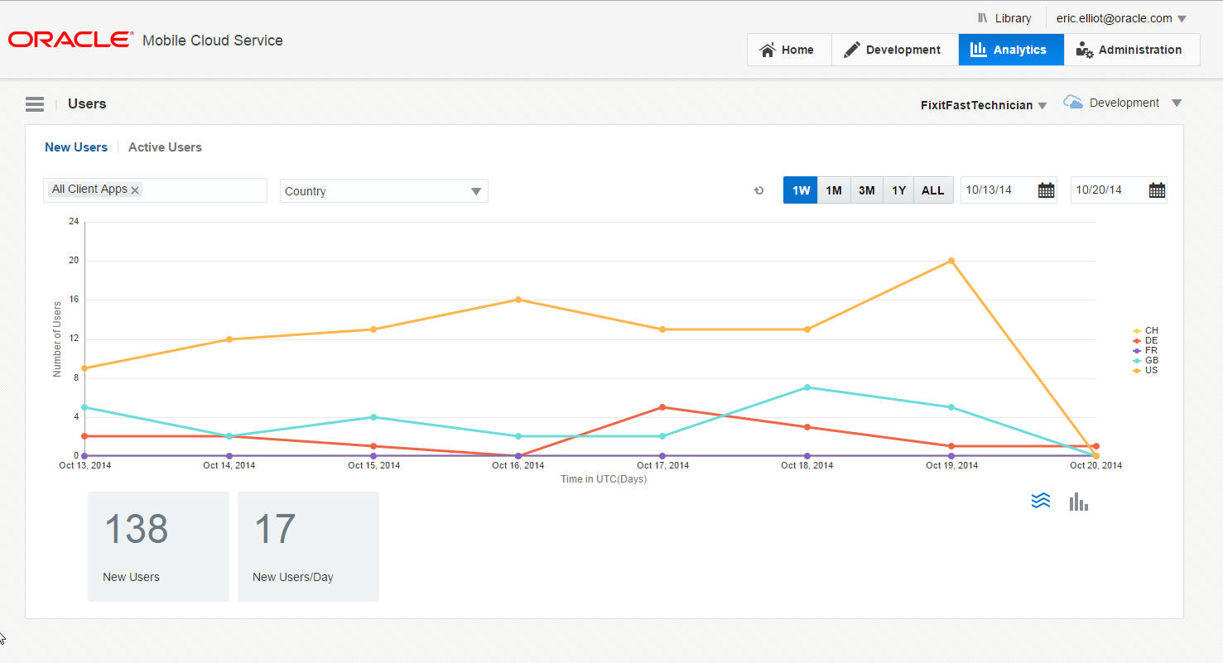
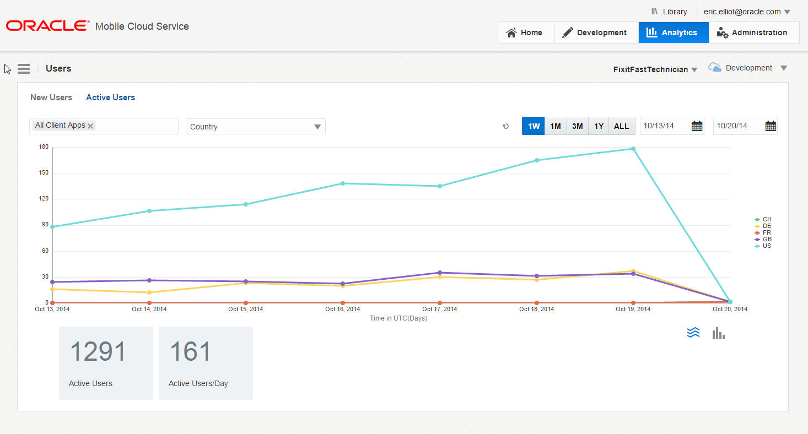
MCS Analytics: Usage

Slide 9
MCS Analytics: Few lines of code
analyticsClient = (Analytics) MobileBackendManager.getManager().
getDefaultMobileBackend(this).getServiceProxy( Analytics.class );
Event incidentCreatedEvent = new Event(“IncidentCreated", new Date(), properties);
HashMap properties = new HashMap<String, String>();
properties.put("Manufacturer","Xyz");
properties.put("Model","Abc");
mAnalyticsClient.logEvent(incidentCreatedEvent);
mAnalyticsClient.flush();

Slide 10
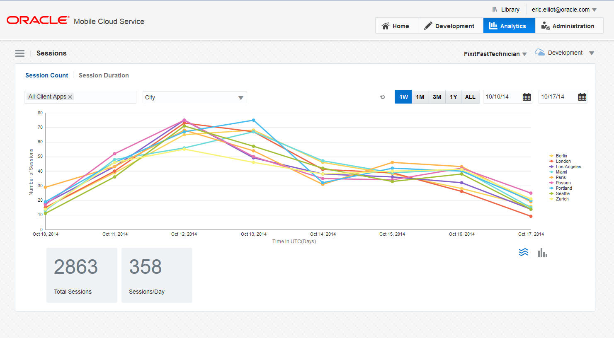
MCS Analytics: Engagement

Slide 11
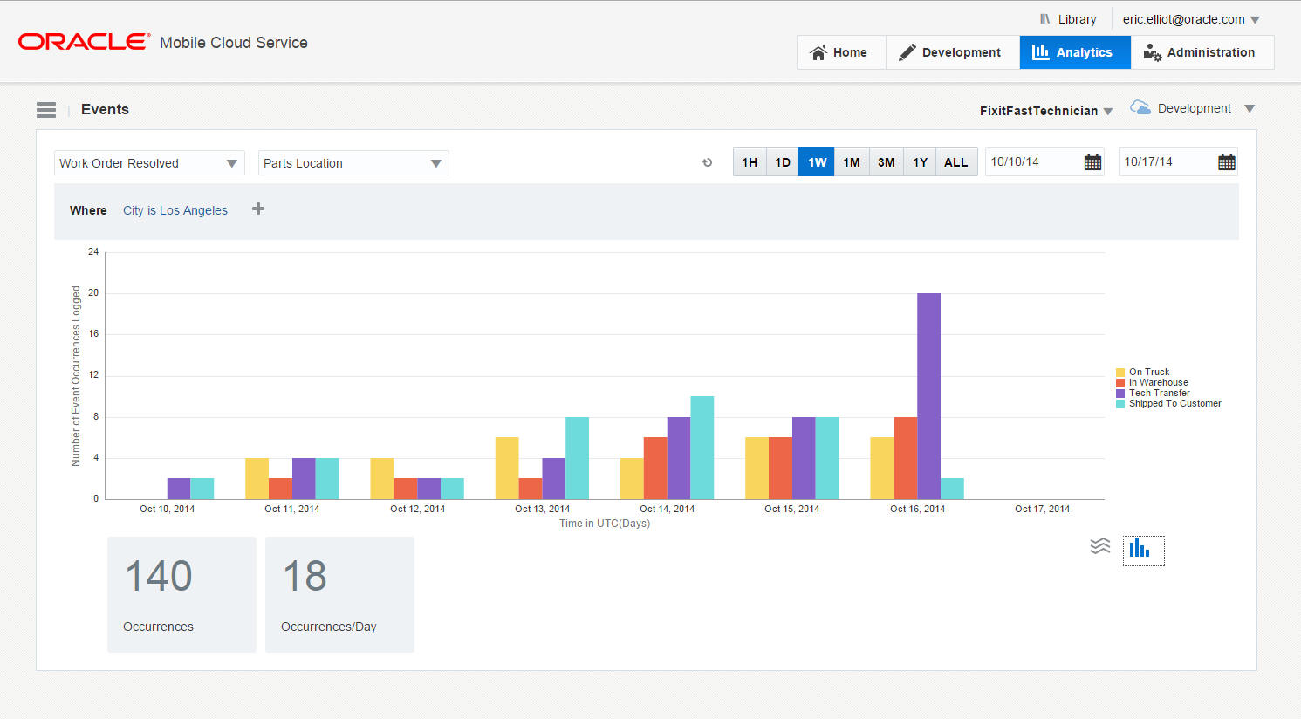
MCS Analytics: Events

Slide 12
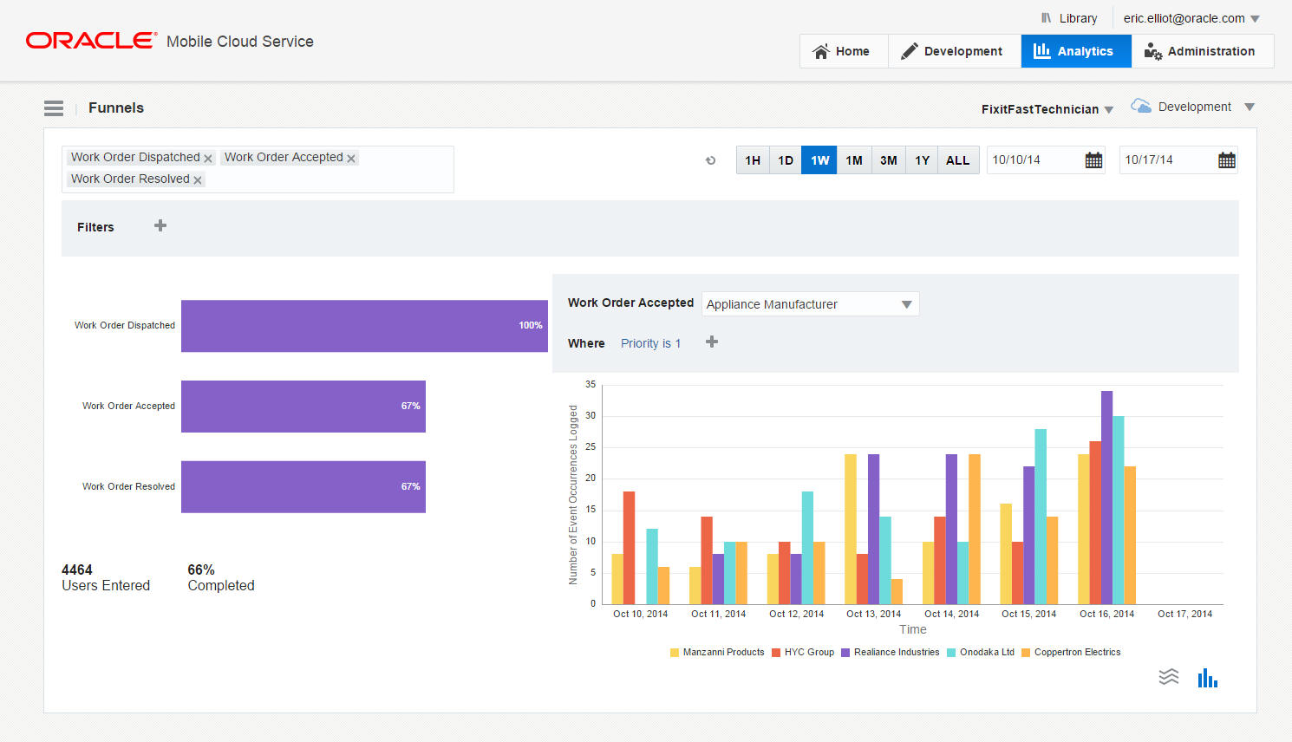
MCS Analytics: Funnels

Slide 13
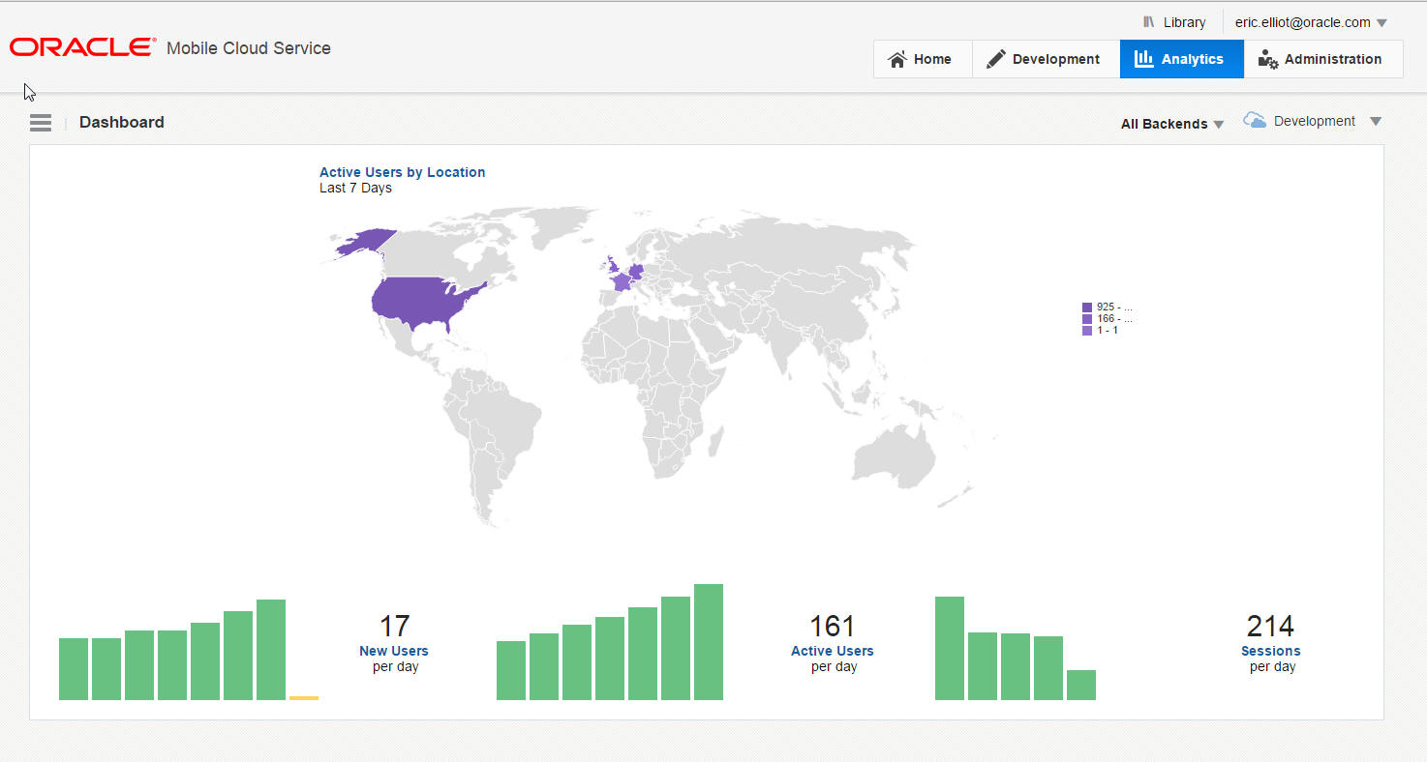
MCS Analytics: Location

Slide 14
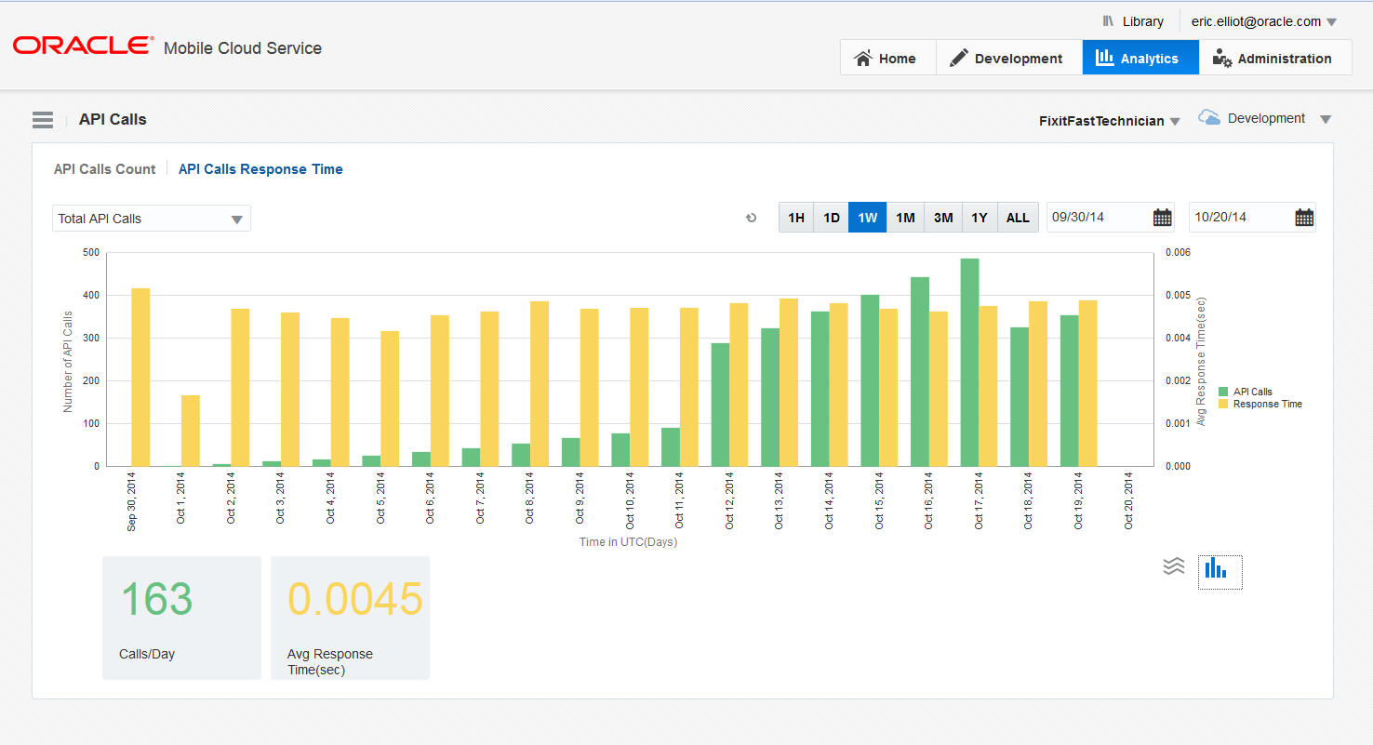
MCS Analytics: API Calls

Slide 15
MCS Analytics : Roadmap
User Engagement & In App Messaging
Segmentation
Retention
User Value Tracking
A/B Testing
Data Export

