Slide 1
DIGITAL Workshop
31 Oct 2026
By Goldman Sachs Engineering x YWLC
This presentation is for educational purposes only and is provided solely for use in connection with this workshop.
Notes:
YWLC – Young Women Leadership Connection

Slide 2
Opening Remarks

Slide 3
agenda
Icebreaker
Basics of Python
Lunch
Panel Discussion
Introduction to AI and Prompt Engineering

Slide 4

Human Computer Icebreaker
Notes:
---

Slide 5

Team Roles Setup
Coder Role
  You will receive a secret image. Your job is to give verbal instructions to the Computer on how to draw it.
Computer Role
  You have a blank piece of paper and a pen. You must draw exactly and literally what the Coder tells you. You cannot ask any questions.
Debugger Role
  You will watch silently. Your job is to assess how clear the instructions were and spot any "bugs" (miscommunications) after the activity.
Notes:
This slide establishes the structure of group interaction by assigning three distinct roles: Coder, Computer, and Debugger. Each role reflects a key function in software development workflows. The Coder is responsible for writing instructions, mimicking how developers create algorithms. The Computer executes these instructions literally, illustrating how machines interpret code without understanding context. The Debugger observes and identifies gaps, errors, or ambiguities, replicating the essential role of testing and quality assurance. This role-based structure ensures that all participants are actively involved while experiencing different perspectives within the development process. It fosters collaboration, accountability, and reflection as each participant contributes to the group's outcome. Additionally, the option to rotate roles ensures that everyone experiences each perspective, reinforcing learning through practice. By setting clear responsibilities, this slide enhances engagement and ensures the activity runs smoothly even in a large group setting.

Slide 6
Game Timeline
Minute 1 (Setup): Assign roles. Coders, come to the front to get your secret image. Computers, get your pen and paper ready.
Minutes 2–6 (Execution): The Coder gives instructions. The Computer draws. The Debugger observes.
Minute 7 (The Reveal): Stop drawing! The Computer reveals their masterpiece. Compare it to the Coder's original image.
Minutes 8–10 (Debugging): The Debugger leads a quick group discussion about what happened.
What was the biggest "bug" or miscommunication? How could the instructions have been more precise?
Notes:
This slide introduces the most critical rule of the activity: no guessing. It emphasizes that the ‘Computer’ must strictly follow the given instructions without making assumptions or asking clarifying questions. This rule is intentionally restrictive to demonstrate the limitations of computational systems, which lack human intuition and cannot interpret vague or implied meaning. By explicitly stating that no guessing or assumptions are allowed, participants quickly realize how often human communication relies on shared understanding and context. This realization highlights the importance of explicit, sequential, and unambiguous instructions when working with machines. The rule also drives engagement by creating humorous or unexpected outcomes when instructions are unclear, reinforcing learning through experience. Ultimately, this slide conveys a fundamental principle of programming and AI: systems operate strictly on defined inputs and logic, and any lack of clarity results in errors or unintended behavior.

Slide 7
Reflection and Debrief
Common Issues in Learning
  Unclear instructions, missing steps, and incorrect sequencing hinder understanding and performance.
Importance of Precision and Iteration
  Precision, testing, and iteration are key to successful coding and problem-solving.
Effective Instructions Lead to Success
  Clear communication drives successful outcomes with both humans and machines.
Notes:
The final slide guides participants through a brief reflection on what went wrong and why. It highlights common issues such as unclear instructions, missing steps, and incorrect sequencing, helping learners connect their experience to underlying concepts. This reflective step is essential as it transforms the activity from a simple game into a meaningful learning experience. By explicitly linking these challenges to programming terms such as algorithm, bug, and fix, the slide bridges the gap between abstract concepts and practical experience. Participants begin to understand that programming is fundamentally about clear communication with machines, and that errors are a natural part of the process. The debrief reinforces the importance of precision, testing, and iteration in both coding and broader problem-solving contexts. This ensures that participants leave with a clear takeaway: effective instructions drive successful outcomes, whether working with humans or machines.

Slide 8

BREAK
THE ICE!

Slide 9
WHO is known as “the father of computer”?
Bill Gates
Charles Babbage
Alan Turing
Steve Jobs
Notes:
B

Slide 10
What animal is said to have caused the first “computer bug”?
A fly
A spider
A moth
A mosquito
Notes:
C

Slide 11
What does “AI” stand for?
Automated Intelligence
Artificial Intelligence
Amazing Ideas
Algorithmic Inputs
Notes:
B

Slide 12
The name “python” comes from?
The snake
A British comedy show
The Greek God of code
An acronym for “Program Your Thoughts on Numbers”
Notes:
B (from Monty Python’s Flying Circus)

Slide 13
What was the first programmer’s name?
Ada Lovelace
Grace Hopper
Katherine Johnson
Marie Curie
Notes:
A

Slide 14
Which AI defeated the world chess champion garry Kasparov in 1996?
AlphaGo
DeepMind
Deep Blue
Watson
Notes:
C

Slide 15
What’s the main goal of machine learning?
Teach computers to learn from data
Replace teachers with robots
Make autopilot cars
Teach humans to code faster
Notes:
A

Slide 16
What’s a neural network inspired by?
Spider webs
Human brain neurons
Internet cables
Neural noodles
Notes:
B

Slide 17
Which company created the first personal computer that became a commercial success in the 1980s?
IBM
Apple
Microsoft
Google
Notes:
B (the Apple II and later the Macintosh)

Slide 18
Which of these is not a type of machine learning?
Supervised Learning
Unsupervised Learning
Reinforcement Learning
Hyperactive Learning
Notes:
D

Slide 19

House Rules
Raise hand when you need help
No photos, audio, or video recordings, please.
Only this floor is accessible!
Washroom is just outside; you don’t have to ask for permission.
Full attention when there is a speaker, plenty of time to talk over lunch!

Slide 20
Python Basics

Slide 21
Python basics
Colab Link: https://tinyurl.com/gs-ywlc-2026-collab
Please click File → Save a copy in Drive to enable editing

Slide 22
Lunch break

Slide 23
panel discussion
A day in the life of GS engineers

Slide 24
Artificial Intelligence

Slide 25
https://tinyurl.com/gs-ywlc-menti-2026

Slide 26

Demystify Ai, ml, nlp, dl
AI
Artificial Intelligence (AI) - broad discipline of creating intelligent machines.
Machine Learning (ML) - systems that can learn from experience.
Natural Language Processing (NLP) - systems that can understand human language.
Deep Learning (DL) - systems that learn from experience on large data sets.
ML
NLP
DL

Slide 27
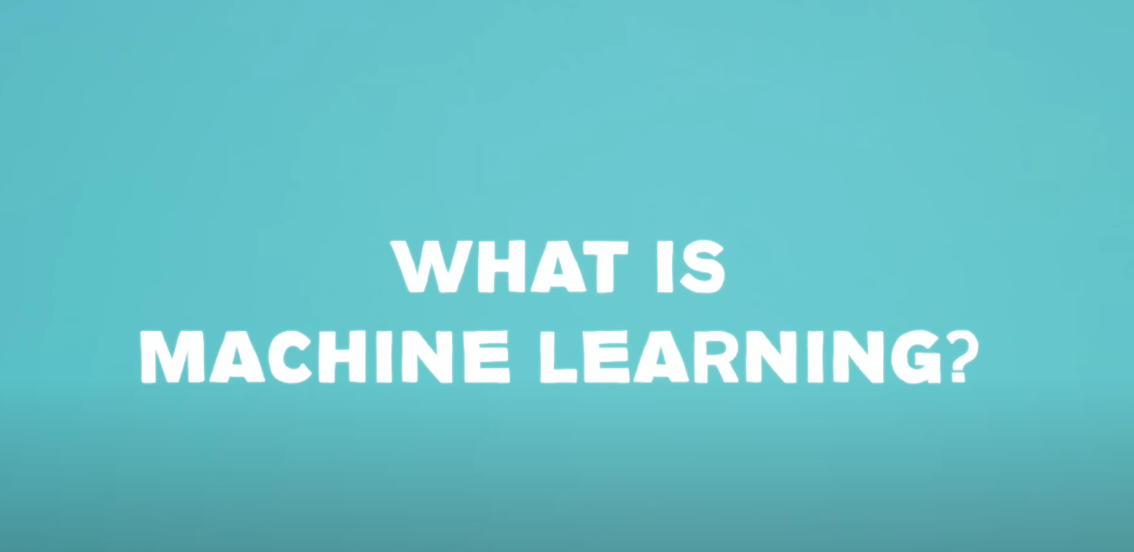
Machine Learning
Watch Video

Slide 28
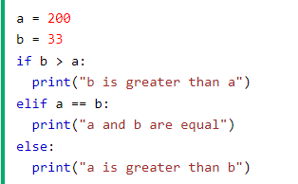
Learning Model
Traditional Programming
Learning Model
Test Data
Data
Training Data
Code
Results
Training
Model
Inference
Predictions
Rules
Expected Results
Model is like an equation used to make predictions
For e.g. if our goal is to create an application which sees an image and classifies if it is a cat or a dog,
We would pass tons of photos (Training Data) and its known types (Expected Results)
Our Deep Learning code will create a Model
When the Model sees a new image (Test Data) of an unknown type, it will run “Inference” to predict.
a and b are Data points
Conditional logic check is the Rule
“a is greater than b” is the output

Slide 29
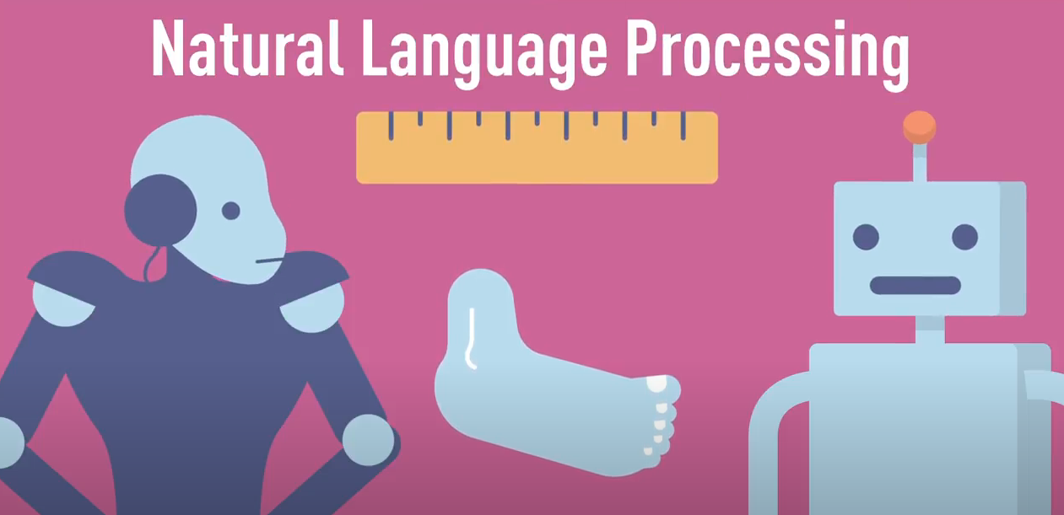
Natural Language Processing
Watch Video

Slide 30
nlp examples

Slide 31

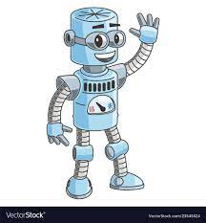
CHATBOTs and iot
Google Nest
Amazon Echo
Alexa
Etc…
<How do I understand what humans want?>
Hey my AI assistant, can you turn on the lights?

Slide 32

Natural language processing
A field of AI dedicated to processing language
This includes application such as
  Intent detection
  Entity extraction
  Translation
  Summarization
  Etc…

Slide 33
Generative AI

Slide 34



Generative ai models
Trained on LARGE amount of data
Has a more complicated model architecture
Designed to generate different types of content, eg text, images, code, video
Able to capture longer contextual info (think input prompts)

Slide 35

Gen ai models use cases/examples
Content Type | Models
Text | GPT 4-o, LLaMa 3
Code | Claude, GPT-o1
Image | DALL-E 3, Firefly
Video | Sora

Slide 36
Prompt Engineering

Slide 37



I want a pizza.

Slide 38
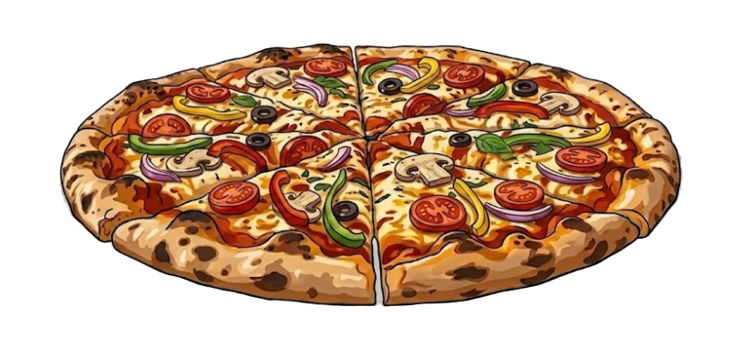
Here’s your pizza.

Slide 39

I want a medium-sized thin crust pepperoni pizza.

Slide 40
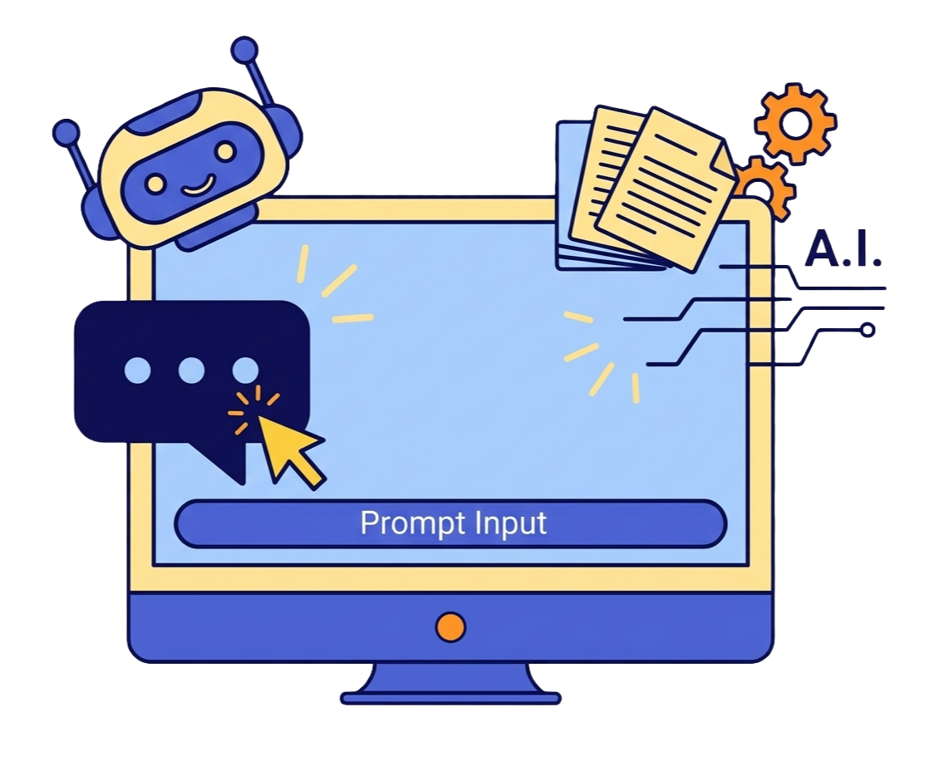
Prompting AI is like talking to a human.
Telling an AI what you want and providing enough context for it to figure out the implementation.
Use creativity + trial and error to create best input to the model

Slide 41
TODAY’S GOAL!
Working effectively with AI to create your first python app.

Slide 42
Best practices
Write clear goals
Provide adequate context within the prompt
Include expected input and output requirements in your prompt input, confining it to a specific format
Use simple language and reduce the prompt size to make your question more understandable.
Experiment and improve the prompt
Goals
Context
Input Requirements
Output Requirements

Slide 43

REAL LIFE example
Goals
Context
Input Requirements
Output Requirements
Create a study plan for a secondary school student. She is preparing for Physics exams in 2 more months. Input is the list of chapters in the curriculum. Output is a weekly study schedule, with 1 hour of study, 3 days per week.
Input: <list of chapters>

Slide 44
Best practices example
Goals
Context
Input Requirements
Output Requirements
Write a Python program that acts as a simple to-do list manager

Slide 45
Best practices example
Goals
Context
Input Requirements
Output Requirements
Write a Python program that acts as a simple to-do list manager
Goal: The program should let a user add tasks, remove tasks, and view their current list, all within one running session.

Slide 46
Best practices example
Goals
Context
Input Requirements
Output Requirements
Write a Python program that acts as a simple to-do list manager
Goal: The program should let a user add tasks, remove tasks, and view their current list, all within one running session.
Context: A simple to-do list for tracking tasks during a work session for a secondary 4 student preparing for national exams.

Slide 47
Best practices example
Goals
Context
Input Requirements
Output Requirements
Input and Output Requirements:
When the program starts, show a menu with these exact options:
  1. Add a task
  2. Remove a task
  3. View tasks
  4. Quit
The user enters a number (1–4) to choose an option.
  If they choose 1, ask "Enter a task to add:" and add it to the list.
  If they choose 2, show the current list with numbers, ask "Enter the number of the task to remove:", and remove that task.
    If the list is empty, print "Your list is empty." instead of asking for a number.
  If they choose 3, print all current tasks in a numbered list. If there are none, print "Your list is empty."
  If they choose 4, print "Goodbye!" and end the program.
  If the user enters anything other than 1–4, print "Please enter a valid number (1-4)." and show the menu again.
The menu should keep repeating after every action until the user quits

Slide 48
Hands-on!
Refer to the Jupyter notebook "My first program built with AI" under https://tinyurl.com/gs-ywlc-2026-collab
Please click File > Save a copy in Drive to enable editing ​

Slide 49
CREATE Your first app
Goals
Context
Input Requirements
Output Requirements
Quiz game
Hangman
Random fact generator
Grade calculator
Pomodoro study tracker

Slide 50
Closing REMARKS

