Slide 1


Smart Office Assistant — Project Presentation
Innovative solutions for efficient workplace management
Notes:
---

Slide 2
Smart Office Assistant Overview
Notes:
Title Slide Summary

Slide 3

Title Slide Summary
Project Introduction
  The slide introduces the Smart Office Assistant focusing on intelligent automation for productivity enhancement.
Scope and Features
  Highlights requirements, architecture, and core functions like meeting management and automated transcription.
Professional Design
  Uses a clean corporate theme and widescreen layout compatible with modern display systems.
Audience Orientation
  Sets expectations for a structured presentation guiding stakeholders from concept to technical details.
Notes:
The Smart Office Assistant project presentation begins with a clear and compelling title slide designed to establish the scope, purpose, and thematic identity of the system. This introductory slide positions the Smart Office Assistant as a technologically advanced solution focused on improving office productivity through intelligent automation. It highlights the high‑level areas of interest: requirements, architecture, and key functional features. In professional settings, a clean corporate theme is often essential to ensure that the content appears modern, credible, and aligned with organizational communication standards. By using a widescreen 16:9 layout, this slide ensures compatibility with most contemporary display systems, including projectors and webinar platforms. A concise subtitle introduces the audience to the overarching narrative—how the system gathers requirements, transforms them into functional capabilities, and integrates a range of technical components to deliver value. Such an introduction sets expectations for a structured, comprehensive walkthrough of the system’s capabilities, including intelligent meeting management, automated transcription, and seamless communication. It also establishes a narrative frame that the rest of the presentation expands on, including both technical underpinnings and the user‑facing functionalities. The placement of this summary slide at the beginning ensures that stakeholders—from engineering teams to decision‑makers—can immediately grasp the system’s purpose and the strategic problems it solves. This enables the entire presentation to unfold in a cohesive manner, guiding viewers from conceptual understanding to technical deep‑dive. Overall, the title slide serves as the entry point into understanding how the Smart Office Assistant integrates natural-language processing, context-aware automation, and business communication tools to redefine workplace efficiency.

Slide 4
Presentation Roadmap
Notes:
Agenda Breakdown

Slide 5
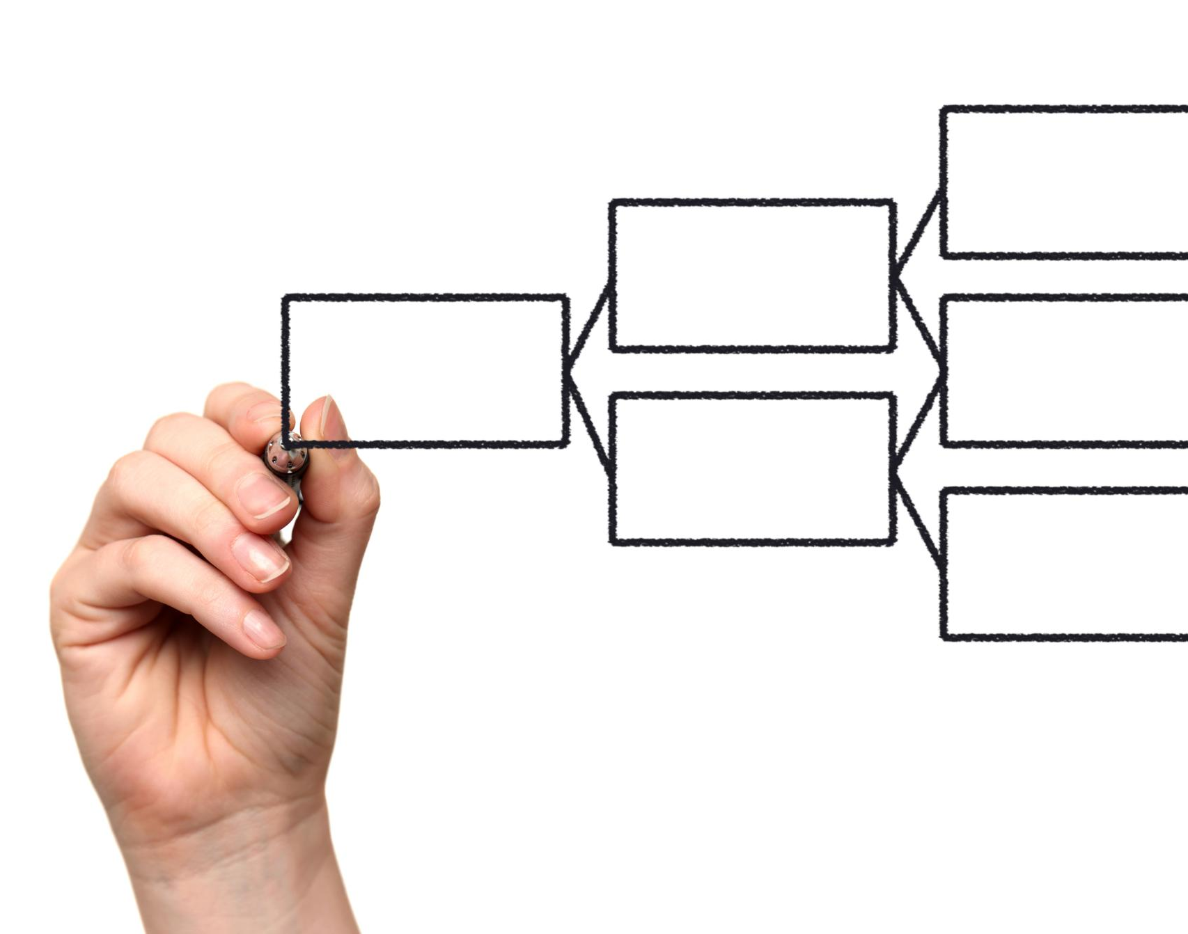
Agenda Breakdown
Project Overview Introduction
  Start with a high-level overview to establish context and introduce system purpose clearly.
Detailed Requirements
  Outline functional and technical needs shaping solution development and defining system boundaries.
Implemented Functionality
  Highlight features transformed from requirements into working components for stakeholder clarity.
Technical Architecture & Sequence
  Explain module interactions and sequence diagrams illustrating system workflows and API communication.
  Live Demo + Q&A
  See the assistant in action; wrap with questions and next steps.
Notes:
The agenda slide provides a structured roadmap to help the audience follow the logical progression of the Smart Office Assistant presentation. This roadmap begins with a high-level project overview that establishes context and introduces the system’s purpose. From there, the discussion transitions into detailed requirements, outlining the functional and technical needs that drove solution development. This structure is essential, as requirements gathering plays a fundamental role in defining system boundaries, user expectations, and operational flow. The agenda then highlights implemented functionality, giving the audience a concrete understanding of which features were transformed from requirements into working components. This section often helps stakeholders compare expectations with deliverables. Next, the technical architecture section explains how various modules—such as the NLU engine, meeting manager, transcription tools, and communication layer—interact to form a cohesive system. Architecture discussions are vital for technical teams evaluating scalability, maintenance, and extensibility. Finally, the agenda concludes with a sequence diagram overview, offering visual insight into the event flow between system components. Sequence diagrams help illustrate API interactions, user-driven triggers, and state transitions, providing clarity on how the system processes scheduling requests, handles transcription, and manages communication workflows. Together, this structured agenda ensures that the audience receives an organized journey through conceptual, functional, and technical layers, enabling them to develop a complete mental model of the Smart Office Assistant system.

Slide 6
System Requirements
Notes:
Meeting Scheduling & Management Requirements, Meeting Documentation Requirements, Communication Requirements

Slide 7

Meeting Scheduling & Management Requirements
Natural-Language Scheduling
  System parses natural-language requests with entity resolution and temporal parsing for accurate scheduling.
Address Book Integration
  References structured databases to identify correct participants by names, roles, and departments with disambiguation.
Calendar API Integration
  Integrates with calendar API to generate invitations, updates, and manage event lifecycle including cancellations and edits.
Meeting Documentation & MoM
  Supports recording uploads, speech-to-text transcription, key insights extraction, and generates structured meeting minutes.
Notes:
The Smart Office Assistant’s meeting scheduling and management requirements outline a comprehensive system designed to handle natural‑language scheduling requests with high accuracy and contextual awareness. This includes the ability to parse statements such as “Schedule a meeting with John next Tuesday at 2 pm,” requiring natural‑language understanding, entity resolution, and temporal parsing. The system must reference an address book stored in JSON or a structured database, enabling lookup of names, departments, roles, and emails to ensure correct participant identification. Robust handling of ambiguous queries—such as duplicate names across departments—requires disambiguation logic and follow‑up clarifying questions. Integration with the Google Calendar API is essential for generating invitations, sending updates, and managing event lifecycles including cancellations and edits. Another core requirement is meeting thread tracking, enabling the system to link follow‑up meetings to prior discussions, improving continuity and contextual relevance. Beyond scheduling, documentation-related requirements include the upload of audio or video recordings, transcription via speech‑to‑text engines, and analysis of transcript content to extract key insights. The system must generate structured Minutes of Meeting (MoM) that include summaries, decisions, and action items. It should also automatically detect task ownership and store prior MoMs in a searchable archive. With communication needs expanding, the system must support both text and voice input, generate TTS summaries, and deliver MoMs via email with embedded audio links. These requirements collectively define a sophisticated assistant capable of enhancing workplace coordination and automating administrative overhead.

Slide 8

Meeting Documentation Requirements
Transcription and Upload
  Users can upload audio or video files for accurate speech-to-text transcription of meeting content.
Structured Meeting Summaries
  Raw transcripts are intelligently summarized into organized Minutes of Meeting with key decisions and responsibilities.
Action Item Detection
  Automated detection links tasks to individual owners based on participant references in transcripts.
Searchable Archive and Formats
  Past meeting minutes are stored in a searchable archive and downloadable markdown format for easy retrieval.
Notes:
Meeting documentation requirements emphasize the Smart Office Assistant’s ability to capture, process, and structure information from recorded discussions. Users must be able to upload audio or video files—up to a maximum of 25 MB—to initiate transcription through a speech‑to‑text API such as Whisper. The transcription must be accurate enough to extract meaningful content, including decisions, discussion highlights, and action items. Intelligent summarization is required to convert raw transcript data into structured Minutes of Meeting (MoM), encompassing sections for meeting summary, key decisions, assigned responsibilities, and follow‑ups. Automated action-item detection ensures that tasks are not only identified but linked to individual owners extracted from participant references within the transcript. The system should maintain a persistent archive of past MoMs stored in a searchable format, enabling retrieval by keywords, dates, attendees, or topics. Additional requirements include providing a “transcribe only” mode for users who may not need full MoM generation. Supporting downloadable markdown formats ensures compatibility with external documentation workflows. These capabilities make documentation seamless and reduce administrative workload, while improving accuracy and accessibility. The system’s capacity to transform unstructured conversational audio into processed, well‑organized records positions it as a powerful tool for teams handling large volumes of meetings. This enhances operational transparency and assists in accountability tracking, knowledge retention, and institutional memory.

Slide 9

Communication Requirements
Multimodal Interaction
  Supports both text and voice input for flexibility and accessibility across devices and user preferences.
Audio Summaries and TTS
  Generates text-to-speech audio summaries for hands-free review and improved engagement with auditory updates.
Structured Formal Communication
  Sends HTML formatted Minutes of Meeting emails with embedded audio links for professionalism and easy access.
Reliable Delivery and Error Handling
  Includes SMTP integration for message delivery, authentication, error handling, and fallback notifications.
Notes:
Communication requirements for the Smart Office Assistant focus on multimodal interaction and seamless information delivery. Users must be able to interact with the assistant through both text and voice input, allowing flexibility across devices and accessibility needs. Voice input support requires accurate speech recognition and latency‑optimized processing. On the output side, the system should generate text‑to‑speech (TTS) audio summaries of action items and meeting takeaways, enabling hands‑free review and improving engagement for users who prefer auditory updates. For formal communication, the assistant must be able to send structured Minutes of Meeting via email, formatted in HTML to enhance readability and professionalism. These emails should include embedded audio links, enabling recipients to quickly access original recordings or TTS summaries. SMTP integration—preferably with Gmail‑compatible services—ensures reliable message delivery and authentication. The communication layer must also manage error handling for failed deliveries and support fallback notifications. Together, these requirements position the assistant as a unified communication hub that bridges synchronous and asynchronous workflows. It supports diverse working styles while ensuring clarity, consistency, and continuity of information exchange. This robust communication backbone elevates the overall user experience while reinforcing the assistant’s role as a central productivity and collaboration enhancer.

Slide 10
Implemented Functionality
Notes:
Meeting Scheduling Functionality, Address Book Functionality, Meeting Documentation Functionality, Communication Functionality

Slide 11

Meeting Scheduling Functionality
Natural Language Scheduling
  Users can schedule meetings conversationally using natural language, with the system interpreting intent and resolving ambiguities.
Temporal Reasoning & Parsing
  The system accurately parses relative dates and times like 'this Friday' using advanced temporal reasoning.
Participant Resolution & Availability
  Accurate matching of participants and departments ensures correct attendee selection, with automatic first-available-slot scheduling.
Calendar Integration & Workflow
  Integration with calendar APIs supports event creation, modification, cancellation, and meeting thread continuity.
Notes:
The Smart Office Assistant’s implemented meeting scheduling functionality translates complex requirements into practical, user‑ready features. Natural‑language scheduling enables users to initiate requests conversationally, while the system interprets intent, extracts time expressions, resolves participant identities, and handles ambiguous cases using clarifying questions. Temporal reasoning supports relative date parsing, allowing phrases like “this Friday” or “two weeks from now” to be accurately interpreted. Participant and department resolution ensures accurate attendee matching, even when duplicate names are present. When users omit critical details—such as duration or location—the system provides follow‑up prompts to complete the scheduling workflow. A sophisticated first‑available‑slot algorithm allows users to schedule meetings automatically based on the availability of all required participants. Integration with the Google Calendar API enables creation, modification, and deletion of events directly through the assistant. Additional features include search capabilities for existing meetings, meeting cancellation flows, and persistent meeting thread tracking, enabling the system to build continuity between related discussions. This comprehensive scheduling engine transforms everyday administrative tasks into seamless automated workflows, reducing errors and improving productivity.

Slide 12

Address Book Functionality
Persistent JSON Storage
  The address book uses a JSON-based storage model for flexible and lightweight contact management.
CRUD Operations
  Users can create, read, update, and delete contacts to adapt to organizational changes seamlessly.
Advanced Search and Grouping
  Search by name, role, email, or department and group contacts by department for quick access.
Integration and Context Understanding
  The address book supports meeting scheduling and action assignments with accurate participant context.
Notes:
The address book functionality is fully implemented using a JSON‑based persistent storage model that acts as a lightweight directory of contacts. Users can create, read, update, and delete entries, ensuring flexibility and adaptability to changing organizational structures. Search capabilities allow filtering by name, role, email, or department, while department‑based grouping helps users identify relevant contacts quickly. Pre‑loaded sample contacts provide a ready‑to‑use starting point for demonstrations or onboarding. The address book serves as a foundational component for other modules, particularly meeting scheduling and action‑item assignment. Its structured format ensures efficient querying and reduces ambiguity during natural‑language interpretation. This functionality enhances the Smart Office Assistant’s ability to understand organizational context and maintain accurate participant information across all workflows.

Slide 13

Meeting Documentation Functionality
Audio and Video Upload
  Users can upload audio or video recordings up to 25 MB for transcription using the Whisper engine.
Automated Minutes Generation
  The system creates structured meeting minutes with summaries, discussion points, decisions, and action items automatically.
Context-Aware Action Assignment
  Action items are assigned to correct individuals using address book references detected in transcripts.
Searchable Archival and Export
  All meeting minutes are archived in searchable formats and can be exported as markdown or transcript-only files.
Notes:
The Smart Office Assistant offers a full suite of meeting documentation features designed to streamline how organizations capture and manage meeting information. Users can upload audio or video recordings up to 25 MB, which are processed through the Whisper transcription engine for high‑accuracy text output. Building upon this transcript, the system automatically generates structured Minutes of Meeting, including summaries, discussion points, decisions, and action items. Context‑aware logic ensures that action items are assigned to the correct individuals by referencing the address book when names appear in transcripts. The system supports persistent archival of all MoMs, stored in searchable formats that facilitate retrieval by keyword, date, or participant. Users can also download documentation in markdown format or utilize a “transcribe only” mode when detailed MoM output is not required. This comprehensive feature set enhances documentation accuracy, reduces manual note‑taking, and improves long‑term knowledge retention.

Slide 14

Communication Functionality
Multimodal User Inputs
  The system supports chat and voice inputs, offering flexible and accessible communication methods for users.
Audio Summaries and TTS
  Generates text-to-speech audio summaries of meetings, allowing users to listen to key points efficiently.
Email Integration and Delivery
  HTML-formatted meeting minutes are sent via SMTP, compatible with Gmail and enterprise workflows.
Error Handling and Feedback
  Robust error handling ensures reliable delivery and provides user feedback when communication issues occur.
Notes:
The communication capabilities implemented within the Smart Office Assistant facilitate natural, efficient exchanges between users and the system. It supports both chat‑based and voice‑based user inputs, providing multimodal flexibility and accessibility. For output, the system generates text‑to‑speech audio summaries of meeting content, enabling users to listen to key points without needing to read long text. HTML‑formatted Minutes of Meeting can be delivered directly to attendees’ inboxes through SMTP integration, ensuring compatibility with Gmail‑based services and standard enterprise workflows. Embedded audio links allow recipients to quickly access original recordings or TTS summaries. Error handling within the communication pipeline ensures delivery reliability and provides user feedback when issues arise. Collectively, these features enable seamless communication loops that augment productivity and support diverse user preferences.

Slide 15
System Architecture
Notes:
Technical Architecture Overview

Slide 17

Technical Architecture Overview
Modular Frontend Interface
  Streamlit frontend provides a lightweight, multi-page interactive interface for scheduling and configuration management.
Intelligent Backend Processing
  GPT-powered NLU engine handles intent detection, entity extraction, and contextual reasoning for natural language commands.
Meeting and Communication Services
  State machine Meeting Manager controls meeting events; communication via text-to-speech and email delivery ensures smooth workflows.
External API Integrations
  Integration with OpenAI, Google Calendar, and SMTP services enables scalability and supports future enhancements.
Notes:
The technical architecture of the Smart Office Assistant consists of a modular, extensible system that integrates frontend, backend, and external services to deliver a cohesive automation platform. The frontend is built using Streamlit, offering a lightweight, interactive interface with multi‑page navigation for managing scheduling, documentation, and system configurations. On the backend, the NLU engine powered by GPT handles intent detection, entity extraction, and contextual reasoning essential for interpreting natural‑language commands. A Meeting Manager built as a state machine governs meeting lifecycle events, ensuring predictable transitions and error‑resilient workflows. The Address Book Service provides structured access to user information stored in JSON, while the Calendar Service works with both Google Calendar and a mock environment for testing. The Transcription Service leverages Whisper for audio processing, and MoM generation is performed through GPT function calling to ensure structured, reliable output. Communication components include text‑to‑speech synthesis and SMTP email delivery. Externally, the system integrates with OpenAI APIs, Google Calendar API, and Gmail‑compatible SMTP servers. This architecture ensures scalability, modularity, and clear separation of concerns, supporting future enhancements such as multi‑language support or advanced analytics.

