Slide 1
Machine Learning for Stock Trading Predictions
CNN, DTW & Kalman Filter
Michel kamel & robert chang
Csci E-82
Advanced machine learning, data mining, and artificial intelligence
12/14/2017

Slide 2
Predicting Stock Price Movements Using Machine Learning
We use tick data (each minute) for the S&P 500 from April – August 2017 for training and testing.
We test two strategies:
CNN architecture for predicting future return for different time intervals.
Dynamic Time Warping and a Kalman Filter expectation maximization (EM) algorithm for pairs trading.

Slide 3
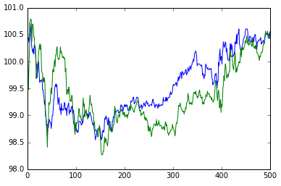
Pairs Trading Overview
Pairs Trading was popularized in the 1980’s by Morgan Stanley
Stocks are bought and sold in pairs for arbitrage opportunities
Two components to a pairs trading strategy
Choose two stocks that move in tandem.
Choose the entry/exit points.

Slide 4
Choosing a Pair of Stocks
Choosing a pair of stocks is not easy as there are 125,000 (500^2 / 2) pairs to choose from in the S&P 500.
Common methods:
Distance Approach - Choose pairs with a small distance between them, the smaller the distance the greater the co-movement of prices.
Cointegration Approach - Perform a cointegration test between each pair, pick the pairs with the lowest t-statistic.
Clustering Approach - Cluster the stocks according to pre-defined risk factors (e.g. tsfresh). Usually combined with dimensionality reduction, such as PCA.
We use a distance-based approach, and use Dynamic Time Warping to produce a distance metric.

Slide 5
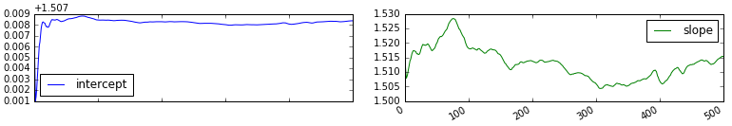
Choosing Entry/Exit Points
We could use a mean-reverting approach and perform a linear regression to determine a hedge ratio between the two stocks.
However, we would ideally like a rolling linear regression as the hedge ratio will be time-varying.
A state-space model would treat the "true" hedge ratio as an unobserved hidden variable and estimate it with "noisy" observations.
In a linear state-space model states are a linear combination of the prior state at time t−1 as well as random noise.

Slide 6
Linear State Space Model
We solve two matrix equations:
The state equation:
State variables have a linear dependence on the prior state by the transition matrix G and normally-distributed system noise.
The observation equation:
States are unobservable and we only get access to observations at each time index. The observations depend on the observation matrix F and normally distributed measurement noise.

Slide 7

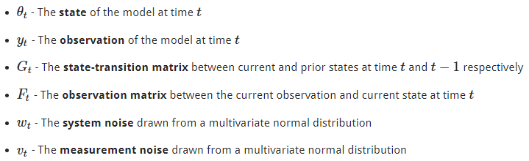
The Kalman Filter – Bayesian Approach
The posterior probability of obtaining a state, given our current observation, is equal to the likelihood of seeing that observation, given the current state multiplied by the prior belief of the current state, normalized by the probability of seeing the observation regardless.

Slide 8
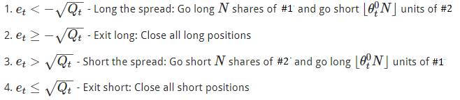
The Pairs Trading Strategy
We go "long the spread" if the forecast error drops below the negative standard deviation of the spread.
We go "short the spread" if the forecast error exceeds the positive standard deviation of the spread.

Slide 9
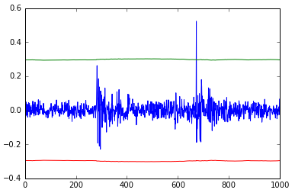
An Example
Receive minute-by-minute market prices.
Use the Kalman filter to estimate stock #1 today based on prior observation of stock #2.
Take the residual of the estimate of stock #1 and the actual value.
Go long/short the spread when the negatively/positively far from the expected value.
Exit the long and short positions when the series reverts to its expected value.

Slide 10
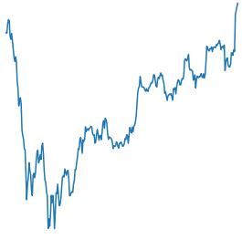
Return Predictions using CNNs
Image of stock price for part of the day
Predict return for several minutes/hours of the day
?
The longer the horizon the less predictive power
What Horizon?
Beginning of day
Several minutes

Slide 11
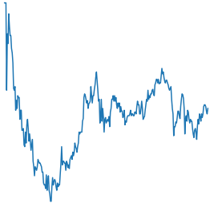
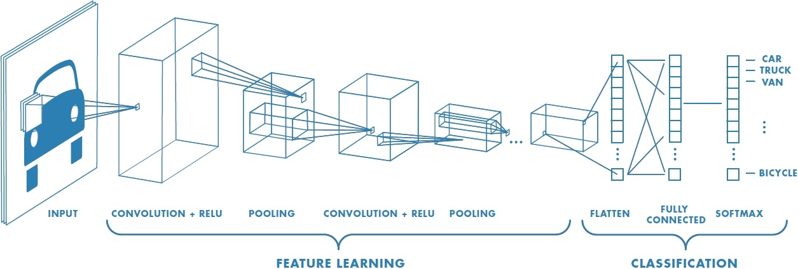
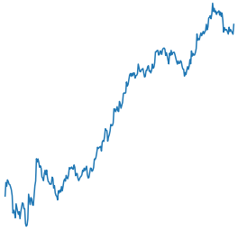
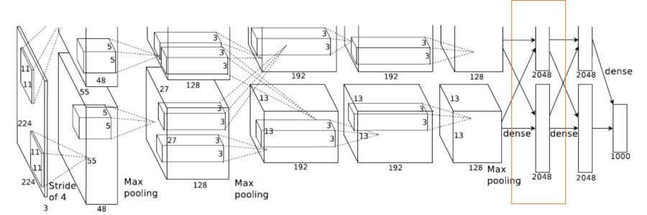
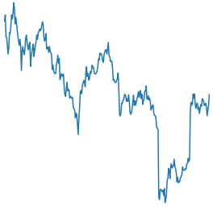
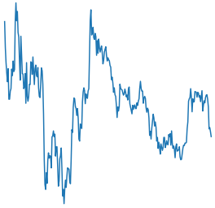
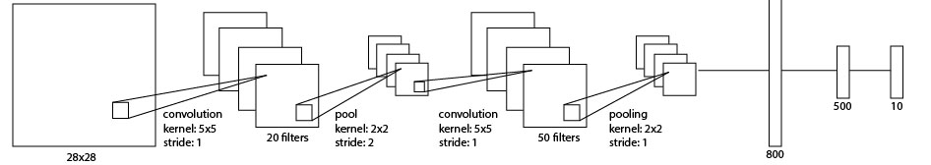
Return Predictions using CNNs

Slide 12
Return Predictions using CNNs
Network Specifications
Continuous target
L2 loss measure on the difference between predicted and actual values
1 channel instead of 3
Try with & without regularization
Some networks are still not performing well but will try to optimize more in the coming two days.

Slide 13
References
https://medium.com/mlreview/a-simple-deep-learning-model-for-stock-price-prediction-using-tensorflow-30505541d877
http://cs231n.stanford.edu/reports/2015/pdfs/ashwin_final_paper.pdf
http://alexminnaar.com/time-series-classification-and-clustering-with-python.html
https://www.quantstart.com/articles/State-Space-Models-and-the-Kalman-Filter
http://jonathankinlay.com/2015/02/statistical-arbitrage-using-kalman-filter/
Dynamic Time Warping Averaging of Time Series allows Faster and more Accurate Classification
http://www.cs.ucr.edu/~eamonn/ICDM_2014_DTW_average.pdf
Machine Learning in Pairs Trading Strategies
http://cs229.stanford.edu/proj2012/ChenRenLuMachineLearningInPairsTradingStrategies.pdf

