Slide 1
Image classification best practices:
Transfer Learning :
- VGG16
- VGG19
- InceptionV3
- Resnet50
- Resnet101
- DenseNet121
Image resizing – feed uniform image size to the pretrained Deep Learning Model
Target size :
(224,224) – VGG16/19, DenseNet121, ResNet50
(299,299) – InceptionV3 and Exception
If the image size is less than target, we zero-pad the image, else we fit the image
and use the appropriate interpolation technique

Slide 2
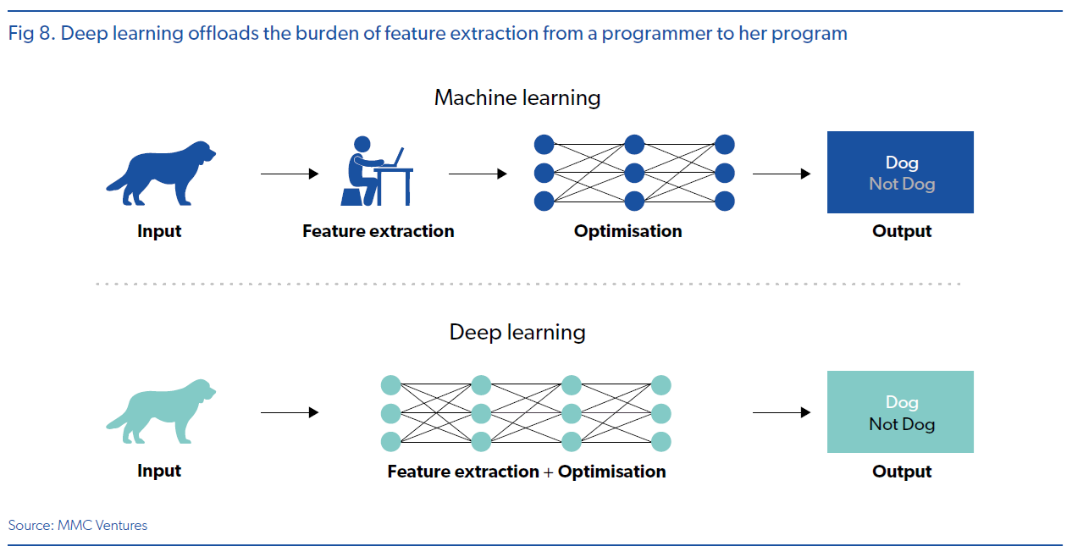

Slide 3
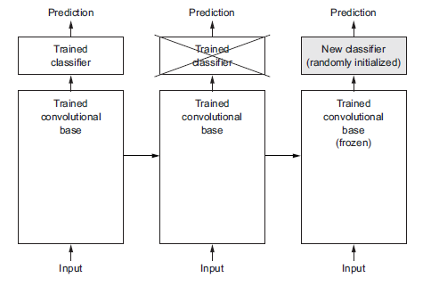
A pretrained network is a saved network that was previously trained on a large dataset, typically on a large-scale image-classification task. If this
original dataset is large enough and general enough, then the spatial hierarchy of features learned by the pretrained network can effectively act as a generic model of the visual world, and hence its features can prove useful for many different computer vision problems, even though these new problems may involve completely different classes than those of the original task.
https://blog.floydhub.com/localize-and-detect-corrosion-with-tensorflow-object-detection-api/

Slide 4
Transfer Learning – its advantages
Easy to use a highly complex Neural Network (Deep Learning system), which
is pre-trained on huge amount of data, and modify it to one’s own Use Case / scenario
Incremental Training of the Deep Learning system is possible, meaning
The Model can be upgraded with incremental amount of data, rather than training
from scratch every time new data becomes available.

Slide 5
For model in model_list :
pre_trained_model = Xception(input_shape = (299, 299, 3), # Shape of our images
include_top = False, # Leave out the last fully connected layer
weights = 'imagenet')
for layer in pre_trained_model.layers:
layer.trainable = False
x = layers.Flatten()(pre_trained_model.output)
x = layers.Dense(128, activation='relu')(x)
x = layers.Dense(64, activation='relu')(x)
x = layers.Dense (1, activation='sigmoid')(x)
model = Model( pre_trained_model.input, x)
model.compile(optimizer = 'adam',
loss = 'binary_crossentropy',
metrics = [keras.metrics.FalseNegatives(name='fn'),keras.metrics.AUC(name='auc')])

Slide 6
train_ds = tf.keras.utils.image_dataset_from_directory(
train_path,
validation_split=0.1,
subset="training",
seed=123,
image_size=image_size,
batch_size=batch_size)
val_ds = tf.keras.utils.image_dataset_from_directory(
train_path,
validation_split=0.1,
subset="validation",
seed=123,
image_size=image_size,
batch_size=batch_size)
AUTOTUNE = tf.data.AUTOTUNE
train_ds = train_ds.cache().shuffle(1000).prefetch(buffer_size=AUTOTUNE)
val_ds = val_ds.cache().prefetch(buffer_size=AUTOTUNE)
checkpoint = ModelCheckpoint(file_path, monitor='val_auc', verbose=1, save_best_only=True, mode='max')
early = EarlyStopping(monitor='val_auc', mode="max", patience=20)
ReduceLR=ReduceLROnPlateau(factor=0.5, patience=5, min_lr=10e-12, verbose=1)
callbacks_list = [checkpoint, early,ReduceLR]
history = model.fit(
train_ds,
validation_data = val_ds,
epochs = 300,
verbose =True,
callbacks = callbacks_list
)

Slide 7
Shuffled set of images (same set of images, shuffled randomly)
Train data
Train data
Train data
Train data
Train data
Test data
Acc 1
Acc 2
Acc 3
Acc 4
Acc 5
Take mean of the accuracy values over multiple shuffled sets
The mean has to be compared for multiple pre-trained networks

Slide 8
Using the ImageDataGenerator to augment the deficient class
datagen =ImageDataGenerator(
rotation_range=40,
width_shift_range=0.2,
height_shift_range=0.2,
shear_range=0.2,
zoom_range=0.2,
horizontal_flip=True,
fill_mode='nearest'
)
for filename in glob.glob(output_folder+"/train/Deficient_Class/*.png"):
img = load_img(filename)
x = img_to_array(img)
x = x.reshape((1,) + x.shape) # this is a Numpy array with shape (1, 3, 299, 299)
i = 0
for batch in datagen.flow(x, batch_size=1,
save_to_dir=output_folder+"/train/Deficient_Class/",
save_prefix='<class name>_aug', save_format='png'):
i += 1
if i > int(ratio):
break

Slide 9
Ref: https://www.stateofai2019.com/chapter-1-what-is-ai
https://blog.floydhub.com/localize-and-detect-corrosion-with-tensorflow-object-detection-api/

