Slide 1
Green Disposal (Green and Sustainable Computing)
By Anirban Roy Choudhury (EEPITM-01-001), Gaurav Pratap Singh (EEPITM-01-004), Satyajit Mohanty (EEPITM-01-020), Siddharth Verma (EEPITM-01-023), Sirish Kumar (EEPITM-01-024)

Slide 2
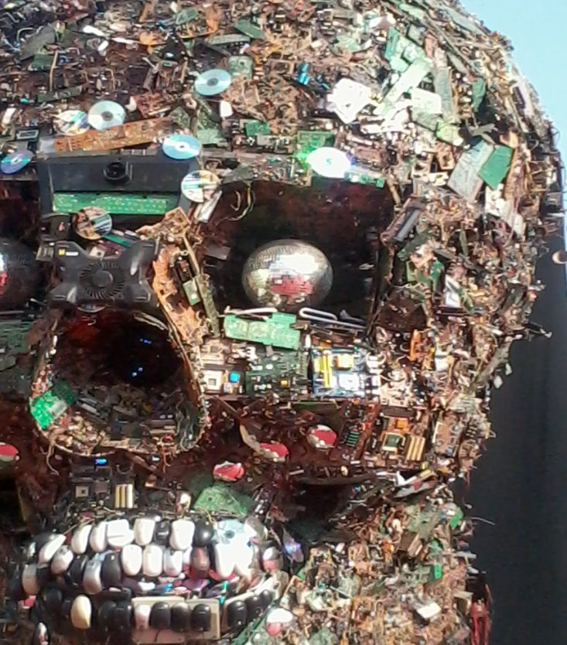
Introduction
With the advancement of newer technology , the life of any new product related to technology like TV, Computer, mobile phone etc. is shortening fast. People are buying and dumping the e-gadgets more frequently.
This leads to an over accumulation of e-Waste and that requires a proper disposal. Discarded PCs, Laptops, Mobile Phones, Digital Cameras etc. are some of the commonly accumulated e-Waste.

Slide 3
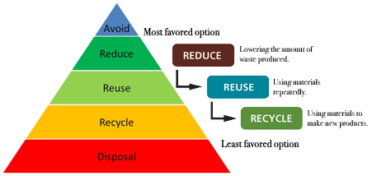
Popular disposal method
5 steps to achieve the proper disposal of electronic waste like TV, Computer, Mobile
Avoid
3-R
Reduce
Reuse
Recycle
Disposal

Slide 4
Three routes to E-Waste disposal
The right route is to process e-Waste through a service that recycles as much of the materials as possible.
Local landfill
The worst route is to transfer the equipment to a recycler who ships the stuff to a third-world country.
$20 to recycle in Developed country
$2 to recycle in Developing / 3rd world countries

Slide 5
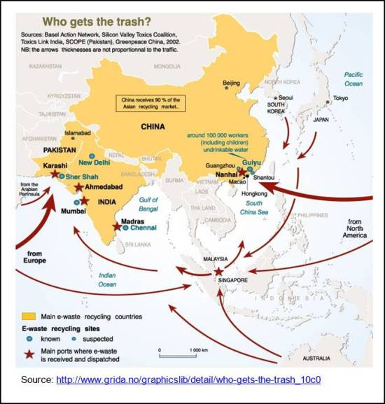
Developing Vs. Developed Country
Land Refill – Developing country
Risks and Hazards
Heavy metals: Lead, Cadmium, Mercury, Barium, Arsenic, Selenium
Precious metals: Gold, Silver, Platinum
Other metals: Copper, Aluminum
Chlorinated compounds: Poly Vinyl Chloride (PVC)
Plastics: Poly Chlorinated Biphenyls (PCB), Poly Chlorinated Diphenyl Ether (PCDE)

Slide 6
Developed Country
Importer/Manufacturer
Distributor/Reseller
Relative/Friends
Industrial Customer
Personal Use
Donate
Exchange with Vendor
Dispose off to the local scrap dealer
Refurbishes/Replaces the Components
Dismantlers
E-Waste recyclers
Extract precious metals
Importer/Manufacturer
Distributor/Reseller
Personal Use
Industrial Customer
Relative/Friends
Donate
Exchange with Vendor
Dispose off to the local scrap dealer
Refurbishes/Replaces the Components
Dismantlers
Extract precious metals
E-Waste recyclers

Slide 7
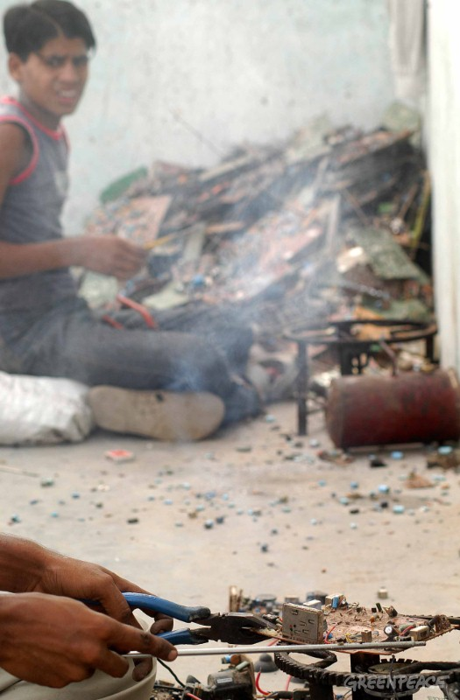
Popular methods for Extraction , Emission and Harmful effects
Open burning
Copper is recovered after burning PVC/PCBs/PWBs
PCDDs and PCDFs emitted are carcinogens which can modify the DNA and cause genetic defects to future generations

Slide 8
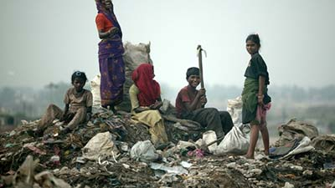
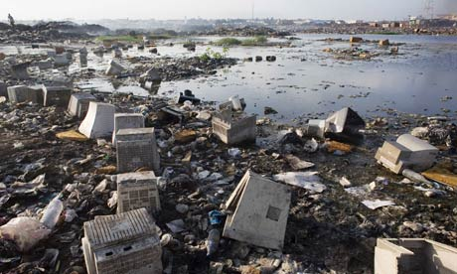
Popular methods for Extraction , Emission and Harmful effects
Land filing and Open dumping
A landfill does not help in controlling toxins and its harmful effects
Heavy metals can cause damage to the nervous system, the brain, and the kidneys and can cause birth defects and cancer.
Toxic water can destroy Flora and Fauna in the rivers and oceans.

Slide 9
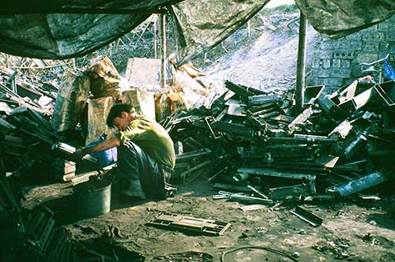
Popular methods for Extraction , Emission and Harmful effects
Toner sweeping by hand
Manually sweeping the toner out of printer cartridge without respiratory protection and many times without hand gloves
Toner contains Class-A2 carcinogenic carbon black
Chances of cancer and respiratory diseases

Slide 10
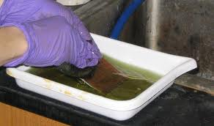
Popular methods for Extraction , Emission and Harmful effects
Acid Stripping of PCBs
PCBs are dipped in a acid bath
Water samples tested around areas of such activities found to contain high level of toxics
Water not fit for human consumptions

Slide 11
Non-Green Vs. Green
Non-Green | Green
CRTs are broken manually to separate its components – glass, metal and copper. The glass, comprising lead, is sold to bakeries or bangle makers. The CRTs are re-sold to non-branded television makers. | Components of the CRTs are separated by heating in a closed chamber, which sucks out Phosphors from the components. They are then crushed in shredder machines. Glass containing lead is sold to the companies that manufacture the CRTs.
Circuit boards have gold plated brass pins, microchips and condensers which are Separated by heating. Fumes released during heating are toxic. Gold-plated brass pins are soaked in acid to recover the gold and brass separately. Microchips and condensers are heated in big containers filled with acid to extract metallic parts. | Circuit boards are crushed in shredder machines. T hey are sent to approved smelters abroad, where after smelting at 1200°C, the metals in the circuit board collect together. Since smelting is carried out in closed chambers at high temperature, it is not hazardous. The metals—lead, copper, nickel, tin, gold, silver, palladium—are then separated by electro-refining.

Slide 12
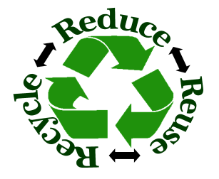
Green Disposal Methods
Reuse:
Design for longevity which can be achieved by variety of design changes.
Recycle: Use Extended Producer Responsibility (EPR) approach in which the manufacturer takes responsibility of maintenance of the product post product life too.
Producer Responsibility:
A producer can recycle the product, refurbish the product or can dispose of the product.
For example, Nokia has established almost more than 1400 bins across India to collect disposed mobile phones and accessories
Globally, Nokia has collected more than 1.5 million pieces of phones & accessories weighing over 70 tones.
Bulk Consumer Responsibility:
e-waste is directed to the authorized e-Waste dealers
e-Waste can also be directed to the re-furbishers, registered dismantlers or recyclers
Bulk consumers are liable to pay a fine if they fail to follow the above process.
Individual Consumers:
Submit the e-Waste or end-o-life electronic products to the dealer
Drop it to the authorized collection centers.
Producers should pay some minimum price on the returned equipments.
Reduce : Reduce the usage of non-toxic and environmentally friendly raw materials in equipments

Slide 13

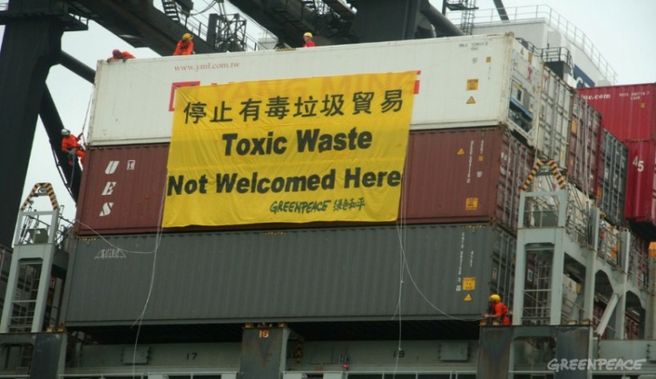
Laws and Regulation
The Basel Convention on the Control of the Trans-boundary movement of Hazardous Waste and Their Disposal is the most comprehensive global environmental agreement on hazardous and other wastes.
Shortcomings:
USA not part of it.
inspections of 18 European seaports found as much as 47% of waste destined for export, including e-waste, was illegal
Still e-waste is transported to the third-world countries like China, India, Pakistan, Bangladesh and Ghana.

Slide 14
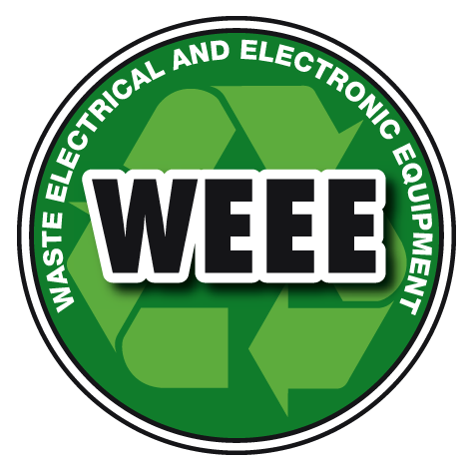
Laws and Regulation
Waste Electrical and Electronic Equipment (WEEE) directives, the producer, re-seller and importer of electronic equipment will have legal obligations with regard to the recycling, reuse and disposal of electronic equipments or components.
Shortcomings:
Product price now decided based on recycling but still cost of recycling is not recoverable by them.
There is need to give subsidies to the manufacturers who are actively involved in the recycling.

Slide 15

Laws and Regulation
In India, The Ministry of Environment and Forests (MoEF) has issued the Guidelines for Environmentally Sound Management of E-Waste.
Extended Producer Responsibility (EPR)
Restriction of Hazardous Substances (RoHS)
Import of used EEE will be prohibited if it is designated for further usage.
Shortcomings:
Lax law enforcement tons of e-waste enters India under the guise of donation
These practices are not caught due to lack of manpower, scanning equipments in ports and also partially due to corruption.
Free Trade Agreements (FTAs) or “Economic Partnership Agreements” (EPAs) are often used to disguise e-waste and developed nation ship the e-Waste to the developing economies.

Slide 16
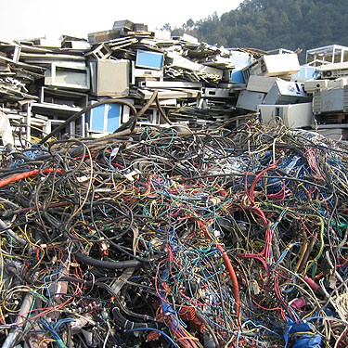
Conclusion
Avoid/Minimize
3-R
Green Disposal
Understanding responsibilities towards society
Reduce greediness
Strengthen Laws and its Enforcements

Slide 17
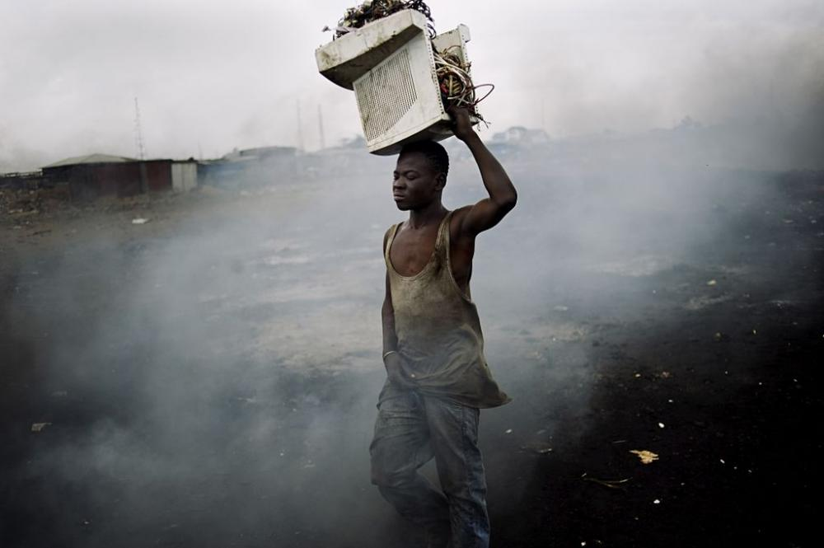
Green Disposal
Q&A

