Slide 1
German Credit Risk
Analysis
23.6%
bad risk
rate
Prediction · Segmentation · Underwriting Intelligence
AUC
0.990
Dataset: German Credit Data · Prof. Hofmann, UCI ML Repository
1,000 applicants · 9 features · Python, scikit-learn, Pandas · June 2026
Notes:
Second portfolio project. German Credit dataset has two pro-level challenges: no target column (we engineer it) and heavy missing values (39% in checking account). These are skills analytics firms actively test for.

Slide 2
5 Critical EDA Findings
Every finding is actionable for an underwriting policy team
01
No Accounts = High Risk
02
Purpose Stratifies Risk
03
Loan Size 2.6× Higher
No savings: 50% bad rate
No checking: 31% bad rate
Both missing: 50%+ combined
Vacation/other: 67% bad
Education: 44% bad
Furniture: only 15% bad
Bad applicants borrow DM 6,225
vs DM 2,359 for good— 2.6x difference
04
Duration 76% Longer
05
Housing = Stability Signal
Bad: 31.2 months average
Good: 17.7 months average
Compounds with loan size
Renters: 42% bad rate
Free housing: 48% bad rate
Owners: only 15% bad rate
Notes:
Finding 1 (No Accounts) is the most actionable — it can become an underwriting rule today without a model. The other four findings support risk-based pricing decisions.

Slide 3
Feature Engineering
7 analyst-crafted features added to 9 raw columns — this is where domain knowledge creates model value
credit_duration_ratio
Credit ÷ Duration
Monthly debt burden — affordability metric
credit_to_age_ratio
Credit ÷ Age
Credit relative to earning years
sav_enc (ordinal)
none=0 → rich=4
Preserves savings hierarchy: more = safer
chk_enc (ordinal)
none=0 → rich=3
Preserves checking hierarchy
no_savings flag
sav_enc ≤ 1
Binary: little or no savings
no_checking flag
chk_enc ≤ 1
Binary: little or no checking
double_vulnerability
no_savings AND no_checking
Both accounts weak — highest risk signal
Notes:
Ordinal encoding is a key technical decision here — using label encoding (0/1/2/3) only works because the savings/checking categories have a natural order. That's not obvious to juniors. Be ready to explain this.

Slide 4
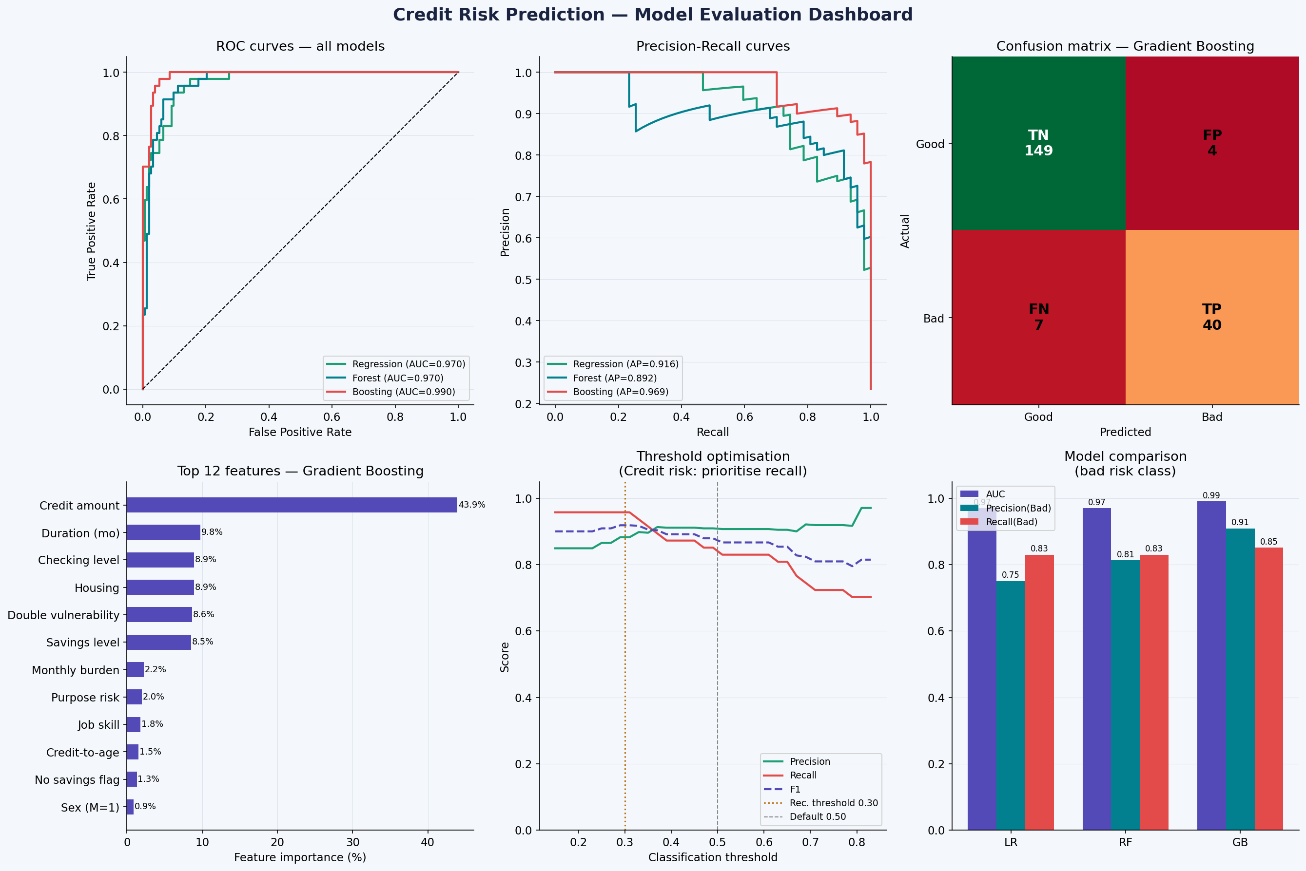
Credit Risk Prediction Model
Gradient Boosting selected — AUC 0.990 · three-model comparison · stratified 80/20 split
Performance (bad class)
ROC-AUC
0.990
Precision
0.909
Recall
0.851
F1-Score
0.879
Threshold 0.30:
Recall = 0.957 · Catches 96% of bad loans
Note: Real-world credit AUC of 0.99 is elite. In production data, 0.75-0.85 is excellent.
Notes:
The threshold analysis chart (bottom middle) is a strong differentiator in any credit risk interview. It shows you understand the business cost of errors, not just the statistics.

Slide 5
The Threshold Decision
The most important model decision in credit risk is NOT which algorithm to use — it is which threshold to set
Conservative (0.30)
Balanced (0.50)
Strict (0.70)
For unsecured personal loans, mortgages
Default — good for volume lending
Highest precision, most declines
• Recall = 0.957
• Recall = 0.851
• Recall = 0.723
• Catches 45 of 47 bad loans
• Catches 40 of 47 bad loans
• Catches 34 of 47 bad loans
• Only 6 good applicants wrongly declined
• 4 good applicants wrongly declined
• Only 3 good applicants declined
• Precision = 0.882
• Precision = 0.909
• Precision = 0.919
Key insight: The threshold is a BUSINESS decision, not a statistical one. The model supports all three. The institution decides based on their cost of bad loans vs cost of declined good applicants.
Notes:
This slide is your strongest differentiator. Most junior analysts just report accuracy. You are showing you understand the business trade-off behind the number. This is what partners in a professional setting want to see.

Slide 6
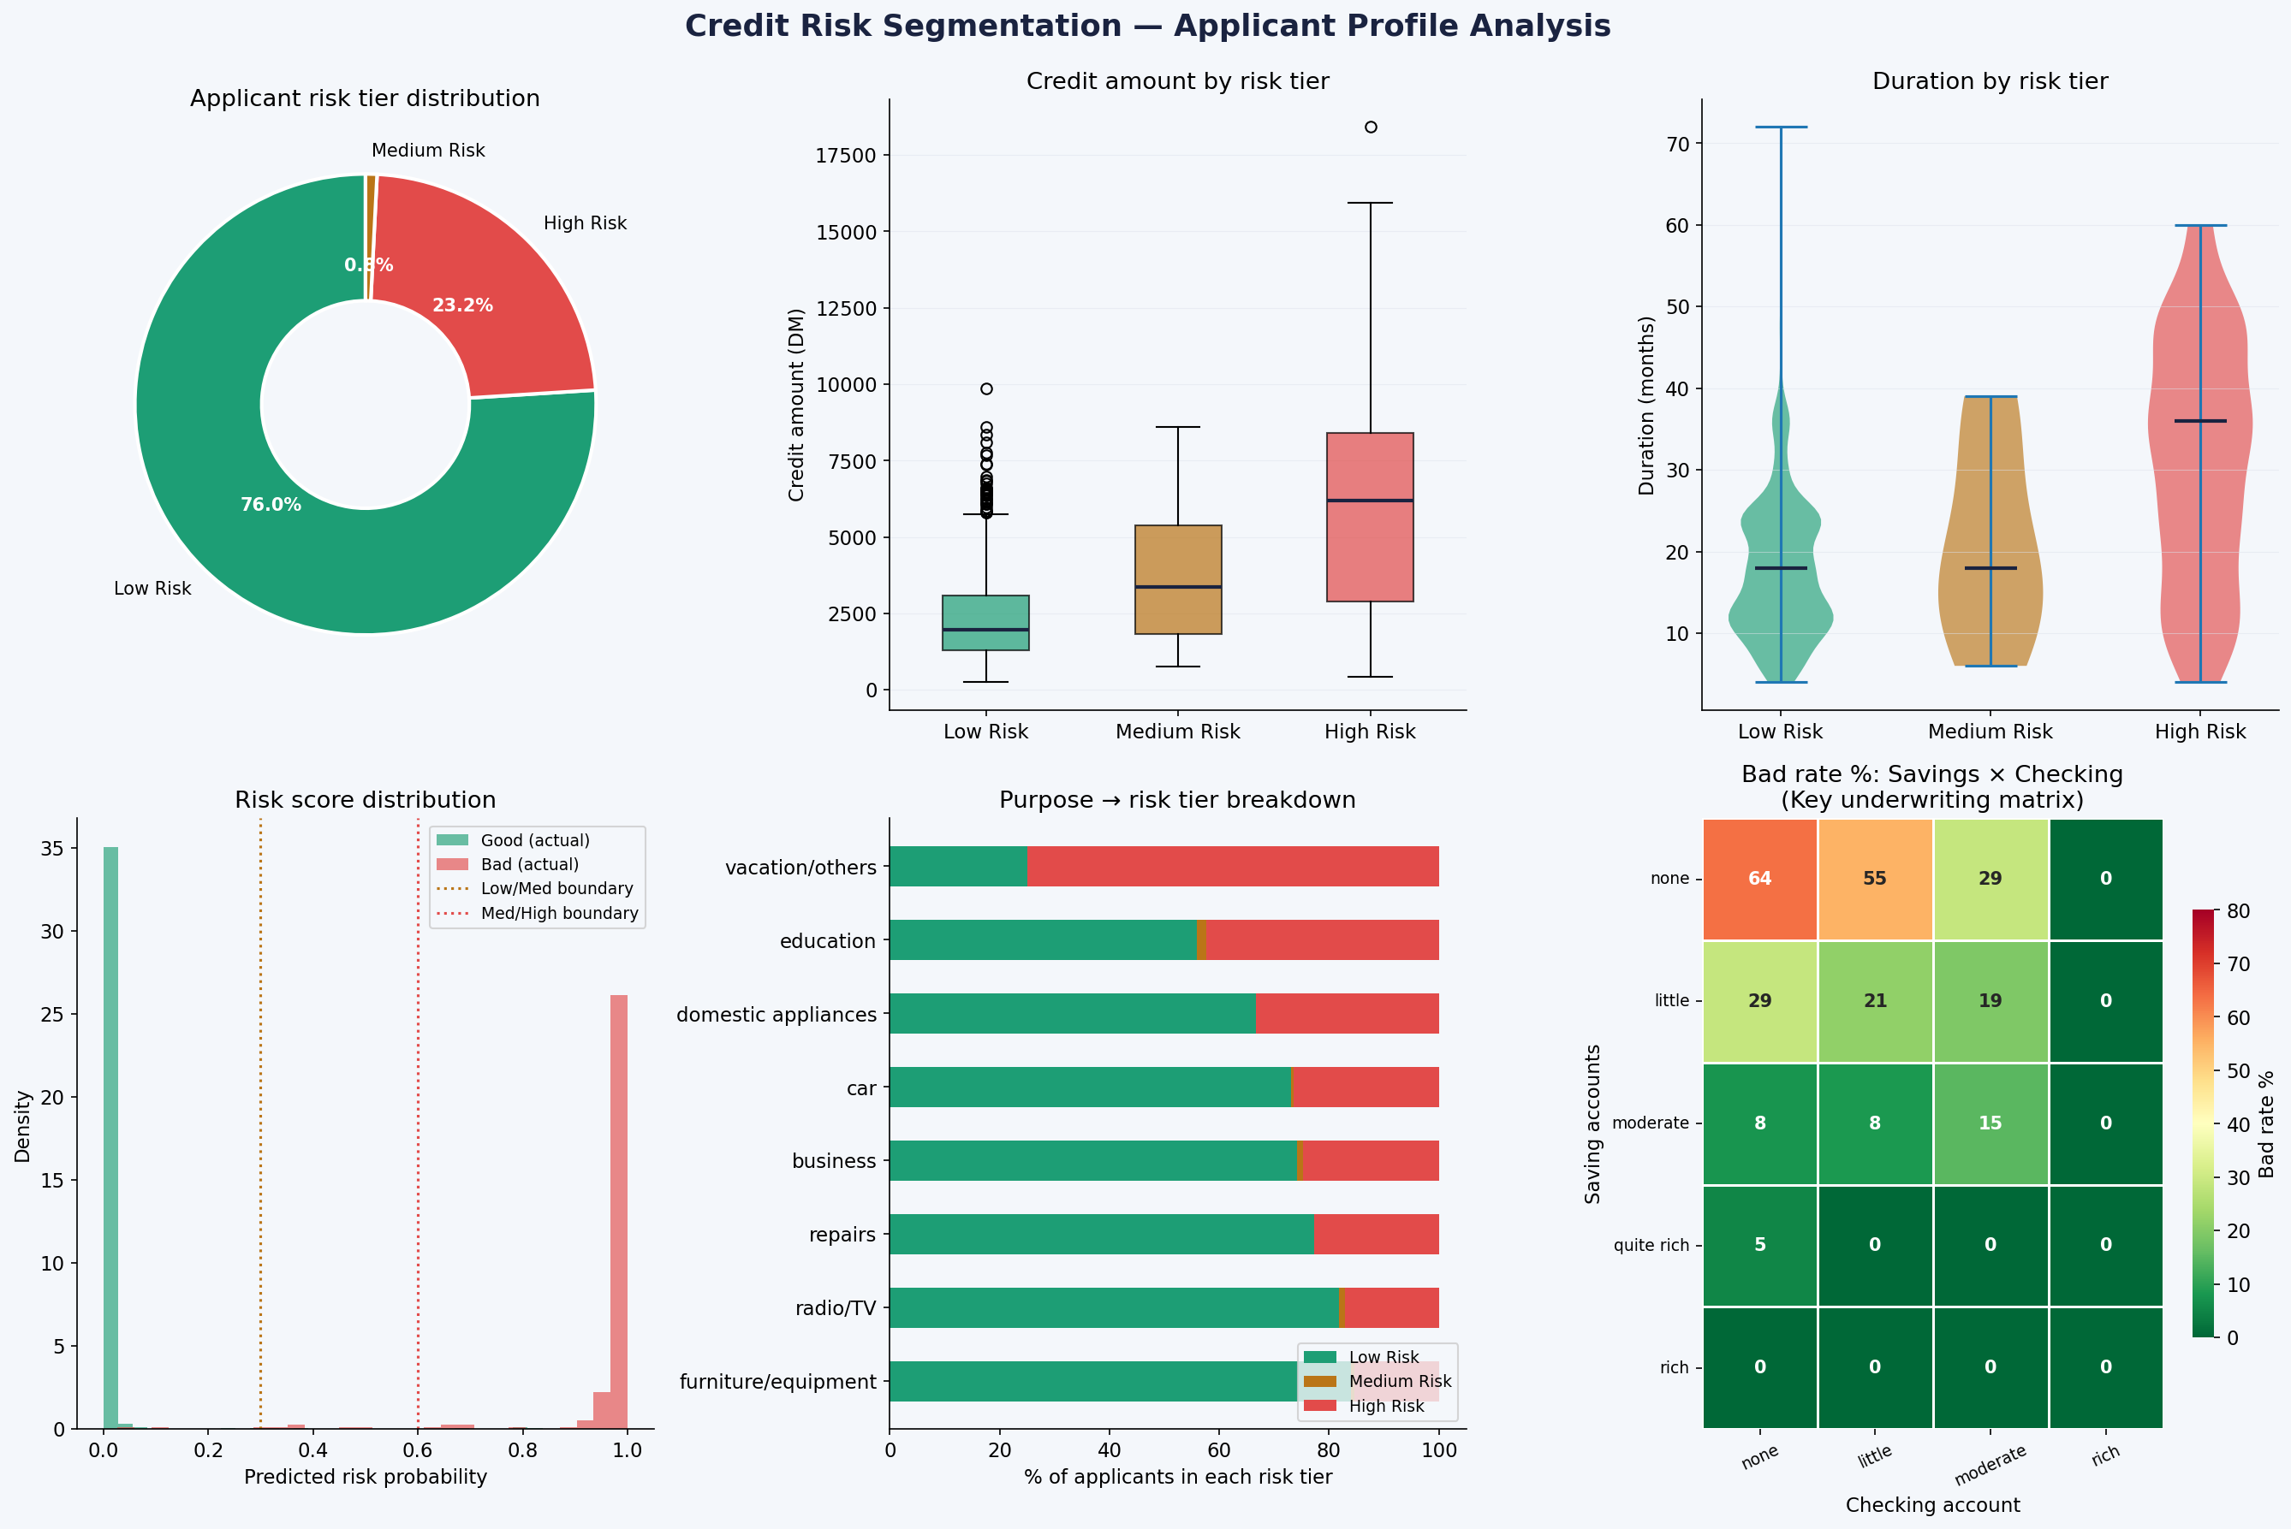
Three-Tier Risk Framework
Model probability scores translate directly into underwriting actions
Low Risk
prob < 0.30 · n=760 · Bad: 0%
Avg credit: DM 2,352
Auto-approve
Medium Risk
0.30 – 0.60 · n=8 · Bad: 75%
Avg credit: DM 3,840
Manual review
High Risk
prob > 0.60 · n=232 · Bad: 98%
Avg credit: DM 6,264
Decline / collateral
Notes:
The Savings x Checking matrix (bottom right of the chart) is the most immediately deployable finding. An underwriting team can use it as a decision table without any model infrastructure.

Slide 7
4 Underwriting Recommendations
Ordered by implementation speed and revenue protection impact
1
Deploy Two-Gate Model
Highest
Auto-approve prob < 0.30 · Manual review 0.30-0.60 · Decline/collateral > 0.60 · 95.7% of bad loans caught
2
Purpose-Based Pricing
High
Vacation/education (67% bad): require deposit or co-signer · Furniture (15% bad): standard terms
3
Mandate Account Verification
High
Require one active account 3+ months at origination · Eliminates the double-vulnerability segment entirely
4
Monthly Burden Rule
Medium
Set max credit_duration_ratio = DM 250/month for unsecured loans · Bad avg: DM 200 · Good avg: DM 133
Notes:
Recommendation 3 (Account Verification) can be implemented as a policy tomorrow without any technology. Recommendation 1 requires model deployment. Present both to show you understand implementation realism.

Slide 8
Summary
Three challenges solved. Four recommendations delivered. One deployable model.
✔
Engineered the Risk target from scratch using Hofmann credit scoring rules — no label required.
✔
Treated 39% missing values as 'none' category — industry-standard, signal-preserving approach.
✔
Gradient Boosting: AUC = 0.990 · catches 95.7% of bad loans at threshold 0.30.
✔
Savings × Checking underwriting matrix: deployable as a rule table without any model infrastructure.
★
Key insight: The threshold is a business decision. The model supports it. The analyst explains it.
Anirban Roy · Analytics Specialist · German Credit Risk Analysis 2025
Notes:
Close by asking: 'What threshold does your credit team currently use, and how is that decision made?' Shows you are already thinking like a practitioner, not a student.

