Slide 1
From Dataset to Insight: Building Powerful R Shiny Apps with minimal coding background
Anirban Shaw

Slide 2
Welcome & Introduction
About Me
Data Science professional with a strong AI & R Shiny foundation
From Kolkata → Worked in Chennai, Bangalore, Pune, Hyderabad
Experienced in:
AI model training & deployment
Interactive analytics in R, Python, Shiny
Fortune 500 scalable R Shiny apps
At Bristol Myers Squibb:
Clinical trial visualization, CDISC-aligned tools
Passionate about statistics, engineering, and design

Slide 3
Scope of Today’s Session
What You’ll Learn:
Journey from dataset → insights in R
R vs Python – different strengths
Hands-on: Build a full-featured Shiny app
Key Concepts:
Data wrangling
Functional programming
Reactive architecture
UX for data dashboards

Slide 4
R for Data Science
Purpose-built for data analysis, statistics, and visualization
Core paradigm: functional programming
Rich ecosystem:
Data manipulation: dplyr, data.table
Visualization: ggplot2, plotly, shiny
Modeling: caret, tidymodels, lme4
Deep integration with academia, surveys, and social sciences

Slide 5
Python for Data Science
General-purpose language with strong data science libraries
Core paradigm: object-oriented, also supports functional
Rich ecosystem:
Data manipulation: pandas, numpy
Visualization: matplotlib, seaborn, plotly, altair
Modeling: scikit-learn, statsmodels, xgboost
Widely used in ML/AI, production pipelines, engineering teams

Slide 6
Summary: R vs Python
Feature | R | Python
Primary Use | Statistics, Visualization | ML/AI, Engineering
Syntax Style | Functional (pipe-based) | Object-oriented (class-based)
Community | Academic, Government | Industry, Tech
Shiny Framework | Yes | Streamlit / Plotly Dash

Slide 7
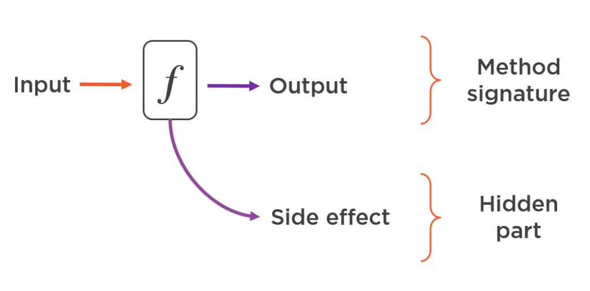
Functional Programming

Slide 8
R Basics: Refresher
# Vectors x <- c(10, 20, 30) length(x) # Summary statistics mean(x) median(x) sd(x) # Data frames df <- data.frame(name = c("A", "B"), age = c(23, 45)) str(df) # Piping library(dplyr) df %>% filter(age > 30) # Functions square <- function(x) x^2 square(4)

Slide 9
R Shiny
# app.R library(shiny) ui <- fluidPage( titlePanel("Single-File Shiny App (No Modules)"), sidebarLayout( sidebarPanel( h4("Choose variable to plot"), selectInput("var", "Select variable:", choices = names(mtcars)) ), mainPanel( plotOutput("plot") ) ) ) server <- function(input, output, session) { output$plot <- renderPlot({ var <- input$var hist(mtcars[[var]], main = paste("Histogram of", var), col = "steelblue", border = "white") }) } shinyApp(ui, server)

Slide 10
R Shiny Modules
# app.R library(shiny) # === Module UI === mod_plot_ui <- function(id) { ns <- NS(id) tagList( selectInput(ns("var"), "Select variable:", choices = names(mtcars)), plotOutput(ns("plot")) ) } # === Module Server === mod_plot_server <- function(id) { moduleServer(id, function(input, output, session) { output$plot <- renderPlot({ var <- input$var hist(mtcars[[var]], main = paste("Histogram of", var), col = "steelblue", border = "white") }) }) } # === App UI === ui <- fluidPage( titlePanel("Single-File Modular Shiny App"), sidebarLayout( sidebarPanel(h4("Choose variable to plot")), mainPanel( mod_plot_ui("plot1") ) ) ) # === App Server === server <- function(input, output, session) { mod_plot_server("plot1") } # === Run App === shinyApp(ui, server)

Slide 11
R Shiny Modules + CSS
# app.R library(shiny) # Define module UI mod_plot_ui <- function(id) { ns <- NS(id) tagList( tags$style(HTML(" h1 { color: darkblue; font-size: 2em; } .btn { background-color: #4CAF50; color: white; } ")), h1("Modular Plot App with Inline CSS"), selectInput(ns("var"), "Select variable:", choices = names(mtcars)), actionButton(ns("go"), "Plot", class = "btn"), plotOutput(ns("plot")) ) } # Define module server mod_plot_server <- function(id) { moduleServer(id, function(input, output, session) { observeEvent(input$go, { output$plot <- renderPlot({ var <- input$var hist(mtcars[[var]], main = paste("Histogram of", var), col = "steelblue", border = "white") }) }) }) } # Main app UI ui <- fluidPage( mod_plot_ui("main") ) # Main app server server <- function(input, output, session) { mod_plot_server("main") } shinyApp(ui, server)

Slide 12
R Shiny Modules + CSS + JS
# app.R library(shiny) # Module UI mod_plot_ui <- function(id) { ns <- NS(id) tagList( # Inline CSS tags$style(HTML(" h1 { color: darkblue; font-size: 2em; } .btn { background-color: #4CAF50; color: white; } ")), # Inline JS using a <script> tag tags$script(HTML(" Shiny.addCustomMessageHandler('greet', function(message) { alert('Hello, ' + message + '!'); }); ")), h1("Modular Plot App with CSS + JS"), selectInput(ns("var"), "Select variable:", choices = names(mtcars)), actionButton(ns("go"), "Plot", class = "btn"), plotOutput(ns("plot")) ) } # Module Server mod_plot_server <- function(id) { moduleServer(id, function(input, output, session) { observeEvent(input$go, { output$plot <- renderPlot({ var <- input$var hist(mtcars[[var]], main = paste("Histogram of", var), col = "steelblue", border = "white") }) # Send JS message session$sendCustomMessage("greet", "Anirban") }) }) } # App UI ui <- fluidPage( mod_plot_ui("main") ) # App Server server <- function(input, output, session) { mod_plot_server("main") } shinyApp(ui, server)

Slide 13
Demo
I have a dataset, how do I build R Shiny App to explore/analyse the data
Using a combination of ChatGPT prompting and R Studio, you can build an app without any knowledge of R programming.

Slide 14
Useful links:
https://www.appsilon.com/post/functional-programming-in-r-part-1
https://www.appsilon.com/post/functional-programming-in-r-part-2
https://mastering-shiny.org/
https://r-pkgs.org/
https://shiny.posit.co/r/articles/improve/modules/
These are some examples. You will find more info if you google or ask ChatGPT

