Slide 1
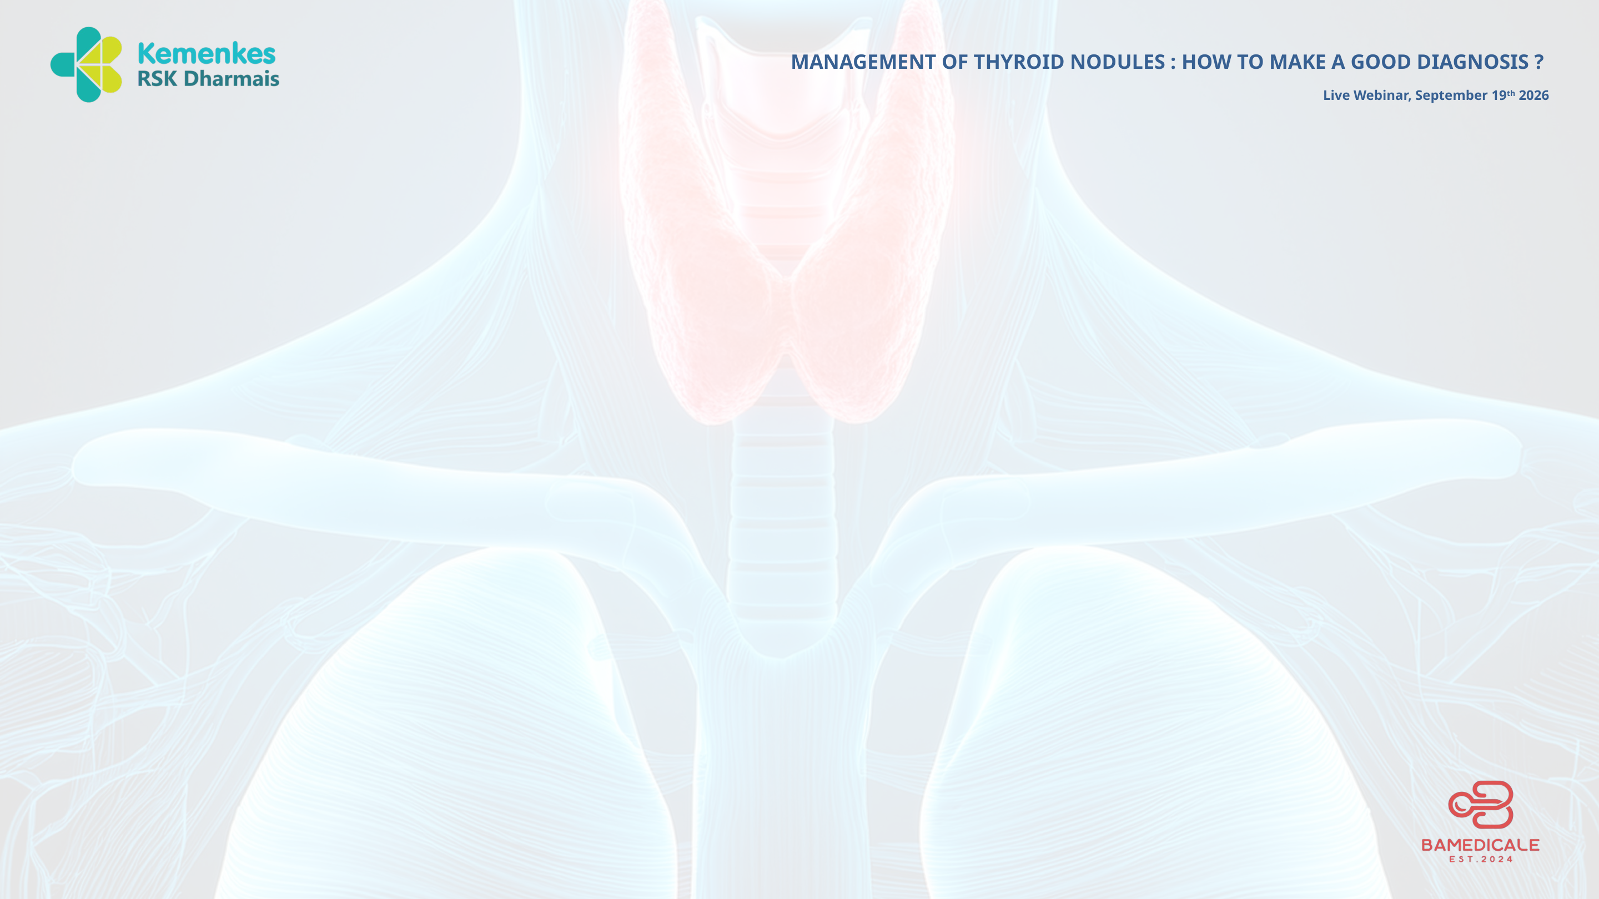
Bethesda System for Reporting
Thyroid Cytopathology
Standardized cytologic diagnosis for thyroid FNA
Dr. Vinesia Lestari Riddi, SpPA, MPH
RS Kanker Dharmais-Pusat Kanker Nasional

Slide 2
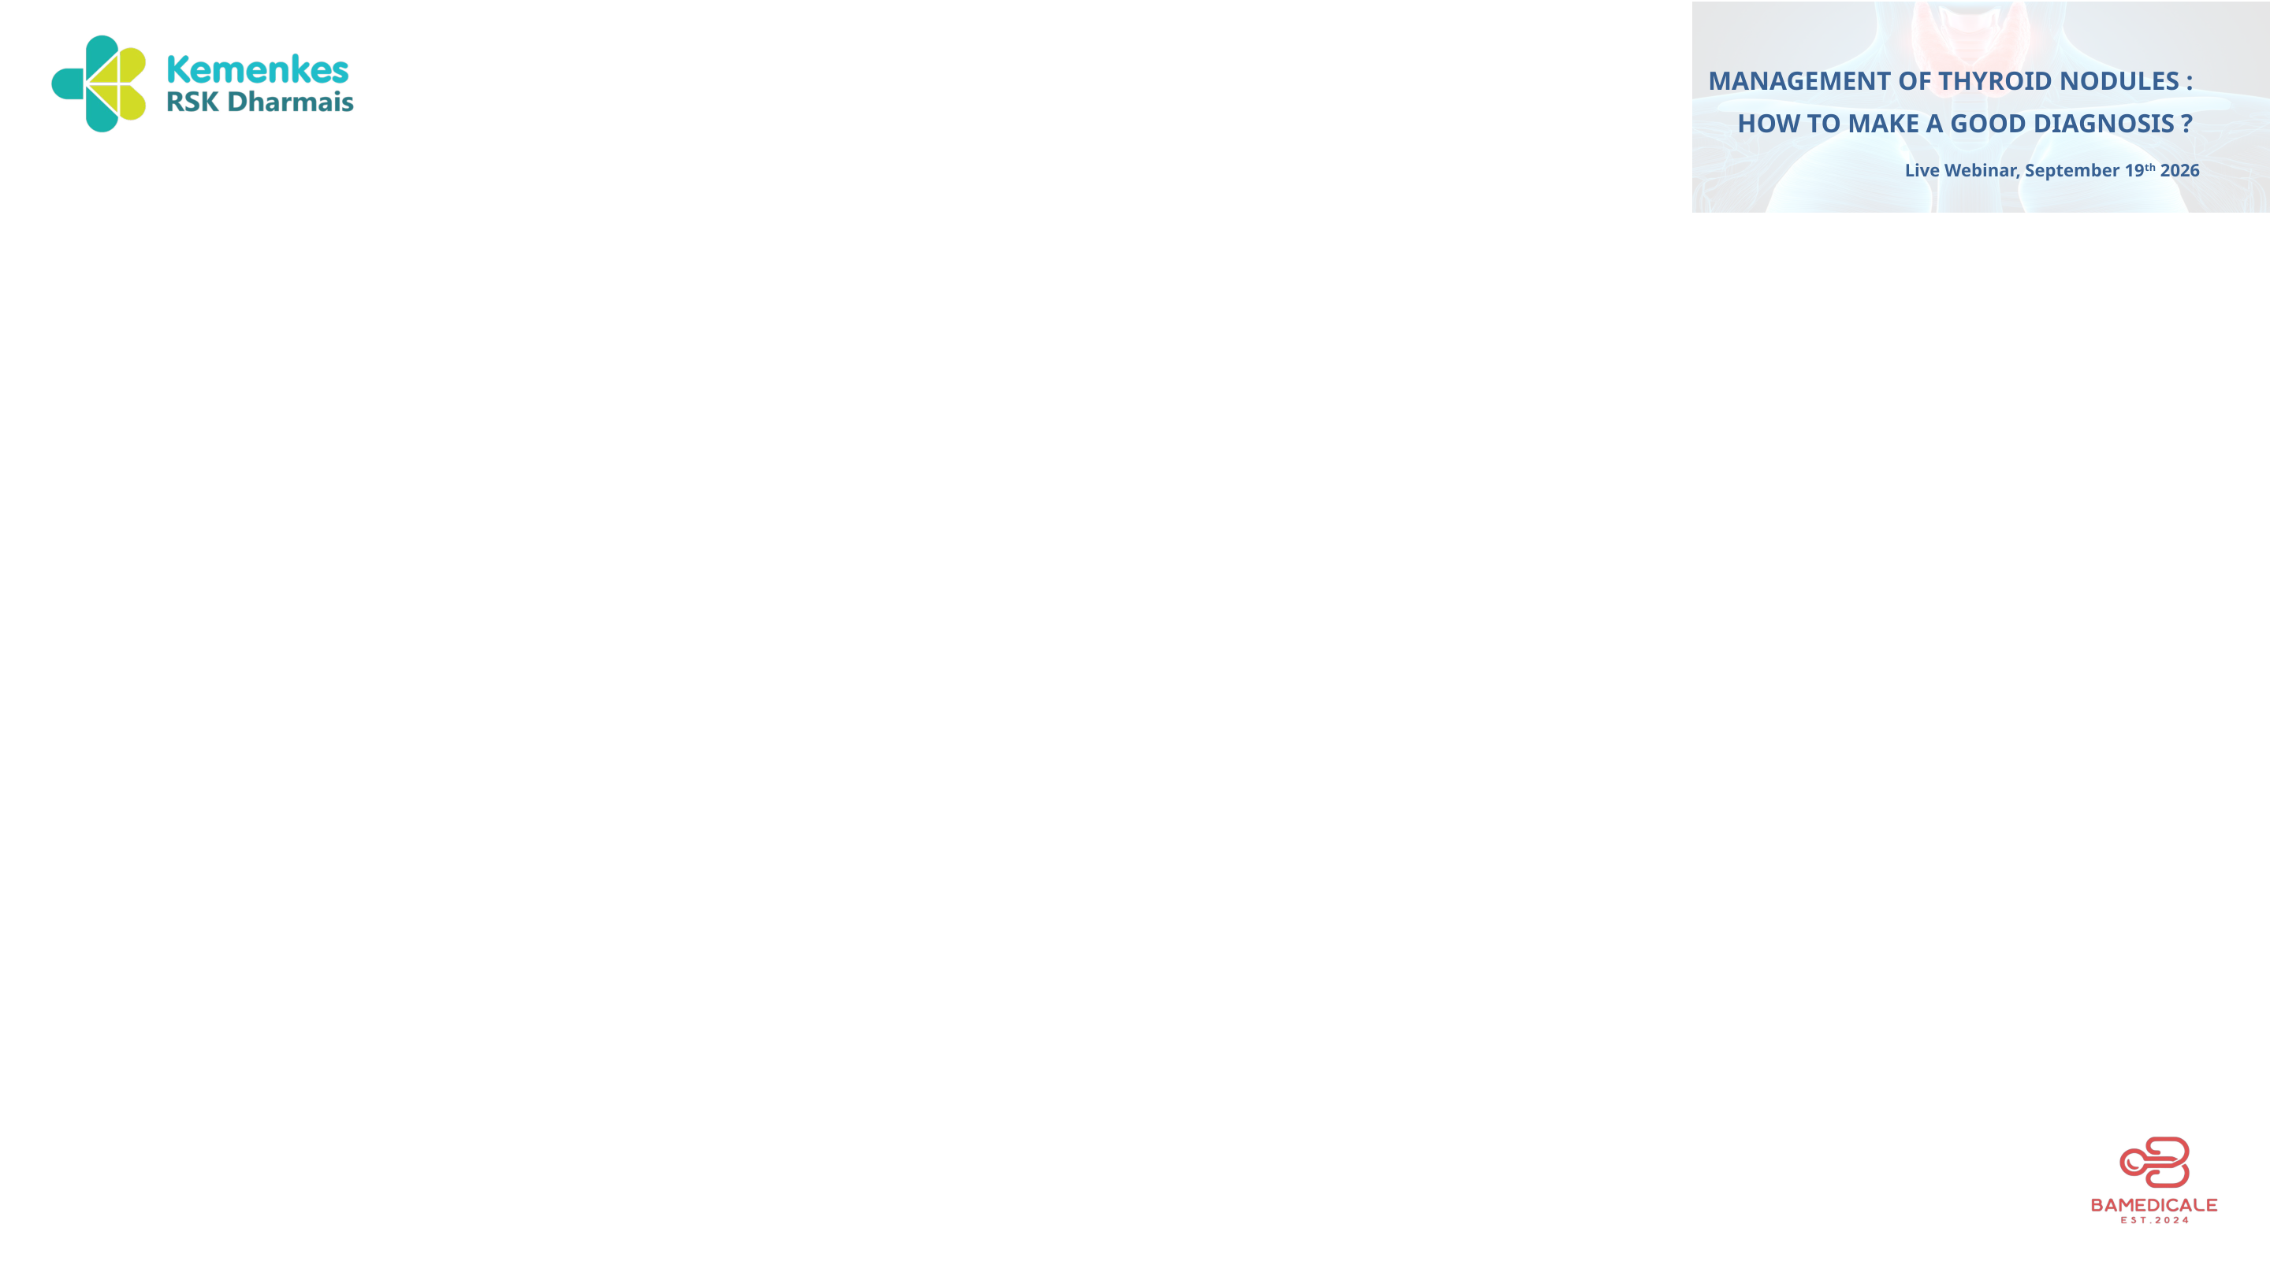
Introduction
BETHESDA REPORTING SYSTEM
Fine-needle aspiration (FNA) is among the first diagnostic tools used in the evaluation of thyroid nodules
Thyroid FNA offers high positive predictive value (97%–99%), with sensitivities 65% to 99% and specificities of 72% to 100%
Many potential diagnostic pitfalls exist that can lead to false-positive (0-28%) and/or false-negative (1-35%)
02
Bethesda System for Reporting Thyroid Cytopathology

Slide 3
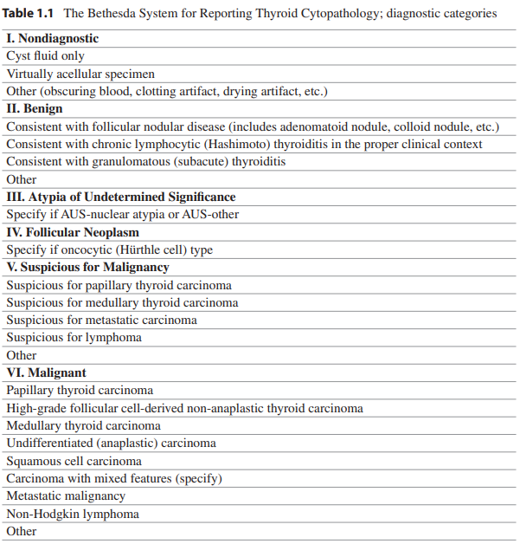
Bethesda System for Reporting Thyroid Cytopathology
BETHESDA REPORTING SYSTEM
BSRTC is the internationally accepted classification to communicate cytological diagnosis in a uniform and unambiguous way
03
Bethesda System for Reporting Thyroid Cytopathology

Slide 4
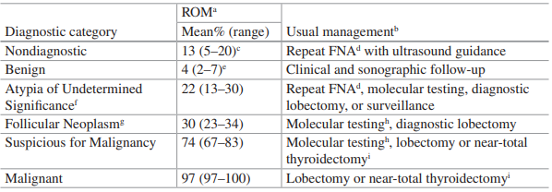
Risk of Malignancy and Management
BETHESDA REPORTING SYSTEM
04
Bethesda System for Reporting Thyroid Cytopathology

Slide 5
Criteria for Adequacy
BETHESDA REPORTING SYSTEM
A thyroid FNA sample is considered adequate for evaluation if it contains a minimum of six groups of well-visualized (i.e., well stained, well preserved, undistorted, and unobstructed) follicular epithelial cells with at least ten cells per group.
These six groups of ten follicular cells could be either on one slide or distributed among several for adequacy determination.
These criteria apply to all cytologic preparations (including conventional smears and liquid-based samples).
05
Bethesda System for Reporting Thyroid Cytopathology

Slide 6
Exceptions to Adequacy Criteria
BETHESDA REPORTING SYSTEM
Exceptions to this requirement apply to a limited number of case types, including:
  Aspirates with cytologic atypia
  Solid nodules with inflammation
  Colloid nodules
06
Bethesda System for Reporting Thyroid Cytopathology

Slide 7
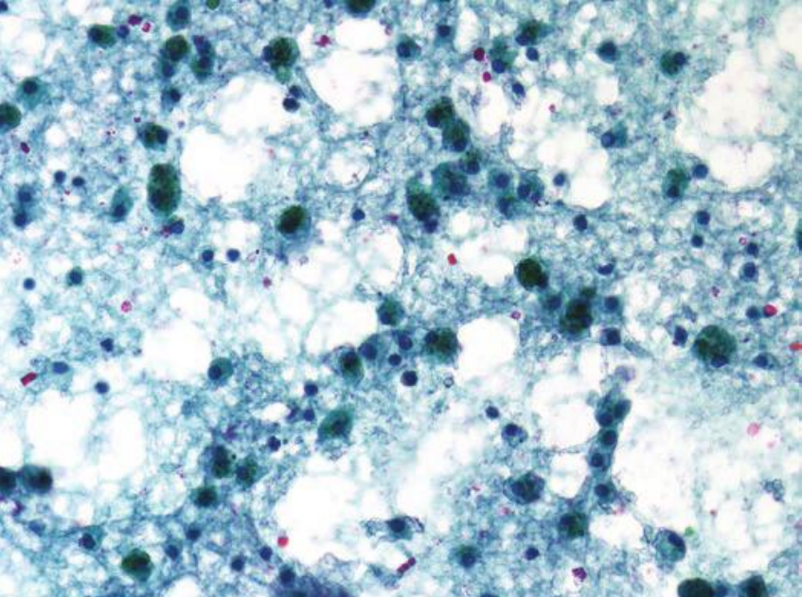
1. Non-diagnostic / Unsatisfactory
BETHESDA REPORTING SYSTEM
Incidence : 10%
Do not meet the criteria for adequacy
Recommendation : FNA with USG guidance
07
Bethesda System for Reporting Thyroid Cytopathology

Slide 8
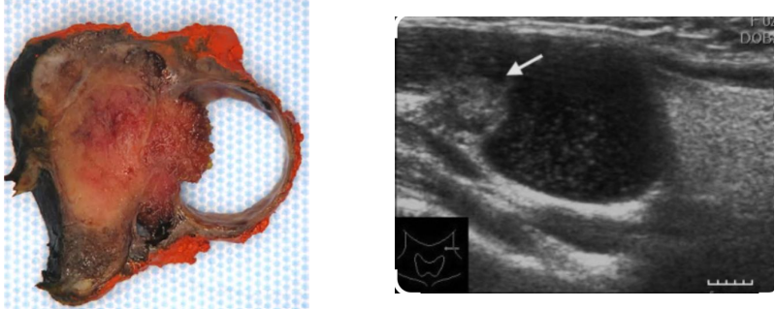
Pitfalls: Cystic Papillary Thyroid Carcinoma
BETHESDA REPORTING SYSTEM
• Rule out papillary thyroid carcinoma, cystic variant
• Up to 10–16 % of PTC can be cystic
• In cystic change, malignant tumor cells commonly misinterpreted as macrophages (non diagnostic) → false negative
08
Bethesda System for Reporting Thyroid Cytopathology

Slide 9
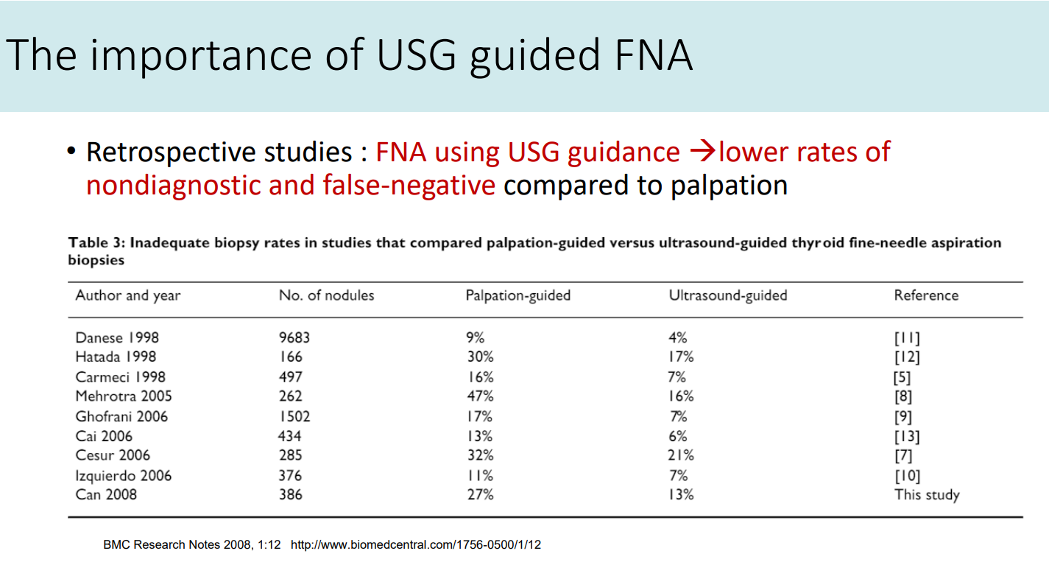
Importance of USG-guided FNA
BETHESDA REPORTING SYSTEM
09
Bethesda System for Reporting Thyroid Cytopathology

Slide 10
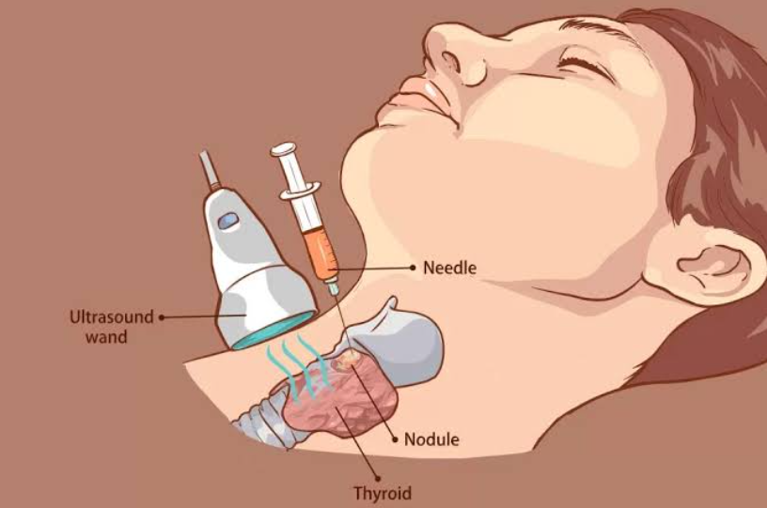
USG-guided FNA Technique
BETHESDA REPORTING SYSTEM
10
Bethesda System for Reporting Thyroid Cytopathology

Slide 11
2. Benign
BETHESDA REPORTING SYSTEM
Adequate for evaluation and consists of colloid and benign-appearing follicular cells in varying proportions
Included entities:
  Benign follicular nodule:
    Colloid nodules
    Nodular goiter
    Hyperplastic (adenomatoid) nodules
    Nodules in Graves’ disease
  Thyroiditis
    Lymphocytic thyroiditis
    Granulomatous thyroiditis
11
Bethesda System for Reporting Thyroid Cytopathology

Slide 12
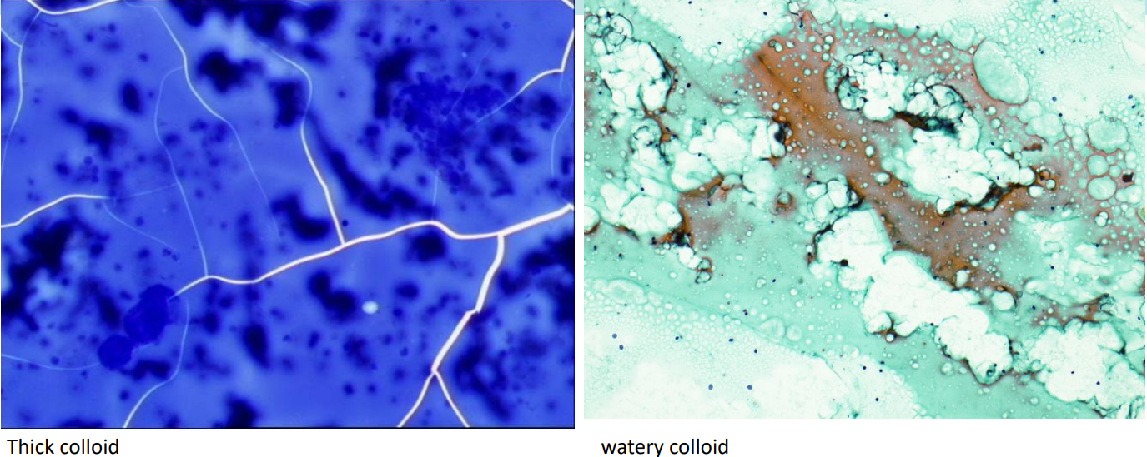
Benign Cytology: Colloid & Follicular Cells
BETHESDA REPORTING SYSTEM
12
Bethesda System for Reporting Thyroid Cytopathology

Slide 13
Benign Cytomorphologic Features
BETHESDA REPORTING SYSTEM
• Monolayered sheets of follicular cells
• Occasional three dimensional balls/spheres
• Evenly spaced nuclear arrangement
• Follicular cell nuclei are round to oval, approximately the size of a red blood cell
• Colloid background
13
Bethesda System for Reporting Thyroid Cytopathology

Slide 14
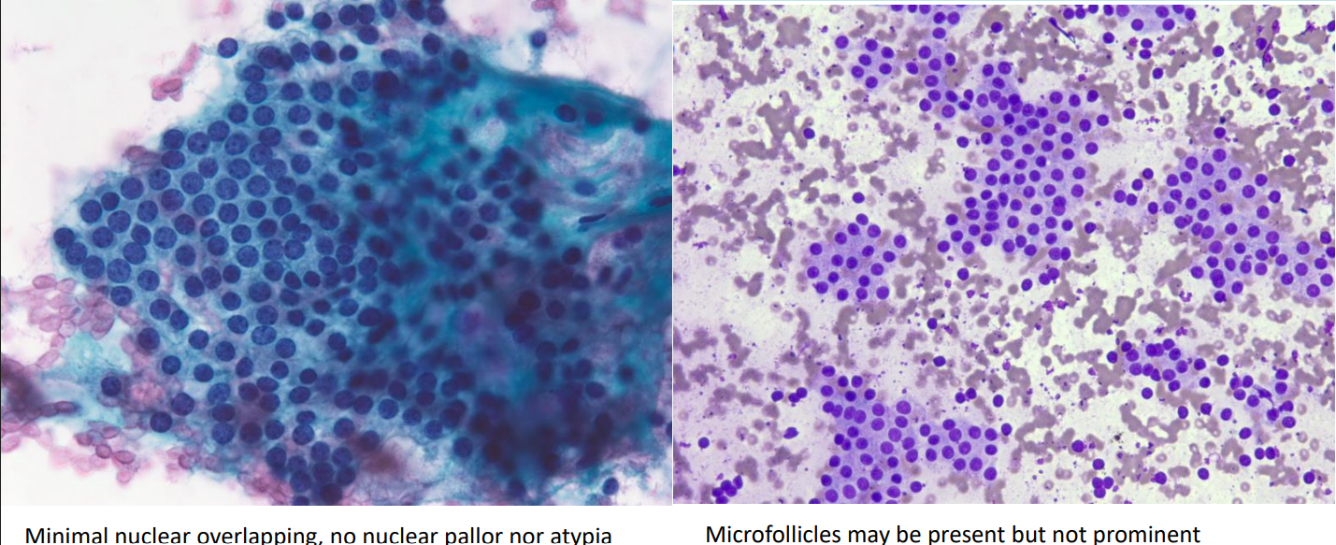
Benign Cytology: Microscopy
BETHESDA REPORTING SYSTEM
14
Bethesda System for Reporting Thyroid Cytopathology

Slide 15
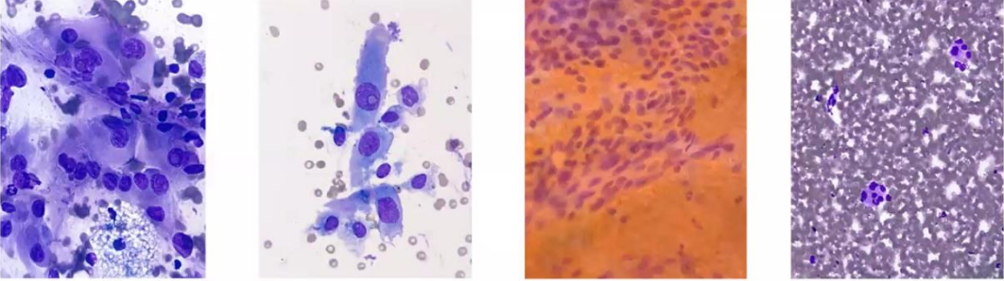
3. Atypia of Undetermined Significance (AUS)
BETHESDA REPORTING SYSTEM
Specimens that contain cells (follicular, lymphoid, or other) with architectural and/or nuclear atypia that is not sufficient to be classified as suspicious for a follicular neoplasm, suspicious for malignancy, or malignant; but more marked than can be ascribed confidently to benign changes.
15
Bethesda System for Reporting Thyroid Cytopathology

Slide 16
4. Follicular Neoplasm
BETHESDA REPORTING SYSTEM
• ROM 25-40%
• Significant architectural atypia
• Predominant microfollicles and trabeculae
• Cellular smear
• Mild nuclear change may be seen (no INCIs or papillae)
• Colloid scant or absent
• Lobectomy is necessary for definitive diagnosis
16
Bethesda System for Reporting Thyroid Cytopathology

Slide 17
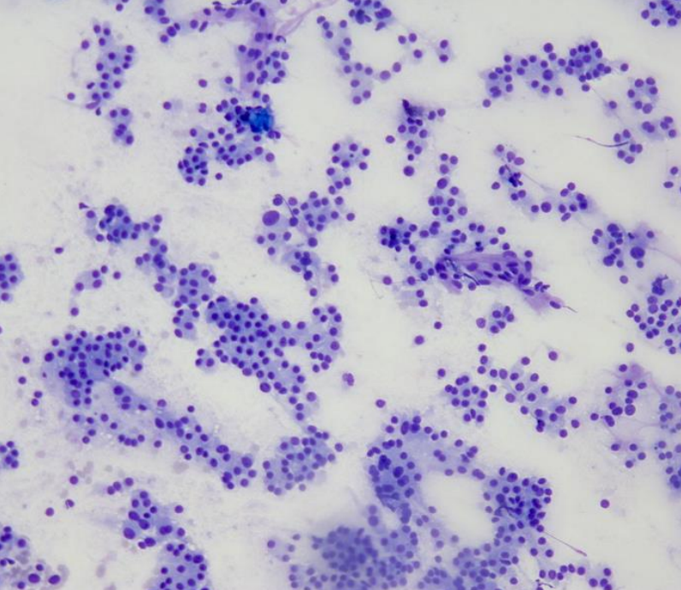
Follicular Neoplasm: Cytology
BETHESDA REPORTING SYSTEM
17
Bethesda System for Reporting Thyroid Cytopathology

Slide 18
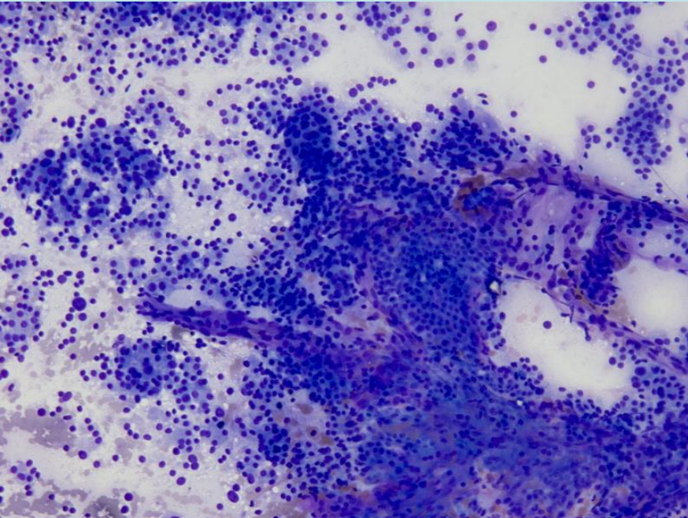
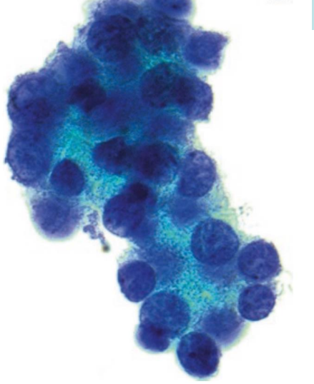
Follicular Neoplasm: Cellular Smears
BETHESDA REPORTING SYSTEM
18
Bethesda System for Reporting Thyroid Cytopathology

Slide 19
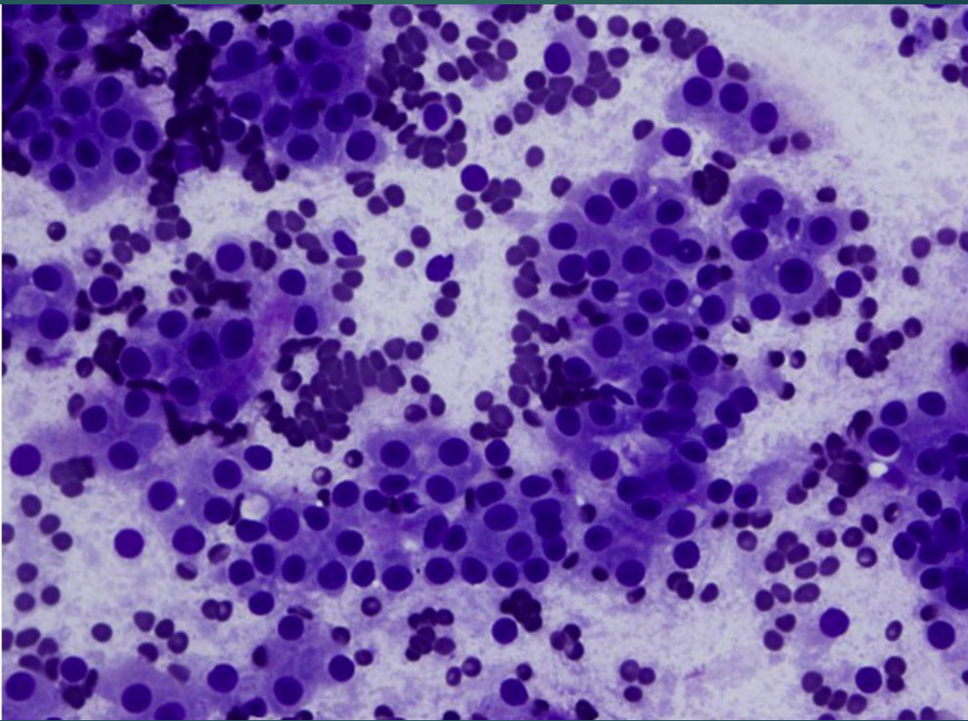
Follicular Neoplasm, Hürthle Cell Type
BETHESDA REPORTING SYSTEM
19
Bethesda System for Reporting Thyroid Cytopathology

Slide 20
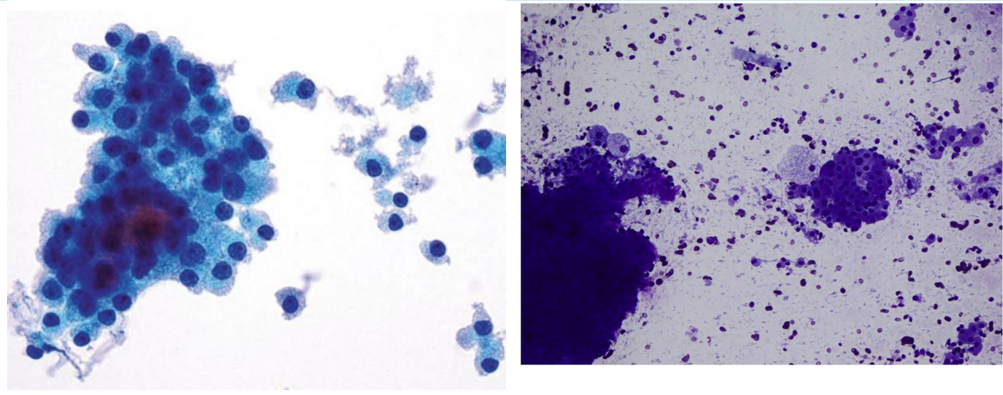
Hürthle Cell Type: Cytology
BETHESDA REPORTING SYSTEM
20
Bethesda System for Reporting Thyroid Cytopathology

Slide 21
5. Suspicious for Malignancy
BETHESDA REPORTING SYSTEM
ROM: 65-75%
Cytomorphologic features (most often those of PTC) raise a strong suspicion of malignancy but the findings are not sufficient for a conclusive diagnosis
Included entities:
  Suspicious for papillary carcinoma (FVPTC/NIFTP may include in this category)
  Suspicious for medullary carcinoma
  Suspicious for lymphoma
  Suspicious for metastatic
21
Bethesda System for Reporting Thyroid Cytopathology

Slide 22
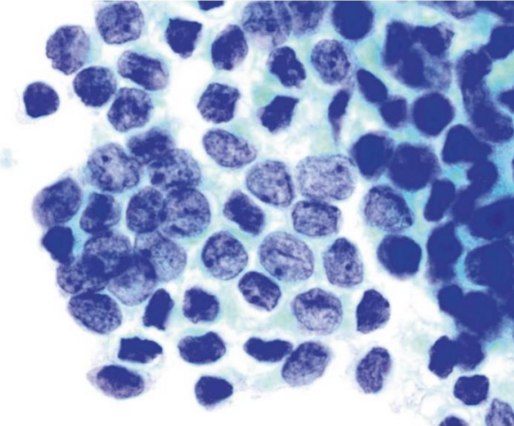
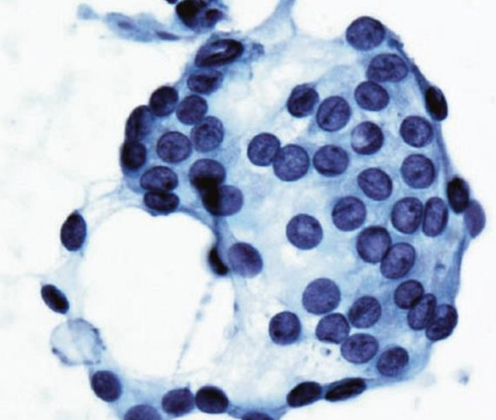
Suspicious for Malignancy: Cytology
BETHESDA REPORTING SYSTEM
22
Bethesda System for Reporting Thyroid Cytopathology

Slide 23
6. Malignant
BETHESDA REPORTING SYSTEM
Includes :
• Papillary carcinoma
• Medullary carcinoma
• Lymphoma
• Metastatic tumors
24
Bethesda System for Reporting Thyroid Cytopathology

Slide 24
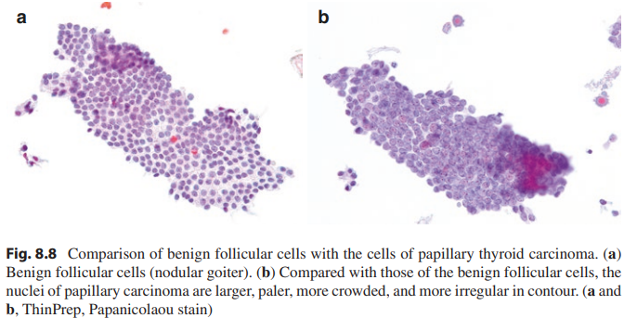
Malignant Cytology: Papillary Carcinoma
BETHESDA REPORTING SYSTEM
25
Bethesda System for Reporting Thyroid Cytopathology

Slide 25
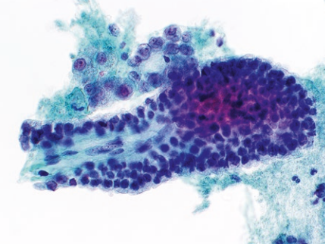
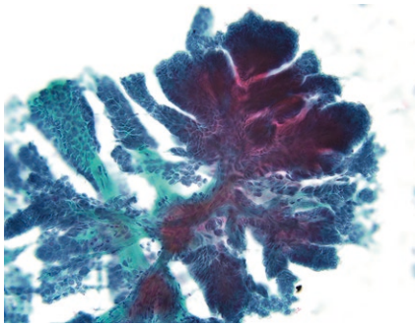
Papillary Thyroid Carcinoma
BETHESDA REPORTING SYSTEM
26
Bethesda System for Reporting Thyroid Cytopathology

Slide 26
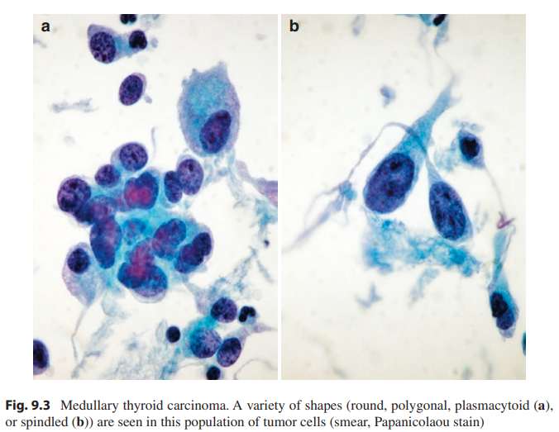
Medullary Thyroid Carcinoma
BETHESDA REPORTING SYSTEM
27
Bethesda System for Reporting Thyroid Cytopathology

Slide 27
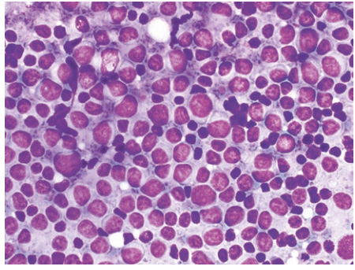
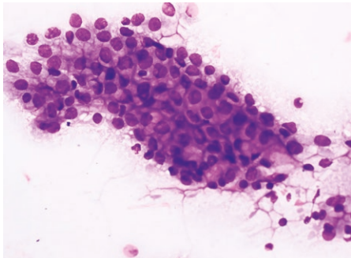
Other Tumors
BETHESDA REPORTING SYSTEM
Lymphoma
Metastatic Adenocarcinoma
28
Bethesda System for Reporting Thyroid Cytopathology

Slide 28
Notes
BETHESDA REPORTING SYSTEM
FNAB cannot diagnose follicular carcinoma because in follicular carcinoma it requires demonstration of capsular invasion or vascular invasion which cannot be seen in FNAB.
NIFTP cannot be definitively diagnosed by FNA; its diagnosis requires histologic examination of the resected lesion.
Bethesda category SHOULD NOT become the sole determinant of management.
Clinical relevances + ultrasound + Bethesda category = management
29
Bethesda System for Reporting Thyroid Cytopathology

Slide 29
Terima Kasih
Source :
• Ali SZ, Baloch ZW, Cochand-Priollet B, et al. The 2023 Bethesda System for Reporting Thyroid Cytopathology. Thyroid. 2023.

