Slide 1
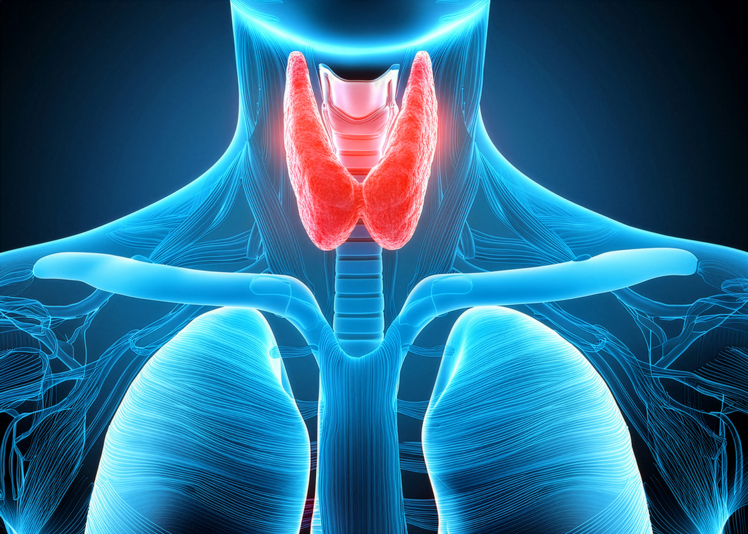


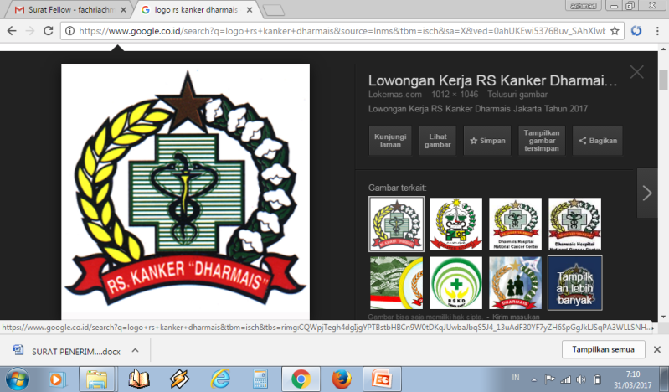
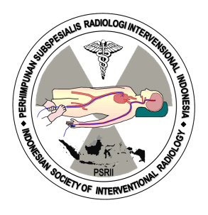
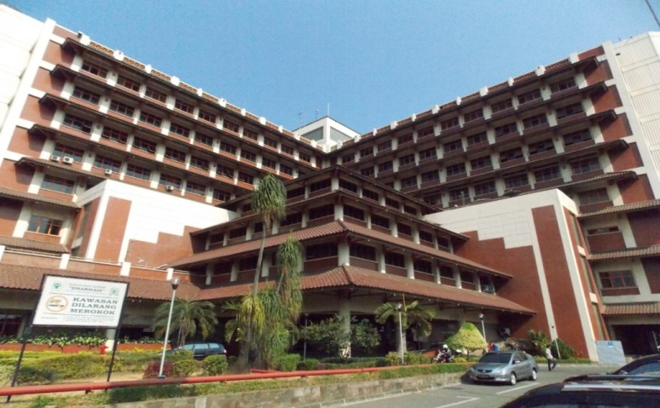

MANAGEMENT OF THYROID NODULES : HOW TO MAKE A GOOD DIAGNOSIS ?
Live Webinar, September 19th 2026
Ultrasound Imaging and TIRADS Classification in Thyroid Nodules
Achmad Fachri, MD
Head and Neck Department
Dharmais National Cancer Center Hospital

Slide 2
Outline
Overview
What is US imaging ?
Why US ?
Anatomy Thyroid
TIRADS

Slide 3
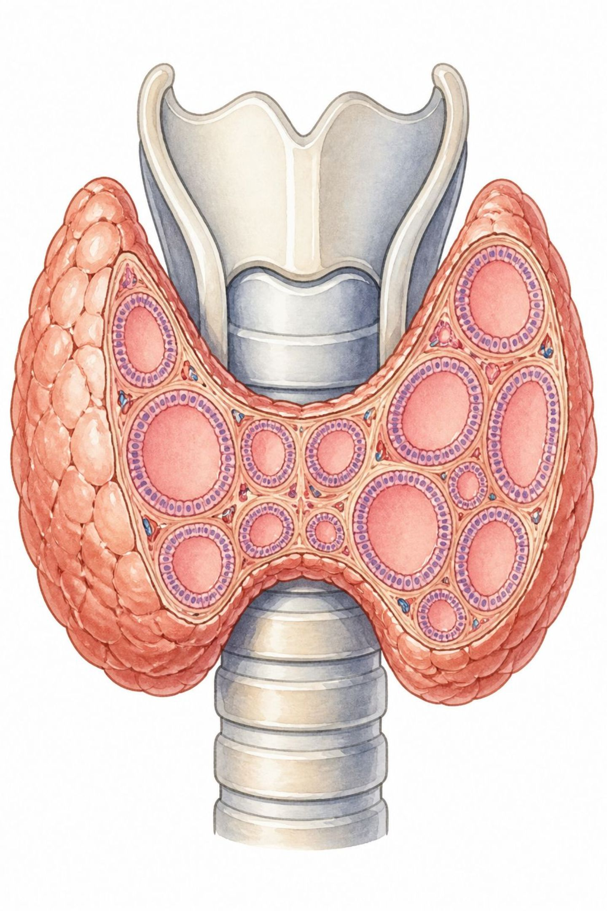
Overview
Common Finding
Malignancy Risk
Thyroid nodules are frequently encountered during routine ultrasonography in healthy adults.
Majority are benign, but carry a 7–15% risk of malignancy requiring careful evaluation.

Slide 4
What is general US imaging?
US imaging → sonography → involves exposing part ot the body to high frequency sound waves → produce images
US examination do not use ionizing radiation (as used in x-rays).
US images are captured in real-time → show the structure and movement of the body’s internal organs → as well as blood flowing through blood vessels

Slide 5
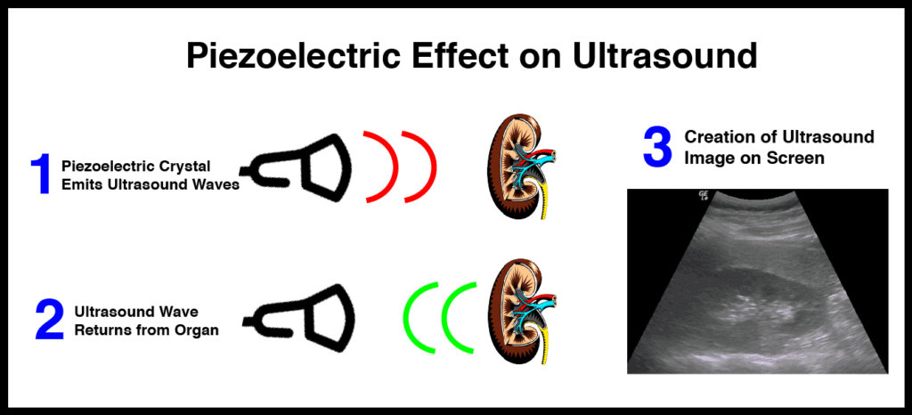
Principles of US
Optimum frequency range for diagnostic → 1-20 MHz.
3,5-5 MHz : abdominal, heart
5-10 MHz : thyroid, carotid, breast, testis, and other superficial tissues, infants.
10-15 MHz : for the eye

Slide 6
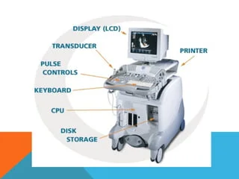
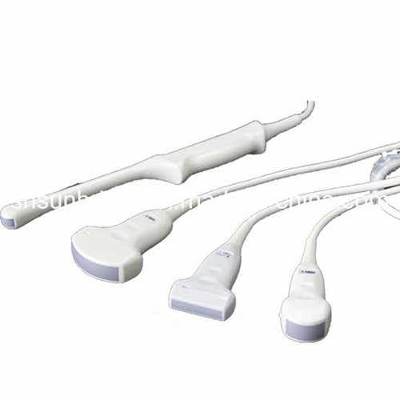
Ultrasound parts
Transducer

Slide 7
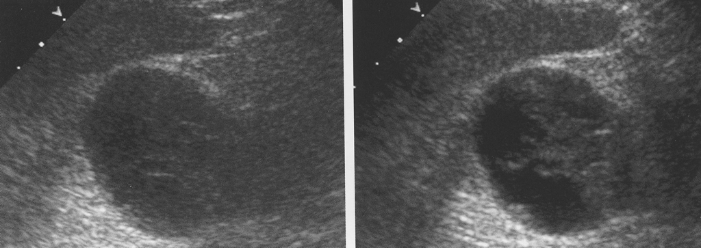
Image Optimization
Depth
Focus
TGC (to obtain a smooth grey-scale picture)
Zoom / magnification
Gain
Harmonic imaging → High contrast, high spatial resolution and low noise

Slide 8
Benefits
Limitations
Mostly noninvasive
Widely available, easy to use and less expensive (relative)
Does not use ionizing radiation
Gives clear soft tissues image better than x ray
Real-time imaging → guide biopsies
Operator dependent
US waves are disrupted by air / gas → not ideal imaging technique for bowel / organs obscured by the bowel
Large patients → Low image quality ec greater amounts of tissue attenuates (weakens) the sound waves
Difficulty penetrating bone

Slide 9
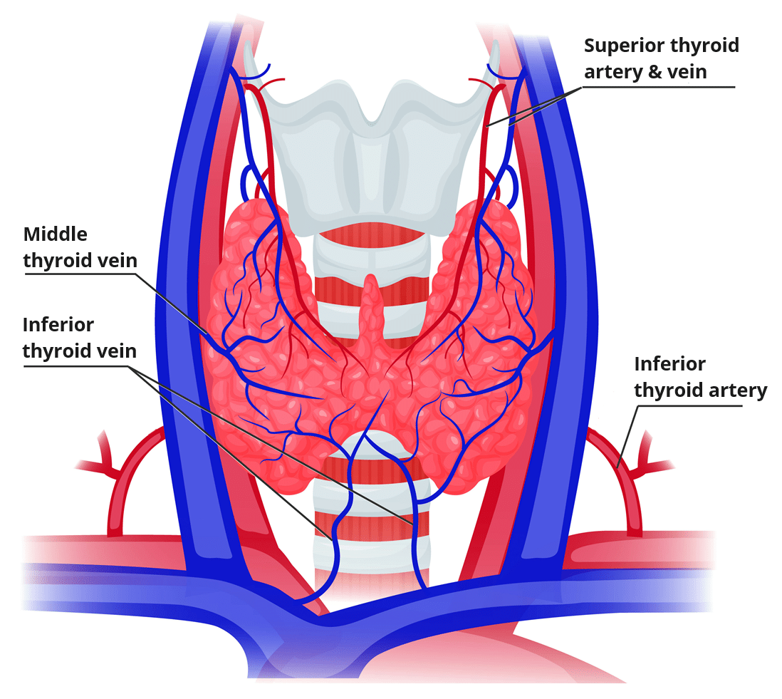
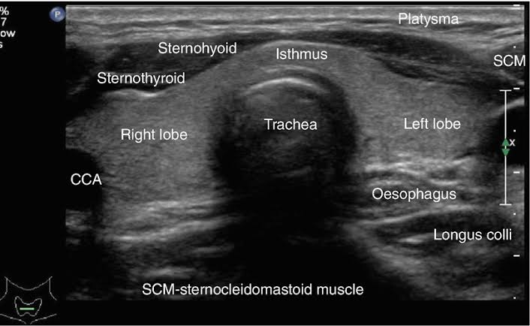
Anatomy Thyroid gland
Endocrine organ → thyroid hormone production.
Enveloped by the pretracheal fascia
Extend from C5 to T1 → anterior to thyroid and cricoic cartilages of larynx
Butterfly or "H"-shaped → two lobes (each +/- 4 cm in length) → connected by Isthmus.
Arterial supply
  A. Superior thyroid ( from External carotid)
  A. Inferior thyroid ( from Thyrocervical trunk)
Venous drainage
  Superior and Middle thyroid ( to Internal jugular vein)
  Inferior thyroid ( to brachiosefalic vein)

Slide 10
ACR TI-RADS: Basic Principles
Goal: Improve the consistency of thyroid nodule evaluation and classification on ultrasound.
Provides specific management recommendations for each thyroid nodule.
Nodules are assessed → 5 sonographic feature categories:
  Composition
  Echogenicity
  Shape
  Margin
  Echogenic foci
Each feature is assigned 0–3 points according to its association with malignancy risk.
Total score → TR category (TR1–TR5) → management recommendation (follow-up or FNA).
Notes:
The American College of Radiology (ACR) Thyroid Imaging Reporting and Data System (TI-RADS)

Slide 11
Why We Need Risk Stratification
The Scope of the Problem
A Fragmented Landscape
Thyroid nodules are found in as many as 68% of high-resolution ultrasound scans — making them one of the most common incidental findings in radiology practice.
Without a consistent framework, management decisions become arbitrary and patients face unnecessary procedures or inadequate follow-up.
Over the past two decades, professional organizations worldwide developed a multitude of independent risk stratification systems (RSSs) — each yielding different management recommendations for identical nodules.
The result: confusion for practitioners and patients alike, and wide variation in biopsy rates across institutions.

Slide 12
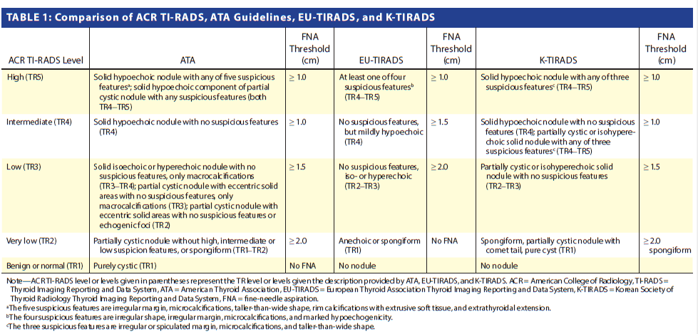

Slide 13
ACR TI-RADS: The Points-Based Approach
Why Points-Based?
Ensures every nodule receives a classification.
By contrast, ATA guidelines left 13.9% of nodules unclassifiable, while K-TIRADS left 3.9% unclassified. ACR TI-RADS eliminates this gap entirely.
Five risk tiers (TR1–TR5) map directly to clear FNA and surveillance thresholds, reducing ambiguity at the point of care.

Slide 14
Key Advantage: Higher Size Thresholds
The Evidence Base
Larger Biopsy Cutoffs
Thyroid cancer carries a 10-year relative survival of 99.4% for tumors smaller than 3 cm.
Mortality does not exceed baseline until tumors surpass 2.5 cm.
ACR TI-RADS sets the TR3 FNA threshold at 2.5 cm — compared to 1.5 cm under ATA guidelines — directly reflecting this survival data.
Biopsy Reduction
Grani et al.: The higher thresholds translate to a 19.9–46.5% reduction in unnecessary biopsies compared to other leading risk stratification systems, with the lowest false-negative rate (2.2%)

Slide 15
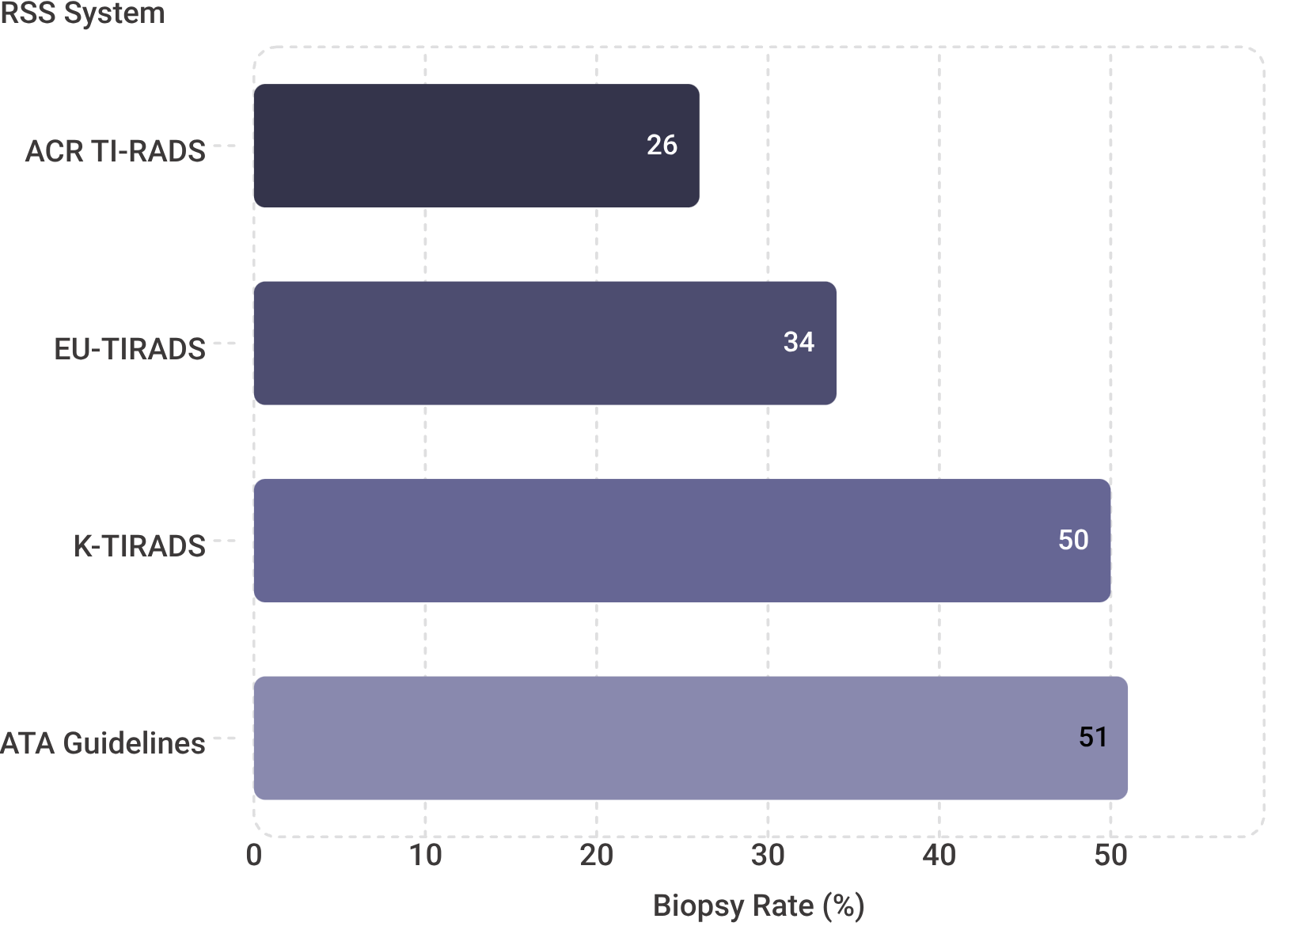
Evidence: Biopsy Reduction Across Studies
ACR Registry: 32,746 Nodules
In the largest comparative analysis, ACR TI-RADS recommended biopsy in only 26% of nodules — half the rate of ATA guidelines (51%) and K-TIRADS (50%).
Grani et al. (502 Nodules)
ACR TI-RADS achieved the lowest benign biopsy rate at 43.8%, versus 54.7% for ATA, 68.0% for EU-TIRADS, and 82.2% for K-TIRADS — reducing unnecessary procedures by 17.1–53.4%.
Notes:
ultrasound-based risk stratification system

Slide 16
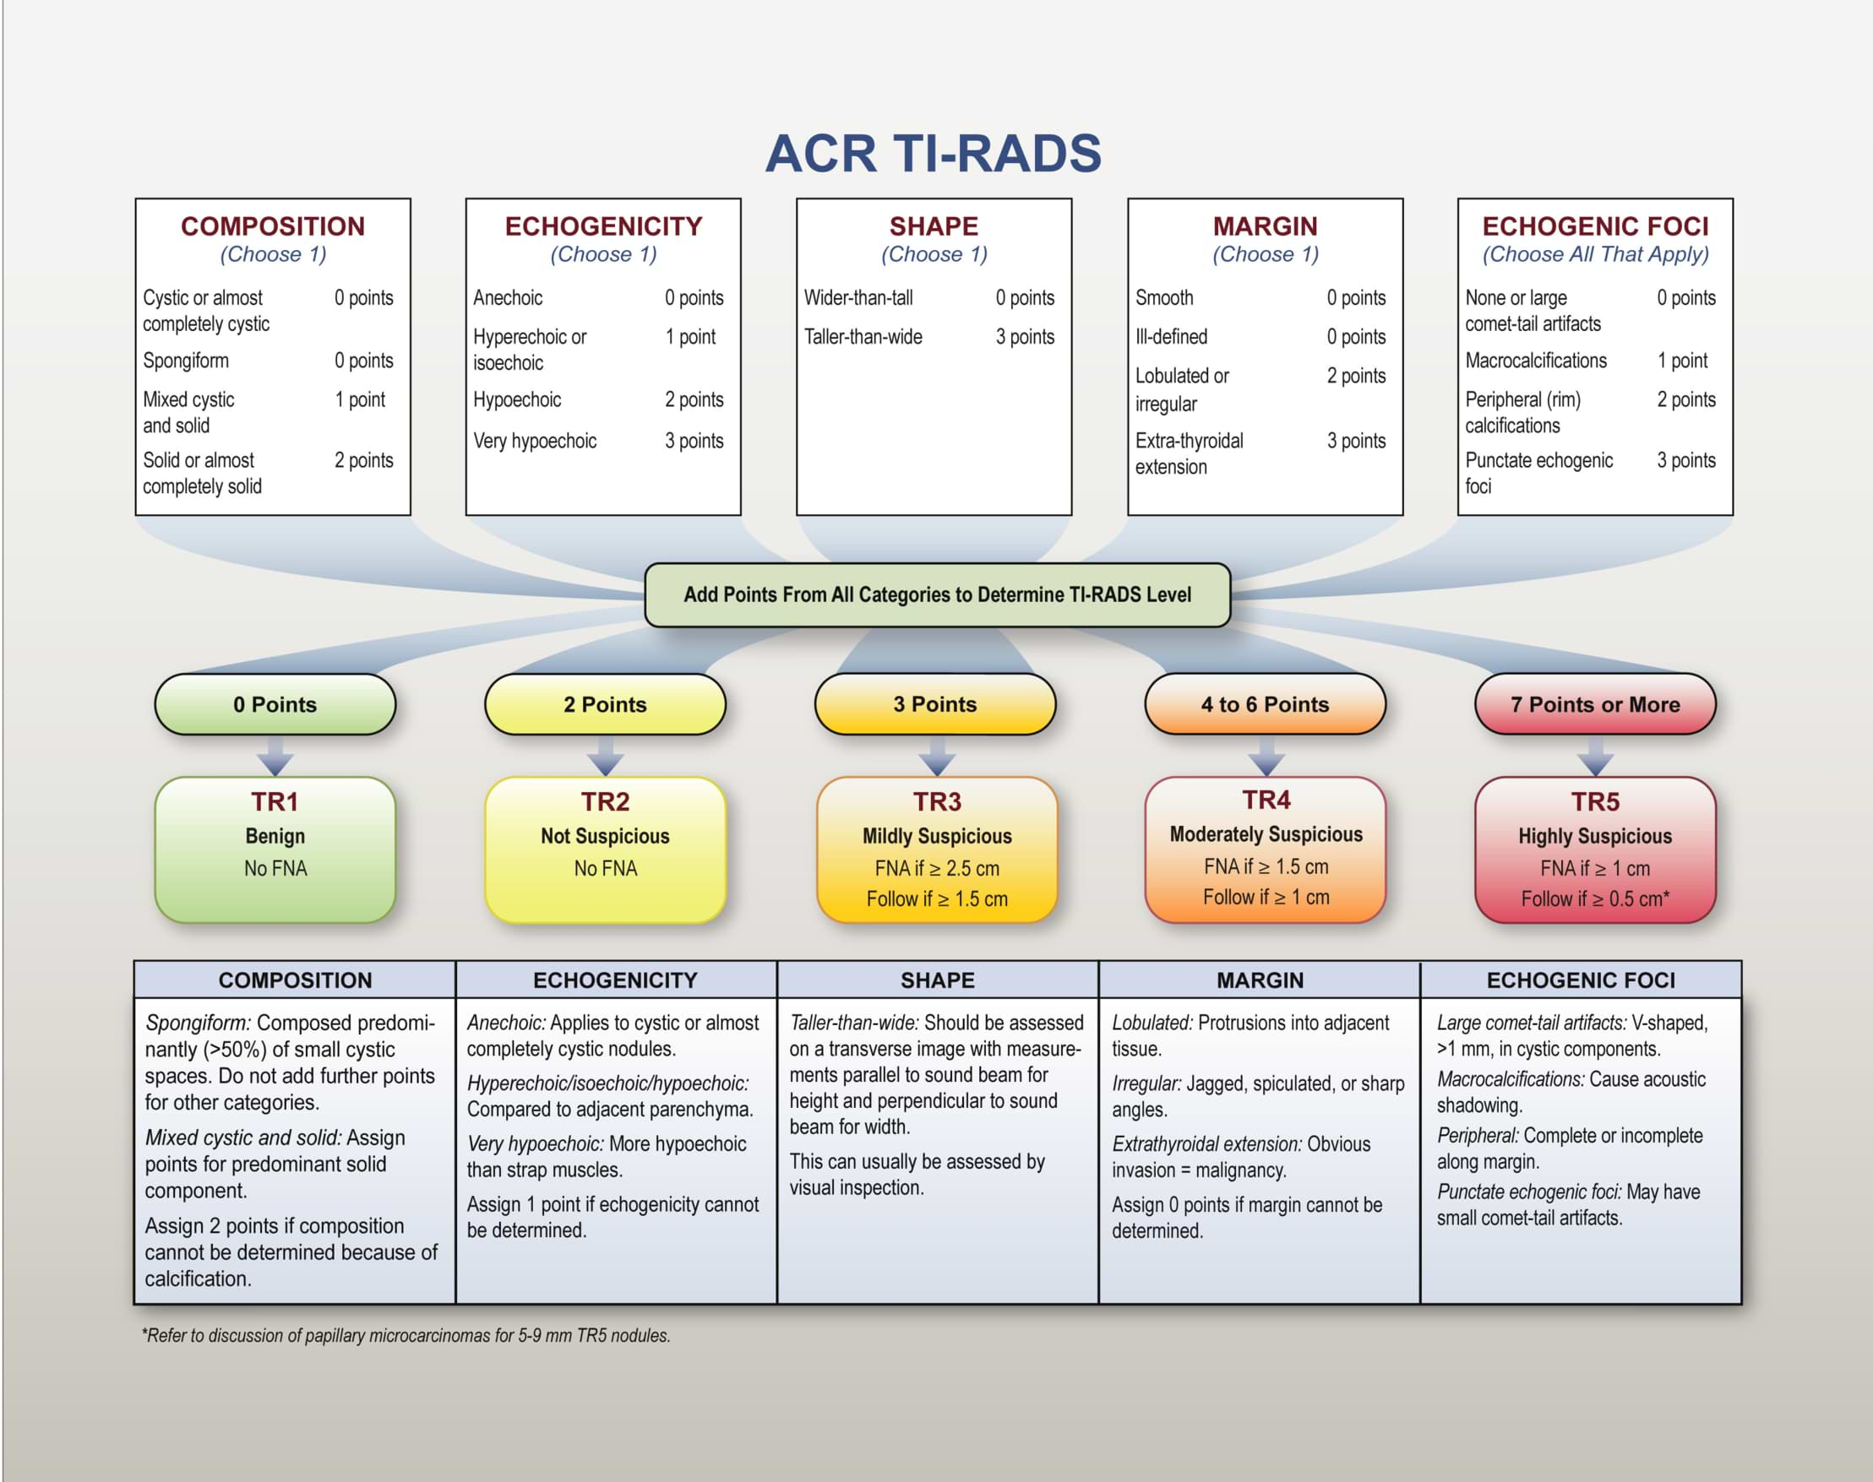

Slide 17
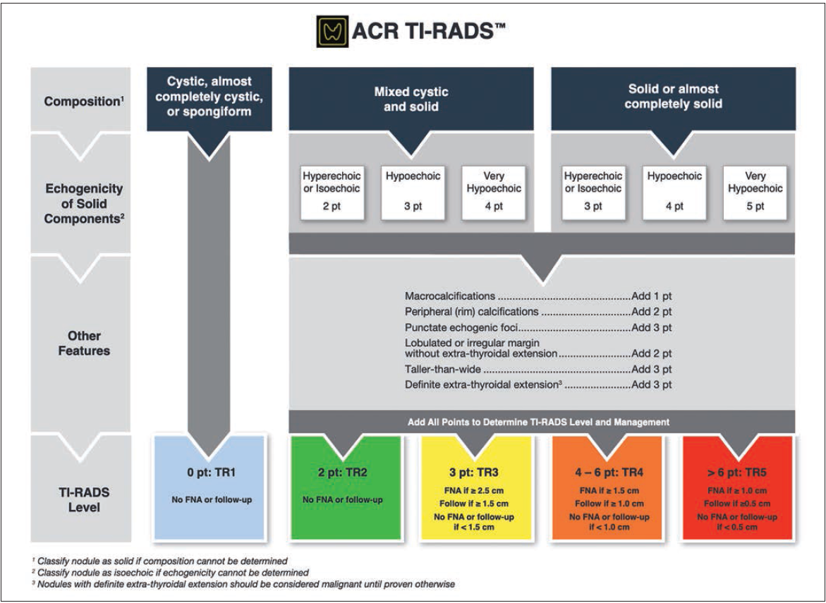
Notes:
ACR TI-RADS seeks to increase the consistency with which thyroid nodules are evaluated and classified with ultrasound. To do so, the system provides specific recommendations for management of every nodule, which may otherwise be absent from ultrasound reports. In ACR TI-RADS, nodules are evaluated in five sonographic feature categories: composition, echogenicity, shape, margin, and echogenic foci
Thyroid nodules are exceedingly common, being found in as many as 68% of high-resolution ultrasound scans [13]. To avoid the need to formally classify every nodule, ACR TI-RADS advises reporting no more than four nodules with the highest scores that warrant follow-up. Additionally, no more than two nodules with the highest scores that meet criteria for FNA should be recommended for biopsy. Again, the goal is to foster greater consistency
in thyroid nodule reporting and management.

Slide 18
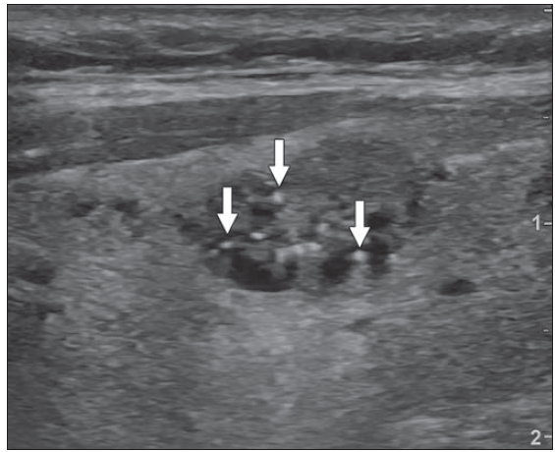
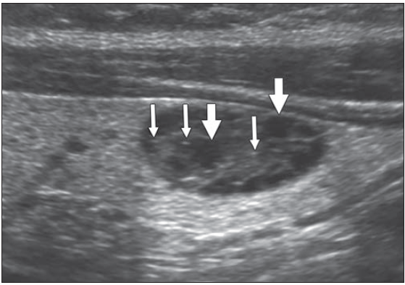
Cystic region
Back wall of cyst
Mixed cystic-solid (1)
Isoechoic (1)
Comet tail artifact (0)
TI-RADS 2
No FNA or follow up
Mixed cystic-solid (1)
hypoechoic (3)
TI-RADS 3
FNA at 2.5 cm and
follow up at 1.5 cm
Notes:
Transverse ultrasound image in 46-year-old woman shows isoechoic, mixed cystic-solid nodule with category of TR2 (2 points). Comet tail artifacts (arrows) could be misinterpreted as punctate echogenic foci. This would result in categorization of nodule as TR4 (5 points) and biopsy with 1.5-cm threshold instead of no biopsy at any size.
Large comet tail artifacts — or high-echogenicity foci from the back wall of tiny cysts — are frequently misread as punctate echogenic foci (PEF). Since PEF carry 3 points, this single misclassification can elevate a TR2 nodule to TR4, triggering biopsy.
Transverse ultrasound image in 78-year-old man showing isoechoic, mixed cystic-solid lesion with category of TR2 (2 points). Posterior acoustic enhancement could be missed and cystic regions (thick arrows) misinterpreted as hypoechoic components of heterogeneous solid nodule (TR4, 4 points). In addition, back wall of cysts (thin arrows) could be misinterpreted as punctate echogenic foci, which would result in categorization of nodule as TR5 (5 points) and biopsy with 1.0-cm threshold instead of no biopsy at any size.

Slide 19
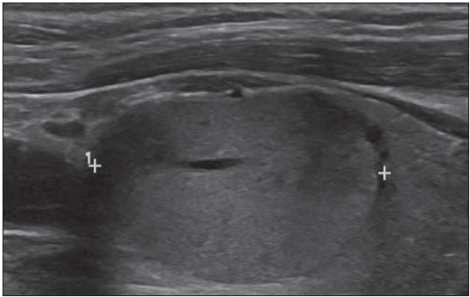
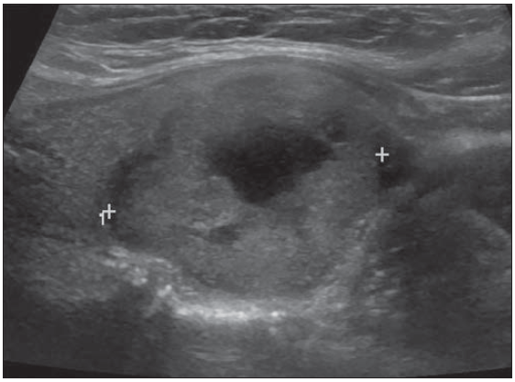
Solid (2)
Isoechoic (1)
TI-RADS 3
FNA at 2.5 cm and
follow up at 1.5 cm
Mixed cystic-solid (1)
Isoechoic (1)
Lobulated margin (2)
TI-RADS 4
FNA at 1,5 cm and
follow up at 1.0 cm

Slide 20

Safety: Will We Miss Cancers?
The Core Concern
The Built-In Safety Net
The Numbers
Reducing biopsies raises the legitimate question: are we deferring diagnosis of clinically significant malignancies?
ACR TI-RADS includes explicit follow-up recommendations for all nodules that do not meet FNA thresholds. Surveillance is a proven safe strategy for small suspicious nodules and even diagnosed small papillary thyroid cancers, given their indolent biology.
68.2% of malignancies received biopsy recommendations. An additional 21% were captured through surveillance monitoring — yielding a combined detection pathway of 89.2% of malignancies addressed under the protocol.

Slide 21
The Interobserver Variability Challenge
Structured Reporting Is Not Enough
The Weakest Links
Despite the explicit points-based framework, a study of 100 nodules interpreted by eight radiologists revealed only moderate agreement for management decisions (κ = 0.51).
Biopsy rates across seven different practices using ACR TI-RADS ranged from 4% to 35% — a nine-fold spread that underscores how much interpretation varies in real-world settings.
Margin
κ = 0.25–0.39
Fair agreement only
Echogenic Foci
κ = 0.25–0.39
Most consequential feature
Management
κ = 0.51
Moderate overall

Slide 22
Sources of Variability: Artifacts & Technique
Comet Tail Artifacts
Scanning Parameters
Training & Experience
Large comet tail artifacts — or high-echogenicity foci from the back wall of tiny cysts — are frequently misread as punctate echogenic foci (PEF). Since PEF carry 3 points, this single misclassification can elevate a TR2 nodule to TR4, triggering biopsy.
Gain settings, transducer frequency, and post-processing compression significantly affect feature conspicuity. The same nodule can appear differently depending on equipment and operator technique — before interpretation even begins.
Reader expertise matters. Training sessions and consensus discussions demonstrably improve feature assignment accuracy and reduce inter-reader discordance across institutions.

Slide 23

Future Directions: Emerging Technologies
Elastography
Contrast‑Enhanced US
Artificial Intelligence
Each technology addresses a distinct limitation of conventional B-mode ultrasound. Elastography offers reproducible stiffness quantification (sensitivity 75–89% in meta-analyses), contrast-enhanced ultrasound interrogates tumor vascularity, and AI-driven point optimization has already demonstrated accuracy gains beyond unmodified ACR TI-RADS — though adoption barriers of time, cost, and regulatory approval remain.

Slide 24
MANAGEMENT OF THYROID NODULES :
HOW TO MAKE A GOOD DIAGNOSIS ?
Live Webinar, September 19th 2026
Thank You

Slide 25
References
1. Hoang JK, Middleton WD, Tessler FN, et al. Update on ACR TIRADS: Successes, Challenges, and Future Directions, From the AJR Special Series on Radiology Reporting and Data Systems. AJR 2021; 216:570–578
2. Tessler FN, Middleton WD, Grant EG, et al. ACR Thyroid Imaging, Reporting and Data System (TI-RADS): white paper of the ACR TI-RADS Committee. J Am Coll Radiol 2017; 14:587–595
3. Grani G, Lamartina L, Ascoli V, et al. Reducing the number of unnecessary thyroid biopsies while improving diagnostic accuracy: toward the “right” TIRADS. J Clin Endocrinol Metab 2019; 104:95–102
4. Bahl M, Sosa JA, Nelson RC, Hoang JK. Imaging-detected incidental thyroid nodules that undergo surgery: a single-center experience over 1 year. AJNR 2014; 35:2176–2180
5. Vaccarella S, Franceschi S, Bray F, Wild CP, Plummer M, Dal Maso L. World wide thyroid-cancer epidemic? The increasing impact of overdiagnosis. N Engl J Med 2016; 375:614–617
6. Hoang JK, Nguyen XV, Davies L. Overdiagnosis of thyroid cancer: answers to five key questions. Acad Radiol 2015; 22:1024–1029
7. Ahn HS, Kim HJ, Welch HG. Korea’s thyroid-cancer “epidemic”: screening and overdiagnosis. N Engl J Med 2014; 371:1765–1767
8. Esserman LJ, Thompson IM Jr, Reid B. Overdiagnosis and overtreatment in cancer: an opportunity for improvement. JAMA 2013; 310:797–798
9. Hoang JK, Nguyen XV. Understanding the risks and harms of management of incidental thyroid nodules: a review. JAMA Otolaryngol Head Neck Surg 2017; 143:718–724
10. Middleton WD, Teefey SA, Tessler FN, et al. Analysis of malignant thyroid nodules that do not meet ACR TI-RADS criteria for fine needle aspiration. AJR 2020 Jun 30 [published online]
11. Tappouni RR, Itri JN, McQueen TS, Lalwani N, Ou JJ. ACR TI-RADS: pitfalls, solutions, and future directions. RadioGraphics 2019; 39:2040–2052
12. Tessler FN, Middleton WD, Grant EG. Thyroid Imaging Reporting and Data System (TI-RADS): a user’s guide. Radiology 2018; 287:29–36
13. Grant EG, Tessler FN, Hoang JK, et al. Thyroid ultrasound reporting lexicon: white paper of the ACR Thyroid Imaging, Reporting and Data System (TI RADS) Committee. J Am Coll Radiol 2015; 12(12 Pt A):1272–1279
14. Guth S, Theune U, Aberle J, Galach A, Bamberger CM. Very high prevalence of thyroid nodules detected by high frequency (13 MHz) ultrasound exam ination. Eur J Clin Invest 2009; 39:699–706
15. Haugen BR, Alexander EK, Bible KC, et al. 2015 American Thyroid Associa tion management guidelines for adult patients with thyroid nodules and differentiated thyroid cancer: the American Thyroid Association Guide lines Task Force on Thyroid Nodules and Differentiated Thyroid Cancer. Thyroid 2016; 26:1–133
16. Qadan L, Ahmed A, Kapila K. Thyroid ultrasound reports: deficiencies and recommendations. Med Princ Pract 2019; 28:280–283
17. Griffin AS, Mitsky J, Rawal U, Bronner AJ, Tessler FN, Hoang JK. Improved quality of thyroid ultrasound reports after implementation of the ACR Thy roid Imaging Reporting and Data System nodule lexicon and risk stratifica tion system. J Am Coll Radiol 2018; 15:743–748
18. Davies L, Ouellette M, Hunter M, Welch HG. The increasing incidence of small thyroid cancers: where are the cases coming from? Laryngoscope 2010; 120:2446–2451
19. Hoang JK, Middleton WD, Farjat AJ, et al. Reduction in biopsies and im proved accuracy for thyroid nodule evaluation: the American College of Radiology Thyroid Imaging Reporting and Data System (ACR TI-RADS). Radiology 2018; 287:185–193
20. Russ G, Bonnema SJ, Erdogan MF, Durante C, Ngu R, Leenhardt L. European Thyroid Association guidelines for ultrasound malignancy risk stratification of thyroid nodules in adults: the EU-TIRADS. Eur Thyroid J 2017; 6:225–237
21. Shin JH, Baek JH, Chung J, et al.; Korean Society of Thyroid Radiology (KSThR) and Korean Society of Radiology. Ultrasonography diagnosis and imaging-based management of thyroid nodules: revised Korean Society of Thyroid Radiology consensus statement and recommendations. Korean J Radiol 2016; 17:370–395

