Slide 1
Serverless real-time Communication
A real-time chat application
Team: Anirudh 100001238
Hussein 100001223
Felipe 100003518
Yohan 100002925

Slide 2

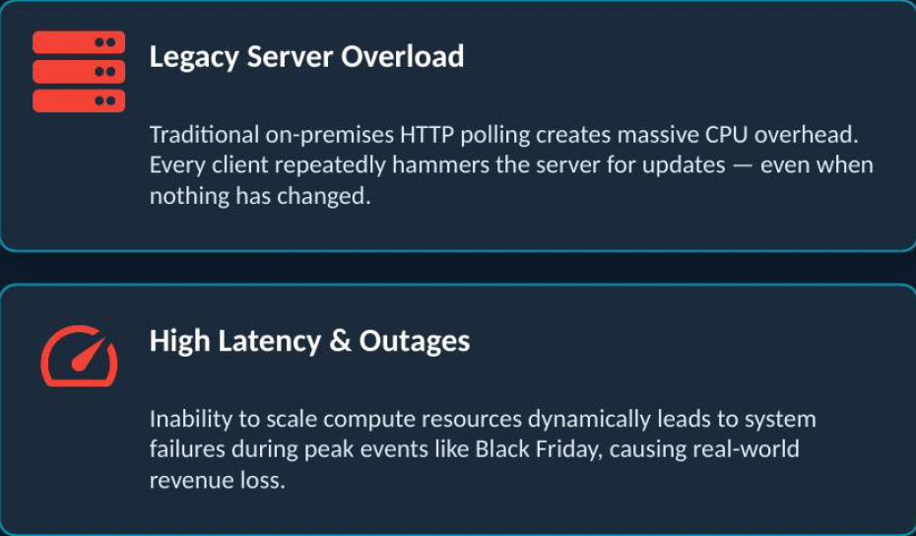
The Problem: The http Bottleneck
For the ShopWorld example,
HTTP Polling causes constant CPU Burn.
No Dynamic Scaling leads to downtime.
Site Outages during high traffic.
Revenue losses during peak traffic.

Slide 3
System architecture on google cloud platform
Why Cloud?
High Scalability
Global Availability
No On-Premises maintenance
The Cloud Platform used is Google Cloud Platform (GCP)
Google Cloud Environment
Phase 2
Target
App Engine
(Serverless Backend)
Firestore DB
NoSQL Real-Time
Global Users
Cloud Load Balancer/ CDN
Cloud Armor (DDoS Protection)

Slide 4
Computing and data strategy
App Engine (Cloud Resource) | FireStore (NoSQL Real-Time Database)
Serverless. | Native real-time data push
Auto-Scaling based on traffic demand. | Replace legacy SQL Databases
No overhead Kubernetes management. | Clients receive instant updates
Preferred over Google Kubernetes Engine (GKE) for simplicity. | Ideal for chat applications

Slide 5
Security and Global Delivery
Zero Trust Architecture: Implementing Zero Trust ensures there’s no implicit trust for any request, This secures the backend.
Edge Security: Cloud armor acts as a Web Application Firewall (WAF) mitigating DDoS attacks before they can hit our serverless backend.
Reduced Global latency: Cloud Load Balancing and Cloud CDN cache assets at google’s edge nodes, This helps with the international latency issues.

Slide 6

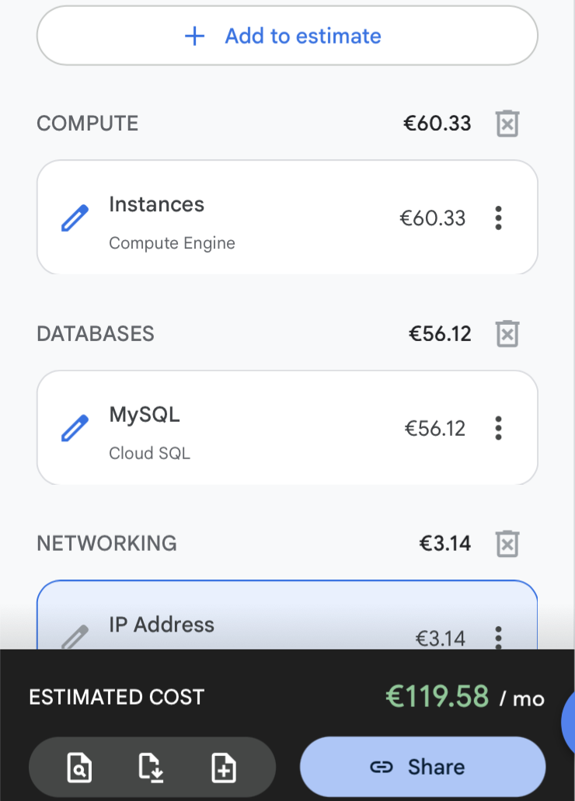
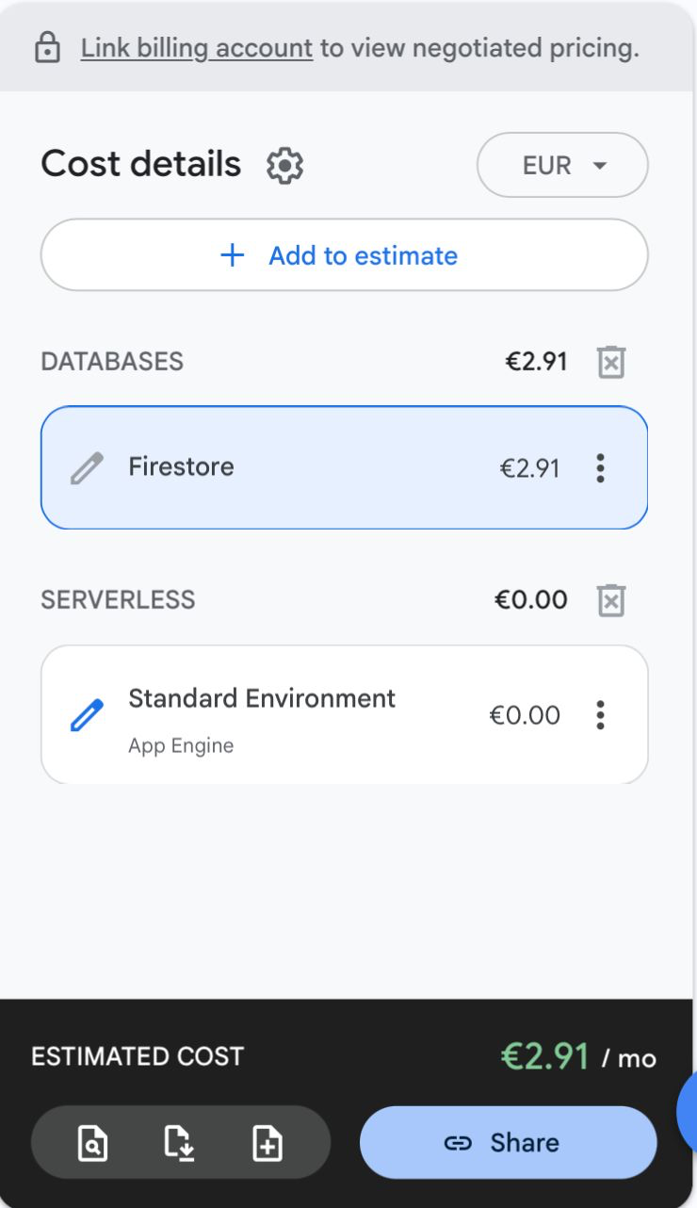
FINOPS and Cost estimation
SERVERLESS
ARCHITECTURE
STANDARD INFRASTRUCTURE
Benefits of Cloud Resources
Charged exclusively for actual compute time and storage operations, entirely eliminating idle server costs.
App Engine dynamically scales down to zero instances during low traffic, and scales up instantly to meet peak demand.
The GCP Projections both assume storage of 30GB and the price difference is clearly visible.

Slide 7
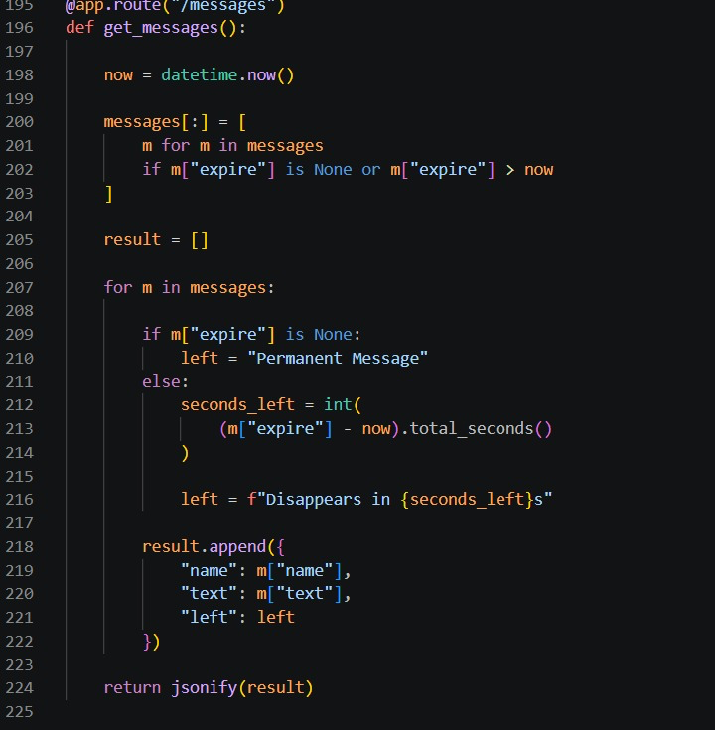
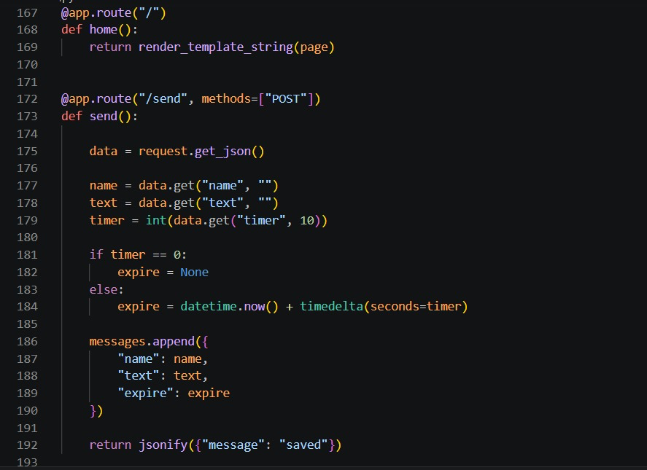
Backend Logic
Image 1 shows the user’s info being received and the expiration time chosen (10s,30s,None) based on the user’s choice.
Image 2 shows the route verifying the current time, removing expired messages, checking remaining time of existing messages and updating the browser with the new list.
Image 1
Image 2

Slide 8
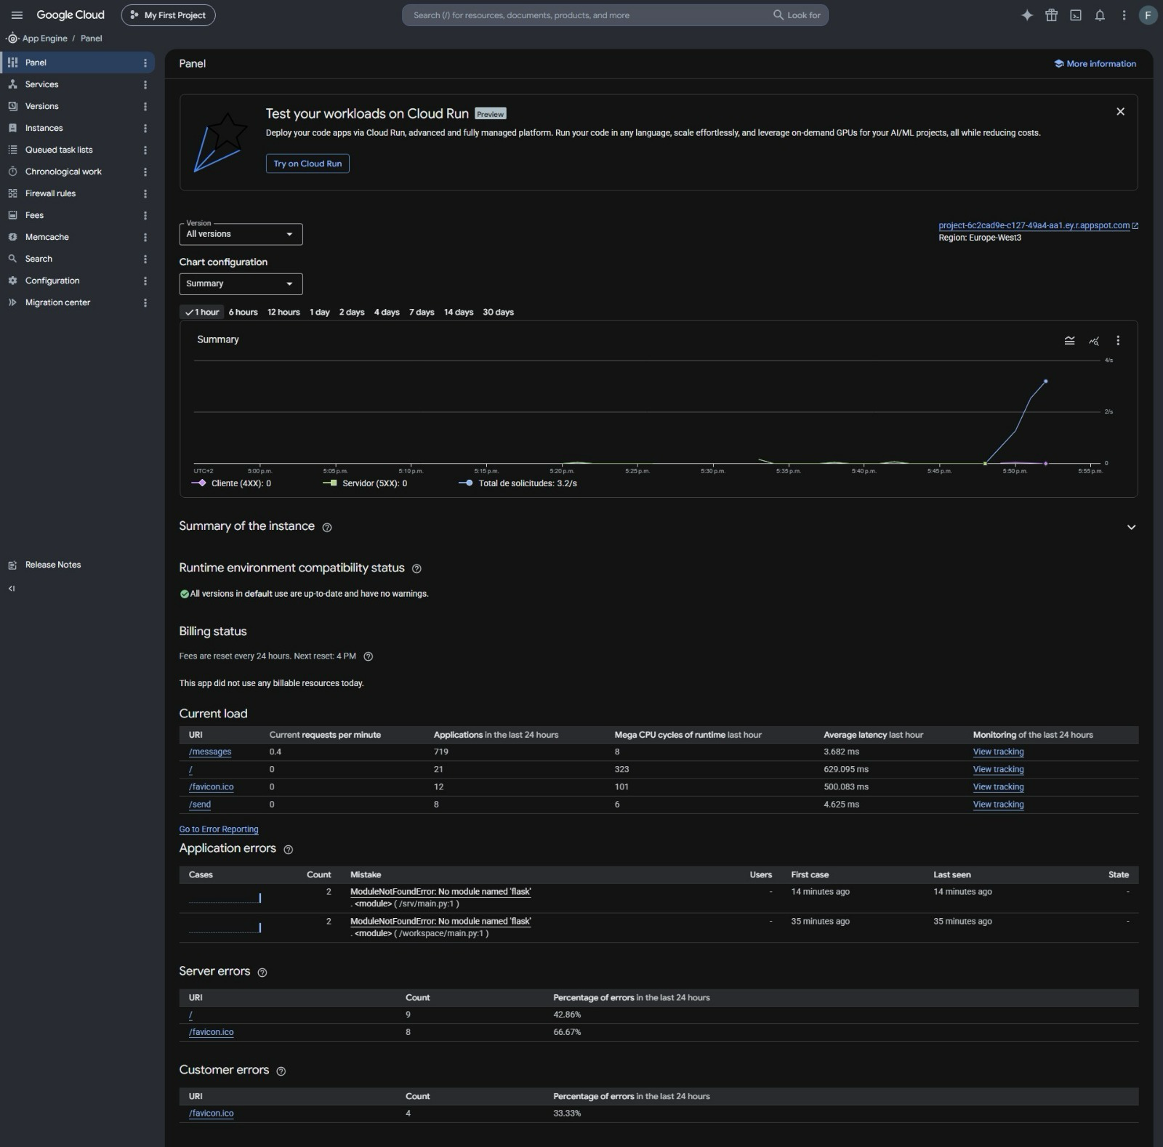
Live Cloud Deployment

Slide 9
Future IMprovements
Google Firestore: Migrating from the Minimum Viable Phase (MVP) in-memory arrays to a fully managed NoSQL database. This will ensure data persistence across ”scale-to-zero” events while maintaining the 3 euro baseline.
Real-Time Communication: Replacing the current HTTP polling mechanism with WebSockets. This will reduce unnecessary API calls to the server and provide instant message delivery for end users.
Identity and Access Management: Implementing Firebase authentication to secure endpoints, This requires verified user sessions, preventing unauthorized access and eliminating the risk of user impersonation.

Slide 10
References
https://cloud.google.com/products/calculator?dl=CjhDaVJsTnpjeU16Z3laQzA0WXpJekxUUTBOMkl0WVRVMk5pMDROamMyT0dRMlpqZzFZVFVRQVE9PRAXGiQ2OTZBQTA1RC1DMUU2LTRGRUMtQjNBMi1FOTE1MTc1ODMwMjU Serverless architecture Cost estimation (GCP calculator)
https://cloud.google.com/products/calculator?dl=CjhDaVE0T0dJMk1USTJPUzAyTVRGaUxUUTVNMlV0WVRObU5pMWpOVGc0TmpJeU5EazRaRGNRQVE9PRAOGiRBRTM0OEJCNC1BQTNCLTREMjAtODc4QS1EQTgyQkVENUVGOUE. Standard Infrastructure Cost estimation (GCP calculator)
https://github.com/anirrudhgg/Real-Time_Chat_Application (Github link)
https://project-6c2cad9e-c127-49a4-aa1.ey.r.appspot.com/. (Live Demo Link)

