Slide 1
OPERATING SYSTEMS
DESIGN AND IMPLEMENTATION
Third Edition
ANDREW S. TANENBAUM
ALBERT S. WOODHULL
Chapter 4
Memory Management
Tanenbaum & Woodhull, Operating Systems: Design and Implementation, (c) 2006 Prentice-Hall, Inc. All rights reserved. 0-13-142938-8

Slide 2
Memory Management
Allocation -
  What memory resources are given to processes
  What is granularity of allocation
  How do you find memory for process
  What do you have to do when memory is released
Translation -
  What is the form of addresses that processes use
  If not physical addresses, how are they translated to physical addresses
Protection -
  How is the OS protected from user processes
  How are user processes protected from each other
Tanenbaum & Woodhull, Operating Systems: Design and Implementation, (c) 2006 Prentice-Hall, Inc. All rights reserved. 0-13-142938-8

Slide 3

Monoprogramming without Swapping or Paging
Figure 4-1. Three simple ways of organizing memory with an operating system and one user process. Other possibilities also exist.
Tanenbaum & Woodhull, Operating Systems: Design and Implementation, (c) 2006 Prentice-Hall, Inc. All rights reserved. 0-13-142938-8

Slide 4
Address Translation
Must eventually generate physical address
only thing the RAM understands!
What kinds of addresses are there?
Logical address
Physical address
When is this done?
Coding time
Compile time/assembly time
Link time
Load time
Run time
Tanenbaum & Woodhull, Operating Systems: Design and Implementation, (c) 2006 Prentice-Hall, Inc. All rights reserved. 0-13-142938-8

Slide 5
Memory Management
Monoprogramming -
  Simple allocation – give process all available memory!
  Protect OS from user process (esp. in batch systems)
Multiprogramming -
  Allocation more challenging – multiple processes come and go; how to find a place for a process?
  Do small processes have to wait for large process that arrived first to find a hole? If not, does large process starve?
  Protect OS and other processes from each user process
Tanenbaum & Woodhull, Operating Systems: Design and Implementation, (c) 2006 Prentice-Hall, Inc. All rights reserved. 0-13-142938-8

Slide 6
Monoprogramming
Memory Protection
Physical Address
<?
YES
Fence Register
Trap – illegal address
NO
Put PA on system bus
Fence Register set by OS (option (a)), never changed
Every physical address generated in user mode tested against FR – protect the OS (req. batch systems)
Test done in hardware – done on every memory access
Tanenbaum & Woodhull, Operating Systems: Design and Implementation, (c) 2006 Prentice-Hall, Inc. All rights reserved. 0-13-142938-8

Slide 7
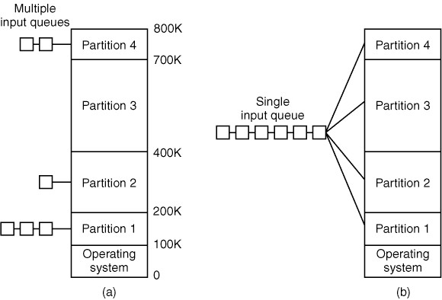
Multiprogramming with Fixed Partitions (1)
Figure 4-2. (a) Fixed
memory partitions with
separate input queues
for each partition.
Tanenbaum & Woodhull, Operating Systems: Design and Implementation, (c) 2006 Prentice-Hall, Inc. All rights reserved. 0-13-142938-8

Slide 8
Multiprogramming with Fixed Partitions (2)
Figure 4-2. (b) Fixed
memory partitions with
a single input queue.
Tanenbaum & Woodhull, Operating Systems: Design and Implementation, (c) 2006 Prentice-Hall, Inc. All rights reserved. 0-13-142938-8

Slide 9
Multiprogramming
Memory Protection
Physical Address
>?
YES
High Register
Trap – illegal address
NO
<?
YES
Low Register
Trap – illegal address
NO
Put PA on system bus
High and Low Registers set by OS on context switch
Every (physical) address generated in user mode tested against these (depends on allocation/partition) – in H/W
Tanenbaum & Woodhull, Operating Systems: Design and Implementation, (c) 2006 Prentice-Hall, Inc. All rights reserved. 0-13-142938-8

Slide 10
Memory Binding Time
At coding -
  Assembler can use absolute addresses
At compile time -
  Compiler resolves locations to absolute addresses
  May be informed by OS automatically
At load time -
  Scheduler can fix addresses
  Possible to swap out, then back in to relocate process
At run time -
  Process only generates logical addresses
  OS can relocate processes dynamically
  Much more flexible
Tanenbaum & Woodhull, Operating Systems: Design and Implementation, (c) 2006 Prentice-Hall, Inc. All rights reserved. 0-13-142938-8

Slide 11
Multiprogramming
Limit-Base Memory Protection
Logical Address
>?
YES
Limit Register
Trap – illegal address
NO
Base Register
Add
Put PA on system bus
Base and Limit Registers set by OS on context switch
Every logical address generated in user mode tested against limit (depends on allocation/partition)
If not too large, added to Base Register value to make PA
Test and manipulations all done in hardware
Tanenbaum & Woodhull, Operating Systems: Design and Implementation, (c) 2006 Prentice-Hall, Inc. All rights reserved. 0-13-142938-8

Slide 12
Multiprogramming
Memory Protection (2)
Proc B
Base Register B
Proc A
Base Register A
OS
Each process has its own Base and Limit Registers set by OS on context switch
Tanenbaum & Woodhull, Operating Systems: Design and Implementation, (c) 2006 Prentice-Hall, Inc. All rights reserved. 0-13-142938-8

Slide 13
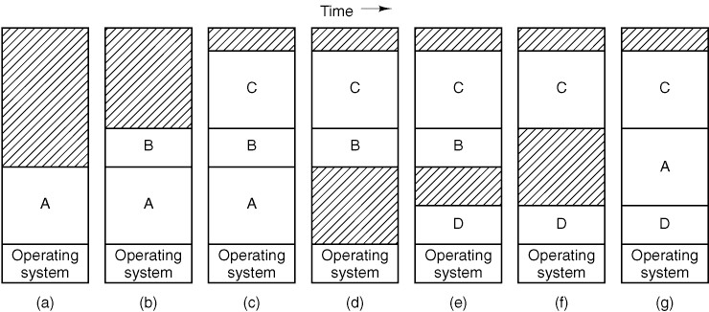
Swapping (1)
Figure 4-3. Memory allocation changes as processes come into
memory and leave it. The shaded regions are unused memory.
Tanenbaum & Woodhull, Operating Systems: Design and Implementation, (c) 2006 Prentice-Hall, Inc. All rights reserved. 0-13-142938-8

Slide 14
Swapping (1)
C
C
C
C
C
B
B
B
B
B
A
A
A
A
A
D
D
D
OS
OS
OS
OS
OS
OS
OS
Figure 4-3. Memory allocation changes as processes come into
memory and leave it. The shaded regions are unused memory.
Tanenbaum & Woodhull, Operating Systems: Design and Implementation, (c) 2006 Prentice-Hall, Inc. All rights reserved. 0-13-142938-8

Slide 15
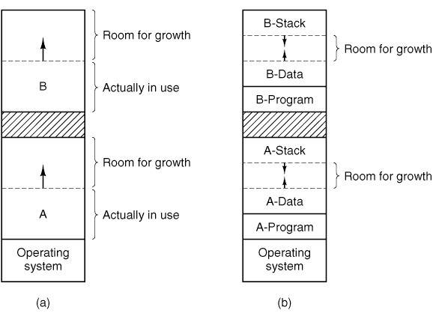
Swapping (2)
Figure 4-4. (a) Allocating
space for a growing data
segment.
Tanenbaum & Woodhull, Operating Systems: Design and Implementation, (c) 2006 Prentice-Hall, Inc. All rights reserved. 0-13-142938-8

Slide 16
Swapping (3)
Figure 4-4. (b) Allocating
space for a growing stack
and a growing data
segment.
Tanenbaum & Woodhull, Operating Systems: Design and Implementation, (c) 2006 Prentice-Hall, Inc. All rights reserved. 0-13-142938-8

Slide 17
Memory Allocation
How to find a “hole” big enough for a process
Fixed partitions
Dynamic partitions
How to keep track of what is allocated and what is free using dynamic partitions
Bit map
Linked list
How to merge holes when an adjacent block of memory is freed
How to allow for process growth – stack, heap, others?
What size should allocation units be?
Tanenbaum & Woodhull, Operating Systems: Design and Implementation, (c) 2006 Prentice-Hall, Inc. All rights reserved. 0-13-142938-8

Slide 18
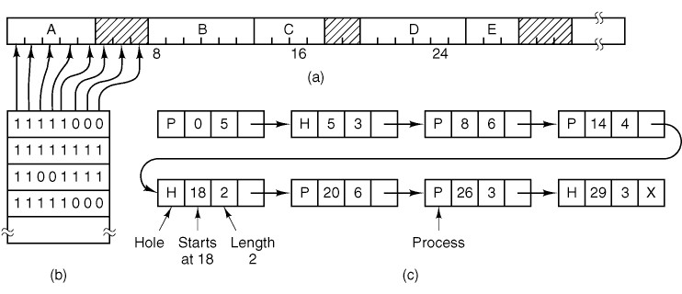
Memory Management with Bitmaps
Figure 4-5. (a) A part of memory with five processes and three
holes. The tick marks show the memory allocation units. The
shaded regions (0 in the bitmap) are free. (b) The corresponding bitmap. (c) The same information as a list.
Tanenbaum & Woodhull, Operating Systems: Design and Implementation, (c) 2006 Prentice-Hall, Inc. All rights reserved. 0-13-142938-8

Slide 19
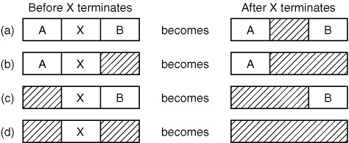
Memory Management with Linked Lists
Figure 4-6. Four neighbor combinations for the terminating process, X.
Tanenbaum & Woodhull, Operating Systems: Design and Implementation, (c) 2006 Prentice-Hall, Inc. All rights reserved. 0-13-142938-8

Slide 20
Memory Allocation Algorithms
First fit
Use first hole big enough
Next fit
Use next hole big enough
Best fit
Search list for smallest hole big enough
Worst fit
Search list for largest hole available
Quick fit
Separate lists of commonly requested sizes
Tanenbaum & Woodhull, Operating Systems: Design and Implementation, (c) 2006 Prentice-Hall, Inc. All rights reserved. 0-13-142938-8

Slide 21
Memory Waste
Fragmentation
Internal – memory allocated to a process that it does not use
  Allocation granularity
  Room to grow
External – memory not allocated to any process but too small to use (checkerboarding)
  Dynamic vs. fixed memory partitions
  Compaction (like defragmentation)
  Paging
Tanenbaum & Woodhull, Operating Systems: Design and Implementation, (c) 2006 Prentice-Hall, Inc. All rights reserved. 0-13-142938-8

Slide 22
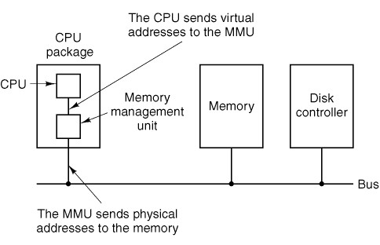
Paging (1)
Figure 4-7. The position and function of the MMU. Here the MMU
is shown as being a part of the CPU chip because it commonly is
nowadays. However, logically it could be a separate chip and
was in years gone by.
Tanenbaum & Woodhull, Operating Systems: Design and Implementation, (c) 2006 Prentice-Hall, Inc. All rights reserved. 0-13-142938-8

Slide 23
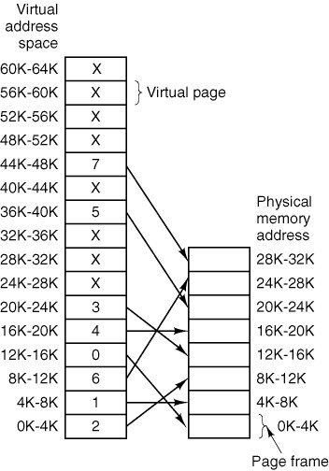
Paging (2)
Figure 4-8. The relation between
virtual addresses and physical
memory addresses is given by
the page table.
Tanenbaum & Woodhull, Operating Systems: Design and Implementation, (c) 2006 Prentice-Hall, Inc. All rights reserved. 0-13-142938-8

Slide 24

Paging (3)
Figure 4-9. The internal
operation of the MMU
with 16 4-KB pages.
Tanenbaum & Woodhull, Operating Systems: Design and Implementation, (c) 2006 Prentice-Hall, Inc. All rights reserved. 0-13-142938-8

Slide 25
Page Tables
Purpose: map virtual pages onto page frames (physical memory)
Major issues to be faced
  The mapping must be fast
    Hardware support
    Cache (TLB)
  The page table can be extremely large
    Page the page table
    Cache – inverted page table
Tanenbaum & Woodhull, Operating Systems: Design and Implementation, (c) 2006 Prentice-Hall, Inc. All rights reserved. 0-13-142938-8

Slide 26
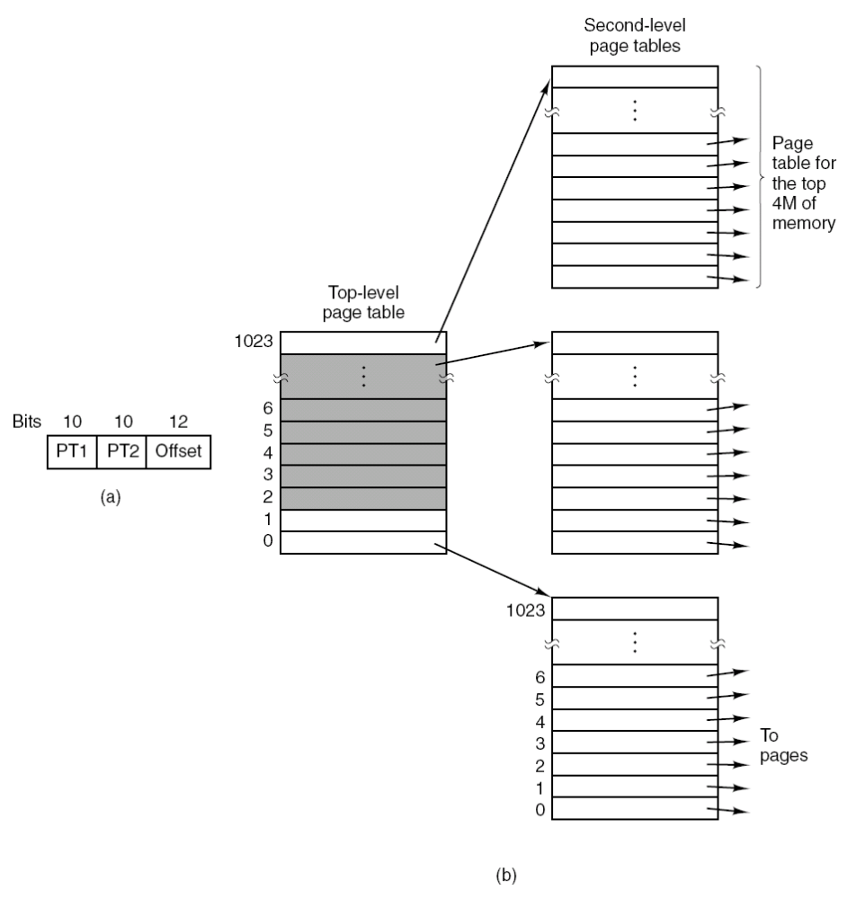
Multilevel Page
Tables
Figure 4-10. (a) A 32-bit
address with two page table
fields. (b) Two-level page
tables.
Tanenbaum & Woodhull, Operating Systems: Design and Implementation, (c) 2006 Prentice-Hall, Inc. All rights reserved. 0-13-142938-8

Slide 27
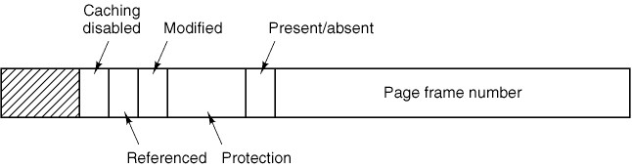
Structure of a Page Table Entry
􀀀Figure 4-11. A typical page table entry.
Tanenbaum & Woodhull, Operating Systems: Design and Implementation, (c) 2006 Prentice-Hall, Inc. All rights reserved. 0-13-142938-8

Slide 28
Memory Hierarchy (1)
Memory exists at multiple levels in a computer:
Registers (very few, very fast, very expensive)
L1 Cache (small, fast, expensive)
L2 Cache (modest, fairly fast, fairly expensive)
Maybe L3 Cache (usu. combined with L2 now)
RAM (large, somewhat fast, cheap)
Disk (huge, slow, really cheap)
Archival storage (tape, DVD, CD-ROM, etc.) (massive, ridiculously slow, ridiculously cheap)
A “hit” at one level means no need to access lower level (at least for a read)
Tanenbaum & Woodhull, Operating Systems: Design and Implementation, (c) 2006 Prentice-Hall, Inc. All rights reserved. 0-13-142938-8

Slide 29
Memory Hierarchy (2)
Registers - tiny
L1 – small
(32KB-128KB)
L2/L3 – modest
(128KB-2M)
RAM – big
(256MB-8GB+)
Disk – huge
(80GB-1TB+)
motherboard
In CPU
In CPU
In/near CPU
on Motherboard
Across bus
Via bus and controller
VERY FAST
CPU
Reg
expensive
L1
L2/L3
RAM
PRETTY FAST
cheap
Disk
Disk
Ctlr
SLOW
Really cheap
Tanenbaum & Woodhull, Operating Systems: Design and Implementation, (c) 2006 Prentice-Hall, Inc. All rights reserved. 0-13-142938-8

Slide 30
Memory Hierarchy (3)
Cache saves access time and use of bus:
Cache hit allows DMA to use bus for xfers
Effective Memory Access Time (EAT) is weighted sum: (prob hit)(hit time)+(prob miss)(miss time)
Tanenbaum & Woodhull, Operating Systems: Design and Implementation, (c) 2006 Prentice-Hall, Inc. All rights reserved. 0-13-142938-8

Slide 31
Memory Hierarchy (3.5)
Cache saves access time and use of bus:
Big issue: what is cache line size?
  Trade off hit rate due to #lines = cache size/line size
  Locality of reference (spatial and temporal)
Big issue: cache replacement policy
  Which line to replace when miss and cache full?
Big issue: cache consistency
  Write-through or write-back (lazy writes)?
  Access by other CPU, peripheral - coherence?
Tanenbaum & Woodhull, Operating Systems: Design and Implementation, (c) 2006 Prentice-Hall, Inc. All rights reserved. 0-13-142938-8

Slide 32
Memory Hierarchy (4)
Various types of cache common on modern processors:
Instruction cache – frequently used memory lines of text segment(s) (may be combined with data)
Data cache – recently/frequently used lines of data and/or stack segments
Translation Lookaside Buffer (TLB) – popular page table entries
Standard cache uses cache lines of 32-256 bytes
TLB uses page table entries (usu. 4 bytes)
All use associative (content-addressable) memory
  Tag is the part of cache line that is used to address it
Tanenbaum & Woodhull, Operating Systems: Design and Implementation, (c) 2006 Prentice-Hall, Inc. All rights reserved. 0-13-142938-8

Slide 33
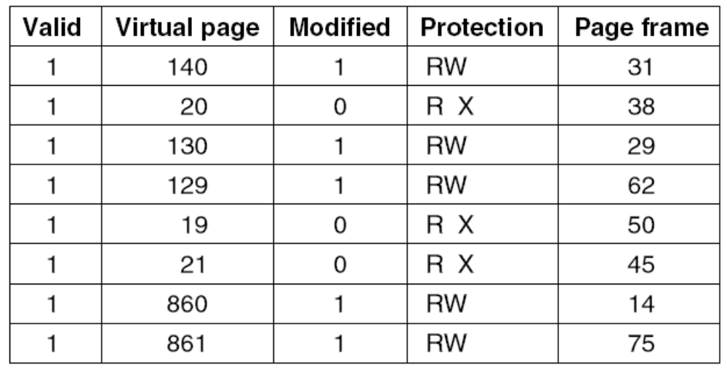
TLBs—Translation Lookaside Buffers
Special kind of cache for page tables
Figure 4-12. A TLB to speed up paging.
Tanenbaum & Woodhull, Operating Systems: Design and Implementation, (c) 2006 Prentice-Hall, Inc. All rights reserved. 0-13-142938-8

Slide 34
TLB Operation
Restart instruction on resume
CPU
CPU generates virtual address
Cache/HW
VA
TLB
MMU
TLB hit?
yes
Physical Addr
VP
PA
no
PT
in
RAM
Page
in
RAM
MMU accesses PT in RAM
(add VP number x entry size
to PT Base register value)
RAM
PT
on
Disk
Page
on
Disk
yes
Page in RAM?
Load TLB
Disk
no
Page Fault – bring in page, update PT
Tanenbaum & Woodhull, Operating Systems: Design and Implementation, (c) 2006 Prentice-Hall, Inc. All rights reserved. 0-13-142938-8

Slide 35
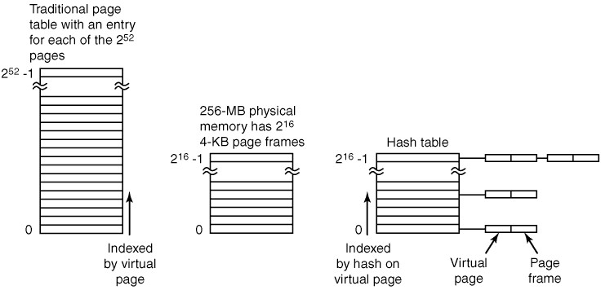
Inverted Page Tables
Used with TLB so relevant part of PT is in RAM
4KB pages => 12 bits => 64-12 = 52 bits of virtual page number
How big is it?
Software version of TLB – bigger and slower
4 B/entry x 2⁵² = 2⁵⁶Bytes
Won't fit in 2²⁸Byte memory!
If PT miss, then must bring in/make PT entry!
Figure 4-13. Comparison of a traditional page table with an
inverted page table in a 64-bit address space.
Tanenbaum & Woodhull, Operating Systems: Design and Implementation, (c) 2006 Prentice-Hall, Inc. All rights reserved. 0-13-142938-8

Slide 36
Page Replacement Algorithms
First-in First-Out (FIFO)
Optimal replacement
Least Recently Used (LRU)
Not Recently Used (NRU)
Second chance page replacement
Clock page replacement
Not Frequently Used (NFU)
Easiest to implement
What is optimal page to replace?
Page not used again for longest time
Not practical, but guess...
Costly
Crude LRU + use M bit
Tanenbaum & Woodhull, Operating Systems: Design and Implementation, (c) 2006 Prentice-Hall, Inc. All rights reserved. 0-13-142938-8

Slide 37
Reduced Reference String
Trace of process execution gives string of referenced logical addresses
Address trace yields reference string of corresponding pages
But multiple addresses are on the same page, so reference string may have many consecutive duplicate pages
Consecutive references to the same page will not produce a page fault – redundant!
Reduced reference string eliminates consecutive duplicate page references
Page fault behavior is the same – unless algorithm works on clock ticks or actual number of references
Tanenbaum & Woodhull, Operating Systems: Design and Implementation, (c) 2006 Prentice-Hall, Inc. All rights reserved. 0-13-142938-8

Slide 38
Reduced Reference String
Trace of referenced logical addresses
Reference string of corresponding pages
Reduced reference string
Assuming 4 kB pages
0x82013 0x82014 0x03295 0x82015 0x82016 0x03295 0x82017
0x82 0x82 0x03 0x82 0x82 0x03 0x82
0x82 0x03 0x82 0x03 0x82
Tanenbaum & Woodhull, Operating Systems: Design and Implementation, (c) 2006 Prentice-Hall, Inc. All rights reserved. 0-13-142938-8

Slide 39
FIFO Page Replacement
3 Frames, Reduced Reference String:
0 1 2 0 2 3 1 0 4 1 2 0 3 0 3 1 2 0 2 1 0
Page Frame
Contents
0 0 0 0 0
_ 1 1 1 1
_ 2 2 2
x x x
3 3
1 1
2 2
x
3
0
2
x
3
0
4
x
1
0
4
x
1
2
4
x
1
2
0
x
3 3 3
2 2 2
0 0 0
x
3
1
0
x
3
1
2
x
0 0 0 0
1 1 1 1
2 2 2 2
x
Page Faults:
Oldest page (FIFO victim) in RAM is underlined
Total of 13 PFs
Tanenbaum & Woodhull, Operating Systems: Design and Implementation, (c) 2006 Prentice-Hall, Inc. All rights reserved. 0-13-142938-8

Slide 40
FIFO Page Replacement
4 Frames, Reduced Reference String:
0 1 2 0 2 3 1 0 4 1 2 0 3 0 3 1 2 0 2 1 0
Page Frame
Contents
0 0 0 0 0 0 0 0
_ 1 1 1 1 1 1 1
_ 2 2 2 2 2 2
_ _ _ 3 3 3
x x x x
4 4 4
1 1 1
2 2 2
3 3 3
x
4 4 4 4
0 0 0 0
2 2 2 2
3 3 3 3
x
4
0
1
3
x
4 4 4 4 4
0 0 0 0 0
1 1 1 1 1
2 2 2 2 2
x
Page Faults:
Oldest page (FIFO victim) in RAM is underlined
Total of 8 PFs
Tanenbaum & Woodhull, Operating Systems: Design and Implementation, (c) 2006 Prentice-Hall, Inc. All rights reserved. 0-13-142938-8

Slide 41
Optimal Page Replacement
3 Frames, Reduced Reference String:
0 1 2 0 2 3 1 0 4 1 2 0 3 0 3 1 2 0 2 1 0
Page Frame
Contents
0 0 0 0 0
1 1 1 1
2 2 2
x x x
0 0 0
1 1 1
3 3 3
x
0 0
1 1
4 4
x
0 0
1 1
2 2
x
0 0 0 0
1 1 1 1
3 3 3 3
x
0 0 0 0 0
1 1 1 1 1
2 2 2 2 2
x
Page Faults:
Total of 8 PFs
(same as FIFO
with 4 frames)
Tanenbaum & Woodhull, Operating Systems: Design and Implementation, (c) 2006 Prentice-Hall, Inc. All rights reserved. 0-13-142938-8

Slide 42
LRU Page Replacement
3 Frames, Reduced Reference String:
0 1 2 0 2 3 1 0 4 1 2 0 3 0 3 1 2 0 2 1 0
0 1 2
0 1
0
x x x
0
2
1
2
0
1
1
3
2
x
Page Frame
Contents
3
2
0
x
0
1
3
x
4 1
0 4
1 0
x
2
1
4
x
0
2
1
x
3 0 3
0 3 0
2 2 2
x
1
3
0
x
2
1
3
x
0 2 1 0
2 0 2 1
1 1 0 2
x
Page Faults:
Total of 13 PFs
Tanenbaum & Woodhull, Operating Systems: Design and Implementation, (c) 2006 Prentice-Hall, Inc. All rights reserved. 0-13-142938-8

Slide 43
What do we have to work with?
Make page replacement policy practical!
Recall typical page table entry:
P bit (or V bit for valid) – page is in RAM (else page fault)
M bit (dirty bit) – page in RAM has been modified
R bit – page referenced since last time R was cleared
Tanenbaum & Woodhull, Operating Systems: Design and Implementation, (c) 2006 Prentice-Hall, Inc. All rights reserved. 0-13-142938-8

Slide 44
NRU Page Replacement
Reference bit set on load or on access
Reference bit cleared on clock tick (for running process)
On page fault, pick a page that has R=0 (only two groups)
To improve performance, better to replace a page that has not been modified...
So – set M bit on write, clear M bit when copied to disk
Schedule background task to copy modified pages to disk
Now 4 groups based on R & M: 11,10, 01, 00
On page fault, pick victim from lowest group
Cheap & reasonably good algorithm
Hey! How can
this happen?
Tanenbaum & Woodhull, Operating Systems: Design and Implementation, (c) 2006 Prentice-Hall, Inc. All rights reserved. 0-13-142938-8

Slide 45
NRU Page Replacement
R set on load or on access, cleared on clock tick
M set on write, cleared on copy to disk
Page in
On Write
Access
Page in
On Read
R=1,M=1
Copy to disk
Clock tick
R=1,M=0
Write
Access
R=0,M=1
Write
Clock tick
Read
Copy to disk
Read
R=0,M=0
Tanenbaum & Woodhull, Operating Systems: Design and Implementation, (c) 2006 Prentice-Hall, Inc. All rights reserved. 0-13-142938-8

Slide 46
NRU Page Replacement
Page: 0 1 2 3 4
R set on load or on access, cleared on clock tick
M set on write, cleared on copy to disk
RM RM RM RM RM
0R
1 0 0 0 0 0 0 0 0 0
1W
1 0 1 1 0 0 0 0 0 0
2W
1 0 1 1 1 1 0 0 0 0
Which page(s) might be replaced
If a page fault occurred here?
4R
1 0 1 1 1 1 0 0 1 0
Page 3 is best candidate (0,0)
Clock tick
0 0 0 1 0 1 0 0 0 0
2R
0 0 0 1 1 1 0 0 0 0
3W
0 0 0 1 1 1 1 1 0 0
Write 2 to disk
0 0 0 1 1 0 1 1 0 0
Which page(s) might be replaced
If a page fault occurred here?
0W
1 1 0 1 1 0 1 1 0 0
4R
1 1 0 1 1 0 1 1 1 0
Page1 is best candidate (0,1)
Tanenbaum & Woodhull, Operating Systems: Design and Implementation, (c) 2006 Prentice-Hall, Inc. All rights reserved. 0-13-142938-8

Slide 47
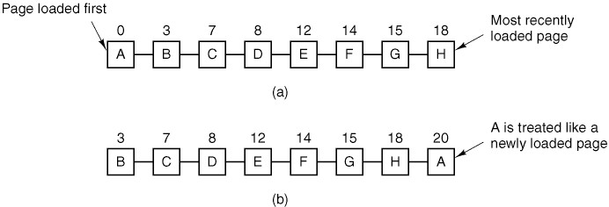
Second Chance Replacement
Figure 4-14. Operation of second chance.
(a) Pages sorted in FIFO order. (b) Page list if a page fault occurs at time 20 and A has its R bit set. Note that shuffle only occurs on a page fault, unlike LRU. The numbers above the pages are their (effective) loading times.
Tanenbaum & Woodhull, Operating Systems: Design and Implementation, (c) 2006 Prentice-Hall, Inc. All rights reserved. 0-13-142938-8

Slide 48
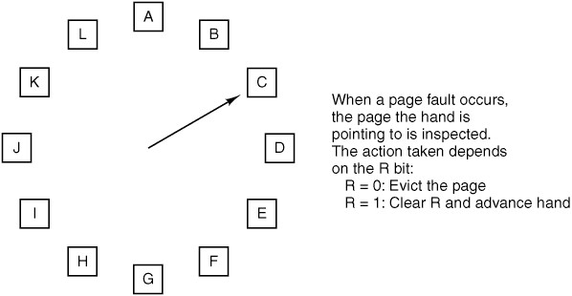
Clock Page Replacement
Figure 4-15. The clock page replacement algorithm. It is essentially the same as Second Chance (only use pointers to implement instead of shuffling)
Tanenbaum & Woodhull, Operating Systems: Design and Implementation, (c) 2006 Prentice-Hall, Inc. All rights reserved. 0-13-142938-8

Slide 49
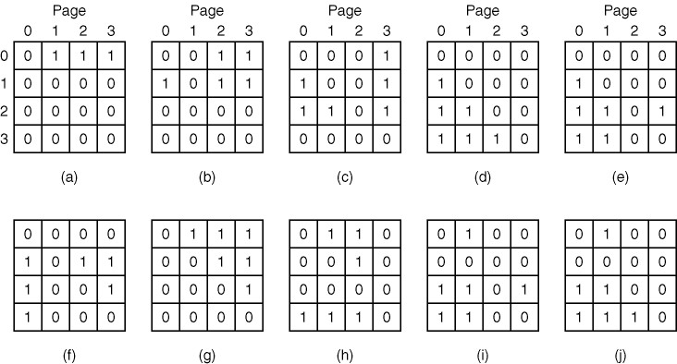
Simulating LRU in Software (1)
Figure 4-16. LRU using a matrix when pages are referenced in the
order 0, 1, 2, 3, 2, 1, 0, 3, 2, 3.
Tanenbaum & Woodhull, Operating Systems: Design and Implementation, (c) 2006 Prentice-Hall, Inc. All rights reserved. 0-13-142938-8

Slide 50
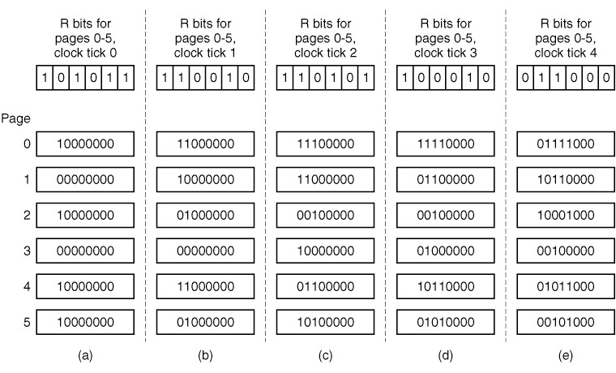
Simulating LRU in Software (2)
Figure 4-17. The aging algorithm simulates LRU in software.
Shown are six pages for five clock ticks. The five clock ticks are
represented by (a) to (e). (May also use M bit as tiebreaker.)
Tanenbaum & Woodhull, Operating Systems: Design and Implementation, (c) 2006 Prentice-Hall, Inc. All rights reserved. 0-13-142938-8

Slide 51
Memory Allocation
Goal:
  Give each process enough memory so that it doesn’t have “too many unnecessary” page faults
  Page fault is necessary if it is the first time a page is referenced
  It is also OK if a page has not been referenced in a long time if it was swapped out for a page that saw more action….
Problem:
  How much memory (how many page frames) is enough?
    More should be better
  Static analysis
    Can’t really go by size of program …
  Dynamic
    Observe behavior
Tanenbaum & Woodhull, Operating Systems: Design and Implementation, (c) 2006 Prentice-Hall, Inc. All rights reserved. 0-13-142938-8

Slide 52
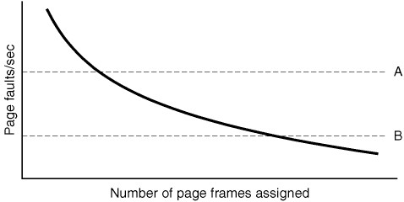
Page Fault Frequency
Observed behavior!!
Figure 4-20. Page fault rate as a function of the
number of page frames assigned.
Tanenbaum & Woodhull, Operating Systems: Design and Implementation, (c) 2006 Prentice-Hall, Inc. All rights reserved. 0-13-142938-8

Slide 53
Stack Algorithms
Belady's anomaly - a.k.a. FIFO anomaly
  Belady noticed that when allocation increased, sometimes the page fault rate increased!
Stack algorithms – never suffer from FIFO anomaly
  Let P(s,i,a) be the set of pages in memory for reference string s after the ith element has been referenced when a frames are allocated.
  A stack algorithm has the property that for any s, i, and a
  P(s,i,a) is a subset of P(s,i,a+1)
  In other words, any page that is in memory with allocation a is also in memory with allocation a+1
Tanenbaum & Woodhull, Operating Systems: Design and Implementation, (c) 2006 Prentice-Hall, Inc. All rights reserved. 0-13-142938-8

Slide 54
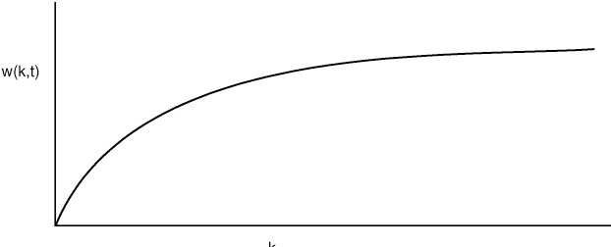
The Working Set Model (1)
t
Figure 4-18. The working set is approximated by the set of pages used by the k most recent memory references. The function w(k, t) is the size of the (approx.) working set at time t.
Tanenbaum & Woodhull, Operating Systems: Design and Implementation, (c) 2006 Prentice-Hall, Inc. All rights reserved. 0-13-142938-8

Slide 55
The Working Set Model (2)
The working set (WS) is the set of pages “in use”
We want the working set in RAM!
But we don't really know what the working set is!
And the WS changes over time – locality of reference in space and time (think about calling a subroutine or loops in code)
It is usually approximated by the set of pages used by the k most recent memory references.
The function w(k, t) is the size of the (approx.) working set at time t.
Note that the previous graph only shows how w(k, t) changes for one locality (one WS) as all of its pages are eventually referenced
Since WS changes over time, so does w(k,t)
So should allocation to the process!
Tanenbaum & Woodhull, Operating Systems: Design and Implementation, (c) 2006 Prentice-Hall, Inc. All rights reserved. 0-13-142938-8

Slide 56
Thrashing
Thrashing is the condition that a process does not have sufficient allocation to hold its working set
This leads to high paging frequency with short CPU bursts
  The symptom of thrashing is high I/O and low CPU utilization
  Can also detect via high Page Fault Frequency (PFF)
The cure? Give the thrashing process(es) more memory
  Take it from another process
  Swap out one or more processes until the demand is lower (medium term scheduler/memory scheduler)
Tanenbaum & Woodhull, Operating Systems: Design and Implementation, (c) 2006 Prentice-Hall, Inc. All rights reserved. 0-13-142938-8

Slide 57
PFF for Global Allocation
thrashing
Figure 4-20. Above A, process is thrashing, below B, it can probably give up some page frames without harm.
Tanenbaum & Woodhull, Operating Systems: Design and Implementation, (c) 2006 Prentice-Hall, Inc. All rights reserved. 0-13-142938-8

Slide 58
Memory Allocation Policies
How many page frames should be given to a process?
  Proportional to image size?
  Subject to some minimum
  Dynamically changed as WS size changes
Allocation Policies
  Local allocation
    When process P has a page fault, replace one of P's other pages
  Global allocation
    When process P has a page fault, replace “best” page from any process
Tanenbaum & Woodhull, Operating Systems: Design and Implementation, (c) 2006 Prentice-Hall, Inc. All rights reserved. 0-13-142938-8

Slide 59
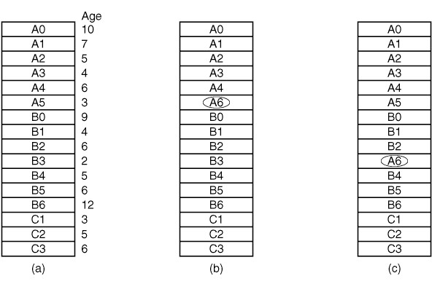
Local versus Global Allocation Policies
Figure 4-19. Local versus global page replacement.
(a) Original configuration. (b) Local page replacement.
(c) Global page replacement.
Tanenbaum & Woodhull, Operating Systems: Design and Implementation, (c) 2006 Prentice-Hall, Inc. All rights reserved. 0-13-142938-8

Slide 60
Segmentation (1)
Examples of tables saved by a compiler …
The source text being saved for the printed listing (on batch systems).
The symbol table, containing the names and attributes of variables.
The table containing all the integer and floating-point constants used.
The parse tree, containing the syntactic analysis of the program.
The stack used for procedure calls within the compiler.
These will vary in size dynamically during the compile process
Tanenbaum & Woodhull, Operating Systems: Design and Implementation, (c) 2006 Prentice-Hall, Inc. All rights reserved. 0-13-142938-8

Slide 61
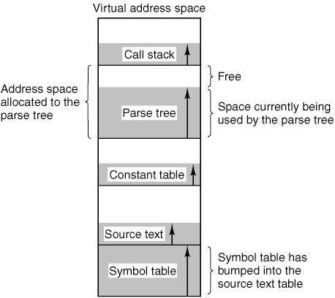
Segmentation (2)
Figure 4-21. In a one-dimensional address space with growing tables, one table may bump into another.
Tanenbaum & Woodhull, Operating Systems: Design and Implementation, (c) 2006 Prentice-Hall, Inc. All rights reserved. 0-13-142938-8

Slide 62
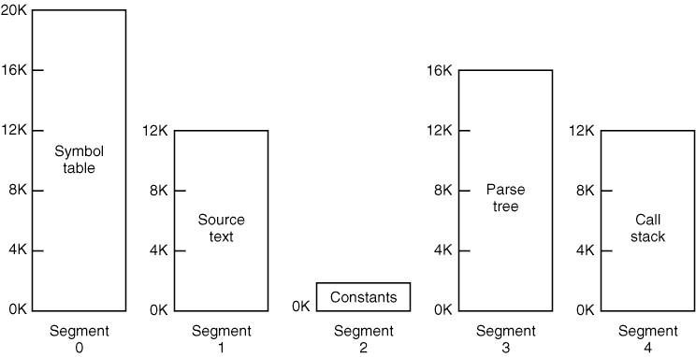
Segmentation (3)
Figure 4-22. A segmented memory allows each table to grow or shrink independently of the other tables.
Tanenbaum & Woodhull, Operating Systems: Design and Implementation, (c) 2006 Prentice-Hall, Inc. All rights reserved. 0-13-142938-8

Slide 63
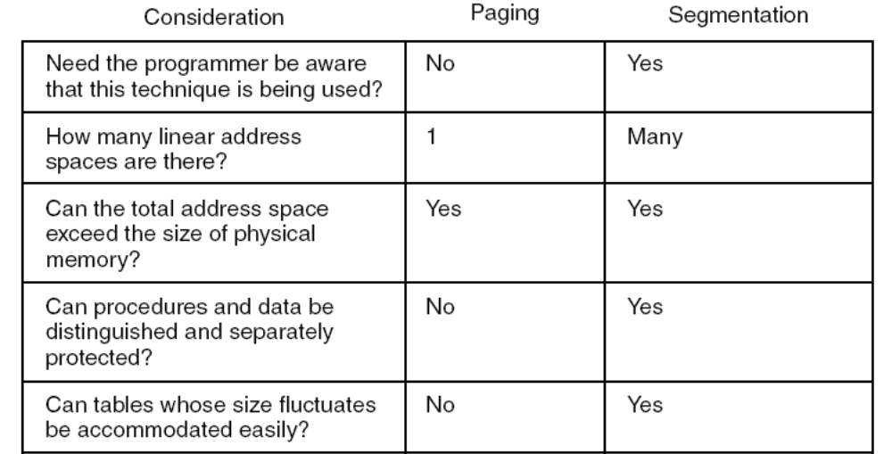
Segmentation (4)
. . .
Figure 4-23. Comparison of paging and segmentation.
Tanenbaum & Woodhull, Operating Systems: Design and Implementation, (c) 2006 Prentice-Hall, Inc. All rights reserved. 0-13-142938-8

Slide 64
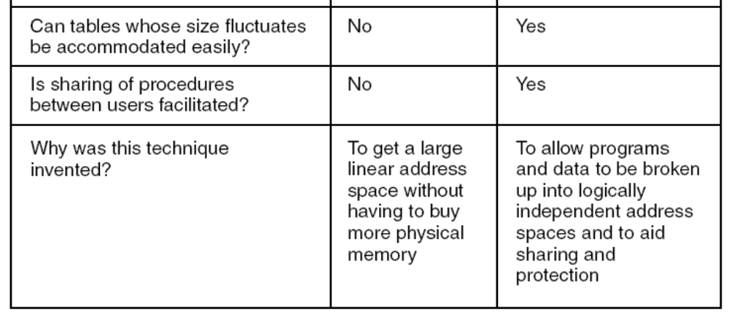
Segmentation (4)
. . .
Figure 4-23. Comparison of paging and segmentation.
Tanenbaum & Woodhull, Operating Systems: Design and Implementation, (c) 2006 Prentice-Hall, Inc. All rights reserved. 0-13-142938-8

Slide 65
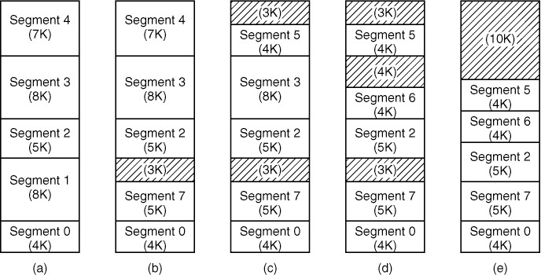
Implementation of Pure Segmentation
Figure 4-24. (a)-(d) Development of checkerboarding.
(e) Removal of the checkerboarding by compaction.
(Much like defragging a disk, only in RAM)
Tanenbaum & Woodhull, Operating Systems: Design and Implementation, (c) 2006 Prentice-Hall, Inc. All rights reserved. 0-13-142938-8

Slide 66
Segmentation with Paging:
The Intel Pentium (0)
Pentium supports up to 16K (total) segments
of 2³² bytes (4 GB) each
Can be set to use only segmentation, only paging, or both
Unix, Windows use pure paging (one 4GB segment)
OS/2 used both
Two descriptor tables
  LDT (Local DT) – one per process (stack, data, local code)
  GDT (Global DT) – one for whole system, shared by all
  Each table holds 8K segment descriptors, each 8 bytes long
Tanenbaum & Woodhull, Operating Systems: Design and Implementation, (c) 2006 Prentice-Hall, Inc. All rights reserved. 0-13-142938-8

Slide 67
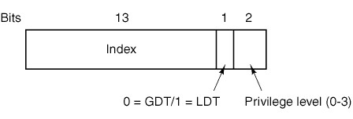
Segmentation with Paging:
The Intel Pentium (1)
Figure 4-25. A Pentium selector.
Pentium has 6 16-bit segment registers
  CS for code segment
  DS for data segment
Segment register holds selector
  Zero used to indicate unused SR, cause fault if used
  Indicates global or local DT, privilege level
  3 LSBs are zeroed and added to DT base address to get entry
Tanenbaum & Woodhull, Operating Systems: Design and Implementation, (c) 2006 Prentice-Hall, Inc. All rights reserved. 0-13-142938-8

Slide 68
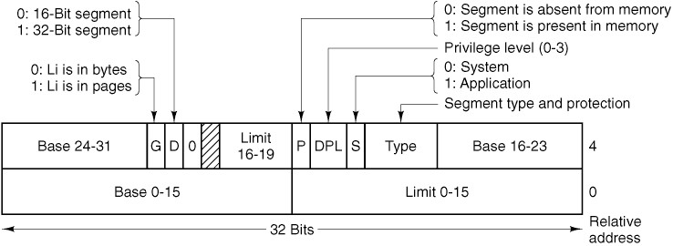
Segmentation with Paging:
The Intel Pentium (2)
Figure 4-26. Pentium code segment descriptor.
Data segments differ slightly.
Tanenbaum & Woodhull, Operating Systems: Design and Implementation, (c) 2006 Prentice-Hall, Inc. All rights reserved. 0-13-142938-8

Slide 69
Segmentation
Address Translation
Physical Memory
Segment Table
Segt C
Selector
Valid Z
Limit Z
Base Z
Which table
Which segt
...
Valid C
Limit C
Base C
Valid B
Limit B
Base B
Segt A
Limit A
Valid A
Limit A
Base A
OS
Each process has its own Base and Limit Registers set by OS on context switch used to translate virtual address of (segment, offset) to physical address
Tanenbaum & Woodhull, Operating Systems: Design and Implementation, (c) 2006 Prentice-Hall, Inc. All rights reserved. 0-13-142938-8

Slide 70
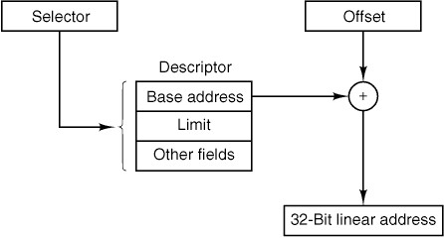
Segmentation with Paging:
The Intel Pentium (3)
<?
no
yes
no
P?
yes
Trap
Page fault
Figure 4-27. Conversion of a (selector, offset)
pair to a linear address.
Tanenbaum & Woodhull, Operating Systems: Design and Implementation, (c) 2006 Prentice-Hall, Inc. All rights reserved. 0-13-142938-8

Slide 71
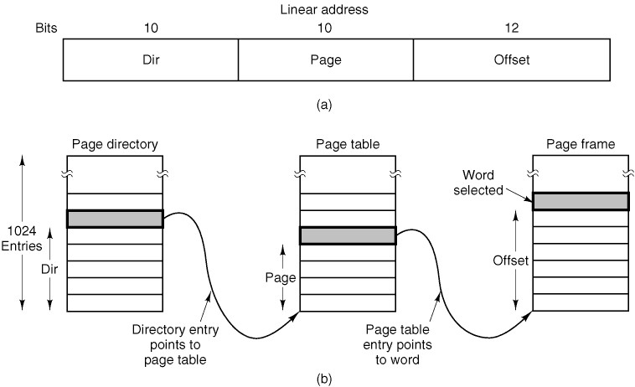
Segmentation with Paging:
The Intel Pentium (4)
Offset into directory
Offset into page table
Offset into page
Figure 4-28. Mapping of a linear address onto a physical address.
Tanenbaum & Woodhull, Operating Systems: Design and Implementation, (c) 2006 Prentice-Hall, Inc. All rights reserved. 0-13-142938-8

Slide 72
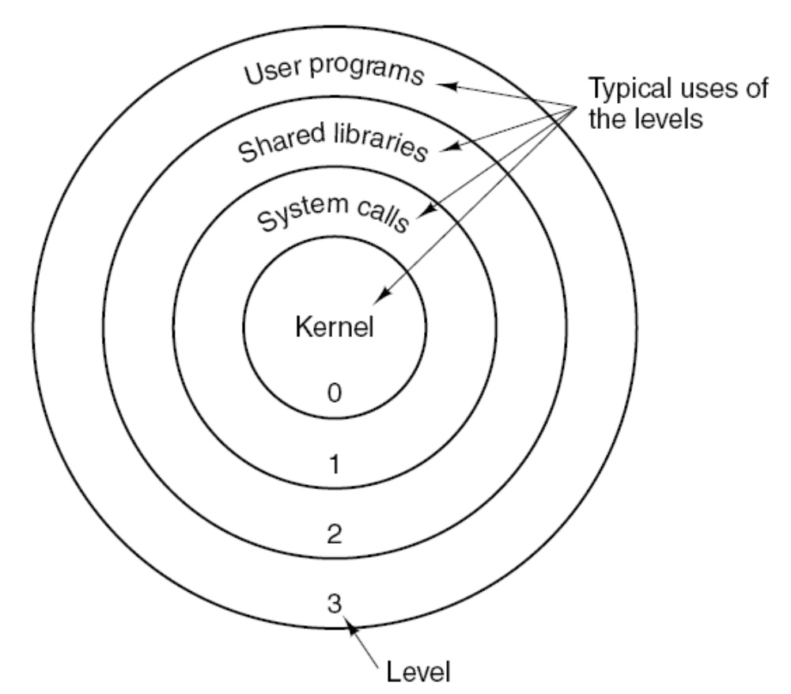
Segmentation with Paging:
The Intel Pentium (6)
Figure 4-29. Protection on the Pentium. Privilege state (changed when calls are made) compared to descriptor protection bits.
Tanenbaum & Woodhull, Operating Systems: Design and Implementation, (c) 2006 Prentice-Hall, Inc. All rights reserved. 0-13-142938-8

Slide 73
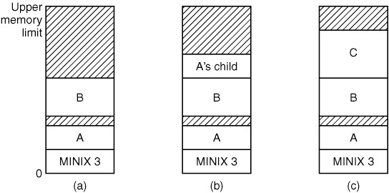
Memory Layout (1)
Copy
overwritten
Identical
copy
Figure 4-30. Memory allocation (a) Originally. (b) After a fork.
(c) After the child does an exec. The shaded regions are unused memory. The process is a common I&D one.
Tanenbaum & Woodhull, Operating Systems: Design and Implementation, (c) 2006 Prentice-Hall, Inc. All rights reserved. 0-13-142938-8

Slide 74
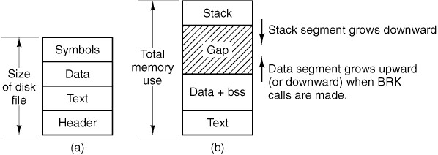
Memory Layout (2)
Figure 4-31. (a) A program as stored in a disk file. (b) Internal memory layout for a single process. In both parts of the figure the lowest disk or memory address is at the bottom and the highest address is at the top.
Tanenbaum & Woodhull, Operating Systems: Design and Implementation, (c) 2006 Prentice-Hall, Inc. All rights reserved. 0-13-142938-8

Slide 75
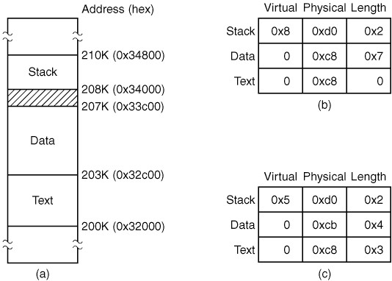
Processes in Memory (1)
Figure 4-33. (a) A process in memory. (b) Its memory representation for combined I and D space. (c) Its memory representation for separate I and D space
Tanenbaum & Woodhull, Operating Systems: Design and Implementation, (c) 2006 Prentice-Hall, Inc. All rights reserved. 0-13-142938-8

Slide 76
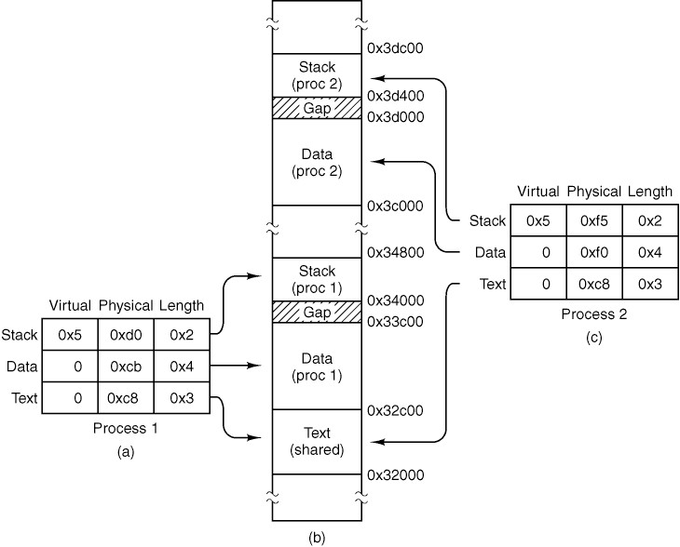
Processes in Memory (2)
Figure 4-34. (a) The memory map of a separate I and D space process, as in the previous figure. (b) The layout in memory after a second process starts, executing the same program image with shared text. (c) The memory map of the second process.
Tanenbaum & Woodhull, Operating Systems: Design and Implementation, (c) 2006 Prentice-Hall, Inc. All rights reserved. 0-13-142938-8

Slide 77
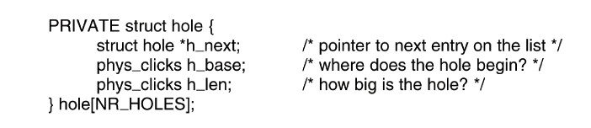
The Hole List
Figure 4-35. The hole list is an array of struct hole.
Tanenbaum & Woodhull, Operating Systems: Design and Implementation, (c) 2006 Prentice-Hall, Inc. All rights reserved. 0-13-142938-8

Slide 78
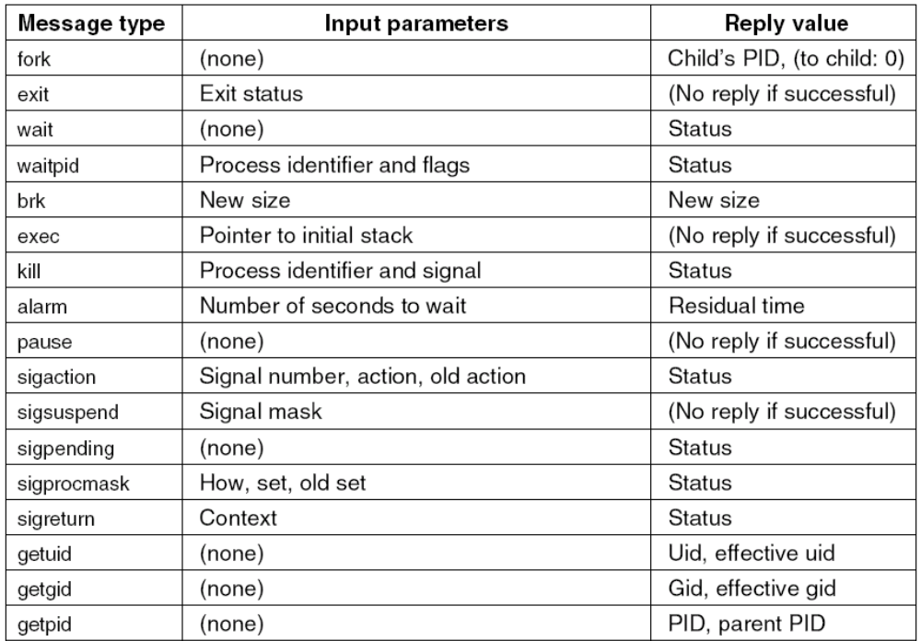
Process Manager Data Structures and Algorithms (1)
Figure 4-32. The message types, input parameters, and reply values used for communicating with the PM.
Tanenbaum & Woodhull, Operating Systems: Design and Implementation, (c) 2006 Prentice-Hall, Inc. All rights reserved. 0-13-142938-8

Slide 79
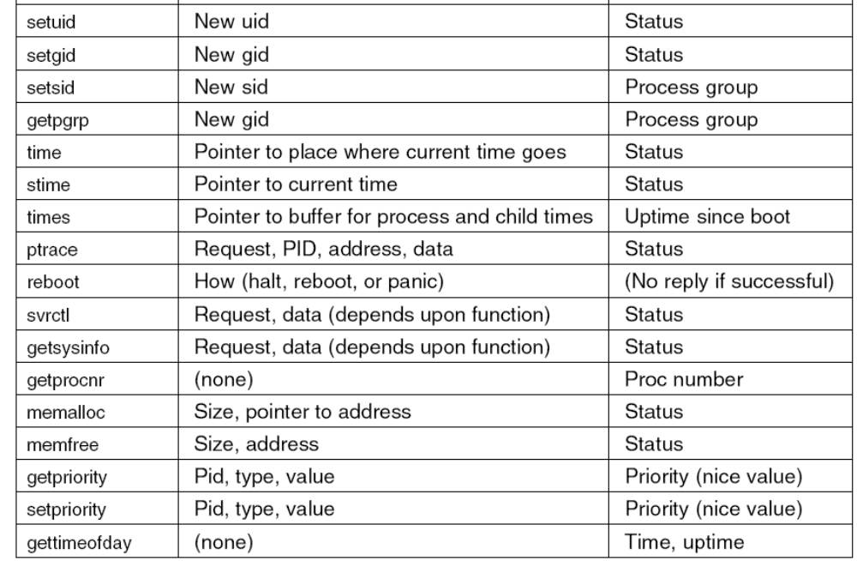
Process Manager Data Structures and Algorithms (2)
. . .
Figure 4-32. The message types, input parameters, and reply values used for communicating with the PM.
Tanenbaum & Woodhull, Operating Systems: Design and Implementation, (c) 2006 Prentice-Hall, Inc. All rights reserved. 0-13-142938-8

Slide 80
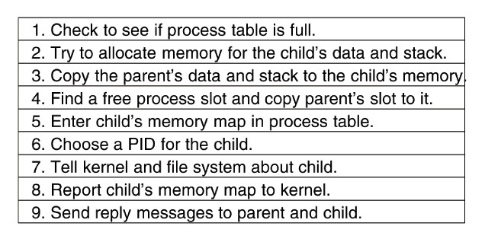
FORK System Call
Figure 4-36. The steps required to carry out the fork system call.
Tanenbaum & Woodhull, Operating Systems: Design and Implementation, (c) 2006 Prentice-Hall, Inc. All rights reserved. 0-13-142938-8

Slide 81
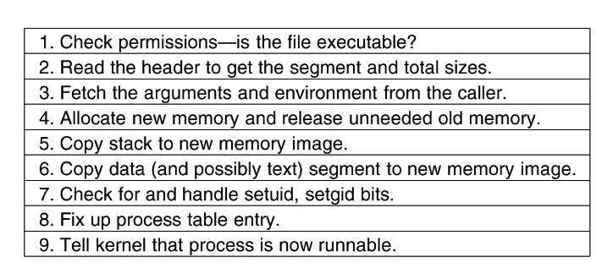
EXEC System Call (1)
Figure 4-37. The steps required to carry out the exec system call.
Tanenbaum & Woodhull, Operating Systems: Design and Implementation, (c) 2006 Prentice-Hall, Inc. All rights reserved. 0-13-142938-8

Slide 82
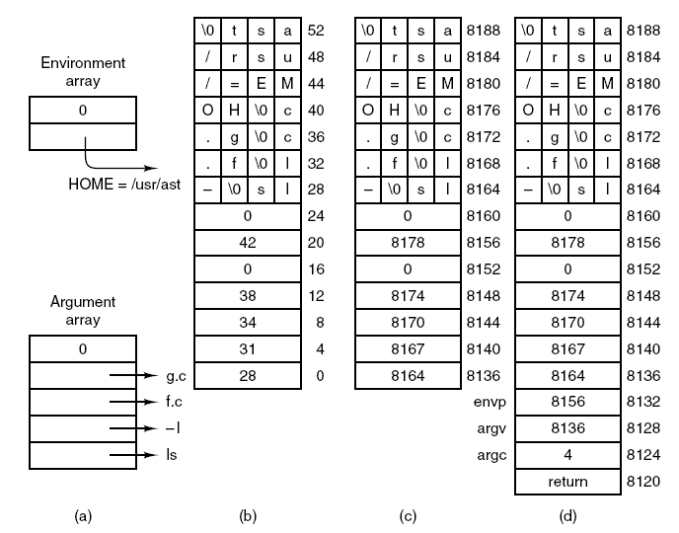
EXEC System Call (2)
Figure 4-38. (a) The arrays passed to execve. (b) The stack built by execve. (c) The stack after relocation by the PM. (d) The stack as it appears to main at start of execution.
Tanenbaum & Woodhull, Operating Systems: Design and Implementation, (c) 2006 Prentice-Hall, Inc. All rights reserved. 0-13-142938-8

Slide 83
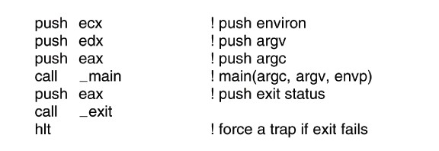
EXEC System Call (3)
Figure 4-39. The key part of crtso,
the C run-time, start-off routine.
Tanenbaum & Woodhull, Operating Systems: Design and Implementation, (c) 2006 Prentice-Hall, Inc. All rights reserved. 0-13-142938-8

Slide 84
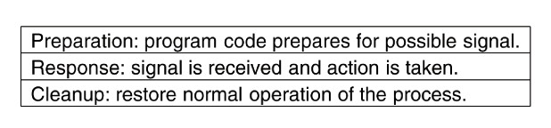
Signal Handling (1)
Figure 4-40. Three phases of dealing with signals.
Tanenbaum & Woodhull, Operating Systems: Design and Implementation, (c) 2006 Prentice-Hall, Inc. All rights reserved. 0-13-142938-8

Slide 85
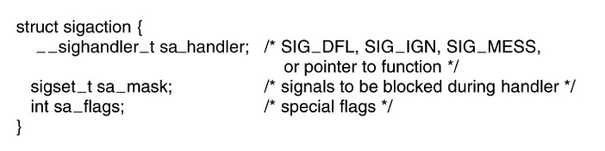
Signal Handling (2)
Figure 4-41. The sigaction structure.
Tanenbaum & Woodhull, Operating Systems: Design and Implementation, (c) 2006 Prentice-Hall, Inc. All rights reserved. 0-13-142938-8

Slide 86
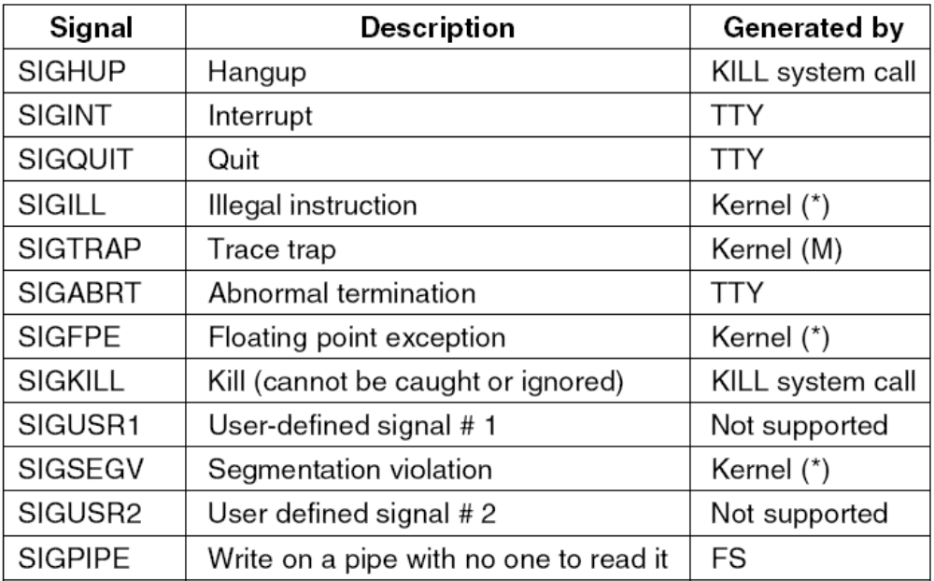
Signal Handling (3)
Figure 4-42. Signals defined by POSIX and MINIX 3. Signals indicated by (*) depend on hardware support. Signals marked (M) not defined by POSIX, but are defined by MINIX 3 for compatibility with older programs. Signals kernel are MINIX 3 specific signals generated by the kernel, and used to inform system processes about system events. Several obsolete names and synonyms are not listed here.
Tanenbaum & Woodhull, Operating Systems: Design and Implementation, (c) 2006 Prentice-Hall, Inc. All rights reserved. 0-13-142938-8

Slide 87
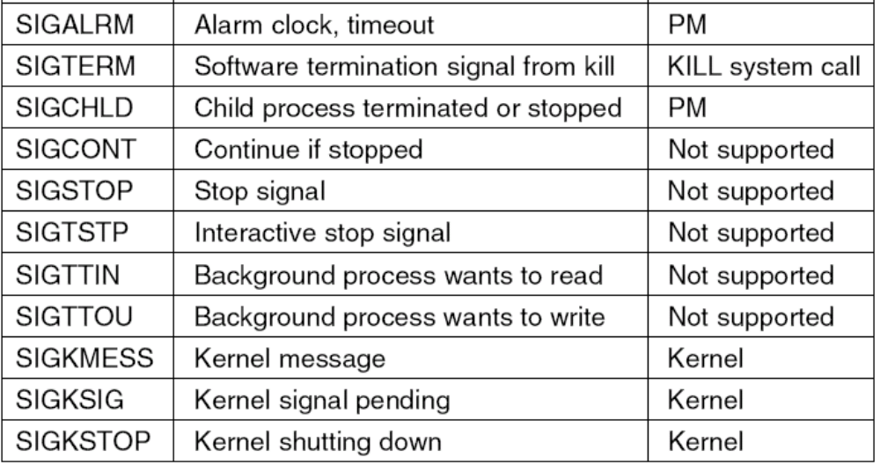
Signal Handling (4)
Figure 4-42. Signals defined by POSIX and MINIX 3. Signals indicated by (*) depend on hardware support. Signals marked (M) not defined by POSIX, but are defined by MINIX 3 for compatibility with older programs. Signals kernel are MINIX 3 specific signals generated by the kernel, and used to inform system processes about system events. Several obsolete names and synonyms are not listed here.
Tanenbaum & Woodhull, Operating Systems: Design and Implementation, (c) 2006 Prentice-Hall, Inc. All rights reserved. 0-13-142938-8

Slide 88
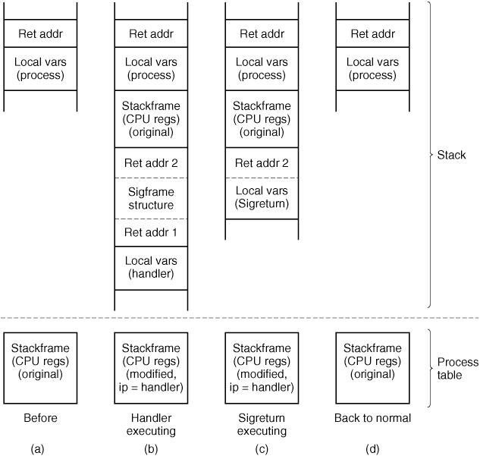
Signal Handling (5)
Figure 4-43. A process’ stack (above) and its stackframe in the process table (below) corresponding to phases in handling a signal. (a) State as process is taken out of execution. (b) State as handler begins execution. (c) State while sigreturn is executing. (d) State after sigreturn completes execution.
Tanenbaum & Woodhull, Operating Systems: Design and Implementation, (c) 2006 Prentice-Hall, Inc. All rights reserved. 0-13-142938-8

Slide 89
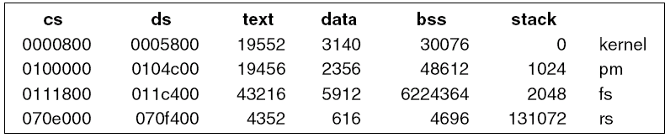
Initialization of Process Manager
Figure 4-44. Boot monitor display of memory usage of first few system image components.
Tanenbaum & Woodhull, Operating Systems: Design and Implementation, (c) 2006 Prentice-Hall, Inc. All rights reserved. 0-13-142938-8

Slide 90
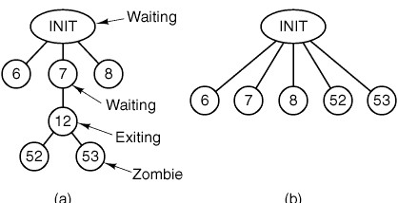
Implementation of EXIT
(a)
(b)
Figure 4-45. (a) The situation as process 12 is about to exit.
(b) The situation after it has exited.
Tanenbaum & Woodhull, Operating Systems: Design and Implementation, (c) 2006 Prentice-Hall, Inc. All rights reserved. 0-13-142938-8

Slide 91
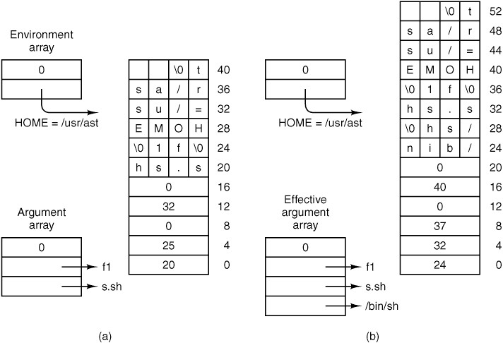
Implementation of EXEC
Figure 4-46. (a) Arrays passed to execve and the stack created when a script is executed. (b) After processing by patch_stack, the arrays and the stack look like this. The script name is passed to the program which interprets the script.
Tanenbaum & Woodhull, Operating Systems: Design and Implementation, (c) 2006 Prentice-Hall, Inc. All rights reserved. 0-13-142938-8

Slide 92
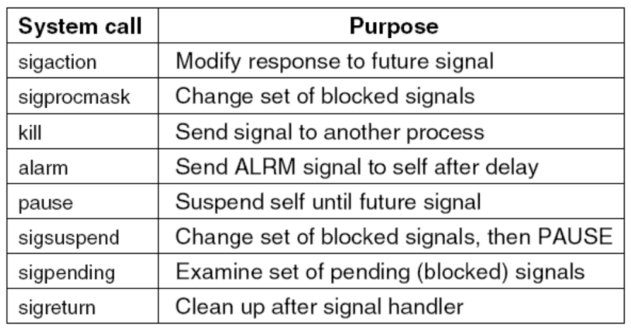
Signal Handling (1)
Figure 4-47. System calls relating to signals.
Tanenbaum & Woodhull, Operating Systems: Design and Implementation, (c) 2006 Prentice-Hall, Inc. All rights reserved. 0-13-142938-8

Slide 93
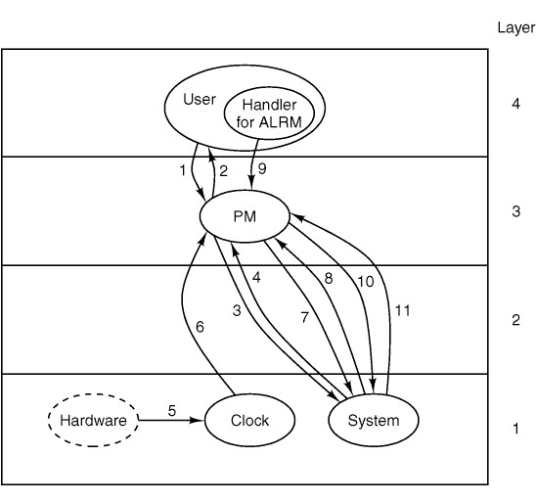
Signal Handling (2)
Figure 4-48. Messages for an alarm. The most important are: (1) User does alarm. (4) After the set time has elapsed, the signal arrives. (7) Handler terminates with call to sigreturn. See text for details.
Tanenbaum & Woodhull, Operating Systems: Design and Implementation, (c) 2006 Prentice-Hall, Inc. All rights reserved. 0-13-142938-8

Slide 94
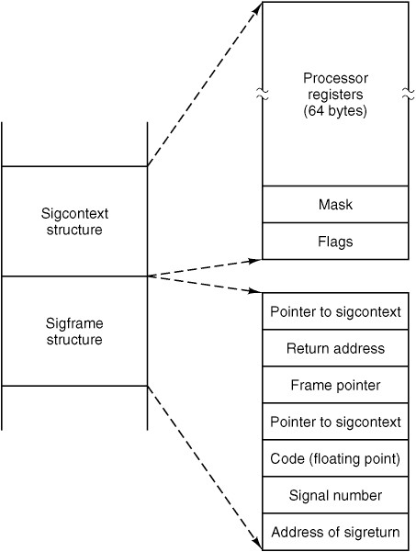
Signal Handling (3)
Figure 4-49. The sigcontext and sigframe structures pushed on the stack to prepare for a signal handler. The processor registers are a copy of the stackframe used during a context switch.
Tanenbaum & Woodhull, Operating Systems: Design and Implementation, (c) 2006 Prentice-Hall, Inc. All rights reserved. 0-13-142938-8

Slide 95

Other System Calls (1)
Figure 4-50. Three system calls involving time.
Tanenbaum & Woodhull, Operating Systems: Design and Implementation, (c) 2006 Prentice-Hall, Inc. All rights reserved. 0-13-142938-8

Slide 96

Other System Calls (2)
Figure 4-51. The system calls supported in servers/pm/getset.c.
Tanenbaum & Woodhull, Operating Systems: Design and Implementation, (c) 2006 Prentice-Hall, Inc. All rights reserved. 0-13-142938-8

Slide 97

Other System Calls (3)
Figure 4-52. Special-purpose MINIX 3 system calls in servers/pm/misc.c.
Tanenbaum & Woodhull, Operating Systems: Design and Implementation, (c) 2006 Prentice-Hall, Inc. All rights reserved. 0-13-142938-8

Slide 98

Other System Calls (4)
Figure 4-53. Debugging commands supported by servers/pm/trace.c.
Tanenbaum & Woodhull, Operating Systems: Design and Implementation, (c) 2006 Prentice-Hall, Inc. All rights reserved. 0-13-142938-8

Slide 99
Memory Management Utilities
Three entry points of alloc.c
alloc_mem – request a block of memory of given size
free_mem – return memory that is no longer needed
mem_init – initialize free list when PM starts running
Tanenbaum & Woodhull, Operating Systems: Design and Implementation, (c) 2006 Prentice-Hall, Inc. All rights reserved. 0-13-142938-8

