Slide 1
The Theory of NP
Tractable and intractable problems
NP, NP-complete & NP-hard problems

Slide 2
The theory of NP-completeness
Tractable and intractable problems
NP-complete problems

Slide 3
Classifying problems
Classify problems as tractable or intractable.
Problem is tractable if there exists at least one polynomial bound algorithm that solves it
An algorithm is polynomial bound if its worst case time complexity is bounded by a polynomial p(n) in the size n of the problem

Slide 4
Intractable problems
Problem is intractable if it is not tractable.
1st Category: All algorithms that solve the problem are not polynomial bound.
It has a worst case growth rate f(n) which cannot be bound by a polynomial p(n) in the size n of the problem.
For intractable problems the bounds are:

Slide 5
Another set of intractable problems
2nd category: Undecidable problems
Cannot give a “yes” or “no” answer
E.g., Halting problem
No algorithm can be devised to solve the halting problem

Slide 6
Halting problem
Input: A string P and a string I. Consider P as a program and I as input to P.
Output: 1 if P halts on I; 0 if P does not halt on I (infinite loop)
Theorem (Turing circa 1940): There is no program to solve the halting problem. See next slide for proof.

Slide 7
Proof: Halting problem is undecidable
Proof: To reach a contradiction, assume that there exists a program Halt(P, I) that solves the halting problem. Halt(P, I) returns true if and only if P halts on I. Otherwise, it returns false. Using Halt(P, I), we construct the following program Z:
program (string x)
begin
If Halt (x, x) then
while(1) printf (“ha ha ha ”);
Else exit(0)
end

Slide 8
Case 1: Program Z halts on input Z. By the correctness of Halt, Halt(Z, Z) returns true. Thus, program Z loops forever on input Z, printing “ha ha ha ….” Contradiction.
Case 2: Program Z does not halt on input Z. Halt(Z, Z) returns false. Hence, program Z halts. Contradiction.

Slide 9
Why is this classification useful?
If problem is intractable, no point in trying to find an efficient algorithm that solves the problem with polynomial time complexity in the worst case
All algorithms will be too slow for large inputs.

Slide 10
Intractable problems
Turing showed some problems are so hard that no algorithm can solve them (undecidable)
Other researchers showed some decidable problems from automata, mathematical logic, etc. are intractable: Presburger arithmetic is doubly exponential
Halting Problem
No problem is known for certain to be in here
NP
P

Slide 11
Problems Proven to be Intractable
All Hamiltonian circuits: For a complete undirected graph, there are (n-1)! Circuits
Halting problem: Undecidable
Presburger Arithmetic
…

Slide 12
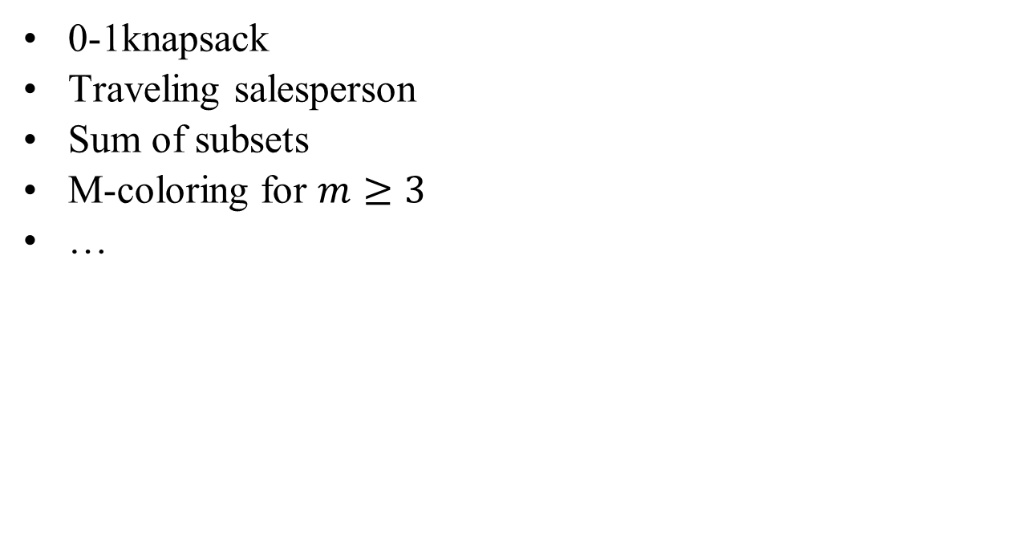
Problems not proven to be intractable but no poly. time alg.
A Hamiltonian circuit or path

Slide 13
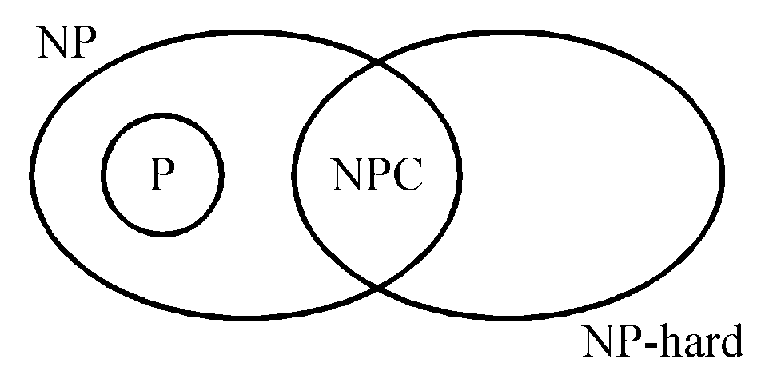
NP : the class of problem which can be solved by a non-deterministic polynomial algorithm.
P: the class of problems which can be solved by a deterministic polynomial algorithm.
NP-hard: the class of problems to which every NP problem reduces.
NP-complete (NPC): the class of problems which are NP-hard and belong to NP.

Slide 14
Coping with NP-Complete/NP-Hard Problems
Rely on approximation algorithms, heuristics, etc.
Sometimes we need to solve only a restricted version of the problem.
If the restricted problem is tractable, design an algorithm for the restricted version

Slide 15
Nondeterministic algorithms
A nondeterminstic algorithm consists of
phase 1: guessing
phase 2: checking
If the checking stage of a nondeterministic algorithm is of polynomial time-complexity, then this algorithm is called an NP (nondeterministic polynomial) algorithm.
NP problems: (must be decision problems)
e.g. searching, MST, sorting
satisfiability problem (SAT)
traveling salesperson problem (TSP)

Slide 16
Nondeterministic operations and functions
Choice(S) : arbitrarily chooses one of the elements in set S
Failure : an unsuccessful completion
Success : a successful completion
Nonderministic searching algorithm:
j ← choice(1 : n) /* guessing */
if A(j) = x then success /* checking */
else failure

Slide 17
A nondeterministic algorithm terminates unsuccessfully iff there exist no set of choices leading to a success signal.
The time required for choice(1 : n) is O(1)

Slide 18
Hard practical problems
There are many practical problems for which no one has yet found a polynomial bound algorithm.
Examples: 3-SAT, traveling salesperson, 0/1 knapsack, sum of subsets, graph coloring, bin packing etc.
Most design automation problems such as testing and routing.
Many OS, networks, database and graph problems.

Slide 19
Satisfiability (SAT) problem

Slide 20
Conjunctive Normal Form (CNF)
A literal is a variable or the negation of a var.
Example: The variable x is a literal, and its negation, ¬ x, is a literal.
A clause is a disjunction (an OR) of literals.
Example: (x ∨ y ∨ ¬ z) is a clause.
A formula is in Conjunctive Normal Form (CNF) if it is a conjunction (an AND) of clauses.
Example: (x ∨ ¬ z) ∧ (y ∨ z) is in CNF.
A CNF formula is a conjunction of disjunctions, i.e., a product (AND) of sums (OR) of literals.

Slide 21
SAT Problem Examples
Satisfiable?
YES
(x₁ ∨ ¬x₂ ∨ x₁)
YES
(x₁ ∨ x₂) ∧ (x₂ ∨ ¬x₃ ) ∧ ¬x₂
NO
(x₁ ∨ x₂ ) ∧ ¬x₁ ∧ ¬x₂

Slide 22
Definition: A CNF formula is a 3CNF-formula iff each clause has exactly 3 literals.
(x₁ ∨ ¬x₂ ∨ x₃) ∧ (x₄ ∨ x₂ ∨ x₅) ∧ ... ∧ (x₃ ∨ ¬x₂ ∨ ¬x₁)
clauses
A literal is a variable or the negation of a var.
A clause is a disjunction (an OR) of literals.
A formula is in Conjunctive Normal Form (CNF) if it is a conjunction (an AND) of clauses.
A CNF formula is a conjunction of disjunctions of literals.

Slide 23
Definition: A CNF formula is a 3CNF-formula iff each clause has exactly 3 literals.
φ = (x₁ ∨ ¬x₂ ∨ x₃) ∧ (x₄ ∨ x₂ ∨ x₅) ∧ ... ∧ (x₃ ∨ ¬x₂ ∨ ¬x₁)
clauses

Slide 24
Boolean Basics: Literals, Clauses, CNF
Boolean function on n variables is a mapping {0,1}^{n}→{0,1}
Literal = Boolean variable or its negation
Clause = disjunction of literals (no complementary pair)
Conjunctive Normal Form (CNF) = conjunction of clauses, i.e., product-of-sums (Fact: Every Boolean function has a CNF representation)

Slide 25
Cook’s theorem
SAT is NP-complete
3-SAT is NP-complete (1-SAT or 2-SAT is P)
It is the first NP-complete problem
Every NP problem reduces to SAT
NP = P iff the SAT problem is a P problem

Slide 26
How are they handled?
A variety of algorithms based on backtracking, branch and bound, dynamic programming, etc.
None can be shown to be polynomial bound (exponential in the worst case)

Slide 27
Theory of NP completeness
The theory of NP-completeness enables showing that these problems are at least as hard as NP-complete problems
Practical implication of knowing a problem is NP-complete is that it is probably intractable (whether it is or not has not been proved yet)
So any algorithm that solves it will probably be very slow for large inputs

Slide 28
We will need to discuss
Decision problems
Converting optimization problems into decision problems
The relationship between an optimization problem and its decision version
The class P
Verification algorithms
The class NP
The concept of polynomial transformations
The class of NP-complete problems

Slide 29
Decision Problems
A decision problem answers yes or no for a given input
Examples:
Given a graph G, is there a path from s to t of length at most k?
Does graph G contain a Hamiltonian cycle?
Given a graph G, is it bipartite?
For a 0-1 knapsack problem, is there a solution whose benefit is $100 or more?

Slide 30
A decision problem: HAMILTONIAN-CYCLE
A Hamiltonian cycle of a graph G is a cycle that visits each vertex of the graph (except for the starting node) exactly once.
Problem: Given a graph G, does G have a Hamiltonian cycle?

Slide 31
Converting to decision problems
Optimization problems can be converted to decision problems (typically) by adding a bound B on the value to optimize, and asking the question:
Is there a solution whose value is at most B? (for a minimization problem)
Is there a solution whose value is at least B? (for a maximization problem)

Slide 32
An optimization problem: traveling salesman
Given:
A finite set C = {c₁,...,c_{m}} of cities and
A distance function d(c_{i}, c_{j}) of nonnegative numbers
Find the length of the minimum distance tour which visits every city exactly once and comes back to the starting city

Slide 33
A decision problem for traveling salesman
Given a finite set C = {c₁,...,c_{m}} of cities, a distance function d(c_{i}, c_{j}) of nonnegative numbers and a bound B
Is there a tour of all the cities (in which each city is visited exactly once) with total length at most B?
There is no known polynomial bound algorithm for TS.

Slide 34
Relation between an optimization problem and the decision problem
If we have a solution to the optimization problem we can compare the solution to the bound and answer “yes” or “no”
Therefore if the optimization problem is tractable so is the decision problem
If the decision problem is “hard” the optimization problem is also “hard”
If the optimization is easy then the decision problem is easy

Slide 35
The class P
P is the class of decision problems that are polynomial bound
Is the following problem in P?
Given a weighted graph G, is there a spanning tree of weight at most B?
The decision versions of problems such as shortest distance path and minimum spanning tree belong to P
Simply compute an MST and compare its weight to B

Slide 36
The goal of verification algorithms
The goal of a verification algorithm is to verify a “yes” answer to a decision problem’s input (i.e., if the answer is “yes” the verification algorithm verifies this answer)
The inputs to the verification algorithm are:
the original input (problem instance) and
a certificate (possible solution)

Slide 37
Verification Algorithms
A verification algorithm takes a problem instance x and answers “yes”, if there exists a certificate y such that the answer for x with certificate y is “yes”
Consider HAMILTONIAN-CYCLE
A problem instance x lists the vertices and edges of G: ({1,2,3,4}, {(3,2), (2,4), (3,4), (4,1), (1, 3)})
There exists a certificate y = (3, 2, 4, 1, 3) for which the verification algorithm answers “yes”
1
4
2
3

Slide 38
Polynomial bound verification algorithms
Given a decision problem d
A verification algorithm for d is polynomial bound if given an input x to d, there exists a certificate y, such that |y|=O(|x|^{c}) where c is a constant, and a polynomial bound algorithm A(x, y) that verifies an answer “yes” for d with input x
Note: |y| is the size of the certificate, |x| is the size of the input

Slide 39
The problem PATH
PATH denotes the decision problem version of shortest path.
PATH: Given a graph G, a start vertex u, and an end vertex v. Does there exist a path in G, from u to v of length at most k?
The instance is: G=({A, B, C, D}, {(A, C,2), (A, D, 15), (C,D, 3), (D, B, 1)} k=6
A certificate y=(A, C, D, B)
A
B
15
1
2
D
C
3

Slide 40
A verification algorithm for PATH
Verification algorithm:
Given the problem instance x and a certificate y
Check that y is indeed a path from u to v.
Verify that the length of y is at most k
Is the verification algorithm for PATH polynomial bound?
Is the size of y polynomial in the size of x?
Is the verification algorithm polynomial bound?

Slide 41
Example: A verification algorithm for TS (Traveling Salesman)
Given a problem instance x for TS and a certificate y
Check that y is indeed a cycle that includes every vertex exactly once except for the starting node
Verify that the length of the cycle is at most B
Is the size of y polynomial in the size of x?
Is the verification algorithm polynomial?

Slide 42
The class NP (Nondeterministic Polynomial)
NP is the class of decision problems for which there is a polynomial bound verification algorithm
It can be shown that:
all decision problems in P, and
decision problems such as traveling salesman, knapsack, bin packing, are also in NP

Slide 43
The relation between P and NP
P ⊆ NP
It is not known whether P = NP or P ≠ NP
Problems in P can be solved “quickly”
Problems in NP can be verified “quickly”
It is easier to verify a solution than solving a problem
Some researchers believe that P and NP are not the same class (But no one has proved whether or not this is true)

Slide 44
Polynomial reductions
Motivation: The definition of NP-completeness uses the notion of polynomial reductions of one problem Α to another problem Β, written as
Α∝ Β
Let tran be a function that converts any input x for decision problem A into input tran(x) for decision problem Β

Slide 45
Polynomial reductions
tran is a polynomial reduction from Α to Β if:
1. tran can be computed in polynomial bound time
2. The answer to Α for input x is yes if and only if the answer to Β for input tran(x) is yes.
x
Algorithm for B
“yes” or “no”
tran
tran(x)
Algorithm for A

Slide 46
Two simple problems
Α: Given n Boolean variables with values x₁,…,x_{n}, does at least one variable have the value True?
Β: Given n integers i₁,…,i_{n} is max{i₁,…,i_{n}}>0?
Algorithm for B :
Check the integers one after the other.
If one is positive, stop and answer “yes”
If none is positive, stop and answer “no”.
Example:
n=4.
Given integers: -1, 0, 3, and 20.
Algorithm for B answers “yes”.
Given integers: -1, 0, 0, and 0.
Algorithm for B answers “no”.

Slide 47
Is there a transformation?
Can we transform an instance of Α into an instance of Β?
Yes.
tran(x)
for ( j =1; j =< n; j ++) if (x_{j} == true) i_{j}=1 else // x_{j}=false i_{j} = 0 T(false, false, true, false)= 0,0,1,0
Is this transformation polynomial bound? yes

Slide 48
Does it satisfy all the requirements?
Can we show that when the answer for an instance x₁,…,x_{n} of Α is “yes” the answer for the transformed instance tran(x₁,…,x_{n})= i₁,…,i_{n} of Β is also “yes”?
If the answer for the given instance x₁,…,x_{n} of Α is “yes”, there is some x_{j}=true.
The transformation assigns i_{j}=1.
Therefore the answer for problem B is also “yes”

Slide 49
The other direction
Can we also show that when the answer for problem B with input tran(x₁,…,x_{n})= i₁,…,i_{n} is “yes”, the answer for the instance x₁,…,x_{n} of Α is also “yes”?
If the answer for problem B is “yes”, it means that there is an i_{j} > 0 in the transformed instance.
i_{j} is either 0 or 1 in the transformed instance. If i_{j}=1, x_{j}=true.
So the answer for A is also “yes”

Slide 50
Polynomial reductions
Theorem:
If Α∝ Β and Β is in P, then Α is in P
If A is not in P then B is also not in P

Slide 51
NP-complete problems
A problem Α is NP-complete if
1. It is in NP and
2. For every other problem A’ in NP, Α’∝ Α
A problem Α is NP-hard if
For every other problem A’ in NP, Α’∝ Α
Example: Halting problem is NP-hard but not NP-complete. How to prove this?

Slide 52
Why is NP-complete important?
If any NP-complete problem is not polynomial bound, then all NP-Complete problems are not polynomial bound.
If any NP-complete problem is in P, then P = NP.
NP ≠ P
P = NP
NP-complete
NP-complete
P
The trival decision problem that always answers “yes” in here

Slide 53
NP-completeness and Reducibility
The existence of NP-complete problems leads us to suspect that P ≠NP.
If HAMILTONIAN CYCLE, which is an NP-complete problem, can be solved in polynomial time, every problem in NP can be solved in polynomial time. This means every problem in NP is polynomial bound and, therefore, P=NP.
If HAMILTONIAN CYCLE could not be solved in polynomial time, every NP-complete problem cannot be solved in polynomial time. Thus NP ≠ P

Slide 54
Revisit the SAT problem
First, Conjunctive Normal Form (CNF) will be defined
Second, satisfiability (SAT) problem will be defined
Finally, we will show a polynomial bounded verification algorithm for the problem

Slide 55
Conjunctive Normal Form (CNF)
A logical (Boolean) variable is a variable that may be assigned the value true or false (p, q, r and s are Boolean variables)
A literal is a logical variable or the negation of a logical variable (p and ¬q are literals)
A clause is a disjunction of literals
( (p∨q∨s) and (¬q ∨ r) are clauses)

Slide 56
Conjunctive Normal Form (CNF)
A logical (Boolean) expression is in CNF if it is a conjunction of clauses
The following expression is in conjunctive normal form:
(p∨q∨s) ∧(¬q ∨ r) ∧(¬p ∨ r) ∧(¬r ∨ s) ∧(¬p∨¬s∨¬q)

Slide 57
Satisfiability (SAT) problem
Is there a truth assignment to the n variables of a logical expression in CNF which makes the value of the expression true?
The answer is yes, if all clauses evaluate to true
Otherwise, the answer is “no”

Slide 58
SAT problem
p=T, q=F, r=T and s=T is a truth assignment for:
(p∨q∨s) ∧(¬q ∨ r) ∧(¬p ∨ r) ∧(¬r ∨ s) ∧(¬p∨¬s∨¬q)
Note that if q=F then ¬q=T
Each clause evaluates to true

Slide 59
A verification algorithm for SAT
1. Check that the certificate s is a string of exactly n characters which are T or F.
2. while (there are unchecked clauses) {
select next clause
if (clause evaluates to false) return( “no”) }
3. return (“yes”)
Is verification algorithm polynomial bound?
Satisfiability is in NP since there exists a polynomial bound verification algorithm for it

Slide 60
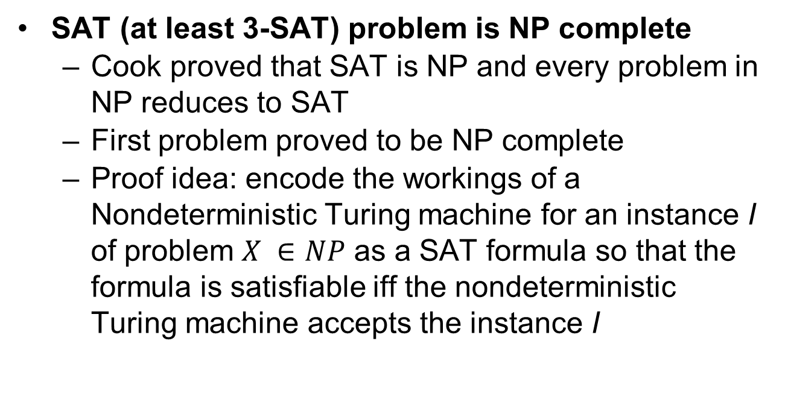
Cook’s theorem

Slide 61
After Cook’s theorem, many NP-complete problems are found
E.g., 3-SAT ∝ Clique, 3-SAT ∝ Hamiltonian Cycle Decision Problem, SAT ∝ 3-coloring, …
How to do this? See the following slides
More NP-complete problems are found from NP complete problems that are not 3-SAT
E.g., Hamiltonian circuit ∝ Traveling Salesperson, Clique ∝ vertex cover …

Slide 62
Shortcut for NP-completeness Proofs
To prove a problem L is NP-complete:
Prove L ∈ NP.
Choose L' ∈ NPC, and show L’∝ L
Transitivity

Slide 63
Reductions
For example, let’s discuss how to:
Reduce 3-SAT to Clique
Reduce Clique to Vertex Cover
Reduce 3-SAT to Hamiltonian Cycle
Reduce Hamiltonian Cycle to TSP

Slide 64
Clique
Show clique is a NP-complete problem via reduction

Slide 65
The Clique Problem
A clique is a complete undirected graph where every vertex is connected to every other vertex.
CLIQUE
Input: An undirected graph G and a positive integer k.
Output: YES iff a clique of size k exists in G.

Slide 66
Clique example
1
2
8
3
7
4
6
5
G contains a clique of 4 (with vertices 3, 5, 6, 7)
The 4 people 3, 5, 6, 7 “know” (can work with each other) each other

Slide 67
The Clique Problem
Theorem: CLIQUE is NP-complete.
Proof:
Step 1. CLIQUE ∈ NP
Given a certificate that contains a set of k vertices V' ⊆ V, we can check if V' forms a clique by checking for every pair of nodes u, v ∈V’ that (u,v) ∈ Ε
Clearly, this can be done in polynomial time.

Slide 68
The Reduction
Step 2. Selection
3-CNF-SAT which is NP-Complete.
Step 3. Mapping
For a formula C₁ ∧ ... ∧ C_{k} such that C_{r} = l_{1,r} ∨ l_{2,r} ∨ l_{3,r} we construct a graph G with vertices v_{1,r} v_{2,r} v_{3,r} for r = 1,…, k, where v_{i,r} represents the literal l_{i,r}

Slide 69
The Reduction
We put an edge between v_{i,r} and v_{j,s} if both of the following hold:
1. r ≠ s and
2. l_{i,r} is not the negation of l_{j,s}.

Slide 70
v_{1,1}
v_{1,2}
k=2
The graph has 6
cliques of size 2
v_{2,1}
v_{2,2}
v_{3,1}
v_{3,2}

Slide 71
Step 4a. Yes for 3-Sat implies yes for clique
Assume formula satisfiable.
With the satisfying assignment each clause contains at least 1 literal that is assigned 1.
Since each literal from each clause is a vertex in the graph, if we pick out a literal that is assigned 1 from each of the k clauses, we get k vertices in the graph.

Slide 72
Step 4a. Yes for 3-SAT implies yes for Clique
This set of k vertices is a clique.
For any two vertices, the corresponding literals are from different clauses, and are both assigned 1, so they cannot be complements of a single variable
Thus there is an edge between any two such vertices.

Slide 73
Step 4b. Yes for Clique implies yes for 3-Sat
Assume G has a clique V' of size k
No edge connects vertices in the same clause, so each of k triples has exactly one vertex in V'
Assign 1 to each literal in V' without getting an inconsistent assignment (why?), and assign arbitrary values to the rest of the variables
For this assignment, each clause is satisfied and thus the answer for 3-SAT is yes

Slide 74
Step 5. Reduction is polynomial
Step 5. The reduction is polynomial.
The formula is read and 3k vertices are generated in O(k) steps. Then, each pair of literals ( ) from two different clauses is checked and an edge is added if the literals are not complimentary.
The reduction is O(k²)

Slide 75
Vertex Cover
Reduce clique to vertex cover

Slide 76
The vertex-cover problem
A vertex cover of an undirected graph is a set of vertices V' such that for every edge (u,v), either u or v or both are in V'. The problem is to find a cover of minimum size.
VERTEX-COVER
Input: A graph G and a number k.
Output: YES iff G has a vertex cover of size k.

Slide 77
Example of a vertex cover problem
G
1
2
3
5
4
k=2

Slide 78
Application of vertex cover
What is the fewest # of guards we need to place in a museum to cover all the corridors? An airport to cover all the main walkways
Hall 1
Hall 5
Hall 2
Hall 3
Hall 6
Hall 4

Slide 79
The vertex-cover problem
Theorem: VERTEX-COVER is NP-complete.
Proof: Step 1. VERTEX-COVER ∈ NP (obvious algorithm, given a subset of vertices).
Step 2. We select CLIQUE (will show that CLIQUE ∝ VERTEX-COVER)

Slide 80
The reduction
Step 3. The mapping.
Given an instance of the CLIQUE problem <G, k> we output an instance <G’, |V|-k> of the VERTEX-COVER problem.
G’ has the same vertices as G and exactly those edges that are not in G.
It is easy to show the reduction is polynomial (step 5)

Slide 81
Reduction Example
G
G’
1
2
1
2
3
3
5
5
4
4
Clique {1,2} of
size 2
Cover {3,4,5} of
size 3

Slide 82
Step 4. Correctness of the reduction
Assume G has a clique C of size k.
In G’ there are no edges between any pair of vertices in C
G
G’
1
2
1
2
3
3
5
5
4
4

Slide 83
Step 4 cont
So all edges in G’ are between a node in C and a node in V-C, or two nodes in V-C.
So V-C is a vertex cover for G’.
G
G’
1
2
1
2
3
3
5
5
4
4

Slide 84
Step 4. Correctness of the reduction
Assume G’=(V, E’) has a vertex cover V' ⊆ V, where |V'| = |V|-k.
Thus for all u, v ∈ V-V’ (not in the cover), (u,v) ∉ E’ and thus (u,v) ∈ E
V-V' is thus a clique.
G
G’
1
2
1
2
3
3
5
5
4
4

Slide 85
Hamiltonian Cycle
A Hamiltonian cycle of a graph G is a cycle that contains each vertex in V exactly once. A graph is Hamiltonian if it has a Hamiltonian cycle.
HAM-CYCLE
Input: A graph G.
Output: YES iff G is Hamiltonian.
Theorem: HAM-CYCLE is NP-complete.
3-CNF-SAT ∝ HAM-CYCLE (proof omitted).

Slide 86
Traveling Salesperson
Reduce Hamiltonian Cycle to Traveling Salesperson

Slide 87
Traveling Salesman
A tour is a Hamiltonian cycle in a graph. We want the minimum cost tour in a weighted graph.
TSP:
Input: A graph G, weights c for edges and a positive integer k.
Output: YES iff G with weights c has a TS tour of cost at most k.

Slide 88
Traveling Salesman
Theorem: TSP is NP-complete.
Proof: Step 1: TSP is in NP
The certificate is a representation of the tour, for example a permutation of the cities.
This certificate can be verified easily by checking that all cities are included exactly once and that the sum of the distances between all pairs of consecutive tour nodes is k or less.
This can be done in polynomial time, so TSP ∈ NP.

Slide 89
The reduction
Step 2: Select HAM-CYCLE (We will show that HAM-CYCLE ∝ TSP).
Step 3: The reduction
Given an instance G of HAM-CYCLE, we construct a graph G' = (V, E'). G' is a complete graph and c(i,j) = 1 if (i,j) is an edge and 2 otherwise.
Find out if there is TSP with length n where n is the number of the vertices.

Slide 90
The reduction (example)
G
G’
1
1
2
1
1
2
1
2
1
2
1
3
2
3
5
4
5
1
4
1

Slide 91
The reduction (step 4)
If G has a Hamiltonian cycle h, each edge in h belongs to E and thus has cost 1 in G'. Thus h is a tour with cost n.
If G' has a tour of cost n, the tour must have edges from E (since any edge not in E adds 2 to the cost). Thus, the tour must be a Hamiltonian cycle in G.

Slide 92
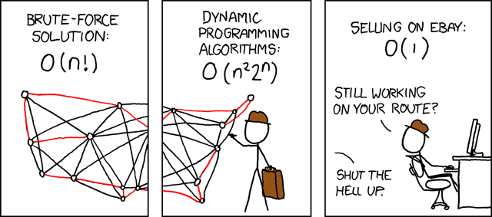
Questions?

