Slide 1

Cost Estimate Using Site Construction Drawing
AI-Powered Symbol Detection, Counting & Cost Estimation from Construction Drawing PDFs
Aziro · Product Walkthrough · 2026

Slide 2
The Problem
2
Manual quantity takeoff from construction drawings
▪ Slow & repetitive — Estimators manually count hundreds of tiny technical symbols (cameras, drops, drains, hatches…) across large multi-page drawing sets.
▪ Error-prone — Symbols are small, dense and look alike; missed or double-counted symbols directly distort the bid price.
▪ Inconsistent pricing — Unit costs live in spreadsheets; keeping counts × prices in sync across revisions is tedious.
▪ No audit trail — It is hard to prove where a number in the estimate came from, or to compare two drawing revisions objectively.
▪ Scale — A single school project can contain 10+ plan sheets, multiple wings and 50+ distinct device classes.

Slide 3
Our Solution
3
Upload a PDF — get a verified, costed estimate
▪ Automatic extraction — Symbol legend, requirement sheets and sheet notes pulled straight from the PDF.
▪ AI symbol detection — YOLO deep-learning models detect and count every legend symbol on every wing of every plan sheet.
▪ Instant costing — Counts are matched to the legend and priced from a maintained catalog — subtotal, tax and grand total in seconds.
▪ Human-in-the-loop — Visual overlay review lets an estimator correct the model in two clicks; corrections auto-save and feed accuracy tracking.
▪ Client-ready output — Printable estimate PDF with Bill-To, tax and validity — plus CSV export.
Input
One construction drawing PDF (any size — full bid sets supported)
Processing
Fully automatic 5-stage AI pipeline, ~minutes per drawing set
Output
Interactive report · corrected counts · estimate PDF / CSV / invoice

Slide 4
End-to-End Workflow
4
From drawing to estimate in five automatic steps
1. Extract Legend
& Requirements
2. Classify
Pages
3. Crop Diagrams
& Wings
4. Detect Symbols
(YOLO)
5. Price &
Invoice
▪ Extract — OCR + vision LLM read the symbol legend table and requirement sheets; every legend row keeps its drawn glyph image.
▪ Classify — Plan/diagram pages are identified; title blocks, notes and legends are excluded.
▪ Crop — Each diagram is split by wing/building name (e.g. B-WING-EAST) into high-resolution zoom tiles.
▪ Detect — The best YOLO model is auto-selected per drawing; detections are matched to legend numbers and verified.
▪ Price — Counts × unit prices from the pricing catalog → invoice JSON, CSV and printable PDF with tax.

Slide 5
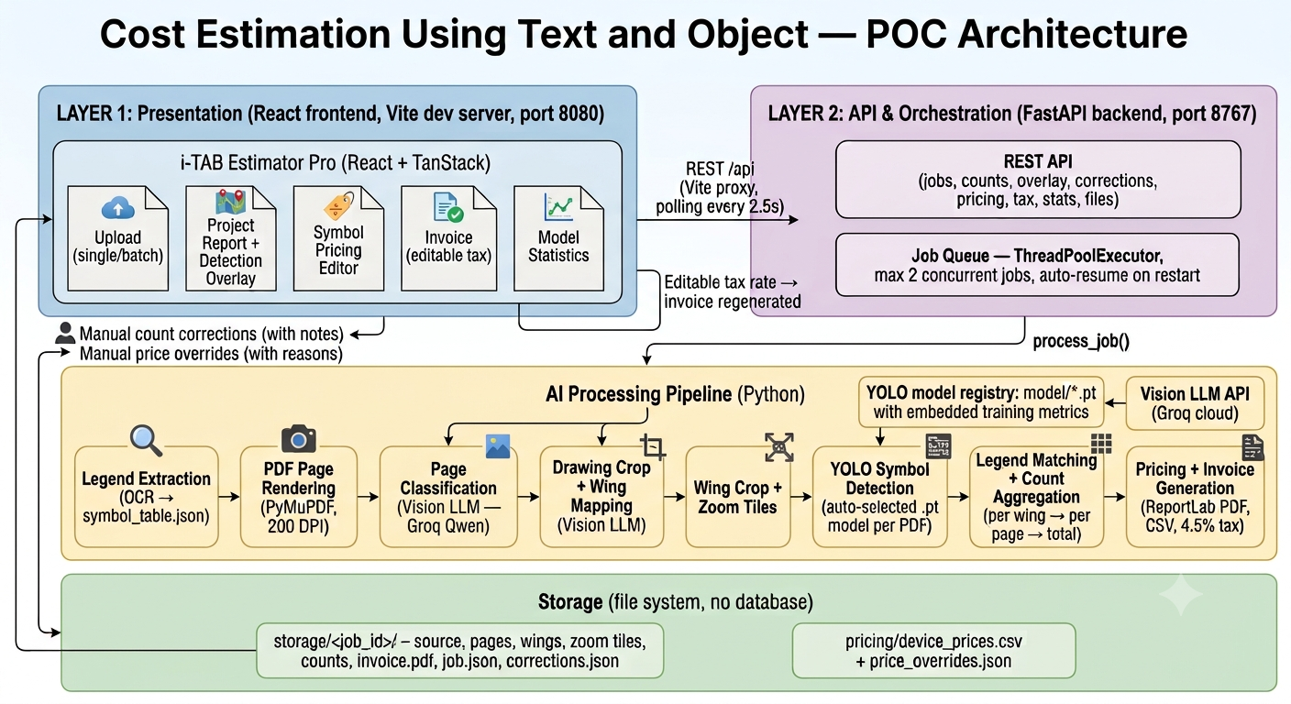
System Architecture
5
Three layers + AI pipeline + file-based storage

Slide 6
AI Processing Pipeline
6
What happens inside a job
1. Legend Extraction
OCR + PDF text layer → symbol_table.json + clean glyph PNG per row
5. Wing Crop + Zoom Tiles
588px tiles, 10% overlap per wing
2. Page Rendering
PyMuPDF, 200 DPI page images
6. YOLO Detection
Auto-selected .pt model; NMS + full-wing pass + verifier
3. Page Classification
Vision LLM (Groq) keeps plan/diagram sheets
7. Legend Match + Count
Detections → legend numbers → per-wing → totals
4. Drawing Crop + Wing Map
OpenCV crop; vision LLM finds wing anchors
8. Pricing + Invoice
Catalog prices, tax; PDF / CSV / JSON output

Slide 7
UI — Upload Drawings
7
Home page: one PDF in, live progress out
▪ Drag & drop — PDF-only upload zone with validation and re-process support.
▪ Live progress card — Five pipeline steps with spinner, progress bar and ETA.
▪ Recent Uploads — Sortable, paginated table of all projects: size, time taken, status badge, invoice download, View Report.
▪ Resilient — Max 2 concurrent jobs; queued uploads wait; jobs auto-resume after a backend restart.
Status lifecycle
Queued → Processing (5 stages) → Complete / Failed
Same file re-uploaded = same project re-processed
For every project
Its own report, corrections, invoice PDF/CSV and full artifact folder on disk

Slide 8
UI — Project Report
8
Everything the AI found — visually verifiable
▪ Project metadata — File, pages, model used, legend rows, wings scanned, processing time.
▪ Detected symbols — Per-class tallies plus average / minimum detection confidence.
▪ Detection overlay — Wing images with color-coded bounding boxes and confidence tooltips; unmatched detections can be toggled.
▪ Symbol legend — Extracted legend rows with download of the technical-symbol PDF.
▪ Detailed costing report — Editable count, unit price and note per device line; model count always stays visible next to the human-corrected value.
▪ Exports — Invoice CSV and estimate PDF downloads.

Slide 9
Human-in-the-Loop Review
9
Correct the model in two clicks — on the drawing itself
▪ Remove false positive — Click any detection box → count −1, with an auto note.
▪ Add missed symbol — Pick a class, click the drawing where it sits → count +1, marker drawn at that spot.
▪ Auto-save — Corrections persist ~2.5 s after the last edit — nothing is lost on refresh.
▪ Feedback loop — Saved corrections drive the live 'human-verified accuracy' metric on the Model Performance page.
Why it matters
The estimator stays in control: AI does the heavy counting, a human signs off — with a full audit trail of what changed and why.
Correction priority
Session edit > saved human correction > model value
(original model value is never overwritten)

Slide 10
UI — Invoice / Cost Estimate
10
Client-ready output
▪ A4-style estimate — Estimate number, issue date, validity window, From / Bill-To.
▪ Editable client block — Name, address, contact — server PDF regenerates on save.
▪ Editable tax rate — Click the tax row, enter %, invoice JSON/CSV/PDF rebuilt.
▪ Print & download — Print-friendly styling; one-click estimate PDF download.
▪ Multi-currency display — USD base with EUR / GBP / INR / AED display conversion.
Estimate contents
Line items (device, qty, unit, unit cost, line total)
Subtotal → Tax → Grand total
Generated from the corrected counts — the estimate always matches what the estimator approved on the Report page.

Slide 11
UI — Pricing Catalog
11
Unit costs with real legend symbols
▪ Symbol image per device — Each row shows the actual drawn symbol, sourced first from the extracted symbol legend (clean vector-quality glyphs); hover to enlarge.
▪ Smart matching — Legend matching tolerates abbreviations (FACP, STC, NVR), initials and misspellings between model class names and legend text.
▪ Full catalog — Every trained device class with description, unit and price — searchable, sortable, paginated.
▪ Locked manual prices — Click a price to edit with a reason; edited prices are marked 'manual' and never drift on refresh.
▪ Single source of truth — Catalog lives in pricing/device_prices.csv and feeds every invoice build.

Slide 12
UI — Model Performance Dashboard
12
Accuracy, transparency, trust
▪ KPIs — Total symbols detected, drawings processed, average processing time, active model.
▪ Charts — Detections by class and per-class detection share.
▪ Class-wise table — Symbol image, trained-in models, and training mAP50 / Precision / Recall meters per class.
▪ Model inventory — Every .pt weight file with size, date, classes and active flag.
Two views of accuracy
Training accuracy — mAP50 / precision / recall embedded in each model checkpoint.
Human-verified accuracy — computed live from estimator corrections: 1 − |model − human| ÷ human, across all verified lines.
Together they show how the model performs in the lab AND on real jobs.

Slide 13
UI — Project Comparison
13
Two drawings side by side
▪ Pick any two projects — e.g. two revisions of the same school, or two similar buildings.
▪ Metadata side-by-side — Pages, wings, models, processing time.
▪ Symbol count deltas — Per-class counts with differences highlighted.
▪ Cost impact — Line-item and total cost deltas — the price of a design change is visible instantly.
Use cases
Revision impact — what did addendum #2 add to the bid?
Benchmarking — do two similar campuses carry similar device densities?
QA — a sudden count jump between revisions flags extraction issues early.

Slide 14
AI / ML Under the Hood
14
Models, data and the learning loop
YOLO symbol detectors
Multiple Ultralytics .pt models (roof + technology classes, 50+ device classes); best model auto-selected per drawing; NMS, tile overlap merging and a CNN verifier reduce false positives.
Vision LLM
Groq-hosted vision model classifies pages and finds wing name anchors; PDF text layer used wherever available.
Legend glyph extraction
Every legend row's drawn symbol is cropped, cleaned and stored — powering symbol displays and CV template matching.
Continuous improvement
Human corrections are stored per line and aggregated into accuracy metrics; datasets in Roboflow/YOLO format enable retraining (Colab pipeline included).

Slide 15
Tech Stack & Summary
15
Frontend
React + TanStack Start/Router/Query, Tailwind CSS, Recharts — responsive, dark/light, multi-currency.
Backend
FastAPI (Python), ThreadPool job queue, auto-resume, file-based storage (no database needed for the POC).
AI
Ultralytics YOLO, CNN verifier, Groq vision LLM, PyMuPDF, OpenCV, Tesseract OCR.
Outputs
Interactive report · estimate PDF (ReportLab) · invoice CSV/JSON · full artifact folder per project.
Upload a drawing → verified counts → client-ready estimate. AI speed with estimator control.

