Slide 1
Linux Commands
Aniruddha Das

Slide 2
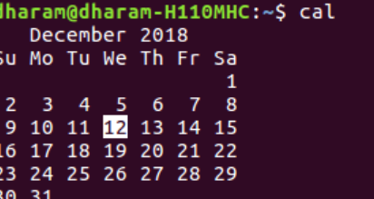
cal command is a calendar command in Linux which is used to see the calendar of a specific month or a whole year.
cal -y’: Shows the calendar of the complete current year with the current date highlighted.
cal [month] [year]’: Shows calendar of selected month and year. For example, ‘cal 08 2000′ displays the calendar for August 2000.

Slide 3
‘cal [year]’: Shows the whole calendar of the year. For example, ‘cal 2018‘ displays the calendar for the year 2018.
‘cal -3’: Shows calendar of previous, current and next month
‘cal -j’: Shows the calendar of the current month in the Julian calendar format not in the default Gregorian calendar format.

Slide 4
who command is used to find out the following information :
Time of last system boot
Current run level of the system
List of logged-in users and more.
who –b : This option tells to print the time of last system boot
who –a :This option tells to print all information.
who –d : This option tells to get a list of all dead processes.
who –q :This option tells the count of currently logged in users.
who –r :This option tells to show the current run level .

Slide 5
The mkdir command creates a directory in the current working directory, unless some other path is specified.
Using the -v (verbose) option, we can get the mkdir command to tell us what it is doing in the background so we can see it in action.
Creating multiple directory using the command:$ mkdir directory03 directory04
Creating parent directories mkdir -p directory1/directory2/directory3
Use the --version option to display the version number and some additional information about the license and exits.

Slide 6
The ‘cd’ command allows users to change their current working directory within the file system
cd/: Root directory
cd dir1/dir2/dir3: Move inside directory from a directory
cd ~ :Change Directory to Home Directory From Any Location

Slide 7
The ‘rmdir' command in Linux is specifically designed for removing empty directories.
Option | Description
--ignore-fail-on-non-empty | It prevents the errors if the directory is not empty.
-p or --parents | It will removes the directory and its parent directories if they are empty.
-v or --verbose | It helps in displaying the message for each directory that is removed.
--help | It will displays the helpful information and exits.
--version | It displays version information and exits.

Slide 8
The $ is a common symbol used to represent the shell prompt for regular users
$HOME refers to the home directory of the current user.
$USER refers to the current username

Slide 9
The Linux home directory is a directory for a particular user of the system and consists of individual files.
$HOME

