Slide 1
Black Friday Sales Prediction
Group 22
Tenzin Palbar 20210165
Shankar Aniruddh Tejomurtula 20210689
Shubham Verma 20210906
Gelmis Bartulis 20213041

Slide 2
Content
Problem Statement
Dataset Overview
Literature Review
EDA
Data Preparation
Model Implementation
Reference

Slide 3
Problem Statement
Analysis and Comparison of Prediction Model on Black Friday Sales Data
Create a Machine Learning algorithm to predict the customer spending on various products based on demographic features.

Slide 4
Dataset Overview
Kaggle: https://www.kaggle.com/sdolezel/black-friday
train.csv (550069 rows and 12 columns)
test.csv (233600 rows and 11 columns)
Since we do not have the actual values for test.csv, we would only be using train.csv for training and testing.

Slide 5
Variable | Definition | Value Example
User_ID | User ID | 1000001, 1000032
Product_ID | Product ID | P00332342, P00032842
Gender | User’s gender or sex | F,M
Age | Age in bins | 0-17, 26-35, 55+
Occupation | Occupation (Masked) | 1,9,20
City_Category | Category of the user’s city | A,B,C
Stay_In_Current_City_Years | Duration in years a user stays in current city | 2,4+
Marital_Status | Marital status | 0,1
Product_Category_1 | Product category (Masked) | 2,8,15
Product_Category_2 | Product category (Masked) | 11,15,16
Product_Category_3 | Product category (Masked) | 14,15,16
Purchase | Purchase amount (Target Variable) | 1057,19215

Slide 6
Literature Review
Ref. | Dataset | Models | Evaluation Metrics
[1] | Same | SVM, Random forest, Gradient Boosting, XGBoost | RMSE
[2] | Same | XGBoost, TfidfTransform, XGBoost + TfidfTransform, ExtraTreesRegressor | RMSE
[3] | Same | Linear Regression, MLK Classifier, Deep Learning Model Using Keras, Decision Tree, Decision Tree with Bagging, XGBoost (Data transformation, missing value imputation with 0) | RMSE

Slide 7
Exploratory Data Analysis (EDA)
Univariate and Bivariate Analysis (distribution of features with Purchase)
Product_Category_2 and Product_Category_3 have missing rows values of 32% and 70% respectively
We’ve dropped Product_Category_3 due to the massive number of missing values
Missing values Imputation
Compared 0, Median, Prob. Distribution of non-missing values
Notes:
Expenditure variation with respect to other attributes.

Slide 8
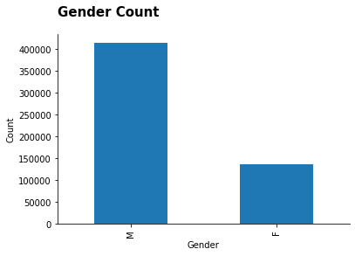
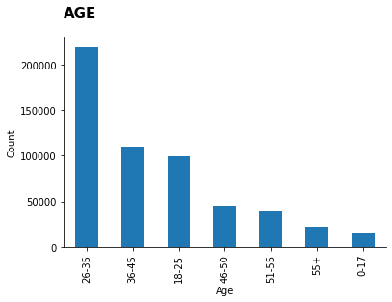
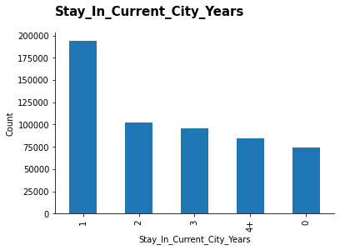
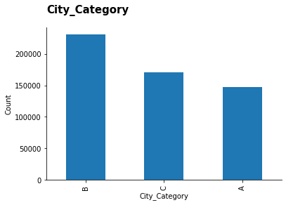
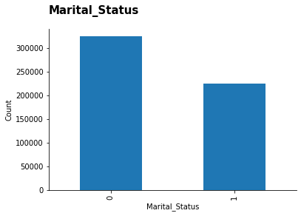
Univariate Analysis

Slide 9
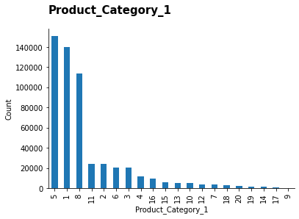
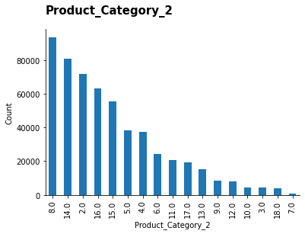
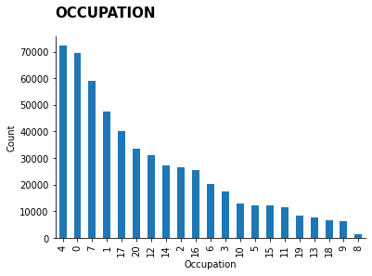
Univariate Analysis

Slide 10
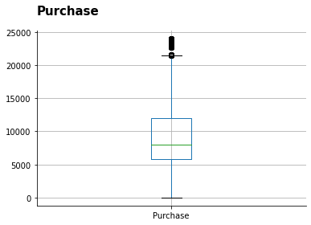
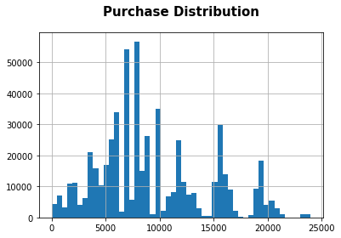
Purchase

Slide 11
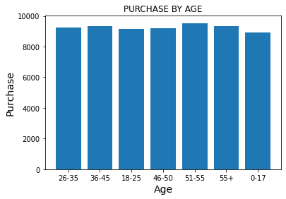
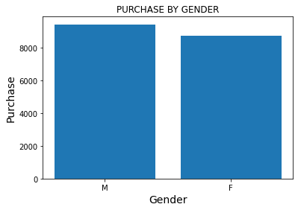
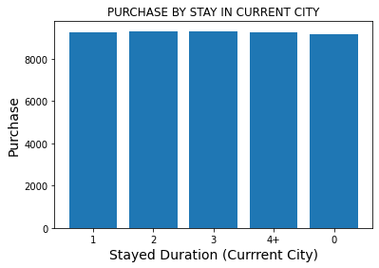
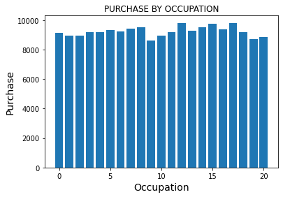
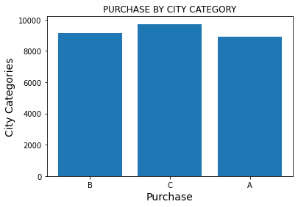
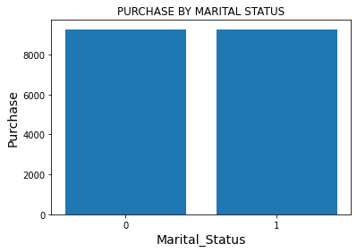
Mean Purchase for each category

Slide 12
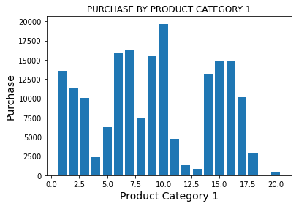
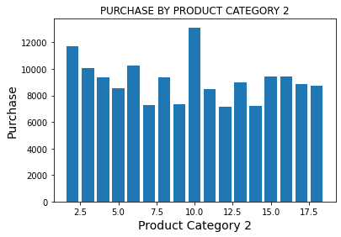
Mean Purchase for each category contd.

Slide 13
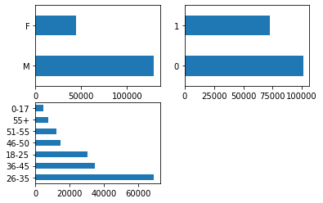
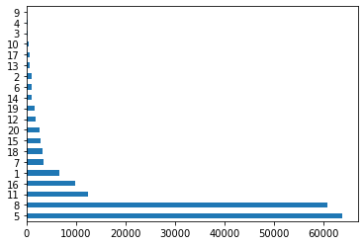
Missing Value Imputation
These graphs indicate the distribution of Gender, Marital Status, Age and Product_Category_1 for the missing rows of Product_Category_2.
They seem similar to the distribution of the overall dataset, and hence the values in Product_Category_2 seem to be MCAR.
Marital Status
Gender
Age
Product Category 1

Slide 14
Data Preparation
Mapping categorical features to numeric values directly. We then applied Ordinary Least Squares (OLS) and calculated the R-squared - 0.152
We then applied one-hot encoding, and after applying OLS, the R-squared turned out to be 0.64
After these results, we decided to use the one-hot encoded features and tried various models, based on literature.

Slide 15
Model Implementation
Model | Evaluation
 | MAE | R-squared | RMSE
Lasso Regression | 2281.29 | 0.64 | 3013.4
Ridge Regression | 2281.21 | 0.64 | 3013.4
Elastic Net Regression | 2435.37 | 0.60 | 3137.8
Linear Regression | 2266.7 | 0.64 | 3000.0
XGBoost | 2398.03 | 0.62 | 3088.1
Random Forest Regression | 2270.9 | 0.61 | 3114.9
Decision Tree Regression | 2379.2 | 0.56 | 3332.2

Slide 16
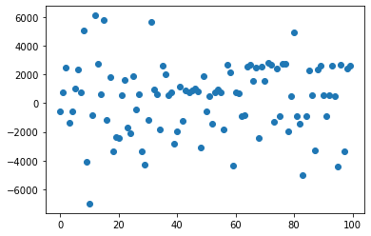
Error Analysis for Linear Regression
The errors seem to normally distributed with a mean close to 0.

Slide 17
References
[1].N. Duong Trung, D. Tan, T.-D. Luu, and H. Huynh, “Black Friday Sale Prediction via Extreme Gradient Boosted Trees”, AIR-Fundamental And Applied IT Research Conference, Huế, 2019, doi: 10.15625/vap.2019.0007.
[2].S. Kalra, B. Perumal, S. Yadav and S. J. Narayanan, "Analysing and Predicting the purchases done on the day of Black Friday", 2020 International Conference on Emerging Trends in Information Technology and Engineering (ic-ETITE), Vellore, India, 2020, pp. 1-8, doi: 10.1109/ic-ETITE47903.2020.256.
[3].C. M. Wu, P. Patil and S. Gunaseelan, "Comparison of Different Machine Learning Algorithms for Multiple Regression on Black Friday Sales Data", 2018 IEEE 9th International Conference on Software Engineering and Service Science (ICSESS), Beijing, China, 2018, pp. 16-20, doi: 10.1109/ICSESS.2018.8663760.

Slide 18
Thank You!

