Slide 1
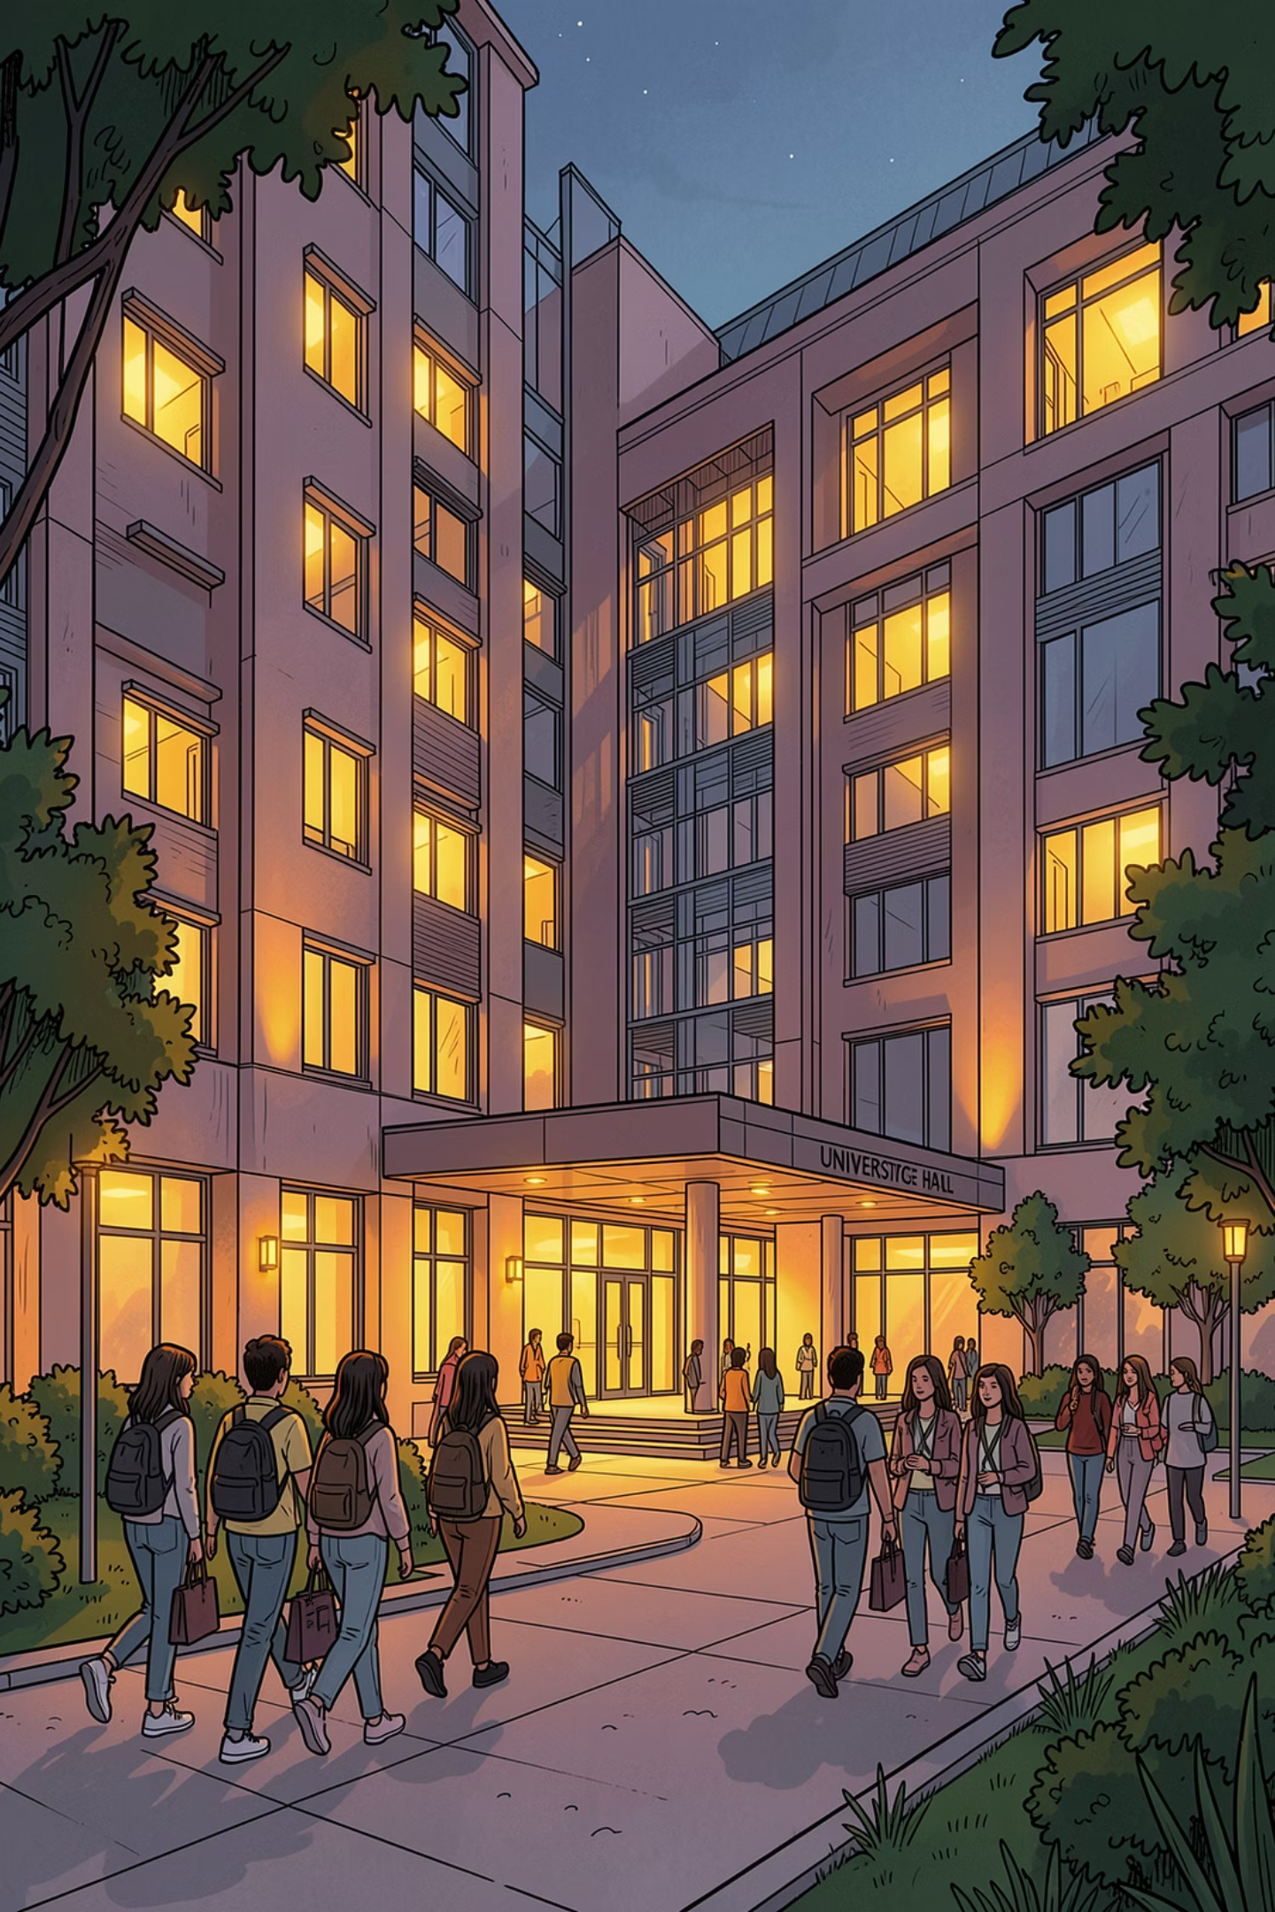

RUET Hall Management
Team Members:
Aniruddha 2203081 (Backend)
Ashfaq 2203161 (Student Panel)
Tareq 2203166 (Testing)
Sefat 2203172 (Teacher Panel)
Course : CSE 3100
Teacher: Utsha Das, Assistant Professor
Department of CSE, RUET

Slide 2
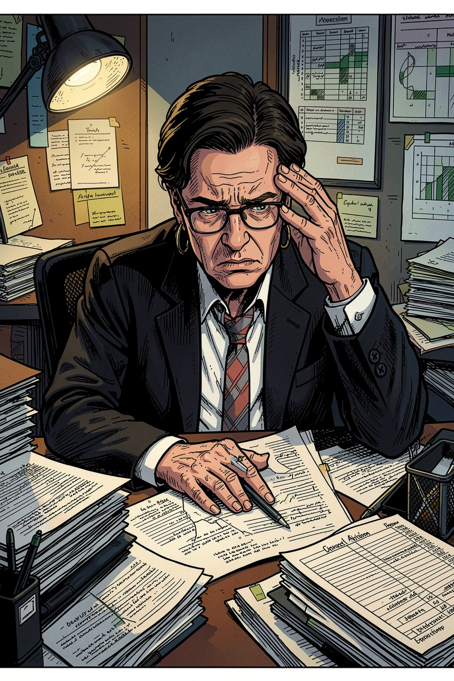
Current Problems:
❌ Paper-based applications
❌ Manual coupon management
❌ Slow complaint handling
❌ Difficult record tracking
↓
Need for Digital Hall Management

Slide 3
Objectives
Digitalize hall services
Centralize administration
Improve transparency
Reduce paperwork
Improve student experience

Slide 4
System Overview
Student
Web Application
Database
Admin Roles

Slide 5
System Overview
Student
Web Application
Database
Admin Roles
User Panel
Buy coupons Apply for seats Report issues
Admin Panel
Dining Management
Inventory Manage
Finance
Hall Allotment

Slide 6
Role-Based Access Control (RBAC)
Student
Coupons
Dining Manager
Menu
Meals
Provost
Hall Manage
Finance
DSW
Applications
Hall Allotment
Finance Manager
Inventory Manager

Slide 7
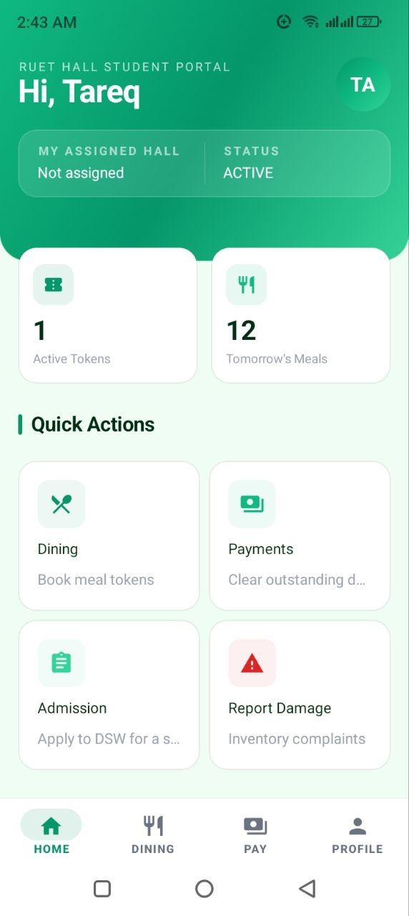
Student Panel Features
Dashboard

Slide 8
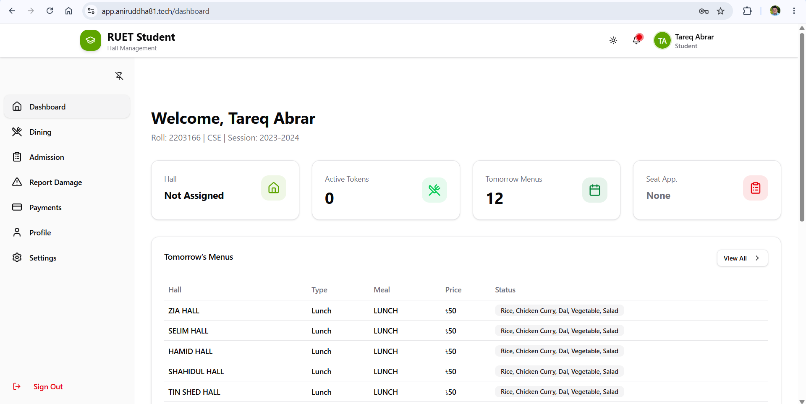
Student Panel Features
Dashboard

Slide 9
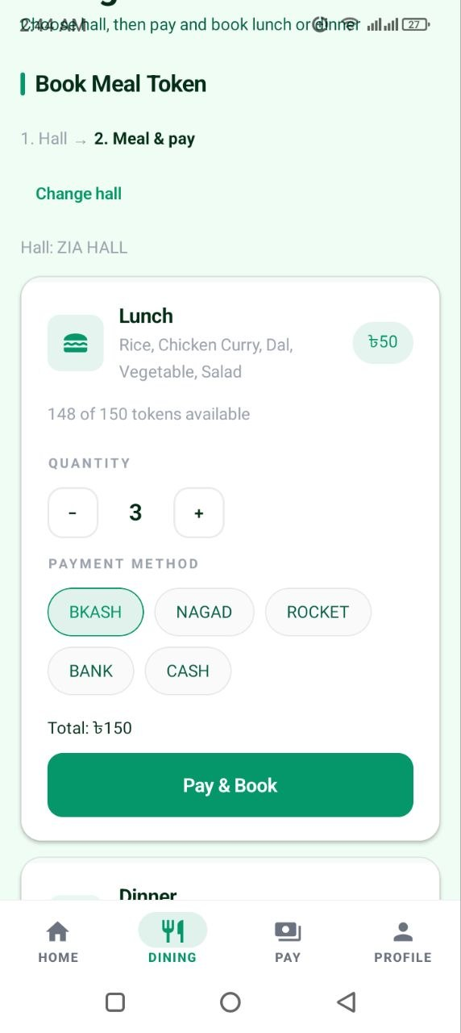
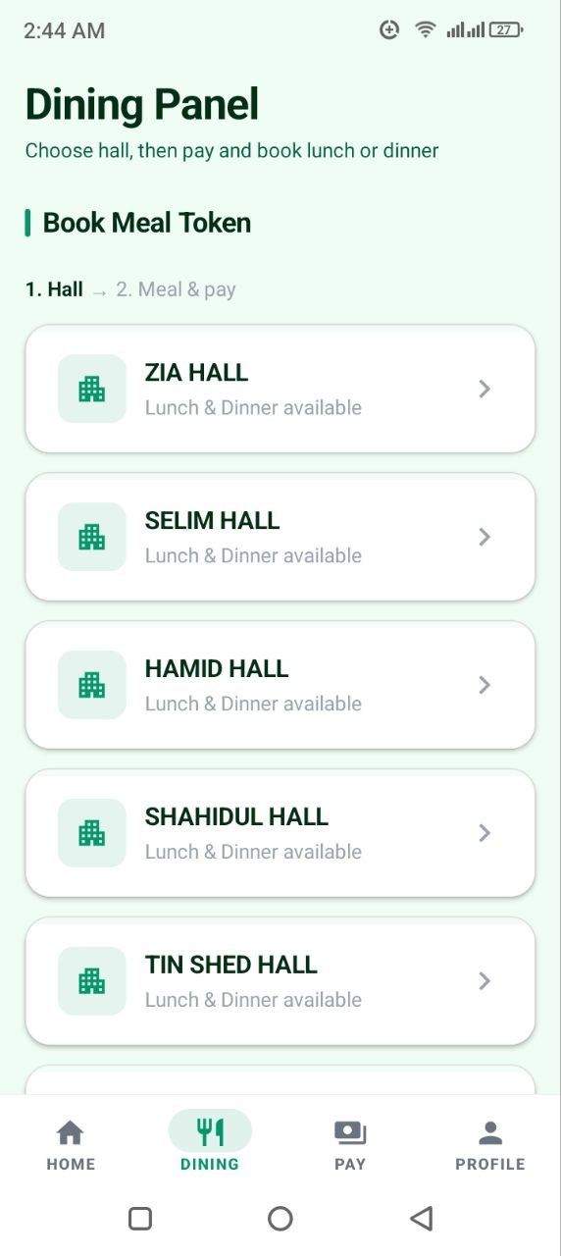
Coupon
Purchase
Student Panel Features

Slide 10
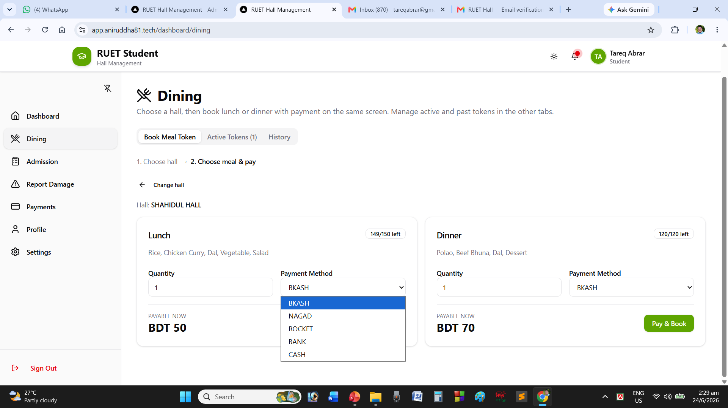
Coupon
Purchase
Student Panel Features

Slide 11
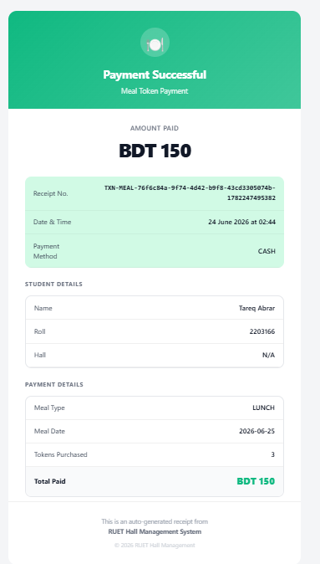
Coupon
Purchase
Student Panel Features
Token sent to email

Slide 12
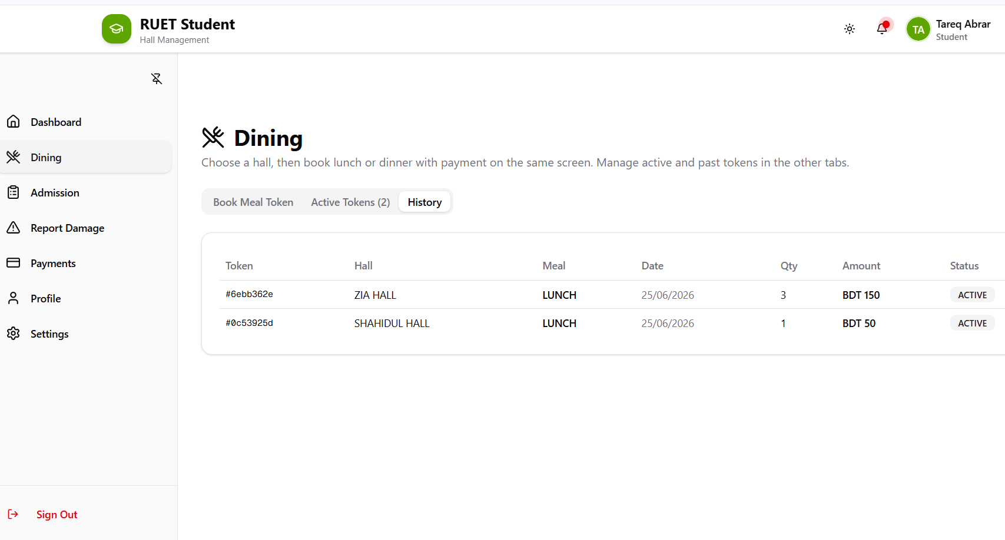
Coupon
History
Student Panel Features

Slide 13
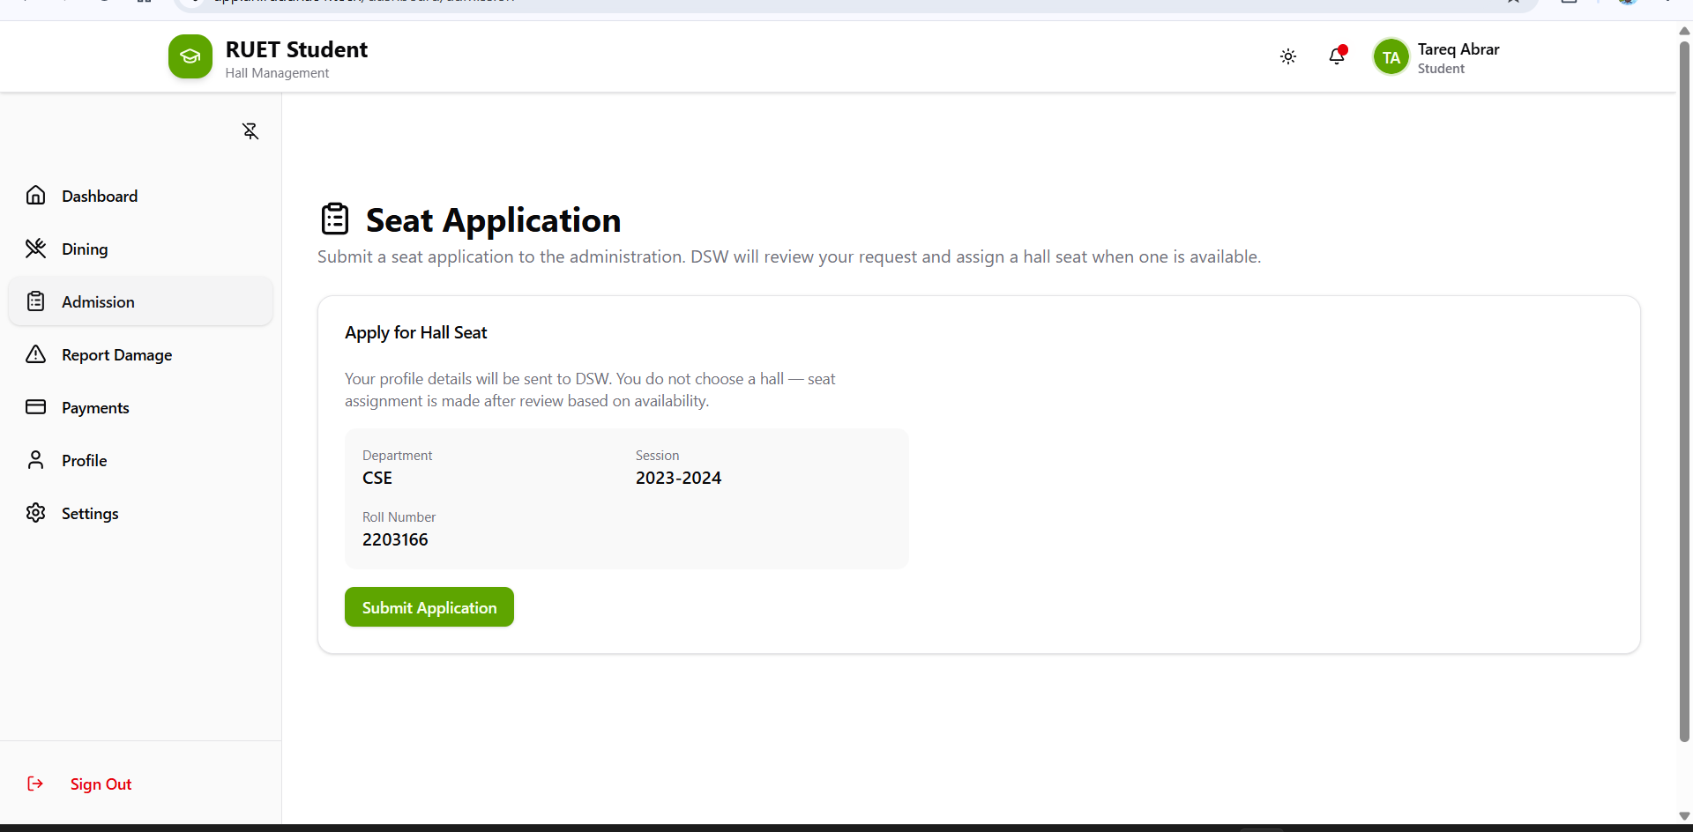
Seat
Application
Student Panel Features

Slide 14
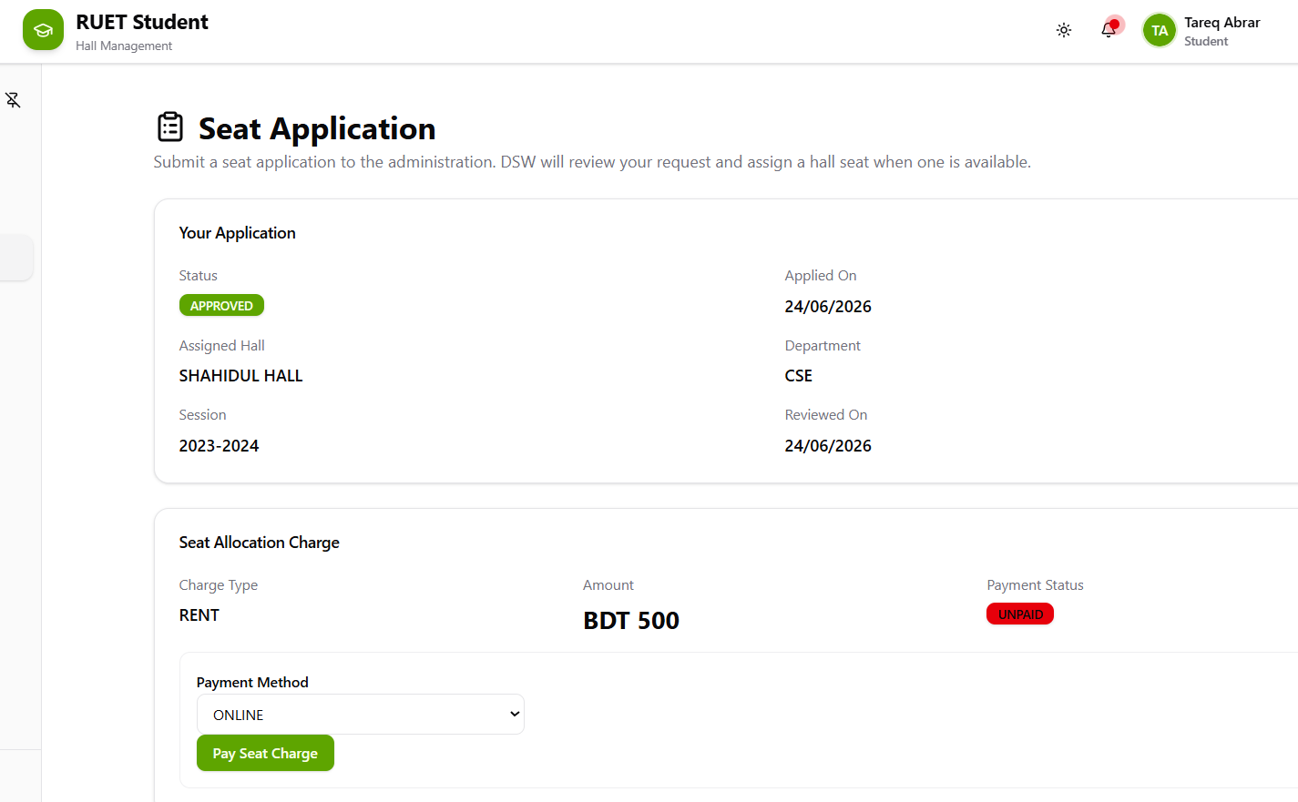
Seat
Application
After approval
Student Panel Features

Slide 15
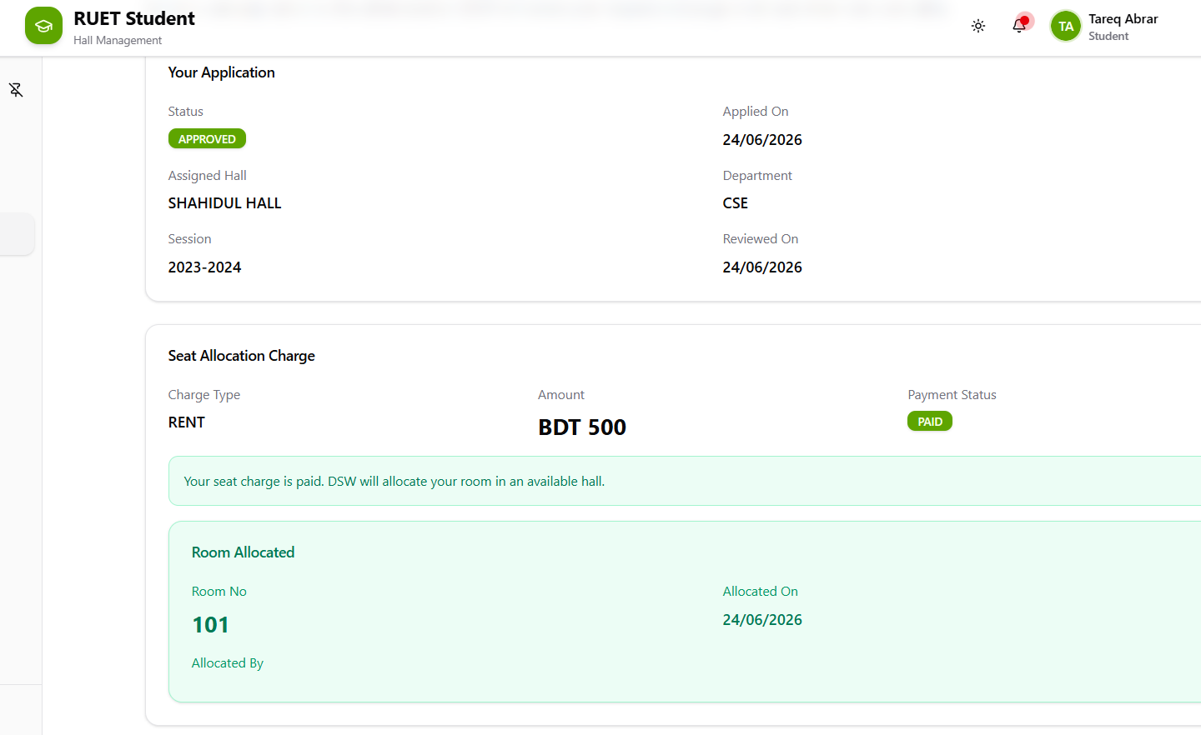
Seat
Application
After payment & room allocation
Student Panel Features

Slide 16
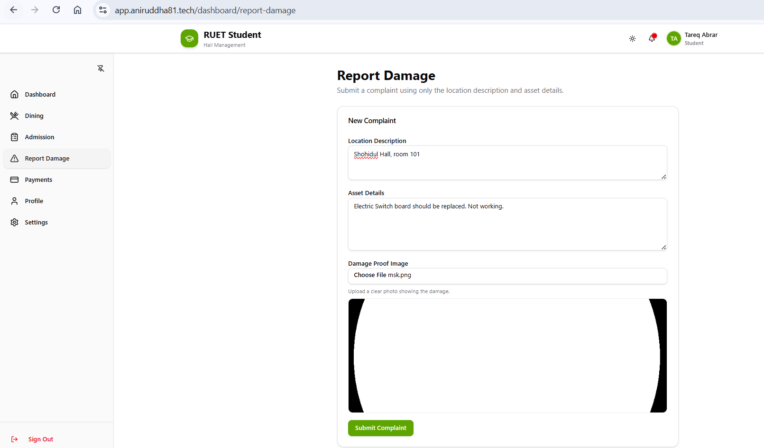
Complaint
Submission
Student Panel Features

Slide 17
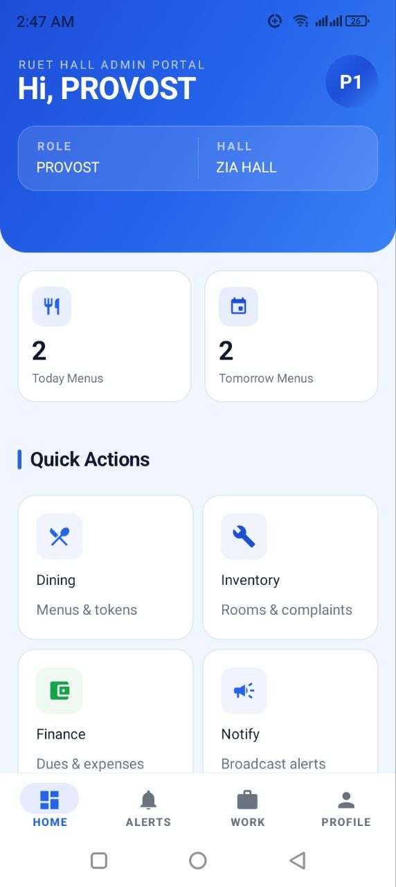
Admin Panel Features
Dashboard

Slide 18
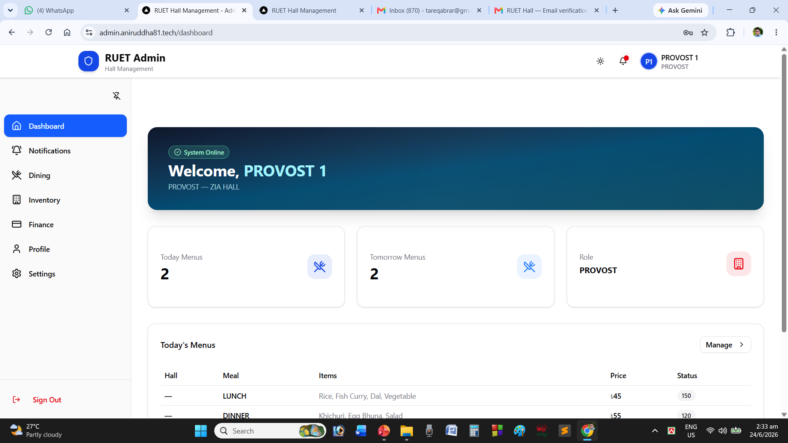
Admin Panel Features
Dashboard

Slide 19
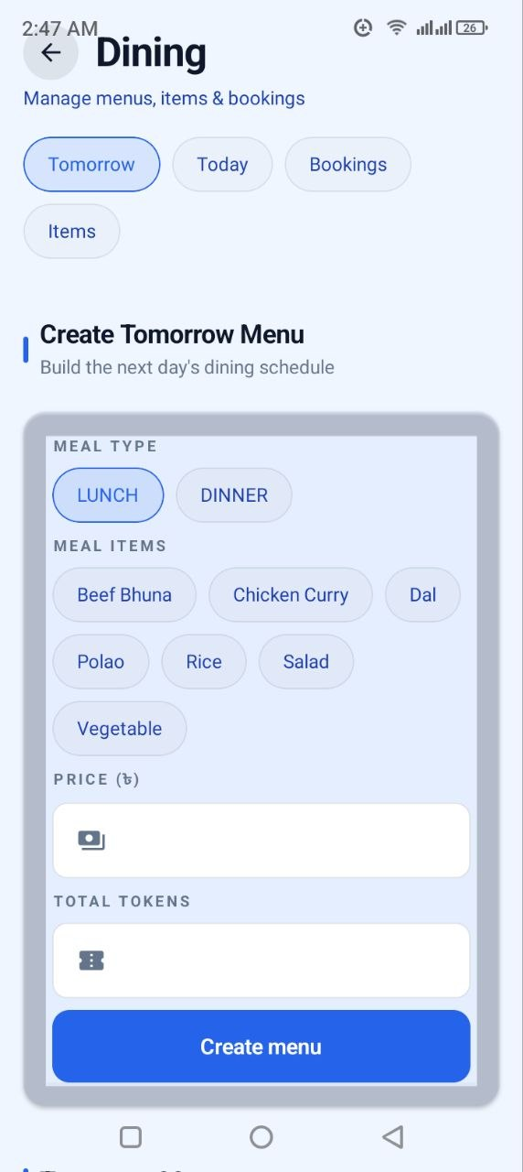
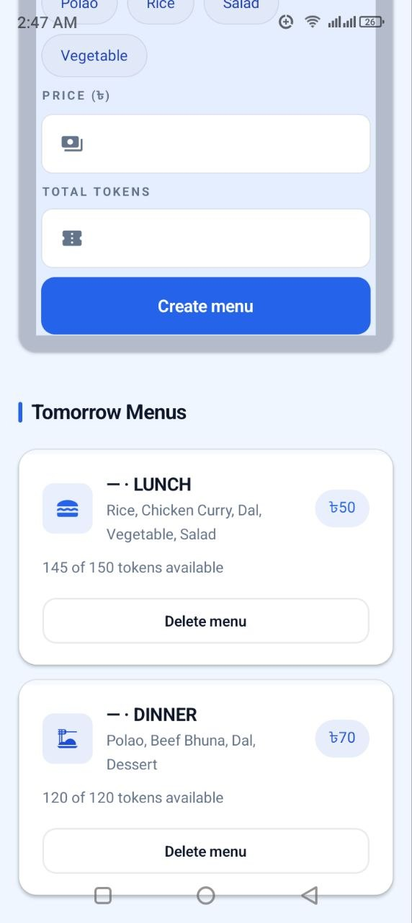
Dining
Management
Admin Panel Features

Slide 20
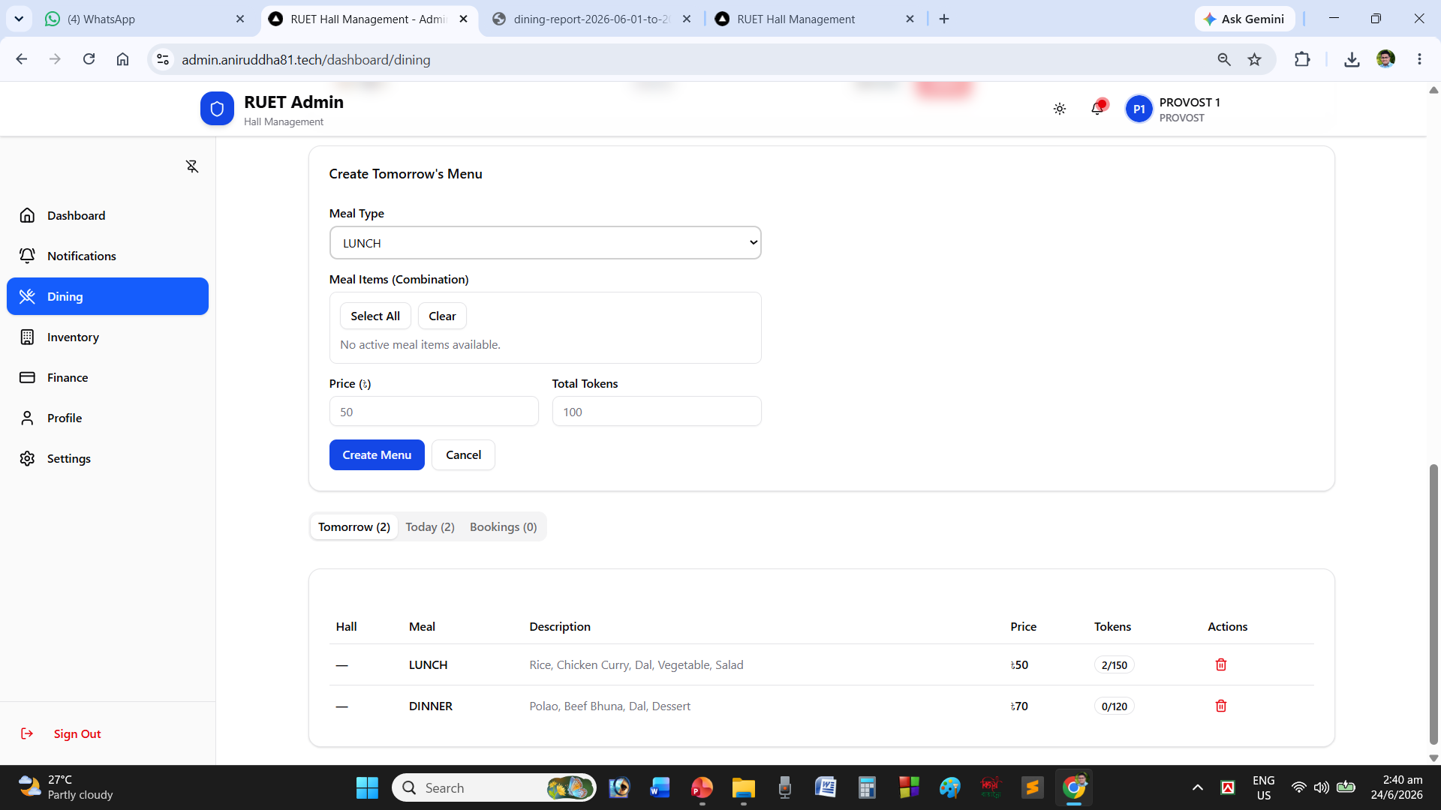
Dining
Management
Admin Panel Features

Slide 21
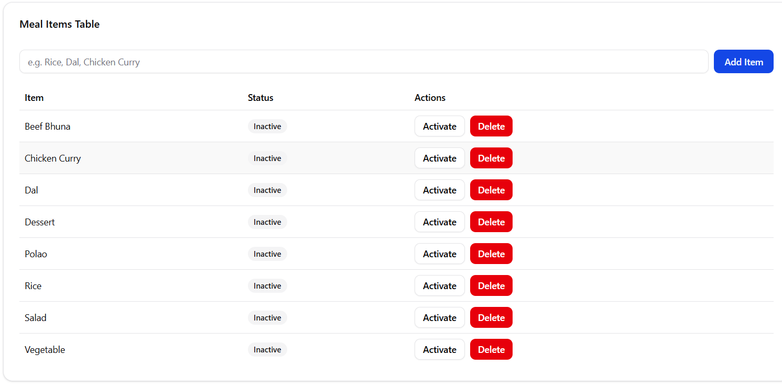
Dining
Management
Admin Panel Features

Slide 22
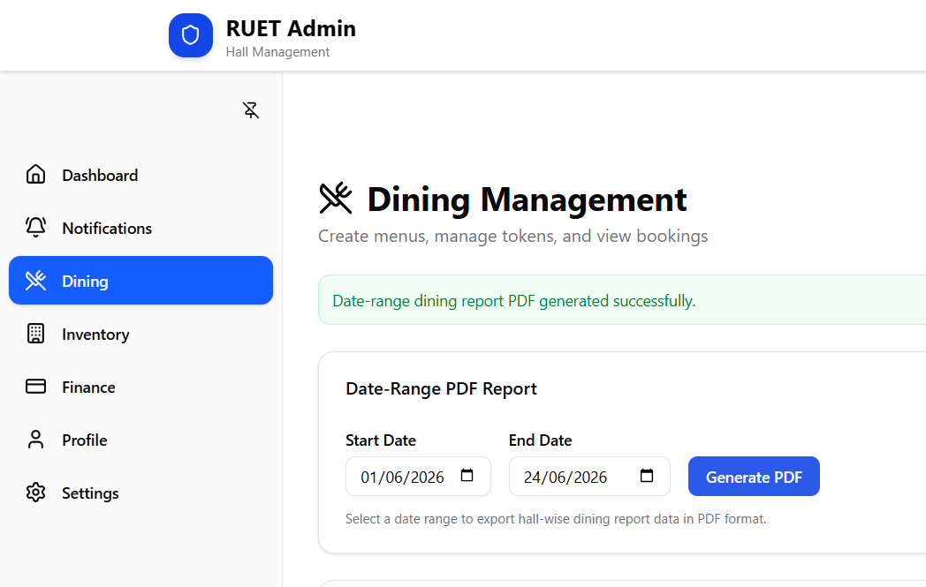
Report
Generate
Admin Panel Features

Slide 23
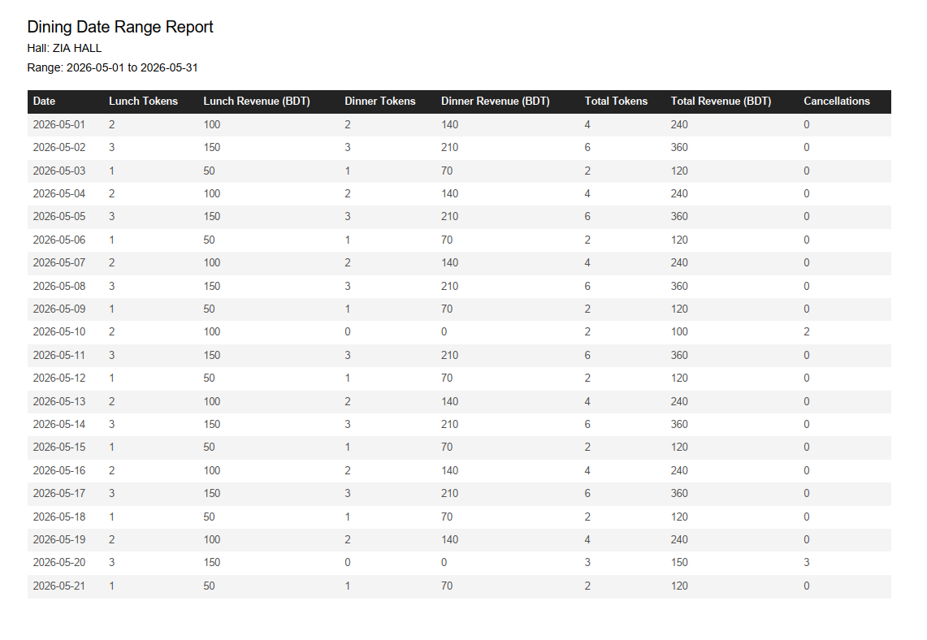
Report
Generate
Admin Panel Features

Slide 24
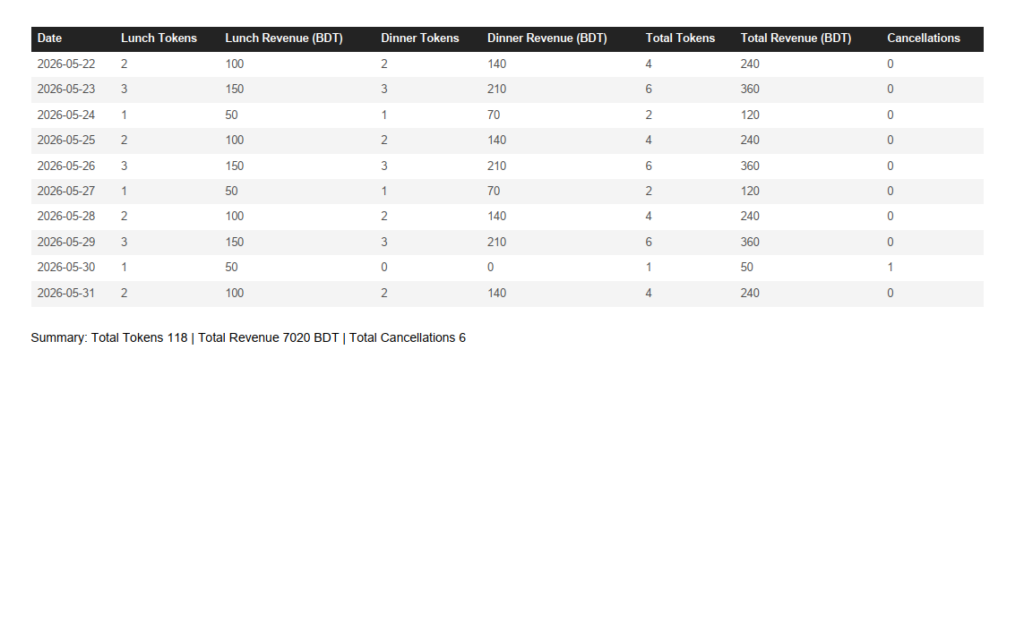
Report
Generate
Admin Panel Features

Slide 25
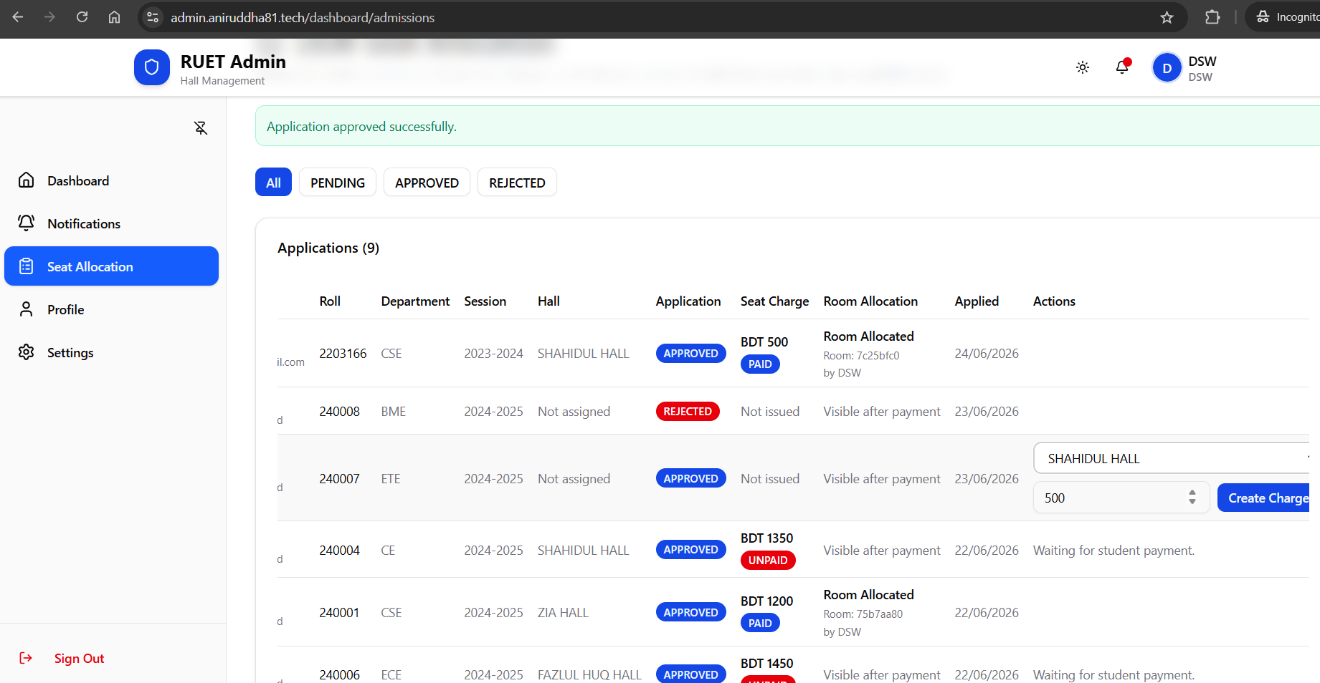
DSW Seat
Approval
Admin Panel Features

Slide 26
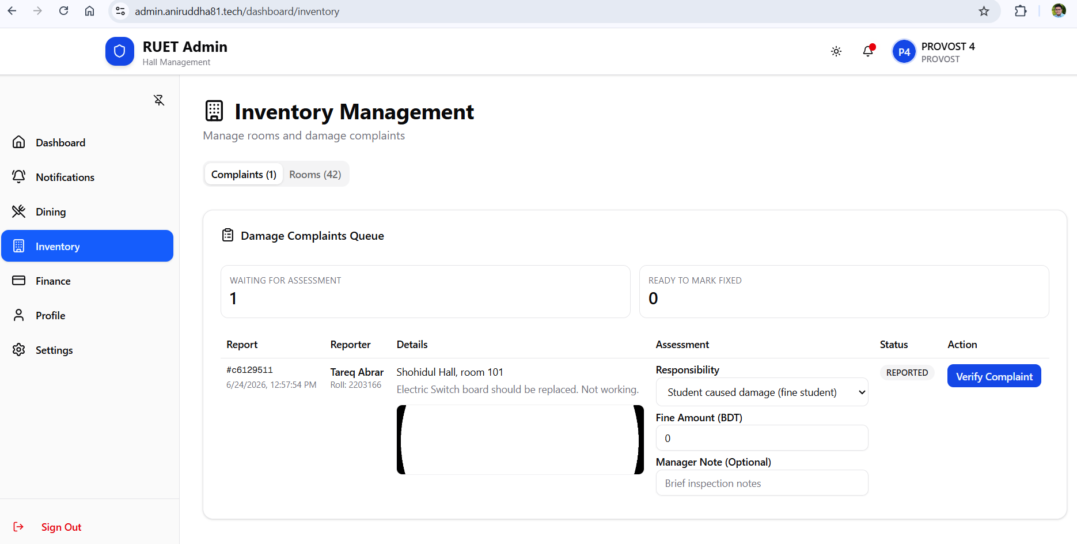
Complaint
Management
Complaint Received
Admin Panel Features

Slide 27
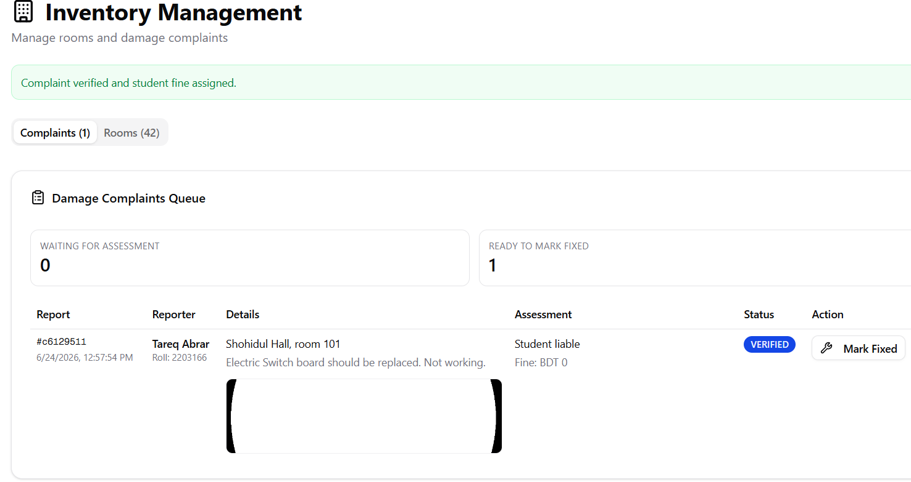
Complaint
Management
Complaint Verified
Admin Panel Features

Slide 28
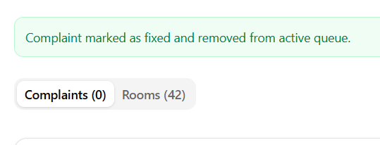
Complaint
Management
Admin Panel Features
Complaint Fixed

Slide 29
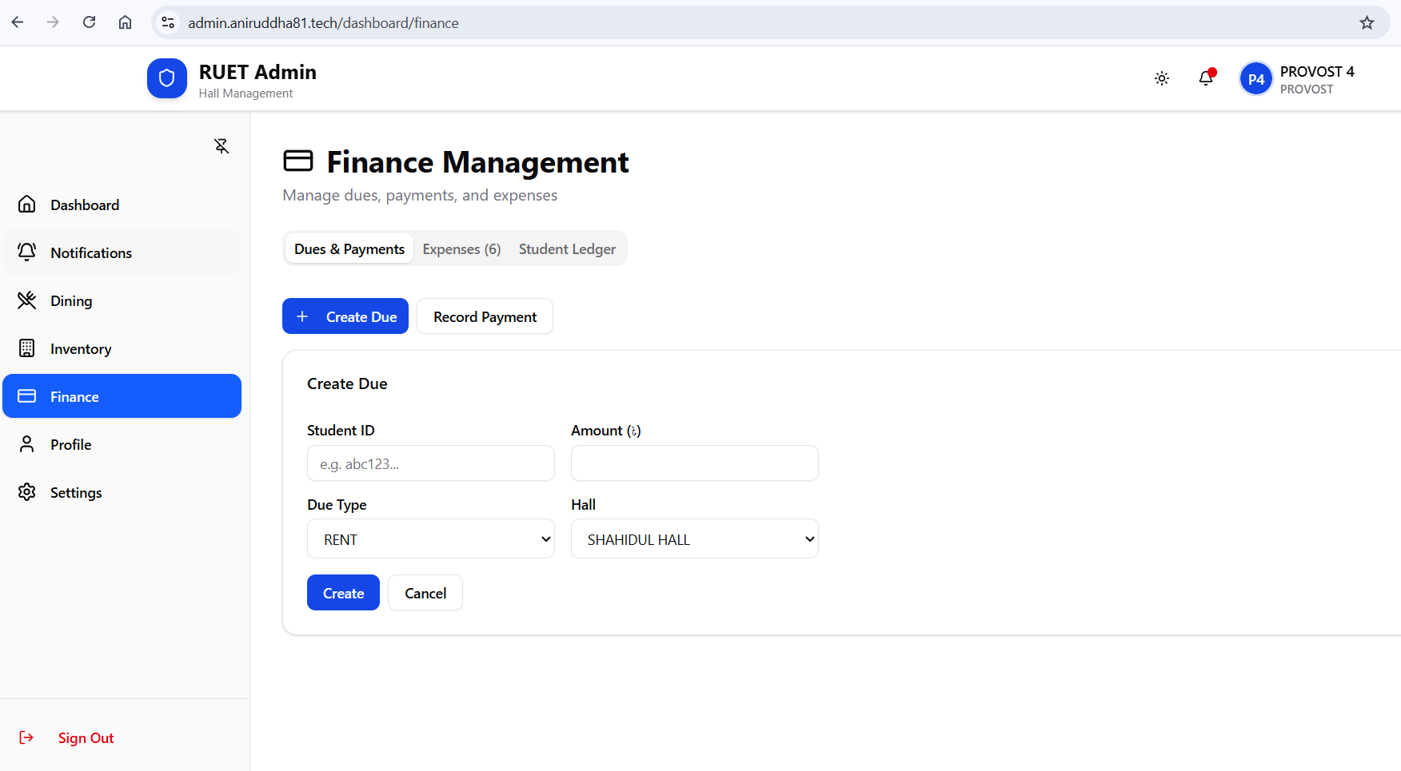
Finance
Management
Create Due / Record Payment
Admin Panel Features

Slide 30
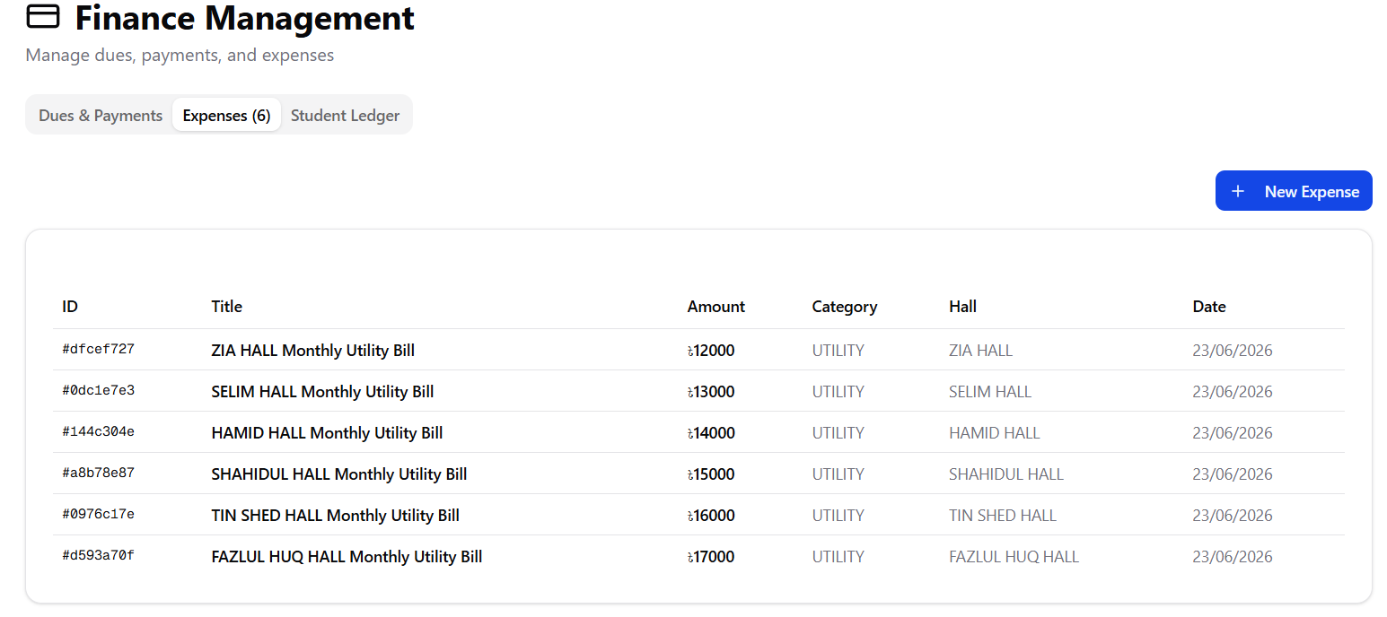
Finance
Management
Expenses
Admin Panel Features

Slide 31
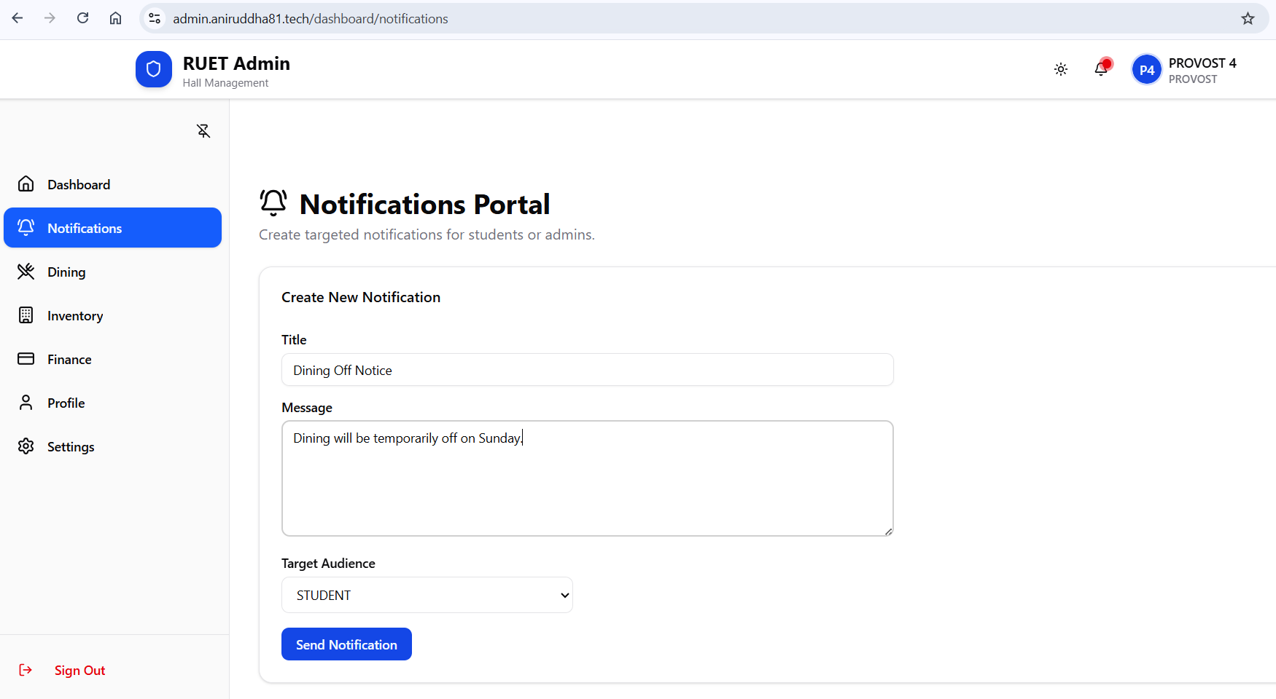
Notification
Portal
Admin Panel Features

Slide 32
System Architecture — High-Level Flow

Slide 33

System Architecture — High-Level Flow
Redis Cache
User (Web/Mobile)
Low-latency caching layer
Client devices interacting
PostgreSQL Database
System Architecture Flow
Next.js Frontend
SSR, static assets via CDN
Primary relational store
Express Backend Services
API Gateway
Routing, auth, rate limiting
Auth, Admissions, Finance, Inventory

Slide 34
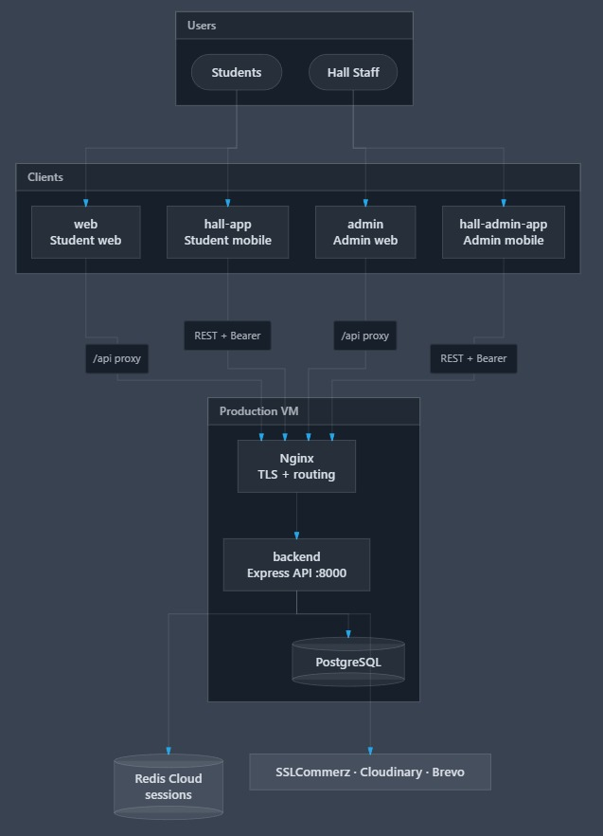
Overall Project Structure

Slide 35
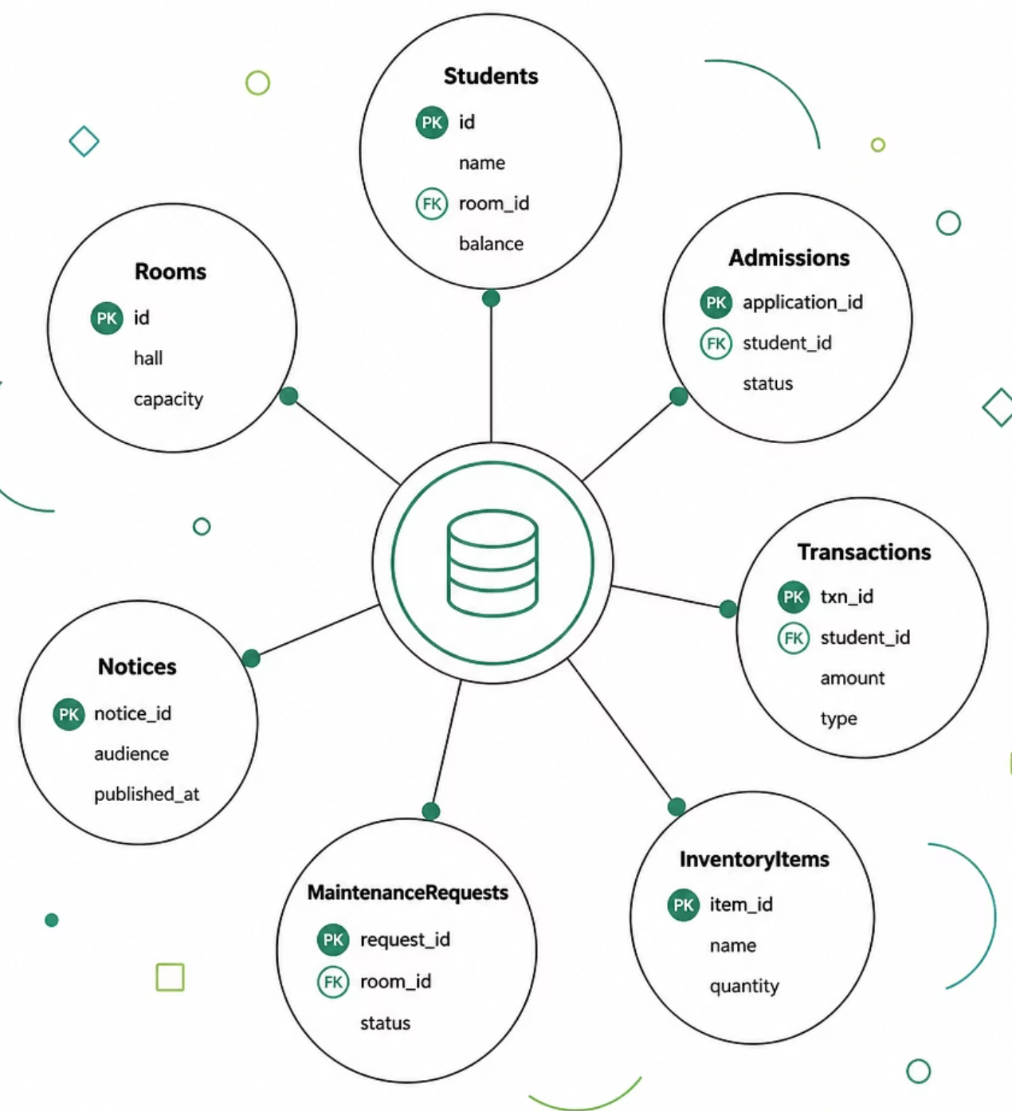
Database

Slide 36
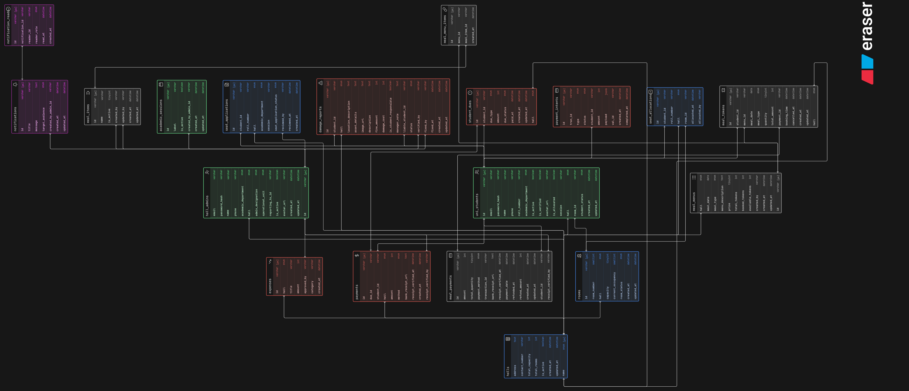
Database
ER Diagram

Slide 37
Technical Highlights
Authentication
1

Slide 38
Technical Highlights
Authentication
1
Authorization
2

Slide 39
Technical Highlights
Authentication
1
Authorization
2
Data Protection & Security
3

Slide 40
Technical Highlights
Authentication
1
Authorization
2
Data Protection
& Security
3
Payment & APIs
4

Slide 41
Technical Highlights
Authentication
1
Authorization
2
Data Protection
& Security
3
Payment & APIs
4
Others
5

Slide 42
Technical Highlights
Authentication
1
Authorization
2
Data Protection
& Security
3
Payment & APIs
4
Others
5

Slide 43
Testing (Manual)

Slide 44
Testing (Manual)
Functional Testing

Slide 45
Functional Testing
U/I Testing

Slide 46
Functional Testing
U/I Testing
Validation Testing

Slide 47
Functional Testing
U/I Testing
Validation Testing
Security Testing

Slide 48
Functional Testing
U/I Testing
Validation Testing
Security Testing
Database Testing

Slide 49
Functional Testing
U/I Testing
Validation Testing
Security Testing
Database Testing
Performance Testing

Slide 50
LIVE Demonstration

Slide 51
Any Question?
Thank You

