Slide 1

FACE EMOTION DETECTION USING DEEP LEARNING
A real-time application of artificial intelligence
in recognizing human emotions.
TEAM MEMBERS:
ANIRUDDH MISHRA E23CSEU1623
DIPANSHU SINGH E23CSEU1648
Notes:
1

Slide 2
Introduction to Face Emotion Detection
Face emotion detection is a cutting-edge AI application focused on identifying emotions from facial expressions. This project compares two models—Convolutional Neural Networks (CNN) and Support Vector Machines (SVM)—to classify seven emotions: 'angry', 'disgust', 'fear', 'happy', 'neutral', 'sad', and 'surprise'.
CNN Model: Achieved an accuracy of 72%, leveraging TensorFlow and Keras for training.
SVM Model: Achieved an accuracy of 35%, implemented with Scikit-Learn.
Libraries Used:
Data Handling and Preprocessing: Pandas, NumPy, OpenCV, tqdm
Development Environment: Jupyter Notebook
Notes:
2

Slide 3



Overview of the Proposed Model
1
Data Preprocessing
2
Convolutional Neural Network
Extracts features from images.
3
Support Vector Machine
Classifies emotions based on features.
Notes:
3

Slide 4
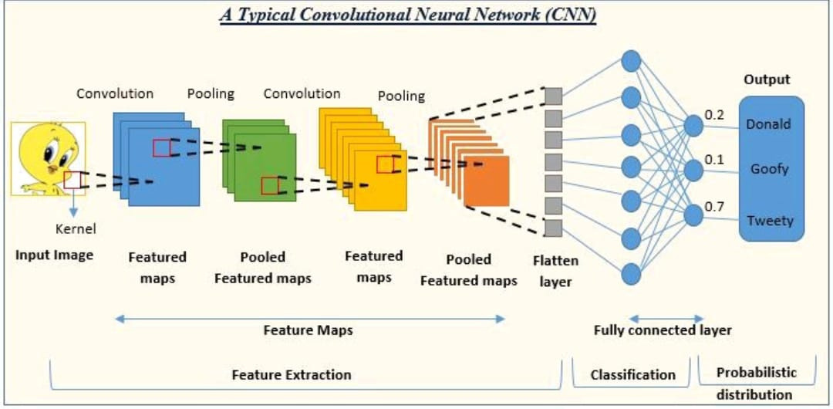
Convolutional Neural Network (CNN) Architecture
CNNs are highly effective in image recognition tasks due to their ability to learn hierarchical features.
Our CNN architecture consists of multiple convolutional layers, pooling layers, and fully connected layers, optimized for extracting features from face images.
High Accurracy
,Layered Architecture,
Complex Feature Handling
Notes:
4

Slide 5
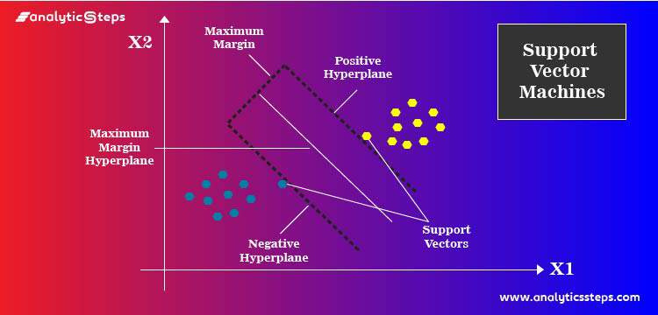
Support Vector Machine (SVM) Approach
SVM is a supervised learning algorithm that finds an optimal hyperplane to separate different classes of data points.
While less effective for complex image tasks, SVM serves as a baseline for comparison with the CNN model.
Comparative Simplicity,Basic Accuracy,Efficient for Small Datasets
Notes:
5

Slide 6

Libraries Used
TensorFlow
Keras
For building and training the deep learning models.
For simplifying the CNN model building process.
Pandas and NumPy
Jupyter Notebook
For interactive code execution and visualization.
For data manipulation and analysis.
Notes:
6

Slide 7
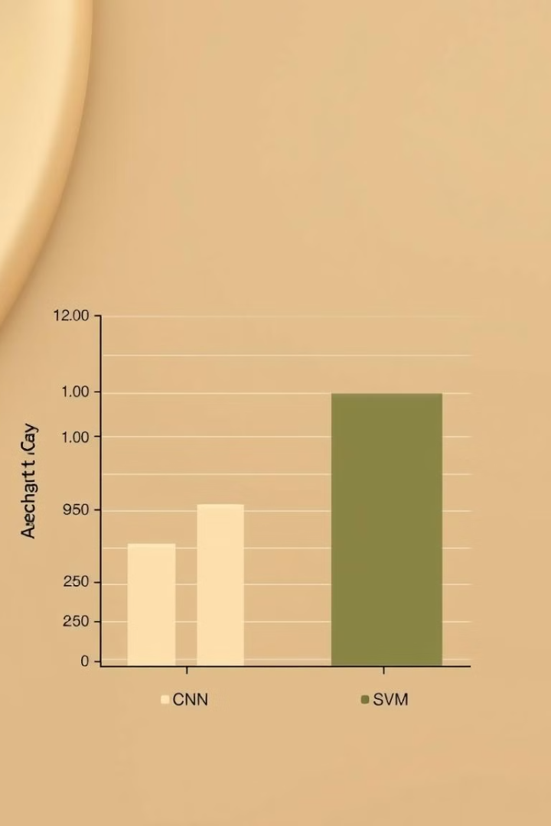
Results and Accuracy Comparison
72%
35%
CNN
SVM
Notes:
7

Slide 8
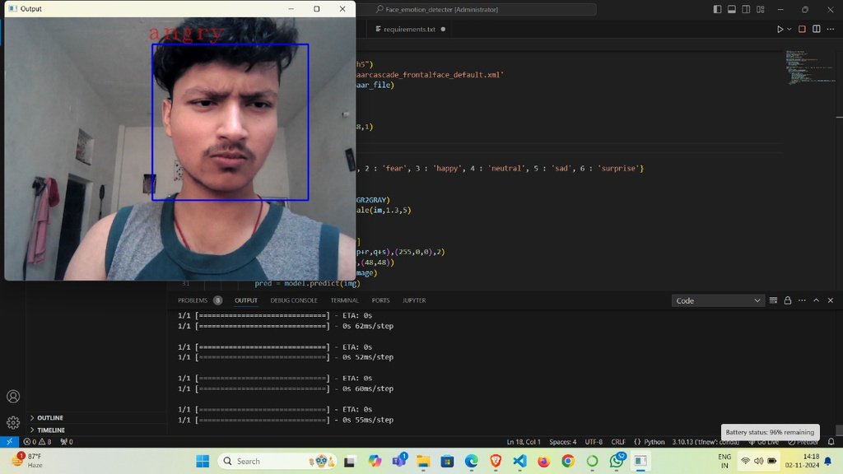
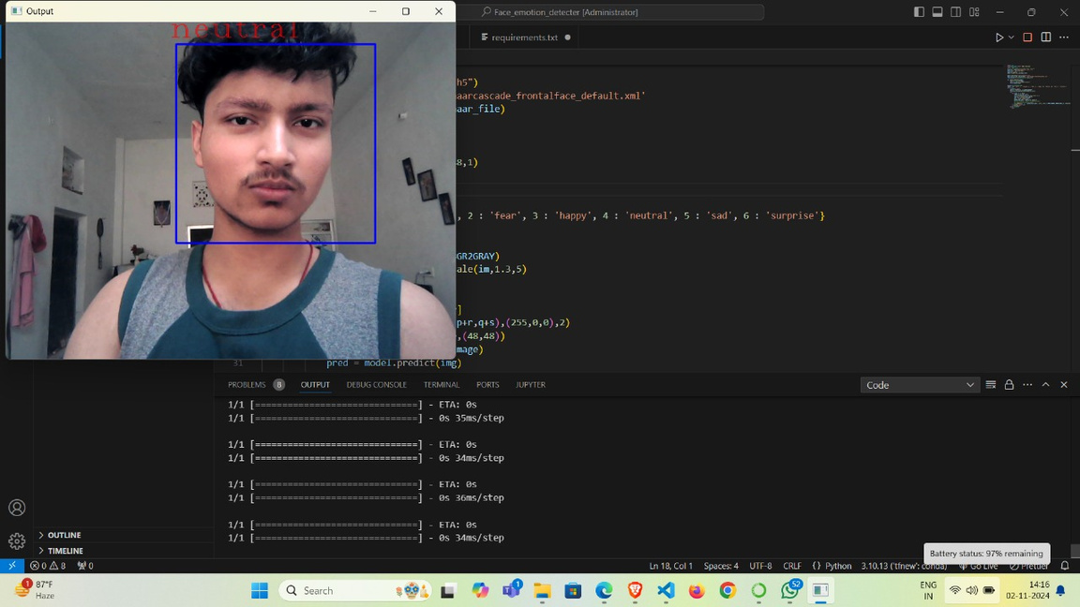
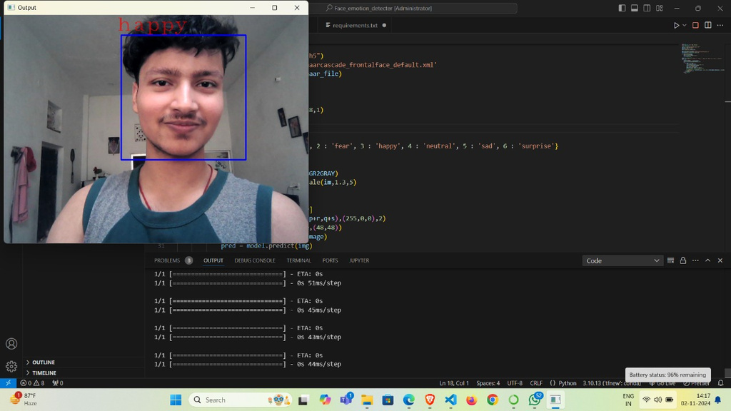
how the model works:
-Model detects the face emotion and give the result.
-Some examples of working of our model:
ANGRY
Neutral
Happy
Notes:
9

Slide 9
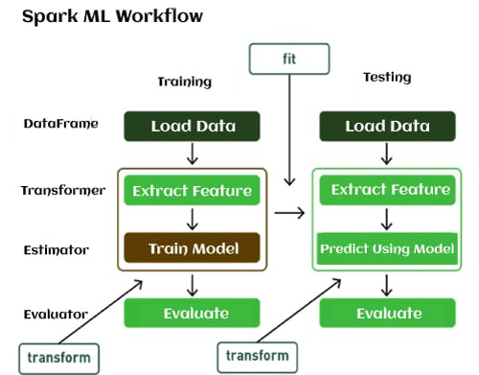
METHODOLOGY
The methodology for building a face emotion detection model using Convolutional Neural Networks (CNN) involves several key steps, which include data collection, preprocessing, model development, training, and evaluation.
1- Data Collection: kaggle dataset with seven emotions
2- Data Preprocessing: Resize images,Normalize pixel values etc...
3- Model Architecture
4- Model Training
5- Model Evaluation: Accuracy, Confusion Matrix, F1-Score..
Deployment
6-
Notes:
10

Slide 10
ABOUT DATASET AND EXPERIMENT
The dataset used for training and testing the models is the Face Expression Recognition Dataset, available on Kaggle. This dataset consists of images that represent seven different facial expressions: Angry, Disgust, Fear, Happy, Neutral, Sad, and Surprise.
Emotion Classes: Angry, Disgust, Fear, Happy, Neutral, Sad, Surprise
COMPARISON OF BOTH CNN AND SVM MODEL
CNN Model
Architecture: Convolutional layers, max-pooling, fully connected layer.
Accuracy: 72%
Performance: Good on "Happy" and "Surprise"; struggled with "Disgust" and "Fear".
SVM Model
Accuracy: 35%
Performance: Struggled across all classes, especially "Fear" and "Surprise".
Comparison Model
Accuracy (%)
CNN 72%
SVM 35%
Conclusion: CNN outperformed SVM, excelling in learning complex features from raw data. SVM struggled without deep learning's feature extraction capabilities.
Notes:
11

Slide 11
KEY OBSERVATIONS
CNN Model: The CNN model performed significantly better than the SVM, likely due to its deep learning architecture's ability to automatically learn features from the raw images.
SVM Model: The SVM model's performance was limited by the need for manually engineered features, and it showed poor results across most emotion categories.Further improvements in both models could include experimenting with more complex CNN architectures (e.g., ResNet, VGG) or incorporating more advanced feature extraction techniques for the SVM.
GITHUB LINK AND DATASET LINK
GITHUB LINK: https://gitlab.com/dipanshu-84/Emotion_detection.git
DATASET LINK: https://www.kaggle.com/datasets/jonathanoheix/face-expression-recognition-dataset/data?select=images
Notes:
12

Slide 12
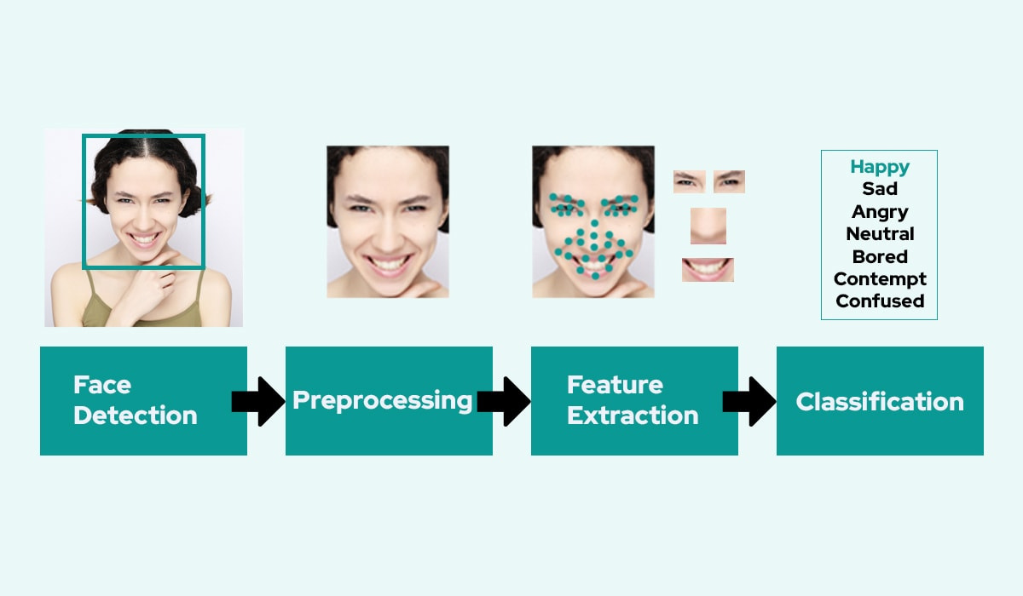
CONCLUSION
In this project, we developed a face emotion detection system using a Convolutional Neural Network (CNN) and a Support Vector Machine (SVM). The CNN, trained on the Face Expression Recognition Dataset, achieved 72% accuracy, outperforming the SVM's 35%. This highlights deep learning's strength in feature extraction. The CNN's performance makes it ideal for real-world applications, while the SVM struggled with manual feature extraction.
CNN Accuracy: 72%
SVM Accuracy: 35%
CNN Strength: Automated feature extraction
SVM Limitation: Difficulty with high-dimensional data
Notes:
13

