Slide 1
CS 6476 Project 3
Warning: Do not delete slides.This includes extra credit slides and any problems you do not complete. All problems, including extra credit, must be assigned to a slide on Gradescope. Failure to follow this will result in a penalty.
Anirudh Arunkumar
aarunkumar8@gatech.edu
aarunkumar8
903572206

Slide 2
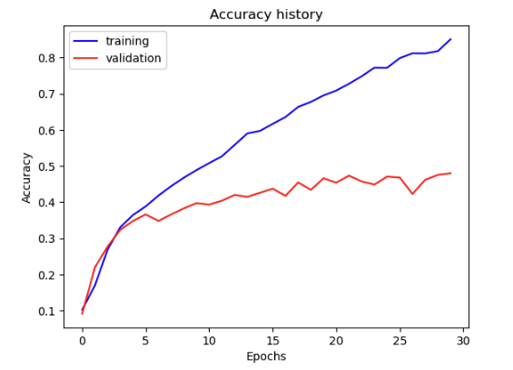
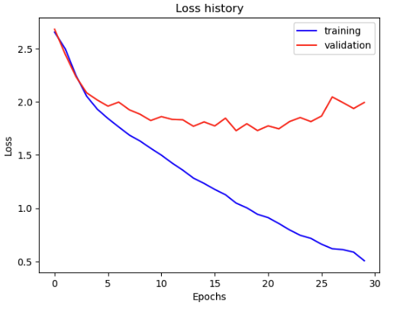
Part 1: SimpleNet
[Insert loss plot for SimpleNet here]
Final training accuracy: 85%
Final validation accuracy: 48%
[Insert accuracy plot for SimpleNet here]

Slide 3
Part 2: SimpleNetFinal
Add each of the following (keeping the changes as you move to the next row):
 | Training accuracy | Validation accuracy
SimpleNet | 85% | 48%
Jittering | 59% | 50%
Zero-centering & variance-normalization | 69% | 61%
Dropout regularization | 68% | 58%
Making network "deep" | 70% | 52%
Batch normalization | 61% | 64%

Slide 4
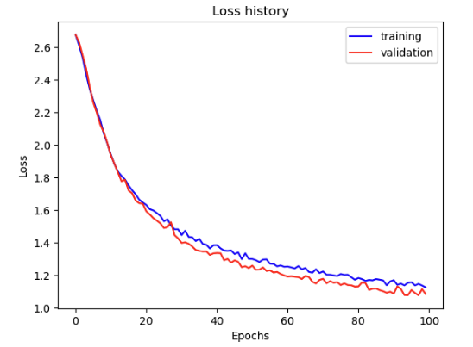
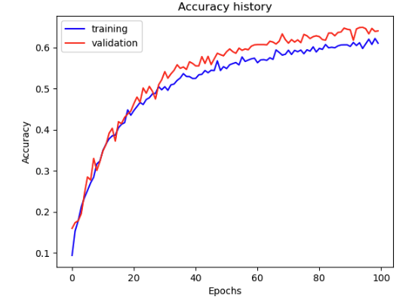
Part 2: SimpleNetFinal
[Insert loss plot for SimpleNetFinal here]
Final training accuracy: 61%
Final validation accuracy: 64%
[Insert accuracy plot for SimpleNetFinal here]

Slide 5
Part 2: SimpleNetFinal
[Name 10 different possible transformations for data augmentation.]
Random Horizontal Flip
Random Vertical Flip
Color Jittering
Random Rotation
Random Crop
Random Affine Transformation
Random Perspective Transformation
Gaussian Blur
Random Erasing
Gaussian Noise
[What is the desired variance after each layer? Why would that be helpful?]
We need to have a variance of 1 after each layer so that there is consistency and stable gradients during backpropagation. Gradient vanishing and exploding are an issue if variance is too low or high. Having a similar variance increases consistency of the magnitude of activations as the network grows deeper.

Slide 6
Part 2: SimpleNetFinal
[What distribution is dropout usually sampled from?]
From Bernoulli Distribution with parameter p which is the rate of dropout.
[How many parameters does your base SimpleNet model have? How many parameters does your SimpleNetFinal model have?]
Base: 32 + 8 + 512 + 16 + (4096*128) + 128 + 1920 + 15 = 526919 parameters
Final: 40 + 16 + 528 + 32 + 6015 + 30 + 4352 + (288 * 128) + 128 + 1920 + 15 = 49940 parameters
[What is the effect of batch norm after a conv layer with a bias?]
After Batch normalizing we can see that the mean of the activation and the bias is subtracted and then scales with its own parameters. So the normalization cancels out the bias from convolutions. Normalizing activations within each layer stabilizes the training process, accelerates convergence, and has an improved generalization.

Slide 7
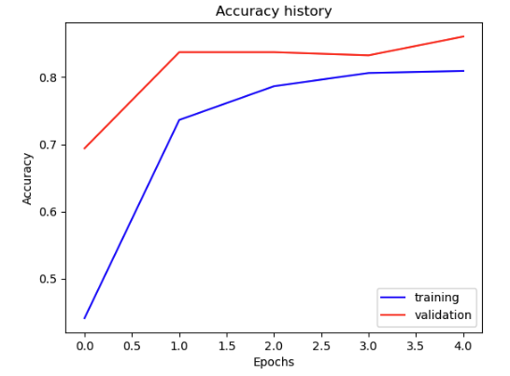
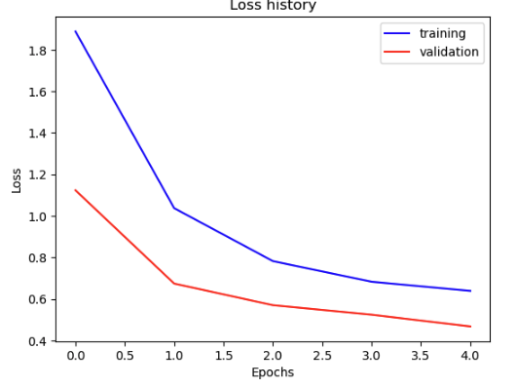
Part 3: ResNet
[Insert loss plot here]
Final training accuracy: 81%
Final validation accuracy: 86%
[Insert accuracy plot here]

Slide 8
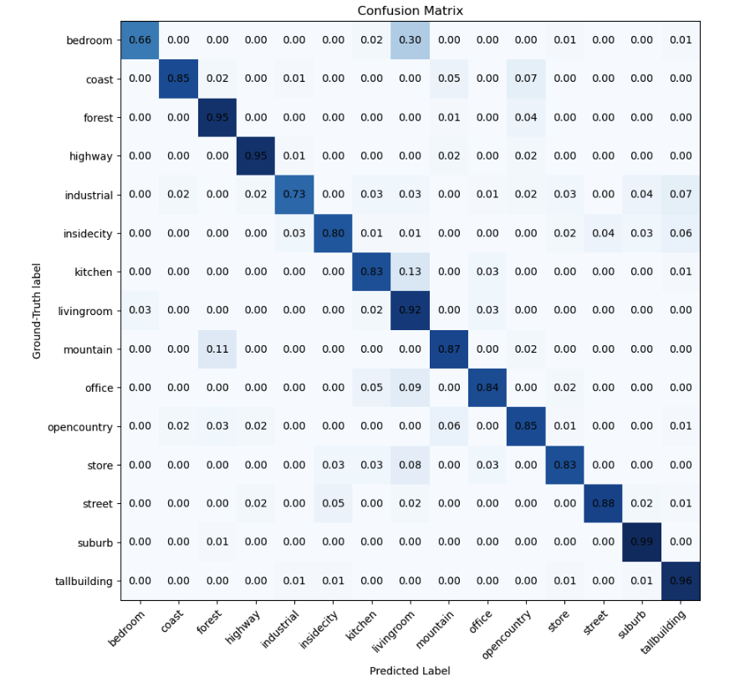
Part 3: ResNet
[Insert visualization of confusion matrix obtained from your final ResNet model.]

Slide 9
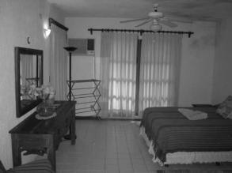
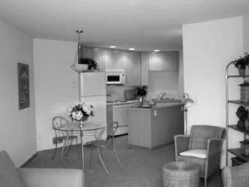
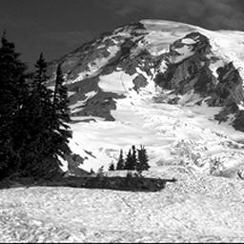
Part 3: ResNet
Bedroom image_0147.jpg
Kitchen image_0185.jpg
(Predicted: livingroom, Ground Truth: Bedroom) 0.3
(Predicted: livingroom, Ground Truth: Kitchen) 0.13
(Predicted: forest, Ground Truth: Mountain) 0.11
This happens because as we can see the bedroom and kitchen has qualities of a living room such as lighting, sofas, and ceiling fan while the mountain image has trees which exists in forests. These misclassifications happen because of these similar visual features which share characteristics so it is hard to distinguish.
Mountain image_0347.jpg

Slide 10
Part 3: ResNet
[Why do we want to "freeze" the conv layers and some of the linear layers from a pre-trained ResNet? Why can we do this?]
We want to freeze conv layers because most importantly it reduces computational costs. We can reduce the costs by directly reducing the number of parameters that are updated during backpropogation. Another reason is because ResNet is well trained to detected edges, textures, and shapes so we do not need to retrain for a smaller dataset. We are able to do this because features that are learned by a network trained on large datasets is able to complete multiple tasks and we can just transfer it over to the new dataset that we want to fine tune it for. Since we transfer these learnings there is no need to relearn reducing computation.
[What does fine-tuning a network mean?]
Fine tuning means that we take an already trained model which was trained maybe on a large dataset and we make modifications so it can adapt to different conditions. This has to do with how the parameters of a pretrained network is then trained on new data. It can be an improvement or it can applies the new learning to a different task.

Slide 11
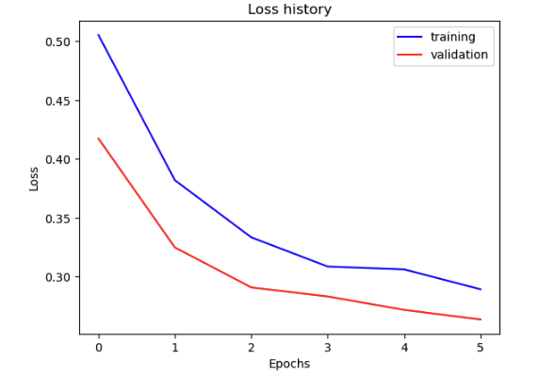
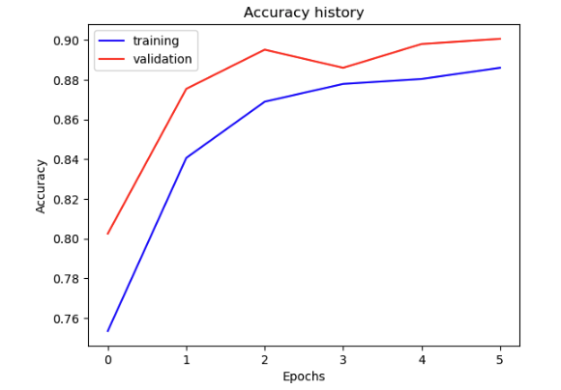
Part 4: Multi-label Scene Attributes
[Insert loss plot here]
Final training accuracy: 89%
Final validation accuracy: 90%
[Insert accuracy plot here]

Slide 12
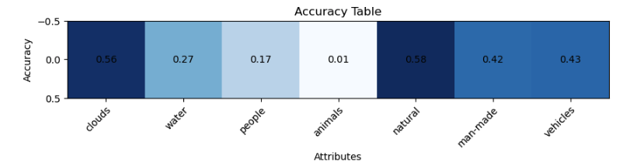
Part 4: Multi-label Scene Attributes
[Insert visualization of accuracy table obtained from your final MultilabelResNet model.]

Slide 13
Part 4: Multi-label Scene Attributes
[List 3 changes that you made in the network compared to the one in part 3.]
We changed the output classes from 15 to 7 which is an individual attribute making it multi-label.
For my model I used a Sigmoid activation at the end in pt 4 because pt expects logits. This was to get the probabilities of the 7 attributes.
We also changed to a BCE loss function in pt 4 because we needed to treat the attributes as a binary classification task.
[Is the loss function of the ResNet model from part 3 appropriate for this problem? Why or why not?]
The Cross Entropy Loss is not appropriate for multi-label classification because it assumes that one class is correct. In multi-label multiple classes can be correct so its better to use binary cross entropy instead. Since we have multiple attributes and Cross Entropy Loss expects one class. Also this funcition expects the target to be a single integer whereas in multilabel we can have a vector representation.

Slide 14
Part 4: Multi-label Scene Attributes
[Explain a problem that one needs to be wary of with multilabel classification. HINT: consider the purpose of visualizing your results with the accuracy table. You might want to do some data exploration here.]
One needs to be wary of some labels being more likely than others in the data sample. From my accuracy table I can see that clouds and natural appears more than 50% of the time. So if the model predicts Clouds = 1 for every image then it will be right 56% of the time and 58% for Natural = 1. This can cause inflation in accuracy readings and create class imbalances because of the way the data sampled. The model might even start overpredicting which can be a major issue.

Slide 15
Extra credit (optional)
[Discuss what extra credit you did and provide analyses.]

