Slide 1
CS 6476 Project 5
Warning: Do not delete slides. This includes extra credit slides and any problems you do not complete. All problems, including extra credit, must be assigned to a slide on Gradescope. Failure to follow this will result in a penalty
Anirudh Arunkumar
aarunkumar8@gatech.edu
aarunkumar8
903572206

Slide 2
Part 2: Voxel Baseline Model
[insert confusion matrix for baseline model on test dataset]

Slide 3
Part 2: Voxel Baseline Model
[Which classes does this baseline perform well for? Why?]
[Which mode (count or occupancy) achieves higher accuracy? Why do you think this is the case?]
[What are some ways we can improve this voxel based model?]

Slide 4
Part 3: Simplified PointNet
[insert confusion matrix for PointNet model on test dataset]

Slide 5
Part 3: Simplified PointNet
[Which classes does this model perform well for? Why?]
[Which classes are most misclassified? What were they classified as and why do you think this is the case?]

Slide 6
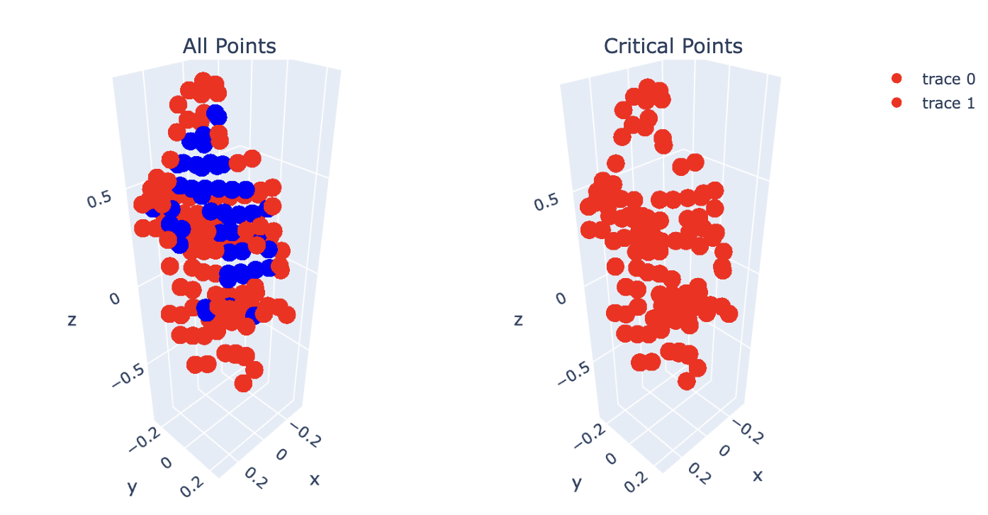
Part 4: Analysis
[insert visualization of critical points on the PEDESTRIAN/11.txt point cloud]

Slide 7
Part 4: Analysis
[insert visualization critical points on one other point cloud, why would it make sense for these to be selected as critical points?]

Slide 8
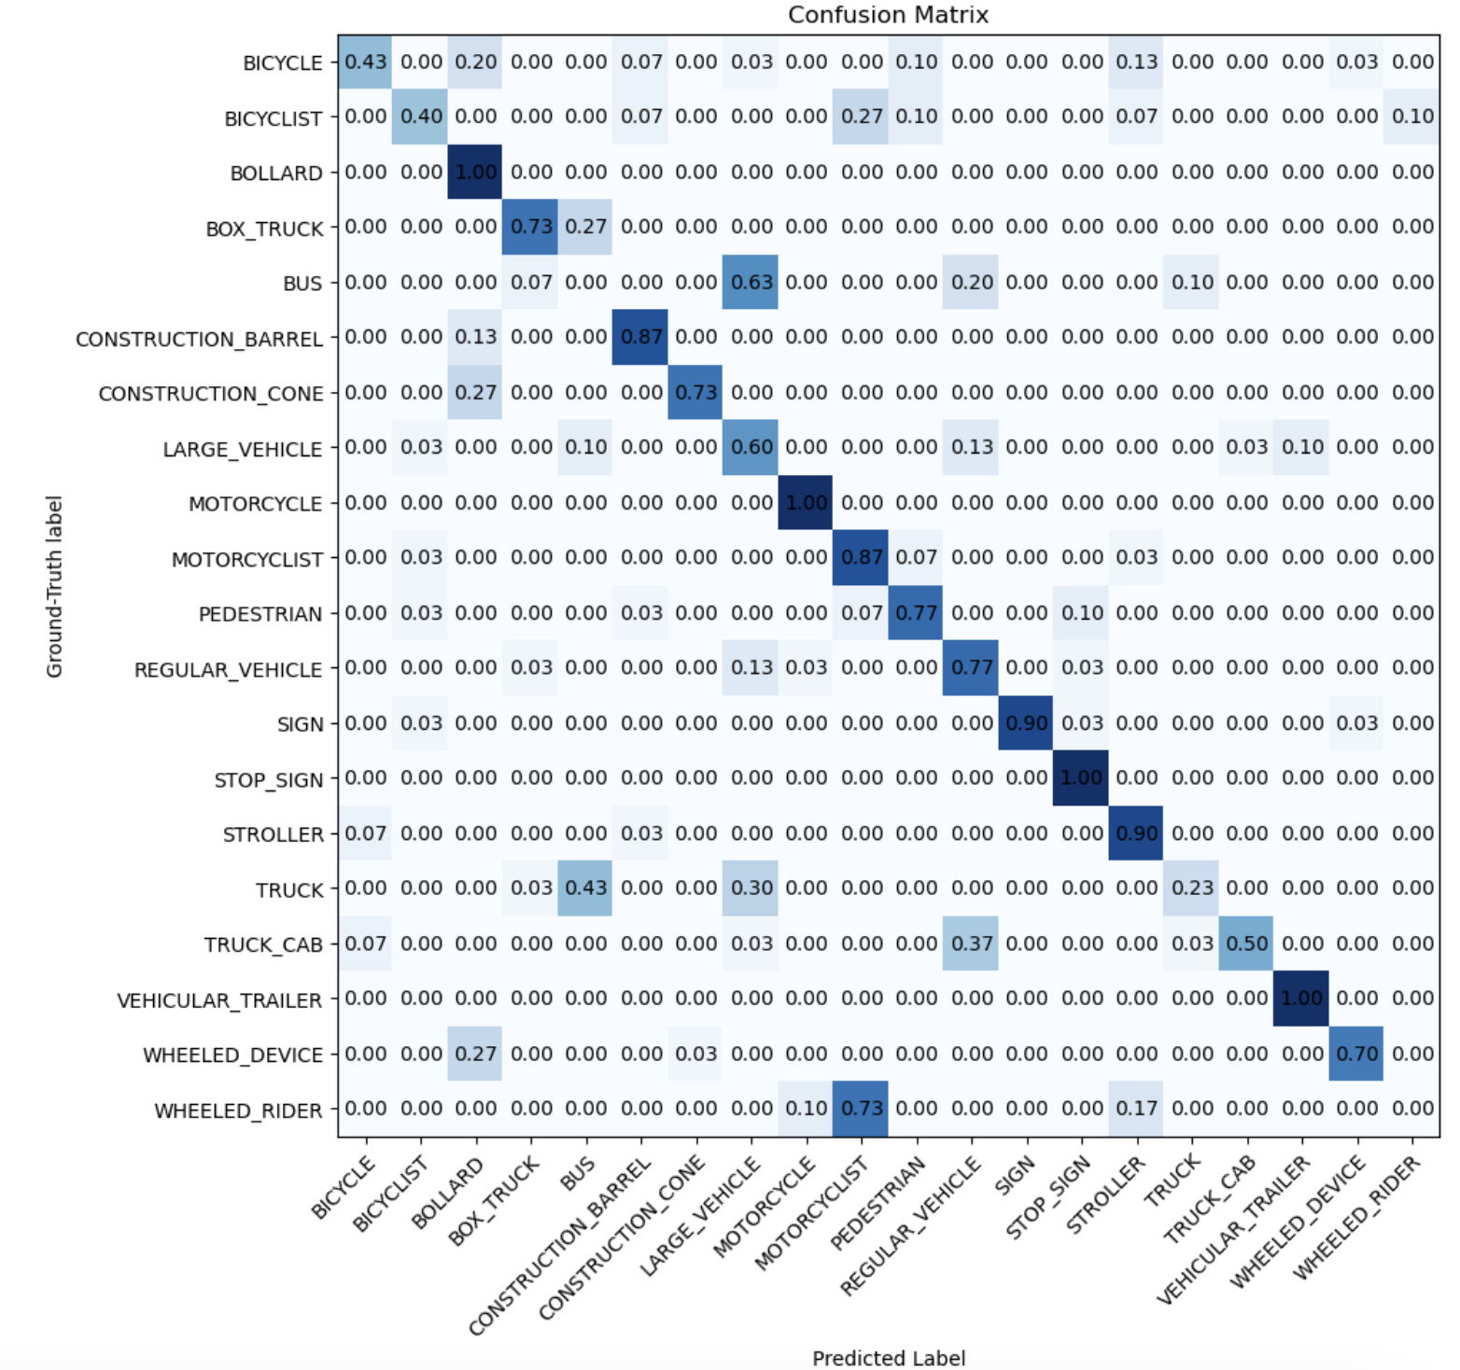
Part 5: PointNet + T-Net
[insert confusion matrix for PointNet with T-Net on test dataset]

Slide 9
Part 5: PointNet + T-Net
[What is the motivation behind using T-Net in PointNet?]
[Which classes saw the most improvement from including T-Net? Why do you think this is the case?]

Slide 10
Additional Extra Credit (Bells & Whistles)
[describe any additional extra credit you implemented]

