Slide 1
CS 6476 Project 4
Warning: Do not delete slides. This includes extra credit slides and any problems you do not complete. All problems, including extra credit, must be assigned to a slide on Gradescope. Failure to follow this will result in a penalty
Anirudh Arunkumar
aarunkumar8@gatech.edu
aarunkumar8
903572206

Slide 2
Parts 4 & 5: mIoU of different models
Add each of the following (keeping the changes as you move to the next row):
 | Training mIoU | Validation mIoU
Simple Segmentation Net (no pretrained weights) | 0.2410 | 0.3295
ImageNet-Pretrained backbone | 0.5328 | 0.6178
Data augmentation | 0.4461 | 0.5370
ImageNet-Pretrained PSPNet w/ Data Aug. without PPM | 0.4637 | 0.5246
PSPNet with PPM | 0.5879 | 0.6781
PSPNet with auxiliary loss | 0.6523 | 0.7487

Slide 3
Parts 4 & 5: Per class IoUs
Report your model’s IoU for the 11 Camvid classes (you can find the order they are listed in at dataset_lists/camvid-11/camvid-11_names.txt):
Class Index | Class name | Simple Segmentation Net Class IoU | PSPNet Class IoU
0 | Building | 0.8834 | 0.8868
1 | Tree | 0.8431 | 0.9072
2 | Sky | 0.9112 | 0.9025
3 | Car | 0.8235 | 0.7622
4 | SignSymbol | 0.0000 | 0.0000
5 | Road | 0.9058 | 0.9382
6 | Pedestrian | 0.3677 | 0.2655
7 | Fence | 0.4495 | 0.7468
8 | Column_Pole | 0.0000 | 0.0000
9 | Sidewalk | 0.8087 | 0.8006
10 | Bicyclist | 0.5231 | 0.5877

Slide 4
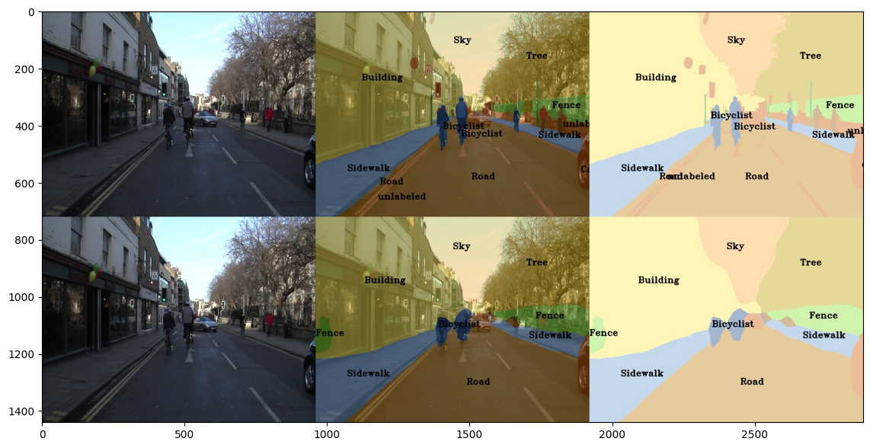
Parts 4 & 5: Most difficult classes
[Which classes have the lowest mIoU? Why might they be the most difficult? Provide an example RGB image from Camvid that illustrates your point]
The SignSymbol class has one of the lowest mloU alongside Column_Pole (0.0000). The signs and the column poles are not as apparent in the picture. Signs are small and distant. The poles are vertical objects and thin which is hard to classify. These small classes can easily blend into the background making it difficult to detect. Check red dot in image for sign

Slide 5
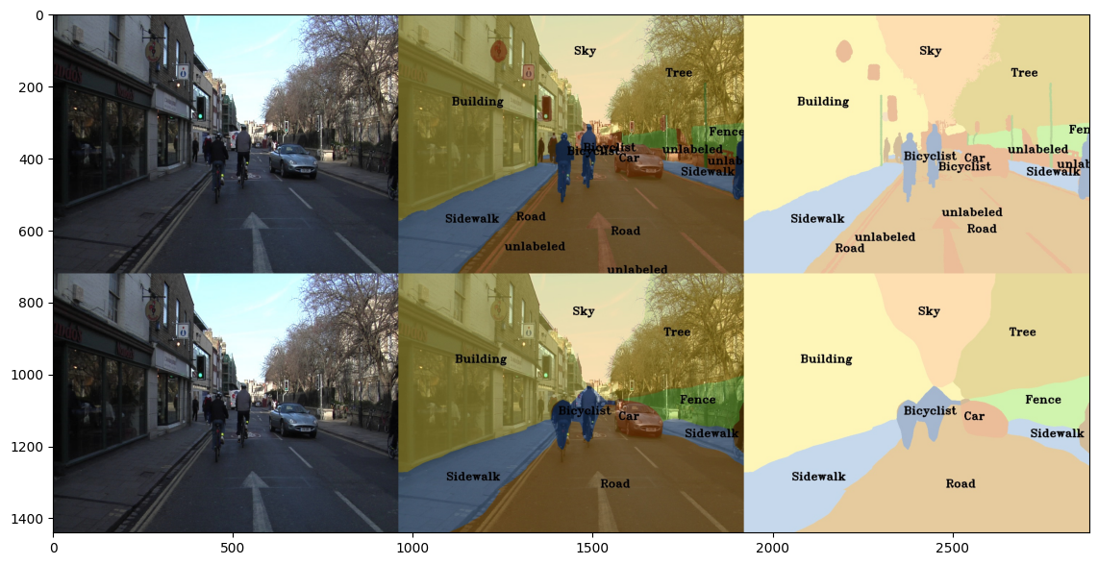
Part 4: Simple segmentation net qualitative results
[Paste a figure of the generated semantic segmentation from Colab. It should be a 2x3 grid, with ground truth on the top row, and your predictions on the bottom row.]

Slide 6
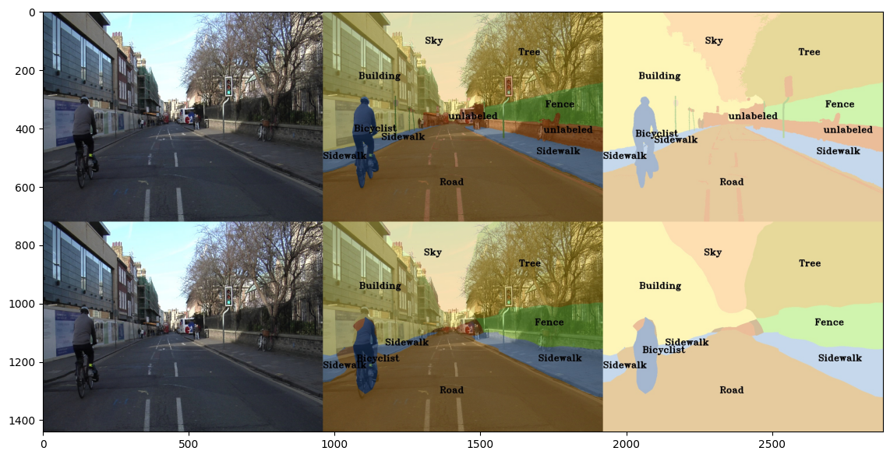
Part 5: PSPNet qualitative results
[Paste a figure of the generated semantic segmentation from Colab. It should be a 2x3 grid, with ground truth on the top row, and your predictions on the bottom row.]

Slide 7
Part 6: Transfer Learning
Report your model’s IoU for the Kitti Dataset.
 | mIoU | mAcc/ | allAcc
Train result | 0.9335 | 0.9622 | 0.9787
Val result | 0.9247 | 0.9565 | 0.9767
Class Index | Class name | iou | accuracy
0 | Road | 0.8773 | 0.9250
1 | Not_Road | 0.9721 | 0.9881

Slide 8
Part 6: Transfer Learning
Compare the training loss generated when training on Kitti dataset and Camvid dataset. Which decreases at a faster rate? If Camvid or Kitti training loss decreases at a faster rate than the other, why do you think this happened? Or, if the loss decreases at a similar rate, why do you think that is so?
The Camvid had an average loss of 0.0166 per epoch and the Kitti had a 0.0169 average loss. Both of these rates are similar but the Kitti decreases slightly faster. Kitti was trained on 20 epochs and Camvid was 50 epochs. Both the losses are at the same rate so the model architecture and training hyperparameters are consistent across both tasks. This tells us that the dataset used for Kitti can be easier to learn but by a negligible amount. This means that the datasets are well structures and provide the sufficient indications for learning. The model slightly benefits from transfer learning.

