Slide 1
CS 6476 Project 5
Warning: Do not delete slides. This includes extra credit slides and any problems you do not complete. All problems, including extra credit, must be assigned to a slide on Gradescope. Failure to follow this will result in a penalty
Anirudh Arunkumar
aarunkumar8@gatech.edu
aarunkumar8
903572206

Slide 2
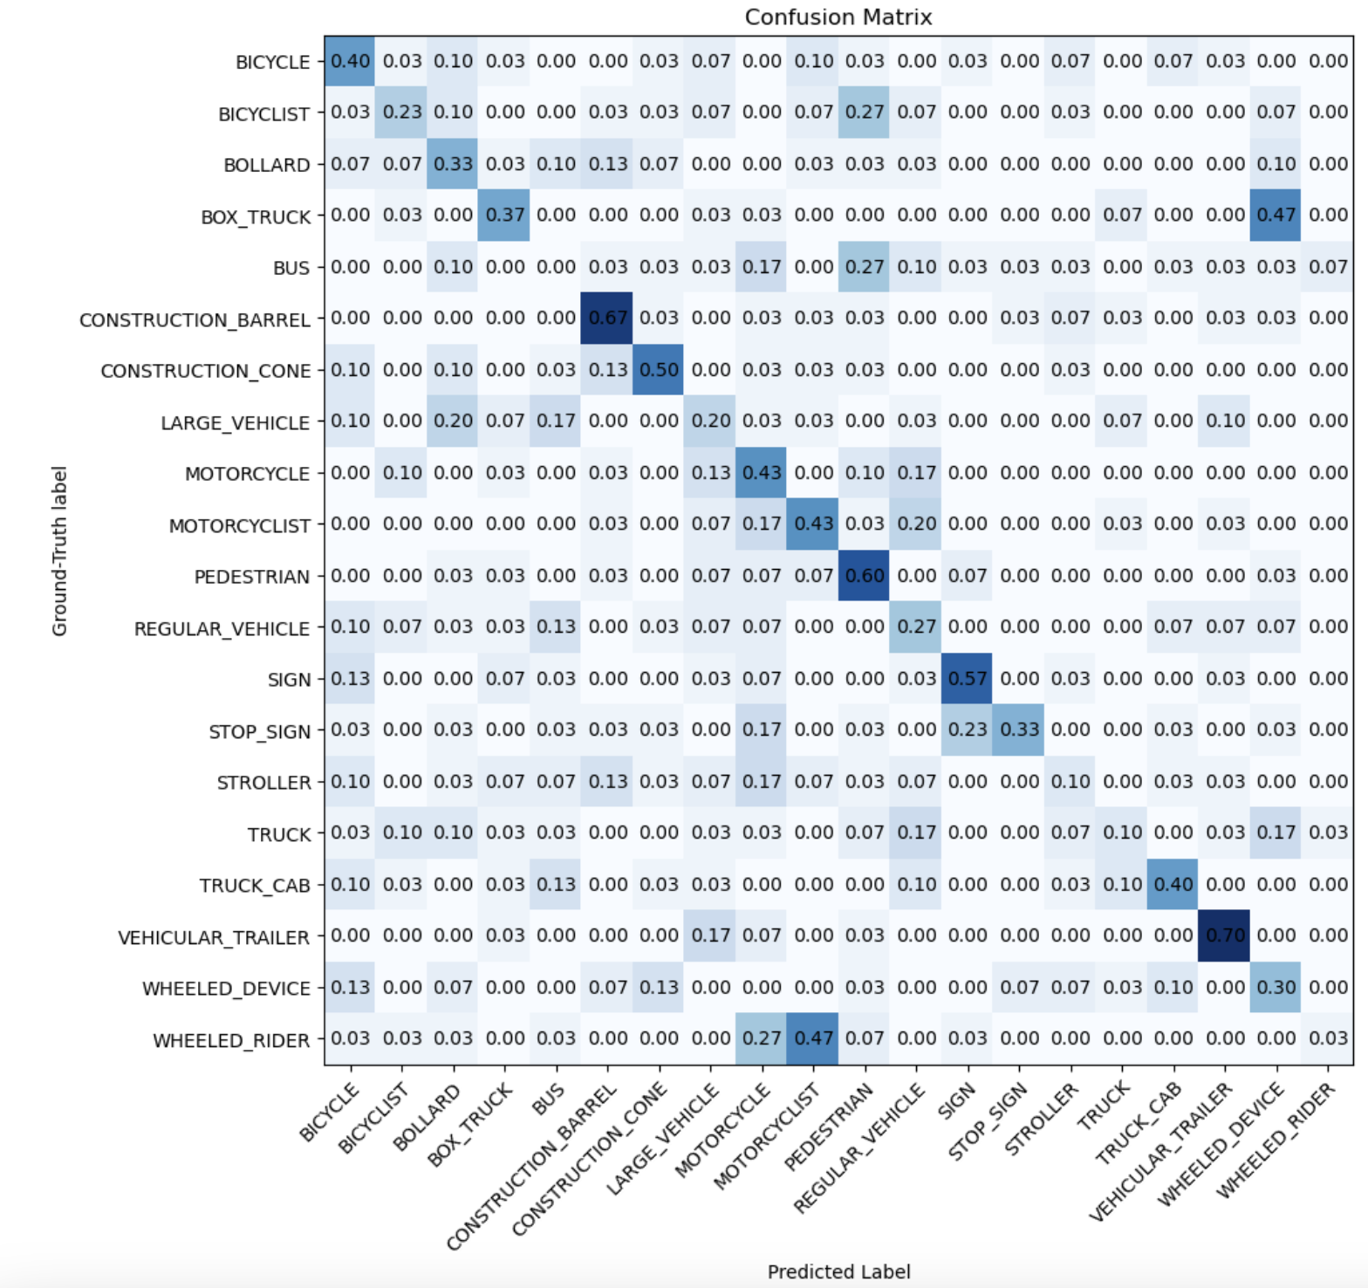
Part 2: Voxel Baseline Model
[insert confusion matrix for baseline model on test dataset]

Slide 3
Part 2: Voxel Baseline Model
[Which classes does this baseline perform well for? Why?]
The highest true positives are VEHICULAR_TRAILER (0.7), CONSTRUCTION_BARREL (0.67), PEDESTRIAN (0.6), SIGN (0.57), CONSTRUCTION_CONE(0.5). This is because these are classes have low variability with consistent geometry. For example, barrels and cones typically have the same point-cloud footprint. Trailer and signs are flat panels.
[Which mode (count or occupancy) achieves higher accuracy? Why do you think this is the case?]
Occupancy outperforms point-counts because it discards the fluctuations from noisy density which occurs from uneven sampling. Point-count is skewed by variations in the point density which is not predictive of the class.
[What are some ways we can improve this voxel based model?]
One way to improve is include a voxel histogram with the PointNet to be able to get fine details and coarse shapes.
Another way is with spatial transformers by aligning the point cloud and a Tnet so that the shapes are always in the same voxel.

Slide 4
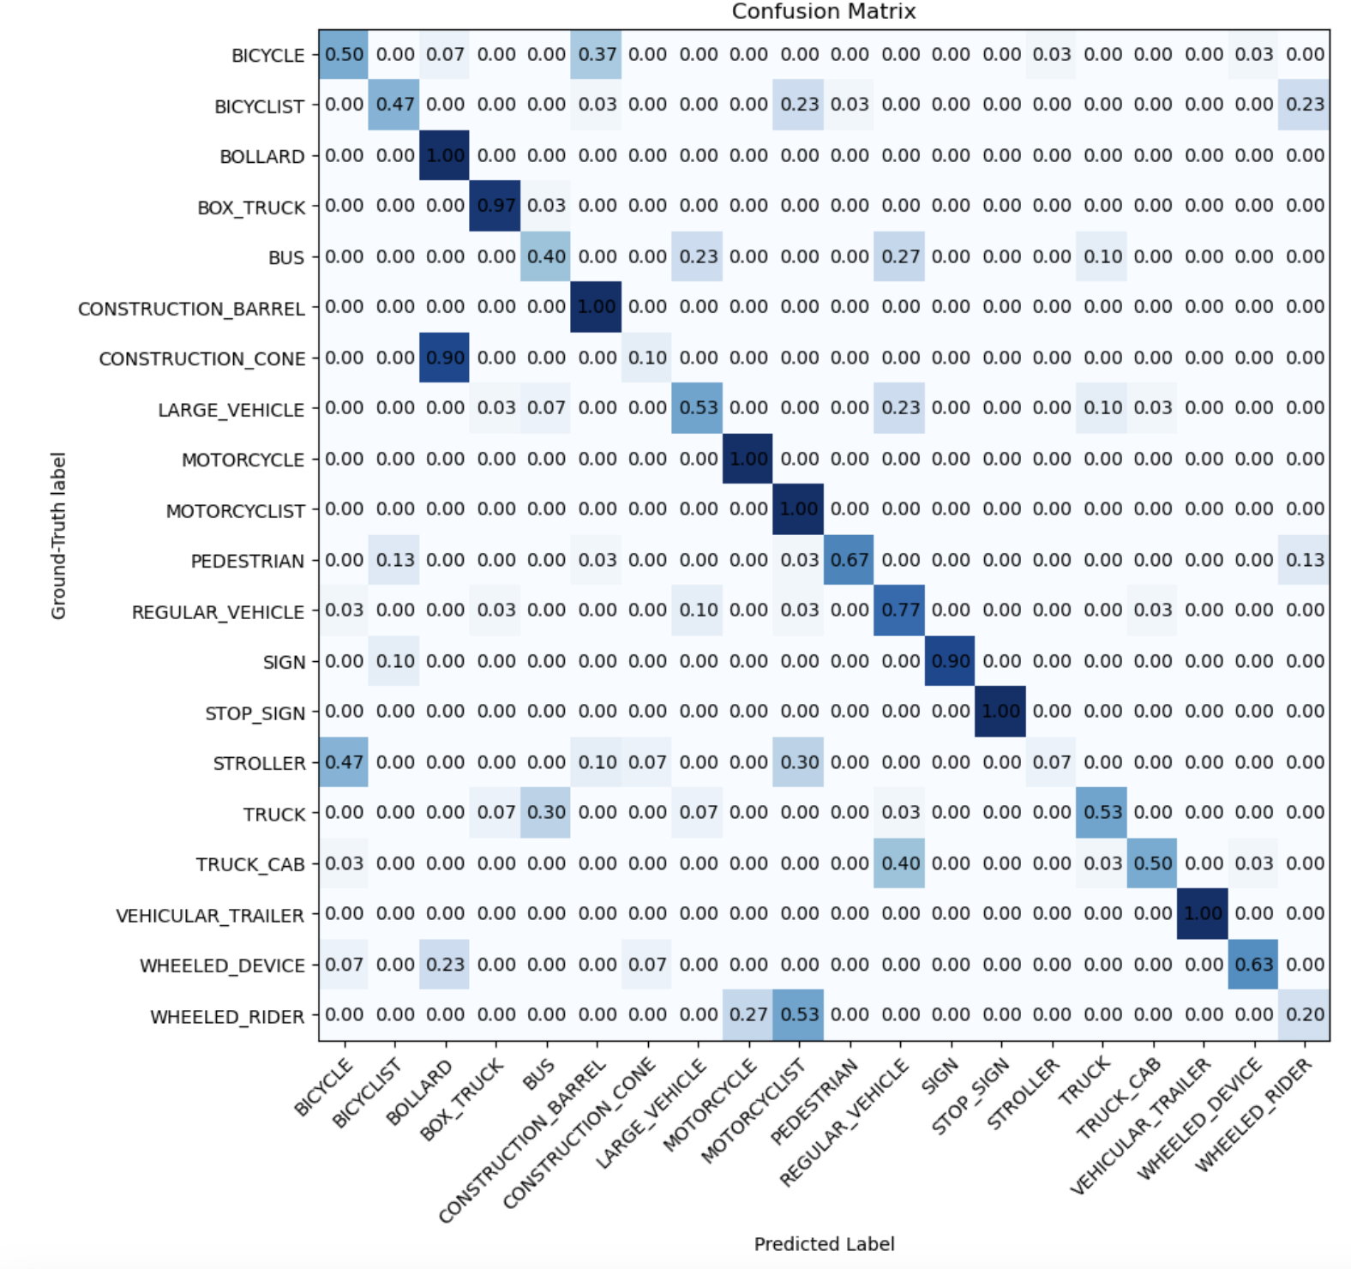
Part 3: Simplified PointNet
[insert confusion matrix for PointNet model on test dataset]

Slide 5
Part 3: Simplified PointNet
[Which classes does this model perform well for? Why?]
BOLLARD, CONSTRUCTION_BARREL, MOTORCYCLE, MOTORCYCLIST, STOP_SIGN, VEHICULAR_TRAILER all have true positive rate of 1.00 and BOX_TRUCK with 0.97. These classes are geometrically simple and have consistent shape. The classes don’t change too much from sample to sample.
[Which classes are most misclassified? What were they classified as and why do you think this is the case?]
STROLLER (0.3), WHEELED_RIDER (0.2), BICYCLIST (0.5) have large confusions. This is because there are too many classes with person + wheels. Strollers have wheels and bicycles have wheels. Wheeled Riders have similar shape to motorcyclists and bicyclists. TRUCK_CAB and BOX_TRUCK have rectangular solids with similar proportions which can be hard to classify.

Slide 6
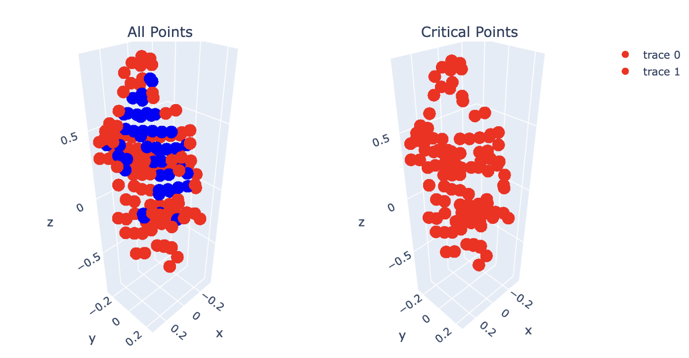
Part 4: Analysis
[insert visualization of critical points on the PEDESTRIAN/11.txt point cloud]

Slide 7
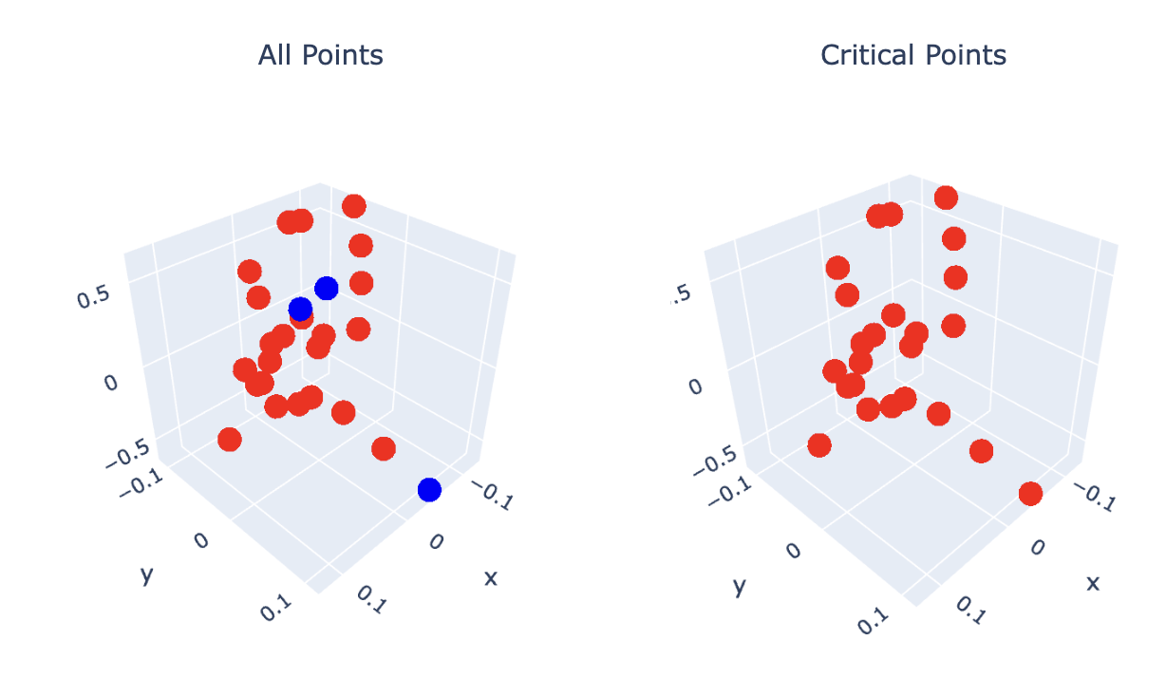
Part 4: Analysis
[insert visualization critical points on one other point cloud, why would it make sense for these to be selected as critical points?]
This is Bollard 11.txt and these are selected because they are the points that maximize the minimum distances. We get the top and bottom extremas and then the evenly spaced rims with saddles. The greedy rule picks the Morse critical locations where the shape’s connectivity changes. Its almost an outline of the Bollard.

Slide 8
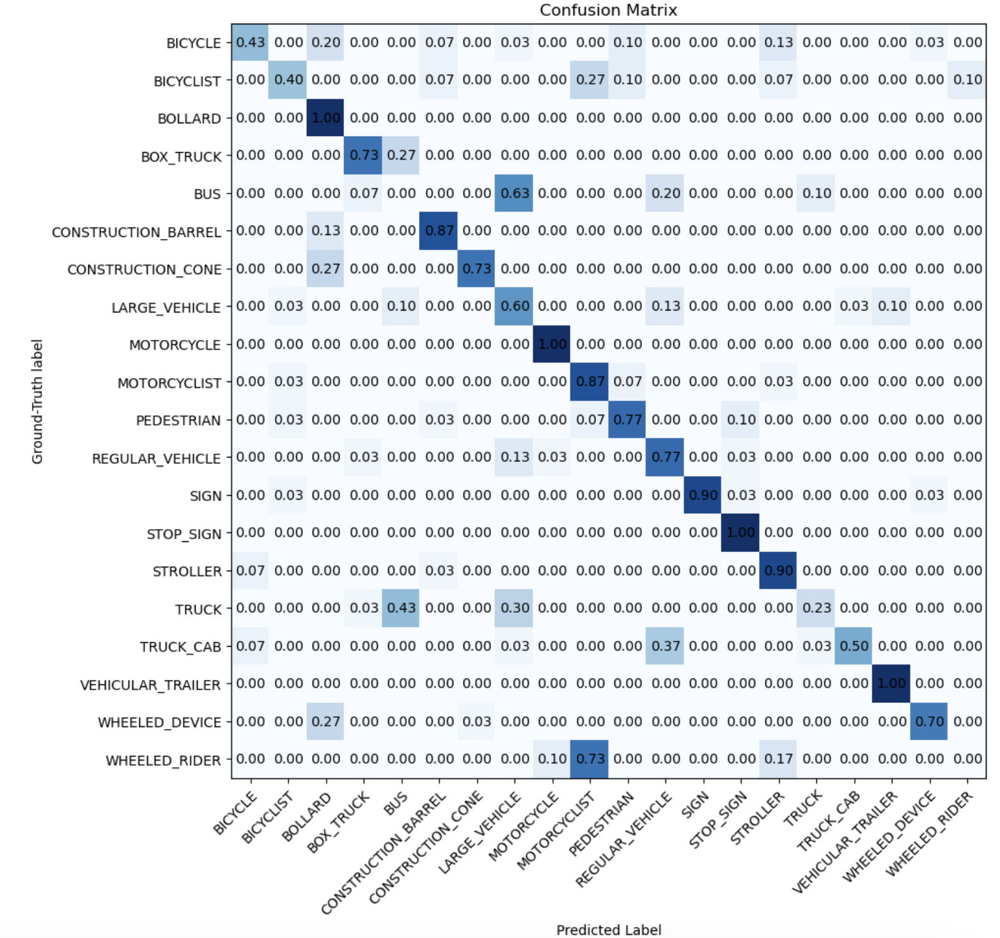
Part 5: PointNet + T-Net
[insert confusion matrix for PointNet with T-Net on test dataset]

Slide 9
Part 5: PointNet + T-Net
[What is the motivation behind using T-Net in PointNet?]
Small T-Net subnets are inserted to mitigate invariance to rigid transformations in images which is a weakness of Point Net’s per point MLP. These T-Nets predict spatial transform and apply to data from input coordinates. It learns to align the feature cloud to a pose which makes the classifer robust towards rotations, scalig, and translations.
[Which classes saw the most improvement from including T-Net? Why do you think this is the case?]
The biggest relative jump in accuracy is BICYCLE, BICYCLIST, MOTORCYCLE, and MOTORCYCLIST which go close to 1 because the T-NET reduces variability in orientation by pre-aligning. This improves the classifier.

Slide 10
Additional Extra Credit (Bells & Whistles)
[describe any additional extra credit you implemented]

