Slide 1


Version Control System with Git

Slide 2
Agenda
Overview of Distributed Version control system
Git lifecycle
Git commands
Branching
Merging
Code Commit in Private GitHub

Slide 3
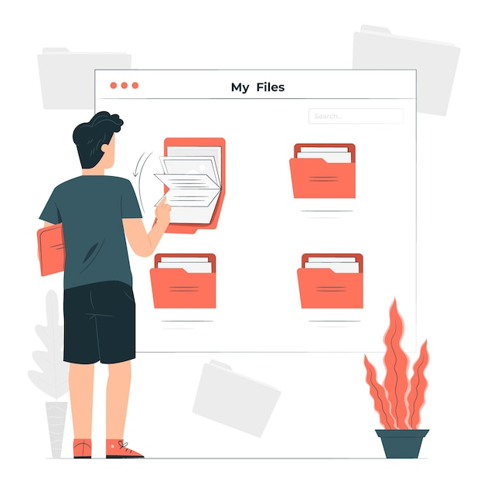
Before Version Control System
File renaming
Login001.java
Login002.java
LoginFinal.java
Directories
June_Release_Code
August_Release_Code
Zip Files
Package_May.zip
Package_June.zip

Slide 4
Version Control
Version Control is a way of storing files in a central location accessible to all team members and enabling them to keep track of changes being done in the source code by whom, when & why. It also helps teams to recover from some inevitable circumstances.
It helps in:
Backups & Restoration
Synchronization
Reverts
Track Changes
Most importantly in Parallel Development

Slide 5
Types of Version Control Systems
Centralized Version Control System
Distributed Version Control System

Slide 6
Key Terms
Repository- A folder/ Project
Commit- To save to the repository

Slide 7



Centralized Version Control System
SERVER
Repository
Update
Commit
Commit
Update
Update
Commit

Slide 8





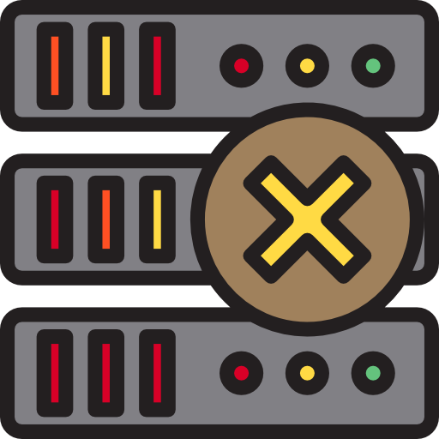
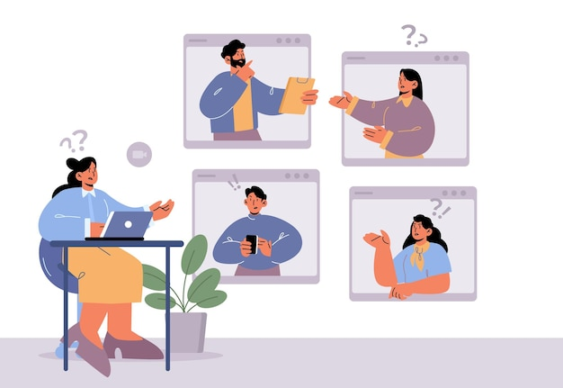
Centralized Version Control System
PROS:
Simplest form of version control
CONS:
Require internet connectivity
Failure in the central server terminates all the versions
Multi-developer conflicts

Slide 9
Distributed Version Control System
SERVER
Repository
Pull
Pull
Push
Push
Pull
Push
Repository
Repository
Repository
LOCAL
Commit
Update
Commit
Update
Commit
Update

Slide 10






Distributed Version Control System
Can work with a local repository without an internet connection
Concept of local repositories
Failure in the main server does not affect the development
Faster

Slide 11

Git
Git is a free and open source distributed version control system.
It emphasises on speed and data integrity

Slide 12


Git
Developed in the year 2005
Initially created for development of the Linux kernel
Linus Torvalds
Junio C Hamano
Author
Core maintainer

Slide 13
Git Lifecycle
There are three Git states:
Working directory
Staging area
Git directory

Slide 14
Git Lifecycle
Stage2: Staging area
Working directory
(Untracked by Git)
Staging area
Local Repository
Remote
Repository
Working directory
(Tracked by Git)
Stage1: Working directory
Stage3: Git Directory
Indexing is the process of adding files to the staging area.
git
commit
git
push
git init
git add
LOCAL
REMOTE
In this state, metadata about project files' history will be tracked.
Working directory is the directory containing hidden .git folder.
In this state, you group, add and organize the files to be committed to Git for tracking their versions.
Remote repository means mirror or clone of the local Git repository in Gitlab.

Slide 15
Basic shell Commands
cd | Change directory | Navigate to other directories | cd <path>
mkdir | Make directory | Creates new directory | mkdir <file_name>
ls | List | List all files in current directory | ls
pwd | Present working directory | Full path of the current directory | pwd

Slide 16
Git- Download and Installation
https://docs.google.com/document/d/1BoXDmQ3PuB4j-mFo5mH59mgLOaYHPXy-9ssFxPQW2Mg/edit?usp=sharing
Install git
sudo apt update
sudo apt install git
git --version
Configuring git
git config --global user.name "first name last name"
git config --global user.email youremail@yourdomain.com
git config --list
mkdir devop
cd devop
snap install dotnet-sdk --classic
dotnet new webapp -f --help
dotnet new webapp -h
dotnet new webapp -f net7.0 -o coreappdemo
cd coreappdemo
git init
git add .
git commit -m "initial commit"
git remote add origin https://github.com/madhuri75jha/coreappdemo.git

Slide 17
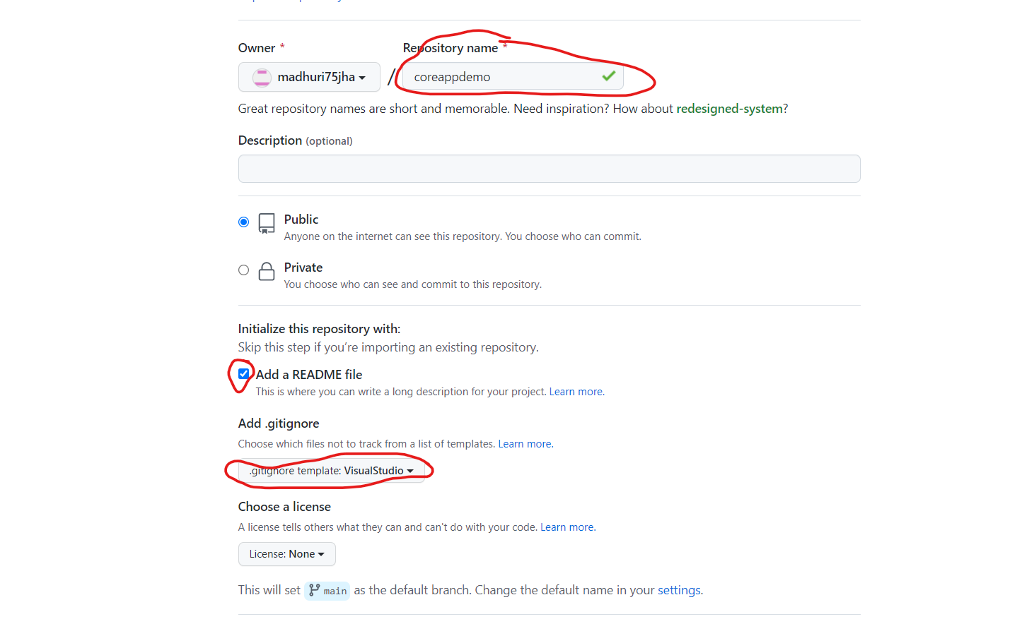

Slide 18
Basic Git Commands
git init | Create a new empty Git repository
git add <file_name> | Stage changes for commit
git commit –m “msg” | Commit staged changes
git status | Current status of the Git repository
git log | Shows the history of changes
git diff --staged | Show difference between working directory and last commit.
git checkout <id/branch> | Checkout the mentioned committed code

Slide 19
GitHub-sign in
https://docs.google.com/document/d/1weuIT_QN2PIIRUEQ6WCJ9O4rD8jUltZEreZl1OMA8aE/edit?usp=sharing

Slide 20
Install git
sudo apt update
sudo apt install git
git --version
Configuring git
git config --global user.name “gitUsername"
git config --global user.email youremail@yourdomain.com
git config --list

Slide 21
LAB 1
Scenario: John is a writer. He writes his story and wants his story to be stored safely every time he makes his changes so that he don’t lose any content. How would you help him?
Create a directory/repository and Navigate inside that repository- mkdir <file_name> and cd <path>
Initialize the empty repository- git init
Create a file inside the folder. Add some text inside it- touch story.txt and echo “text1”
Check the status of the repository- git status
Stage and commit changes- git add story.txt and git commit –m “first version”
Edit the file- vi story.txt
Stage changes. Check the difference. Commit changes- git add story.txt, git diff --staged and git commit –m “second version”
Check the history of the repository- git log
Checkout to the first version of the commit- git checkout <first_commit_id>
https://docs.google.com/document/d/1Q4liPE2XN1jpSAuH4WvpAlxiCDA9DclVI09oIBI_mHo/edit?usp=sharing

Slide 22
Git Branch
Main Branch
1
2
3
4
A
B
Feature Branch

Slide 23
Git Branch
Branching is the way to work on different versions of a repository at one time.
By default your repository has one branch named master which is considered to be the definitive branch.
We use branches to experiment and make edits before committing them to master.
When you create a branch off the master branch, you’re making a copy, or snapshot, of master as it was at that point in time.
If someone else made changes to the master branch while you were working on your branch, you could pull in those updates.

Slide 24
Git Commands- Branch
git branch <branch_name> | A new branch will be created
git branch | List all of the branches in your repo.
git diff <branch1> <branch2> | Lists the difference between working directory and last commit.

Slide 25
LAB 2
Scenario: John has two versions of his story ending and is not sure which one would be the best choice. He wants to keep both the versions for now and decide on which one to choose later. He wants to store both of the versions in a local repository. How would you help him?
Create a branch - git branch <branch_name>
Checkout the branch – git branch
Make some changes in the new branch- vi story.txt
Stage and commit the changes- git add story.txt and git commit –m “message”
Checkout master and verify if the new changes are reflecting- git checkout master and git log
Compare the difference of two branches- git diff <branch_name>
https://docs.google.com/document/d/1CeYpoS0BUKrd5g72fa7MsiKq6W3uHKXytv82RTOHPDw/edit?usp=sharing

Slide 26
Git Merge
Join two or more development histories together
New merge commit
Main Branch
Main Branch
1
2
3
4
1
2
3
4
5
A
B
A
B
Feature Branch
Feature Branch

Slide 27
Git Commands- Merge
git merge <branch> | Merge <branch> into the current branch.

Slide 28
LAB 3
Scenario: John wants to keep both the versions in his story. How would you help him?
Note the history of both the branches- git log and git checkout <branch_name>
Merge the branches- git merge <branch_name>
Check the history of the master. You should be able to see changes from the secondary branch as well- git log
https://docs.google.com/document/d/14RXC1oWRnYhgV2o8DtxOLXyg6G5WBaV_539jnjzC7Yo/edit?usp=sharing

Slide 29
Working with remote repository

Slide 30



UI Solution for Git
Allows all the team members to collaborate in every phase of the project.

Slide 31
Git vs GitHub
GitHub is designed as a Git repository hosting service
Git is installed and maintained in your local system(rather than in the cloud)
GitHub is a cloud-based hosting service
Git is a high quality version control system

Slide 32
Git Workflow
LOCAL
REMOTE
Working
directory
Staging
area
Local
repo
Remote
repo
git add
git commit
git push
git pull
git checkout
git merge
git clone

Slide 33
Git Commands- Remote
git remote add <remote_name> <remote_github_url> | Associate the working directory to the remote directory
git push <remote_name> <branch> | Publish local changes on a remote repository
git pull <remote_name> <current_branch_name> | Get changes from specific remote branch and get it merge in current local branch
git clone <remote_repo_url> | Creates a copy of a specific repository or branch within a repository

Slide 34
LAB 5
Publish to remote repository
Login into your GitHub Account.
Copy the URL.
Associate the working directory to the remote directory- git remote add <remote_name> <remote_github_url>
Publish local changes on the remote repository- git push <remote_name> <branch>
Create merge request and merge
The content from local repository will be reflected in GitHub
Get changes from remote repository
In the GitHub, make some changes and commit.
Get the changes from remote repository.- git pull <remote_name> <current_branch_name>
Create a copy of a repository
Create a copy of a repository- git clone <remote_repo_url>
https://docs.google.com/document/d/17l-22XkYOU_kZBeGPmoEaHlMiARoTVpM56temPuZ__4/edit?usp=sharing

Slide 35
LAB 6
Create a remote repository in GitHub
Associate the working directory to the remote directory
Publish local changes on a remote repository
Refresh the remote repository. You should be able to see the changes from local repository

Slide 36
Cheat sheet
https://thinknyx.com/git-cheat-sheet-2-2/
https://www.youtube.com/watch?v=1nRJCyY8r08&t=24s

Slide 37







