Slide 1


Mint Plants-Consultancy Project
Final Report
Team: Leafy Insights
Anirudh Balaji (Lead)
Akash Rajkumar
Tingxuan Wang
Yiwen Xiao
Academic Supervisor:
Prof. Koichi Yonezawa

Slide 2
Focal Business Analysis Questions
Key Business trends and patterns
Identify and reward the loyalty of repeat customers
Customer Segmentation for Targeted Marketing
Improve Efficiency of Customer Support & Interaction
Improve the delivery of expert plant care knowledge
Other Literature Research Based Sales & Marketing strategies
Notes:
To answer these questions, we’ve used multiple characteristics/features of the provided datasets and by answering them, we aim to present key figures, metrics and recommendations that will help enhance business.
The presentation is structured in a way that the data insights are described followed by recommendations based on the patterns identified.

Slide 3
Data
Orders: ~14,000 orders from November 2018 to February 2024 (project commencement month).
Key Features: Order date and time, Billing and Shipping Addresses, Product, Price and Quantity.
Customers: Anonymized data of ~5,000 customers
Key Features: Customer ID, Addresses, Total Spent, Total Orders.

Slide 4
Discerning Shopping Trends:
Time, Seasonality & Product Perspective

Slide 5
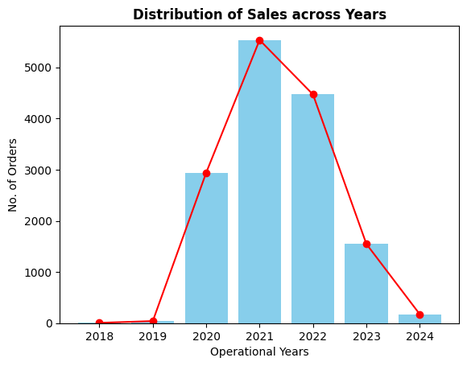
What drove sales and how?
The houseplants industry flourished courtesy the COVID-19 pandemic.
Such rapid growth is seen for Mint Plants as well.
2021 saw an 88% increase in sales from 2020 and stands as the peak sales year.
Pandemic isolation, turned people towards houseplants for companionship and mental well-being.
Plant enthusiasts spent £6.1 billion across UK on their gardens, plants and flowers in 2022 alone.
Notes:
We’ll start with key drivers of sales and how it was distributed over the years.

Slide 6
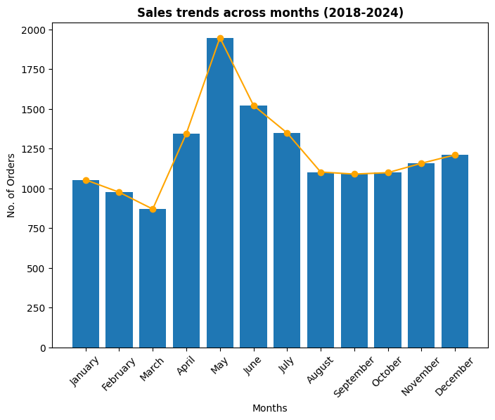
Seasonality and Monthly Trends
Spring and Summer dominated the sales with the peak in May.
“Searches for gardening in the UK climb in March every year, usually peaking in May”- Google Trends Report
Attributed to favorable plant growth conditions like longer hours of sunlight.
Autumn through Winter saw relatively flatter sales with March being the leanest.
Notes:
As we know Plants are influenced by Seasons. So we tried to understand its influence on sales by looking at sales every month over the years.
Next we’ll see which products were influenced by this seasonality.

Slide 7
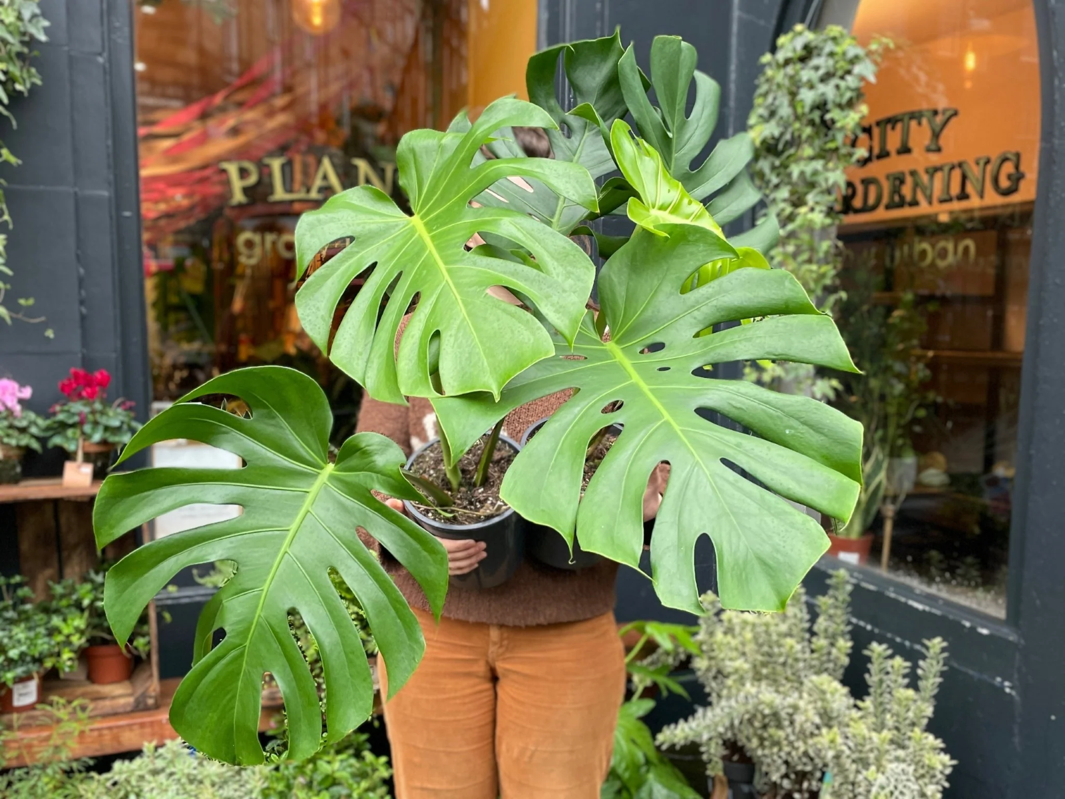
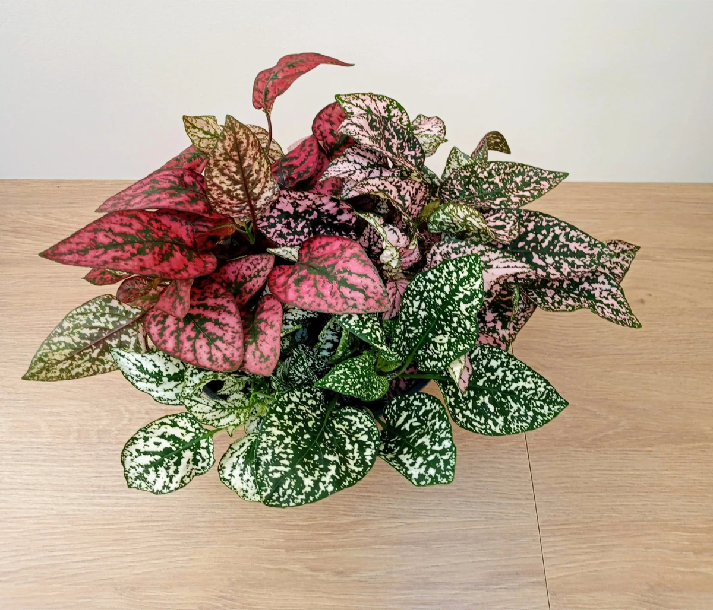
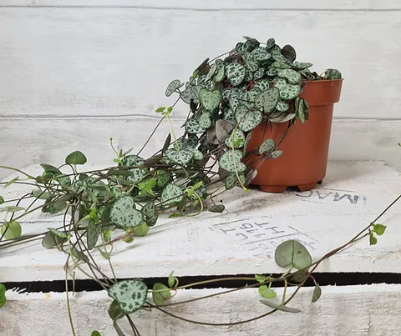
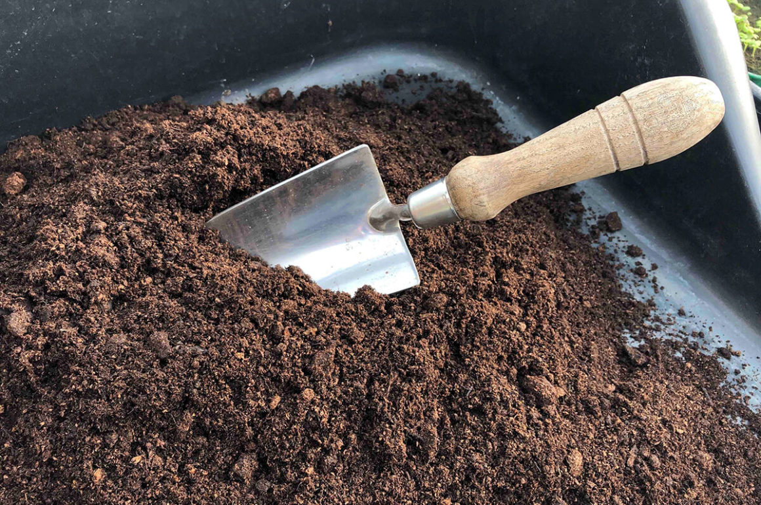
Product Level Analysis
Cross Seasonal Best-Selling Products
Swiss Cheese Plant Varieties
Among the top sellers across Spring, Summer and Winter
Hypoeste
Among the top sellers in Autumn & Winter
Peat Free Compost
Among top sellers in Spring, Summer and Autumn
String Of Hearts
Among top sellers in Summer & Winter
Notes:
It is important to identify the top sellers in each season to help with inventory and promotions. So products were grouped by seasons to identify best sellers

Slide 8
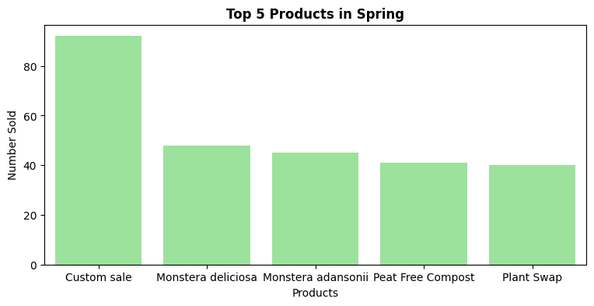
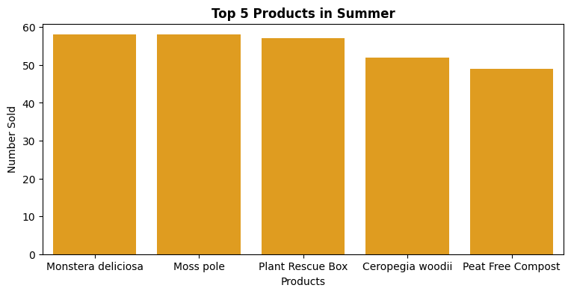
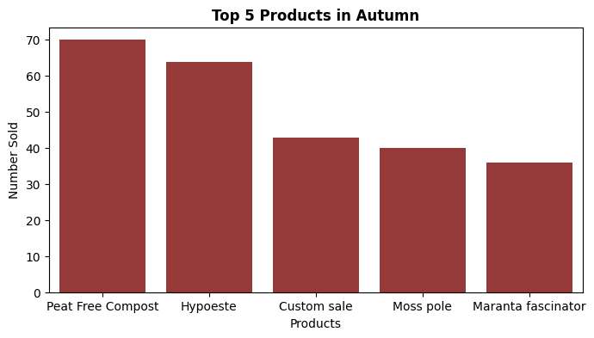
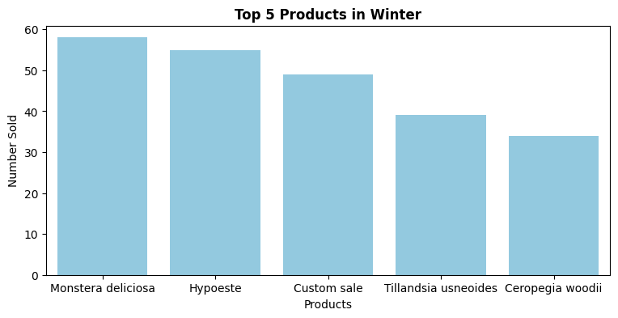
Notes:
This offers a broader picture on the top 5 in each season.

Slide 9
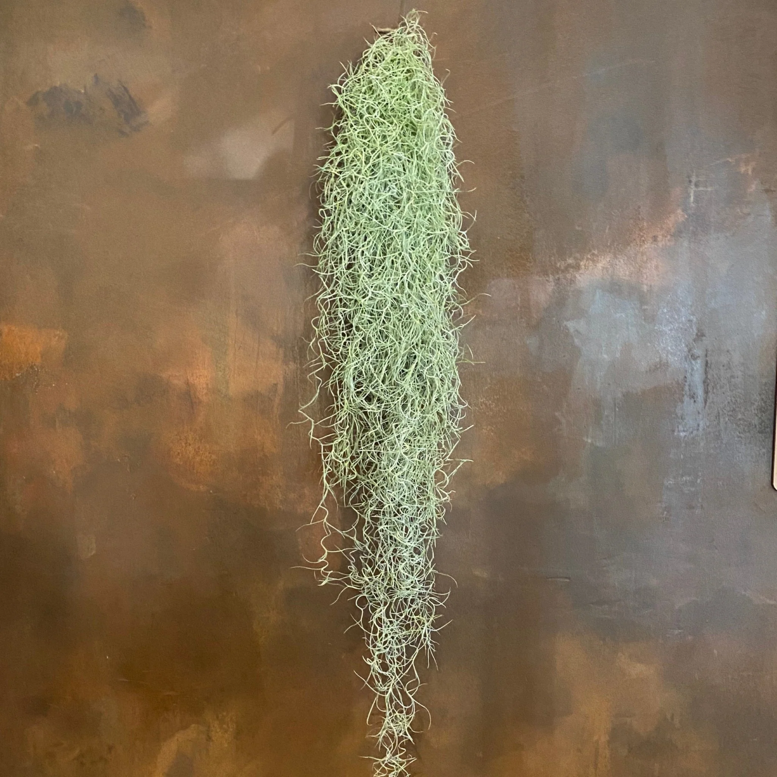
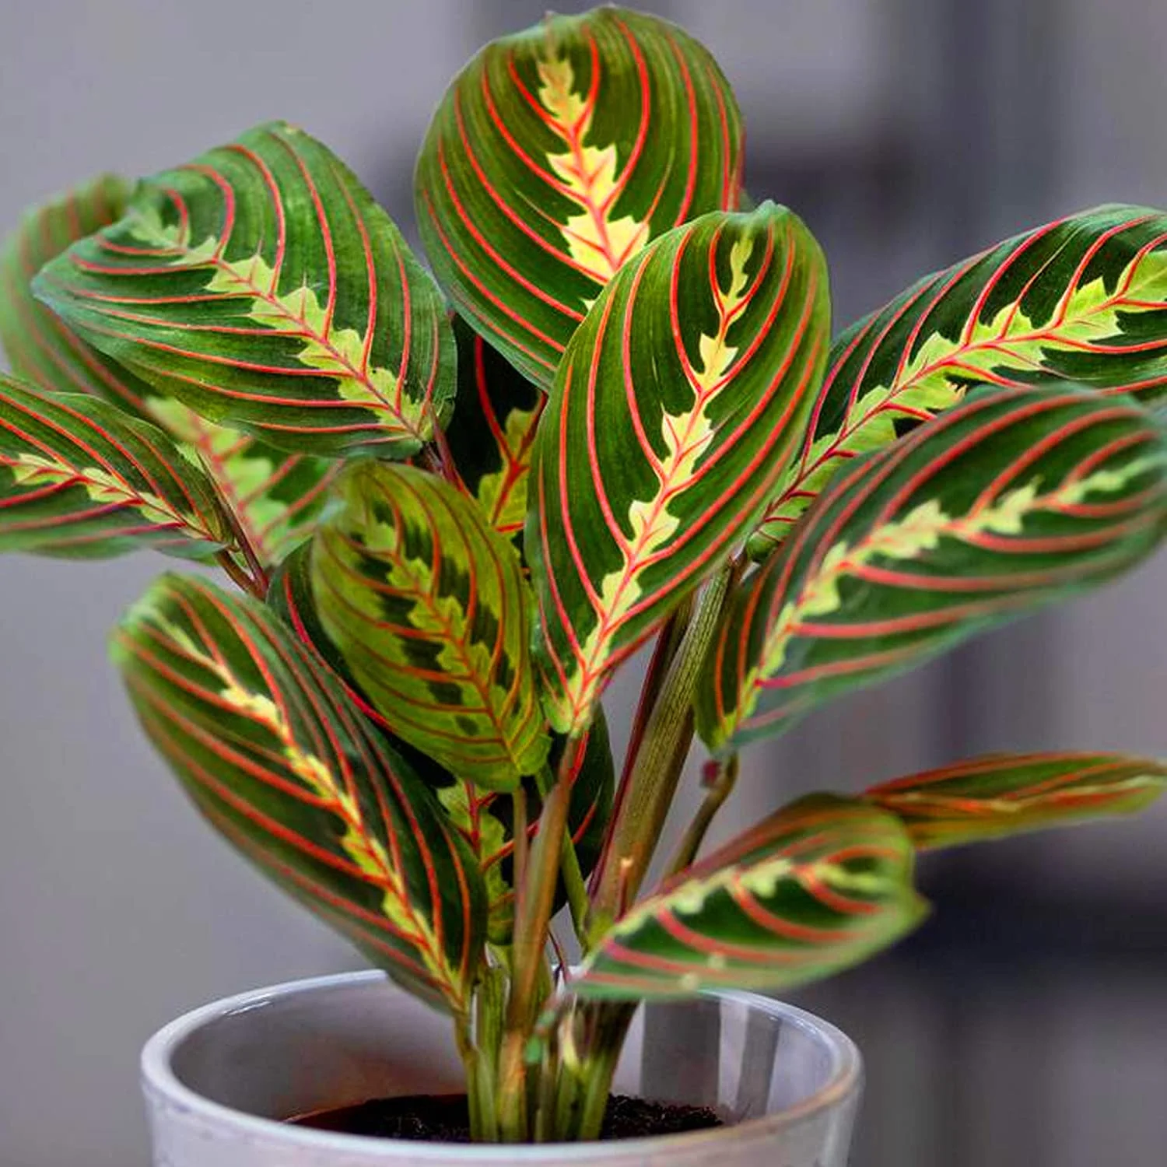
Tillandsia Usneoides (Spanish Moss)-
Popular In Winter
Maranta Fascinator (Prayer Plant)-
Popular In Autumn

Slide 10
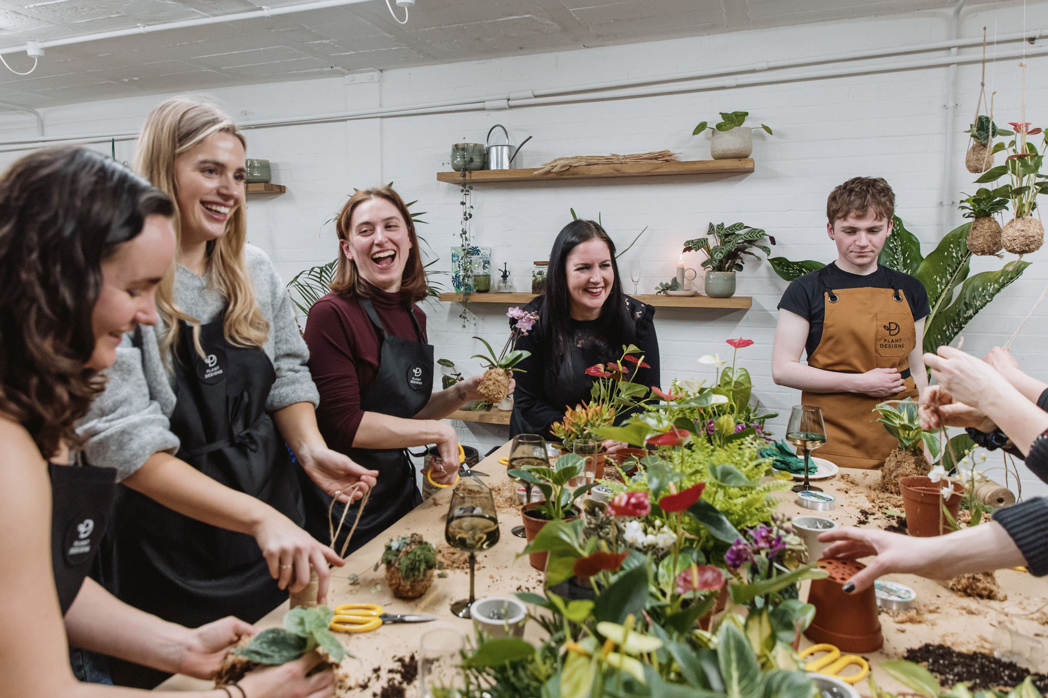

Recommendations for Seasonality
Workshops and Events
Particularly Christmas and New Year themed events.
Winter-exclusive line
Introduce plants that are tolerant to the cold and easy winter care.
The HTA advice stocking on tropical species like Devil’s Ivy and Philodendrons for winters.
Notes:
Now that we’ve seen a seasonality component to business, here are some recommendations to utilize this
1. Mint plants already offers a few workshops and DIY events. It is a very good practice that we recommend retaining and offer them during off-peak months (Sept- March).
2. HTA- Horticultural Traders Association

Slide 11
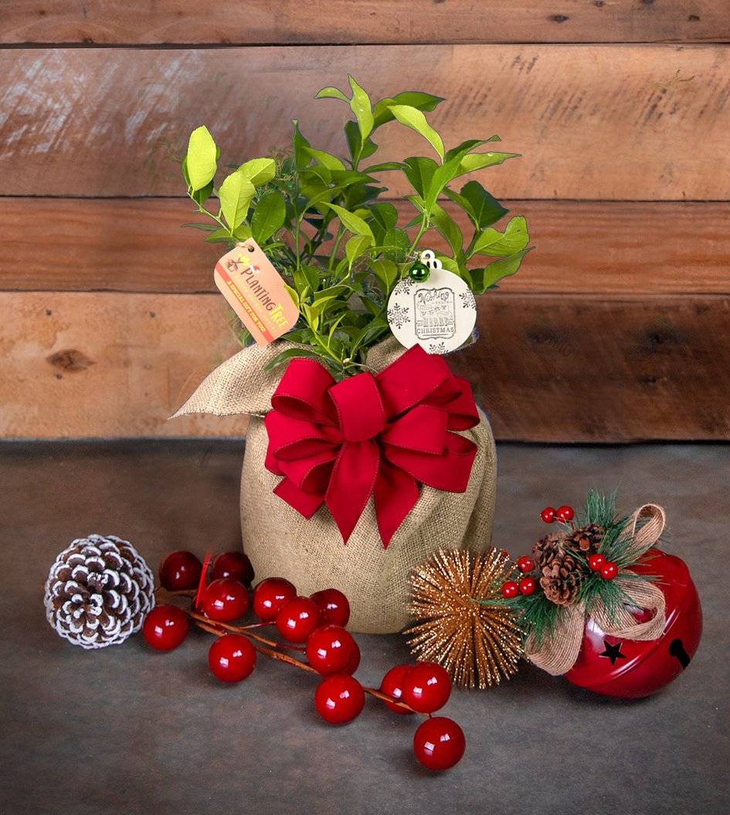
Capitalize on Christmas
13% of yearly houseplants sales happen during December in the UK.
For Mint Plants, December accounts for 8% of the sales.
Christmas gift line
Consumers pay higher prices for plants if they identify the,
-Symbolic value of plants
-Aesthetic and personal well-being.
Introduce plants with symbolic significance and gifting sets and actively market the symbolic value.
Notes:
1. There is potential to boost sales to the national average and beyond.
2. Research has found that… symbolic value- like a particular plant symbolises wealth and prosperity in certain cultures etc,
Well-being benefits like air purifying capabilities, mental-health boosters etc. We’ll dive deeper into this aspect in another section.

Slide 12
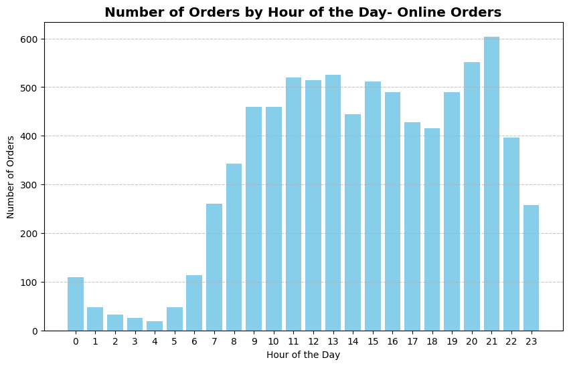
Tracking Website Traffic
First peak is from 11:00 AM-1:00 PM
Last peak is from 7:00-9:00 PM
3000+ orders cumulatively over the six hours.
Notes:
In a similar vein, we used the order times to identify the hours of the day that saw the best business.
From 11 a.m. to 1 p.m., when folks are on their lunch breaks, and then again from 7 p.m. to 9 p.m., after work when they're relaxing.
During these times, people are most active online, and we got over 3000 orders in these six hours.
This information can be used to formulate customer support policies and times.
Using this info, strategies like Happy hours with special discounts can be introduced.
For example, lucky draw for free delivery on orders placed during happy hours or reduced prices on long-time unsold plants

Slide 13
Recommendations for peak hours
Happy Hours:
The business can run happy hours during off-peak times.
Smartly plan customer service:
Peak hours -> highest online footfall.
Many customers may have questions about purchase.
The second peak of 7:00-9:00 PM is past closing time.
Set the business apart by investing in dedicated customer service personnel for the evening peak.
Promptly answer customer queries coming in via chatbots, WhatsApp or Instagram.
Offer perks like:
Lucky draw for free delivery on orders placed during happy hours.
Reduced prices on long-time unsold plants during the happy hours.
Themed happy hours/days like ‘Minty Mondays’ or ‘Plant of the week’.

Slide 14
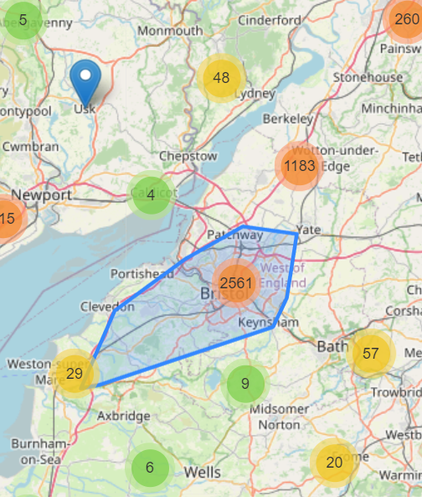
Geographical Analysis
4000+ orders were from the Bristol area
The local market of Bristol is the most important for Mint Plants.
Due to positive word-of-mouth, better brand reputation and awareness.
Notes:
Next, we’ll look at Geographical Analysis.
This map was extracted using customer addresses. Bristol was our top spot with over 4000 orders.
This extended from Weston-Super-Mare up to Wotton-Under-Edge.
This makes sense since we've built a good reputation there.

Slide 15
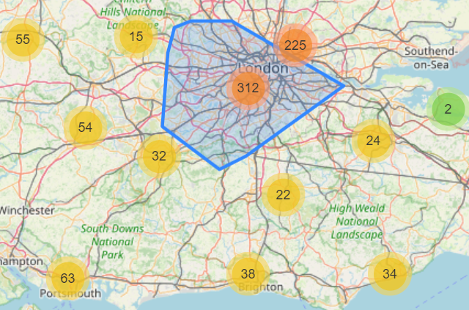
The second highest contributing location was London.
Recommendations
Conduct workshops in high value areas other than Bristol, like London or Southampton.
Conduct innovative events like Plant Pageants.
Notes:
London came in second, surprising given all the competition there. Future analysis can identify what set Mint Plant’s apart by surveying customers outside of Bristol.
Invite most valuable customers to showcase their plants purchased from Mint. to increase brand exposure in those areas and bolster business.

Slide 16
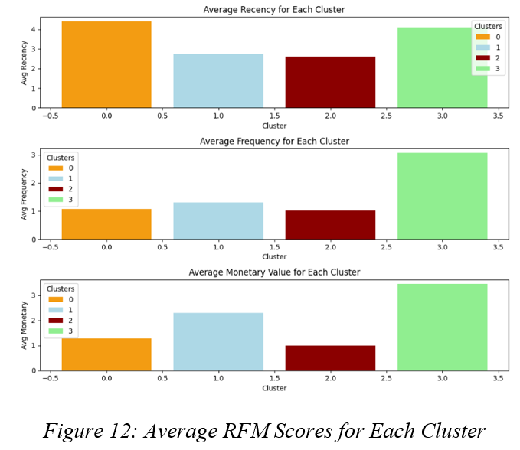
Customer Segmentation using RFM Analysis
Customers were divided on three questions.
Recency- How many days has it been since their last order?
Frequency- How frequently have they been shopping historically?
Monetary- How much revenue over their lifetime with the business?
Orange- New customers
Blue- Potential Loyalists
Red- Need Attention
Green- Champion Shoppers
Notes:
The key part of the analysis was segmenting the customers into logical groups to understand the value of customers and their shopping patterns.

Slide 17
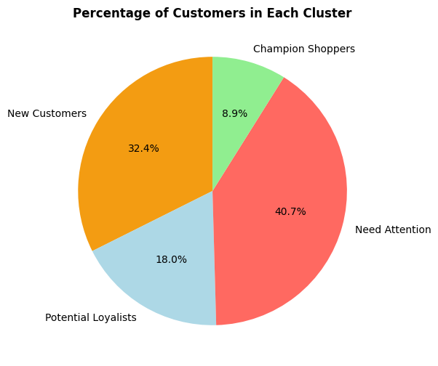
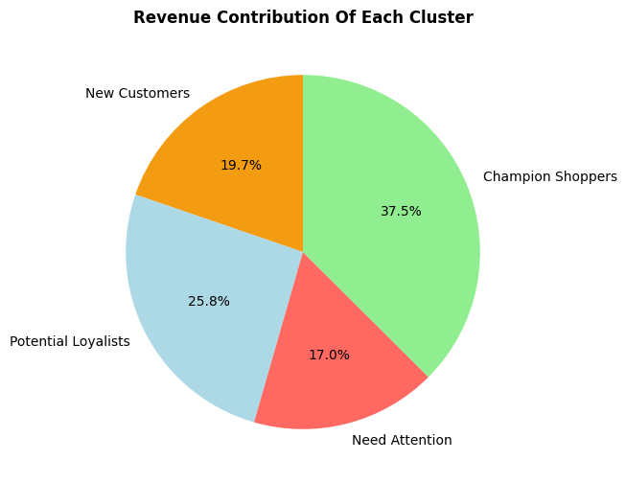
9% loyal Champion Shoppers who contributed 38% of Mint Plants’ revenue.
New customers contributed 20% of the revenue.
>40% of the customers fall under the ‘Need Attention’ cluster.
9% of customers are ‘Champion Shoppers’.
‘New Customers’ cluster make up 30% of the customers.
“Increasing customer retention rates by 5% increases profits by 25% to 95%”-
Harvard Business Review.
Notes:
Silver lining for the business is the New customers
which shows that Mint Plants effectively captured new businesses.

Slide 18

Recommendations for RFM driven marketing
For New Customers:
Market research shows that people preferred easy-to-care plants.
Target with mainstream popular flowering, fruit or vegetable plants
Easily identified and easy-to-care.
Like
“how’s your *last purchased plant* doing? Get in touch with us for any support”
Notes:
1. They mostly preferred ornamental and flowering plants. Fruit, vegetable and medicinal plants stood second.
2. New customers may not all be experts in knowing the right plant for them. Slide. Continue with existing discounts like 10% off on the first order.
3. Monitor order frequency and send marketing nudges to show the business cares.

Slide 19

For Champion Shoppers and Potential Loyalists
May be beneficial to introduce a loyalty program and invest in customer loyalty software.
Loyalty programs
Special discount vouchers based on purchase points accumulated.
Tokens of appreciation like personalized thank you cards with every purchase.
Free Shipping for certain orders.
Personalized marketing emails on launch of new collections.

Slide 20

Plant expert consultation
Offer in person or online consultation hours.
Market it as ‘Plant Doctor’.
For Need Attention customers:
Previously loyal customers who stopped or moved brands.
There may not be much benefit from marketing to them.
Occasional marketing like
‘haven’t seen you in a while’, ‘what can we do better’.
Send incentivized surveys to understand their shopping experience
Find areas of improvement.
Notes:
1. Provide tailored advice on most suitable plants for them and care advice if their plants are damaged.

Slide 21
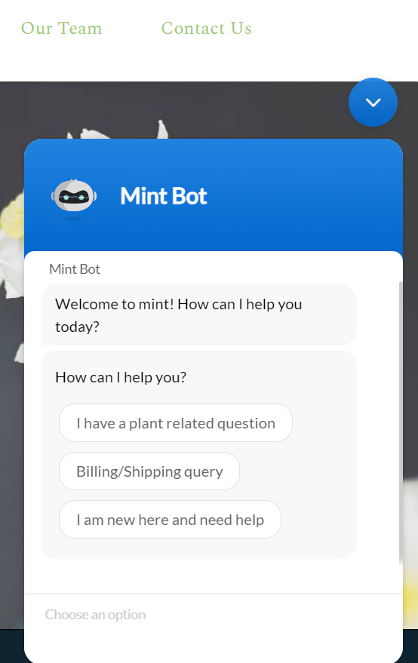

Chatbot Implementation
Motivation
Deflect repetitive queries
Provide manual support only, when necessary.
Keyword driven responses generated.
More complex inquiries escalated to live operators.
A demo was created and tailored to Mint Plants’ use case.
Textual content from their website trained the chatbot.
Notes:
The AI-backed bot directs customers to relevant information based on keyword searches. By this FAQs are majorly deflected

Slide 22
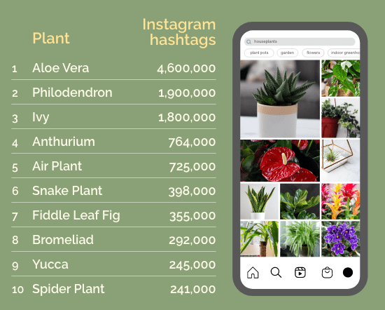
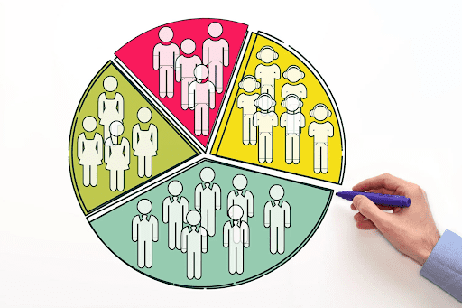
Other Recommendations
Be Mindful of national trends
In 2022, Aloe vera was the most searched and most ‘instagrammable’ plant in the UK with over 4 million hashtags.
Age and gender data collection
Highly recommended for better targeted marketing.
Notes:
2. For instance, research found that women tend to shop more in the afternoons while men prefer morning.
People aged 35 and above preferred cheaper and common houseplants & ages 26-35 preferred rare plants.

Slide 23
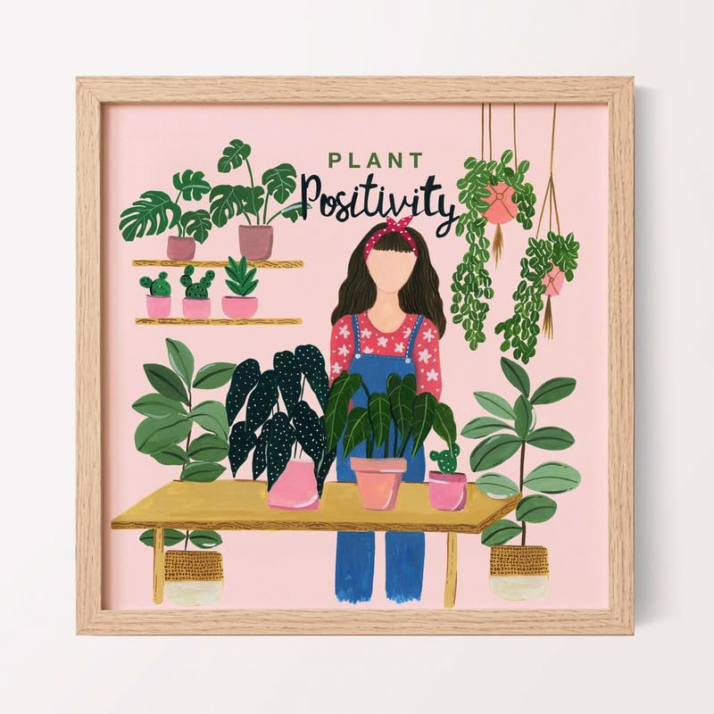
Promoting Plant Positivity
Mental state can be enhanced by the viewing of greenery when working on laborious tasks.
Marketing the health benefits and symbolic value of plants significantly improved sales.
During the pandemic, people who lived with houseplants for a long time, were found to be
Happier
Tolerant
Less aggressive
Ultimately suffer less from depression.
Notes:
1. Mint Plants should promote this positivity of plants.
3. Marketing focused on the message that plants make people happy and relieve stress.
Visible tags can be added to each plant’s description stating their benefits in easy-to-understand ways.

Slide 24
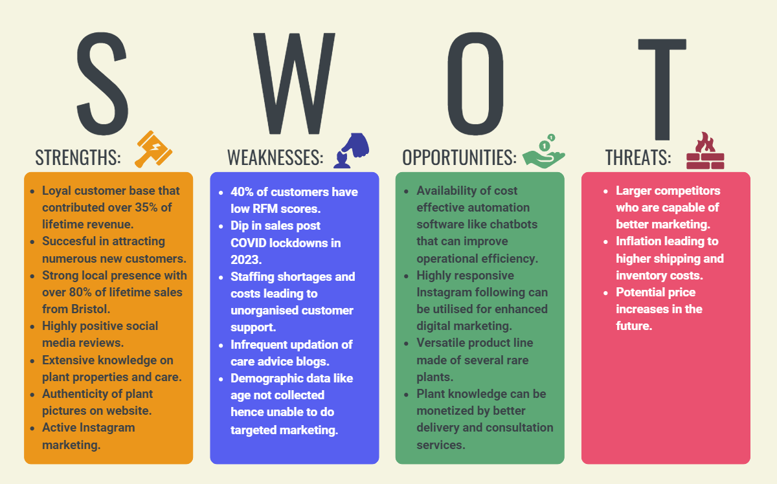

Slide 25
THANK YOU!

