Slide 1
Churn Analysis 2020 Anirudh Balaji
The year 2020 was shaped by the COVID-19 pandemic that brought unforeseen challenges to businesses worldwide who faced great operational and financial stresses which could potentially have long-term ripple effects.
It had profound impact on customer behavior as well greatly influencing purchasing power, patterns and loyalty and makes it a crucial point in time for a retrospection.
This report analyses churn data for customers churned in 2020 and is structured as below:
Executive Summary: 2-3
Region wise Insights- NAMER: 4
Region wise Insights-EMEA: 5
Region wise Insights- APAC: 6
Key Takeaways: 7
Snapshots of the interactive dashboard: 8-11
CSM Data Analysis (Assignment Part C)- From 12

Slide 2
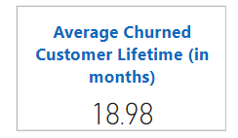
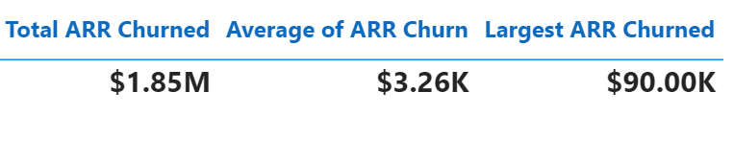
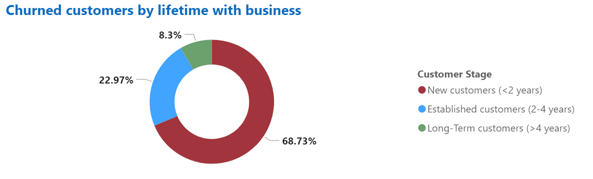
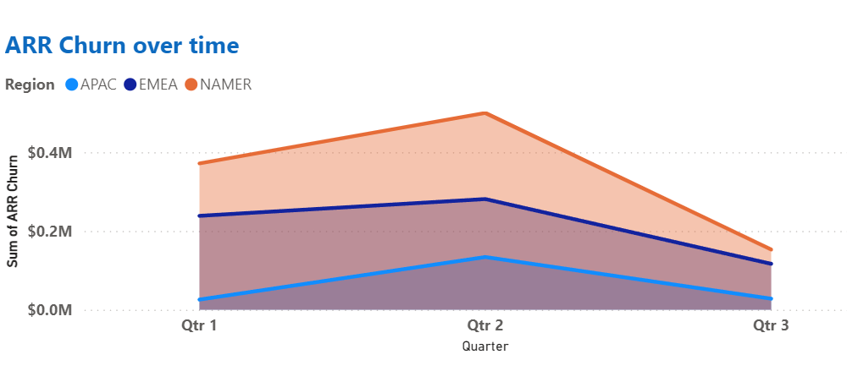
Executive Summary- Churned Customers 2020
New customers retention risk
We are facing a challenge with new customer retention as 69% of churned customers were with us for < 2 years and the average lifetime of churned customers was 19 months.
This could indicate gaps in onboarding , post go-live engagement, early value delivery and support and underlines the need for enhanced support in the initial stages of product adoption.
Fortunately, only 8% of churned customers were long-term (4+ years) highlighting the potential long-term value of the product, customer loyalty and healthy working relationships.
Focus needed on NAMER
The NAMER region was an area of concern recording the highest churn of $1M ARR and the single largest ARR churn of $90k reflecting a need for dedicated efforts to secure this region. Q2 of 2020 saw maximum ARR churn potentially driven by the economic pressures of the COVID-19 pandemic which severely impacted all businesses.

Slide 3
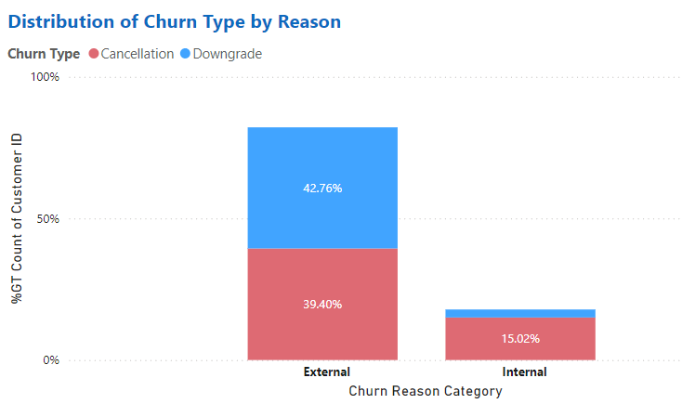
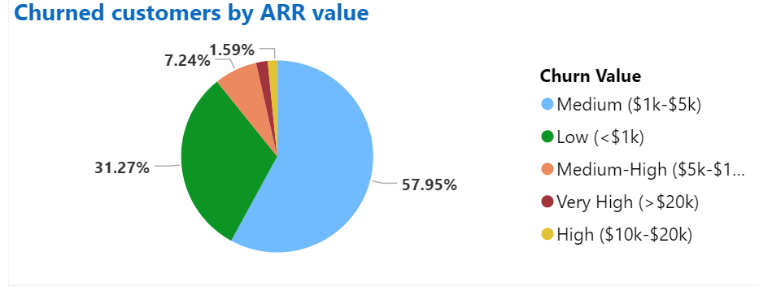
Executive Summary- Churned Customers 2020 (Contd.)
Importantly, almost all the churn due to internal reasons resulted in cancellations and negligible downgrades which shows the greater impact of the internal reasons.
Low and Medium Value Accounts at Risk
Though only 4% of churned accounts were of very-high (>$20k) and high value (>$10k), there is a striking concern on the 90% share of medium ($1k-$5k) and low (<$1k) churned accounts.
This could potentially be due to smaller businesses more susceptible to economic pressures or less dedicated support and engagement efforts for smaller accounts compared to enterprise accounts.
External factors influenced churn- The Silver Lining
A significant 82% of churned customers were due external reasons like business shutdown, switch to competitor and non-payment issues. Out of this, there was an almost equal distribution between downgrades and cancellations.
Only 18% churned customers indicated product issues like feature unavailability, pricing and unsatisfactory service which suggests a strong product and service offering that meets customer expectations but increased switching to competitors needs to be analyzed in-depth.

Slide 4
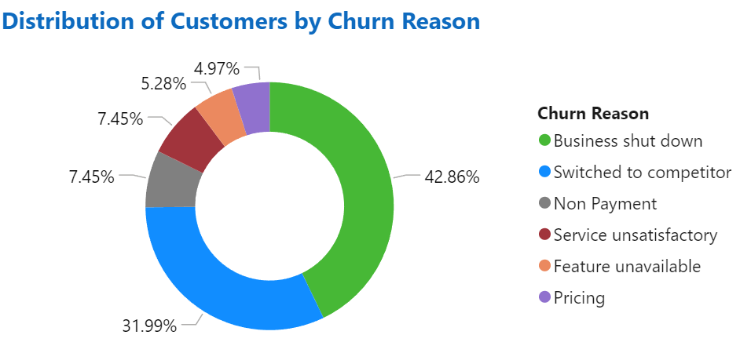
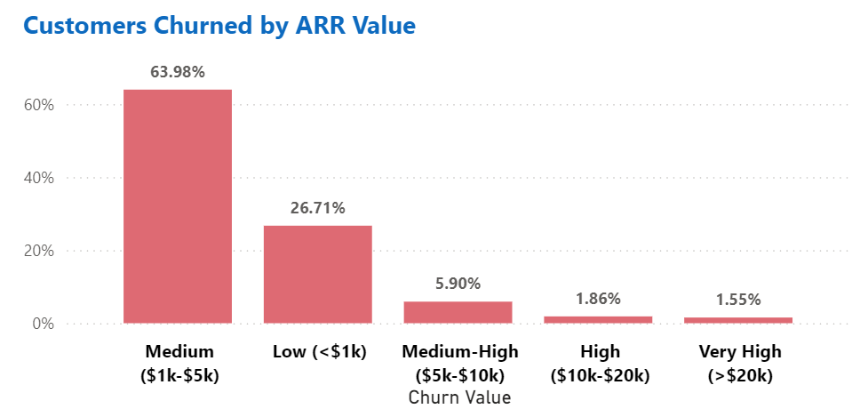
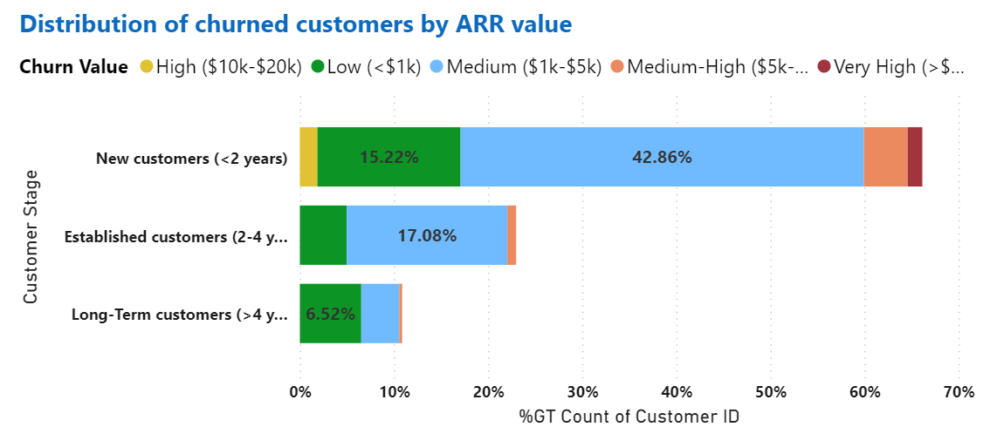
NAMER- Region Wise Insights
Business Shutdown and Competitor switch dominated the churn reasons in NAMER but a noticeable 13% were due to unsatisfactory service and feature unavailability.
Aligning with the overall trend , medium ($1k-$5k) and low(<$1k) value accounts accounted for 90% of churn.
But the 4% High and Very High customers churned due to unsatisfactory service and feature unavailability which was an area of concern.
70% of churned customers were new (<2 years) and in this cohort majority (43%) were medium value accounts ($1k-$5k) but also a noticeable 5% were medium-high value accounts.

Slide 5
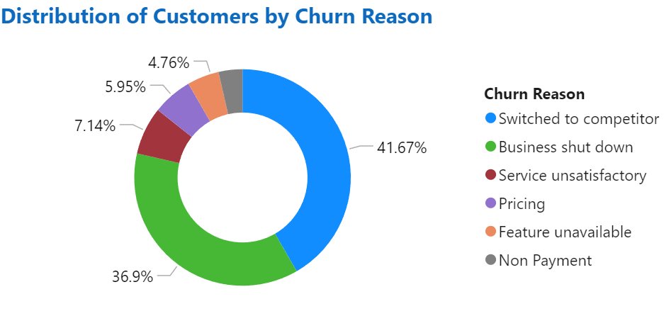
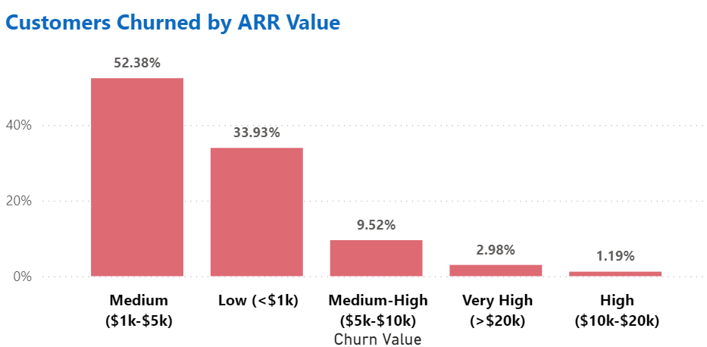
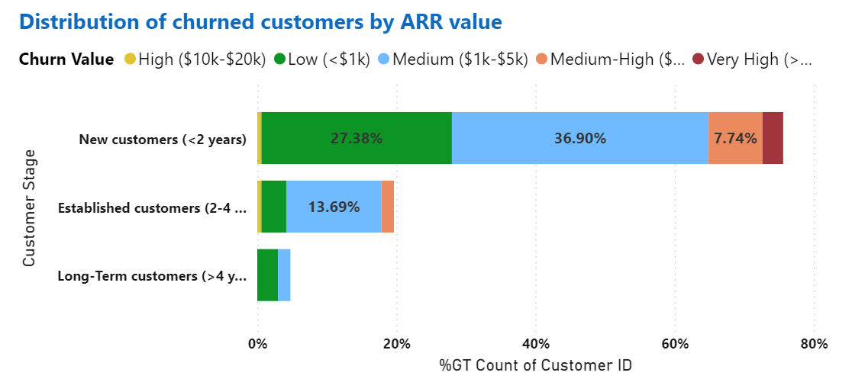
EMEA- Region Wise Insights
Competitor switch dominated the churn reason more in EMEA than NAMER but a similar 12% were due to unsatisfactory service and feature unavailability.
Medium and low value accounts accounted for 85% of churn. But almost double the Medium-High ($5k-$10k) accounts churned than NAMER.
4% of churned customers were High and Very High value and churned majorly due to business shutdown.
80% of churned customers were new (<2 years) and in this cohort more than 50% were low and medium value accounts ($1k-$5k) but also a noticeable 8% were medium-high value accounts.

Slide 6
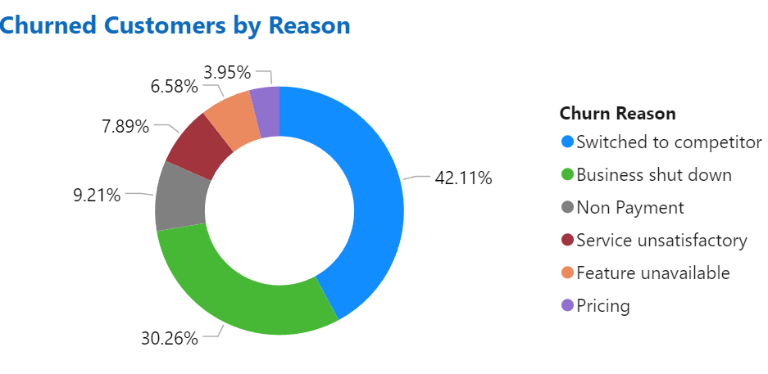
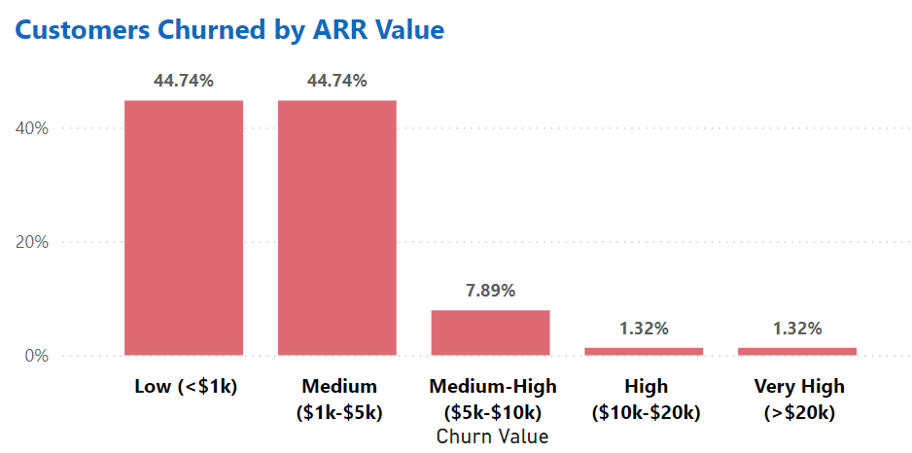
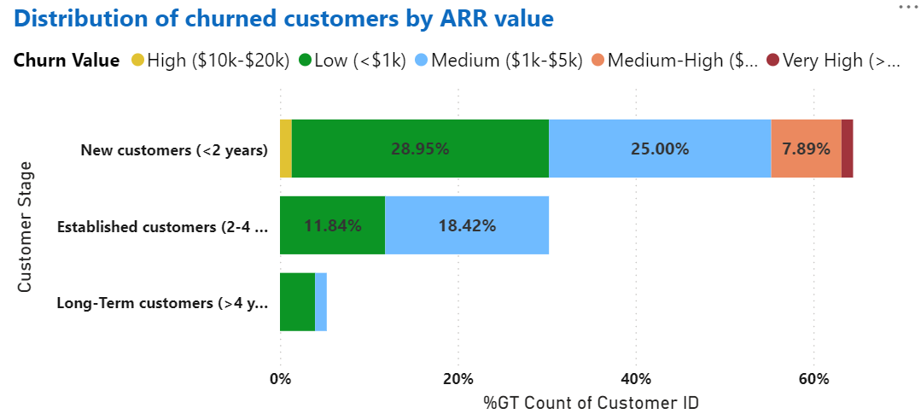
APAC- Region Wise Insights
Competitor switch dominated the churn more in APAC than NAMER and EMEA and 15% of churned customers left due to unsatisfactory service and feature unavailability.
Medium and low value accounts accounted for 90% of churn in APAC.
A lower 2.5% of churned customers were High and Very High value (>$10k) who churned majorly due to feature unavailability.
60% of churned customers were new (<2 years) and in this cohort majority were low and medium value accounts ($1k-$5k) but also a noticeable 8% were medium-high value accounts.
But concerningly, 30% of churn was established customers (2-4 years) and highest of the three regions.

Slide 7
Key Takeaways
Silver Linings
Only 18% of churned customers cited internal reasons like unsatisfactory service, feature unavailability and pricing.
Only 4% of the churned accounts were High and Very High value accounts with ARR >$10k which reflected high quality enterprise account support and product fit for large businesses as well.
Long term customers (lifetime> 4 years) made up only 8% of the churn volume which showcased a loyal customer base and long -term value realised through the product.
Needs Attention
All three regions saw a significant number of switches to competitor with over 40% of cases in APAC and EMEA.
Competitor comparative analysis could be conducted to identify influencers like pricing, features, local language support etc.
Vast majority of Very High and High value churned accounts (>$10k) resulted in cancellations. In APAC and EMEA, these cohorts cited Unsatisfactory service and Feature unavailability as the predominant reasons. CSAT surveys could shed light on potential influences and areas of improvement could be identified.
The key cohort of concern were the low ($1K) and medium ($1k-$5k) value New customers (<2 years) and accounted for over 50% of the churned accounts across all the regions.
Though it is widely accepted that retaining old customers is more valuable and cost effective than acquiring new ones, but there is a need to acquire new customers who can become potential loyalists in the future.
But a high volume, 69% of the churned customers were new with a lifetime of < 2 years which requires introspection into post go-live engagement, support and adoption.

Slide 8
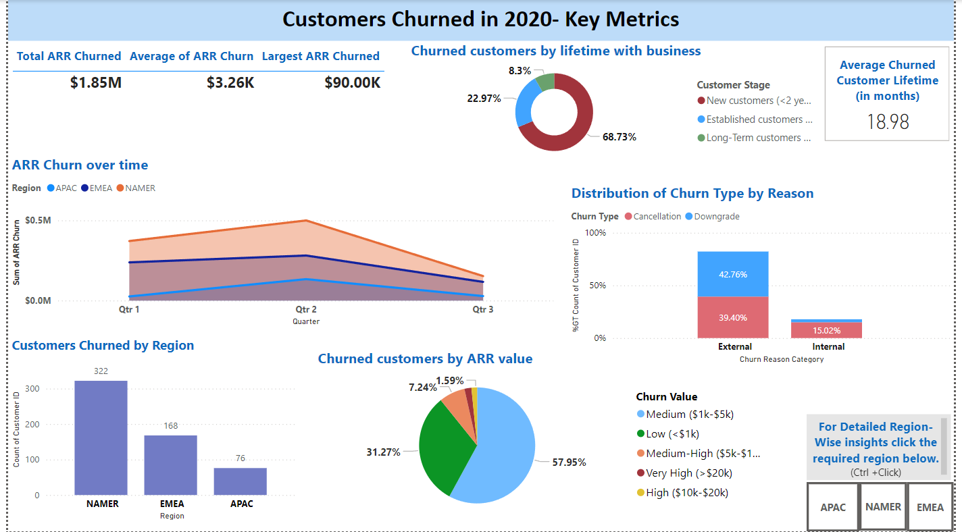
Dashboard Snapshots from PowerBI

Slide 9
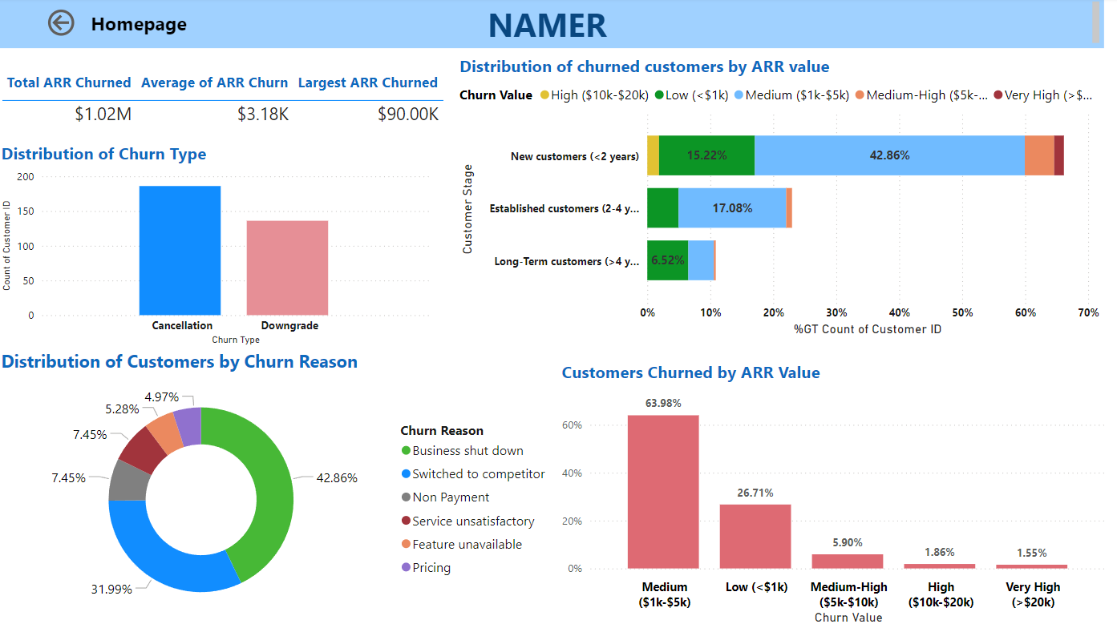

Slide 10
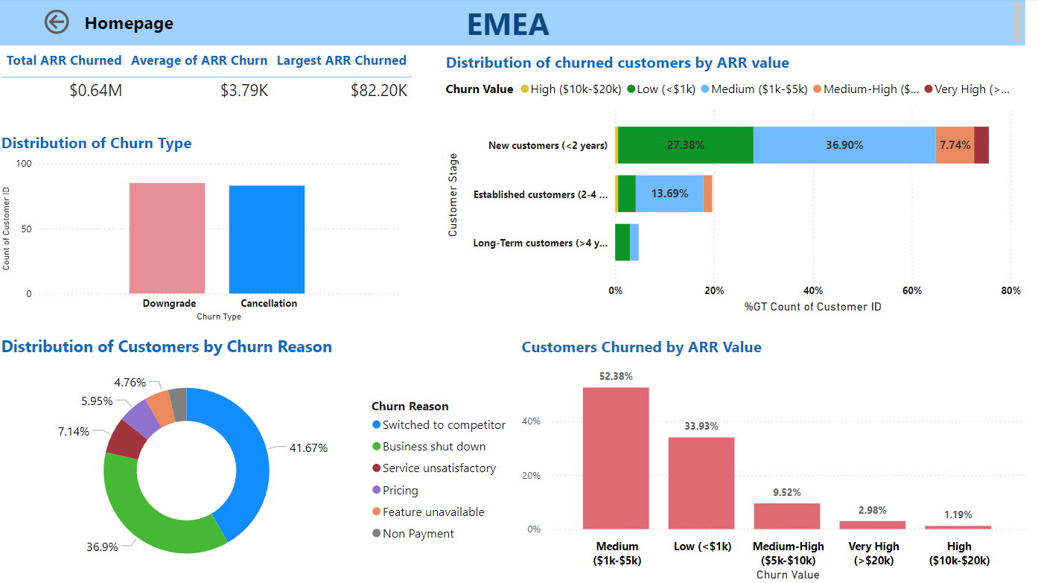

Slide 11
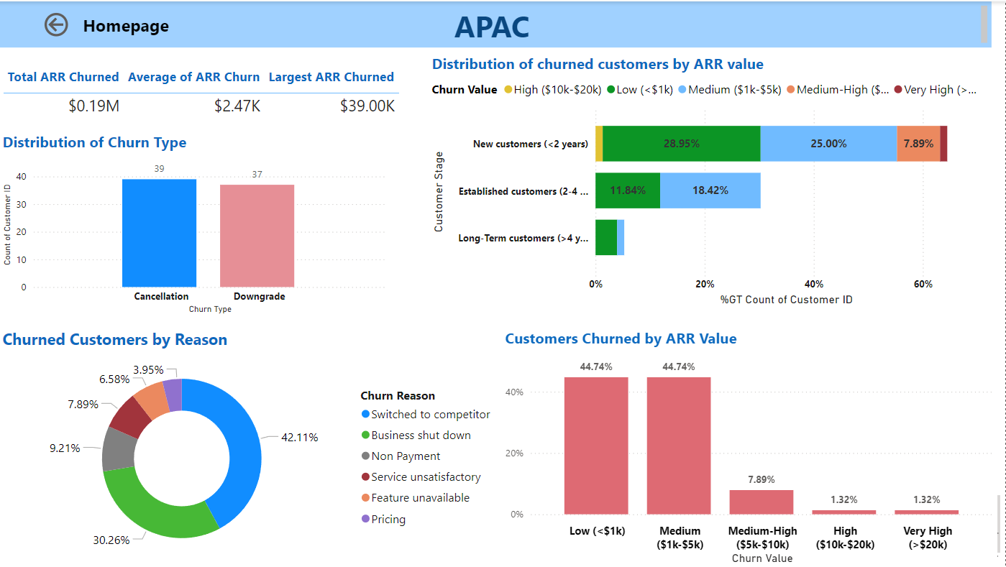

Slide 12
ARR-CSM Analysis 2023 Anirudh Balaji
This report analyses CSM and ARR data from Jan 2023 to Jan 2024 and is structured as below:
Executive Summary: 12-13
Snapshots of the interactive dashboard: 15-16
DAX Queries for NRR and GRR : 17

Slide 13
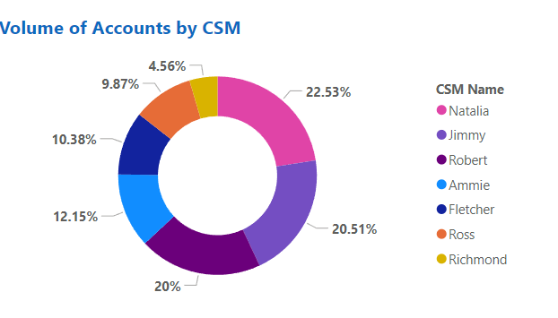
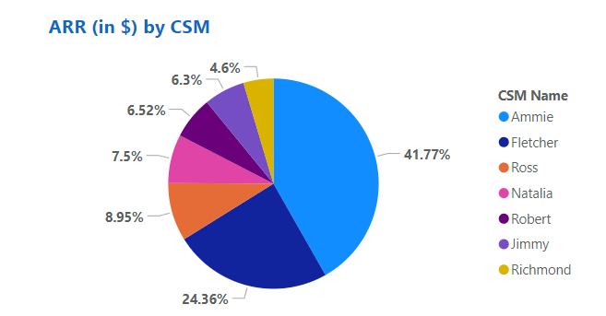
Executive Summary
Based on the latest point in time in the MRR data- Jan 2024
Potential Resource Underutilization
Natalia (NA), Jimmy (NA) and Robert (APAC+EMEA) managed 60% of the accounts while Richmond (APAC) and Ross (EMEA) managed the least percentage of accounts.
To avoid overload and proper resource utilisation, a portion Robert’s accounts could possibly be transferred to Richmond and Ross as they work on the same regions.
Accounts-ARR Efficiency
Despite managing significantly fewer accounts, Ammie (APAC+EMEA) and Fletcher (NA) held the largest share of ARR (65%) possibly highlighting the presence of more enterprise accounts in their basket. Thus, they could benefit from additional support to enhance value and retain these accounts.
Though Natalia (NA) managed the most accounts, held only 7.5% of the ARR share possibly due to managing smaller accounts or downgrades which requires further investigation

Slide 14
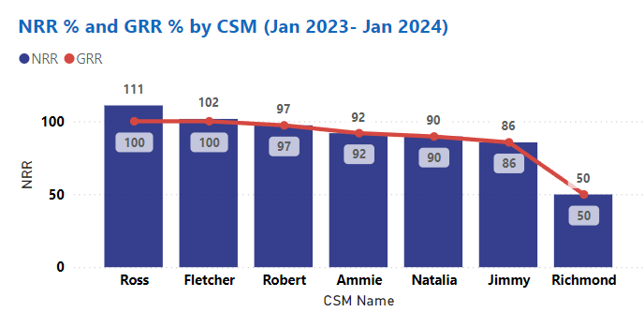
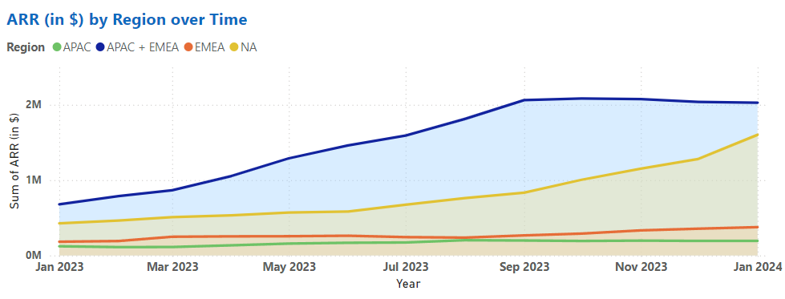
Executive Summary (Contd.)
NRR and GRR Concerns
The visual shows the NRR and GRR with Jan 2023 as the starting point and Jan 2024, the latest point in the data, as the ending point.
Only 2 CSMs, Ross (EMEA) and Fletcher (NA) had NRR % significantly over 100 and a GRR of 100 reflecting excellent upsells. cross-sells and customer satisfaction.
On the other hand, Jimmy, despite managing 20% of the accounts as of Jan 2024 as seen prior, had a NRR of only 86% possibly reflective of downgrades over the year.
Richmond despite managing only 4% of the account had a poor NRR of 50% indicative of overwhelming downgrades and would possibly need support with future accounts.
Growing ARR in NA and APAC+EMEA
APAC+EMEA saw the steadiest and highest growth followed by NA reflective of potential upsells and cross sells through the year.
While APAC and EMEA as separate regions saw minimal growth but remained stable through the year and possibly did not witness churns or significant downgrades. Localised CS strategies could boost these regions to better growth levels.

Slide 15
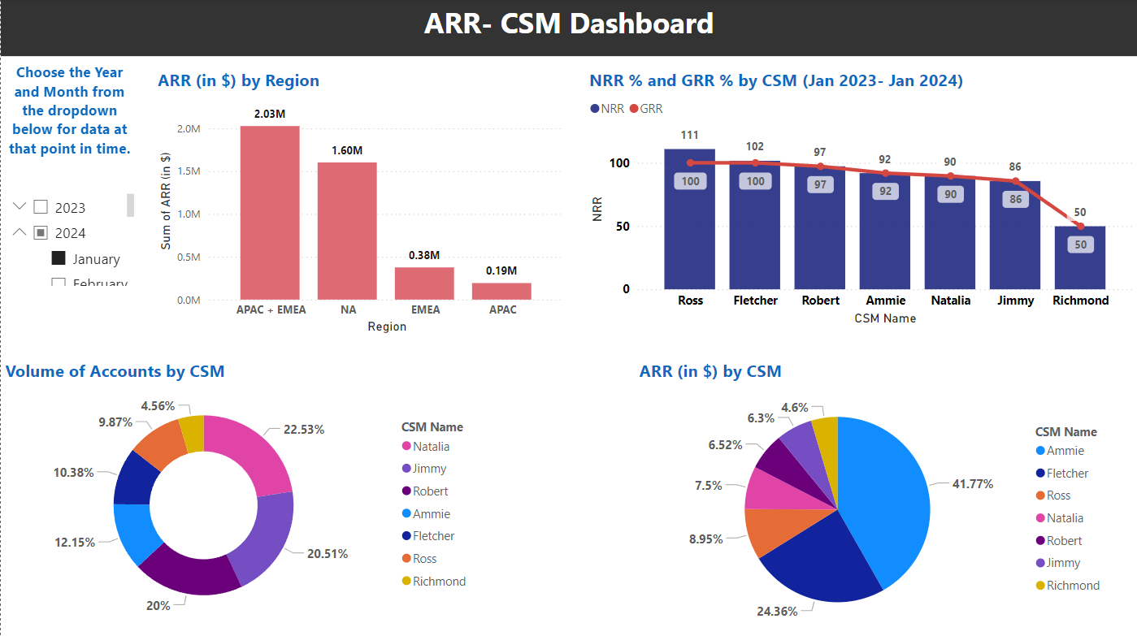
Dashboard Snapshots from PowerBI

Slide 16
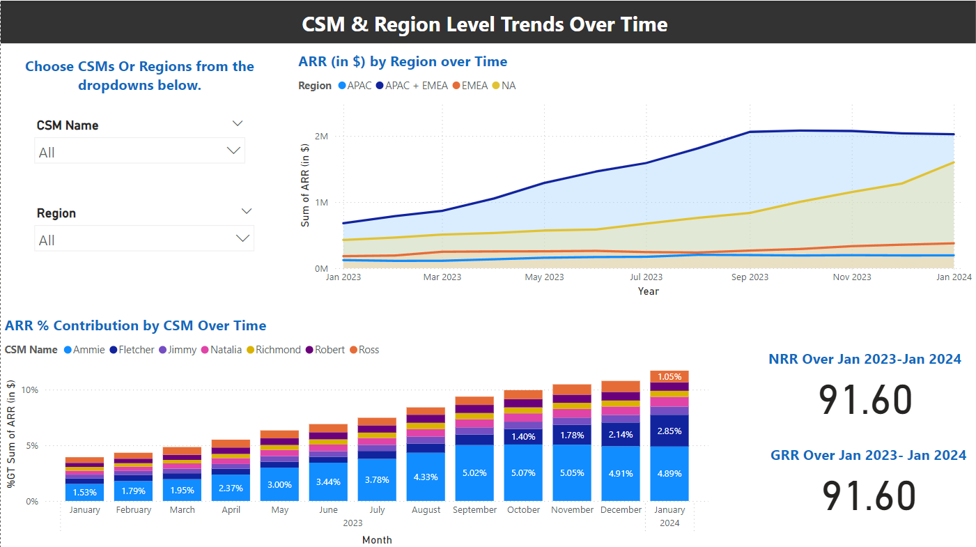

Slide 17
DAX Queries for NRR and GRR calculation
NRR =
VAR Starting_Month_Accounts =
CALCULATETABLE(
VALUES('MRR Data'[Account ID]),
'MRR Data'[Year] = 2023,
'MRR Data'[Month] = "January"
)
VAR Starting_ARR =
CALCULATE(
SUM('MRR Data'[ARR (in $)]),
'MRR Data'[Year] = 2023,
'MRR Data'[Month] = "January"
)
VAR Ending_ARR =
CALCULATE(
SUM('MRR Data'[ARR (in $)]),
'MRR Data'[Year] = 2024,
'MRR Data'[Month] = "January",
'MRR Data'[Account ID] IN Starting_Month_Accounts
)
RETURN
DIVIDE(Ending_ARR, Starting_ARR) * 100
GRR =
VAR Starting_Month_Accounts =
CALCULATETABLE(
VALUES('MRR Data'[Account ID]),
'MRR Data'[Year] = 2023,
'MRR Data'[Month] = "January"
)
VAR Starting_ARR =
CALCULATE(
SUM('MRR Data'[ARR (in $)]),
'MRR Data'[Year] = 2023,
'MRR Data'[Month] = "January"
)
VAR Ending_ARR =
CALCULATE(
SUM('MRR Data'[ARR (in $)]),
'MRR Data'[Year] = 2024,
'MRR Data'[Month] = "January",
'MRR Data'[Account ID] IN Starting_Month_Accounts
)
VAR Min_ARR=MIN(Ending_ARR, Starting_ARR)
RETURN
DIVIDE(Min_ARR, Starting_ARR) * 100

