Slide 1


Veeva AI Insights
Unlocking Next-Level Field Excellence through AI
Internal Innovation Demo | Presented by Anirudh Sharma
by Ani Sharma

Slide 2





Why We're Here
AI-enhanced HCP targeting
Boost sales rep productivity with intelligent prioritization.
Next Best Action assistant
Guide reps with context-aware recommendations.
TRx/NBRx forecasting
Predict prescription trends for proactive planning.
Geo-routing optimization
Maximize field time with intelligent route planning.

Slide 3




System Overview
Data Sources
CMS, CRM, Historical Calls
AI Models
XGBoost, Prophet, GPT-4
Streamlit UI
Interactive dashboard interface
No patient data used. All data is anonymized or public.

Slide 4
HCP Targeting – ML Prioritization
Problem
Solution
Reps manually prioritize HCPs, often missing key behavior patterns.
Live XGBoost model calculates conversion scores using TRx/NBRx, specialty, and rep activity.
Visual breakdown by score bucket
Filter by specialty
Feature importance for transparency

Slide 5
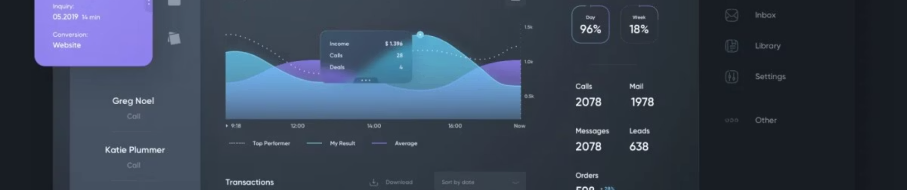
Next Best Action Assistant
Problem
Solution
Features
Reps unsure about what action to take next (call, sample, coaching).
GPT-4 suggests tiered actions with context-aware prompting.
✅ Recommended, 🤔 Optional, and 🟡 Low Priority actions based on data.
Built-in assistant chat responds to queries like "When was last call?" or "Show TRx trend."

Slide 6
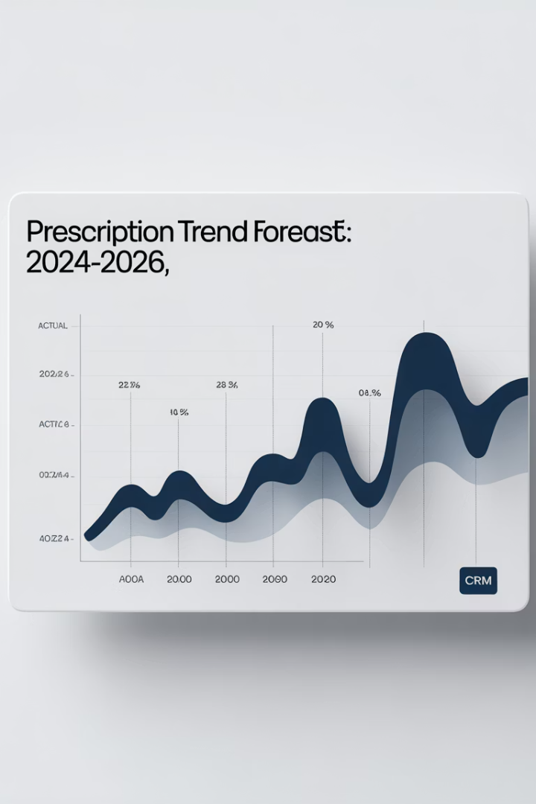



TRx/NBRx Forecasting
Historical Data
Past prescription patterns
Prophet Model
Meta's time-series forecasting
3-Month Forecast
With confidence intervals
Helps prioritize accounts with upward or downward momentum.

Slide 7
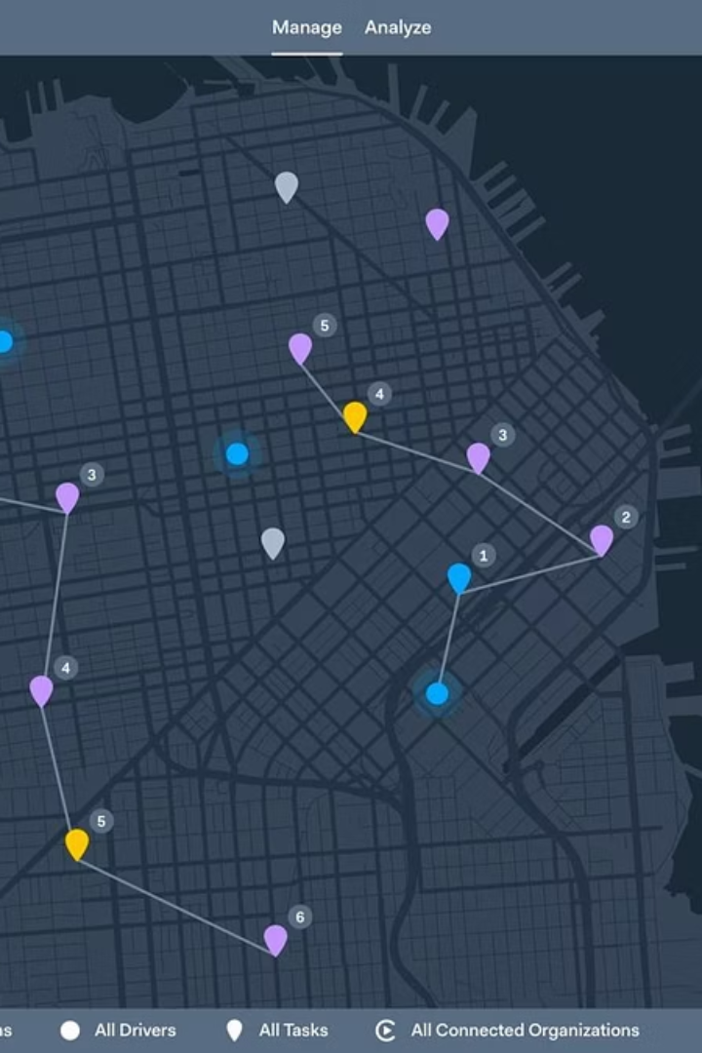
Geo-Routing Optimization
KMeans Clustering
Creates logical multi-day visit groupings
TSP + Google Maps
Calculates real-world optimal driving paths
Visual Route Planning
Maps with start/end points and step-by-step guidance

Slide 8

What's Under the Hood
Component
Tech Used
HCP Prioritization
XGBoost + Sigmoid Scaling
Recommendation Engine
GPT-4 (OpenAI API)
Trend Forecasting
Prophet (Meta)
Route Optimization
KMeans + TSP + Google Maps
UI
Streamlit
All code is modular and deployable to internal environments.

Slide 9








Future Enhancements
Veeva Integration
GPT Fine-tuning
Connect with MyInsights or CLM modules
Improve prompts with call outcomes
Impact Tracking
A/B Testing
Monitor AI recommendation adoption
Test sample allocation logic

Slide 10






Why This Matters
Enhanced Performance
Boost sales effectiveness
Predictive Intelligence
Integrate AI into daily workflow
Easy Integration
Works with current tech stack
Let's pilot 1–2 modules with real rep territories and gather feedback.

Slide 11
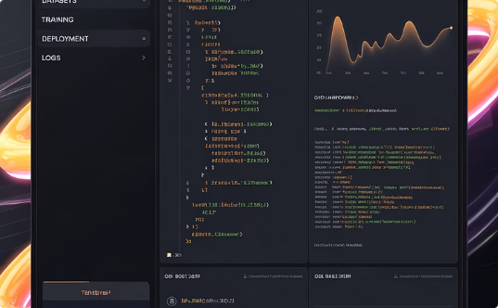
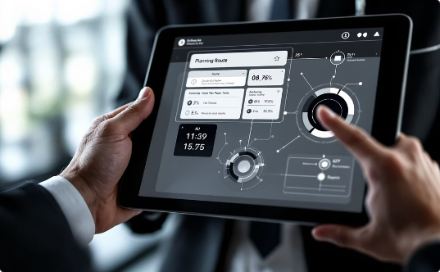
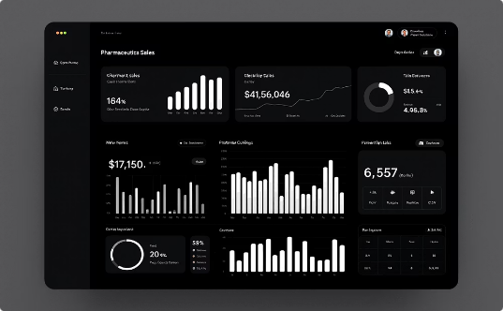
Thank You!
AI-Powered Assistance
Optimized Field Execution
Data-Driven Decisions
Intelligent recommendations at your fingertips.
Maximum impact with every customer interaction.
Turn insights into actionable strategies.
Let's bring AI-driven excellence into field execution.

Slide 12





Scientific Foundation
XGBoost
Chain-of-Thought
Prophet
Chen & Guestrin, 2016 – ACM Paper
Taylor & Letham, 2017 – IJF
Wei et al., 2022 – arXiv
K-Means & TSP
Lloyd's Algorithm & Johnson & McGeoch

Slide 13
References
1
XGBoost
2
Chain-of-Thought Prompting
3
ReAct (Reasoning + Acting)
Paper
Paper
Paper
4
Prophet: Forecasting at Scale
5
K-Means Clustering
6
Traveling Salesman Problem - Heuristic
Paper
Paper
Paper
7
Google Distance Matrix API Documentation
Link
All models and techniques are built on established research and industry-standard technologies to ensure reliability and performance.

