Slide 1
Smart Grid Communication
Communication strategies among master/slave nodes
Seminar - Automation Systems - SoSe 2020

Slide 2
Outline
Introduction
Proposed Model
Design
Implementation
Results
Vision and Outlook

Slide 3
Outline
Introduction
Proposed Model
Design
Implementation
Results
Vision and Outlook

Slide 4
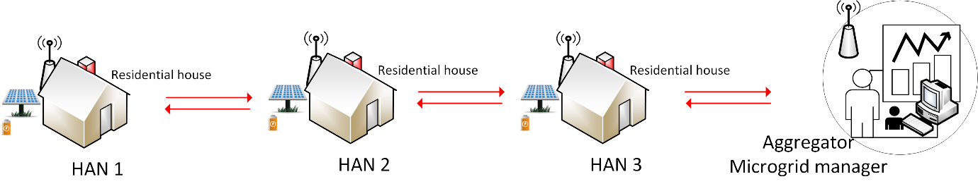
Introduction
Wireless communication between homes using existing infrastructure.
Communication strategies among master/slave nodes.
Current, voltage and other sensor data are transmitted between houses and to the main server.
These values are continuously logged and monitored.
Based on the collected data, optimization is carried out and then actuated.

Slide 5
Outline
Introduction
Proposed Model
Design
Implementation
Results
Vision and Outlook

Slide 6
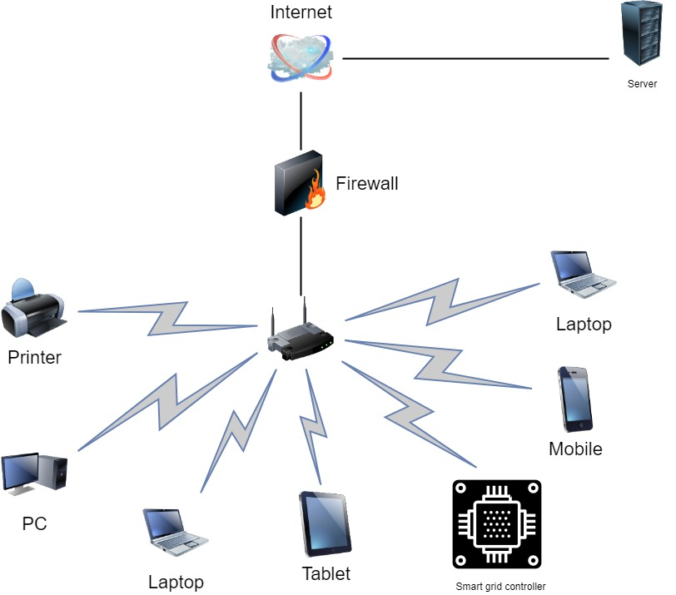
Proposed Model
Smart Grid hardware is setup in every home which makes use of existing communication infrastructure.

Slide 7
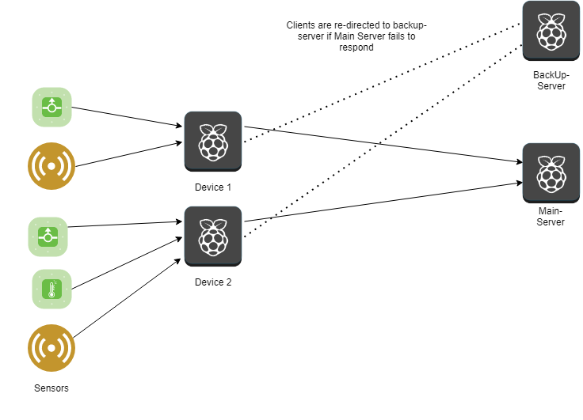
Proposed Model
The hardware set-up consists of Raspberry Pis communicating between each other.

Slide 8
Outline
Introduction
Proposed Model
Design
Implementation
Results
Vision and Outlook

Slide 9
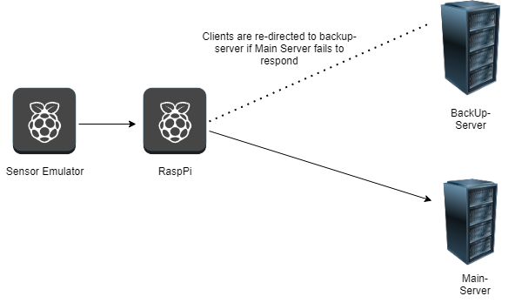
Design
Sensor data are emulated and is transferred to neaby Pi where it is logged.
From Pi the data is transmitted to the server.
This creates a small scale home to home communication environment.

Slide 10
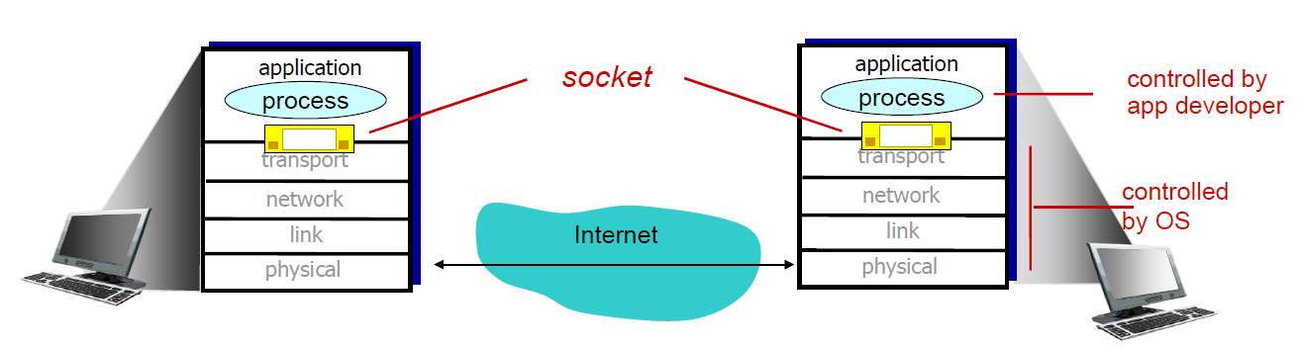
Design
Client Server Communication topology is adapted.
Independent sockets are used to communicate between client and server.
Network stack of TCP/IP is used to communicate.

Slide 11
Design
The data received are extracted and logged to excel.
Signal extraction algorithm is coded which extracts data based on the different values of sensors received and then logs it to excel.
BBR congestion control is used which prevents the data from getting lost and maintains the integrity of the data

Slide 12
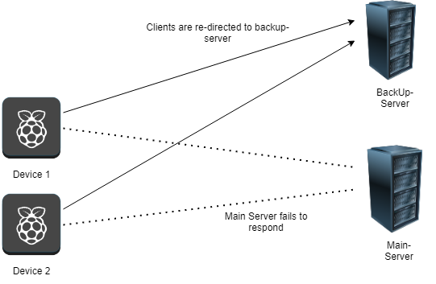
Design
The data from the sensor emulator is received at Raspberry Pi and then this data is logged.
This data is then transferred to server.
If the server is not able to respond, then the data is transferred to the backup server.

Slide 13
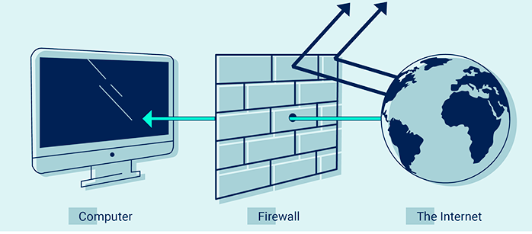
Design
Firewall is used in all the devices which allows us to connect to only the devices which are registered.
Network address for exclusion from firewall rules are manually added to each device.
This allows to secure the devices from malicious internet.

Slide 14
Outline
Introduction
Proposed Model
Design
Implementation
Results
Vision and Outlook

Slide 15
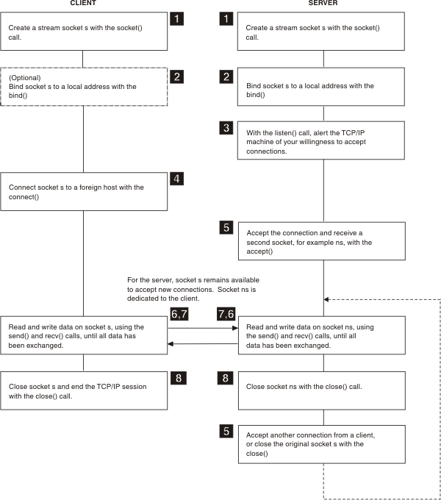
Implementation
Client-Server socket program flow chart

Slide 16
Outline
Introduction
Proposed Model
Design
Implementation
Results
Vision and Outlook

Slide 17
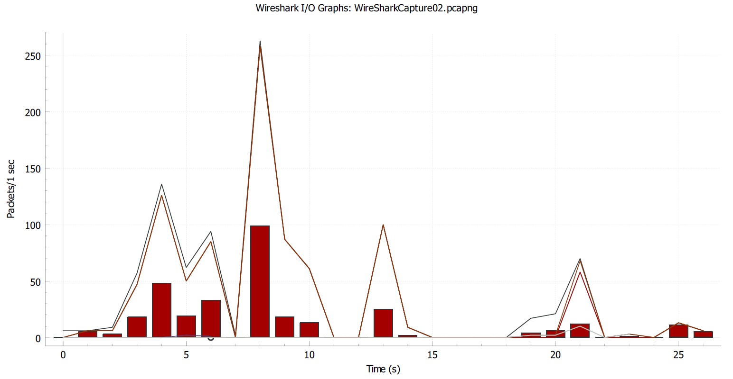
Results
The number of packets/second transmitted from client to the server with respect to time in seconds

Slide 18
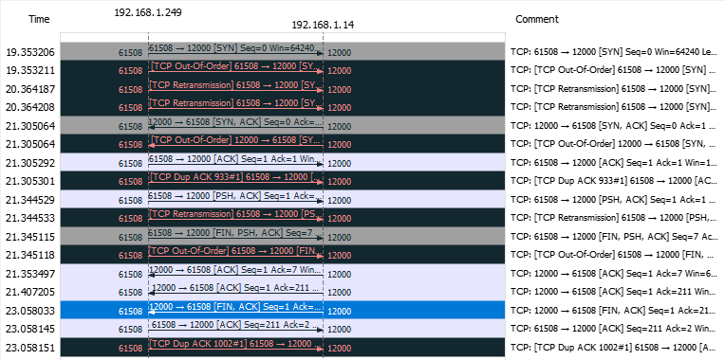
Results
Flow graph of communication between client and server on one of the lossy channel

Slide 19
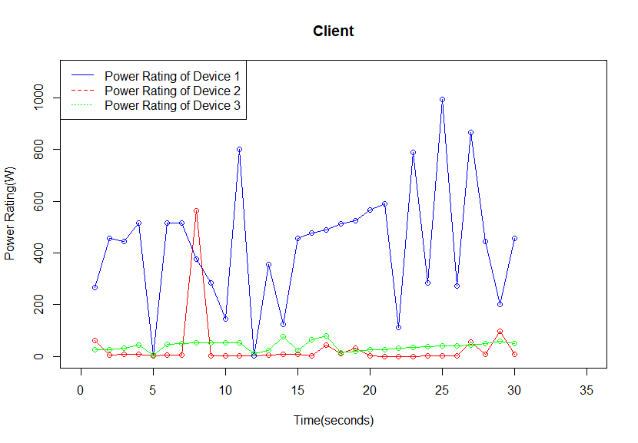
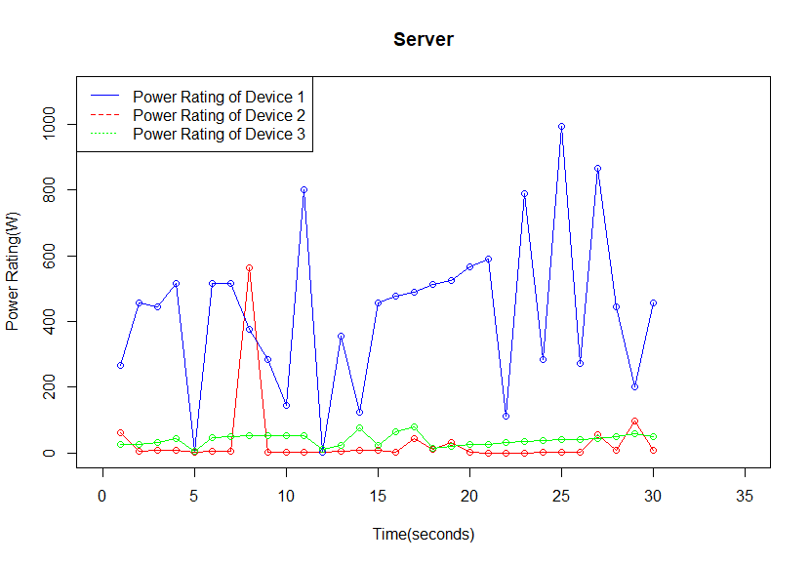
Results
Data integrity of all the data transmitted between client and server on a lossy channel

Slide 20
Outline
Introduction
Proposed Model
Design
Implementation
Results
Vision and Outlook

Slide 21
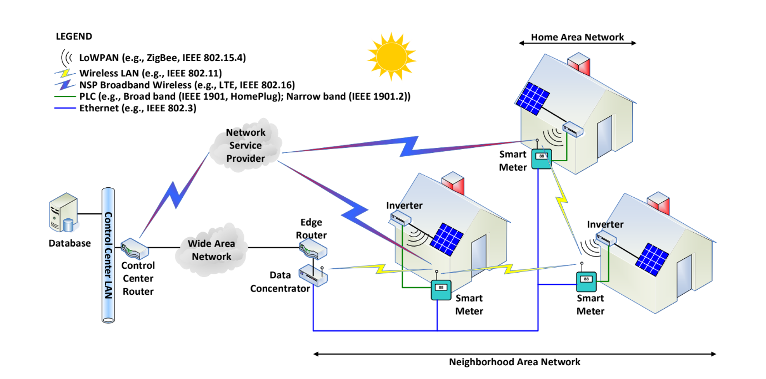
Vision and Outlook
This base idea can be extended to have a fully functional smart home communication.

Slide 22

Demo

Slide 23
Thank You!

Slide 24

Questions please..

