Slide 1
Smart Grid Communication
Communication strategies among master/slave nodes
Seminar - Automation Systems - SoSe 2020

Slide 2
Approach
PDLC(Product Development Life Cycle)
1. Requirement Analysis
2. Design
3. Coding
4. Testing/Verification

Slide 3
Requirement Analysis
All the requirement should be clarified and analyzed.
Clear mapping between verification and requirements.

Slide 4
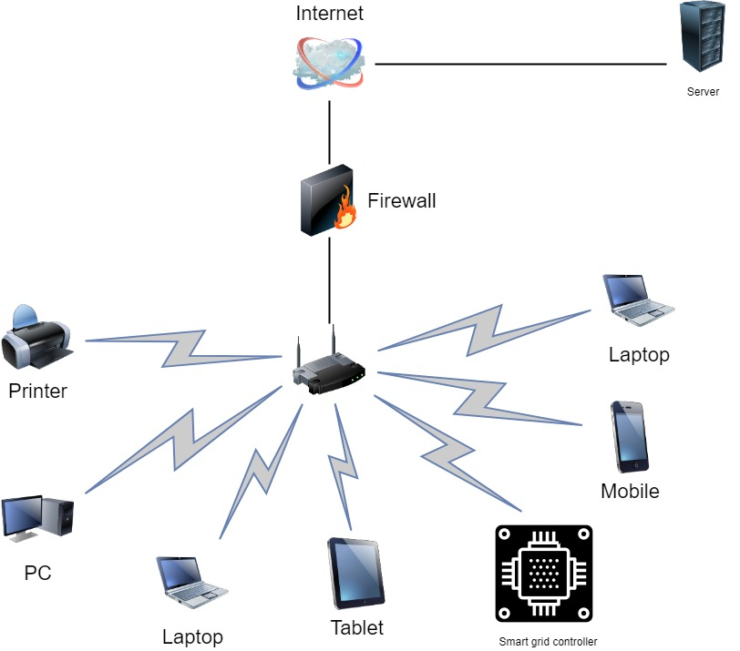
Design

Slide 5
Design

Slide 6
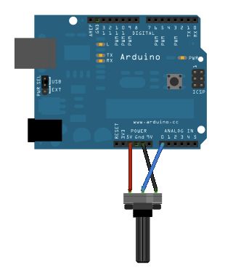
Design
The anlog input from the sensors are fed to the Arduino UNO Wifi Rev 2.
This data is then mapped to processable value.

Slide 7
Design
The controller is made to connect to the nearby router.
Using HTTP1.1/POST the data collected is converted to certain format and then posted to the server.
Using .html/.php the data is then visible at the server
Optionally data logging for larger duration can be done using MYSQL or MongoDB.
The optimized value from the server can be again sent back to the controller.
The controller will then actuate and correct based the feedback from the server.
HTTP, TCP/IP is used as communication protocol.
Additionally CRC and Alive checks can be added to the transferred data between client and server.

Slide 8
Design
Controllers used: Arduino Uno Wifi Rev2/MKR WiFi 1010/Nano 33 IoT/MKR WiFi 1000/ Raspberry pi 4/ Arduino Mega with ESP8266

Slide 9
Design
Communication between Raspberry Pis and making use built in network stack.

Slide 10
Design
TCP vs UDP
TCP | UDP
It is a connection-oriented protocol. | It is a connectionless protocol.
TCP is reliable as it guarantees delivery of data to the destination router. | The delivery of data to the destination cannot be guaranteed in UDP.
TCP provides extensive error checking mechanisms. | UDP has only the basic error checking mechanism using checksums.
TCP is comparatively slower than UDP. | UDP is faster, simpler and more efficient than TCP.
Retransmission of lost packets is possible in TCP, but not in UDP. | There is no retransmission of lost packets in User Datagram Protocol (UDP).
It has congestion and flow control | It doesn’t have flow control mechanism
TCP is used by HTTP, HTTPs, FTP, SMTP and Telnet. | UDP is used by DNS, DHCP, TFTP, SNMP, RIP, and VoIP.

Slide 11
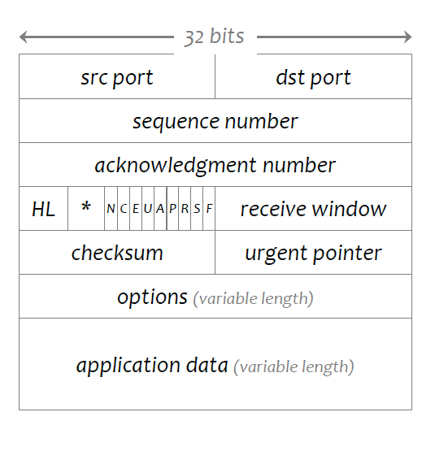
Design
TCP segment structure

Slide 12
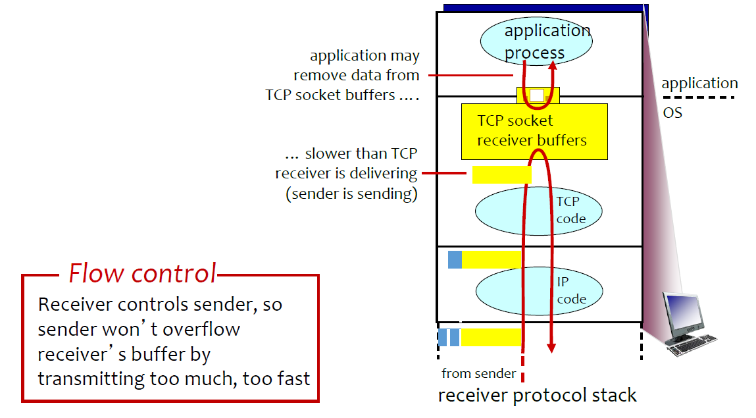
Design
Flow Control in TCP

Slide 13
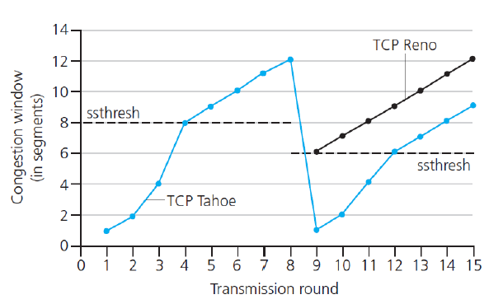
Design
Congestion Control in TCP

Slide 14
Design
Congestion Control in TCP
Raspberry Pi use BBR congestion control.
The BW is probed by using exponential increase till congestion window threshold and linear increase after that.
If in case a loss is identified due to duplicate ACKs then the window is decreased to threshold and again it increases linearly.
If in case the its due to time out then the congestion window starts from beginning and increases exponentially till threshold

Slide 15
Design
From the above advantages we can decide that TCP/IP would be better option.
As we are making use of the existing infrastructure of routing mechanisms it would be better to have a reliable data transfer rather than a non reliable one.
As in UDP the checksum is only used to accept or reject the packet at the receiver and not to re-initiate the transfer of lost packet.
No need of additional checksum as such as the data is always delivered with quality.

Slide 16
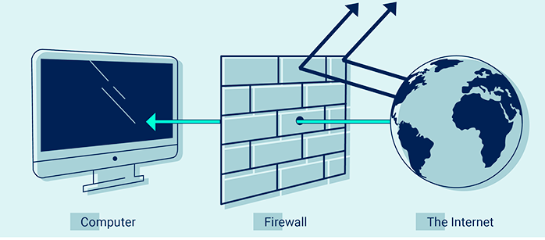
Design
Firewall configuration
The internet can be malicious. Several types of malware and cyber hacking codes can infect networks and dramatically damage them instantaneously. As a result, firewall network security features diverse types of methods to combat damaging malware. The method for intrusion prevention depends on the type of firewall in effect and the predicted dangers.

Slide 17
Design
Firewall Configuration
In our project we would configure it in way that its only accessible by the other 3 Raspberry Pis connected to it and we will block all the rest of the connections.
This can be done installing firewall security application to Pi OS and configuring it manually to the desired IP addresses.

Slide 18
Design
Socket Programming
Socket programming is a way of connecting two nodes on a network to communicate with each other. One socket(node) listens on a particular port at an IP, while other socket reaches out to the other to form a connection. Server forms the listener socket while client reaches out to the server.
I have created 2 programs one for client and one for server.
Both will communicate with each other and exchange data.
As of now, server is raspberry pi and client is the PC.

Slide 19
Design
Data logging
As discussed previously, the data logging prototype has been started using excel.
The data from the excel is read and then transmitted per time stamp.
In the server the data is received, conditioned and logged on to another excel file.
Pandas and openpyxl extensions are used to do this.

Slide 20
Challenges
As of now, the data transmitted from client is not able to maintain the time stamp. i.e. sometimes 2 packets are received in a single interval.
This can be resolved by further analysis with respect to socket connection time and type.
Writing on to excel is cumbersome due to various environment having their own drawbacks. So further research needs to be done as to which library to choose to write.

Slide 21
Thank You for your attention. ©

