Slide 1
DOCUMENT SEARCH PLATFORM
An Agentic, Contextual RAG Backend
Docling • PostgreSQL + PGVector • LlamaIndex • CrewAI • Ollama • Arize Phoenix • RAGAs • OpenWebUI
Technical Assessment — Solution Overview

Slide 2
OVERVIEW
What We Built
1
Agentic RAG Backend
2
REST API, Fully Documented
A FastAPI service where a CrewAI agent crew plans, retrieves, synthesizes, and verifies every answer before it's returned.
OpenAPI/Swagger-described endpoints for ingestion, retrieval, chat, prompts, and evaluation.
3
OpenWebUI Frontend
4
Traced & Evaluated
Connected via an OpenAI-compatible /v1/chat/completions surface — no custom plugin runtime required.
Every inference call traced in Arize Phoenix; pipeline quality measured with RAGAs against a curated Q&A set.
02

Slide 3
REQUIREMENTS TRACEABILITY
Mandated Toolset → Role in This Build
Tool
Role in this build
Docling
PDF/DOCX preprocessing: layout, table structure, Markdown export
PostgreSQL + PGVector
Sole vector store — HNSW / cosine index over document_chunks
LlamaIndex
Node parsing, embedding, and retrieval orchestration
CrewAI
4-agent contextual RAG crew with a verify → retry loop
Ollama
Sole LLM + embedding provider — generation, agents, and RAGAs judge
Arize Phoenix
OpenInference tracing for every LLM / agent / tool call
RAGAs
Faithfulness, answer relevancy, context precision & recall
OpenWebUI
Chat frontend via the OpenAI-compatible API surface
03

Slide 4
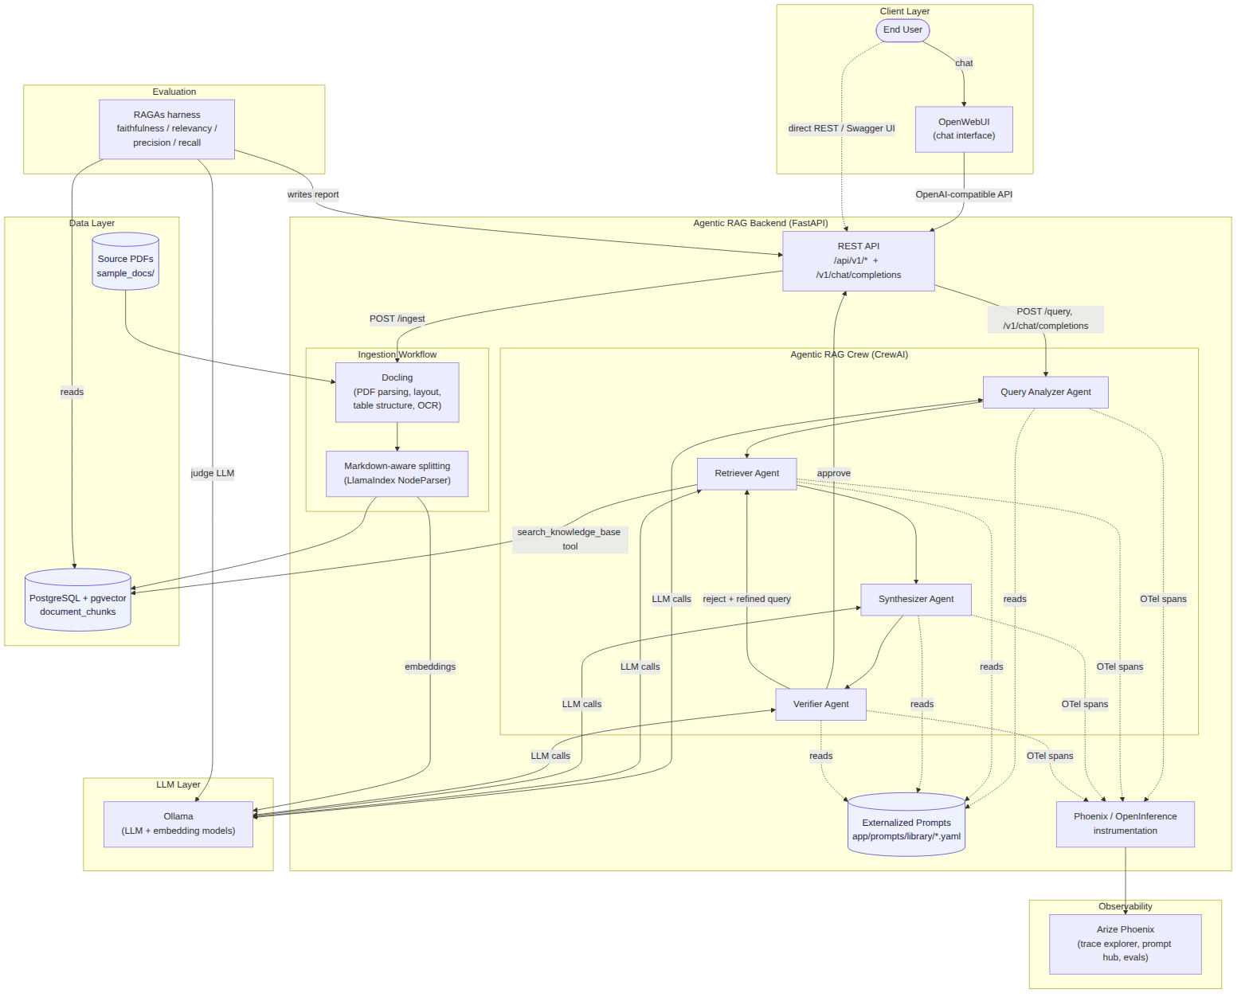
ARCHITECTURE
System Architecture
Component view: client layer, agentic RAG backend, data layer, LLM layer, and observability — see doc/architecture/architecture.md for the full rationale.
04

Slide 5
INGESTION
Docling → Split → Embed → Index
Heading-aware splitting first (MarkdownNodeParser), then a token-size ceiling (SentenceSplitter) — chunks never straddle unrelated sections.
05

Slide 6
CORE DESIGN
The Agentic RAG Crew
1. Query Analyzer
2. Retriever
Rewrites the question, resolves chat-history context, plans 1–3 focused sub-queries.
Calls the search_knowledge_base tool (LlamaIndex + PGVector) per sub-query; flags evidence gaps explicitly.
3. Synthesizer
4. Verifier
Writes a direct, cited answer using only the retrieved evidence — no fabrication from general knowledge.
Checks every claim against the evidence. APPROVE, or REJECT with a refined query for another pass.
The Retriever → Synthesizer → Verifier hand-off runs as a CrewAI sequential crew; a REJECT verdict feeds the refined query back into the Retriever for up to CREW_MAX_ITERATIONS passes — this loop is what makes the pipeline agentic and contextual rather than a single retrieve-then-generate call.
06

Slide 7
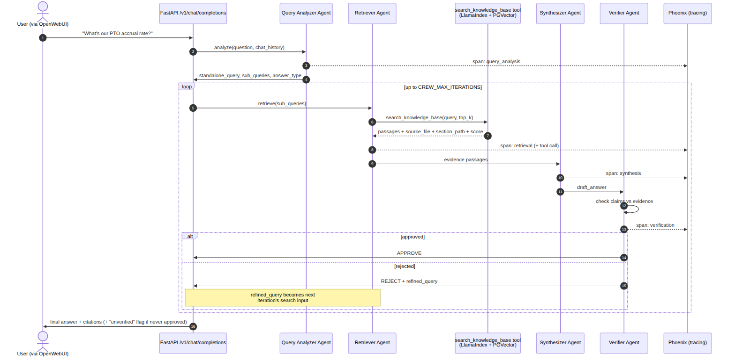
REQUEST FLOW
Agentic RAG — Sequence
Verifier rejections feed a refined query back into the Retriever — up to CREW_MAX_ITERATIONS passes — before the API returns a final, cited answer.
07

Slide 8
PROMPTOPS
Prompts Externalized From Application Code
Every agent persona + task prompt lives in app/prompts/library/*.yaml — zero hardcoded prompt strings in Python.
name: verifier_agent
version: "1.0.0"
role: >
Faithfulness & Groundedness Reviewer
goal: >
Approve the answer, or reject it with
a refined search query.
description: |
Draft answer: $draft_answer
Evidence: $evidence
Check every claim, then decide:
APPROVE or REJECT + refined_query.
Semantically versioned per file, so a Phoenix trace can record exactly which prompt version produced a given span.
Hot-reloadable via POST /api/v1/prompts/reload — a wording change ships without a redeploy.
GET /api/v1/prompts exposes the live inventory for audit.
08

Slide 9
OBSERVABILITY
Every Inference Call Is Traced
3
1x
100%
libraries instrumented
(LlamaIndex, CrewAI, LiteLLM)
instrumentation point
(FastAPI startup event)
of LLM / agent / tool calls
covered by construction
init_tracing() runs once, before the first request — a new call site added later is traced automatically, not opt-in.
Phoenix captures the full query-analysis → retrieve → synthesize → verify span tree, including every retry iteration.
Each span records prompt, completion, latency, and token usage — plus the exact search_knowledge_base tool arguments and results.
Phoenix UI doubles as a debugging tool: a low-faithfulness eval score points straight at the offending span.
09

Slide 10
QUALITY
Evaluation With RAGAs
Faithfulness
Answer Relevancy
Context Precision
Context Recall
Is the answer supported by the retrieved context?
Does the answer address the actual question?
How much of what was retrieved is relevant?
Did retrieval surface what the reference answer needs?
Judged by the same Ollama-backed LlamaIndex LLM/embeddings used in production — no OpenAI key anywhere in the stack.
Runs every curated question through the real run_agentic_rag() path (not a retrieval-only shortcut), so scores reflect what a user actually experiences, retries included.
12-question seed set over the placeholder corpus; app/prompts/library/ragas_testset_seed.yaml bootstraps more questions once the real corpus is ingested.
Full methodology + latest results: doc/evaluation/evaluation_report.md
10

Slide 11
DEPLOYMENT
One Compose File, Five Services
REST API (full spec: doc/api/openapi.json)
docker compose up -d --build
POST
/api/v1/ingest
Docling → split → embed → index
postgres — pgvector/pgvector:pg16
POST
/api/v1/query
Rich RAG answer + sources + trace
ollama — LLM + embedding models
POST
/api/v1/search
Raw retrieval, no generation
phoenix — trace collector + UI
GET/POST
/api/v1/prompts
Inspect / hot-reload prompts
backend — this FastAPI app
POST
/api/v1/eval/run
Run the RAGAs harness
openwebui — chat frontend
POST
/v1/chat/completions
OpenAI-compatible — OpenWebUI
+ ollama-pull (one-shot model download)
11

Slide 12
STATUS
Delivered, and What's Next
DELIVERED
NEXT STEPS
Full source: ingestion, agentic crew, API, tracing, eval
Swap sample_docs/ placeholders for the real Google Drive corpus
docker-compose stack for all 5 services
Run the live stack end-to-end and record real Phoenix traces + RAGAs scores
Architecture diagrams + ADR-style design doc
Streaming responses; native OpenWebUI citation cards via a Pipelines plugin
Swagger/OpenAPI spec + Postman-ready REST surface
Content-hash based incremental ingestion for large, changing corpora
Externalized, versioned, hot-reloadable prompts
Per-user auth / document ACLs for multi-tenant deployment
12

Slide 13
Thank You
Full source, docs, and diagrams: this repository's README.md
doc/architecture/architecture.md • doc/api/openapi.json • doc/evaluation/evaluation_report.md

