Slide 1
F & O for Diesel Prices
Anirudh Arora (G00894977)
Saurabh Patil (G00907573)

Slide 2
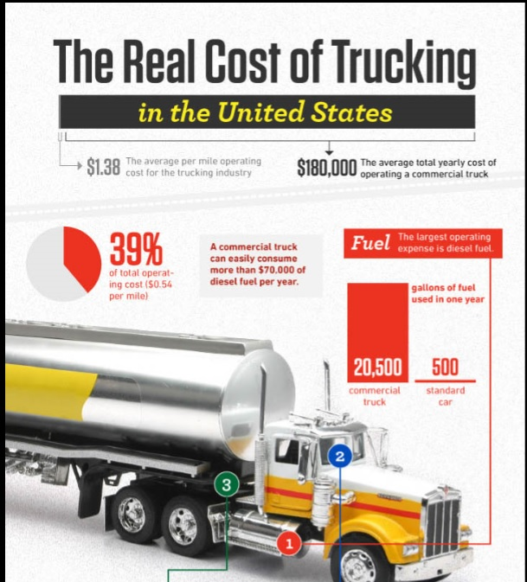
How Changes in Diesel Prices affects Trucking Companies
Changes in diesel prices have great effects on trucking companies significantly in both the short and long term.

Slide 3
Need for F&O in Diesel Prices
In late 2008, the American Transportation Research Institute (ATRI) published an Analysis of the Operational Costs of Trucking in an effort to provide more accurate marginal cost data for motor carrier operations.
The goal of the research was to identify current and accurate operational costs based on data provided directly from motor carriers.
The resulting dataset could then be used by both motor carriers as a high-level benchmarking tool and by government agencies for transportation improvement analyses.

Slide 4
Need for F&O in Diesel Prices
Motor carriers operate in an extremely competitive market, with very thin profit margins and must therefore be particularly attentive to fuel expenses
Given the rise in fuel prices that was experienced in 2010 and again in 2012, motor carrier fuel costs are almost certain to continue to be the first or second largest cost center for fleets.

Slide 5
How are Commodities traded
Most commodities are traded on exchanges, which are places where buyers and sellers meet and decide on a price.
Buyers Bidding Price
Selling Price
Sellers Bidding Price

Slide 6
What is Option
In finance, an option is a contract which gives the buyer (the owner or holder of the option) the right, but not the obligation, to buy or sell an underlying asset or instrument at a specified strike price on a specified date, depending on the form of the option.

Slide 7
What is Future
In finance, a futures contract (more colloquially, futures) is a standardized forward contract which can be easily traded between parties other than the two initial parties to the contract. The parties initially agree to buy and sell an asset for a price agreed upon today (the forward price) with delivery and payment occurring at a future point, the delivery date.

Slide 8
How does F&O work
For example, on one hand we have A, who holds a barrel Oil, currently trading at $ 100. A expects the price go down to $ 90. This ten-Dollar differential could result in reduction of investment value.

Slide 9
How does F&O work
On the other hand, we have B, who has been tracking the price of Oil and given his intuition and expertise, feels that the price could increase to $ 130 in the next three months.

Slide 10
How does F&O work
B wishes to buy the barrel of Oil at a lower price now, thereby making a quick profit in the bargain. However, he can only pay a nominal sum now and arrange for the necessary funds to buy the barrel in three months.
Now, A and B submit their order requests to the Exchange to enter into a contract with a maturity period of three months Once the orders are matched and traded, both traders hold their desired positions as decided

Slide 11
Possibilities
Case 1: No change of price
No profit or loss in both F & O
Seller(A)
Buyer(B)

Slide 12
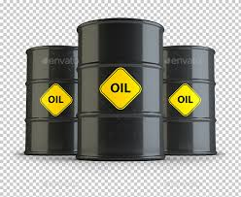
Possibilities of Future
Price of Oil is $115
Seller(A)
Buyer(B)

Slide 13
Possibilities of Future
Price of Oil is $95
Seller(A)
Buyer(B)

Slide 14
Possibilities of Option
Price of Oil is $115
Seller(A)
Buyer(B)

Slide 15
Possibilities of Option
Price of Oil is $95
Seller(A)
Buyer(B)

Slide 16
Data Preprocessing
Our data consists of time series of monthly Diesel Prices from the year 1994 to present from the Website www.eia.gov which is also known as U.S. energy information, a site operated by the U.S. department of energy.
Next Since we were more interested in the present Trend or more recent Trend we filtered this data and kept the diesel prices from January 2008 to April 2016.
We would now use this data to calculate the Mean and Standard Deviation of the change in diesel prices.

Slide 17
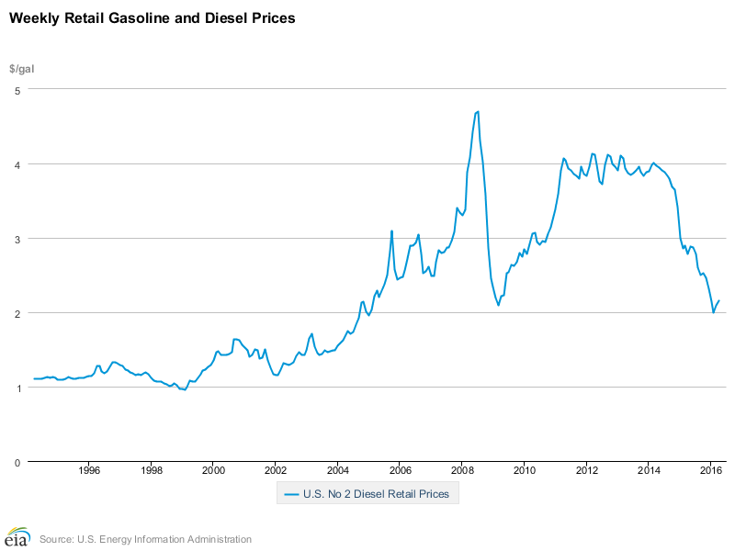
Data Preprocessing
The Trend in the Diesel Prices from 1994 to 2016

Slide 18
Measure Return and the Probability Distribution of Return
To explicitly display the distribution of monthly return, we build the probability distributions corresponding to the entire trading time of Monthly Diesel Prices.
A number of studies investigated the time series of returns on varying time scales in order to probe the nature of the stochastic process underlying it.
To construct the time series of returns using the time series of the monthly diesel price , the price change R(T) is defined as the change in the logarithm of the monthly diesel price , R(T)= ln Z(T+dT)-ln Z(T) where dT denotes the time interval of sampling with dT = 1 month in the data.
The time series of daily returns is shown in Figure

Slide 19
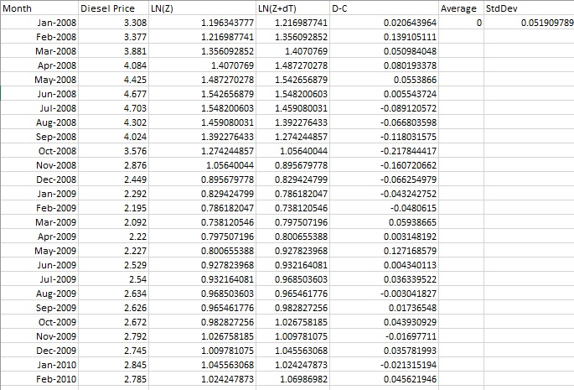
Measure Return and the Probability Distribution of Return

Slide 20
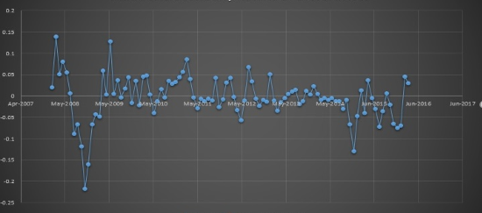
Time Series for Monthly return of Diesel Prices from 2008 to 2016

Slide 21
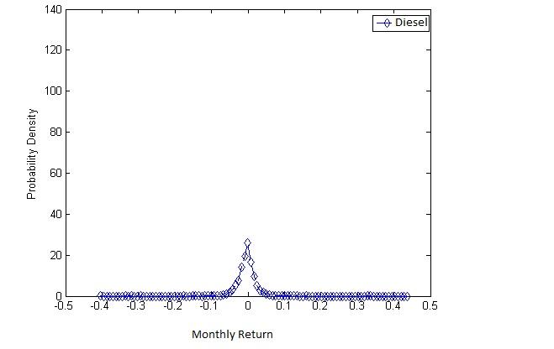
Probability Distribution
To display the probability distribution of monthly returns more clearly, we will construct the probability distribution for the time series of monthly returns.
To construct the probability distribution, we adopt the histogram method and group the total samples into 100 intervals.
Then, we count the number of monthly return ranging between each interval. The Figure below shows the probability distribution of monthly returns for the sampling market.

Slide 22
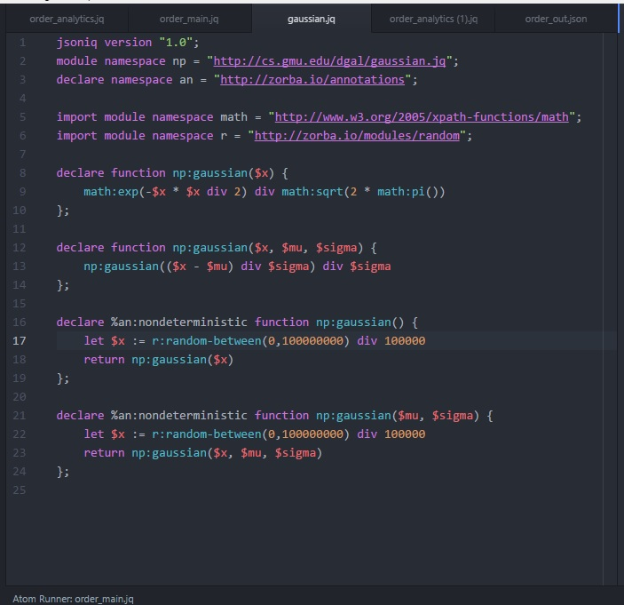
Gaussian Function

Slide 23
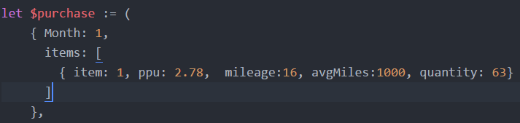
Input taken from the user
Present Cost of diesel
Mileage of truck
Average Miles traveled by the trucks in a month
Quantity which will be computed using Mileage and avgMiles

Slide 24


The Process of Calculation
$ppu computation for future: A random value drawn from the Gaussian distribution is used.
When this is done, the variable $ppu on the left of the assignment statement represents the future cost with some randomness.

Slide 25
Different Computations
We have implemented the project for
Monthly prediction
Quarterly prediction(3 months)
Half Year prediction(6 months)
Yearly prediction(12 months)

Slide 26
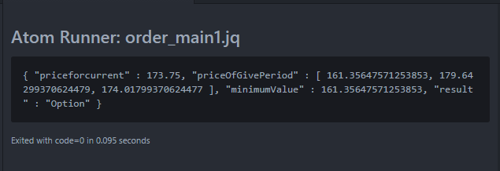
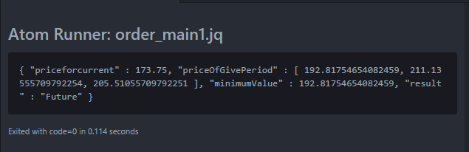
The Result

Slide 27
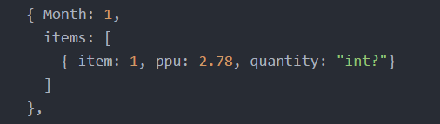
Future Enhancements
We can calculate the optimal cost of fuel if we use DGAL and run over code through the DGAL argmin function
It could be subject to a budget constraint which would be the maximum/ minimum cost on fuel for the previous year.

Slide 28
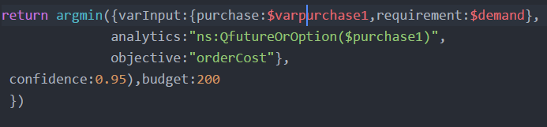
Future Enhancements
This would support our decision to actually go for future or option.
Below is the snippet for the gausian function implemented in DGAL and used in order to calculate the stochastic cost of fuel

Slide 29
Future Enhancements
We have implemented this project for Trucking companies
In the future we propose to expand it to cover Airlines and Shipping Companies too.

Slide 30
Conclusion
Our project will help mitigate the expenses spent on fuel
This in turn will help the Trucking company to lower the operational cost of fuel and Increase the overall profits.

