Slide 1
AI‑Powered Career Guidance & Skill Recommendation Agent
CSRBOX – IBM SkillsBuild Applied AI Internship 2025
SDG 8: Decent Work and Economic Growth
Capstone Project
Prepared by: Rahul Singla

Slide 2
Outline
Introduction
SDG Alignment
Problem Statement
Objectives
AI Solution
Architecture & Flow
Implementation
Ethics & Impact
Conclusion

Slide 3
Introduction
Students and graduates face difficulty choosing suitable careers
Skill mismatch leads to unemployment and underemployment
AI can provide scalable and personalized career guidance

Slide 4
SDG Alignment – SDG 8
Supports Decent Work and Economic Growth
Improves employability through skill awareness
Encourages sustainable workforce development

Slide 5
Problem Statement
Lack of clarity about job roles
Unawareness of required skills
Need for an intelligent guidance system

Slide 6
Project Objectives
Analyze user skills using AI
Recommend suitable job roles
Identify missing skills
Suggest learning paths

Slide 7
Proposed AI Solution
AI‑powered career guidance agent
Uses prompt‑based reasoning
Provides job and skill recommendations

Slide 8
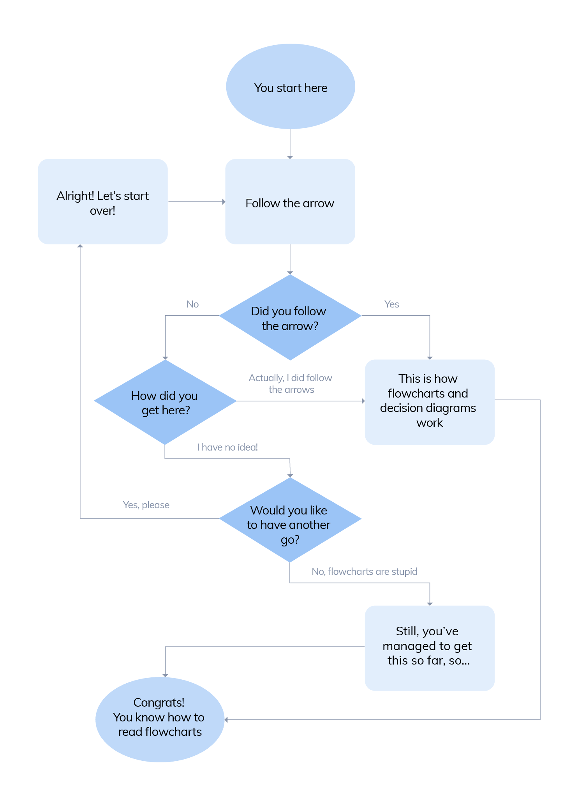
AI Architecture & Flow Diagram User │ ▼ Skill / Resume Input │ ▼ Prompt Construction (Python) │ ▼ AI Model (Simulated / IBM Granite) │ ▼ Skill Analysis & Job Matching │ ▼ Career Recommendations Output

Slide 9
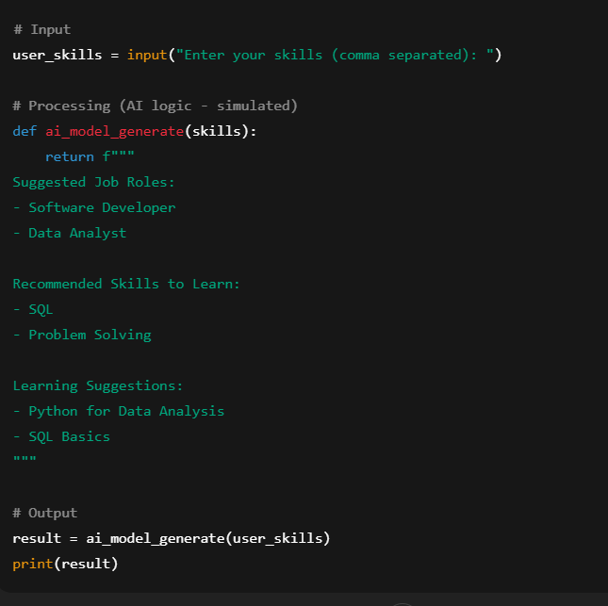
Sample Code Implementation
The user provides skills as input. The system uses AI-based reasoning (simulated here) to analyze skills and generate job role and learning recommendations as output

Slide 10
Ethical & Responsible AI
No personal data storage
Bias‑aware recommendations
Transparent AI usage

Slide 11
Expected Outcomes & Impact
Improved career awareness
Reduced skill mismatch
Better employment readiness

Slide 12
Conclusion
Applies AI to a real‑world problem
Aligned with SDG 8 goals
Scalable and impactful solution

