Slide 1
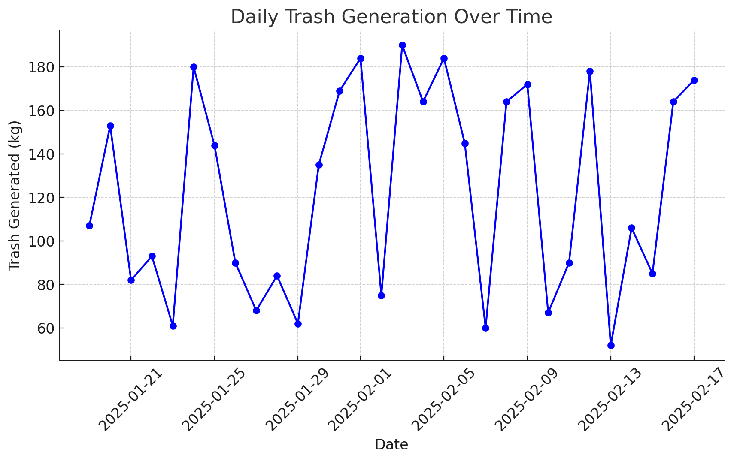
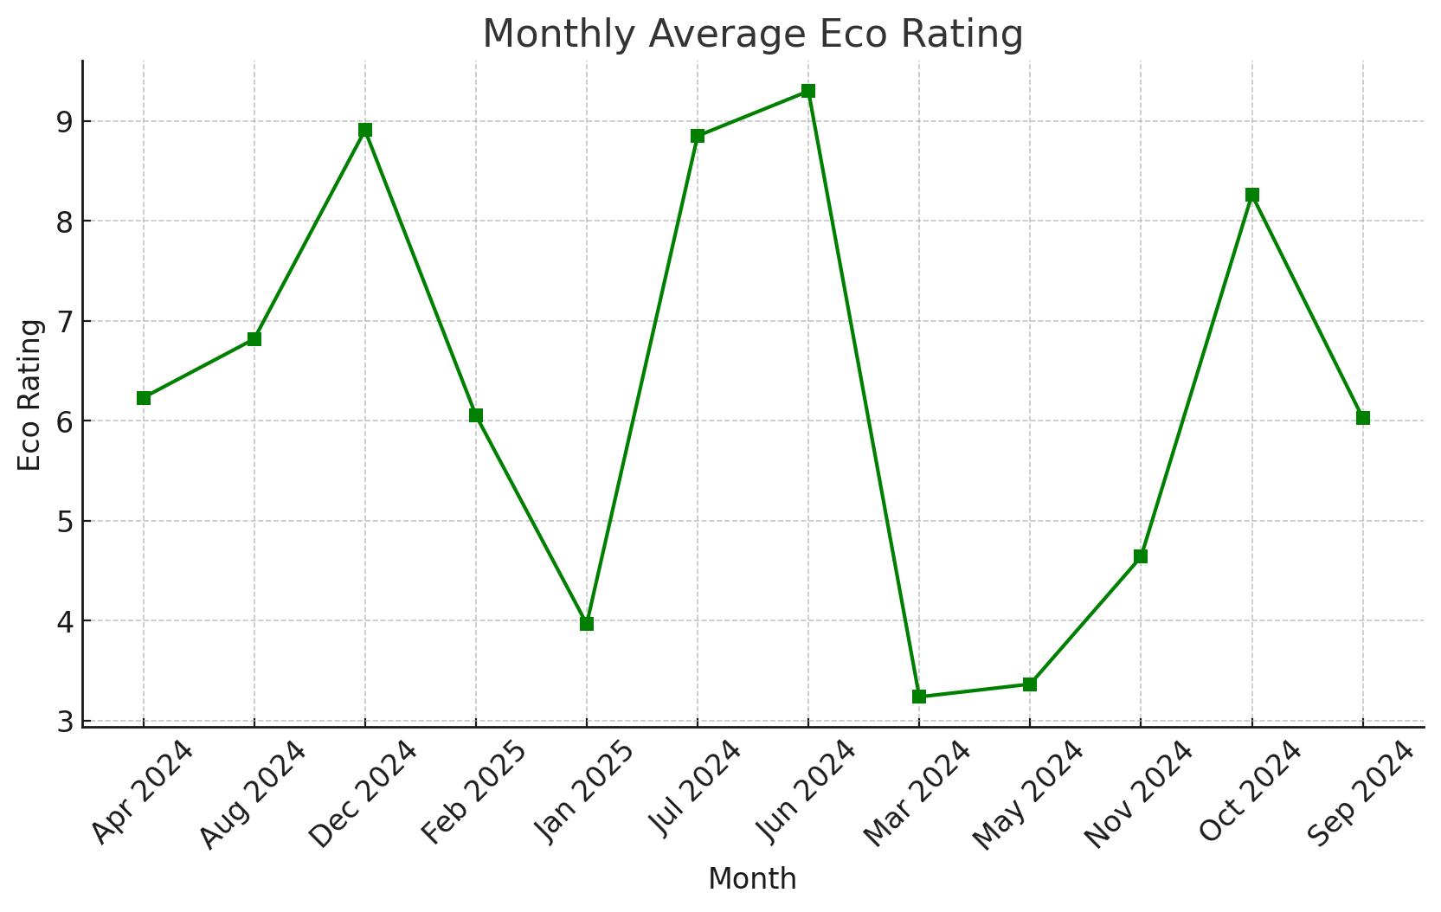
Knowing Your Surrounding
AQI
Greenery Rating (% of plants in the area)
Trash Rating
(% of trash produced daily)
Eco Rating (Our Generated KPI rating the area based on eco-friendlyness)
Daily Trash Generation
Monthly Average Eco Rating
Date (dd-mm-yyyy) | Air Quality Index | Eco Rating (in %) | Green Rating (in %)
16-02-2025 | 63 | 14 | 10
17-02-2025 | 70 | 13 | 11
(Daily Update)

